Slide 1
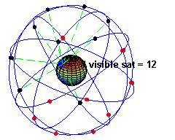
無線網路 Wireless Network
Chapter 18 GPS定位技術

Slide 2

舉頭三尺有衛星！

Slide 3
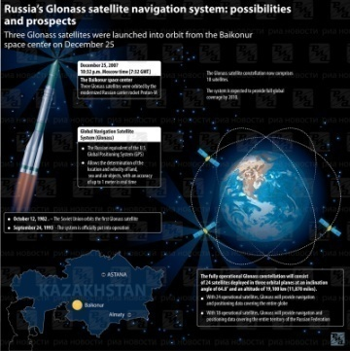
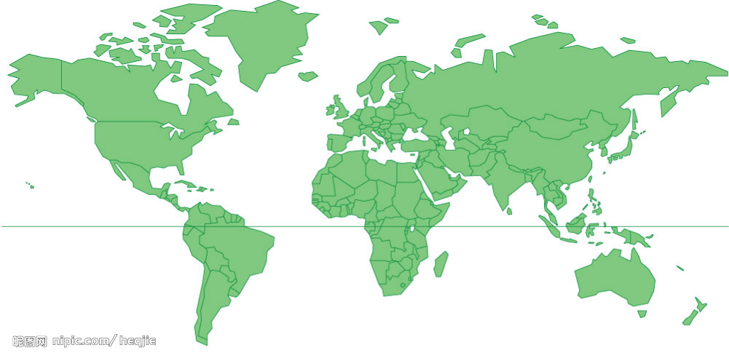

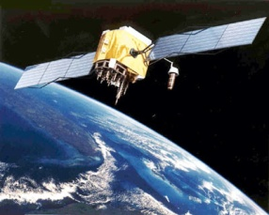
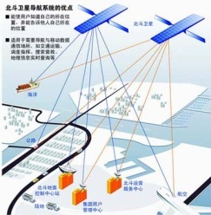
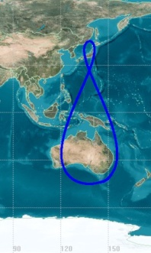
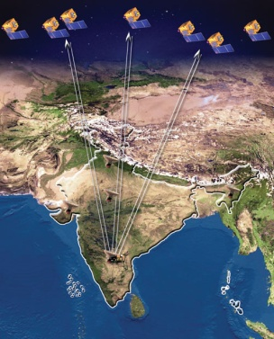
各國衛星導航系統
GPS(美國)、GLONASS(蘇聯)、Galileo(歐盟)、北斗(中國)、QZSS(日本)、IRNSS(印度)

Slide 4
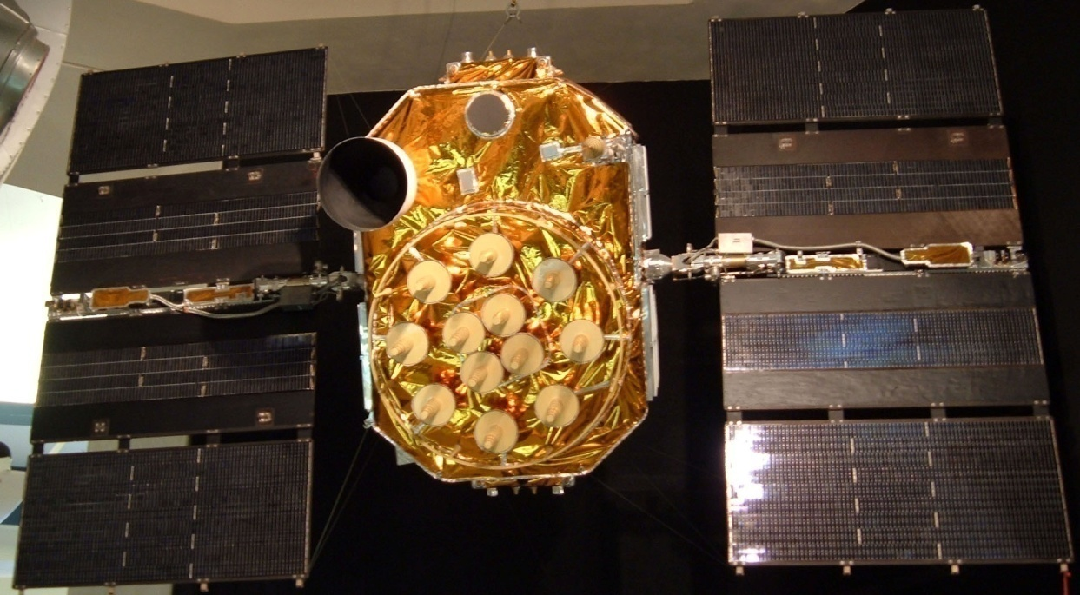
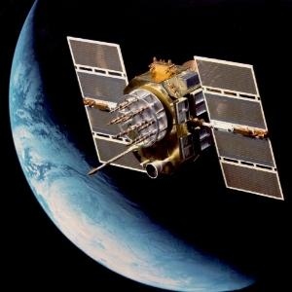
GPS簡介
1973 美國國防部開始研發
1995 建立完成
全方位即時三度空間定位能力

Slide 5
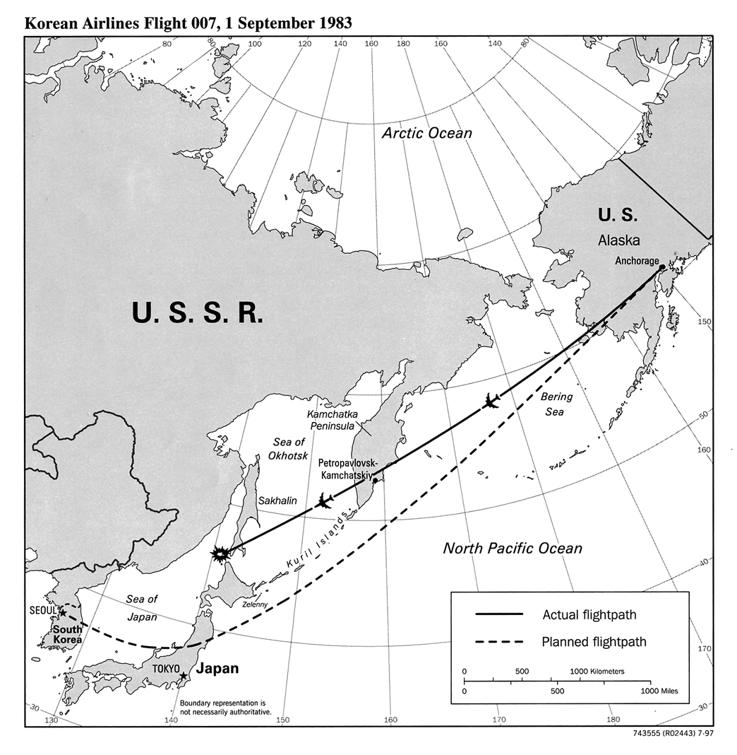
千呼萬喚始出來
大韓航空007號班機遭擊落事件，發生於當地時間1983年9月1日清晨，大韓航空007號班機進入蘇聯領空，遭蘇聯空軍Su-15攔截機擊落於庫頁島西南方的公海
美國政府因此事件，宣佈開放部份的GPS功能給民間使用

Slide 6
GPS特點
全天候，不受任何天氣的影響
全球覆蓋（高達98%）
三維定點定速定時高精度
快速、省時、高效率
應用廣泛、多功能
可移動定位

Slide 7
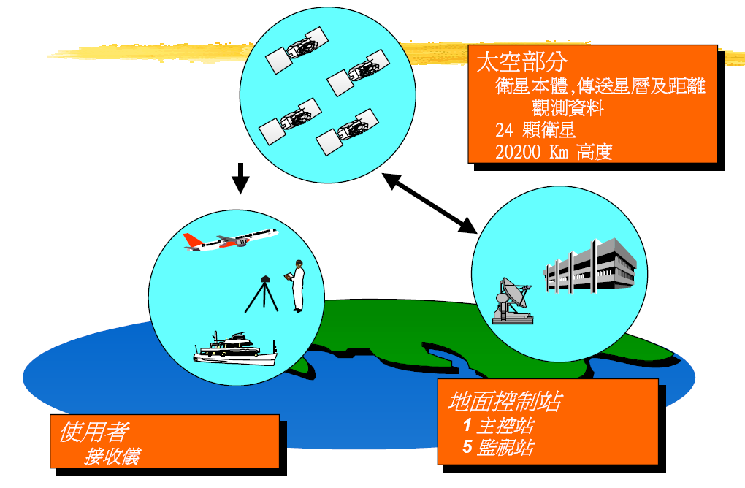
GPS系統組成

Slide 8
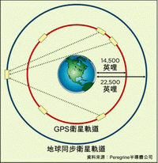
GPS衛星
24顆衛星（21顆是工作衛星，3顆是備用衛星）
Block II 型式的定位衛星， 由Rockwell International 製造
傳送的功率低於50瓦特
高度約20000公里
運行週期約為11小時58分
6軌道面
任何時間、任何地點至少可觀測到4顆以上的衛星

Slide 9
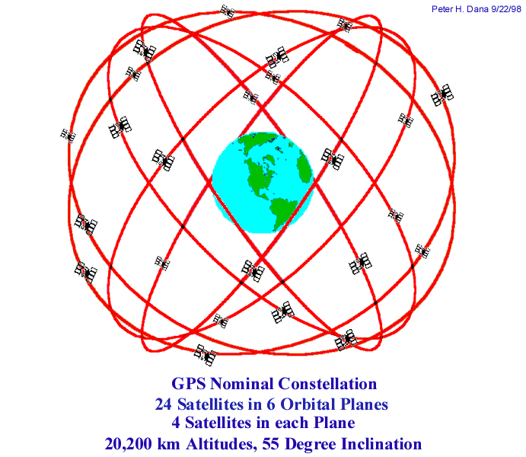
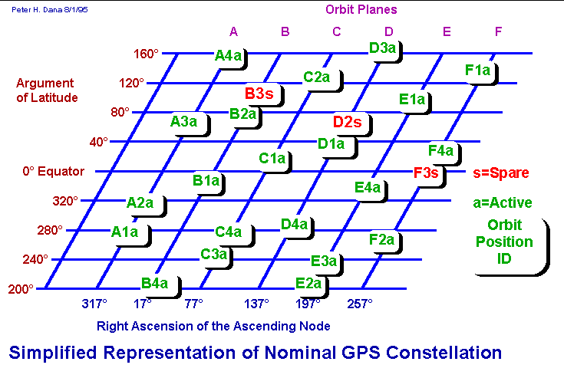
GPS衛星軌道分佈

Slide 10
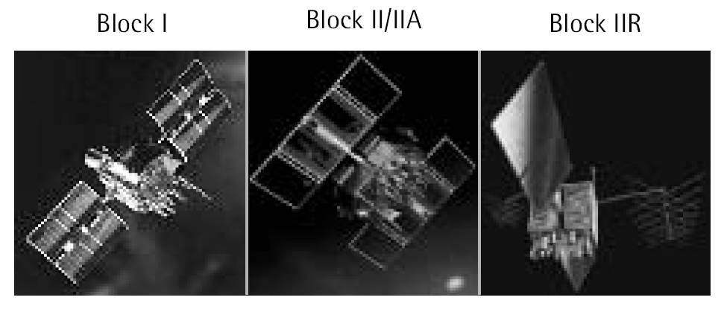
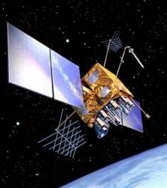
GPS衛星
Block III

Slide 11
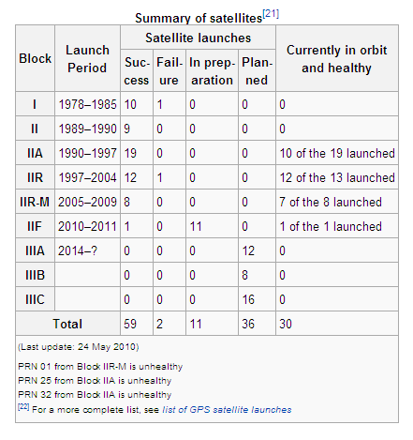
GPS衛星概況

Slide 12
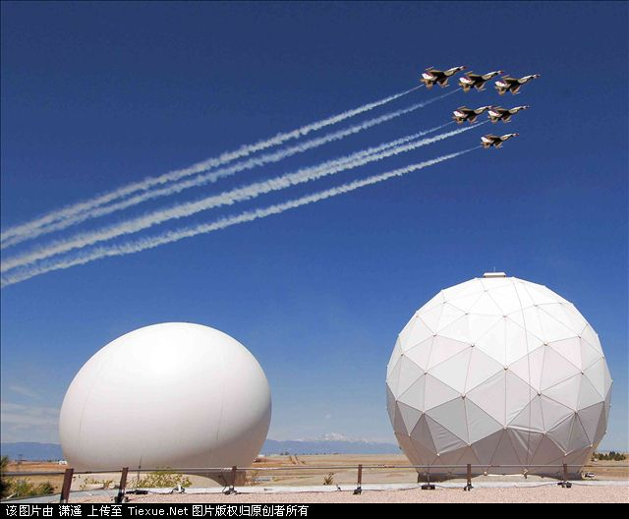

GPS地面監控站
地面監控部分
主控站(Master Control Station)
美國科羅拉多州的Schriever空軍基地
收集監測站的資料，計算軌道與時間校正
地面天線(Ground Antenna)

Slide 13
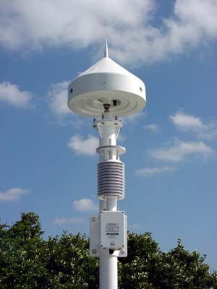
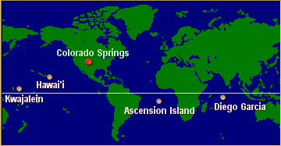

GPS地面監控站
地面監控部分
監測站(Monitoring Station)
夏威夷、亞森欣島、迪亞哥加西亞、瓜加林島、科羅拉多州
取得衛星觀測資料，將資料傳送至主控站

Slide 14
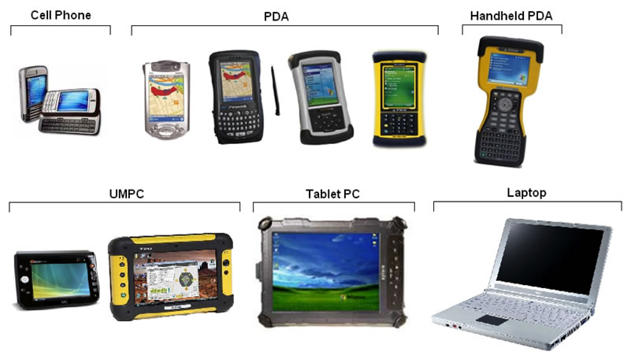
使用者接收器

Slide 15
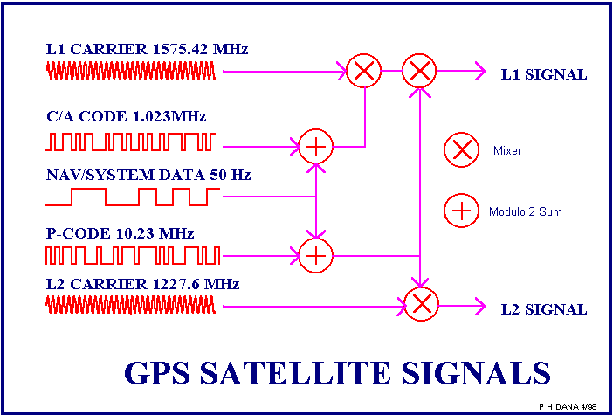
GPS編碼
訊號部分
兩組隨機電碼，一組稱為C/A碼 (Coarse-Acquisition)，一組稱為P碼 (military-only)
C/A碼主要開放給民間使用
P碼則是美國國防部保留為其軍事用途的電碼
GPS衛星傳送兩種頻 率的載波
L1 (Link 1)載波的頻 率為1575.42 MHZ
L2 (Link 2)載波的頻 率為1227.60MHZ

Slide 16
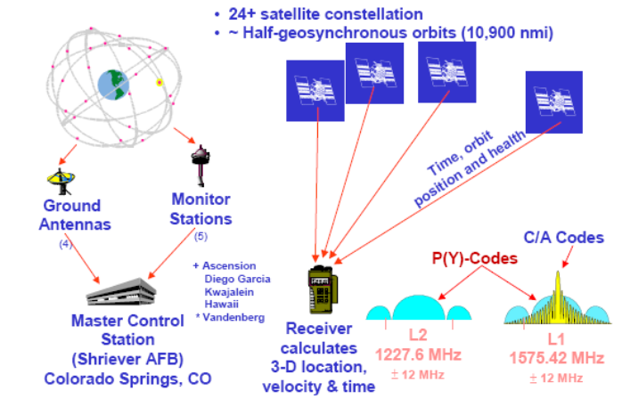
GPS系統

Slide 17
GPS訊號格式
NMEA 0183
美國國家海洋電子學會
大部份的GPS receiver都具有此標準規格
格式
ASCII
Sentence
$..........<CR><LF>
常用
GGA: Global Positioning System Fixed Data
RMC: Recommended Minimum Specific GNSS Data
GSA: GNSS DOP and Active Satellites
GSV: GNSS Satellites in View
GLL: Geographic Position - Latitude/Longitude
VTG: Course Over Ground and Ground Speed

Slide 18
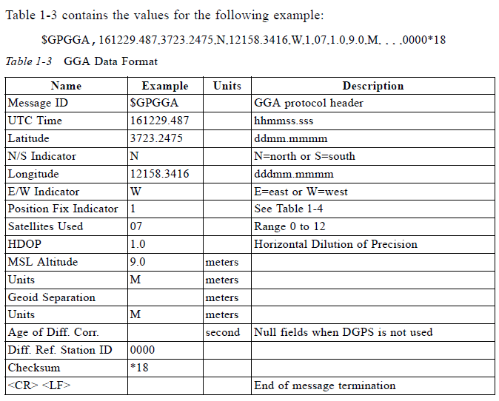
GGA (GPS固定資料)

Slide 19
精確度
精確定位系統（Precise Positioning System, PPS）
水平精度17.8 m
垂直精度27.7 m
時間精度100 ns
標準定位系統（Standard Positioning System, SPS）
水平精度100 m
垂直精度156 m
時間精度167 ns

Slide 20
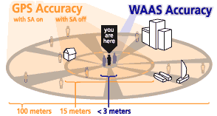
精確度
SA (Selective Availability)
刻意將衛星上的時鐘撥亂，以及廣播不準確的軌道參數使定位誤差達100 m以上
關閉後，誤差降為15 m
2000.5.2 美國取消SA
WAAS (Wide Area Augmentation System)
WAAS 是美國聯邦航空局（FAA）及美國交通部為提升飛行精確度而發展出來的，因為目前單獨使用 GPS 並無法達到聯邦航空局針對精確飛行導航所設定的要求
WAAS 可以校正由電離層干擾、時序控制不正確以及衛星軌道錯誤等因素所造成的 GPS 訊號誤差，也能提供各衛星是否正常運轉之資訊

Slide 21
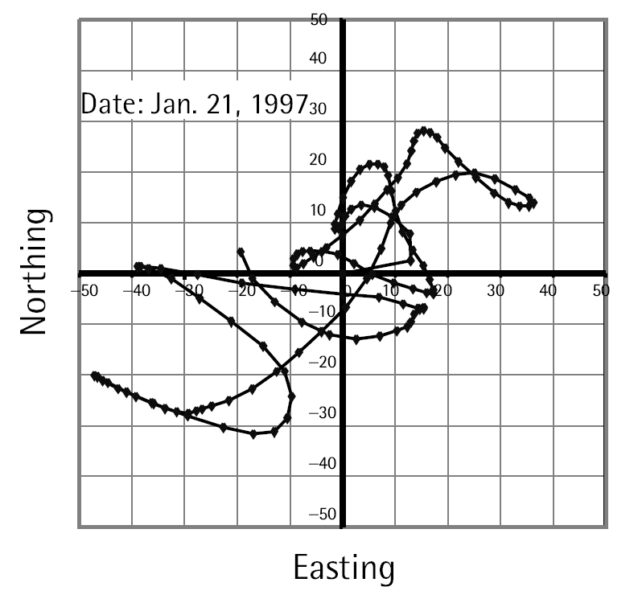
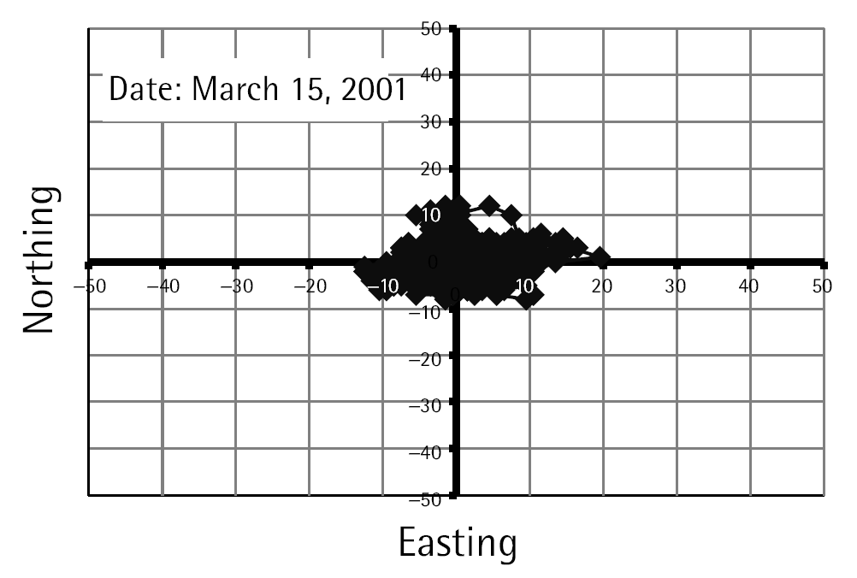
SA的影響
On May 2, 2000, SA was disabled by the then President of the United States Bill Clinton, and in late 2001, the entity managing the GPS confirmed that they never intend to enable selective availability again.
Though Selective Availability still exists, on 19 September 2007, the US Department of Defense announced that the new GPS satellites will not be capable of implementing Selective Availability.
Block IIF satellites launched in 2009 (and all subsequent GPS satellites) do not support SA.

Slide 22
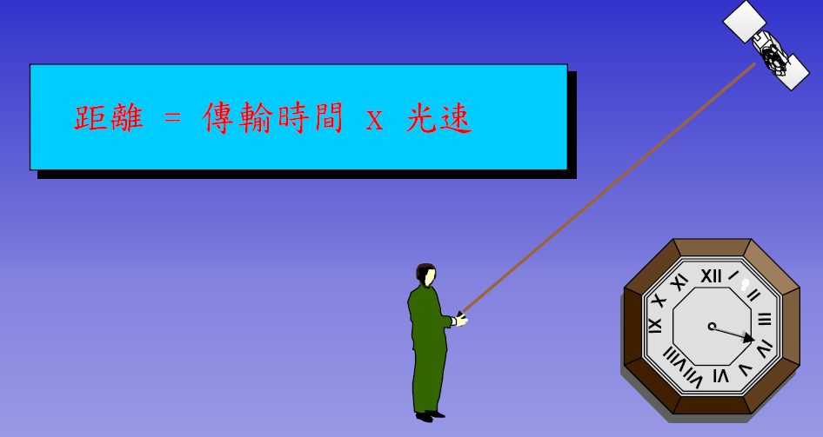
GPS定位原理

Slide 23
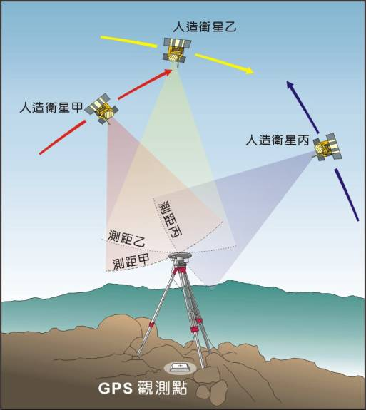
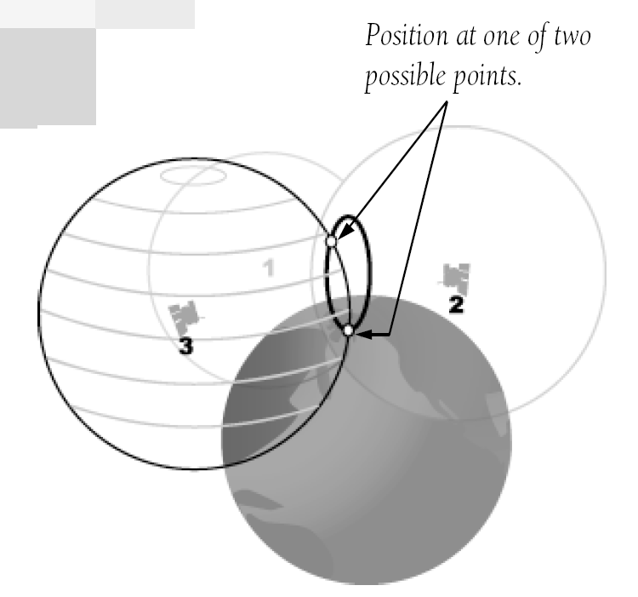
GPS定位原理

Slide 24
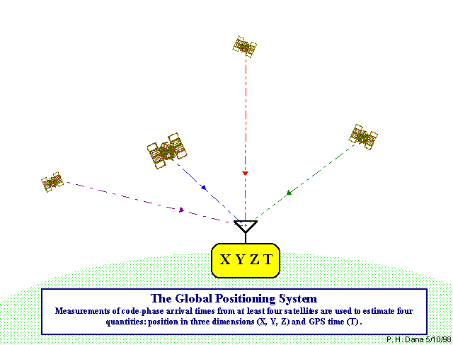
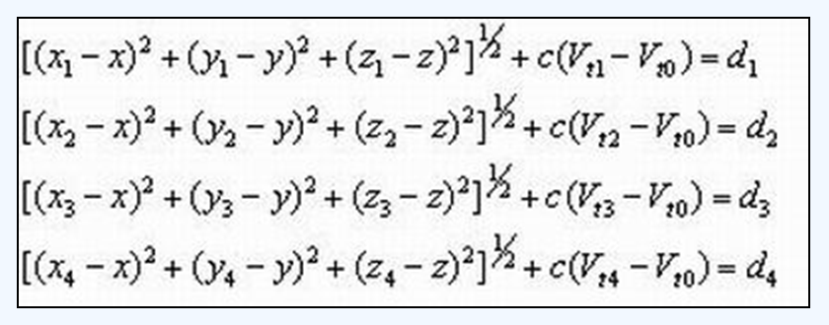

GPS定位原理
4點定位公式
$V_{t_{0}}$：接收機的時鐘誤差
$V_{t_{i}}$：衛星的時鐘誤差

Slide 25
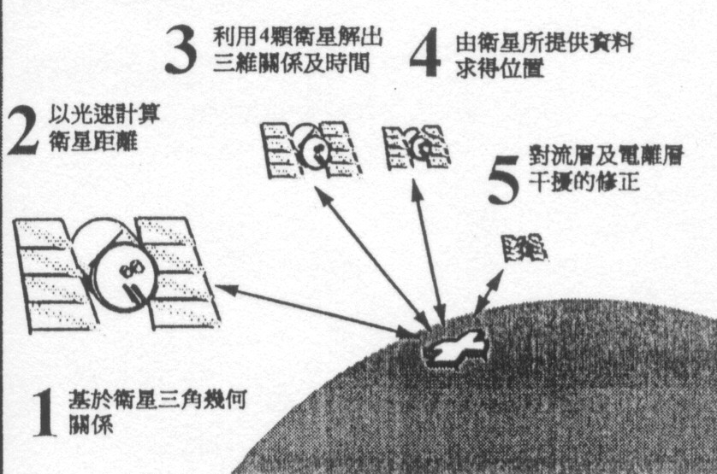
GPS定位的5個步驟

Slide 26
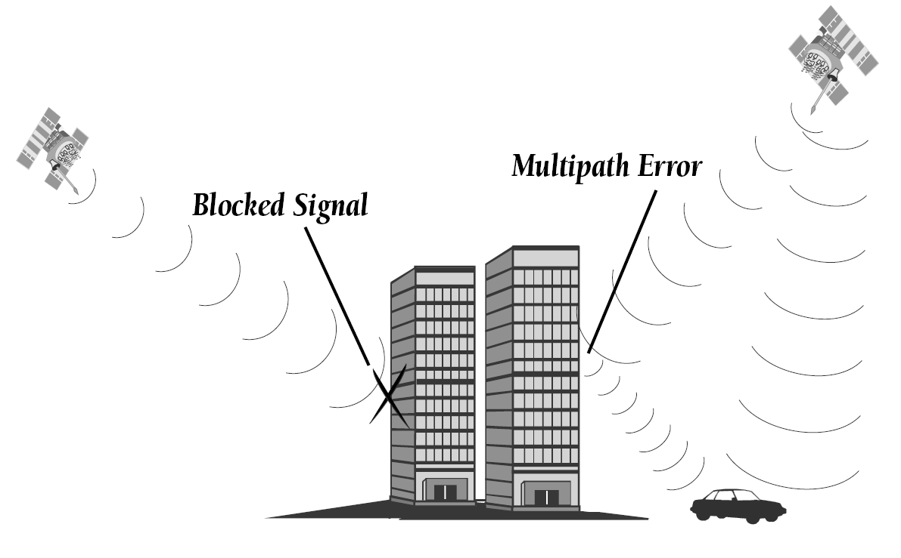
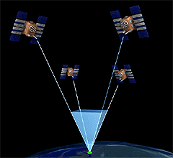
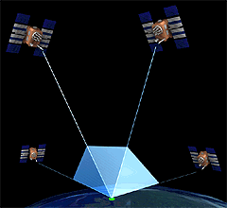
誤差來源
電離層與對流層延遲
訊號多重路徑
接收器時間誤差
軌道誤差
可見的衛星數

Slide 27
改善GPS
AGPS (Aiding GPS or Assisted GPS)
DGPS (Differential GPS)
WAAS (Wide Area Augmentation System)
LAAS (Local Area Augmentation System)
RTK (Real Time Kinematic)

Slide 28
AGPS Assisted Global Positioning System
透過手機基站連接輔助伺服器，配合傳統GPS衛星信號，讓定位的速度更快
改善開機效率，或稱為time-to-first-fix (TTFF)
利用連接遠程伺服器的方式下載衛星星曆 (Almanac Data)
定位的計算可由輔助定位伺服器完成，如：冷開機到暖開機的工作

Slide 29
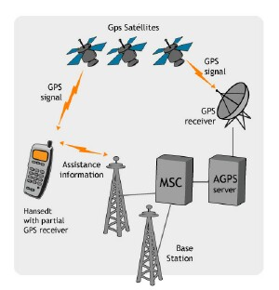
AGPS Architecture

Slide 30
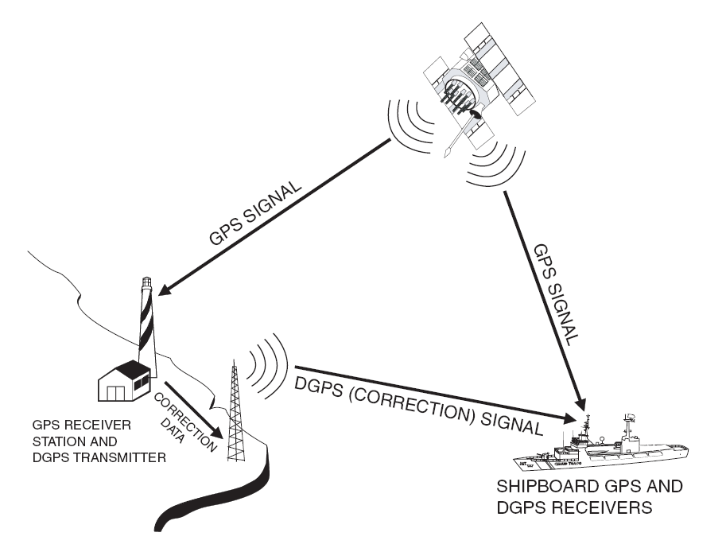
Differential GPS
Improve positioning accuracy from 15m (nominal GPS) to about 10cm.
Fixed ground-based reference stations
Measure the difference between the measured satellite pseudoranges and actual (internally computed) pseudoranges.
Broadcast the difference and the known position
GPS receivers may correct their pseudoranges by the same amount.
E.g., USCG and CCG have such a system on the longwave radio frequencies between 285 kHz and 325 kHz near major waterways and harbors.

Slide 31
WAAS
WAAS 是美國聯邦航空局（FAA）及美國交通部為提升飛行精確度而發展出來的，因為目前單獨使用 GPS 並無法達到聯邦航空局針對精確飛行導航所設定的要求
WAAS 可以校正由電離層干擾、時序控制不正確以及衛星軌道錯誤等因素所造成的 GPS 訊號誤差，也能提供各衛星是否正常運轉之資訊

Slide 32
Wide Area Augmentation System
“Essentially, WAAS is intended to enable aircraft to rely on GPS for all phases of flight, including precision approaches to any airport within its coverage area.”
It is a satellite-based augmentation system (SBAS) developed by the Federal Aviation Administration.
System architecture
A network of ground-based reference stations
Measure the GPS satellites' signals
Send correction messages to WAAS satellites
Geostationary WAAS satellites
Receive the correction messages
Broadcast the correction messages back to Earth

Slide 33
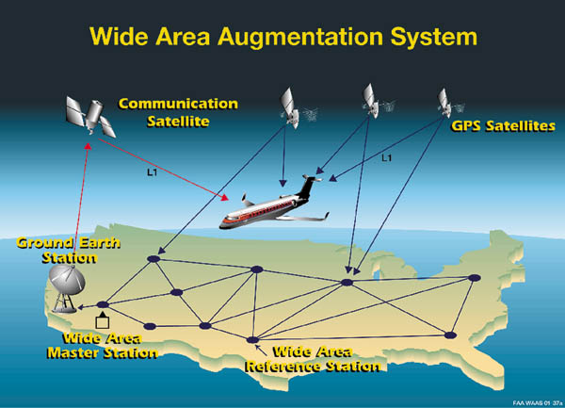
WAAS Architecture

Slide 34
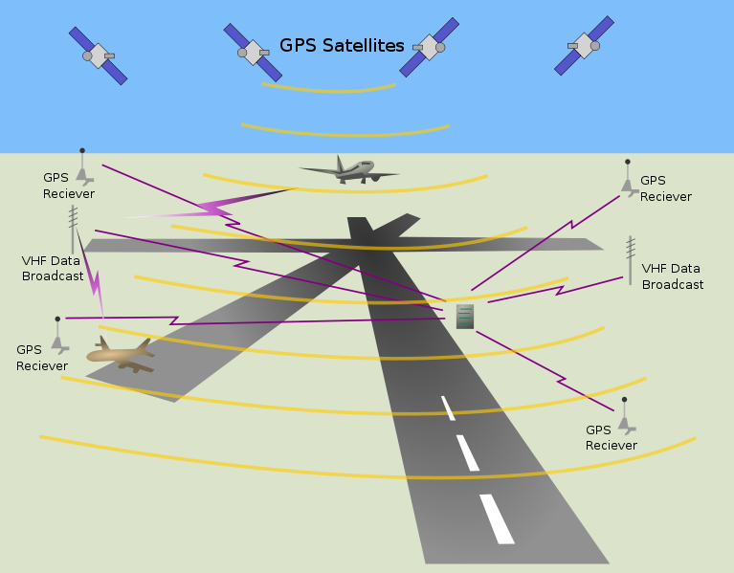
Local Area Augmentation System (LAAS)
Ground Based Augmentation System (GBAS)
An all-weather aircraft landing system based on real-time differential correction of the GPS signal
System architecture
Local reference receivers located around the airport send data to a central location at the airport.
This data is used to formulate a correction message, which is then transmitted to users via a VHF Data Link.
Accuracy
Currently, Category I ILS accuracy of 16m laterally and 4m vertically
Future, Category III ILS capability that will allow aircraft to land with zero visibility utilizing 'autoland' systems

Slide 35
Real Time Kinematic (RTK)
Real Time Kinematic (RTK) satellite navigation based on the use of carrier phase measurements provides real-time corrections up to centimetere-level accuracy.
Referred to as Carrier-Phase Enhancement for GPS (CPGPS) in particular
The difficulty in making an RTK system is properly aligning the signals.

Slide 36
Concepts of RTK
In general receivers are able to align the signals to about 1% of one bit-width
The coarse-acquisition (C/A) code sent on the GPS system sends a a bit every 0.98 microsecond, so a receiver is accurate to 0.01 microsecond, or about 3 meters in terms of distance
The military-only P(Y) signal sent by the same satellites is clocked ten times as fast, so with similar techniques the receiver will be accurate to about 30 cm.
RTK follows the same general concept, but uses the satellite's carrier as its signal, not the messages contained within.
The GPS C/A code broadcast in the L1 signal changes phase at 1.023 MHz, but the L1 carrier itself is 1575.42 MHz, over a thousand times as fast. This frequency corresponds to a wavelength of 19 cm for the L1 signal.
Thus a ±1% error in L1 carrier phase measurement corresponds to a ±1.9mm error in baseline estimation.

Slide 37
GLONASS
Global Navigation Satellite System
Globalnaya navigatsionnaya sputnikovaya sistema
Operated for the Russian government by the Russian Aerospace Defence Forces
Development began in 1976
Beginning on 12 October 1982
Completed in 1995
Achieved 100% coverage of Russia's territory (2010) and full global coverage (Oct. 2011) after the full orbital constellation of 24 satellites was restored.
GLONASS is currently the most expensive program of the Russian Federal Space Agency, consuming a third of its budget in 2010.

Slide 38
GLONASS Facts
Satellite orbit
Altitude: 19,100 km (middle circular orbit )
Inclination: 64.8 degree
Period: 11 hours and 15 minutes
Constellation
3 orbital planes with 8 evenly spaced satellites on each
24 satellites for fully global coverage, and 18 satellites for covering the territory of Russia
Accuracy (as of 2010)
Precisions of GLONASS navigation definitions (for p=0.95) for latitude and longitude were 4.46-7.38 m with mean number of NSV equals 7-8
Precisions of GPS navigation definitions were 2.00-8.76 m with mean number of NSV equals 6-11

Slide 39
Compass Navigation System
Also known as Beidou-2 (BD2), developed by China
With coverage of China and surrounding areas (Dec. 2011)
Asia-Pacific region by 2012
Global coverage by 2020
Constellation
35 satellites including 5 geostationary orbit (GEO) satellites and 30 medium Earth orbit (MEO) satellites
Two levels of positioning service: open and restricted (military)
Accuracy
Trial run (December 201)
Positioning: 25 meters
Officially launched next year
Positioning: 10 m
Speed: 0.2 m/s
Clock synchronization: 0.02 microseconds

Slide 40
Galileo Positioning System
Being built by the European Union (EU) and European Space Agency (ESA)
To provide a high-precision positioning system
Provide a global Search and Rescue (SAR) function
Blueprint
Two ground operations centres, near Munich, Germany and in Fucino, Italy.
As of 2011, initial service is expected around 2014 and completion by 2019.
Galileo satellites
30 in-orbit spacecraft (including 3 spares)
Altitude: 23,222 km (MEO)
3 orbital planes
56° inclination, ascending nodes separated by 120° longitude
9 operational satellites and one active spare per orbital plane

Slide 41
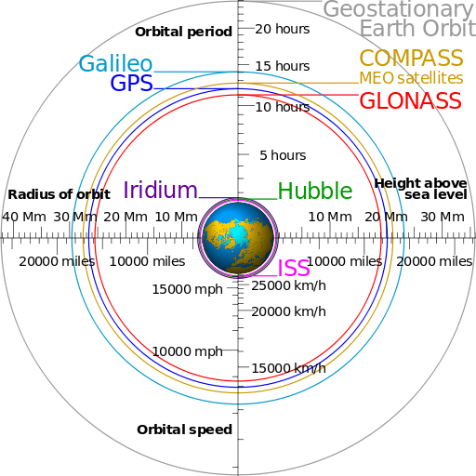
Global Navigation Satellite System (GNSS)

