Slide 1
System Administration HW5 - Micro Computer Center
weicc, zjlin

Slide 2
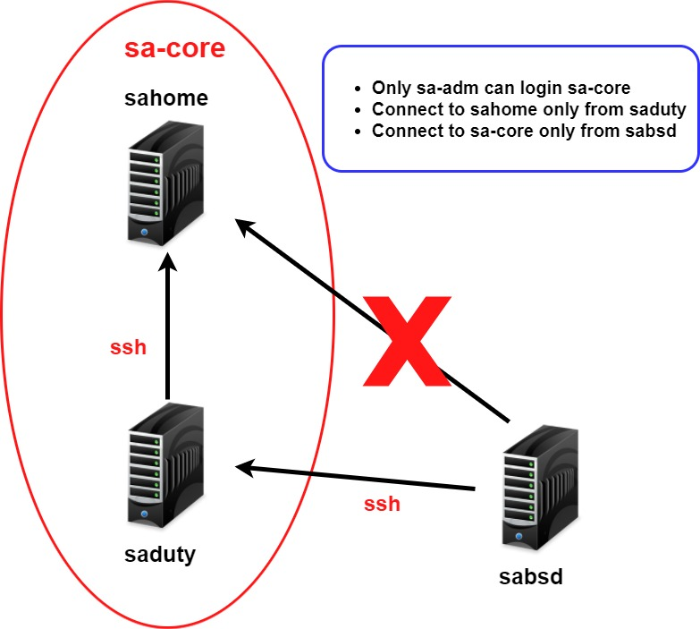

Slide 3
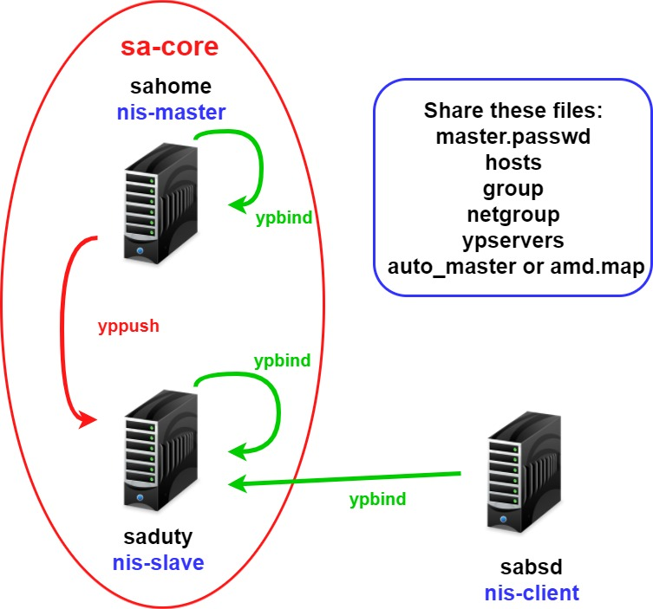
Bonus

Slide 4
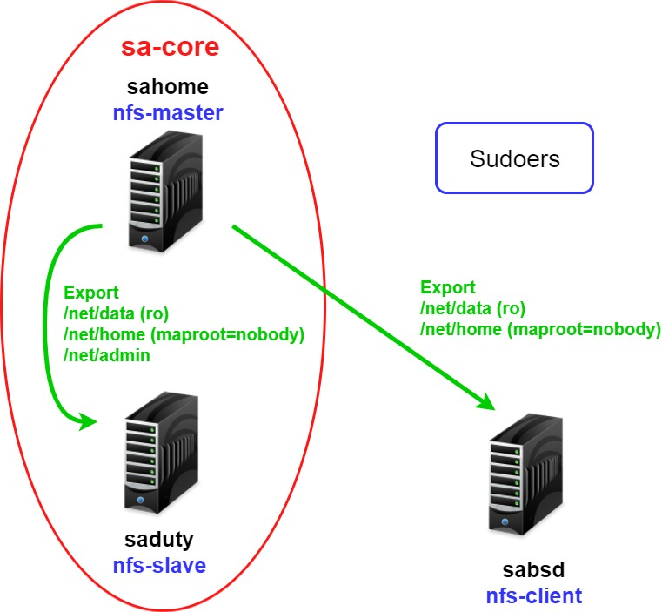

Slide 5
Requirements (1) - Overview
Machines
sahome: NFSv4 Server, NIS Master Server, (NIS Client)
saduty: NIS Slave Server, (NIS/NFSv4 Client)
sabsd: (NIS/NFSv4 Client)
Groups
sysadm: can access /net/data/sata, can sudo everything but su and any shells
nctucs: everyone
Netgroups
sa-adm: admin users, can login sa-core
sa-core: core machines (sahome and saduty)
sa-bsd: all freebsd machines (sahome, saduty, sabsd)

Slide 6
Requirements (2) - sahome
NFSv4
exports
/net/home
/net/data
/net/admin
NIS
Bind priority: sahome > saduty
login
sa-adm only
Only from saduty

Slide 7
Requirements (3) - saduty
NFSv4
sahome:/net/home (maproot=nobody) -> /net/home
sahome:/net/data (ro) -> /net/data
sahome:/net/admin (ro) -> /net/admin
NIS
Bind priority: saduty > sahome
login
sa-adm only

Slide 8
Requirements (4) - sabsd
NFSv4
sahome:/net/home (maproot=nobody) -> /net/home
sahome:/net/data (ro) -> /net/data
NIS
Bind priority: saduty>sahome
login
ALL

Slide 9
Requirement (5)
All machines share /net/data/sudoers
All user’s home directory must be in /net/home except root
Auto-start all services
Auto-mount all folders with amd or autofs
NFSv4 use nfsuserd mapping uid and username
/etc/exports must be NFSv4 format
User can change password on NIS Clients
NIS share file must be in /var/yp/src
confiure /var/yp/Makefile

Slide 10
Rup
You can run rup on all servers.

Slide 11
ZFS snapshot
Using ZFS snapshot to create snapshot
zroot/net/home@5min-<date> * 2
zroot/net/home@15min-<date> * 3
zroot/net/home@1hour-<date> * 2
e.g. zroot/net/home@5min-20171221-1555
Using crontab or any tools
The script must run at least 2 hour
5min * 2
15min *3
1hour *2

Slide 12
Log server
Sahome as a Log server
others use syslog to transfer log to sahome
Use syslog to record all machine’s sshd log
store at /net/data/ssh/
newsyslog for log rotation
separated by day, store 10 days
compressed to .bz2

Slide 13
Step 1 - Setup sahome as NIS Master Server
Edit /etc/rc.conf
nis_server, nisdomainname, yppasswdd
Edit /var/yp/Makefile
#NOPUSH = "True"
$(YPSRCDIR) = < to be modified >
TARGETS = < to be modified >
Create /var/yp/src/hosts, /var/yp/src/group…etc
Edit /var/yp/src/master.passwd & /var/yp/src/group to create your accounts
Initial and start services
ypinit
service [ ypserv | ypbind | rpcbind ] [ start | restart | stop ]
services started order is important!

Slide 14
Step 2 - Setup NIS Clients
Add NIS Servers’ IP to /etc/hosts
Edit /etc/master.passwd & /etc/group
vipw
vigr
Edit /etc/nsswitch.conf
hosts : files nis dns
Edit /etc/rc.conf
nis_client, nis_client_flags, nisdomainname
Modity ypbind sequence (on every clients)
Testing tools
ypcat
ypwhich

Slide 15
Step 3 - Setup saduty as a NIS Slave Server
Edit /etc/rc.conf
nis_server, nisdomainname
Edit /var/yp/ypservers (on cshome)
Initial and (re)start services
ypinit

Slide 16
Step 4 - Setup NFSv4 environment
Edit /etc/rc.conf
autofs (NFS Client)
nfs_server, mountd, nfsv4_server, nfsuserd, nfsuserd_flags (NFS Server)
ZFS create dataset
zroot/net/
zroot/net/home
zroot/net/data
zroot/net/admin
Edit /etc/exports (NFSv4 Server)
Must be NFSv4 format
Edit autofs.map / amd.map

Slide 17
Step 4 - Setup NFSv4 environment (Cont.)
Initial and start services
service [ rpcbind | nfsd | nfsuserd | mountd ] [ start | restart | stop ]
Do something for mapping uid/gid and user/group
nfsuserd

Slide 18
Step 5 - Finishing
sudoers (/usr/local/etc/sudoers)
Including other sudoers file from /net/data/sudoers
man sudoers to see more about “include”.
Login permissions
only sa-adm(netgroup) can login sa-core.
sahome:/etc/hosts.allow
sa-adm(netgroup) only can login sahome from saduty.
/net/data/sata
sysadm only
If you restart rpcbind, all of service based on rpc also need to restart

Slide 19
After NIS & NFS servers.
Rup
rpc
Log server
syslog
ZFS snapshot

Slide 20
Help
Email ta@nasa.cs.nctu.edu.tw
Goto CSCC@EC3F

Slide 21
Bonus - share autofs.map
Share autofs.map by yp
yp key map name must be auto_master_forSA
ypcat -k auto_master_forSA
So you need share auto_master_forSA and autofs.map defined in auto_master_forSA
Hint
Reference workstation
/var/yp/Makefile

Slide 22
Bonus - Script to create account
Write a script to create accounts on NIS
random password
read from <account_info> file only contain username, fullname
e.g. zjlin, Zih-Jing
define group by args
e.g. ./autocreate gcs <gcs_account.txt>
user home directory must be created on NFS
you can use any language to implement

