Slide 1
System Administration Practice Homework 2: Shell Programming
wlliou

Slide 2
Requirements
2-1: Filesystem Statistics (20%)
2-2: Web Crawler + Dialog(60%)
用 shell 爬課表，並且用 column 排版輸出。 ❤
Modify code by yourself at demo (20%)
Please write the scripts in Bourne Shell (sh)
No score if you use csh, bash or other languages.
Due: 2017/10/12 upload ${student_ID}.tar on E3
Demo at next week. 2017/10/16~19 19:00~22:00

Slide 3
2-1: Filesystem Statistics

Slide 4
2-1: Filesystem Statistics - Requirement
Inspect the current directory(“.”) and all sub-directory.
Calculate the number of directories.
Do not include ‘.’ and ‘..’
Calculate the number of files.
Calculate the sum of all file size.
List the top 5 biggest files.
Only consider the regular file. Do not count in the link, FIFO, block device... etc.

Slide 5
2-1: Filesystem Statistics - Requirement
Use one-line command
No temporary file or shell variables.
No “&&” “||” “>” “>>” “<” “;” “&”, but you can use them in the awk command. Actually, you don’t need them to finish this homework.
Only pipes are allowed.
Hint: ls(1) with -A and -R

Slide 6
2-1: Filesystem Statistics - Requirement
Grade
File is executable. (4%)
List top 5 file size and name. (4%)
Dir num is correct. (4%)
File num is correct. (4%)
Total size is correct. (4%)

Slide 7
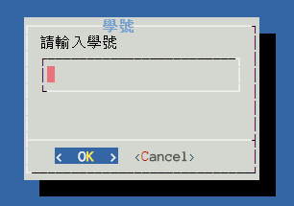
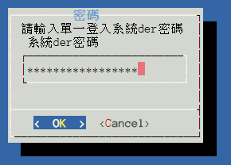
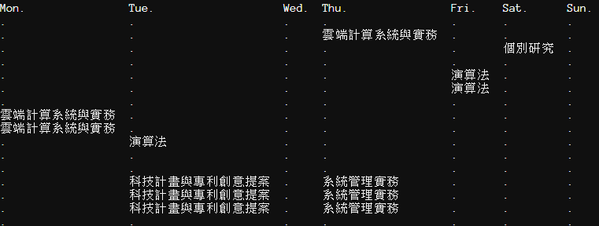
2-2: Web Crawler + Dialog

Slide 8
2-2: Requirements
爬到自己的課表(HTML)，用任何入口都可以。(40%)
用 column 排版輸出。(5%)
需要用戶輸入的地方使用 dialog。(10%)
登入或辨識驗證碼時如果失敗要能自動重試(retry)。(5%)
輸入密碼時要用星號遮罩。(-10%)
不能自建伺服器。(-40%) 除了 cookie jar 和驗證碼圖片以外，寫一個檔案-10分，請善用變數。(-10%/次)

Slide 9
2-2: Dialog
Dialog is a program that will let you to present a variety of questions or display messages using dialog boxes from a shell script.
These types of dialog boxes are implemented (though not all are necessarily compiled into dialog):
buildlist, calendar, checklist, dselect, editbox, form, fselect,
gauge, infobox, inputbox, inputmenu, menu, mixedform,
mixedgauge, msgbox (message), passwordbox, pause,
prgbox, programbox, progressbox, radiolist, rangebox,
passwordform, tailbox, tailboxbg, textbox, timebox,
treeview, and yesno (yes/no).

Slide 10
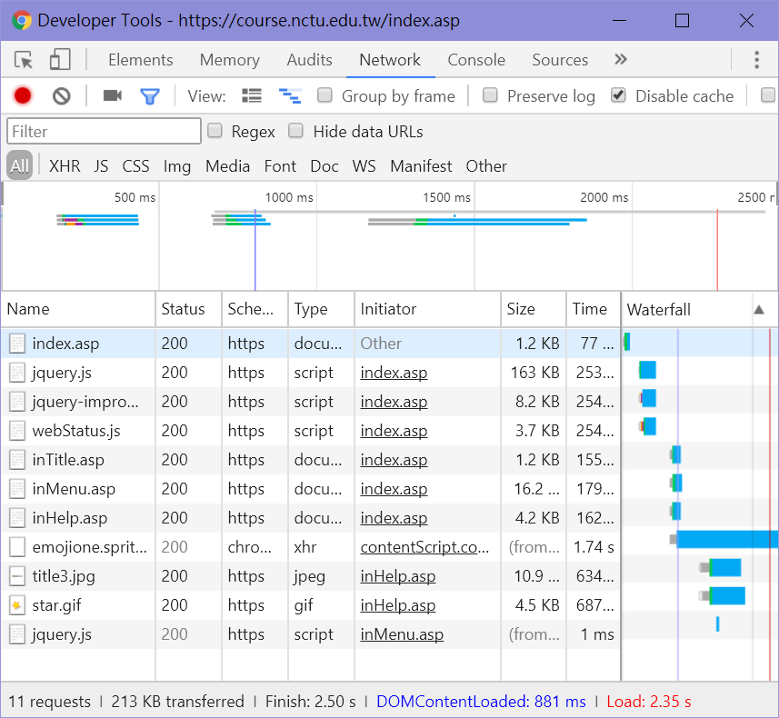
2-2: Hint
課表在一般選課系統裡有。
可以用校園系統單一入口來登入一般選課系統。
善用Browser Devtool (F12) / Network

Slide 11
2-2: Hint (Keywords)
dialog
function (retry)
sed
awk
grep
curl
Cookie jar
iconv (轉編碼)
while
if
HTML
HTTP form-data

Slide 12
2-2: Recommend Workflow
登入「校務系統單一入口」
登入「一般選課系統」
爬+剖析課表
辨識驗證碼
Bonus(+5%): 使用自己的方式辨識，可使用外部服務或工具。
POST https://portal.nctu.edu.tw/portal/chkpas.php?
https://portal.nctu.edu.tw/portal/relay.php?D=cos
https://course.nctu.edu.tw/index.asp
https://course.nctu.edu.tw/adSchedule.asp
可使用提供的 tool 處理 HTML: https://github.com/nctu-cscc/sa2017-hw2/tree/master/extractFormdata
可以 call 提供的 API，請參照 https://nasa.cs.nctu.edu.tw/sap/2017/hw2/captcha-solver/README.md
先存取 https://portal.nctu.edu.tw/captcha/pic.php 讓登入系統建立 session 與驗證碼
再使用 https://portal.nctu.edu.tw/captcha/pitctest/pic.php 取得驗證圖片
body: username=<帳號>&password=<密碼>&seccode=<驗證碼>&pwdtype=static&Submit2=登入(Login)
注意：系統限制10分鐘內僅能登入5次，超過必須等待時間解鎖。

Slide 13
2-2: Bonus
3-2
使用自己的方式辨識驗證碼，可使用外部服務或工具。(+5%)
自己處理登入一般選課系統的 Form (將 HTML 的 form 轉為 url 格式)。(+5%)

Slide 14
2-2: Help
FB Group: nctu nasa 課程討論區https://www.facebook.com/groups/NCTUCSNASA/
Email ta@nasa.cs.nctu.edu.tw or E3
Q為何出這個作業？ A覺得好玩😜
Notes:
如果有變動，會公布在FB社團上

