Slide 1
Serial Devices

Slide 2
Serial devices
Terminal
Modem
Mice
…

Slide 3
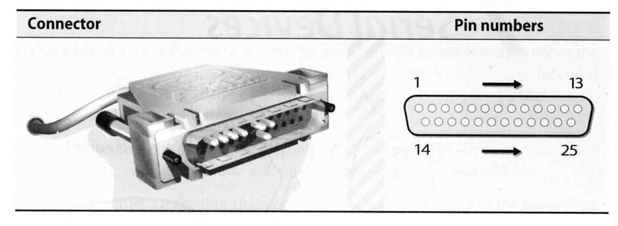
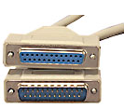
Serial standard (1)
RS-232 standard on DB25 connector
Electrical characteristics
Meaning of each signal wire
Ping assignment
DB25P (male)
DB25S (female)
DTE (Data Terminal Equipment)
DCE (Data Circuit-terminating Equipment)

Slide 4
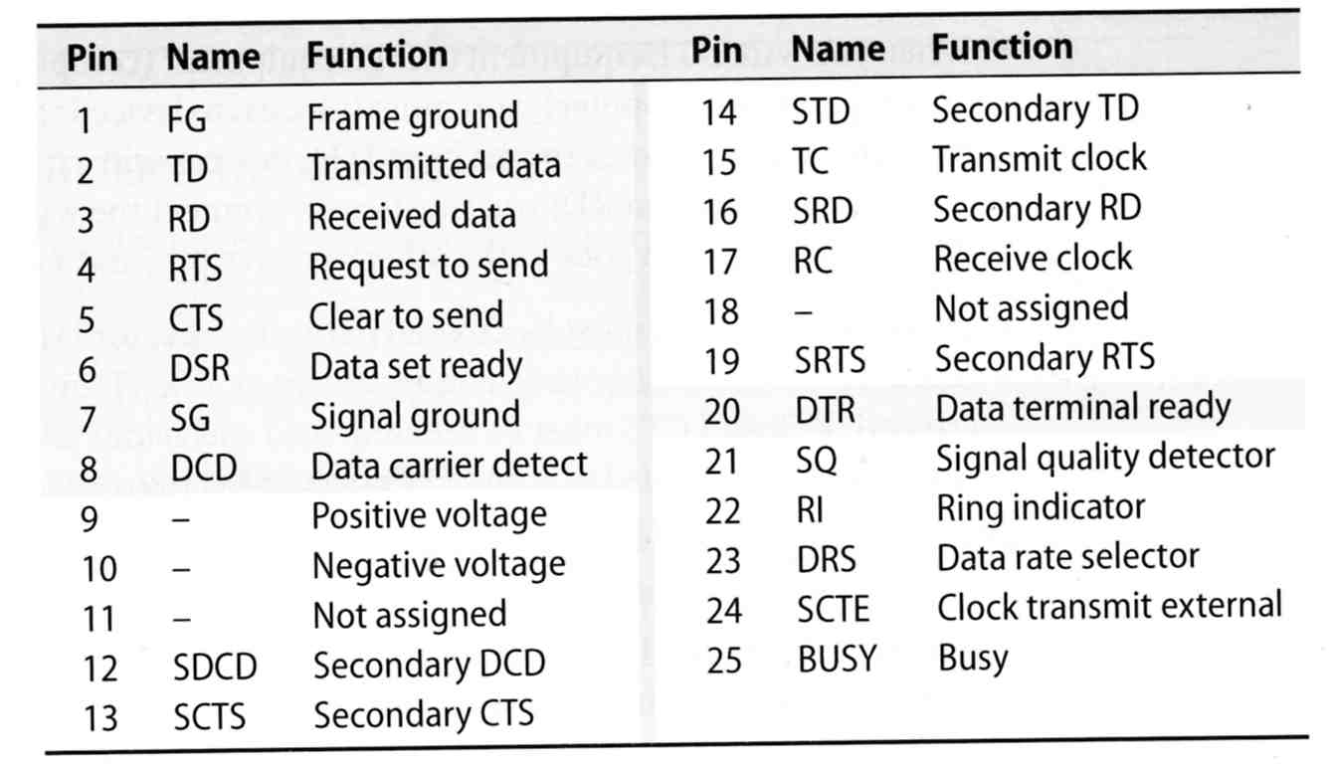
Serial standard (2)
RS-232 signals and ping assignment

Slide 5
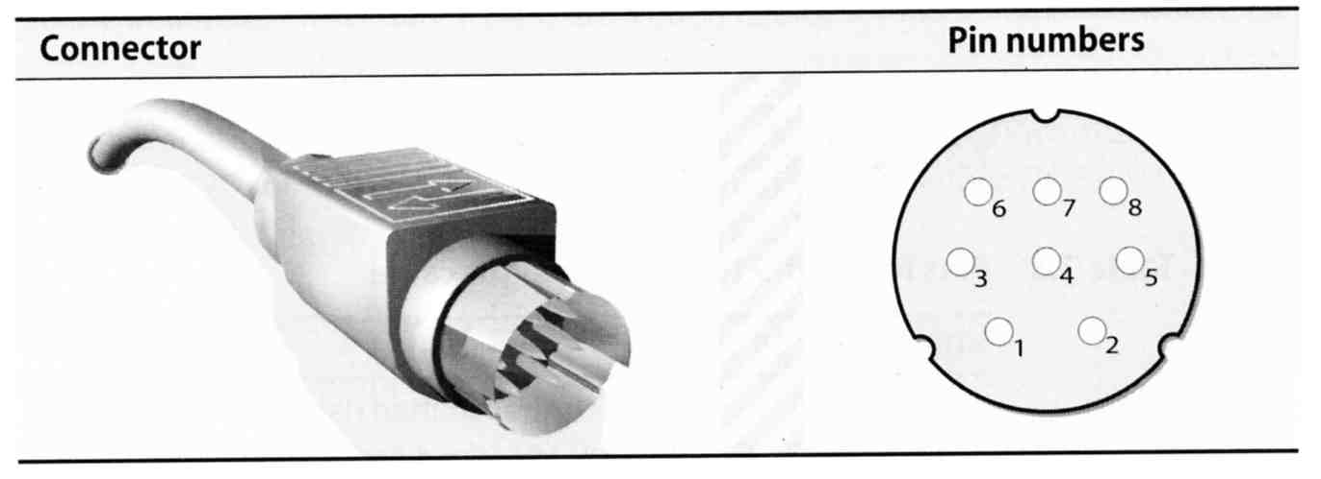
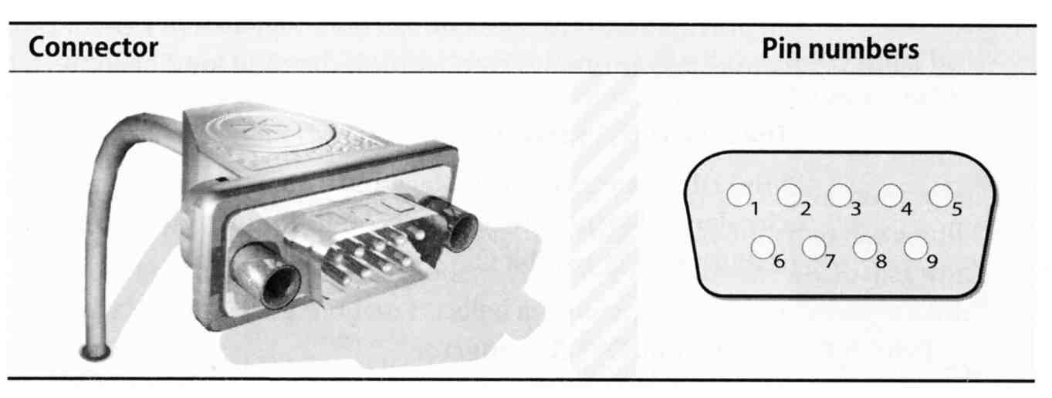
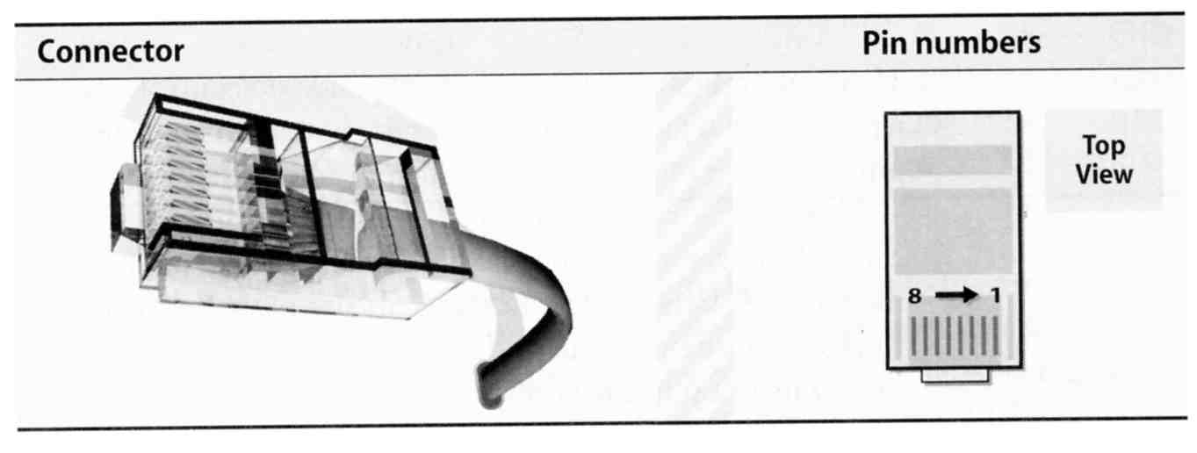
Serial standard (3)
Alternative connectors
Since RS-232 is overkill for all real-world situation
Mini DIN-8
DE-9
RJ-45

Slide 6
Serial standard (4)
Cable Length
RS-232 specifies a maximum length of 75 feet at 9600 bps
75 * 30.5 ≒ 22 m
In reality, they hit the limit between 800 ~ 1000 feet

Slide 7
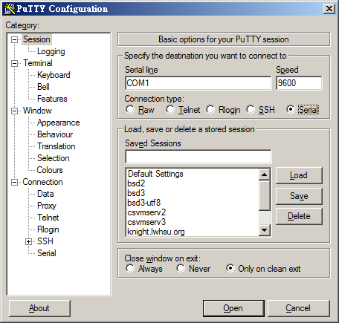
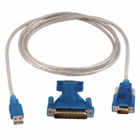
Serial Console
/boot/loader.conf
console="vidconsole,comconsole"
Connect
PuTTY
tip(1)
comms/minicom
http://www.freebsd.org/doc/en/books/handbook/serialconsole-setup.html

Slide 8
Serial Device File
Serial ports are represented by device files under /dev
The name of the device file is no big deal
behavior is determined by the major and minor device number
System | Device files for the first two serial ports
FreeBSD | /dev/ttyu[0,1] (com 1, com 2)
Red Hat | /dev/ttyS[0,1]
Solaris | /dev/term[a,b]
SunOS | /dev/tty[a,b]
liuyh@NASA ~ $ ls -l /dev/ttyu0*
crw------- 1 root wheel 0, 39 Sep 25 10:57 /dev/ttyu0
crw------- 1 root wheel 0, 40 Sep 25 10:57 /dev/ttyu0.init
crw------- 1 root wheel 0, 41 Sep 25 10:57 /dev/ttyu0.lock

Slide 9
Kernel Configuration
Kernel configuration file
device uart
dmesg
% grep uart /var/run/dmesg.boot (8.x)
Kernel Module
% kldload uart
uart_load="YES" in /boot/loader.conf
uart0: <16550 or compatible> port 0x3f8-0x3ff irq 4 flags 0x10 on acpi0
uart0: [FILTER]
uart1: <16550 or compatible> at port 0x2f8-0x2ff irq 3 on isa0
uart1: [FILTER]

Slide 10
Configuration of Hardwired Terminals (1)
Two main tasks
Make sure each process is attached to a terminal to accept logins
Make sure that information about the terminal is available once a user login

Slide 11
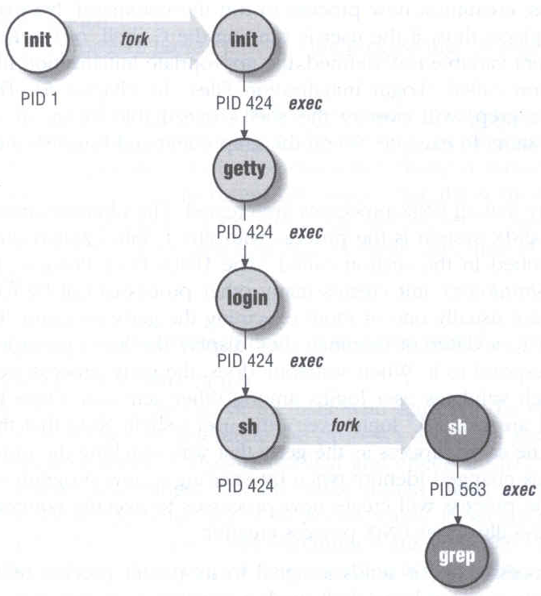
Configuration of Hardwired Terminals (2)
The login process
init spawn getty according to /etc/ttys
getty sets the port’s initial characteristics and print the prompt
User enter login name
getty executes login program
login request password
login prints /etc/motd
login sets up environment variables
login runs a shell for user
login(1), getty(8)

Slide 12
Configuration of Hardwired Terminals (3)
Terminal Configuration Files
On/Off
whether the terminal should be run a getty
Term type
virtual console, network, dial-in
Parameter
Terminal parameters, such as speed
System | On/Off | Term Type | Parameters | Monitor
FreeBSD | /etc/ttys | /etc/ttys | /etc/gettytab | getty
Red Hat | /etc/inittab | /etc/ttytype | /etc/gettydefs | getty
SunOS | /etc/ttytab | /etc/ttytab | /etc/gettytab | getty
Solaris | _sactab | _sactab | zsmon/_pmtab | ttymon

Slide 13
Configuration of Hardwired Terminals (4)
FreeBSD: /etc/ttys
Format
device program termtype {on|off} [secure]
Restart init process
kill -1 1
kill -HUP 1
ttys(5)
#name getty type status comments
ttyv1 "/usr/libexec/getty Pc" cons25 on secure
ttyv2 "/usr/libexec/getty Pc" cons25 on secure
ttyd0 "/usr/libexec/getty std.9600" dialup off secure
ttyd1 "/usr/libexec/getty std.9600" dialup off secure
ttyp0 none network
ttyp1 none network

Slide 14
Configuration of Hardwired Terminals (5)
FreeBSD: /etc/gettytab
Associate symbolic names with port configuration information, such as speed, parity, prompt
man gettytab
default:\
:cb:ce:ck:lc:fd#1000:im=\r\n%s/%m (%h) (%t)\r\n\r\n:sp#1200:\
:if=/etc/issue:
2|std.9600|9600-baud:\
:np:sp#9600:
P|Pc|Pc console:\
:ht:np:sp#115200:
Notes:
sp: line speed
np: no parity
ht: terminal has real tabs
cb: use crt backspace mode
ce: use crt erase algorithm
ck: use crt kill algorithm
lc: terminal has lower case
fd: form feed delay
im: login prompt
if: display named file before prompt

Slide 15
Special Characters and The terminal driver
The terminal driver supports several special function when typing special keys
Name | Default | Function
Erase | ^H | Erases one character of input
WErase | ^W | Erases one word of input
Kill | ^U | Erases the entire line of input
EOF | ^D | Sends an “end of file” indication
INTR | ^C | Interrupts the currently running process
Quit | ^\ | Kills the current process with a core dump
Stop | ^S | Stops output to the screen
Start | ^Q | Restarts output to the screen
Discard | ^O | Throws away pending output
Suspend | ^Z | Suspends the current process
LNext | ^V | Interprets the next character literally

Slide 16
stty – Set Terminal Options
Change and query various settings of the terminal drivers
There are about a zillion options
tty(4), stty(1)
Example
stty intr "^C" kill "^U" erase "^H"
stty -a
reset tty
reset
stty sane
speed 38400 baud; 24 rows; 80 columns;
lflags: icanon isig iexten echo echoe -echok echoke -echonl echoctl
-echoprt -altwerase -noflsh -tostop -flusho pendin -nokerninfo
-extproc
iflags: -istrip icrnl -inlcr -igncr ixon -ixoff ixany imaxbel -ignbrk
brkint -inpck -ignpar -parmrk
oflags: opost onlcr -ocrnl -oxtabs -onocr -onlret
cflags: cread cs8 -parenb -parodd hupcl -clocal -cstopb -crtscts -dsrflow
-dtrflow -mdmbuf
cchars: discard = ^O; dsusp = ^Y; eof = ^D; eol = <undef>;
eol2 = <undef>; erase = ^?; erase2 = ^H; intr = ^C; kill = ^U;
lnext = ^V; min = 1; quit = ^\; reprint = ^R; start = ^Q;
status = ^T; stop = ^S; susp = ^Z; time = 0; werase = ^W;

Slide 17


Other Common I/O ports (1)
Parallel ports
Similar to serial ports in concept, but parallel ports transfer 8 bits of data at once
IEEE-1284 standard
Male DB25 ←→ male Centronics connector
Female Centronics connector
Male Centronics connector

Slide 18
Other Common I/O ports (2)
USB – Universal Serial Bus
Up to 127 devices can be connected
Standardized connectors
Devices can be connected and disconnected without powering down
Up to 12Mb/s
USB 2.0
Up to 480Mb/s
USB 3.0 (USB 3.1 Gen1)
Up to 5Gbps
USB 3.1 (USB 3.1 Gen2)
Up to 10Gbps
USB 3.2

