Slide 1
Drivers and the Kernel

Slide 2
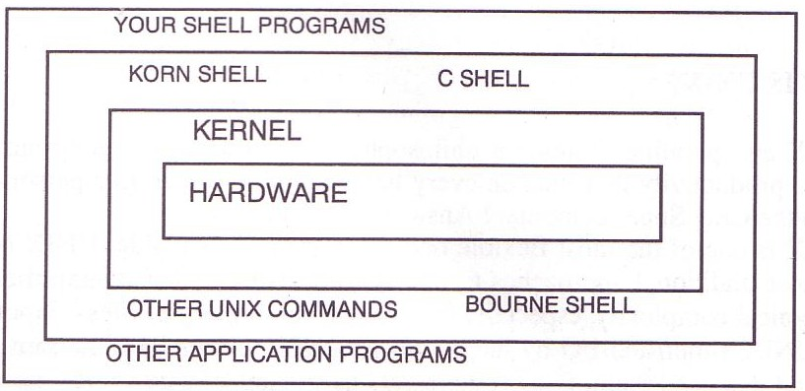
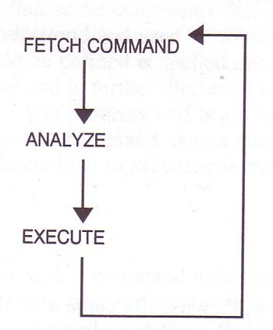
Introduction –
UNIX Kernel and Shell
interpret

Slide 3
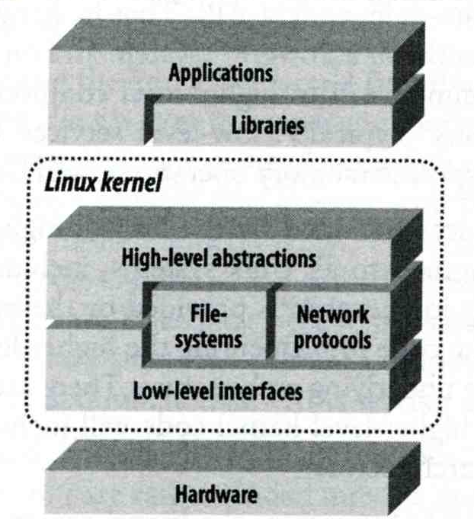
Roles of Kernel
Components of a UNIX System
  User-level programs
  Kernel
  Hardware
Two roles of kernel (OS)
  High-level abstractions
    Process managements
      Time sharing, memory protect
    File system management
    Memory management
    I/O management
  Low-level interface
    drivers

Slide 4
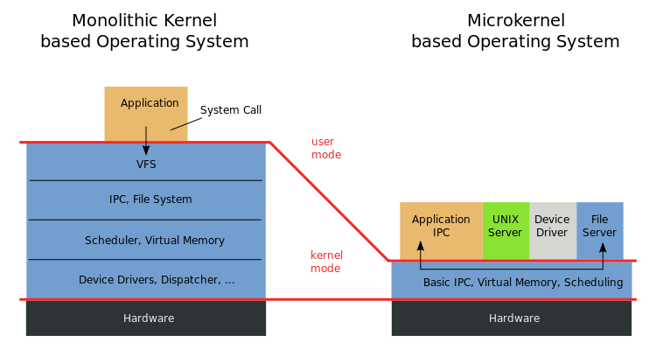
Kernel Types
Since BSD…
https://en.wikipedia.org/wiki/Microkernel

Slide 5
Kernel Types
Concept of being modulized…
only provides essential functionalities;
Put other sophisticated functions into user level
e.g. I/O management in the user level
increase scalability and less difficult in maintenance
How to communicate?
  Message passing – less efficient
Two extreme types
  Microkernel
    Provide only necessarily, compact and small functionalities
    Other functions is added via well-defined interface
  Monolithic kernel (龐大的kernel – e.g., UNIX)
    Whole functionalities in one kernel
Modern OS
  Solaris
    Completely modular kernel
    Load necessarily module when it is needed
  BSD/Linux-derived system
    Much of the kernel's functionality is contained in modules
More integrated…
Monolithic kernel developing towards micro kernel (being more modulized),
but without IPC (message passing) problem

Slide 6
Kernel related directory
Build directory and location
System | Build Directory | Kernel file
FreeBSD | /usr/src/sys | /kernel ( < 4.x) /boot/kernel/kernel (> 5.x)
Red Hat | /usr/src/linux | /vmlinuz or /boot/vmlinuz
Solaris | - | /kernel/unix
SunOS | /usr/kvm/sys | /vmunix

Slide 7
Why configure the kernel?
Generic: with various devices…,
functions supported
The native kernel is often big and common
Tailoring kernel to match site situation
  Purge unnecessary kernel devices and options
  Add functionalities that you want
OS patch
  Remedy security hole of kernel implementation
Fine-tune system performance
  Such as adjusting important system parameters
Adding device drivers
Fast boot time
Lower memory usage
kernel image → memory usage

Slide 8
Building a FreeBSD Kernel
<ARCH> represents one of i386, amd64, ia64, powerpc, sparc64
Kernel source
  /usr/src/sys
Kernel configuration file
  /usr/src/sys/<ARCH>/conf
    GENERIC, LINT (< 4.X)
    GENERIC, “make LINT” under this dir ( > 5.x)
Steps to build a new kernel
  Edit /usr/src/sys/<ARCH>/conf/<KERNCONF>
    For example, save a configuration file named as SABSD
  % cd /usr/src ;
  % make buildkernel KERNCONF=SABSD
  % make installkernel KERNCONF=SABSD
https://www.freebsd.org/doc/en/books/handbook/kernelconfig-building.html
LINT file: lists all options
→ To generate LINT file

Slide 9
To Build a FreeBSD Kernel…
What to Choose?
What to Load?
Option Settings?
Device Drivers?

Slide 10
Finding the system hardware (1)
Listing devices from M$ windows
Before venturing into kernel configuration
  Get an inventory of the machine’s hardware
  Microsoft's Device Manager
dmesg
  cat /var/run/dmesg.boot
Listing devices from dmesg
psm0: <PS/2 Mouse> irq 12 on atkbdc0
psm0: [GIANT-LOCKED]
psm0: [ITHREAD] psm0: model Generic PS/2 mouse, device ID 0

Slide 11
Finding the system hardware (2)
pciconf
  pciconf -l
ath0@pci0:3:0:0: class=0x020000 card=0x058a1014 chip=0x1014168c
vendor = 'Atheros Communications Inc.'
device = 'AR5212 Atheros AR5212 802.11abg wireless'
class = network subclass = ethernet
May not support by GENERIC…

Slide 12
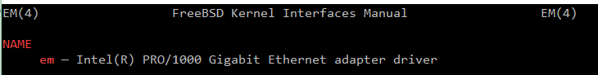
Finding the system hardware (3)
pciconf & man page
  man -k Atheros
    Find drivers from company name
  pciconf -l & man
    List all attached devices
    man [device]
      man em
ehci1@pci0:0:29:7: class=0x0c0320 card=0x3a3a8086 chip=0x3a3a8086 rev=0x00 hdr=0x00
pcib10@pci0:0:30:0: class=0x060401 card=0x244e8086 chip=0x244e8086 rev=0x90 hdr=0x01
isab0@pci0:0:31:0: class=0x060100 card=0x3a168086 chip=0x3a168086 rev=0x00 hdr=0x00
ahci0@pci0:0:31:2: class=0x010601 card=0x3a228086 chip=0x3a228086 rev=0x00 hdr=0x00
none8@pci0:0:31:3: class=0x0c0500 card=0x3a308086 chip=0x3a308086 rev=0x00 hdr=0x00
em0@pci0:3:0:0: class=0x020000 card=0x00008086 chip=0x10d38086 rev=0x00 hdr=0x00
em1@pci0:2:0:0: class=0x020000 card=0x00008086 chip=0x10d38086 rev=0x00 hdr=0x00

Slide 13
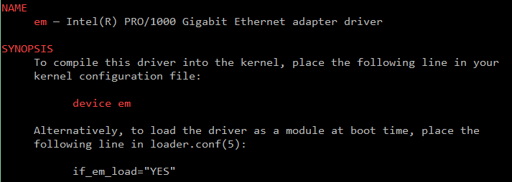
Finding the system hardware (4)
Man page for devices
  man [device]

Slide 14
Building a FreeBSD Kernel –
Configuration file
The explanations on
options and devices…
Each line is a control phrase
  Keyword + arguments
https://www.freebsd.org/doc/en/books/handbook/kernelconfig-config.html
Keyword | Function | Example
machine | Sets the machine type | i386 or amd64
cpu | Sets the CPU type | I586_CPU or HAMMER
ident | Sets the name of the kernel | SABSD
maxusers | Sets the kernel’s table sizes | 0
options | Sets various comiple-time options | INET or INET6
device | Declares devices | fxp or em
cpu I486_CPU
cpu I586_CPU
cpu I686_CPU
ident GENERIC
options SCHED_ULE # ULE scheduler
options PREEMPTION # Enable kernel thread preemption
options INET # InterNETworking
device em
i386/conf/GENERIC

Slide 15
Kernel backup
Your last chance to prevent module
missing…to survive!!
Old kernel is automatically moved to kernel.old
when you’re making the new kernel
Kernel file locations
  Put in the /boot directory
  /boot/GENERIC/kernel, /boot/kernel.old/kernel
  /kernel.GENERIC, /kernel.old (Freebsd 4.x)
If something goes wrong
  ok mode !
    unload kernel; load kernel.old/kernel
    load kernel modules
  mv /boot/kernel /boot/kernel.bad
Or just simply cp your GENERIC /boot/kernel first!

Slide 16
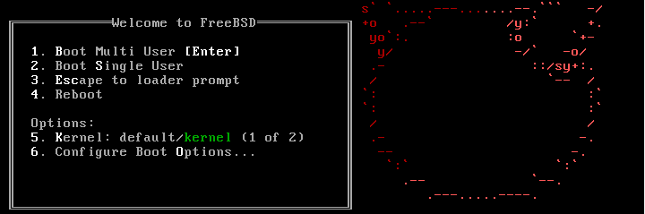
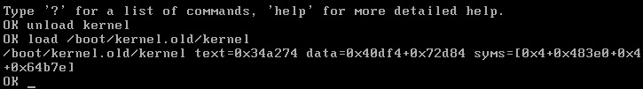
Ok mode
Or “enable modules” in the ok mode..

Slide 17
Tuning the FreeBSD Kernel
sysctl command
  Dynamically set or get kernel parameters
  All changes made by sysctl will be lost across reboot
  Use sysctl to tune the kernel and test it, then recompile the kernel
  Format:
  % sysctl [options] name[=value] …
  Ex:
  % sysctl -a list all kernel variables
  % sysctl -d kern.maxfiles print the description of the variable
  % sysctl kern.maxfiles print the value of the variable
  % sudo sysctl kern.maxfiles=2048
The other way is to write your settings into /etc/sysctl.conf…

Slide 18
Kernel modules
Kernel module location
  /boot/kernel/*.ko
  /modules ( FreeBSD 4.x)
kldstat
Load/unload kernel modules
  kldload(8), kldunload(8)
    E.g., kldload if_fxp
zfs[/boot/kernel] -chiahung- kldstat
Id Refs Address Size Name
1 15 0xc0400000 4abd60 kernel
2 1 0xc08ac000 13b0fc zfs.ko
3 2 0xc09e8000 3d5c opensolaris.ko
4 2 0xc09ec000 16b84 krpc.ko
5 1 0xc0a03000 8c48 if_le.ko

Slide 19
Procedure of Loading a Device Module
Loading a device module
  pciconf -l for a device
  man vendor name for module name in BSD
  grep the name in /boot/kernel/*.ko
  kldload [module name]
  Setup permanently by
    Recompile the kernel or
    Add [module name]_enable="YES" in /boot/loader.conf

Slide 20
Reference
http://www.freebsd.org/doc/en/books/handbook/kernelconfig-config.html
/usr/src/sys/<ARCH>/conf
  NOTES
  LINT
  GENERIC
→ machine dependent kernel configuration notes.

