Slide 1
Syslog and Log Rotate

Slide 2
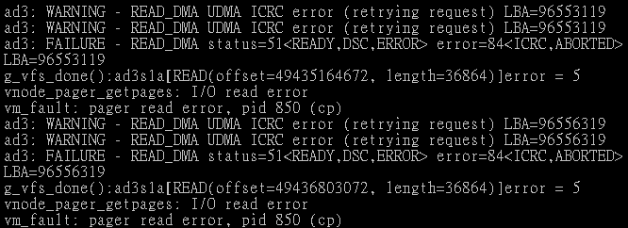
Log files
Execution information of each services
  sshd log files
  httpd log files
  ftpd log files
Purpose
  For post tracking
  Like insurance

Slide 3
Logging Policies
Common schemes
  Throw away all log files
  Rotate log files at periodic intervals
  Archiving log files
#!/bin/sh
/usr/bin/cd /var/log
/bin/mv logfile.2.gz logfile.3.gz
/bin/mv logfile.1.gz logfile.2.gz
/bin/mv logfile logfile.1
/usr/bin/touch logfile
/bin/kill –signal pid
/usr/bin/gzip logfile.1
0 3 * * * /usr/bin/tar czvf /backup/logfile.`/bin/date +\%Y\%m\%d`.tar.gz /var/log

Slide 4
Finding Log Files
Ways and locations
  Common directory
    /var/log
  Read software configuration files
    Ex: /usr/local/etc/apache22/httpd.conf
    TransferLog /home/www/logs/access.log
    Ex: /usr/local/etc/smb.conf
    log file = /var/log/samba/%m.log
  See /etc/syslog.conf

Slide 5
Under /var/log in FreeBSD (1)
You can see that under /var/log …
Lots of logs
Applications
zfs[/var/log] -chiahung- ls
./ lastlog maillog.7.bz2 sendmail.st
../ lpd-errs messages sendmail.st.0
auth.log maillog messages.0.bz2 sendmail.st.1
cron maillog.0.bz2 messages.1.bz2 sendmail.st.2
cron.0.bz2 maillog.1.bz2 messages.2.bz2 sendmail.st.3
cron.1.bz2 maillog.2.bz2 mount.today setuid.today
cron.2.bz2 maillog.3.bz2 mount.yesterday wtmp
debug.log maillog.4.bz2 pf.today xferlog
dmesg.today maillog.5.bz2 ppp.log
dmesg.yesterday maillog.6.bz2 security

Slide 6
Under /var/log in FreeBSD (2)
Logs – because of syslogd
bsd5[~] -chiahung- cat /etc/syslog.conf | grep -v ^#
*.* /var/log/all.log
*.* @loghost
*.err;kern.warning;auth.notice;mail.crit /dev/console
*.notice;authpriv.none;kern.debug;lpr.info;mail.crit;news.err /var/log/messages
security.* /var/log/security
auth.info;authpriv.info /var/log/auth.log
mail.info /var/log/maillog
lpr.info /var/log/lpd-errs
ftp.info /var/log/xferlog
cron.* /var/log/cron
*.=debug /var/log/debug.log
*.emerg *
console.info /var/log/console.log
!sudo
*.* /var/log/sudo.log

Slide 7
Syslogd

Slide 8
Syslog –
The system event logger (1)
Two main functions
  To release programmers from the tedious of writing log files
  To put administrators in control of logging
Three parts:
  syslogd, /etc/syslog.conf
    The logging daemon and configure file
  openlog(), syslog(), closelog()
    Library routines to use syslogd
  logger
    A user command that use syslogd from shell

Slide 9
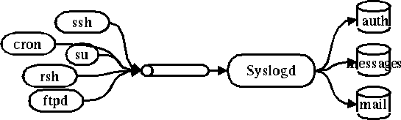
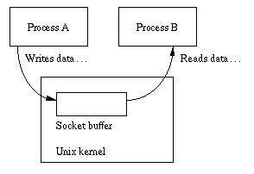
Syslog –
The system event logger (2)
/var/run/log
derek[~] -chiahung- ls -al /var/run/log /var/run/logpriv /dev/klog
crw------- 1 root wheel 0x17 Sep 9 18:19 /dev/klog
srw-rw-rw- 1 root wheel 0 Sep 9 18:20 /var/run/log
srw------- 1 root wheel 0 Sep 9 18:20 /var/run/logpriv

Slide 10
Configuring syslogd (1)
Basic format
  The configuration file /etc/syslog.conf controls syslogd’s behavior
  selector <Tab> action
    Selector: program.level
      Program: the program that sends the log message
      Level: the message severity level
    Action: tells what to do with the message
  Ex:
    mail.info /var/log/maillog

Slide 11
Configuring syslogd (2)
selector
  Syntax: facility.level
    Facility and level are predefined
    (see next page)
  Combined selector
    facility.level
    facility1,facility2.level
    facility1.level;facility2.level
    *.level
  Level indicate the minimum importance that a message must be logged
  A message matching any selector will be subject to the line’s action

Slide 12
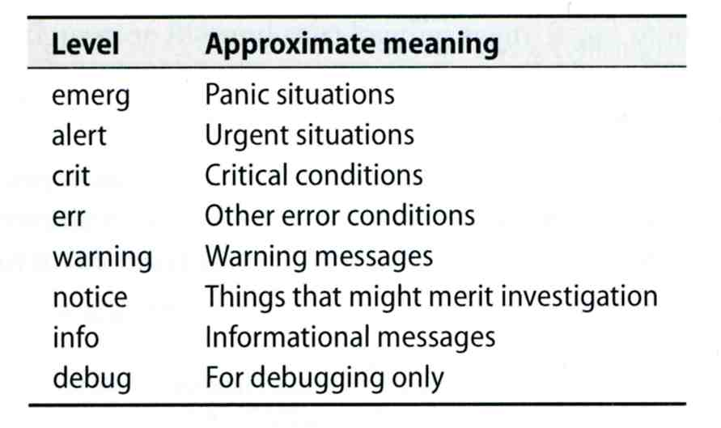
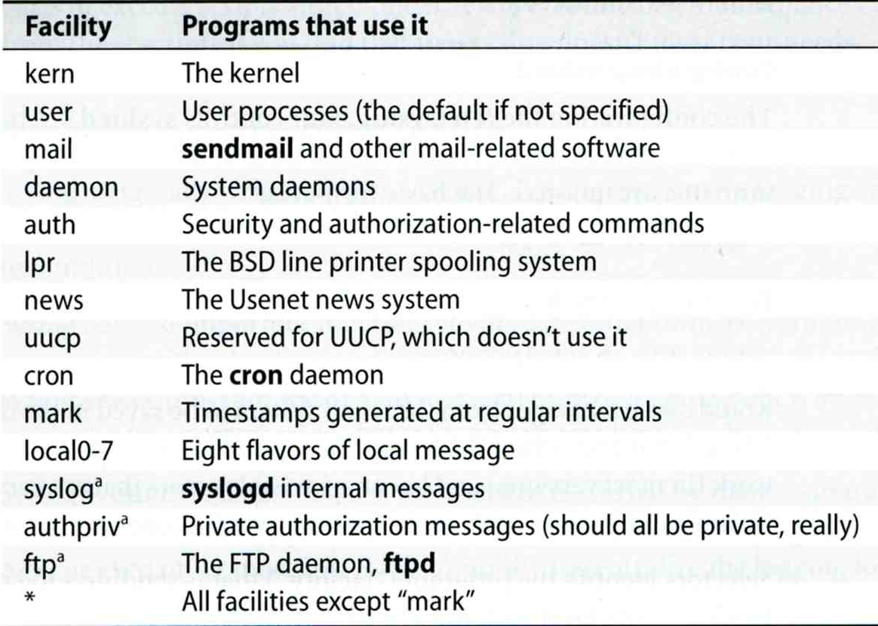
Configuring syslogd (3)
facility: auth, authpriv, console, cron, daemon, ftp, kern, lpr, mail, mark,
news, ntp, security, syslog, user, uucp, and local0 through local7

Slide 13
Configuring syslogd (4)
Action
  filename
    Write the message to a local file
  @hostname
    Forward the message to the syslogd on hostname
  @ipaddress
    Forwards the message to the host at that IP address
  user1, user2
    Write the message to the user’s screen if they are logged in
  *
    Write the message to all user logged in

Slide 14
Configuring syslogd (5)
Ex:
*.emerg /dev/console
*.err;kern,mark.debug;auth.notice;user.none /var/log/console.log
*.info;kern,user,mark,auth.none @loghost
*alert;kern.crit;local0,local1,local2.info root
lpr.err ➔ /var/log/console.log
@loghost

Slide 15
Configuring syslogd (6)
Output of syslogd
Aug 28 20:00:00 chbsd newsyslog[37324]: logfile turned over due to size>100K
Aug 28 20:01:45 chbsd sshd[37338]: error: PAM: authentication error for root from 204.16.125.3
Aug 28 20:01:47 chbsd sshd[37338]: error: PAM: authentication error for root from 204.16.125.3
Aug 28 20:07:15 chbsd sshd[37376]: error: PAM: authentication error for root from 204.16.125.3
Aug 28 20:07:17 chbsd sshd[37376]: error: PAM: authentication error for root from 204.16.125.3
Aug 30 09:47:49 chbsd sudo: chwong : TTY=ttyp4 ; PWD=/usr/home/chwong ; USER=root ; COMMAND=
Aug 30 22:02:02 chbsd kernel: arp: 140.113.215.86 moved from 00:d0:b7:b2:5d:89 to 00:04:e2:10:
Aug 30 22:05:13 chbsd kernel: arp: 140.113.215.86 moved from 00:04:e2:10:11:9c to 00:d0:b7:b2:
Sep 1 14:50:11 chbsd kernel: arplookup 0.0.0.0 failed: host is not on local network
Sep 3 13:16:29 chbsd sudo: chwong : TTY=ttyp4 ; PWD=/usr/ports ; USER=root ; COMMAND=/usr/b
Sep 3 13:18:40 chbsd sudo: chwong : TTY=ttyp4 ; PWD=/usr/ports ; USER=root ; COMMAND=/usr/l
Sep 3 13:25:06 chbsd sudo: chwong : TTY=ttyp4 ; PWD=/usr/ports ; USER=root ; COMMAND=/usr/l
Sep 3 13:27:09 chbsd kernel: arp: 140.113.215.86 moved from 00:d0:b7:b2:5d:89 to 00:04:e2:10:
Sep 3 13:27:14 chbsd kernel: arp: 140.113.215.86 moved from 00:04:e2:10:11:9c to 00:d0:b7:b2:
Sep 3 15:27:05 chbsd sudo: chwong : TTY=ttyp4 ; PWD=/usr/ports ; USER=root ; COMMAND=/usr/l
Sep 3 15:27:10 chbsd sudo: chwong : TTY=ttyp4 ; PWD=/usr/ports ; USER=root ; COMMAND=/usr/l
Sep 3 15:27:25 chbsd sudo: chwong : TTY=ttyp4 ; PWD=/usr/ports ; USER=root ; COMMAND=/usr/l

Slide 16
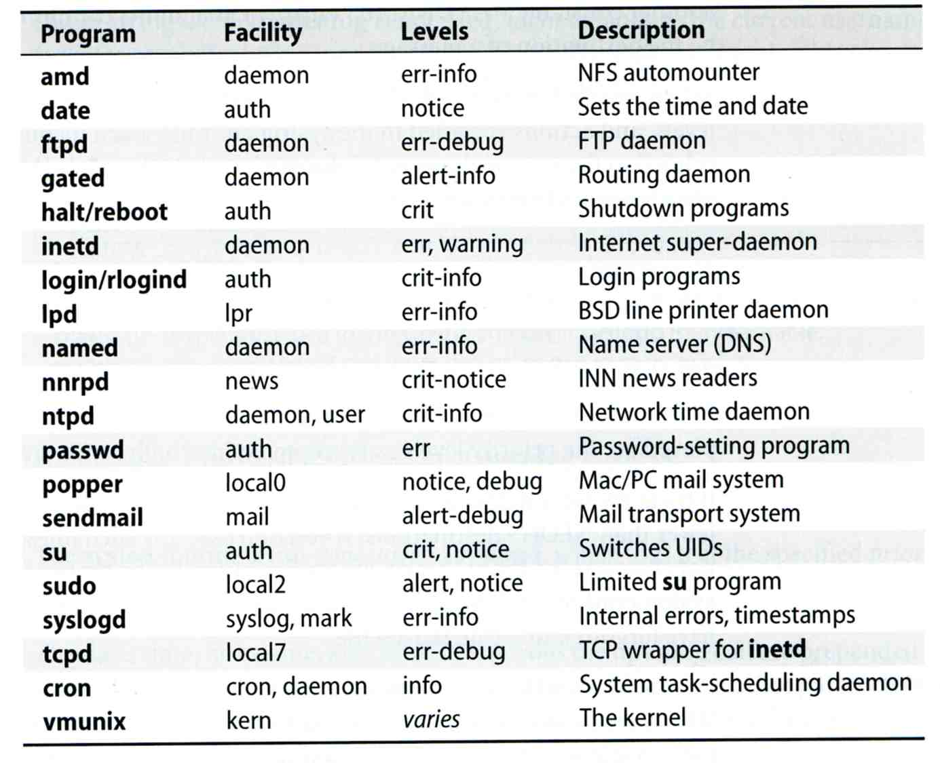
Software that use syslog

Slide 17
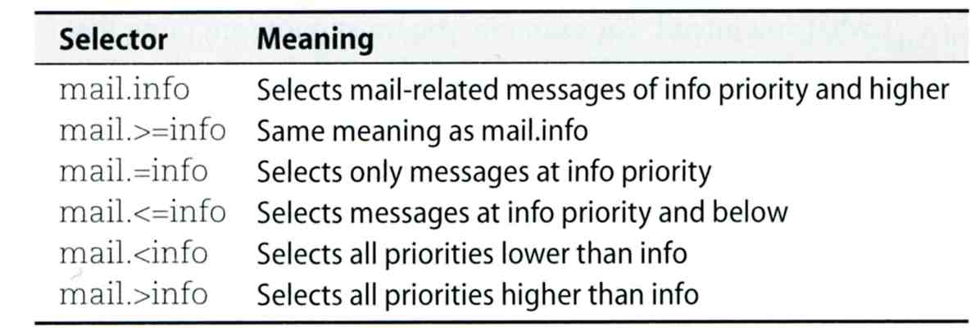
FreeBSD Enhancement (1)
Facility name
  FreeBSD allows you to select messages based on the name of the program
Severity level
!sudo
*.* /var/log/sudo.log

Slide 18
FreeBSD Enhancement (2)
Restriction log messages from remote hosts
  syslogd -a *.csie.nctu.edu.tw -a 140.113.209.0/24
  Use -ss option to prevent syslogd from opening its network port
  rc.conf
syslogd_enable="YES"
syslogd_flags="-a 140.113.209.0/24:* -a 140.113.17.0/24:*"

Slide 19
Debugging syslog
logger
  It is useful for submitting log from shell
For example
  Add the following line into /etc/syslog.conf
  Use logger to verify
    logger(1)
    The default priority is user.info
    logger -h host
local5.warning /tmp/evi.log
# logger –p local5.warning "test message"
# cat /tmp/evi.log
Nov 22 22:22:50 zfs chiahung: test message

Slide 20
Using syslog in programs
#include <syslog.h>
int main() {
openlog("mydaemon", LOG_PID, LOG_DAEMON);
syslog(LOG_NOTICE, "test message");
closelog();
return 0;
}
zfs[~] -chiahung- tail -1 /var/log/messages
Nov 22 22:40:28 zfs mydaemon[4676]: test message

Slide 21
Log rotate
Logs are rotated – because newsyslog facility
  In crontab
  newsyslog.conf
    ISO 8601 restricted time format: [[[[[cc]yy]mm]dd][T[hh[mm[ss]]]]]
    Day, week, and month time format: [Dhh], [Ww[Dhh]], and [Mdd[Dhh]]
chbsd [/etc] -chwong- grep newsyslog /etc/crontab
0 * * * * root newsyslog
chbsd [/etc] -chwong- cat /etc/newsyslog.conf
# logfilename [owner:group] mode count size when flags [/pid_file] [sig_num]
/var/log/all.log 600 7 * @T00 J
/var/log/amd.log 644 7 100 * J
/var/log/auth.log 600 7 100 * JC
/var/log/console.log 600 5 100 * J
/var/log/cron 600 3 100 * JC
/var/log/daily.log 640 7 * @T00 JN
/var/log/debug.log 600 7 100 * JC
/var/log/maillog 640 7 * @T00 JC
/var/log/messages 644 5 100 * JC
/var/log/monthly.log 640 12 * $M1D0 JN
/var/log/security 600 10 100 * JC
/var/log/sendmail.st 640 10 * 168 B
  newsyslog.conf(5)
  newsyslog(8)

Slide 22
Vendor Specifics
FreeBSD
  newsyslog utility
    /etc/newsyslog.conf
  /usr/ports/sysutils/logrotate
Red Hat
  logrotate utility
  /etc/logrotate.conf, /etc/logrotate.d directory
linux1[/etc/logrotate.d] -chiahung- cat mail
/var/log/mail/maillog /var/log/mail/mail.info /var/log/mail.warn /var/log/mail.err {
missingok
monthly
size=100M
rotate 4
create 0640 root security
nocompress
}

