Slide 1
Samba
weicc

Slide 2
Network-based File Sharing
FTP (File Transfer Protocol)
NFS (UNIX-based)
  mountd is responsible for mount request
  nfsd and nfsiod
  Based on RPC
CIFS (Microsoft)
  Common Internet File System
  網路芳鄰
  SMB (Server Message Block)
  Share access to files, printers, …
  Based on NetBIOS
Applikation
SMB
NetBIOS
NetBEUI | TCP/IP | IPX/SPX
NDIS (2,3,3.1,4,5)-Interface
Karten-Treiber (MAC)
Netzwerk-Karte

Slide 3
Service of SMB and NetBIOS
NetBIOS (Network Basic Input/Output System)
  API related to the session layer allowing applications to communicate over a local area network
  Name Service for name registration and resolution
  Session service for connection-oriented communication
  Datagram distribution service for connectionless communication
SMB
  File and printer sharing service
  Authentication

Slide 4
NetBIOS – Network Basic Input/Output System
NetBIOS (API)
  1983 – developed as an API for software communication over IBM’s PC-Network LAN
    NetBIOS relied on proprietary Sytek networking protocols
  In 1985, IBM went forward with the token ring network scheme
    NetBEUI – NetBIOS Extended User Interface
    using the NetBIOS Frames (NBF) routing protocol
  1985 – Microsoft created a NetBIOS implementation for its MS-Net network topology
    By NBF protocol
  Difference between local filesystem and network filesystem when accessing
  Used to share or access network-based filesystem just as BIOS does in local filesystem
NetBIOS over TCP/IP
  In 1987
  NBT

Slide 5
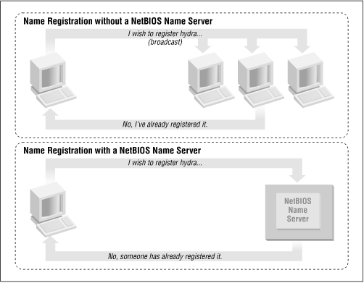
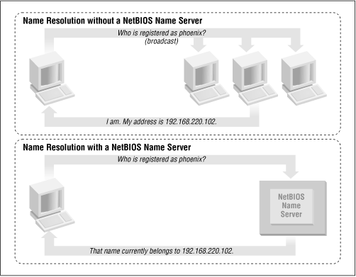
NetBIOS Naming Service
Peer to peer (Workgroup model)

Slide 6
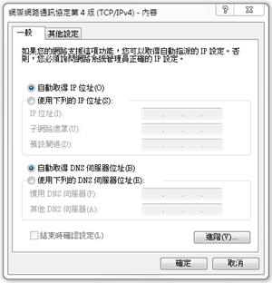
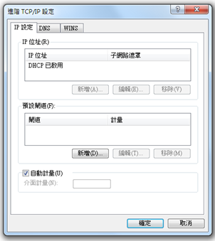
NetBIOS Naming Service
WINS

Slide 7
SMB – Server Message Block
SMB
  Original designed by IBM with the aim of turning DOS interrupt local file access into a network filesystem
    Run on top of netbios
    Microsoft has made considerable modifications to the most common used version
  1990 – Microsoft merged the SMB protocol with LAN Manager
  1992 – Microsoft merged and add features to SMB protocol in Windows for Workgroup
  1996 – Microsoft renames SMB as CIFS
    Support for symbolic link, hard link, larger file sizes, …
    Initial attempt at supporting direct connections over TCP port 445
  2006 – Microsoft introduced SMB2 with Windows vista
  Windows 7 – SMB 2.1
    Performance enhancement with a new opportunistic locking
  Windows 8/Windows Server 2012 – SMB 3.0 (Previously named SMB 2.2)
    Enables the use of multiple physical network interfaces

Slide 8
UNIX-Windows communication
SAMBA
  1991 – Andrew Tridgwell developed the first version of Samba
    Using a packet sniffer on DEC Pathworks server software
  A UNIX application that speak SMB protocol
  Can not use the Original Name: Server Message Block (SMB)
    Samba
    grep -i '^s.*m.*b' /usr/share/dict/words
      Napster, Simba
Why samba ?
Applikation
SMB
NetBIOS
NetBEUI | TCP/IP | IPX/SPX
NDIS (2,3,3.1,4,5)-Interface
Karten-Treiber (MAC)
Netzwerk-Karte

Slide 9
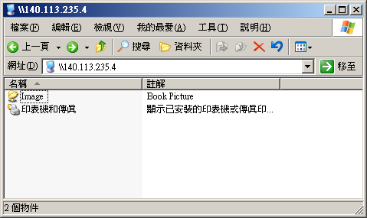
What SAMBA can do?
Sharing
  Sharing files or printers just like Microsoft does
  Authenticate user identity just like Microsoft does
  Resolve NetBIOS name just like Microsoft does

Slide 10
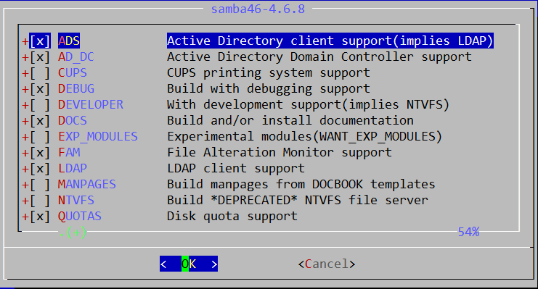
Install SAMBA
Using ports
  % cd /usr/ports/net/samba46
    Samba 4.6.8
  % portmaster -BD net/samba46
Using package
  % pkg install samba46

Slide 11
SAMBA components
Configuration files
  /usr/local/etc/smb.conf.sample → /usr/local/etc/smb.conf
    chmod 644 smb.conf
  /usr/local/etc/lmhosts
Major execution files
  smbd (/usr/local/sbin/smbd)
    Management of sharing directories, files and printers
  nmbd (/usr/local/sbin/nmbd)
    Resolve NetBIOS name and manage workgroup
  winbindd (/usr/local/sbin/winbindd)
    WINS services
  pdbedit (/usr/local/bin/pdbedit)
    Manage the Samba user database
  smbpasswd (/usr/local/bin/smbpasswd)

Slide 12
SAMBA password
samba4 password file
  Now samba stores accounts and passwords in tdb
    Default database path: /var/db/samba4
tdb v.s. smbpasswd
derek[~] -chiahung- sudo pdbedit -L -v
---------------
Unix username: chiahung
NT username:
Account Flags: [U ]
User SID: S-1-5-21-3763889141-129722405-4261865294-1000
Primary Group SID: S-1-5-21-3763889141-129722405-4261865294-513
Full Name: Chia-Hung Tsai
Home Directory: \\derek\chiahung
HomeDir Drive:
Logon Script:
Profile Path: \\derek\chiahung\profile
Domain: DEREK
Account desc:
Workstations:
Munged dial:
Logon time: 0
Logoff time: never
Kickoff time: never
Password last set: Mon, 12 Jul 2010 00:03:29 CST
Password can change: Mon, 12 Jul 2010 00:03:29 CST
Password must change: never
Last bad password : 0
Bad password count : 0
Logon hours : FFFFFFFFFFFFFFFFFFFFFFFFFFFFFFFFFFFFFFFFFF
---------------
derek[/var/db] -chiahung- sudo pdbedit -w -u chiahung
chiahung:1000:
XXXXXXXXXXXXXXXXXXXXXXXXXXXXXXXX:
3CDEC7966A2F9837F9F628DC13CC02AE:
[U ]:
LCT-4C39EB51:
https://www.samba.org/samba/docs/man/manpages/smbpasswd.5.html

Slide 13
SAMBA password
smbpasswd command
  -a
    Add new user
  -d
    Let some account in smbpasswd file can not login (to disable)
  -e
    Let some disable account resume (to enable)
pdbedit command
  pdbedit -a username
    Add new user
  pdbedit -x username
    delete user
  pdbedit -L -v
    List user
  pdbedit -r -c username
    pdbedit -r -c “[DX]” test

Slide 14
SAMBA configuration file
smb.conf
  Sections
    Each section in the smb.conf file represents either a share or a meta-service
    Global section is special
      Global setting
    Meta-service
      Printer Sharing Setting
      Home Sharing Setting
# comments
[global]
para1 = value1
…
[printers]
para2 = value2
…
[homes]
para3 = value3
…
[share-dir]
para4 = value4
…

Slide 15
SAMBA configuration file –
Global Setting (1)
Global Configuration
  workgroup
    Group name to join
    Ex: workgroup = chwong
  server string
    Description of this host
    Ex: server string = Samba Server of SA Course
  netbios name
    NetBIOS name of this host
    Ex: netbios name = sabsd
  Charset Settings
    “display charset”, “unix charset”, “dos charset”
    Ex:
      unix charset = CP850
      dos charset = CP850
  hosts allow
    Apply to all services, regardless or individual service setting;
    Ex: hosts allow = 140.113.235. 140.113.

Slide 16
SAMBA configuration file –
Global Setting (2)
  guest ok (or public = yes)
    If this is yes, no password is required
    Ex: guest ok = no
  guest account
    If guest can use this samba service, any guest request will map to this guest account
    Ex: guest account = ftp
      Add this account into your /etc/passwd
    Otherwise, the user nobody is used
  log file
    Full path of log file
    Ex: log file = /var/log/samba/log.%m
  max log size (KB)
    Ex: max log size = 500

Slide 17
SAMBA configuration file –
Global Setting (3)
  security = [share/user/server/domain]
    share: no need of id and password to login
    user: default option, login with id and password
    domain: check id and password by domain controller
    ads: check id and password by AD server
    server: check id and password by another server
      It is highly recommended not to use this feature
    Ex:
      security = user
      passdb backend = tdbsam

Slide 18
SAMBA configuration file –
Global Setting (4)
Example of global setting
[global]
server string = Samba Server Version %v
unix charset = CP850
workgroup = MYGROUP
log file = /var/log/samba/log.%m
max log size = 50
usershare allow guests = Yes
guest account = pcguest
security = USER
idmap config * : backend = tdb
cups options = raw

Slide 19
Samba parameters
Default parameters in samba
  %m
    Client NetBIOS name
  %M
    Client Hostname
  %I
    Client IP
  %L
    Samba server NetBIOS name
  %h
    Samba server Hostname
  %H
    User home directory
  %U
    Login name
  %T
    Current Date time

Slide 20
SAMBA configuration file –
Home Sharing Setting (1)
Home sharing setting
  comment
    Description of this directory
  path
    Sharing directory path
  browseable
    Display sharing name or not
  read only , writeable
  admin users = $username
  valid users = %S (write list)
    Only users on this can write content if read only
  create mode / create mask
    Default permission when file is created
  directory mode / directory mask
    Default permission when directory is created
  guest ok (or public = yes)

Slide 21
SAMBA configuration file –
Sharing Setting (2)
Example of image sharing
[Image]
comment = Book Picture
path = /home/image
read only = no
public = yes
writable = yes
create mode = 0664
directory mode = 0775

Slide 22
SAMBA configuration file
Additional tuning
Disable printer
  load printers = no
  printing = bsd
  printcap name = /dev/null
  disable spoolss = yes
Performance tuning
  max protocol = SMB2
  socket options = TCP_NODELAY
  socket options = TCP_NODELAY SO_RCVBUF=8192 SO_SNDBUF=8192
  read size
  read prediction
  …

Slide 23
Starting SAMBA
Script
  /usr/local/etc/rc.d/samba {start|stop}
  /etc/rc.conf
    samba_enable="YES"
      smbd_enable="YES"
      nmbd_enable="YES"
    winbindd_enable="YES"

Slide 24
smbstatus
Report on current Samba connections
hscc[~] -chiahung- smbstatus
Samba version 3.0.37
PID Username Group Machine
-------------------------------------------------------------------
47945 hscc hscc hscc-d30aedc531 (140.113.240.124)
48533 Pegasus hscc simba-pc (140.113.240.135)
47944 zn hscc bdeca39d90d4 (140.113.240.133)
Service pid machine Connected at
-------------------------------------------------------
zn 47944 bdeca39d90d4 Mon Oct 18 17:12:02 2010
hscc 47945 hscc-d30aedc531 Mon Oct 18 17:12:02 2010
Pegasus 48533 simba-pc Mon Oct 18 17:58:46 2010
Locked files:
Pid Uid DenyMode Access R/W Oplock SharePath Name Time
--------------------------------------------------------------------------------------------------
47947 509 DENY_NONE 0x100001 RDONLY NONE /home/hscc UG/Films/[USA
47946 509 DENY_NONE 0x100001 RDONLY NONE /home/hscc UG/Animation

Slide 25
Tool: smbclient (1)
A client program that can talk to an SMB server
Usage:
  -L [hostname]
    List sharable resource
  -U [username]
    Login with username
  smbclient -L host_IP -U user_ID

Slide 26
Tool: smbclient (2)
hsccws5[~] -chiahung- smbclient -L hscc -U chiahung
Enter chiahung's password:
Domain=[HSCCLAB] OS=[Unix] Server=[Samba 3.0.37]
Sharename Type Comment
--------- ---- -------
IPC$ IPC IPC Service (HSCC SAMBA)
chiahung Disk Home Directories
Domain=[HSCCLAB] OS=[Unix] Server=[Samba 3.0.37]
Server Comment
--------- -------
HSCC HSCC SAMBA
Workgroup Master
--------- -------
EC219 EC219
HSCCLAB HSCC
LAB635 JJSU-LABPC
LAB636 2AMW1GP6PMLTL77

Slide 27
Tool: smbtree
A smb browser program in text mode
Usage:
  -b Query network nodes by sending requests as broadcasts instead of querying the local master browser.
  -D Only print a list of all the domains known on broadcast or by the master browser
  -S Only print a list of all the domains and servers responding on broadcast or known by the master browser.
smbtree -b
mango@mango:~ $ smbtree
WORKGORUP
\\MANGOCOLD
SANA
\\SATA sata server
\\SATA\IPC$ IPC Service (sata server)
\\SATA\Video ftp directory
\\SATA\Image test directory

Slide 28
Tool: mount_smbfs
Mount a shared resource from an SMB file server
Usage:
  -I
    Do not use NetBIOS name resolver and connect directly to host, which can be either a valid DNS name or an IP address.
  -N
    Do not ask for a password.
Mount_smbfs (-I IP or host name) -N ‘//NetBIOS name/dir’ mount_point

Slide 29
Tool: testparm
check an smb.conf configuration file for internal correctness
Usage
  testparm /usr/local/etc/smb4.conf
  Load smb config files from /usr/local/etc/smb4.conf
  Processing section "[homes]”
  Processing section "[printers]”
  Processing section "[public]”
  Loaded services file OK.
  Server role: ROLE_STANDALONE
  Press enter to see a dump of your service definitions

Slide 30
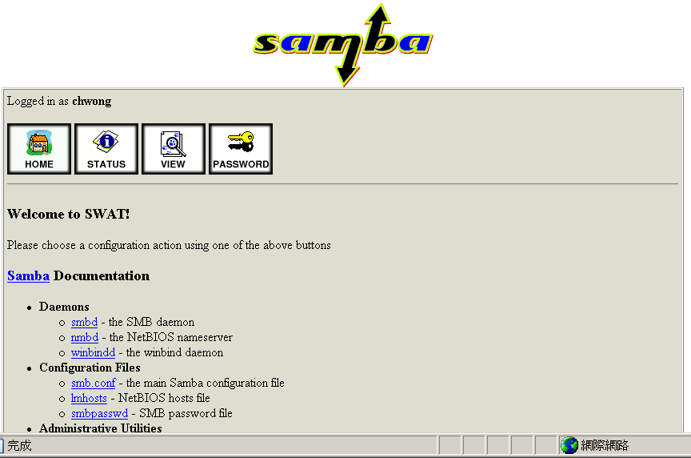
SWAT (1)
Edit /etc/inetd.conf
  Unmark
Restart inetd
Browse http://sabsd.cs.nctu.edu.tw:901/
swat stream tcp nowait/400 root /usr/local/sbin/swat swat

Slide 31
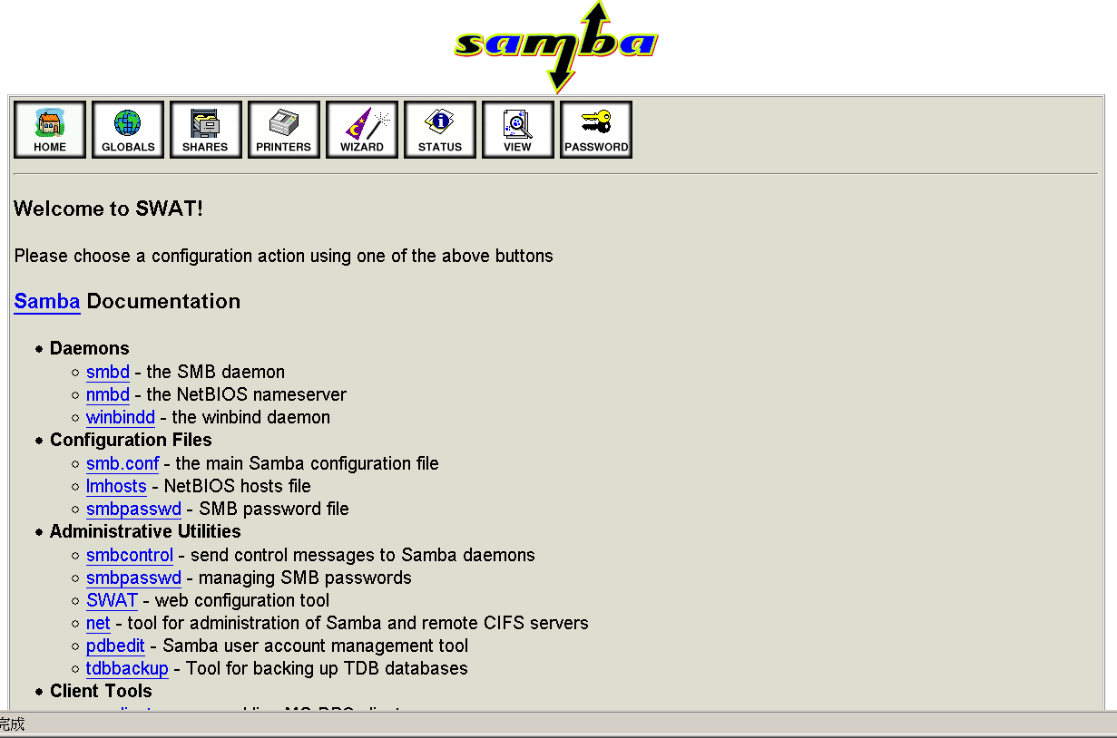
SWAT (2)
Root access

