Slide 1
GUID Partition Table
Unified Extensible Firmware Interface (UEFI)
Master Boot Record (MBR)
GUID Partition Table (GPT)

Slide 2
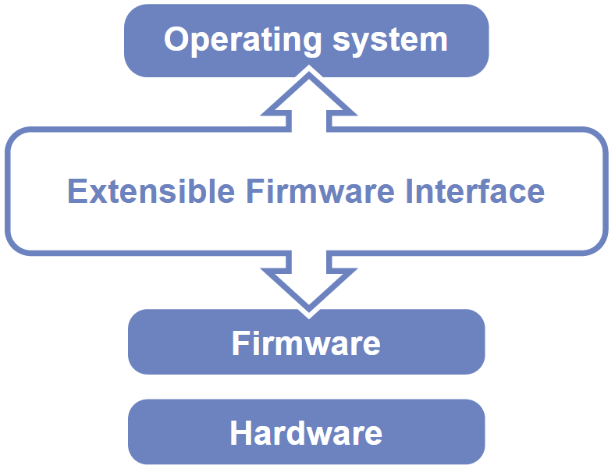
Unified Extensible Firmware Interface
Legacy BIOS limitations
  16-bit processor mode
  1 MB addressable space
Advantages
  32-bit/64-bit processor mode
  Ability to boot from larger disk with a GPT
  Flexible pre-OS environment, including network capability
  Modular design
Compatibility Support Module (CSM)
  BIOS-MBR
  BIOS-GPT

Slide 3
Master Boot Record (1/2)
The Master Boot Record (MBR) is the first 512 bytes of a storage device
Offset | Length | Contents
0 | 446 bytes | Boot code area
446 | 64 bytes | Partition tables, each has 16 bytes
510 | 2 bytes | Boot signature (0xAA55)
128 | Total

Slide 4
Master Boot Record (2/2)
Drawbacks
  (4 primary partitions) or (3 primary + 1 extended partitions)
    Arbitrary number of logical partitions within the extended partition
  The logical partition meta-data is stored in a linked-list structure
  One byte partition type codes which leads to many collisions
  Maximum addressable size is 2 TiB, i.e. any space beyond 2 TiB cannot be defined as a partition
    MBR stores partition sector information using 32-bit LBA values
    512 bytes per sector
    2³² * 512 bytes = 2 TiB

Slide 5
Booting Process
System initialization with firmware called BIOS
The BIOS looks for the bootloader on the MBR, then executes it
Bootloader reads the partition table
  Conventional Windows/DOS MBR bootloader search for one active and primary partition
  GRUB safely ignores this
Loading operating system

Slide 6
GUID Partition Table (1/9)
GUID stands for Globally Unique Identifier
  Ex: 3F2504E0-4F89-41D3-9A0C-0305E82C3301
Part of the UEFI specification
Solves some legacy problems with MBR but also may have compatibility issues
Can be used also on BIOS system via a protective MBR

Slide 7
GUID Partition Table (2/9)
Advantages
  Filesystem-independent
  No partition type collision because of GUIDs
  8 ZiB
    GPT uses 64-bit LBA
    512 bytes per sector
    2⁶⁴ * 512 bytes = 8 ZiB
  Backup header and partition table at the end of the disk
  CRC32 checksums for header and partition table

Slide 8
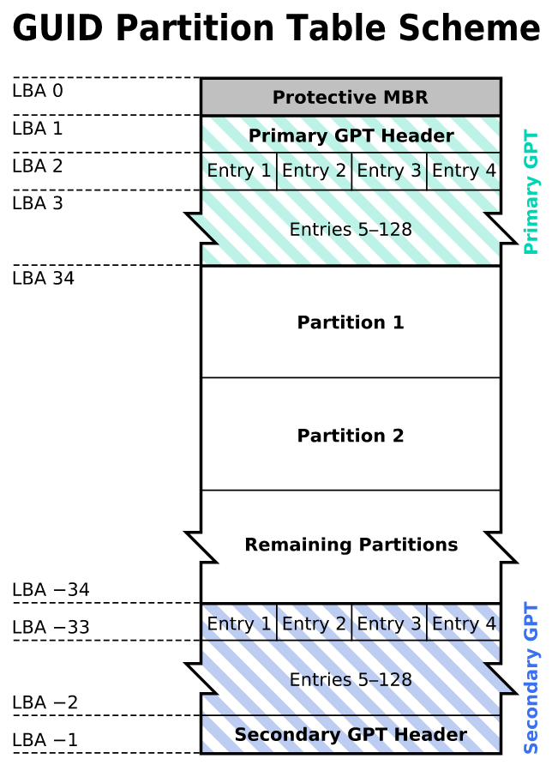
GUID Partition Table (3/9)
GPT Scheme
  LBA 0: Legacy MBR
  LBA 1: GPT header
  LBA 2~33: Partition entries
    Up to 128 partitions
  LBA 34~: Partitions
  LBA -34~-1: Secondary GPT data

Slide 9
GUID Partition Table (4/9)
Legacy MBR (LBA 0)
  A single partition type of 0xEE
  For OSes cannot read GPT disks: Unknown type, no empty space
  For GPT-aware OSes: check the protective MBR

Slide 10
GUID Partition Table (5/9)
GPT header (LBA 1)
Offset | Length | Contents
0 | 8 bytes | Signature ("EFI PART", 45 46 49 20 50 41 52 54)
8 | 4 bytes | Revision (For GPT version 1.0 (through at least UEFI version 2.3.1), the value is 00 00 01 00)
12 | 4 bytes | Header size in little endian (in bytes, usually 5C 00 00 00 meaning 92 bytes)
16 | 4 bytes | CRC32 of header (0 to header size), with this field zeroed during calculation
20 | 4 bytes | Reserved; must be zero
24 | 8 bytes | Current LBA (location of this header copy)
32 | 8 bytes | Backup LBA (location of the other header copy)
40 | 8 bytes | First usable LBA for partitions (primary partition table last LBA + 1)
48 | 8 bytes | Last usable LBA (secondary partition table first LBA - 1)
56 | 16 bytes | Disk GUID (also referred as UUID on UNIXes)
72 | 8 bytes | Partition entries starting LBA (always 2 in primary copy)
80 | 4 bytes | Number of partition entries
84 | 4 bytes | Size of a partition entry (usually 128)
88 | 4 bytes | CRC32 of partition array
92 | * | Reserved; must be zeroes for the rest of the block (420 bytes for a 512-byte LBA)

Slide 11
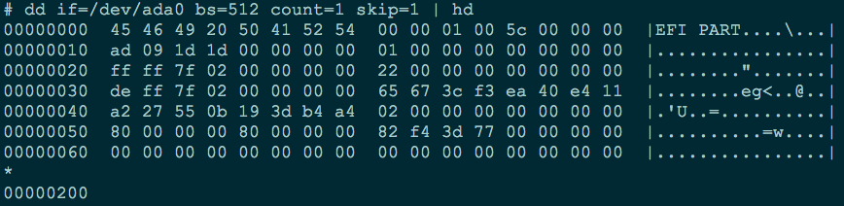
GUID Partition Table (6/9)
GPT header (LBA 1)
  dd if=/dev/ada0 bs=512 count=1 skip=1 | hd

Slide 12
GUID Partition Table (7/9)
Partition entries (LBA 2)
Offset | Length | Contents
0 | 16 bytes | Partition type GUID
16 | 16 bytes | Unique partition GUID
32 | 8 bytes | First LBA (little-endian)
40 | 8 bytes | Last LBA (inclusive, usually odd)
48 | 8 bytes | Attribute flags (e.g. bit 60 denotes read-only)
56 | 72 bytes | Partition name (36 UTF-16LE code units)
 | 128 bytes | Total

Slide 13
GUID Partition Table (8/9)
Partition type GUID
freebsd-boot | 83BD6B9D-7F41-11DC-BE0B-001560B84F0F
freebsd | 516E7CB4-6ECF-11D6-8FF8-00022D09712B
freebsd-swap | 516E7CB5-6ECF-11D6-8FF8-00022D09712B
freebsd-ufs | 516E7CB6-6ECF-11D6-8FF8-00022D09712B
freebsd-vinum | 516E7CB8-6ECF-11D6-8FF8-00022D09712B
freebsd-zfs | 516E7CBA-6ECF-11D6-8FF8-00022D09712B

Slide 14
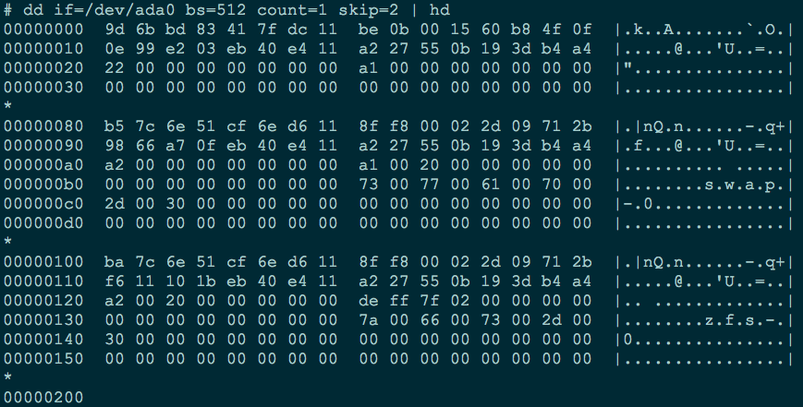
GUID Partition Table (9/9)
Partition entries (LBA 2)
  dd if=/dev/ada0 bs=512 count=1 skip=2 | hd

Slide 15
References
http://pansci.tw/archives/8111
http://www.rodsbooks.com/gdisk/whatsgpt.html

