Slide 1
Services & Settings

Slide 2
Basic Services

Slide 3
Common Flow of Running a Service
Installation
Through ports, packages, or source tarballs
pkg install kde4
Configuration
Service specific configuration file(s)
/etc/rc.conf
kdm4_enable="YES"
Start
rc.d/*
/usr/local/etc/rc.d/kdm4 start
service kdm4 start
Maintenance
Updating、Restarting

Slide 4
Configuration Files (1/3)
Local installed programs’ configuration files are located under /usr/local/etc
Daemon → program-name.conf
pure-ftpd.conf
user-program → program-namerc
vimrc
screenrc
Default config file usually installed with .sample or .default suffix
pure-ftpd.conf.sample
or different suffix for different purpose
php.ini-dist
php.ini-recommended
copy and rename before use it

Slide 5
Configuration Files (2/3)
A program with multiple config files are usually located in /usr/local/etc/program-name/
apache*
postfix
Most configuration files have clear comment at the beginning or before each description
Most popular styles
key <space>value
key = value
Read documents to know each option’s meaning
# pure-ftpd.conf
# IP address/port to listen to (default=all IP and port 21)
Bind 127.0.0.1,21
# Fork in background
Daemonize yes
Notes:
5

Slide 6
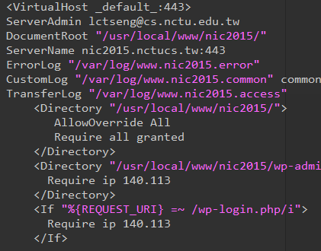
Configuration Files (3/3)
Some with local effectiveness (e.g. http server)
Markup language-like
<directory /path> setting-for-this-path… </directory>
Samba、rsync、devfs…
[xxxx]
settings…
[yyyy]
settings….

Slide 7
RC Script
Scripts for starting / stopping a service

Slide 8
What does RC means?
Run Commands (RunCom)
Command scripts for auto-reboot and daemon startup
rc(8)
https://www.freebsd.org/doc/handbook/configtuning-rcd.html

Slide 9
Why do we need RC Script?
Start services on system startup
Starting and Stopping services in a standard way
Without rc
/usr/local/sbin/pure-ftpd -g /var/run/pure-ftpd.pid -A -c50 -B -C8 -D -fftp -H -I15 -lpam -lunix -L10000:8 -m4 -s -U133:022 -u100 -k99 -Z
v.s.
With rc
service pure-ftpd start

Slide 10
RC Script
Dependency between each service is described in header of the script
rcorder is used to find out dependency ordering of each script
Each rc script defines what to do when start / stop …
/etc/rc.subr defines what to do & check before / after start stop ….
rc.subr(8)

Slide 11
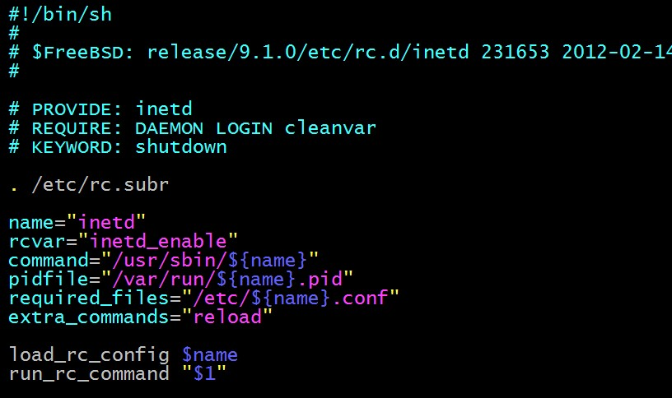
Inside the RC Script
Example: /etc/rc.d/inetd
for rcorder(8) to sort.
need to be included
by every RC script.
what to do with
start/stop/....

Slide 12
How to use rc script (1/2)
Example: ntpd
After booting… (rc.conf)
Pidfile: Record (master) process id of the service
Start / Stop / Restart (Start after stop)
An easy way to access: “service”
$ service ntpd start/stop/restart/reload/…
Search /etc/rc.d and /usr/local/etc/rc.d
nctucs [~] -wangth- /etc/rc.d/ntpd
Usage: /etc/rc.d/ntpd [fast|force|one|quiet](start|stop|restart|rcvar|enabled|fetch|status|poll)
nctucs [~] -wangth- cat /var/run/ntpd.pid
660
nctucs [~] -wangth- ps aux | grep ntp
root 660 0.0 0.4 26132 18052 - Ss 9Sep17 1:27.13 /usr/sbin/ntpd -g -c /etc/ntp.conf -p /var/run/ntpd.pid -f /var/db/ntpd.drift

Slide 13
How to use rc script (2/2)
Status
Check the service is running or not
Reload
Reload configuration file if the service support
[one | fast | force]
One
Skip the check of rcvar="YES"
Start the service even if XXXX_enable="NO"
Force
Force start the service
Ignore any error it encountered (no prerequisite test)
ignore rcvar="YES" and set rc_force="YES"
Fast
Skip the check for an existing running process (pid check)
Set rc_fast="YES"

Slide 14
Local installed service
Use path-to-rcscript rcvar command to know which variable should set to “YES” to enable this service
For further information, read comments from that script
/usr/local/etc/rc.d/pure-ftpd
nctucs [~] -wangth- /usr/local/etc/rc.d/pure-ftpd rcvar
# pureftpd
#
pureftpd_enable="no"
# (default: "")
# Add the following lines to /etc/rc.conf to enable pure-ftpd:
#
# pureftpd_enable="yes"
# pureftpd_flags="<set as needed>"
#
# Add the following lines to /etc/rc.conf to enable pure-authd daemon:
#
# pureftpd_authd_enable="yes"
# pureftpd_authdscript="/full/path/to/auth_script"
# pureftpd_authsocket="/var/run/ftpd.sock"
#
# Add the following lines to /etc/rc.conf to enable uploadscript daemon:
#
# pureftpd_upload_enable="yes"
# pureftpd_uploadscript="/full/path/to/upload_script"

