Slide 1
FreeBSD

Slide 2
Outline
FreeBSD version
11.1-RELEASE
Installing FreeBSD
From CD-ROM
From USB

Slide 3
FreeBSD Version

Slide 4
FreeBSD Branches/Tags
Three parallel development branches:
-RELEASE
Latest Release Version:
11.1 (July, 2017)
http://www.freebsd.org/releases/
Upcoming 10.4 (October, 2017)
https://www.freebsd.org/releases/10.4R/schedule.html
-STABLE
Tested new features and bug fixes
MFC: Merge From Current
-CURRENT
Working space for FreeBSD developers
Current version:
12.0-CURRENT
http://www.freebsd.org/releng/

Slide 5
FreeBSD Version
FreeBSD–A.B.C–Type
A: major version Number
B: minor version Number
C: slight patch version number
Type: version type
PRERELEASE
BETA
RC
RELEASE
STABLE
CURRENT

Slide 6
FreeBSD Installation

Slide 7
FreeBSD View of Disk (1)
Guided partitioning layout between UFS and Root on ZFS
GPT
Slice 1 (/dev/ada0p1)
Slice 2 (/dev/ada0p2)
Slice 3 (/dev/ada0p3)
GPT
Slice 1 (/dev/ada0p1)
Slice 2 (/dev/ada0p2)
Slice 3 (/dev/ada0p3)
freebsd-boot
freebsd-boot
/ freebsd-ufs
freebsd-swap
freebsd-swap
zfs0

Slide 8
FreeBSD View of Disk (2)
MBR
Slice 1 (ada0s1)
Slice 2 (ada0s2)
Slice 3 (ada0s3)
Slice 4 (ada0s4)
Windows XP (NTFS)
Linux (EXT4FS)
bsdlabel
ada0s3a
ada0s3b
ada0s3c
ada0s3d
ada0s3e
/ (root)
swap
Extended Partiton
/home
D Drive NTFS | Linux Swap

Slide 9
FreeBSD View of Disk (3)
What is the meaning of ada0s1a
Disk name
ada : IDE, SATA
da: SCSI, usb stick
Slice is equal to the partition of common use
Primary partition: s1 ~ s4
Extended partition: s5 ~ sn
Label in each slice
a: root partition /
b: swap
c: entire slice
defgh: /usr, /home, …
MBR
Slice 1 (/dev/ada0s1)
Slice 2 (/dev/ada0s2)
Slice 3 (/dev/ada0s3)
Slice 4 (/dev/ada0s4)
Slice 5 (/dev/ada0s5) | Slice 6 (/dev/ada0s6)

Slide 10
Knowing Your Hardware
CPU
32bit or 64bit
Intel、AMD
Architecture: amd64, i386 (, ia64, pc98, powerpc, sparc64)
RAM
Size
HD
Size, amount, SCSI or IDE
VGA
Brand, ram size
Sound
Brand
Network Interface Card
Brand
IP、Netmask、Default gateway、Hostname、DNS
Other Special device
pciconf -lv

Slide 11
Pre-Installation Tasks
One PC, Laptop
Another Hard Disk or Shrink a Partition on Your Hard Drive (20 GB)
Or Virtual Machine
Network Information
IP address
Subnet mask
Default router IP address
domain name of the local network
DNS server IP address(es)
Prepare the Installation Media
http://ftp.tw.freebsd.org/pub/FreeBSD/releases/

Slide 12
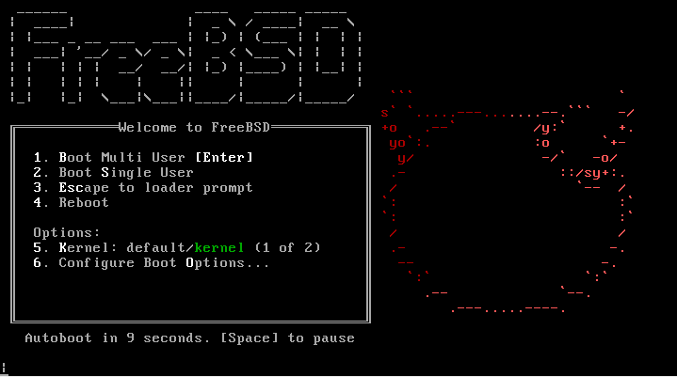
bsdinstall – (1)
An easy to use, text-based installation program
Beginning with FreeBSD 9.0-RELEASE

Slide 13
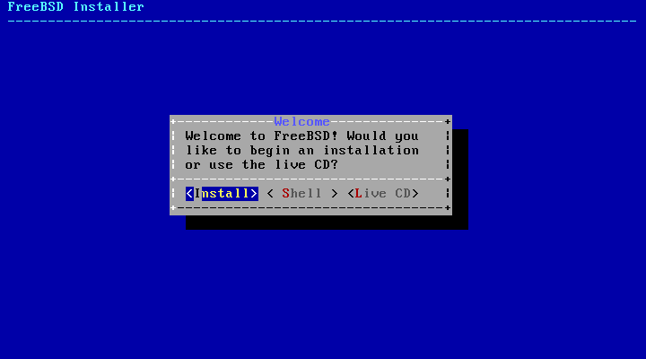
bsdinstall – (2)
Install、Shell、Live CD

Slide 14
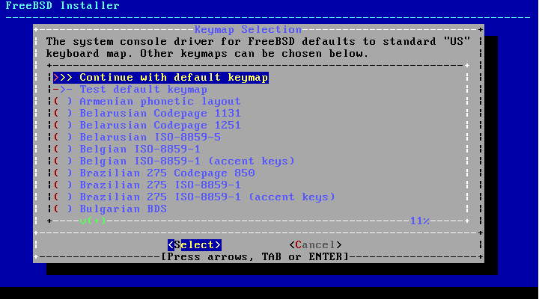
bsdinstall – (3)
Select keymap

Slide 15
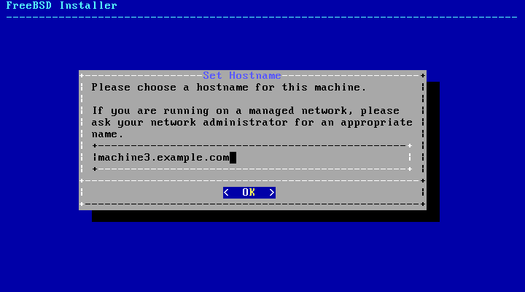
bsdinstall – (4)
Setting hostname
e.g., xxxsa.cs.nctu.edu.tw

Slide 16
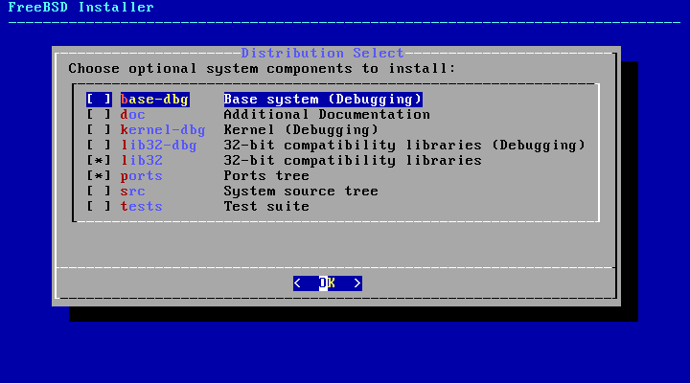
bsdinstall – (5)
Selecting components to install

Slide 17
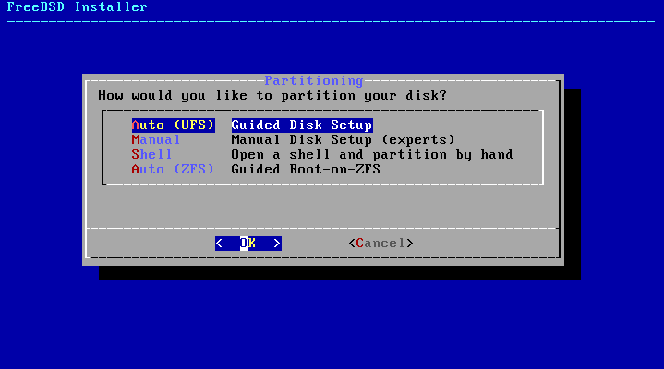
bsdinstall – (6)
Partitioning methods
Shell – gpart(8)、fdisk(8)、bsdlabel(8)

Slide 18
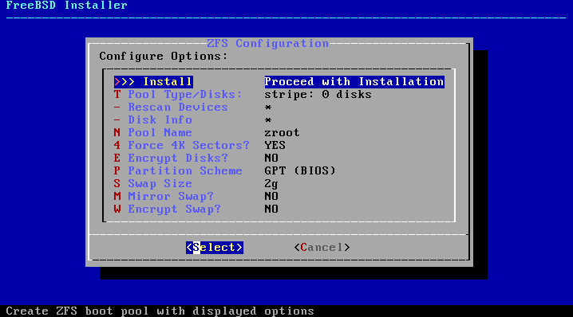
bsdinstall – (7) Auto (ZFS)
Guided Root-on-ZFS
Enter a pool name, disable forcing 4k sectors, enable or disable encryption
Switch between GPT (recommended) and MBR partition table types, and select the amount of swap space

Slide 19
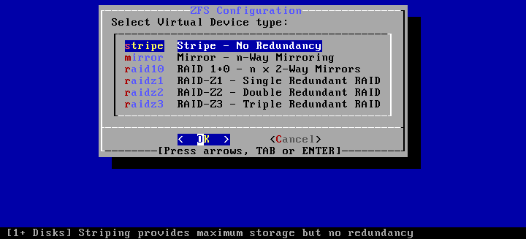
bsdinstall – (8) Auto (ZFS)
Virtual Device type
Stripe
Mirror
RAID10
RAID-Z 1, 2, 3

Slide 20
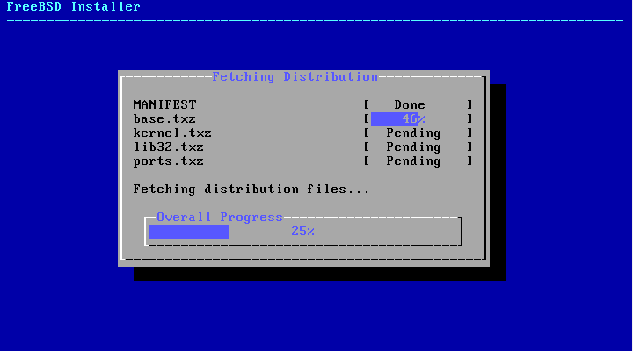
bsdinstall – (9)
Fetching → Checksum Verification → Extraction

Slide 21
bsdinstall – (10)
Post-installation
root password
Network interfaces
Wired – Static IPv4 / DHCP / Static IPv6 / SLAAC
Wireless
DNS
Time Zone
Services
System security hardening options
Add users

Slide 22
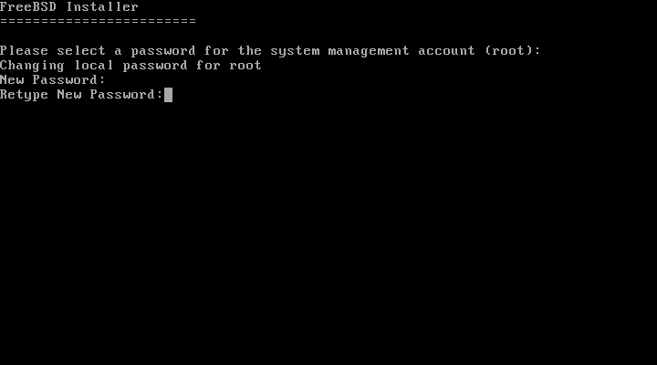
Post-installation
Setting the root Password

Slide 23
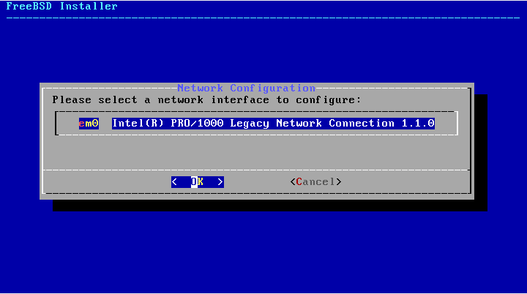
Post-installation
Select a network interfaces

Slide 24
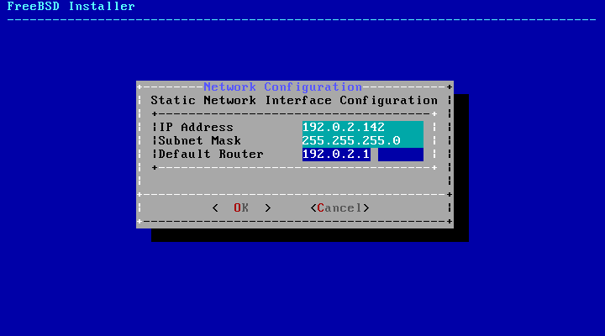
Post-installation
Configuring IPv4 Networking

Slide 25
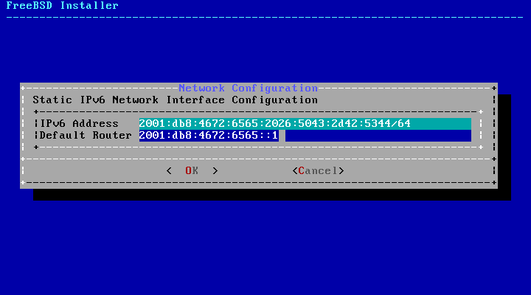
Post-installation
Configuring IPv6 Networking
IPv6 Stateless Address Auto configuration (SLAAC)

Slide 26
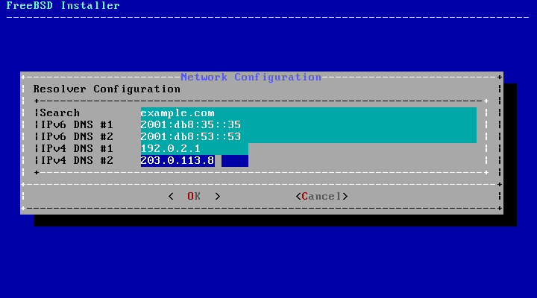
Post-installation
Configuring DNS

Slide 27
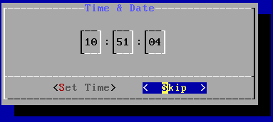
Post-installation
Setting the Time Zone
5 Asia → 42 Taiwan

Slide 28
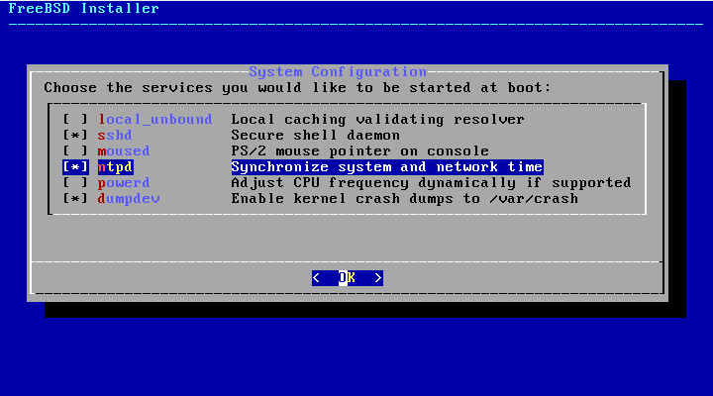
Post-installation
Selecting services to be enabled at boot
Enable ntpd
Disable dumpdev

Slide 29
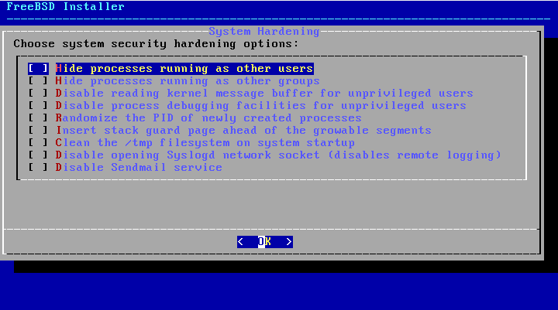
Post-installation
Selecting system security hardening options

Slide 30
Post-installation
Add Users
Username - wangth
Full name - Tse-Han Wang
Uid - User ID. Typically left blank for default.
Login group - The user's group.
Invite user into other groups? - wheel
Login class - Typically left blank for default.
Shell - The interactive shell for this user. CSCC use tcsh.
Home directory - The user's home directory.
Home directory permissions - The default is usually correct.
Use password-based authentication? - Typically "yes".
Use an empty password? - Typically "no".
Use a random password? - Typically "no".
Enter password - The actual password for this user.
Enter password again - The password must be typed again for verification.
Lock out the account after creation? - Typically "no".

Slide 31
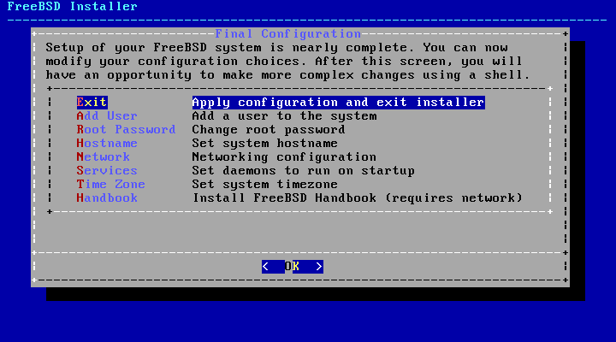
Post-installation
Final Configuration

Slide 32
FreeBSD Handbook
Chapter 2. Installing FreeBSD (FreeBSD 9.0 Release and Later)
http://www.tw.freebsd.org/doc/en/books/handbook/bsdinstall.html
Chinese resources
http://www.tw.freebsd.org/doc/zh_TW/books/handbook/install.html
Chapter 2 Installing FreeBSD 8.X and Earlier

Slide 33
Appendix
bsdinstall – Manual (UFS)

Slide 34
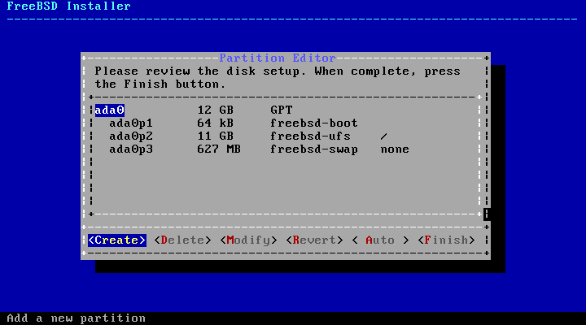
bsdinstall – Manual (UFS)
Guided Partitioning result

Slide 35
bsdinstall – (7) Manual
Guided Partitioning
Select disk
How to partition the disk
Entire Disk
Partition – use free space

Slide 36
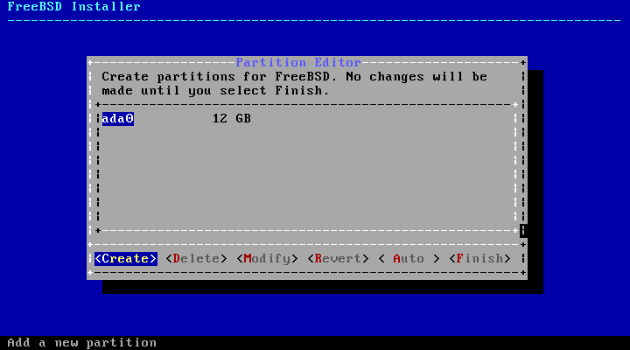
bsdinstall – (8) Manual
Manual Partitioning

Slide 37
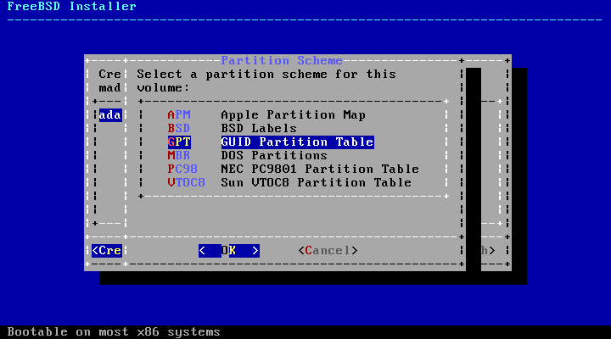
bsdinstall – (9) Manual
Choose a partitioning scheme
Master Boot Record (MBR)
4 Primary Partition, 1 Extended Partition, multiple Logical Partition
GUID Partition Table (GPT)
128 Partitions per disk
DON’T use BSD!!!

Slide 38
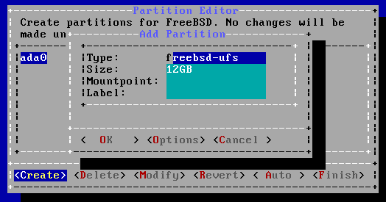
bsdinstall – (10) Manual
Add partitions
freebsd-boot
FreeBSD boot code. This partition must be first on the disk.

Slide 39
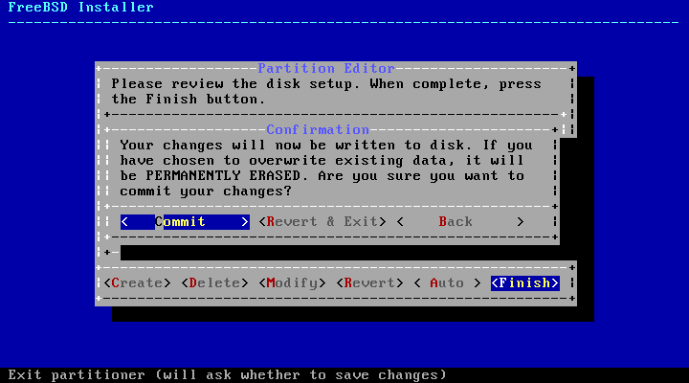
bsdinstall – (11) Manual
Final confirmation

