Slide 1
System Administration Practice

Slide 2

What System Administrator Should do? (1)
Ordinary list
  Install new system, programs and OS updates
  Monitoring system and trying to Tune performance
  Adding and removing users
  Adding and removing hardware
  Backup and Restore
  Configuration management (Ansible, Chef, Puppet, SaltStack, …)
  Continuous Integration / Continuous Delivery (Git, Jenkins / Travis CI, Sonarqube, …)
  Log management (Fluentd / Logstash, Elasticsearch, Kibana )
  Security
  Virtualization (KVM, Xen, …)
  …

Slide 3
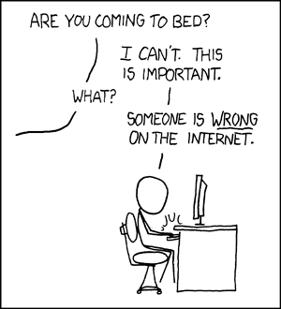
What System Administrator Should do? (2)
Non-technique list
  Helping users
  Maintaining documentation
  Moving furniture
  Burning your liver
  Good communication
  and memorization

Slide 4
What System Administrator Should do? (3)
The best words to describe the job
  Thankless job.
    http://www.sysadminday.com/
  System administration is like keeping the trains on time;
  no one notices except when they’re late.
  氣象局：「我們對的時候，沒人記得；我們錯的時候，沒人忘記。」
Philosophy of system administration
  Know how things really work.
  Plan it before you do it.
  Make it reversible.
  Make changes incrementally.
  Test before you unleash it.

Slide 5
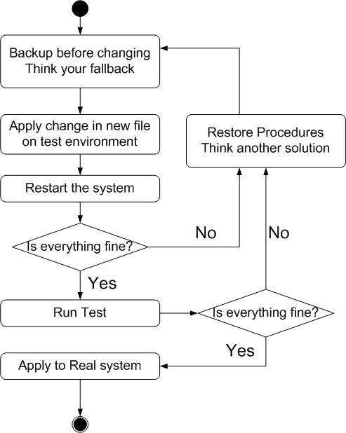
What System Administrator Should do? (4)
Flow of Change

Slide 6
What you can learn in this course?
The skill to be a candidate of system administrator
Information about CS computer center
System Admin / Network Admin ?
  Play with computers
What FreeBSD can do.

Slide 7
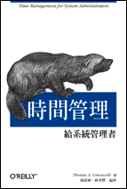
Attitude
Attend every class
Do every exercise
  As early as possible
  On your own
Read book and practice at least 6 hours every week
  Use unix-like environment
  Recommend: more than 1.5 hours/day averagely.
Collect information on the internet
  The newer, the better.

Slide 8

Syllabus
Website:
  http://www.cs.nctu.edu.tw/~wangth/course/sysadm/
Instructors:
  王則涵 wangth@cs.nctu.edu.tw
Time:
  Thu. IJK (PM 6:30 ~ 9:20)
Place:
  EC122
TAs:
  We might get about 3~5 TAs.
  Email to TAs: (ta@nasa.cs.nctu.edu.tw)
  3GH every week
Textbook:
  Unix and Linux System Administration Handbook (5th Edition)

Slide 9
Syllabus – Content
We will cover the following chapters in this semester (SysAdmPractice):
  Chapter 1 ~ 14
  Chapter 16, 19, 20
  Chapter 27, 31
The following chapters is covered in the next semester (NetAdmPractice):
  Chapter 15 ~ 18, 21, 23 ~ 25, 30 ~ 32
  NAT, DHCP, VPN, Proxy, …
  Perl Programming

Slide 10
Syllabus – Text book outline
Part I. Basic Administration
Chap 1 – Where to start.
Chap 2 – Booting and Shutting Down
Chap 3 – The Filesystem
Chap 4 – Access control and rootly
powers
Chap 5 – Controlling processes
Chap 6 – User Management
Chap 7 – Storage
Chap 8 – Periodic processes
Chap 9 – Backups
Chap 10 – Syslog and log files
Chap 11 – Software installation and
management
Chap 12 – The Kernel
Chap 13 – Scripting and the Shell
Chap 14 – Configuration Management
Part II. Networking
Chap 15 – Physical Networking
Chap 16 – TCP/IP
Chap 17 – Routing
Chap 18 – DNS: Domain Name System
Chap 19 – NFS: Network File System
Chap 20 – HTTP: Hypertext Transfer Protocol
Chap 21 – SMTP: Simple Mail Transfer Protocol
Chap 22 – Directory Services
Chap 23 – Electronic Mail
Chap 24 – Web Applications
Chap 25 – Network Management and Debugging

Slide 11
Syllabus – Text book outline (Cont.)
Part III. Operations
Chap 26 – Continuous Integration and Delivery
Chap 27 – Security
Chap 28 – Cloud Computing
Chap 29 – Containers and Virtualization
Chap 30 – Monitoring
Chap 31 – Performance Analysis
Chap 32 – Policy and Politics

Slide 12
Syllabus – Grade Policy
Mid
  15 ~ 20%
Final
  15 ~ 20%
Exercise (Homeworks)
  60 ~ 70%
    No Delay Work
    4 exercises
    1 term project

Slide 13
What you should prepare?
Background knowledge
  UNIX commands
  Basic of TCP/IP Networking (not required)
Environment
  One dedicated PC
    Or dual OS in your PC.
Yourself
  Your hard study

Slide 14
Finally, Am I OK to take this course?
Are you willing to devote yourself to exercise?
  Yes! Please come
Are you newbie in this area?
  Yes!? It’s ok, Please come
Do you take more than 3 major courses?
  Yes!??? It is quite dangerous, but I can not stop u

Slide 15
Basic knowledge in this course

Slide 16
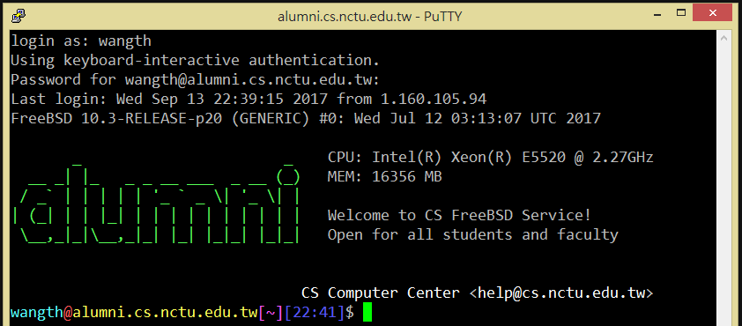
Login
SSH (Secure Shell)
  PuTTY:
  https://www.chiark.greenend.org.uk/~sgtatham/putty/latest.html
  Workstation:
  https://help.cs.nctu.edu.tw/help/index.php?title=分類:工作站

Slide 17
Commands
Useful commands
  passwd, chsh, chfn, chpass
  ls
  ps, top
  mkdir/rmdir
  cp/mv/rm
  write
  Email reader: mutt, …etc.
  News reader: tin
  Connecting: ssh/telnet
  Manual: man, info, …etc.
  Editor: vim, joe, ee, …etc.
  File Transmittion: ftp, ncftp, lftp, scp, wget, curl, …etc.
  Compilers: gcc, g++, javac, …etc.
  Scripting: perl, php, ruby, python …etc.
  login/exit/logout/screen/tmux

Slide 18
Conventions
Syntax of commands:
  Anything between “[” and “]” – is optional.
  Anything followed by “…” – can be repeated.
  {a | b} – you should choose one of them.
  Example:
    bork [-x] { on | off } filename …
    bork on /etc/hosts ○
    bork –x off /etc/hosts /etc/passwd ○
    bork –x /etc/hosts Ｘ
    bork -h /etc/hosts Ｘ
Globing characters
  “*” matches zero or more characters.
  “?” match one character.
  “~” (twiddle) means home directory
  “~user” means home directory of user

Slide 19
man pages (manual)
man pages (manual)
  Contain descriptions of
    Individual command.
      % man cp
    File format.
      % man rc.local
    Library routines.
      % man strcpy

Slide 20
man command
Command
  % man [section] title (BSD)
    % man printf (printf command)
    % man 3 printf (C Standard printf func.)
    % man -k exit (keyword search)
Man pages organization
%man man
AT&T | BSD | Contents
1 | 1 | User-Level commands and applications
2 | 2 | System calls and kernel error code
3 | 3 | Library calls
4 | 5 | Standard file format
5 | 7 | Miscellaneous files and documents
6 | 6 | Games and demonstrations
7 | 4 | Device Drivers and network protocols
1m | 8 | System administration commands
9 | 9 | Obscure kernel specs and interfaces

Slide 21
HOWTO - Shutdown
FreeBSD Shutdown
  shutdown -p now
  shutdown -r now (reboot)

Slide 22
Q&A
Break time.

