Slide 1
tmux
wengyc

Slide 2
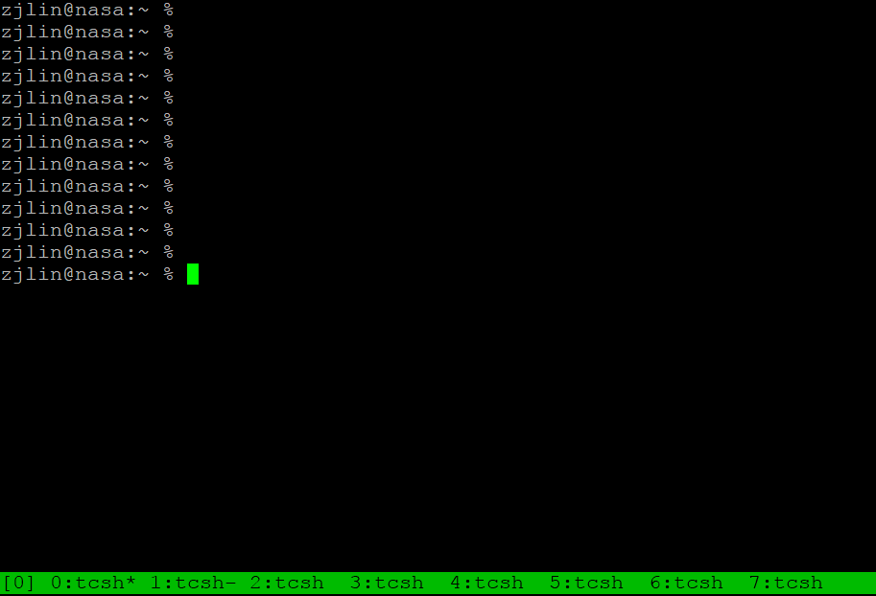
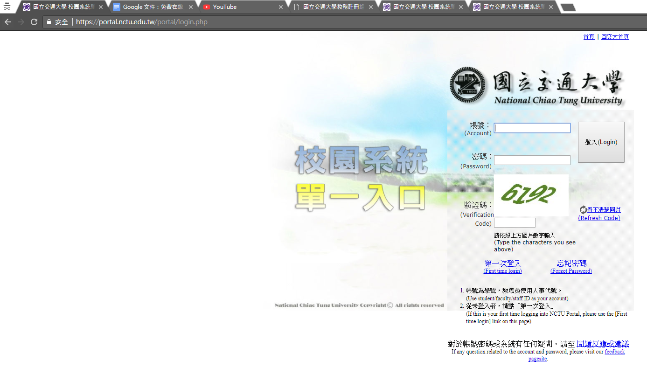
What is tmux?
terminal multiplexer
可以開很多分頁(terminal)

Slide 3
What is tmux?

Slide 4
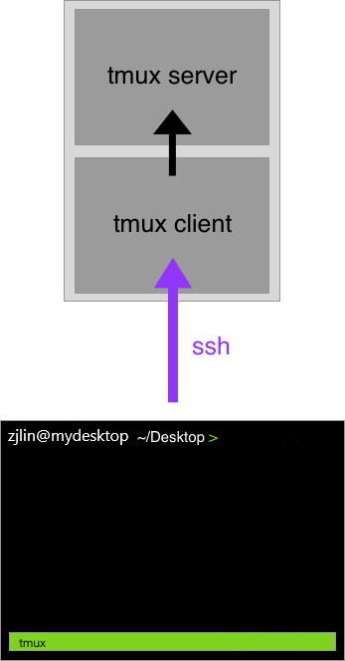
What is tmux?

Slide 5
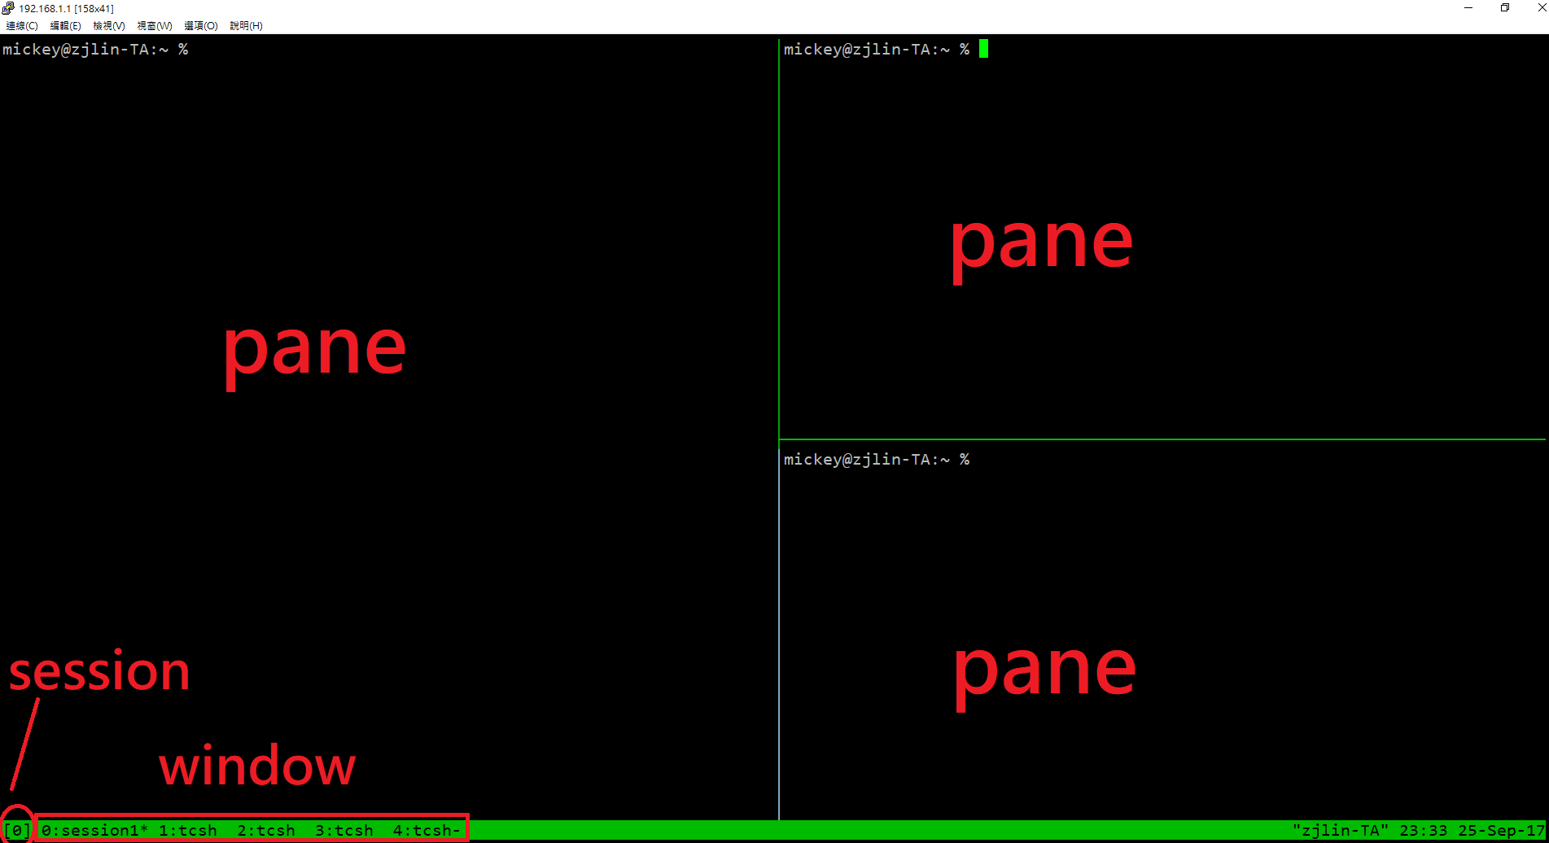
What is tmux?

Slide 6
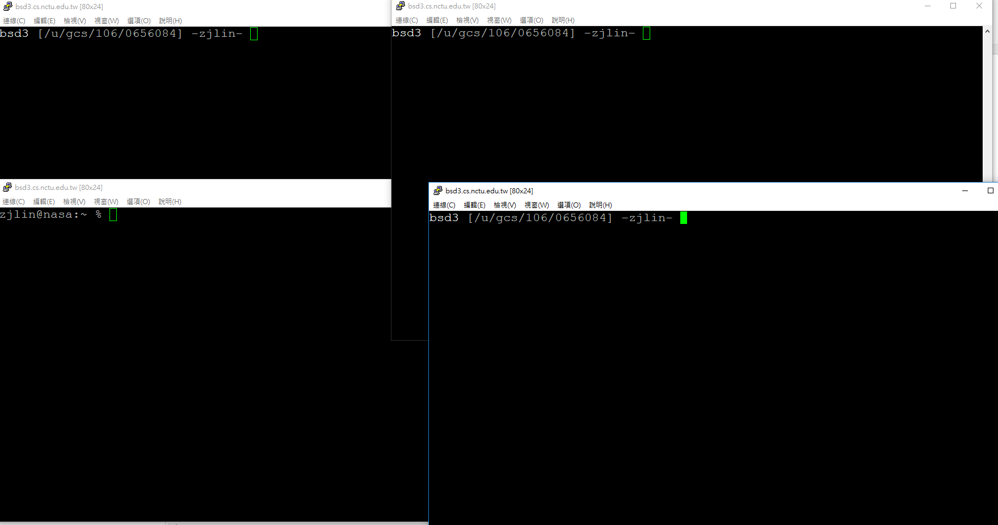
Why should I use tmux?

Slide 7
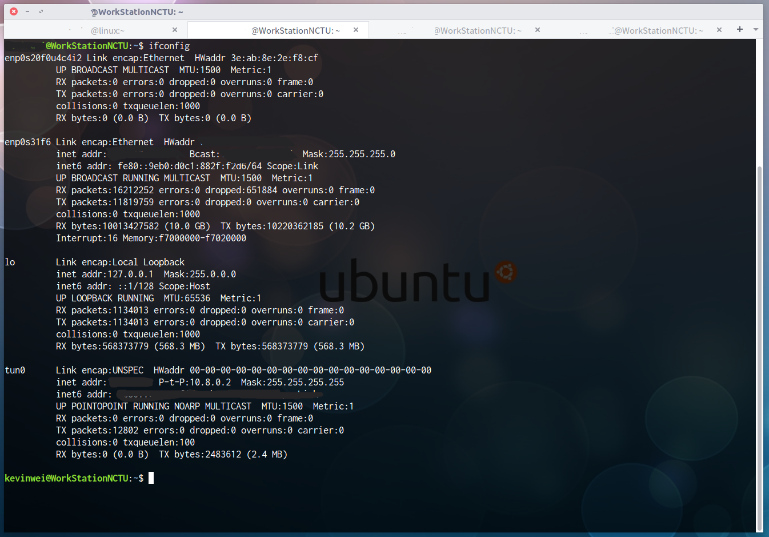
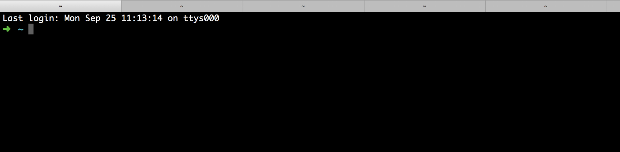
Why should I use tmux?

Slide 8


Why should I use tmux?
程式 debug 到一半沒存檔斷線?
更新到一半斷線?

Slide 9

Advantage of tmux
同時管理多個 session, window, pane
保留工作狀態隨時 attach/detach
強大的畫面分割
同時 attach => 分享畫面

Slide 10
Start tmux
tmux
tmux attach [ -t <number> ]
tmux detach
tmux ls
tmux kill-session [ <number> ]

Slide 11

Tmux - session, window, pane
session - browser
window - tab
pane - split window

Slide 12
Tmux - session, window, pane

Slide 13

tmux 101

Slide 14
Bindkey - window
bindkey (default is C-b) //C === control | c | new-window
 | n | next-window
 | p | previous-window
 | l | last-window
 | <num> | select-window -t := <num>
 | & | confirm-before -p "kill-window #W? (y/n)" kill-window
 | , | command-prompt -I "#W" "rename-window '%%'"
 | . | command-prompt "move-window -t '%%'"

Slide 15

more skill

Slide 16
Bindkey - pane
bindkey (default is C-b) //C === control | % | split-window -h
 | “ | split-window
 | 方向鍵 | select-pane
 | alt+方向鍵 | resize-pane
 | x | confirm-before -p "kill-pane #P? (y/n)" kill-pane
 | { | swap-pane -U
 | } | swap-pane -D

Slide 17
Tmux - session, window, pane

Slide 18
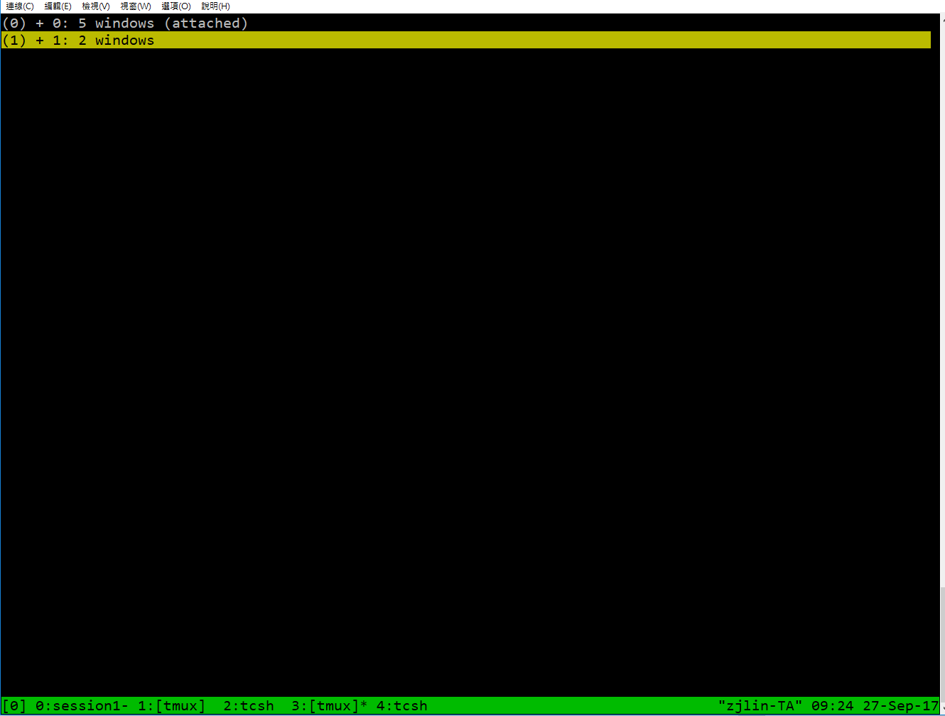
Bindkey - session
多開幾個瀏覽器

Slide 19
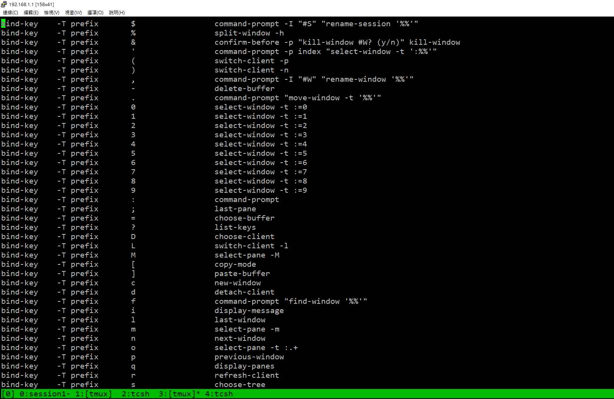
Tmux - bindkey
bindkey + ?

Slide 20
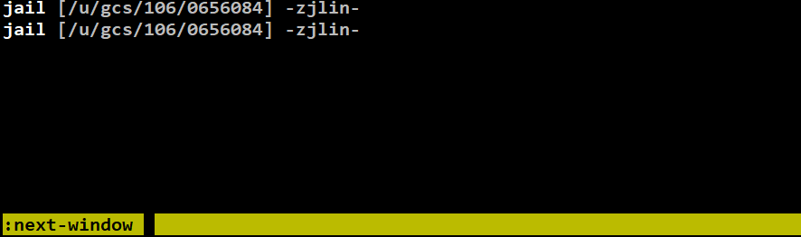
Tmux - command
command
  bindkey + :

Slide 21

Feel unfriendly?

Slide 22

Configuration - tmux.conf
~/.tmux.conf
design yourself style
colorful

Slide 23
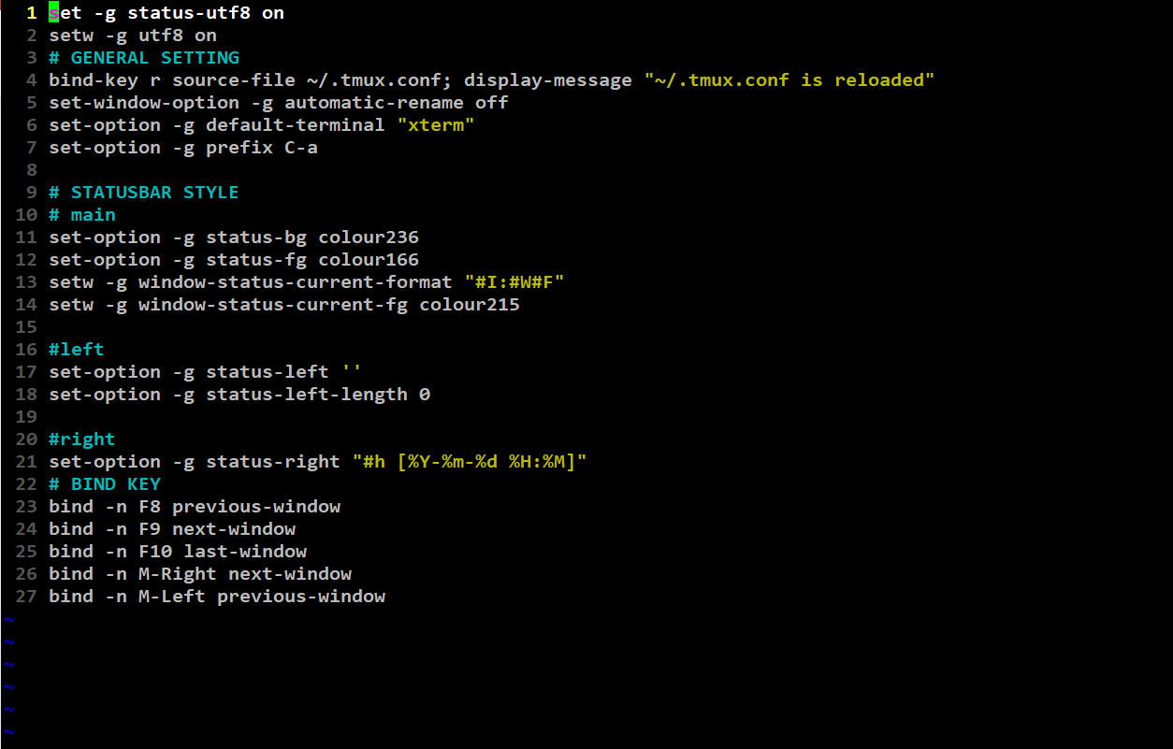

Configuration - tmux.conf
~/.tmux.conf

Slide 24
Configuration - bindkey
~/.tmux.conf
  bind-key ( alias: bind )
  C ( alias: <Ctrl> )
  M ( alias: <Alt> )
bind-key <key> <command>
  -T key-table ( default table is prefix )
  -n : alias for -T root
  -r : repeat

Slide 25
Configuration - set
~/.tmux.conf
  set-window-option ( alias: setw )

Slide 26
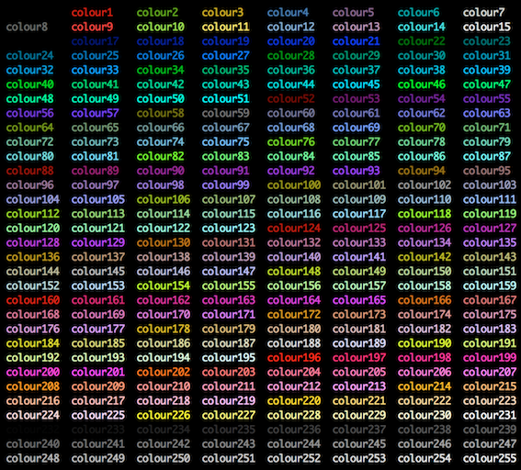
Configuration - set

Slide 27
Tmux v.s. Screen
 | Tmux | Screen
畫面切割 | detach 還在 | detach 消失
 | 可分割上下&左右 | 僅能切上下(預設)
 | 不同 session 不同分割 | 分割後每個 session 相同
session | 可直接切換 | 需要 detach 再重新 attach
 | 可同時在同一個 session | 一個 session 只能一個人
profile | .tmux.conf | .screenrc
 | 客製化狀態列 | 可更改處較少

Slide 28
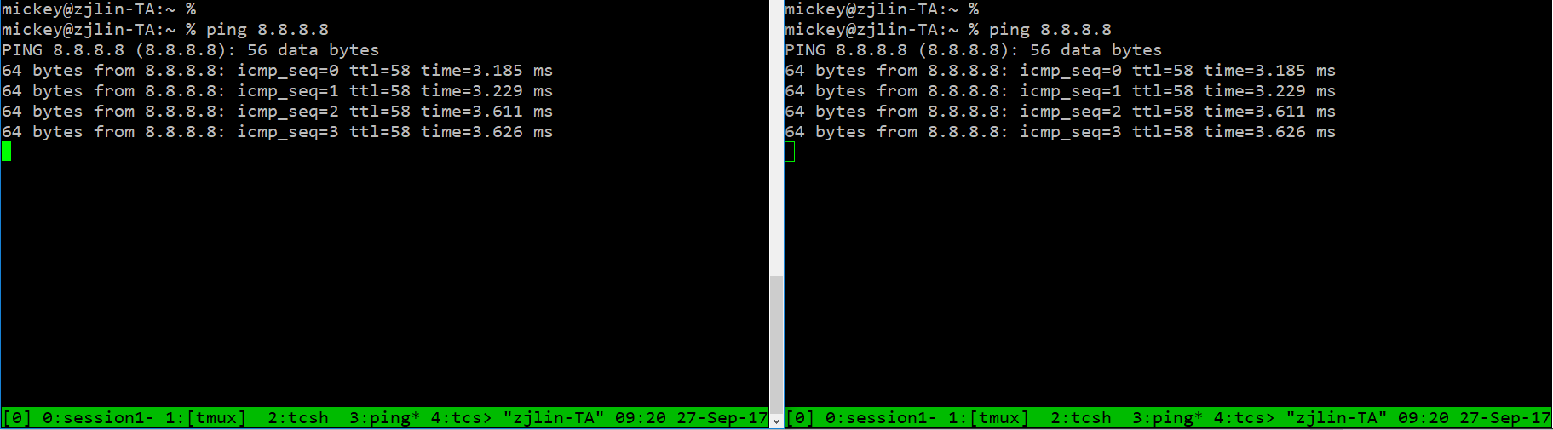
Tmux - share session
共同編輯

Slide 29

Q&A

