Slide 1
System Administration Homework 4 – Web Server
kuohh

Slide 2
Requirements
You need to build two different web servers for this assignment
Apache (50%) and NGINX (50%)
Virtual Host (10%)
Indexing (5%)
htaccess (5%)
Reverse Proxy (10%)
Hide Server Token (10%)
HTTPS and Auto redirect (10%)

Slide 3
Virtual Host
Setup a name-based virtual hosts in Apache
Show different content between visiting with IP address and domain name
IP Address: Access from ip is not allowed
Domain Name: Welcome
You can get domain names from the following sites
https://www.nctucs.net/
https://nctu.me/
https://www.noip.com/

Slide 4
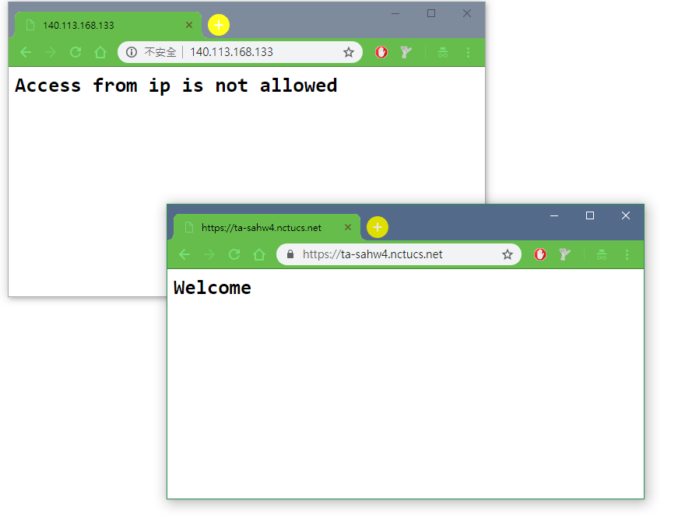

Slide 5
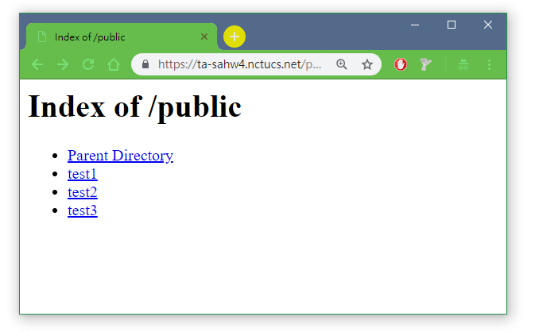
Indexing
When visit http://$yourdomain/public, showing what the directory contains

Slide 6
htaccess
When visit http://$yourdomain/public/admin, you need to login to see the content
Account: admin
Password: $your_student_ID

Slide 7
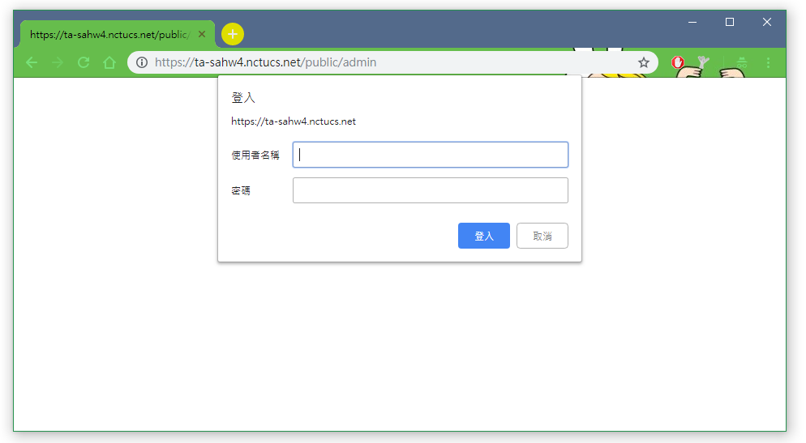
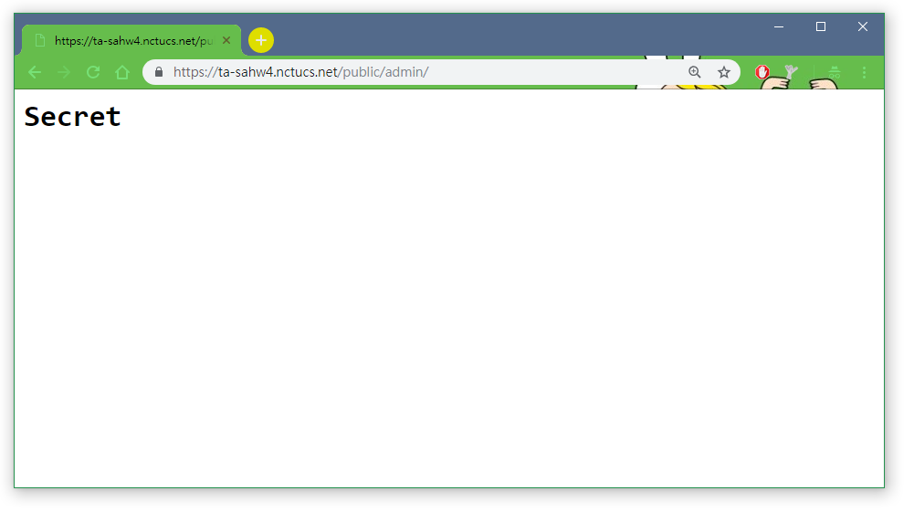

Slide 8
Reverse Proxy
A reverse proxy server is a server that itself does not generate or host the data, but rather the content is obtained by two backend servers
Make a reverse proxy under http://$yourdomain/reverse Content obtained from
http://sahw4-loadbalance1.nctucs.net/
http://sahw4-loadbalance2.nctucs.net/

Slide 9
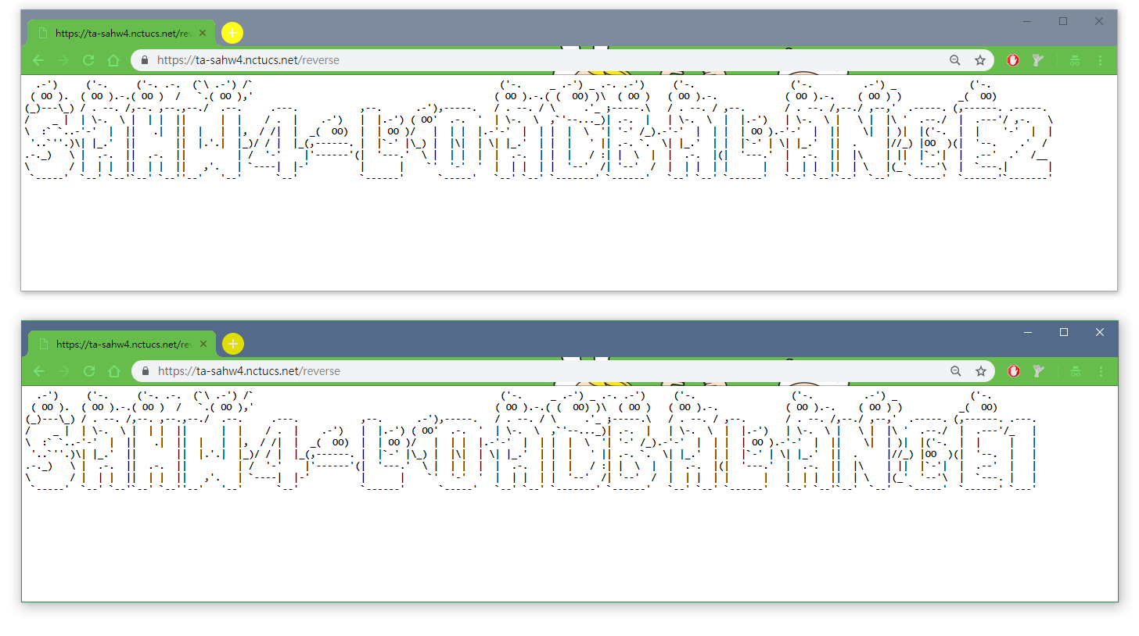

Slide 10
Hide Server Token (1/2)
For Apache server:
Response header only shows the Apache info without the version of Apache (5%)
Completely remove Apache info or disguise as other service (10%)
For Nginx server:
Response header only shows the Nginx info without the version of Nginx (10%)
Completely remove Nginx info or disguise as other service (+5% Bonus)

Slide 11
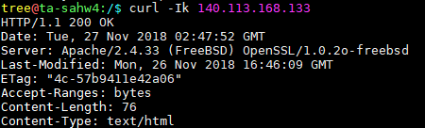
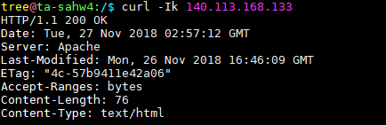
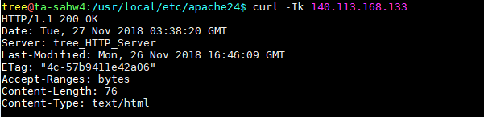
Hide Server Token (2/2)
Apache info only (5%)
Remove Apache info or disguise as other service (10%)

Slide 12
HTTPS and Auto redirect (1/2)
Activate https (5%)
You can use self-signed certificate
The browser might state that your website is unsafe when you use self-signed certificate
If you use self-signed certificate and want to test with curl, remember to add –k as on of the parameter
Auto redirect HTTP request to HTTPS (5%)

Slide 13
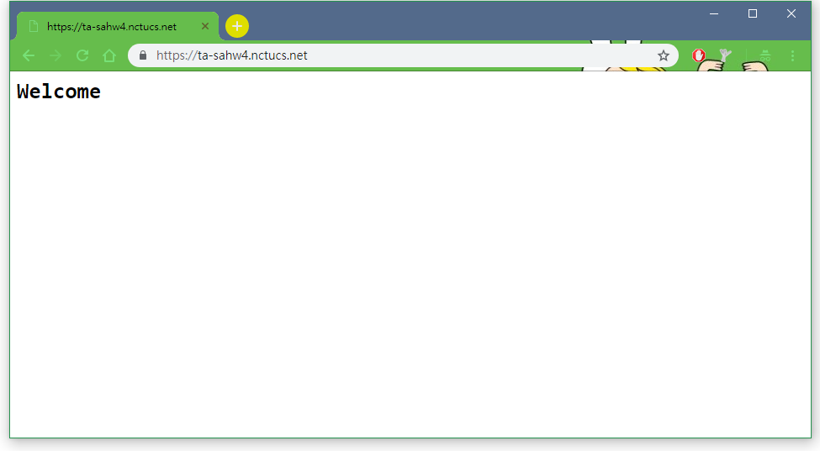
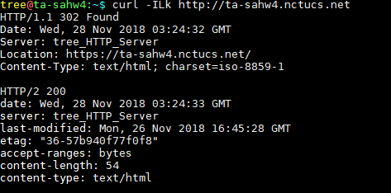
HTTPS and Auto redirect (2/2)

Slide 14
Deadline
2018/12/12
You do not need to submit anything

Slide 15
Help!
Email to ta@nasa.cs.nctu.edu.tw
New E3 https://e3new.nctu.edu.tw/
Office hour: 3GH at EC318

