Slide 1
Computer System Administration Homework 3 – File Server
fchsieh / zswu

Slide 2
Overview
Image that you are a TA of course, the professor want you to build a file server that students can submit their homework
To prevent your stupid colleagues accidentally deleting files on the server, the snapshot and rollback features is needed
File Server (100% + 40%)
FTP Server (60%)
ZFS on /home/ftp (20% + 10% Bonus)
RC (20% + 30% Bonus)
Upload script for pure-ftpd (20%)
ZFS auto backup service, zbackupd (30% Bonus)

Slide 3
FTP
fchsieh

Slide 4
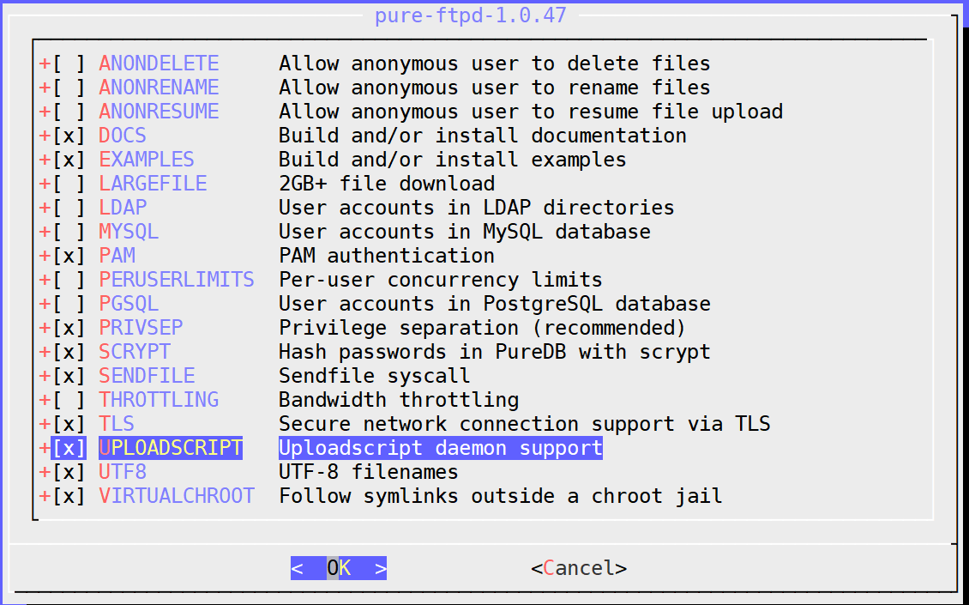
Installation
Install a FTP server for FreeBSD
Pure-FTPd: /usr/ports/ftp/pureftpd/
Compile it with “upload script” support from ports

Slide 5
Requirements (1/2)
Anonymous Login
Can download from /home/ftp/public
Can upload & mkdir from /home/ftp/upload
But no download or delete from /home/ftp/upload
Hidden directory problem /home/ftp/hidden
There is a directory called “treasure” inside /home/ftp/hidden/
Client can’t list /home/ftp/hidden/ but can enter hidden/treasure

Slide 6
Requirements (2/2)
Create a system user “sysadm”
Could login by SSH
Password is your student id
Full access to /home/ftp and subdirectories under “ftp”
Private directory is visible to sysadm
Create a virtual user “ftp-vip”
Password is your student id
Permission setting is same as “sysadm”
Your ftp server should support Explicit FTP over TLS (FTPES)
All accounts are chrooted (/home/ftp is the root directory)

Slide 7
Grading (1/2)
Anonymous login (30%)
Chrooted (/home/ftp) (5%)
Download from “/home/ftp/public” (5%)
Upload to “/home/ftp/upload” (5%)
Can’t download or delete form “/home/ftp/upload” (5%)
Hidden directory “/home/ftp/hidden” problem: can enter but can’t retrieve directory listing (5%)
FTP over TLS (5%)
sysadm (10%)
Login from SSH (2%)
Full access to “/home/ftp”, “upload”, “public” (3%)
Full access to “hidden” (list, mkdir, upload, download…) (3%)
FTP over TLS (2%)

Slide 8
Grading (2/2)
ftp-vip (20%)
Chrooted (/home/ftp) (5%)
Full access to “/home/ftp”, “upload”, “public” (5%)
Full access to “hidden” (list, mkdir, upload, download, …) (5%)
FTP over TLS (5%)

Slide 9
Hint (1/2)
Lots of README
/usr/local/share/doc/pure-ftpd/*
Accounts related
Virtual user
pure-pw(8)
pure-pwconvert(8)
README.Virtual-Users
If `pure-pw mkdb` is not working
Check your pure-ftpd.conf
PureDB /usr/local/etc/pureftpd.pdb

Slide 10
Hint (2/2): Demo Environment Setting
Within VM, using notebook or connect to your machine using remote desktop
Don’t need to open GUI for VM
You only need SSH and FileZilla
Use host-only network interface, connect from host OS
Host-only network interface: create connection between host and VM
Within VM, no remote desktop
Using the public IP
Port forwarding
Real Machine
Using the public IP
Firewall settings
If you have a public IP, using bridge mode is better for VM

Slide 11
ZFS on /home/ftp
fchsieh / zswu

Slide 12
Requirements (1/6)
Enable ZFS service
Reboot and everything is fine (ZFS still mount)
Create a mirror (RAID 1) storage called “mypool”
Create a mirror storage pool using the zpool command
Usually it is required to create a mirror storage pool with two different physical disk, you can just use two partition or even use “file as device” for this demo project

Slide 13
Requirements (2/6)
Create ZFS datasets
mypool/upload on /home/ftp/upload
mypool/public on /home/ftp/public
mypool/hidden on /home/ftp/hidden
Set gzip compression to all datasets

Slide 14
Requirement (3/6): Zbackup
Automatic Snapshot Script
Specification
Usage: zbackup [[--list | --delete | --export] target-dataset [ID] | [--import] target-dataset filename | target dataset [rotation count]]
Example
$ sudo ./zbackup data/to/backup 5
$ sudo ./zbackup data/to/backup 5
$ sudo ./zbackup --list data/to/backup
ID Dataset Time
1 data/to/backup 2018-10-05 10:12:23
2 data/to/backup 2018-10-05 10:14:25

Slide 15
Requirement (4/6): Zbackup
Specification
Create (Default)
No more than rotation count snapshots per dataset
If no rotation count specified, max 20 snapshots are allowed
If rotation count has reached, delete the oldest one
List
List the snapshot created by zbackup
If dataset is specified, list only the snapshot of that dataset
Otherwise, list all of the snapshot
Delete
Delete snapshots created by zbackup
Must specify dataset
If ID is specified, delete that one
Otherwise delete all snapshot of the dataset

Slide 16
Requirement (5/6): Zbackup
Specification
Export
Must specify dataset
ID defaults to 1
Must compress with xz
Must encrypt with aes256 (Hint: Use openssl; Ask user to input password)
The filename should be dataset/to/backup@2018-10-12.xz.enc
Import
Must specify dataset
Filename is the file exported by zbackup
Ask user to input password
Load the snapshot to the dataset

Slide 17
Requirement (6/6): Zbackup
For others non-define operation, just print an error message and exit
For create, print log message to stdout
Snap dataset@create time of the new snap, e.g.,
Snap mypool/mydataset@Sun Oct 21 16:32:09 CST 2018
Rotate dataset@create time of the deleted snap, e.g.,
Rotate mypool/mydataset@Sun Oct 21 16:32:09 CST 2018
Log must contain the action (snap/rotate), time and dataset name, but the format has no requirement

Slide 18
Grading
ZFS on /home/ftp (20% + 10% Bonus)
Create a mirror storage (5%)
Create all dataset and set up correctly (5%)
Zbackup (20%)
Create (10%)
List, Delete (+5%)
Export, Import (+5%)

Slide 19
Hint
Check handbook first
https://www.freebsd.org/doc/en/books/handbook/zfs-zfs.html
https://www.freebsd.org/doc/en/books/handbook/zfs-term.html

Slide 20
RC: Upload script for Pure-FTPd
fchsieh

Slide 21
Requirements (1/5)
Create a RC service which can run a command after a successful upload, e.g., do zfs snapshot
Auto start on boot
Execute a shell command when a file is successfully uploaded to the FTP Server
Passing arguments described in rc.conf
Don’t hardcore the command, the command can be specified in rc.conf
ftp_watchd_enable="YES"
ftp_watchd_command="zbackup mypool/upload 10"

Slide 22

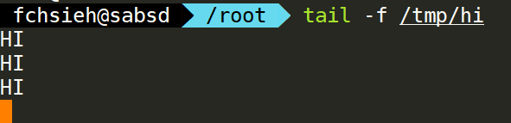
Requirements (2/5)
Execute a command defined in rc.conf whenever a file is uploaded
For example, echo “HI” and write to a file /tmp/hi
Set the command in rc.conf
The command should be invoked as expected after a successful upload

Slide 23


Requirements (3/5)
You can use pure-uploadscript to help you to do that
Automatically run an external program after a successful upload
Write a RC script, and turn pure-uploadscript into a daemon
You may also need to create a script for uploadscript
pure-uploadscript(8)
store
pure-ftpd
upload
filename
pure-uploadscript
sh
execute

Slide 24
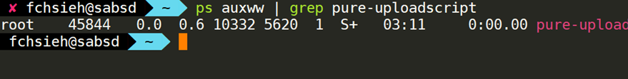
Requirements (4/5)
RC script can be used to start the pure-uploadscript program
Daemonize the uploadscript by ftp_watchd
pure-uploadscript should be run in the background when ftp_watchd is running
Your service must support these operation
$ service start ftp-watchd
$ service stop ftp-watchd
$ service restart ftp-watchd
$ service status ftp-watchd
$ service poll ftp-watchd

Slide 25

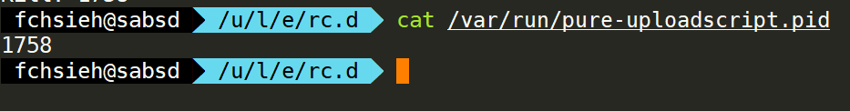
Requirements (5/5)
To stop ftp_watchd service, you need to kill pure-uploadscript service
This requires a pid file to indicate which process to stop
You may need this to write the stopping function

Slide 26
Hint
Enable upload script under pure-ftpd.conf
CallUploadScript yes
For pure-uploadscript, you can manually start the daemon by following command
pure-uploadscript -B -r /your/script/to/execute

Slide 27
Grading
ftp_watchd (20%)
All features work correctly (10%)
Command will be execute after a successful file upload
rc.conf (5%)
Auto start on boot
User can specify command in rc.conf
Service operation work correctly (5%)
start/stop/restart
status/poll

Slide 28
RC: ZFS auto backup service Zbackupd
zswu

Slide 29
Requirement (1/4): Zbackupd
Automatic Backup Service
Specification
Usage: zbackupd [-d] [-c /path/to/config/file.yaml] [-p /path/to/pid/file]
-d, Background execution (Main process fork and exit)
-c, Path to config file, defaults to /usr/local/etc/zbackupd.yaml
-p, Path to pid file (A file contains the daemon process pid), defaults to /var/run/zbackup.pid
If the daemon is running (i.e., pid file exists), show error and exit.
Once you do a snapshot, print a log message to stdout
Just output the message output by zbackup

Slide 30
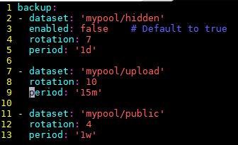
Requirement (2/4): Zbackupd
Configuration file syntax

Slide 31
Requirement (3/4): Zbackupd
Configuration file syntax
YAML format
backup
enabled: defaults to ture
rotation: rotation count for zbackup
period: [number][s|m|h|d|w] represent seconds, minutes, hours, days, weeks. The period of backup
Do the first snapshot when the program started

Slide 32
Requirement (4/4): Zbackupd
You need to provide a RC script that can dynamically start/stop service (e.g., $ service zbackupd start)
In /etc/rc.conf
zbackupd_enable=“YES”
zbackupd_config=“/path/to/the/config/file” (Default: /usr/local/etc/zbackupd.yaml)
Actions that need to be supported
start/stop/restart/reload
status/poll
list
If configuration file doesn’t exist, you need to show error message.
Redirect stdout to /var/log/zbackup.log

Slide 33
Hint (1/2)
How to write a rc start-up script:
https://www.freebsd.org/doc/en/articles/rc-scripting/
You may need some shell script technique
https://www.twbsd.org/cht/book/ch24.htm
/etc/rc.subr can help you to build rc service
https://www.freebsd.org/doc/en/articles/rc-scripting/

Slide 34
Hint (2/2)
You can use any language you want to implement this homework, however, we recommend you to use sh/bash to implement zbackup, use sh/bash/c/python etc… to implement zbackupd
When exec “$ service zbackupd reload”, the zbackupd process must have the same pid before and after reload. i.e. You need to send signal to the process to ask it to reload the config file instead of just restart the program

Slide 35
Grading
Zbackupd (30% Bonus)
All features work correctly (+10%)
Follow the config file and do snapshot
Support start/stop/restart/status/poll/list (+10%)
Support reload (+10%)
Load new config file
Pid must not be changed

Slide 36
Reminder
Demo with root is not allowed
Please use sudo
File/directory permissions are important
Owner, group, other
Read, write, execute
Set UID, set GID, sticky bit
Executable must be placed under /usr/local/bin/
Setting port forwarding to allow your services to be accessible over the Internet
Host → NAT Port Forwarding → VM → FTP Server, etc.

Slide 37
Deadline
You do not need to submit anything
Due(Demo): 2018/11/21

Slide 38
Help!
Email to ta@nasa.cs.nctu.edu.tw
New E3 https://e3new.nctu.edu.tw/
Office hour: 3GH at EC318

