Slide 1
Compute System Administration Homework 2: Shell Script
zswu

Slide 2
Requirements
2-1: Filesystem Statistics (20%)
2-2: Course Registration System (60%+20%)
Basic School Timetable Simulator ❤
Bonus
Modify code by yourself at demo (20%)
Please write the scripts in Bourne Shell (sh)
No score if you use csh, bash or other languages.
Due date: 2018/10/17 12:00
Upload ${student_ID}.tar on New E3 (http://e3new.nctu.edu.tw)

Slide 3
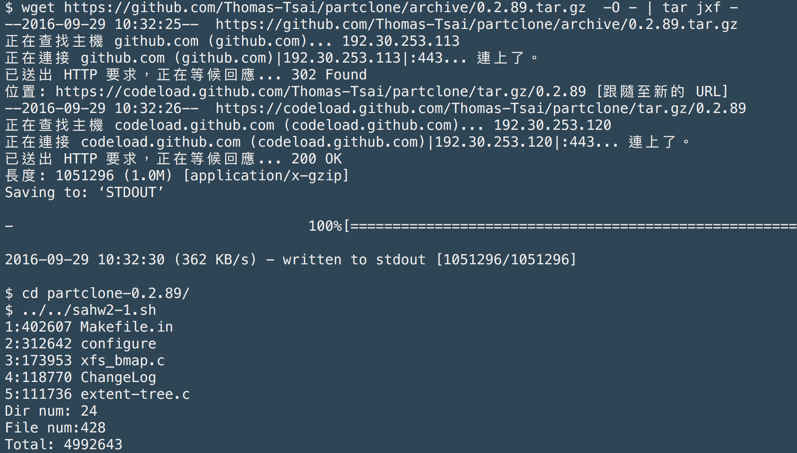
2-1: Filesystem Statistics

Slide 4
2-1: Filesystem Statistics – Requirement (1/3)
Inspect the current directory(“.”) and all sub-directory.
Calculate the number of directories.
Do not include ‘.’ and ‘..’
Calculate the number of files.
Calculate the sum of all file size.
List the top 5 biggest files.
Only consider the regular file. Do not count in the link, FIFO, block device... etc.

Slide 5
2-1: Filesystem Statistics – Requirement (2/3)
Use one-line command
No temporary file or shell variables.
No “&&” “||” “>” “>>” “<” “;” “&”, but you can use them in the awk command. Actually, you don’t need them to finish this homework.
Only pipes are allowed.
Hint: ls(1) with -A and -R

Slide 6
2-1: Filesystem Statistics – Requirement (3/3)
Grade
File is executable. (4%)
List top 5 file size and name. (4%)
Dir num is correct. (4%)
File num is correct. (4%)
Total size is correct. (4%)

Slide 7
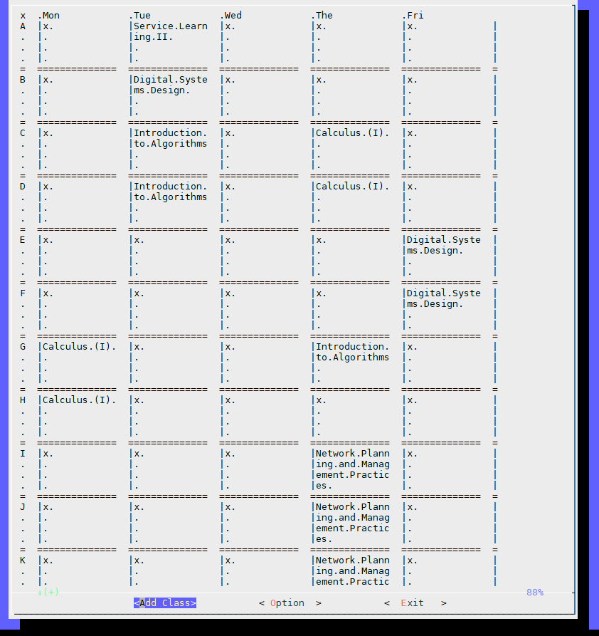
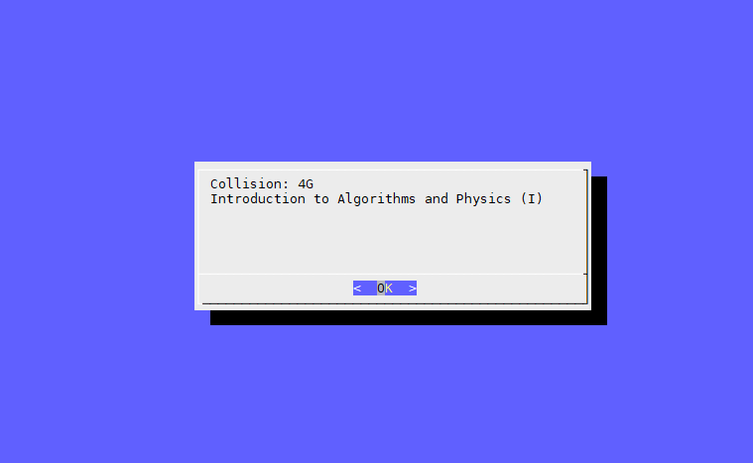
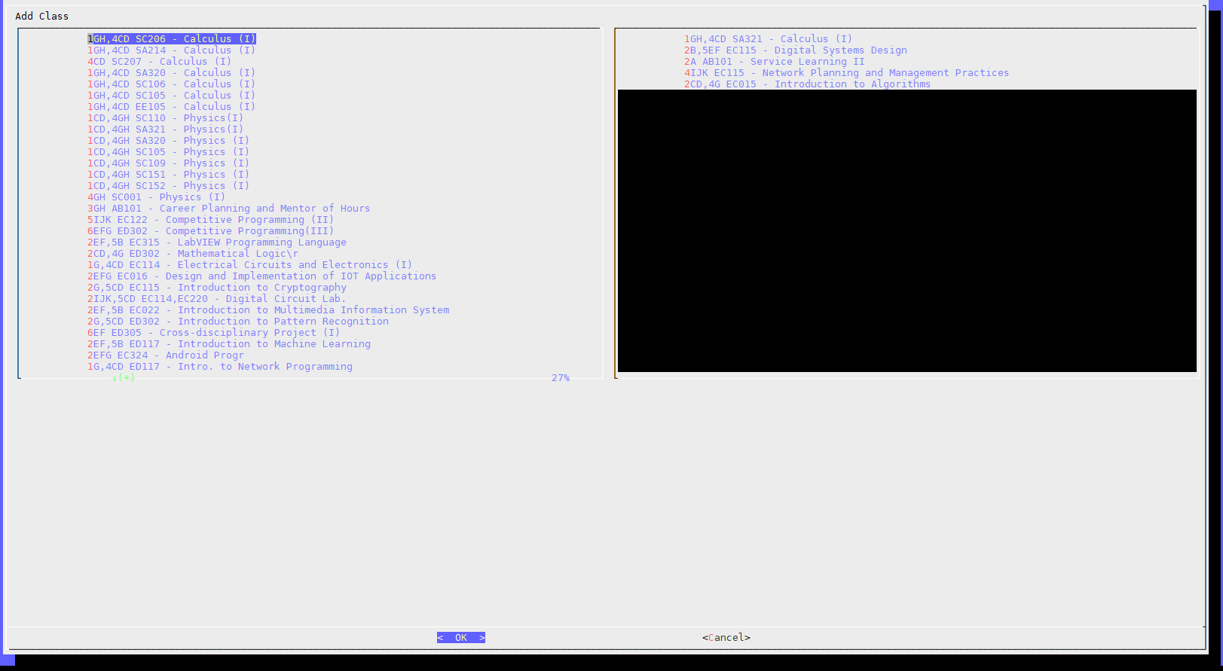
2-2: Course Registration System (CRS)

Slide 8
2-2: CRS – Requirements
Download timetable from timetable.nctu.edu.tw using curl, do this step only when no data kept at local. (15%)
CRS needs to list all courses，Keep record of all selected courses and options (including after program restart)，no modification if user select cancel while saving. (15%)
Check time conflict and ask user to solve the conflict by reselect courses. (15%)
Options for display course title or classroom number / display Sat.、Sun.、NMXY … less important time or not. (3%+3%)
Output aligned chart(3%), can display multi-line per grid. (6%)
Python … all other language and Shell except sh are restricted. Available packages are based on Workstation(bsd1~4)。

Slide 9
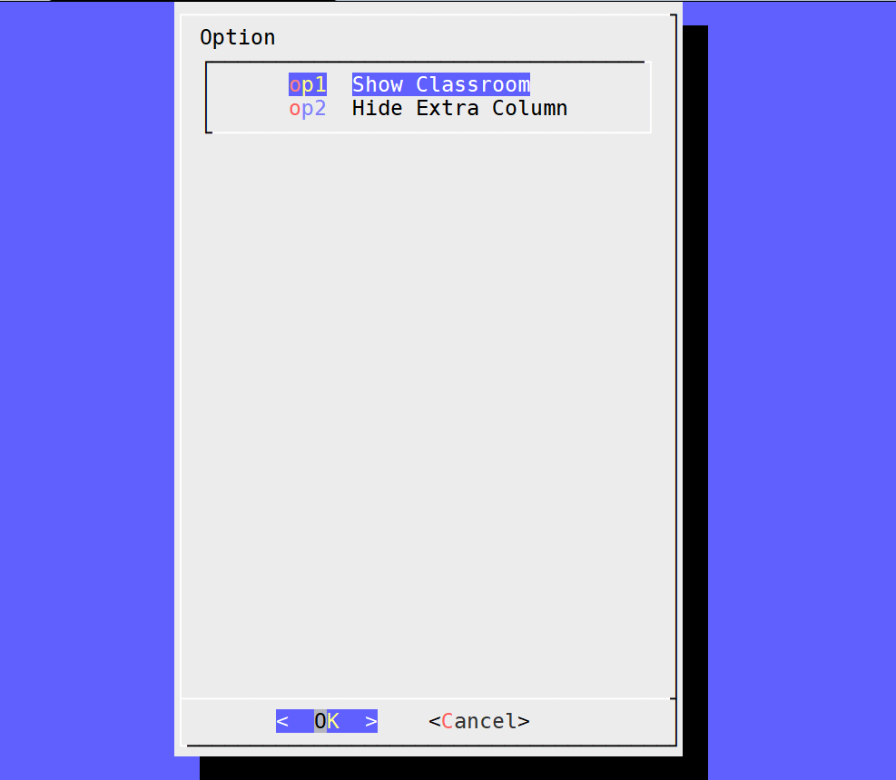
2-2: CRS
Option should at least contain these two functions。

Slide 10
2-2: CRS – Dialog
Dialog is a program that will let you to present a variety of questions or display messages using dialog boxes from a shell script.
These types of dialog boxes are implemented (though not all are necessarily compiled into dialog):
buildlist, calendar, checklist, dselect, editbox, form, fselect,
gauge, infobox, inputbox, inputmenu, menu, mixedform,
mixedgauge, msgbox (message), passwordbox, pause,
prgbox, programbox, progressbox, radiolist, rangebox,
passwordform, tailbox, tailboxbg, textbox, timebox,
treeview, and yesno (yes/no).

Slide 11
2-2: CRS – Hint (1/2)
JSON file of timetable can be download with :
curl 'https://timetable.nctu.edu.tw/?r=main/get_cos_list' --data 'm_acy=107&m_sem=1&m_degree=3&m_dep_id=17&m_group=**&m_grade=**&m_class=**&m_option=**&m_crsname=**&m_teaname=**&m_cos_id=**&m_cos_code=**&m_crstime=**&m_crsoutline=**&m_costype=**’
Will download timetable of CS courses, please complete homework base on this timetable, JSON parsing should be done with build-in tools.
If trouble occurs while curling timetable, please generate the timetable manually to complete the rest parts. Scores will not be count for this part (15%).

Slide 12
2-2: CRS – Hint (2/2)
Use English course name.
Display all classroom number in every grid if the course uses multiple classrooms.
No further restricts besides align all fields.

Slide 13
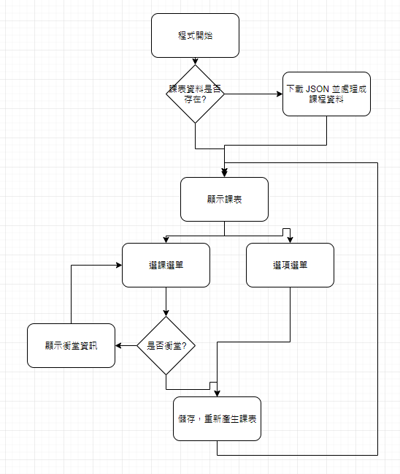
2-2: CRS – Recommend Workflow

Slide 14
2-2: CRS – Bonus
Course for free time (Show all current available courses)。(10%)
Course searching
Input: part of the course name, Output: all courses containing the search word in the course name. (5%)
Input: part of the course time, Output: all courses containing the search time. (5%)
Ex. Input: 4GH, Output: courses of 4GH、1B4GH …etc, but not courses with only 4G or 4H.

Slide 15
Help!
Email to ta@nasa.cs.nctu.edu.tw
New E3 https://e3new.nctu.edu.tw
Office hour: 3GH at EC318
Q：Why this assignment？ A ：Fun.😜

