Slide 1
Compute System Administration
Homework 2: Shell Script
zswu

Slide 2
Requirements
2-1: Filesystem Statistics (20%)
2-2: Course Registration System (60%+20%)
  簡易的模擬排課系統 ❤
  Bonus
Modify code by yourself at demo (20%)
Please write the scripts in Bourne Shell (sh)
  No score if you use csh, bash or other languages.
Due date: 2018/10/17 12:00
  Upload ${student_ID}.tar on New E3 (http://e3new.nctu.edu.tw)

Slide 3
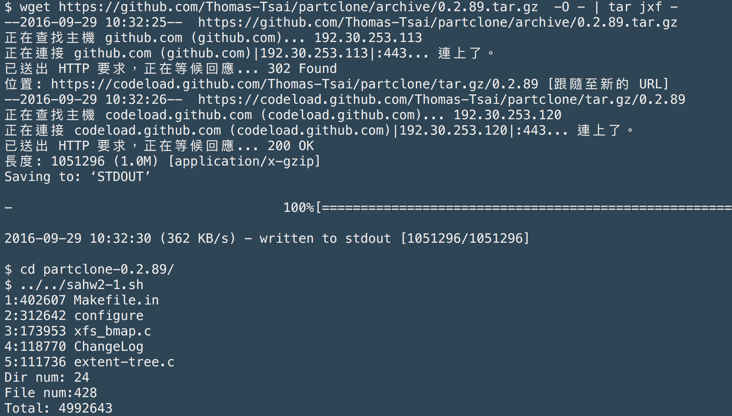
2-1: Filesystem Statistics

Slide 4
2-1: Filesystem Statistics – Requirement (1/3)
Inspect the current directory(“.”) and all sub-directory.
Calculate the number of directories.
Do not include ‘.’ and ‘..’
Calculate the number of files.
Calculate the sum of all file size.
List the top 5 biggest files.
Only consider the regular file. Do not count in the link, FIFO, block device... etc.

Slide 5
2-1: Filesystem Statistics – Requirement (2/3)
Use one-line command
No temporary file or shell variables.
No “&&” “||” “>” “>>” “<” “;” “&”, but you can use them in the awk command. Actually, you don’t need them to finish this homework.
Only pipes are allowed.
Hint: ls(1) with -A and -R

Slide 6
2-1: Filesystem Statistics – Requirement (3/3)
Grade
  File is executable. (4%)
  List top 5 file size and name. (4%)
  Dir num is correct. (4%)
  File num is correct. (4%)
  Total size is correct. (4%)

Slide 7
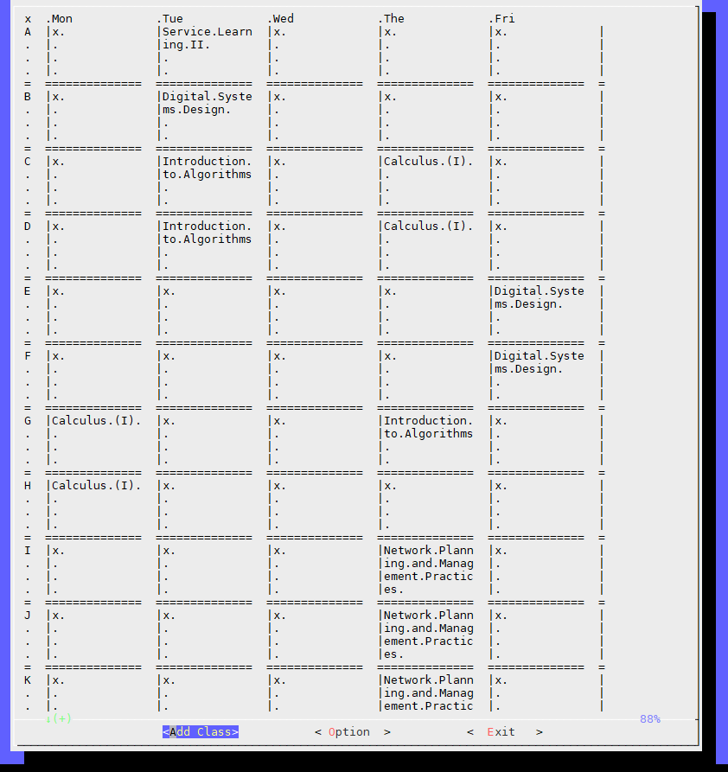
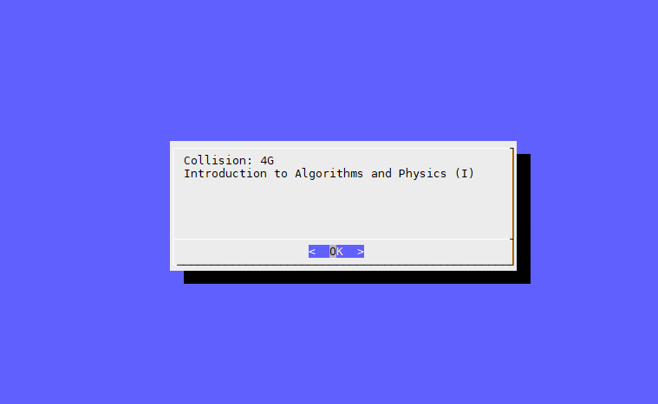
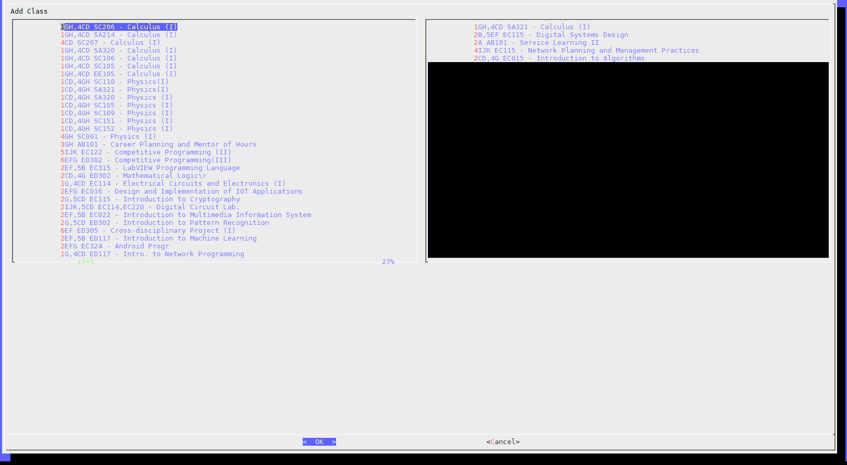
2-2: Course Registration System (CRS)

Slide 8
2-2: CRS – Requirements
使用 curl 到 timetable.nctu.edu.tw 下載課程表，只有在資料不存在時才要執行此步驟。(15%)
選課程式可以在選單列出課程，必須記住上次選取的課程和所有的選項(包含程式重開後)，若使用者選擇取消則不修改。(15%)
判斷衝堂並讓使用者回到選單修改衝堂的課程。(15%)
輸出課表時可以選擇顯示課程名稱或教室、是否顯示星期六日和 NMXY 等較不重要的時間。(3%+3%)
輸出整齊的表格(3%) ，表格中可以在同一格內換行顯示。(6%)
禁止使用 Python、Ruby等其他程式語言和sh以外的Shell。可使用的套件以工作站(bsd1~4)為準。

Slide 9
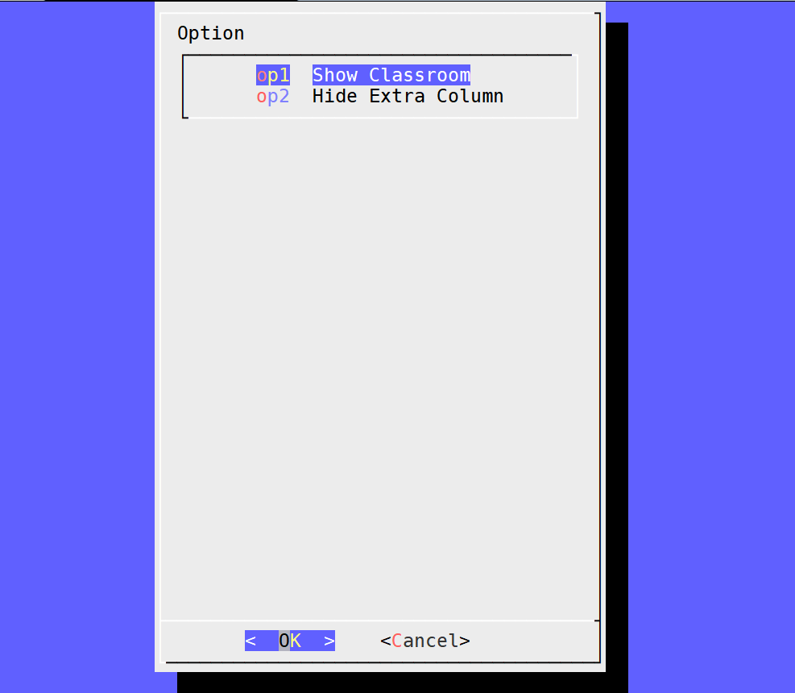
2-2: CRS
選擇Option 應至少出現這兩個功能的選項。

Slide 10
2-2: CRS – Dialog
Dialog is a program that will let you to present a variety of questions or display messages using dialog boxes from a shell script.
These types of dialog boxes are implemented (though not all are necessarily compiled into dialog):
buildlist, calendar, checklist, dselect, editbox, form, fselect,
gauge, infobox, inputbox, inputmenu, menu, mixedform,
mixedgauge, msgbox (message), passwordbox, pause,
prgbox, programbox, progressbox, radiolist, rangebox,
passwordform, tailbox, tailboxbg, textbox, timebox,
treeview, and yesno (yes/no).

Slide 11
2-2: CRS – Hint (1/2)
下載課表的 JSON 檔可以使用以下指令:
curl 'https://timetable.nctu.edu.tw/?r=main/get_cos_list' --data 'm_acy=107&m_sem=1&m_degree=3&m_dep_id=17&m_group=**&m_grade=**&m_class=**&m_option=**&m_crsname=**&m_teaname=**&m_cos_id=**&m_cos_code=**&m_crstime=**&m_crsoutline=**&m_costype=**'
以上指令會下載資工系的課表，作業請用上面的課表為主，JSON的處理請使用內建的工具想辦法完成。
若無法完成可以自行手動輸出課表資料完成後面的部份，並扣除此部分的分數。

Slide 12
2-2: CRS – Hint (2/2)
課程名稱請使用英文課程名稱。
若課程使用多間教室，則在所有的課程時間中顯示所有的課程教室。
顯示表格只要能對齊對應的欄位即可。

Slide 13
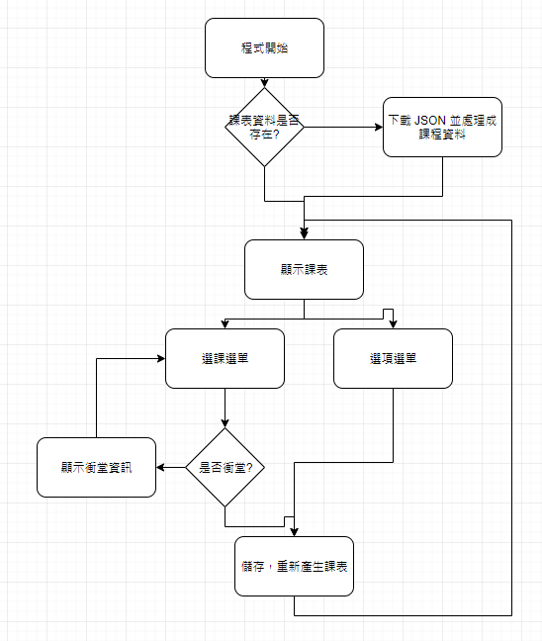
2-2: CRS – Recommend Workflow

Slide 14
2-2: CRS – Bonus
空堂選課(顯示所有目前可選且不會衝堂的課程)。(10%)
課程搜尋
  輸入課程部分名稱，顯示包含該關鍵字的所有課程。(5%)
  輸入課程時間，顯示包含該時間的所有課程。(5%)
    ex. 輸入: 4GH ；顯示: 4GH或是1B4GH等的課程，但不包含只有 4G 或是 4H 的課程

Slide 15
Help!
Email to ta@nasa.cs.nctu.edu.tw
New E3 https://e3new.nctu.edu.tw
Office hour: 3GH at EC318
Q：為何出這個作業？
A ：覺得好玩😜

