Slide 1
Sharing System Files

Slide 2
Why share?
One functioning host depends on hundreds of configuration files
But groups of hosts in your network needs more !!
Think about you have bsd1 ~ bsd6, linux1 ~ linux6, and each year, there are about 250 new students in cs.

Slide 3
What to share?
Good candidates to share
Filename | Function
/etc/passwd | User account information
/etc/group | UNIX group definitions
/etc/hosts | Maps between IP and hostname
/etc/services | Well-known network service port
/etc/protocols | Maps text names to protocol numbers
/etc/mail/aliases | E-mail alias
/etc/rpc | Lists ID numbers for RPC services
/etc/printcap | Printer information
/etc/termcap | Terminal type information

Slide 4
How to share?
Keep a master copy of each configuration file in one place and distribute it
Push vs. Pull model
Copy files around
rdist
expect
Let each machine obtain its configuration file from a center server
NIS

Slide 5
rdist – push files (1)
Advantage
Simple
Preserve owner, group, mode, and modification time of files
Control file
makefile like
distfile
How to distribute the files
[Usage] % rdist [-f distfile] [label]
[Format] label: pathnames -> destinations commands
Command | Description
notify namelist | Sends email to namelist
except pathlist | Do not distribute files in pathlist
except_pat patternlist | Do not distribute files that matches patternlist
Special [pathlist] “string” | Execute an sh “string” command

Slide 6
rdist – push files (2)
Example
% rdist
% rdist -f distfile
% rdist -f distfile all
SYS_FILES = (/etc/passwd /etc/group /etc/mail/aliases)
GET_ALL = (bsd1 bsd2 linux1)
GET_SOME = (csduty alumni)
all: ${SYS_FILES} -> ${GET_ALL}
notify chwong@cs.nctu.edu.tw;
special /etc/mail/aliases “/usr/bin/newaliases”;
some: ${SYS_FILES} -> ${GET_SOME}
except /etc/mail/aliases;
except_pat /etc/passwd*;
notify root@cs.nctu.edu.tw;

Slide 7
rdist – push files (3)
Disadvantage
Based on rsh
/.rhosts or /etc/hosts.equiv permit root access
rdist in FreeBSD
/usr/ports/net/rdist6
Use more secure “ssh” to replace rsh
Use public-key cryptography to do identification
Encrypt entire rdist conversation
% rdist –P /usr/local/bin/ssh –f myDistfile

Slide 8
expect – pull files (1)
Write control scripts for interactive programs
Fundamental expect commands
spawn
Start up a subprocess to control
send
Feed input to subprocess
expect
Take action depending on a subprocess’s output
expect “pattern” {action}
timeout and eof are special patterns
Our tactic
Connect to server using ftp and pull down what we want

Slide 9
expect – pull files (2)
example
spawn /usr/bin/ftp netserver
while 1 { expect {
“Name*:” {send “netclient\r”}
“Password:” {send “netclientpassword\r”}
“ftp> ” {break}
“failed” {send_user “Can’t login.\r”; exit 1}
timeout {send_user “Timeout problem.\r”; exit 2}
}}
send “lcd /etc\r”
expect “ftp> ” {send “cd pub/sysfiles\r”}
expect “ftp> ” {send “get passwd\r”}
expect “ftp> ” {send “quit\r”; send_user “\r”}
exit 0

Slide 10
NIS – The Network Information Service (1)
NIS (YP – Yellow Page)
Release by SUN in 1980s
For master server
System files are kept in original locations and edited as before
There will be a server process takes care of availability of these files over the network
Data files are hashed and formed a database for lookup efficiency
yp_mkdb
Makefile
NIS domain
The NIS server and it’s clients
Multiple NIS server
One master NIS server and multiple NIS slave servers

Slide 11
NIS – The Network Information Service (2)
/etc/netgroup
Group users, machines, nets for easy reference in other system files
Can be used in such as /etc/{passwd,group,exports}, /etc/exports
[format]
groupname list-of-members
[member-format]
(hostname, username, nisdomainname)
Example of /etc/netgroup
adm_user (,chwong,) (,chiahung,) (,liuyh,)
adm_cc_cs (cshome,,) (csduty,,) (csmailgate,,)
sun_cc_cs (sun1,,) (sun2,,) (sun3,,)
bsd_cc_cs (bsd1,,) (bsd2,,) (bsd3,,)
linux_cc_cs (linux1,,) (linux2,,) (linux3,,)
all_cc_cs adm_cc_cs sun_cc_cs bsd_cc_cs linux_cc_cs

Slide 12
NIS – The Network Information Service (3)
Prioritizing sources
System information can come from many resource
Local, NIS, …
Specify the sources that we are going to use and the order of them
/etc/{passwd, group}
+
Entire NIS map is included
+@
Include only certain netgroup
+name
Include only a single
/etc/nsswitch.conf
…
passwd: compat
group: compat
shadow: files nis
hosts: files nis dns
…

Slide 13
NIS – The Network Information Service (4)
Use netgroup in other system files
Example for used in /etc/passwd
Example for used in /etc/exports
…
pop:*:68:6:Post Office Owner:/nonexistent:/sbin/nologin
www:*:80:80:World Wide Web Owner:/nonexistent:/sbin/nologin
nobody:*:65534:65534:Unprivileged user:/nonexistent:/sbin/nologin
+@admin-user:*:::::
+:*:::::/usr/local/bin/cs.nologin
/raid -alldirs –maproot=root mailgate ccserv backup
/raid -alldirs –maproot=65534 –network 140.113.209 –mask 255.255.255.0
/home -ro –mapall=nobody –network 140.113.235.0 –mask 255.255.255.0
/usr/src /usr/obj –maproot=0 bsd_cc_csie

Slide 14
NIS – The Network Information Service (5)
Advantages of NIS
Not necessary for administrator to be aware of NIS internal data format
Cross-platform
Disadvantages of NIS
If a slave NIS server is down, the slave’s copy may not be updated
Periodically poll data (cron)
Not secure
Any host on a network can claim to be NIS Server
Any one can read your NIS maps
Consume network bandwidth

Slide 15
How NIS works (1)
NIS directory
/var/yp
NIS Server Map directory
In a subdirectory of the NIS directory named for the NIS domain
/var/yp/+cs.nis
Example:
csduty [/var/yp] -chwong- sudo ls +cs.nis/
auto.home group.byname netgroup.byuser publickey.byname
auto.master hosts.byaddr netid.byname rpc.byname
auto.net hosts.byname networks.byaddr rpc.bynumber
auto.user mail.aliases networks.byname services.byname
bootparams master.passwd.byname passwd.byname shadow.byname
ethers.byaddr master.passwd.byuid passwd.byuid sudoers.pwd.byname
ethers.byname netgroup protocols.byname ypservers
group.bygid netgroup.byhost protocols.bynumber

Slide 16
How NIS works (2)
NIS master server → NIS slave servers
“ypxfr” pull command
Every NIS slave server runs ypxfr periodically
“yppush” push command
NIS master server use yppush to instruct each slave to execute ypxfr
ypservers special map
It does not correspond to any flat file
A list of all NIS slave servers in that NIS domain
ypinit

Slide 17
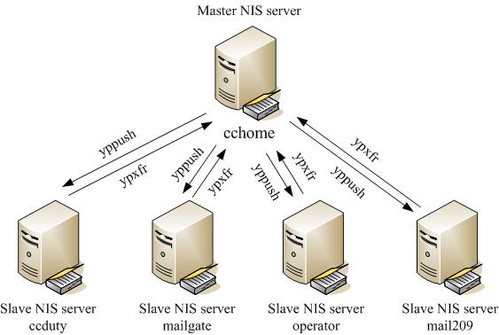
How NIS works (3)
cshome [/var/yp] -chwong- sudo cat ypservers
csduty.cs.nctu.edu.tw
csmailgate.cs.nctu.edu.tw
Example of cs

Slide 18
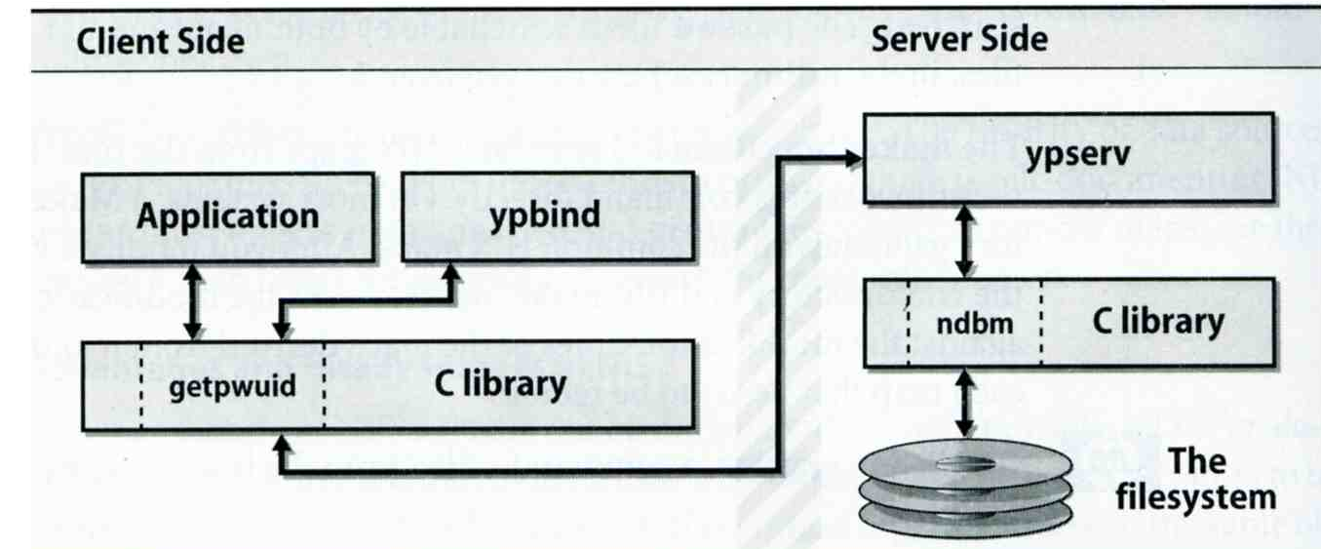
How NIS works (4)
After all maps are ready
Request and response
ypserv daemons
Run on NIS servers
Waiting for NIS requests and answering them by looking up information in maps
ypbind daemons
Run on every machine in NIS domain
Locate a ypserv and return the identity to the C library, which then contact the server directly

Slide 19
How NIS works (5)
NIS commands and daemons
Program | Description
domainname | Set or print name of current NIS domain
makedbm yp_mkdb (FreeBSD) | Build hashed map
ypinit | Configure a host as master or slave
ypset | Let ypbind to bind a particular NIS server
ypwhich | Find out which yp server is using
ypcat | Print the value contained in an NIS map
yppasswd | Change password on the NIS server
ypchfn | Change GECOS information on NIS server
ypchsh | Change login shell on NIS server
yppasswdd | Server daemon for yppasswd,ypchsh,ypchfn

Slide 20
Configuring NIS Servers
Steps
Sequence: Master Server → Slave Servers → each client
Master Server
Set nis domain name: ypinit -m domainname
Use ypinit to construct a list of slave servers
ypinit –u [domainname]
Run ypserv and rpc.yppasswdd daemons
Slave Servers
Set nis domain name: ypinit -s YP master server domainname
Get NIS maps
NIS client
Set nis domain name
Modify /etc/passwd, /etc/group
Run ypbind daemons

Slide 21
Configuring NIS Servers – FreeBSD (1)
Edit /etc/rc.conf
If your host does not want to be a NIS client, remove nis_client related entries
It is a good idea to force NIS master server to ypbind itself
% man ypbind
…
# NIS
nisdomainname="sabsd.nis"
nis_server_enable="YES"
nis_server_flags=""
nis_client_enable="YES"
nis_client_flags="-s -m -S sabsd.nis,sabsd"
nis_yppasswdd_enable="YES"
nis_yppasswdd_flags=""
…

Slide 22
Configuring NIS Servers – FreeBSD (2): NIS Server configuration
Initializing the NIS Maps
NIS maps are generated from configuration files in /etc with exceptions : /etc/master.passwd, /etc/netgroup, /etc/passwd
% cp /etc/master.passwd /var/yp/master.passwd
% cp /etc/netgroup /var/yp/netgroup
Edit /var/yp/master.passwd , removing all system accounts
% cd /var/yp
% ypinit -m sabsd.nis
% reboot
Rebuild yp maps whenever the configuration files are changed
Example
When you change /var/yp/master.passwd
% cd /var/yp
% make

Slide 23
Configuring NIS Servers – FreeBSD (3)
Makefile of NIS
…
YPSRCDIR = /etc
YPDIR = /var/yp
YPMAPDIR = $(YPDIR)/$(DOMAIN)
ETHERS = $(YPSRCDIR)/ethers # ethernet addresses (for rarpd)
BOOTPARAMS= $(YPSRCDIR)/bootparams # for booting Sun boxes (bootparamd)
HOSTS = $(YPSRCDIR)/hosts
NETWORKS = $(YPSRCDIR)/networks
PROTOCOLS = $(YPSRCDIR)/protocols
RPC = $(YPSRCDIR)/rpc
SERVICES = $(YPSRCDIR)/services
SHELLS = $(YPSRCDIR)/shells
GROUP = $(YPSRCDIR)/group
ALIASES = $(YPSRCDIR)/mail/aliases
NETGROUP = $(YPDIR)/netgroup
PASSWD = $(YPDIR)/passwd
MASTER = $(YPDIR)/master.passwd
YPSERVERS = $(YPDIR)/ypservers # List of all NIS servers for a domain
PUBLICKEY = $(YPSRCDIR)/publickey
NETID = $(YPSRCDIR)/netid
AMDHOST = $(YPSRCDIR)/amd.map
…

Slide 24
Configuring NIS Servers – FreeBSD (4)
sabsd [/home/chwong] -chwong- ps auxww | grep yp
root 367 0.0 0.2 1384 1096 ?? Is 2:57PM 0:00.01 /usr/sbin/ypserv
root 381 0.0 0.2 1400 1152 ?? Is 2:57PM 0:00.00 /usr/sbin/ypbind -s -m -S sabsd.nis,sabsd
root 396 0.0 0.2 1616 1236 ?? Ss 2:57PM 0:00.00 /usr/sbin/rpc.yppasswdd
sabsd [/home/chwong] -chwong- ypwhich
sabsd.cs.nctu.edu.tw
sabsd [/home/chwong] -chwong- ypcat -x
Use "passwd" for "passwd.byname"
Use "master.passwd" for "master.passwd.byname"
Use "group" for "group.byname"
Use "networks" for "networks.byaddr"
Use "hosts" for "hosts.byaddr"
Use "protocols" for "protocols.bynumber"
Use "services" for "services.byname"
Use "aliases" for "mail.aliases"
Use "ethers" for "ethers.byname"
sabsd [/home/chwong] -chwong- ypcat passwd
chiahung:*:1000:1000:chiahung:/home/chiahung:/bin/tcsh
chwong:*:1001:1000:chwong:/home/chwong:/bin/tcsh
sabsd [/home/chwong] -chwong- ypcat hosts
140.113.17.215 sabsd.cs.nctu.edu.tw sabsd
140.113.17.221 tphp.csie.nctu.edu.tw tphp

Slide 25
Configuring NIS Servers – FreeBSD (5): NIS client configuration
NIS client configuration
Edit /etc/rc.conf
Edit /etc/master.passwd (using vipw) and /etc/group
reboot
…
# NIS
nisdomainname="sabsd.nis"
nis_client_enable=“YES”
nis_client_flags=“-s”
…
…
nobody:*:65534:65534::0:0:Unprivileged user:/nonexistent:/usr/sbin/nologin
+:*::::::::
nobody:*:65534:
+:*::

