Slide 1
Disks

Slide 2
Outline
Interfaces
Geometry
Add new disks
  Installation procedure
  Filesystem check
  Add a disk
RAID
  GEOM

Slide 3
Disk Interfaces
Expensive!
SCSI
  Small Computer Systems Interface
  High performance and reliability
IDE (or ATA)
  Integrated Device Electronics (or Advanced Technology Attachment)
  Low cost
  Become acceptable for enterprise with the help of RAID technology
SATA
  Serial ATA
SAS
  Serial Attached SCSI
USB
  Universal Serial Bus
  Convenient to use
SCSI Card ~ 10k
Low Price!
Enhancement
Speeds up!

Slide 4
Disk Interfaces –
ATA & SATA
ATA (AT Attachment)
  ATA2
    PIO, DMA
    LBA (Logical Block Addressing)
  ATA3, Ultra DMA/33/66/100/133
  ATAPI (ATA Packet Interface)
    CDROM, TAPE
  Only one device can be active at a time
    SCSI support overlapping commands, command queuing, scatter-gather I/O
  Master-Slave
  40-pin ribbon cable
SATA
  Serial ATA
  SATA-1 1.5Gbit/s, SATA-2 3Gbit/s, SATA-3 6GBit/s
  SATA 3.1, SATA 3.2 16Gbit/s, SATA 3.3, eSATA, mSATA
Primary Master (0) / Slave (1)
Secondary Master (2) / Slave (3)

Slide 5
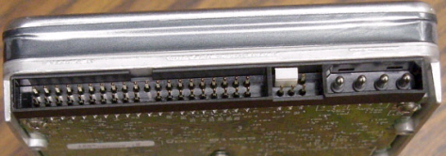
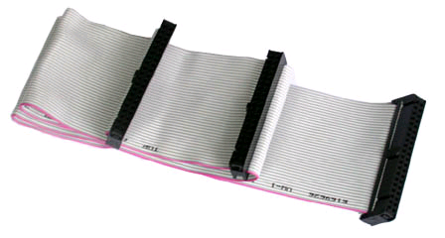
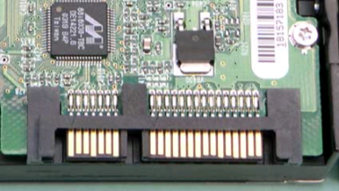
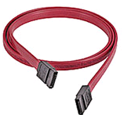
Disk Interfaces –
ATA & SATA Interfaces
ATA interface and it’s cable
SATA interface and it’s cable
Data
Power
Data
Power

Slide 6
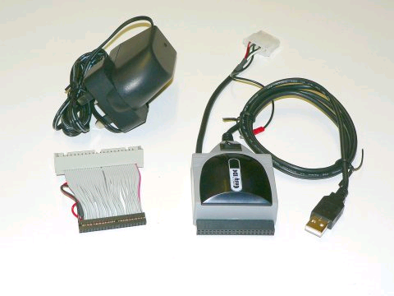

Disk Interfaces –
USB
IDE/SATA to USB
Converters

Slide 7
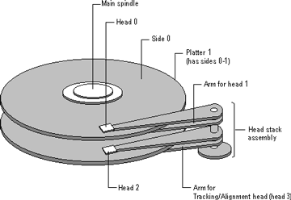
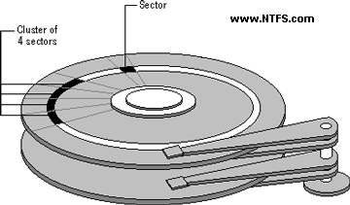
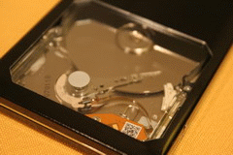
Disk Geometry (1)
Like CDs..
Sector
  Individual data block
Track
  circle
Cylinder
  circle on all platters
Position
  CHS:
  Cylinder,
  Head (0, 1, …),
  Sector

Slide 8
Disk Geometry (2)
40G HD
  4866 cylinders, 255 heads
  63 sectors per track, 512 bytes per sector
  512 * 63 * 4866 * 255 = 40,024,212,480 bytes
  1KB = 1024 bytes
  1MB = 1024 KB = 1,048,576 bytes
  1GB = 1024 MB = 1,073,741,824 bytes
  40,024,212,480 / 1,073,741,824 ≒ 37.275 GB
G
M
K
Why?
10^3 vs. 2^10…

Slide 9
Disk Installation Procedure
(in BSD…)

Slide 10
Disk Installation Procedure (1)
The procedure involves the following steps:
  Connecting the disk to the computer
    IDE: master/slave
    SATA
    SCSI: ID, terminator
    power
  Creating device files
    Auto created by devfs
  Formatting the disk
    Low-level format
      Manufacturer diagnostic utility
      Kill all address information and timing marks on platters
      Repair bad sectors → mark the bad sectors and don’t use them!
Please do it offline…
Meta data
a HD
data
Format (metadata + data)
v.s. fast format (metadata only)

Slide 11
Disk Installation Procedure (2)
  Partitioning (and Labeling) the disk)
    Allow the disk to be treated as a group of independent data area
    e.g. root, home, swap partitions
    Former Suggestions:
      /var, /tmp ➔ separate partition (for backup issue)
      Make a copy of root filesystem for emergency
  Establishing logical volumes
    Combine multiple partitions into a logical volume
    Related to RAID
    Software RAID technology
      GEOM: geom(4)、geom(8)
      ZFS: zpool(8)、zfs(8)、zdb(8)

Slide 12
Disk Installation Procedure (3)
  Creating UNIX filesystems within disk partitions
    Use “newfs” to install a filesystem for a partition
    Establish all filesystem components
      A set of inode storage cells
      A set of data blocks
      A set of superblocks
      A map of the disk blocks in the filesystem
      A block usage summary

Slide 13
Disk Installation Procedure (4)
    Superblock contents
      The length of a disk block
      Inode table’s size and location
      Disk block map
      Usage information
      Other filesystem’s parameters
    sync
      The sync() system call forces a write of dirty (modified) buffers in the block buffer cache out to disk.
      The sync utility can be called to ensure that all disk writes have been completed before the processor is halted in a way not suitably done by reboot(8) or halt(8).

Slide 14
Disk Installation Procedure (5)
  mount
    Bring the new partition to the filesystem tree
    mount point can be any directory (empty)
    # mount /dev/ad1s1e /home2
  Setting up automatic mounting
    Automount at boot time
      /etc/fstab
      % mount -t ufs /dev/ad2s1a /backup
      % mount -t cd9600 -o ro,noauto /dev/acd0c /cdrom
ad1
d
partition,
newfs
s1
e
f
Mount CD
Also for ISO image file
liuyh@NASA:/etc> cat fstab
# Device Mountpoint Fstype Options Dump Pass#
/dev/ad0s1b none swap sw 0 0
/dev/ad2s1b none swap sw 0 0
/dev/ad0s1a / ufs rw 1 1
/dev/acd0 /cdrom cd9660 ro,noauto 0 0
/dev/ad2s1a /backup ufs rw,noauto 2 2
csduty:/bsdhome /bsdhome nfs rw,noauto 0 0
Usually: 2, 1 for root;
No write = 0
Mount from the network; talk about it in “NFS”…

Slide 15
Disk Installation Procedure (6)
  Setting up swapping on swap partitions
    swapon, swapoff, swapctl
      # swapon -a
        mount all partitions for swap usage
    swapinfo, pstat
nctucs [~] -wangth- swapinfo
Device 1K-blocks Used Avail Capacity
/dev/da0p2 2097152 42772 2054380 2%

Slide 16
fsck – check and repair filesystem (1)
System crash will cause
  Inconsistency between memory image and disk contents
fsck
  Examine all local filesystem listed in /etc/fstab at boot time. (fsck -p)
  Automatically correct the following damages:
    Unreferenced inodes
    Inexplicably large link counts
    Unused data blocks not recorded in block maps
    Data blocks listed as free but used in file
    Incorrect summary information in the superblock
    fsck(8)、fsck_ffs(8)
    ffsinfo(8): dump metadata
Check if filesystem is clean…
1: clean (ro)
0: dirty (rw)

Slide 17
fsck – check and repair filesystem (2)
No guarantee on
fully recover you HD…
Run fsck in manual to fix serious damages
  Blocks claimed by more than one file
  Blocks claimed outside the range of the filesystem
  Link counts that are too small
  Blocks that are not accounted for
  Directories that refer to unallocated inodes
  Other errors
fsck will suggest you the action to perform
  Delete, repair, …

Slide 18
Adding a disk to FreeBSD (1)
Check disk connection
  Look system boot message
Use gpart(8) to create a partition on the new HD
  # gpart create -s GPT ada3
  # gpart add -t freebsd-ufs -a 1M ada3
Use newfs(8) to construct new UFS file system
  # newfs -U /dev/ada3p1
Make mount point and mount it
  # mkdir /home2
  # mount -t ufs /dev/ada3p1 /home2
  # df
Edit /etc/fstab
https://www.freebsd.org/doc/handbook/disks-adding.html
ada3: 238475MB <Hitachi HDS722525VLAT80 V36OA6MA> at ata1-slave UDMA100
Line, speed

Slide 19
Adding a disk to FreeBSD (2)
If you forget to enable soft-update when you add the disk
  % umount /home2
  % tunefs -n enable /dev/ada3p1
  % mount -t ufs /dev/ada3p1 /home2
  % mount
https://www.freebsd.org/doc/handbook/configtuning-disk.html
/dev/ada0p2 on / (ufs, local, soft-updates)
/dev/ada1p1 on /home (ufs, local, soft-updates)
procfs on /proc (procfs, local)
/dev/ada3p1 on /home2 (ufs, local, soft-updates)

Slide 20
GEOM
Modular Disk Transformation Framework

Slide 21
GEOM – (1)
Support
  ELI – geli(8): cryptographic GEOM class
  JOURNAL – gjournal(8): journaled devices
  LABEL – glabel(8): disk labelization
  MIRROR – gmirror(8): mirrored devices
  STRIPE – gstripe(8): striped devices
  …
  http://www.freebsd.org/doc/handbook/geom.html
Journalize (logs) before write
Software RAID1
Software RAID0

Slide 22
GEOM – (2)
GEOM framework in FreeBSD
  Major RAID control utilities
  Kernel modules (/boot/kernel/geom_*)
  Name and Prodivers
    “manual” or “automatic”
    Metadata in the last sector of the providers
Kernel support
  {glabel,gmirror,gstripe,g*} load/unload
    device GEOM_* in kernel config
    geom_*_enable="YES" in /boot/loader.conf
devices
Logical
volumes
On demand load/unload kernel modules
  load automatically at booting
Build-in kernel and recompile

Slide 23
GEOM – (3)
Why use it? → bundle by name instead of bundle by provider
LABEL
  Used for GEOM provider labelization
  Kernel
    device GEOM_LABEL
    geom_label_load="YES"
  glabel (for new storage)
    # glabel label -v usr da2
    # newfs /dev/label/usr
    # mount /dev/label/usr /usr
    # glabel stop usr
    # glabel clear da2
  UFS label (for an using storage)
    # tunefs -L data /dev/da4s1a
    # mount /dev/ufs/data /mnt/data
e.g. ad0s1d → usr
glabel label … → Create permanent labels
glabel create … → Create transient labels
/dev/label/usr
Stop using the name
Clear metadata on provider
“data” is a name

Slide 24
GEOM – (4)
MIRROR
  Kernel
    device GEOM_MIRROR
    geom_mirror_load="YES"
  gmirror
    # gmirror label -v -b round-robin data da0
    # newfs /dev/mirror/data
    # mount /dev/mirror/data /mnt
    # gmirror insert data da1
    # gmirror forget data
    # gmirror insert data da1
    # gmirror stop data
    # gmirror clear da0
logical volume called “data”,
using HD: da0, …
Add in HD
Kill inexist HDs

Slide 25
GEOM – (5)
STRIPE
  Kernel
    device GEOM_STRIPE
    geom_stripe_load="YES"
  gstripe
    # gstripe label -v -s 131072 data da0 da1 da2 da3
    # newfs /dev/stripe/data
    # mount /dev/stripe/data /mnt
    # gstripe stop data
    # gstripe clear da0
Create logical volume “data”,
which stripe da0~da3 HDs

Slide 26
RAID

Slide 27

RAID – (1)
Redundant Array of Inexpensive Disks
  A method to combine several physical hard drives into one logical unit
Depending on the type of RAID, it has the following benefits:
  Fault tolerance
  Higher throughput
  Real-time data recovery
RAID Level
  RAID 0, 1, 0+1, 2, 3, 4, 5, 6
  Hierarchical RAID
e.g. HD1, HD2 → D:\ in windows
RAID1
- RAID0
- HD
- HD
- HD
- RAID0
- HD
- HD
- HD
RAID1
RAID0
RAID0

Slide 28
RAID – (2)
Hardware RAID
  There is a dedicate controller to take over the whole business
  RAID Configuration Utility after BIOS
    Create RAID array, build Array
Software RAID
    GEOM
      CACHE、CONCAT、ELI、JOURNAL、LABEL、MIRROR、MULTIPATH、NOP、PART、RAID3、SHSEC、STRIPE、VIRSTOR
    ZFS
      JBOD、STRIPE
      MIRROR
      RAID-Z、RAID-Z2、RAID-Z3

Slide 29
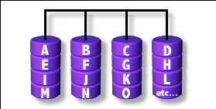
RAID 0
(normally used)
(500GB+500GB=1TB)
Stripped data intro several disks
Minimum number of drives: 2
Advantage
  Performance increase in proportional to n theoretically
  Simple to implement
Disadvantage
  No fault tolerance
Recommended applications
  Non-critical data storage
  Application requiring high bandwidth (such as video editing)
e.g. HD1 (500GB), HD2 (500GB)
→ D:\ in windows (1TB)
parallel file io from/to different HDs

Slide 30
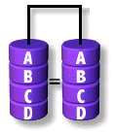
RAID 1
(normally used)
(500GB+500GB=500B)
Mirror data into several disks
Minimum number of drives: 2
Advantage
  100% redundancy of data
Disadvantage
  100% storage overage
  Moderately slower write performance
Recommended application
  Application requiring very high availability (such as home)
Cause by double check mechanisms on data…

Slide 31
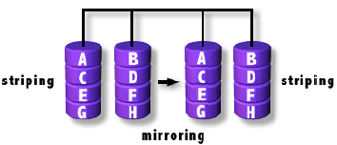
RAID 0+1
(normally used)
[(500GB+500GB)+(500GB+500GB)]=1TB)
Combine RAID 0 and RAID 1
Minimum number of drives: 4
RAID1, RAID1
Them RAID0 above it

Slide 32
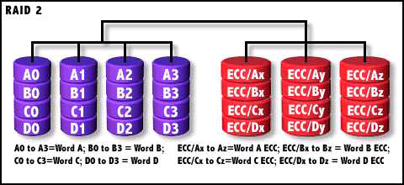
RAID 2
Hamming Code ECC Each bit of data word
Advantages:
  "On the fly" data error correction
Disadvantages:
  Inefficient
  Very high ratio of ECC disks to data disks
Recommended Application
  No commercial implementations exist / not commercially viable
Read, check if correct, then read

Slide 33
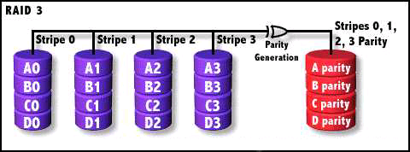
RAID 3
Parallel transfer with Parity
Minimum number of drives: 3
Advantages:
  Very high data transfer rate
Disadvantages:
  Transaction rate equal to that of a single disk drive at best
Recommended Application
  Any application requiring high throughput
RAID1 if two HDs
Save parity

Slide 34
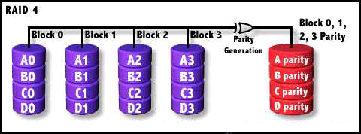
RAID 4
Similar to RAID3
RAID 3 V.S RAID 4
  Byte Level V.S Block Level
  Block interleaving
    Small files (e.g. 4k)
Block normally 512bytes (4k for WD HDs)

Slide 35
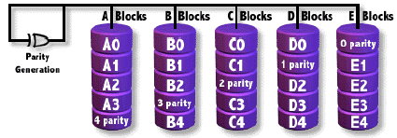
RAID 5
(normally used)
Independent Disk with distributed parity blocks
Minimum number of drives: 3
Advantage
  Highest read data rate
  Medium write data rate
Disadvantage
  Disk failure has a medium impact on throughput
  Complex controller design
  When one disk failed, you have to rebuild the RAID array
Origin from RAID3
Parallel file I/O
Can tolerate only 1 HD failure

Slide 36
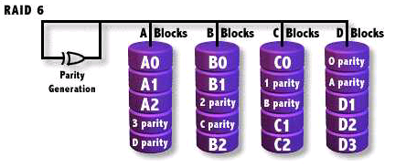
RAID 6
(normally used)
Similar to RAID5
Minimum number of drives: 4
2 parity checks, 2 disk failures tolerable.
Slower than RAID5 because of storing 2 parities…

