Slide 1
FAMP
FreeBSD/Apache/MySQL/PHP
zswu

Slide 2
Introduction
Web service
  Apache
  GWS, Nginx, IIS
SQL service
  MySQL, MariaDB
  MS SQL, Oracle DB, PostgreSQL
NoSQL service
  MongoDB
Web backend language
  Go, Python, Node.js, PHP

Slide 3
Outline
Introduction
  Apache
  MySQL
  PHP
Installation and Administration
  MySQL
  Apache
  PHP
Appendix
  phpMyAdmin
  lighttpd
  FastCGI

Slide 4
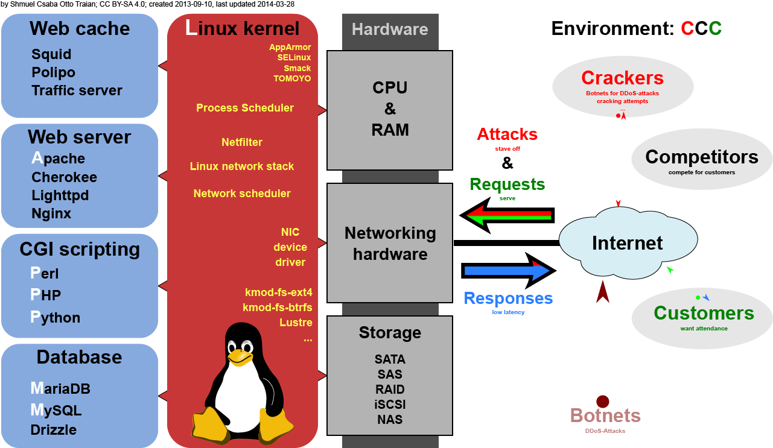
Overview
https://commons.wikimedia.org/w/index.php?curid=28224098

Slide 5
Apache
Apache Software Foundation: http://www.apache.org/
Apache HTTP Server Project: http://httpd.apache.org/
Web httpd server that
  HTTP/2
  Modular design
  Can be customized by writing modules using Apache module API
  Freely available cross many platforms
Two main parts
  Core: implement basic functions and provide the interface for Apache modules
  Modules: extend or override the function of Core
    Example: Access control, logging, CGI, proxy, cache control, PHP…

Slide 6
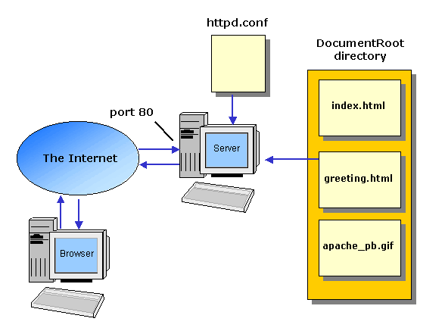
How Apache Works – request and response

Slide 7
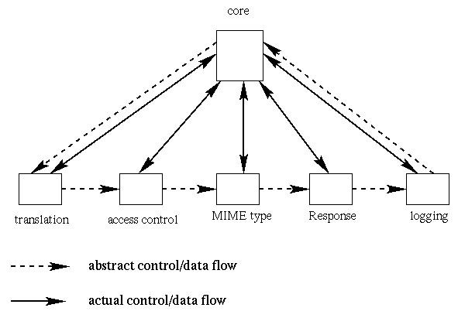
How Apache Works –
Each request-response
Apache breaks client request into several steps which are implemented as modules

Slide 8
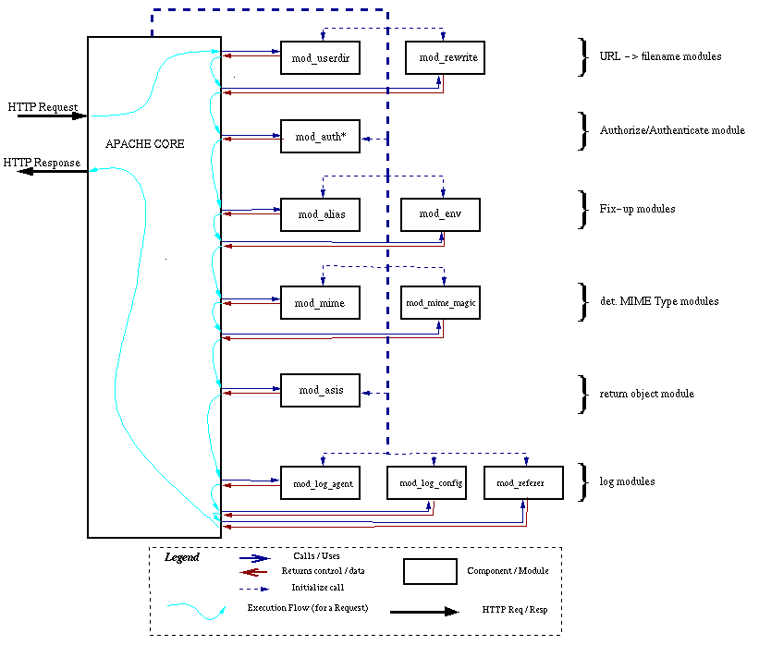

Slide 9
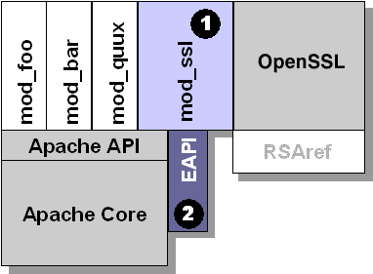
Apache with mod_ssl

Slide 10
MySQL (1)
SQL (Structured Query Language)
  The most popular computer language used to create, modify, retrieve and manipulate data from relational database management systems.
  Introduction to SQL: http://www.1keydata.com/tw/sql/sql.html
A multithreaded, multi-user, SQL Database Management System.
Owned and sponsored by a Swedish company MySQL AB, acquired by Sun Microsystems 2008.
Official Site: http://www.mysql.com
Documentation: http://dev.mysql.com/doc

Slide 11
MySQL (2)
Features:
  Writing in C/C++, tested by many compilers, portable to many platforms.
    AIX, FreeBSD, HP-UX, Linux, Mac OS, Solaris, Windows, …etc.
  Providing APIs for C/C++, Java, Perl, PHP, Python, Ruby, Tcl, …etc.
  Multi-threaded kernel, supporting systems with multiple CPUs.
  Optimized algorithm for SQL Query.
  Multi-Language (coding) Supports.
  Lots of connecting method: TCP/IP, ODBC, JDBC, Unix domain socket.
  Free Software (GNU General Public License version 2)
  Popular for web applications

Slide 12
PHP
PHP: Hypertext Preprocessor
  A widely-used Open Source general-purpose scripting language.
  Originally designed to create dynamic web pages, PHP's principal focus is server-side scripting.
  PHP scripts can be embedded into HTML.
  The LAMP architecture has become popular in the Web industry as a way of deploying inexpensive, reliable, scalable, secure web applications.
Official Site: http://php.net/

Slide 13
Installation and Administration
MySQL
Apache
PHP
phpMyAdmin

Slide 14
Installing MySQL (1)
Steps
  ＃cd /usr/ports/databases/mysql57-server/
  ＃make OPTIONS install clean
You may use the following build options:
WITH_CHARSET=charset Define the primary built-in charset (latin1).
WITH_XCHARSET=list Define other built-in charsets (may be 'all').
WITH_COLLATION=collate Define default collation (latin1_swedish_ci).
WITH_OPENSSL=yes Enable secure connections
(define WITHOUT_YASSL for backward compatibility).
WITH_LINUXTHREADS=yes Use the linuxthreads pthread library.
WITH_PROC_SCOPE_PTH=yes Use process scope threads
(try it if you use libpthread).
WITH_FAST_MUTEXES=yes Replace mutexes with spinlocks.
BUILD_OPTIMIZED=yes Enable compiler optimizations
(use it if you need speed).
BUILD_STATIC=yes Build a static version of mysqld.
(use it if you need even more speed).
WITH_NDB=yes Enable support for NDB Cluster.

Slide 15
Installing MySQL (2)
OPTIONS:
  WITH_CHARSET=utf8
  WITH_XCHARSET=ascii,big5,… (all)
Installed…
===> SECURITY REPORT:
This port has installed the following files which may act as network
servers and may therefore pose a remote security risk to the system.
/usr/local/libexec/mysqld
This port has installed the following startup scripts which may cause
these network services to be started at boot time.
/usr/local/etc/rc.d/mysql-server

Slide 16
Installing MySQL (3)
Startup script…
#
# Add the following line to /etc/rc.conf to enable mysql:
# mysql_enable (bool): Set to "NO" by default.
# Set it to "YES" to enable MySQL.
# mysql_limits (bool): Set to "NO" by default.
# Set it to yes to run `limits -e -U mysql`
# just before mysql starts.
# mysql_dbdir (str): Default to "/var/db/mysql"
# Base database directory.
# mysql_args (str): Custom additional arguments to be passed
# to mysqld_safe (default empty).
#

Slide 17
Administrating MySQL (1)
Configuration file
  Copy config file
    # cd /usr/local/share/mysql
    # cp my-huge.cnf /usr/local/etc/my.cnf
  Edit /usr/local/etc/my.cnf
Start mysql daemon
  Using startup script
    # /usr/local/etc/rc.d/mysql-server start

Slide 18
Administrating MySQL (2)
Test
  % mysql –u root –p
    The initial password for root is empty
nasa [/usr/local/etc] -randy- mysql -u root -p
Enter password:
Welcome to the MySQL monitor. Commands end with ; or \g.
Your MySQL connection id is 1
Server version: 5.1.41-log FreeBSD port: mysql-server-5.1.41
Type 'help;' or '\h' for help. Type '\c' to clear the current input statement.
mysql> show databases;
+-------------------------+
| Database |
+-------------------------+
| information_schema |
| mysql |
| test |
+-------------------------+
3 rows in set (0.06 sec)

Slide 19
Administrating MySQL (3)
Securing initial accounts
  Two initial accounts
    root
    anonymous
mysql> SELECT Host, User From mysql.user;
+-----------------------------+------+
| Host | User |
+-----------------------------+------+
| 127.0.0.1 | root |
| nasa.cs.nctu.edu.tw | |
| nasa.cs.nctu.edu.tw | root |
| localhost | |
| localhost | root |
+-----------------------------+------+
mysql> UPDATE mysql.user SET Password = PASSWORD('test123') WHERE User = 'root';
Query OK, 3 rows affected (0.08 sec)
Rows matched: 3 Changed: 3 Warnings: 0
mysql> FLUSH PRIVILEGES; # Reload the grant tables
Query OK, 0 rows affected (0.00 sec)
mysql> SET PASSWORD FOR 'root'@'localhost' = PASSWORD('ttt123');
Query OK, 0 rows affected (0.02 sec)

Slide 20
Installing Apache (1)
Steps
  # cd /usr/ports/www/apache24/
  # make install clean
Options
  A lot of options for modules
  WITH_SSL (default)
  WITH_MPM=worker
  WITH_THREADS=yes
  WITH_SUEXEC=yes

Slide 21
Installing Apache (2)
Installed…
Startup script
  /usr/local/etc/rc.d/apache24
  apache24_http_accept_enable
To run apache www server from startup, add apache22_enable="YES"
in your /etc/rc.conf. Extra options can be found in startup script.
Your hostname must be resolvable using at least 1 mechanism in
/etc/nsswitch typically DNS or /etc/hosts or apache might
have issues starting depending on the modules you are using.
===> SECURITY REPORT:
This port has installed the following binaries which execute with
increased privileges.
/usr/local/sbin/suexec

Slide 22
Apache configuration –
Configuration files
Location
  The default location of apache (in ports) is /usr/local/etc/apache24
  Major configuration file: httpd.conf
    Other configuration files could be included. (setting in httpd.conf)
    extra/httpd-*.conf, Includes/*.conf
Two types
  Global settings
    Server configurations
    Options of modules
  Directory Configuration
    Local setting for certain directory

Slide 23
Apache configuration –
Global Settings (httpd.conf)
Server configuration
  Listen 80
  ServerAdmin liuyh@cs.nctu.edu.tw
  ServerName nasa.cs.nctu.edu.tw
  DocumentRoot "/home/wwwadm/data“
    Remember create DocumentRoot directory if you modify it
Options of modules
Include supplemental configuration files
  Include etc/apache22/extra/httpd-*.conf
  Include etc/apache22/Includes/*.conf

Slide 24
Apache configuration –
Directory Configuration (1)
Configuration parameters
  Options
    All
    ExecCGI
    FollowSymLinks
    Indexs
    MultiViews
    SymLinksIfOwnerMatch
  http://httpd.apache.org/docs/2.4/mod/core.html#options
<Directory "/home/wwwadm/data">
Options Indexes FollowSymLinks MultiViews
AllowOverride None
Order allow,deny
Allow from all
</Directory>

Slide 25
Apache configuration –
Directory Configuration (2)
Configuration parameters
  AllowOverride
    All (Read .htaccess)
    None (ignoring .htaccess)
  Order
    Solve collision of deny and allow rules
  Deny/Allow
    IP/DN (control access to this directory)
<Directory "/home/wwwadm/data">
Options Indexes FollowSymLinks MultiViews
AllowOverride None
Order allow,deny
Allow from all
</Directory>

Slide 26
Apache configuration –
Options of Modules
dir_module
alias_module (http://httpd.apache.org/docs/2.2/mod/mod_alias.html)
mime_module
<IfModule dir_module>
DirectoryIndex index.html
</IfModule>
<IfModule alias_module>
Redirect /foo http://www.example.com/bar
Alias /webpath /full/filesystem/path
ScriptAlias /cgi-bin/ "/usr/local/www/apache22/cgi-bin/"
</IfModule>
DefaultType text/plain
<IfModule mime_module>
TypesConfig etc/apache22/mime.types
AddType application/x-compress .Z
AddHandler cgi-script .cgi
</IfModule>

Slide 27
Supplemental configuration – httpd-mpm.conf (Multi-Processing Module)
Server-pool management (MPM specific)
  Include etc/apache22/extra/httpd-mpm.conf
WITH_MPM
  prefork: non-threaded, pre-forking
  worker: hybrid multi-process multi-threaded
<IfModule mpm_worker_module>
StartServers 2
MaxClients 150
MinSpareThreads 25
MaxSpareThreads 75
ThreadsPerChild 25
MaxRequestsPerChild 0
</IfModule>

Slide 28
Supplemental configuration – httpd-userdir.conf
User home directories
  Include etc/apache22/extra/httpd-userdir.conf
  Methods: http://www.w3.org/Protocols/rfc2616/rfc2616-sec9.html
UserDir public_html
UserDir disabled root toor daemon operator bin tty kmem games news man sshd bind proxy _pflogd _dhcp uucp pop www nobody mailnull smmsp
<Directory "/home/*/public_html">
AllowOverride FileInfo AuthConfig Limit Indexes
Options MultiViews Indexes SymLinksIfOwnerMatch IncludesNoExec
<Limit GET POST OPTIONS>
Order allow,deny
Allow from all
</Limit>
<LimitExcept GET POST OPTIONS>
Order deny,allow
Deny from all
</LimitExcept>
</Directory>

Slide 29
Supplemental configuration – httpd-vhosts.conf
Listen 80
Listen 8080
NameVirtualHost 172.20.30.40:80
NameVirtualHost 172.20.30.40:8080
<VirtualHost 172.20.30.40:80>
ServerName www.example.com
DocumentRoot /www/domain-80
</VirtualHost>
<VirtualHost 172.20.30.40:8080>
ServerName www.example.com
DocumentRoot /www/domain-8080
</VirtualHost>
<VirtualHost 172.20.30.40:80>
ServerName www.example.org
DocumentRoot /www/otherdomain-80
</VirtualHost>
<VirtualHost 172.20.30.40:8080>
ServerName www.example.org
DocumentRoot /www/otherdomain-8080
</VirtualHost>
Virtual hosts
  Include
  etc/apache24/extra/httpd-vhosts.conf
  Name-based
    NameVirtualHost
    <VirtualHost>
  IP-based
    <VirtualHost>
  ServerName
  DocumentRoot
  http://httpd.apache.org/docs/2.2/vhosts/

Slide 30
Supplemental configuration –
More…
Multi-language error messages
  httpd-multilang-errordoc.conf
Fancy directory listings
  httpd-autoindex.conf
Language settings
  httpd-languages.conf
Real-time info on requests and configuration
  httpd-info.conf
Local access to the Apache HTTP Server Manual
  httpd-manual.conf
Various default settings
  httpd-default.conf

Slide 31
Other configuration for Apache – log
Rotate your log using newsyslog
In httpd config
  ErrorLog "/var/log/httpd-error.log“
  TransferLog "/var/log/httpd-access.log“
In startup script
  _pidprefix="/var/run/httpd"
  pidfile="${_pidprefix}.pid"
/var/log/httpd-access.log 640 5 * @T00 Z /var/run/httpd.pid
/var/log/httpd-error.log 640 5 * @T00 z /var/run/httpd.pid

Slide 32
.htaccess (1)
.htaccess
  Allow admin or users to control access to certain directory
Usage
  Modify httpd.conf
  Create .htaccess file
  Generate password database
  Test

Slide 33
.htaccess (2)
<Directory "/home/wwwadm/data/test1">
Options None
AllowOverride All
Order allow,deny
Allow from all
</Directory>
Example
  Modify httpd.conf
  Create .htaccess file
  Generate password file
$ cat .htaccess
AuthName "SA-test1"
AuthType "Basic"
AuthUserFile "/home/wwwadm/data/test1/.htpasswd"
Require valid-user
Options Indexes
$ htpasswd -c ./.htpasswd SA-user1
New password:
Re-type new password:
Adding password for user SA-user1

Slide 34
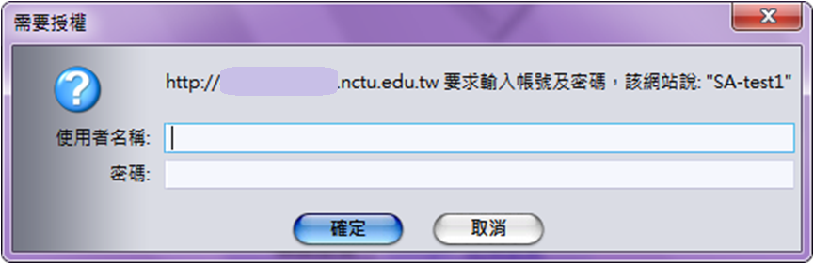
.htaccess (3)
You can use these tools to generate .htaccess
  http://www.linuxkungfu.org/tools/htaccesser/index.php
  http://www.htaccesseditor.com/

Slide 35
Installing PHP (1)
Steps
  ＃cd /usr/ports/lang/php5
  ＃make config
    Remenber to choose Apache module
  # make install clean (in 2009 SA course)
  http://www.freshports.org/lang/php5
# make install clean
===> php5-5.2.11_1 has known vulnerabilities:
=> php -- multiple vulnerabilities.
Reference: <http://portaudit.FreeBSD.org/39a25a63-eb5c-11de-b650-00215c6a37bb.html>
=> Please update your ports tree and try again.
*** Error code 1
Stop in /usr/ports/lang/php5.
*** Error code 1
Stop in /usr/ports/lang/php5.

Slide 36
Installing PHP (2)
Installed…
  For use of Apache, you should restart apache to load php5_module
Install php5-extensions
  ＃cd /usr/ports/lang/php5-extensions
  ＃make install clean
    Choose what you need
    Remember to choose mysql module
  Or installing from /usr/ports/*/php5-*
    databases/php5-mysql
Make sure index.php is part of your DirectoryIndex.
You should add the following to your Apache configuration file:
AddType application/x-httpd-php .php
AddType application/x-httpd-php-source .phps

Slide 37
Installing PHP7 (1)
Steps
  # pkg install php71 php71-mysqli mod_php71 \
  php71-mbstring php71-gd php71-json php71-mcrypt \
  php71-zlib php71-curl
  # vim /usr/local/etc/apache24/Includes/php.conf
<IfModule dir_module>
DirectoryIndex index.php index.html
<FilesMatch "\.php$">
SetHandler application/x-httpd-php
</FilesMatch>
<FilesMatch "\.phps$">
SetHandler application/x-httpd-php-source
</FilesMatch>
</IfModule>

Slide 38
Test PHP5 in apache
Edit httpd.conf
  % mkdir –p /home/wwwadm/data
  % cd /usr/local/etc/apache24/
  Edit httpd.conf
<IfModule mime_module>
…
AddType application/x-httpd-php .php .phtml .php5
AddType application/x-httpd-php-source .phps
…
</IfModule>
<IfModule dir_module>
DirectoryIndex index.php index.html
</IfModule>

Slide 39
Test PHP7 in apache (2)
Start apache
  /usr/local/etc/rc.d/apache24 start
  service apache24 restart
Test PHP
  # vim /usr/local/www/apache24/data/index.php
<?
phpinfo();
?>

Slide 40
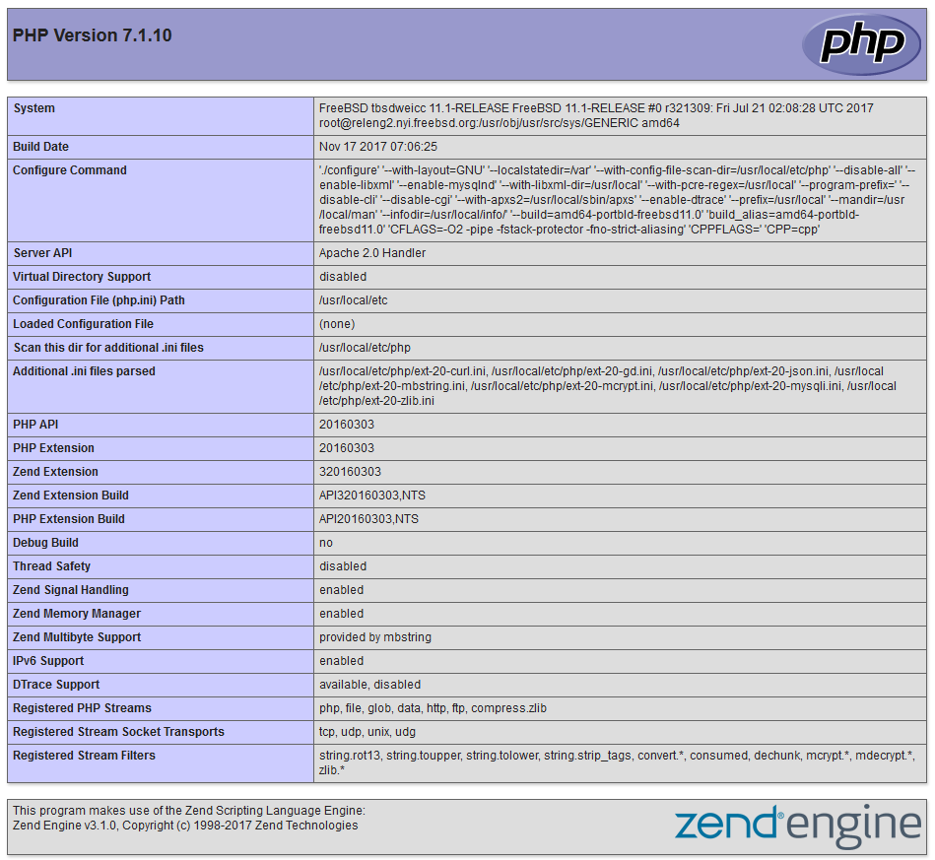
phpinfo()

Slide 41
Architecture
cluster

Slide 42
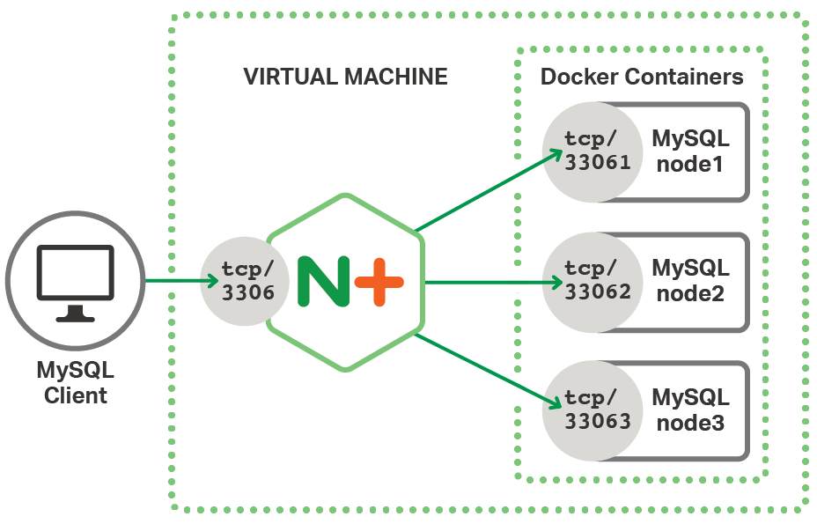
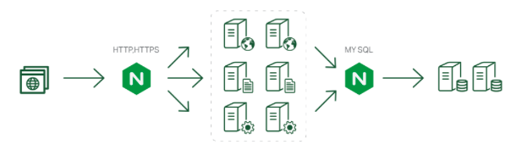
Load balance
Nginx proxy
upstream backend {
server 172.16.1.1:3000;
server 172.16.1.2:3000;
}
server {
listen 80;
server_name www.example.com;
location / {
proxy_pass http://backend;
}
}

Slide 43
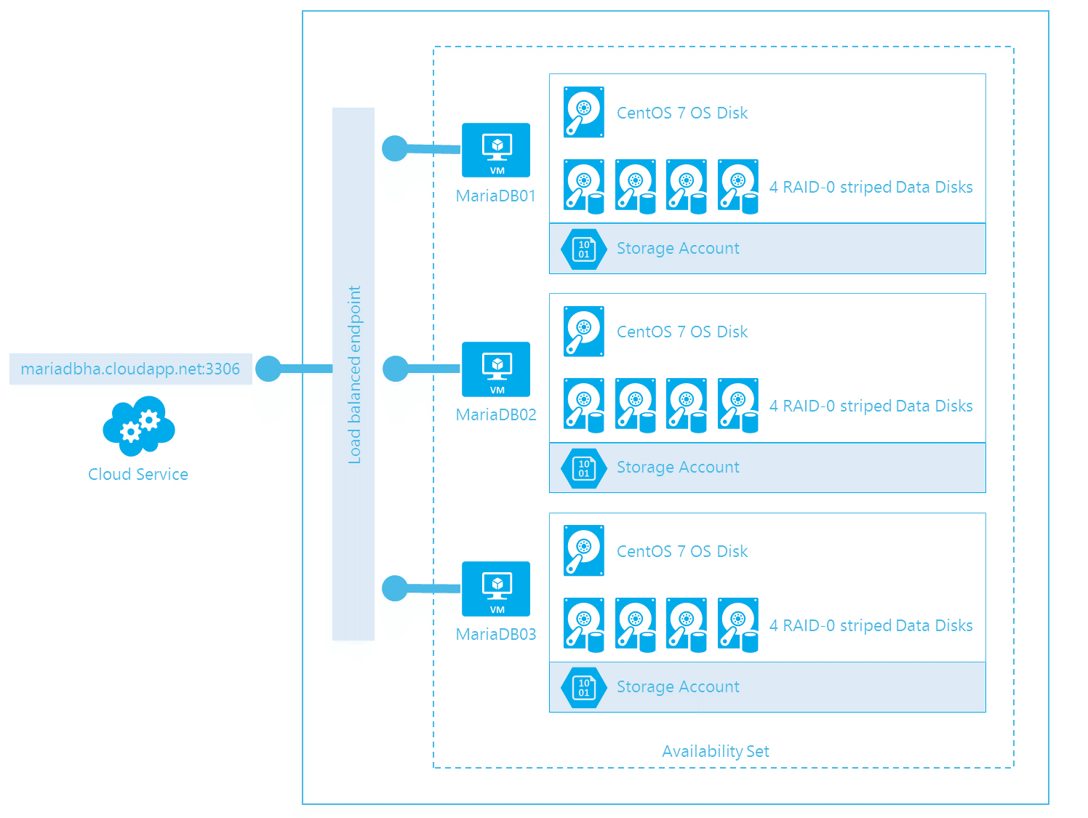
MySQL cluster

Slide 44

Up to 150 users
One machine running the application server.
Web server
database server
local storage
Authentication via an existing LDAP or Active Directory server.

Slide 45
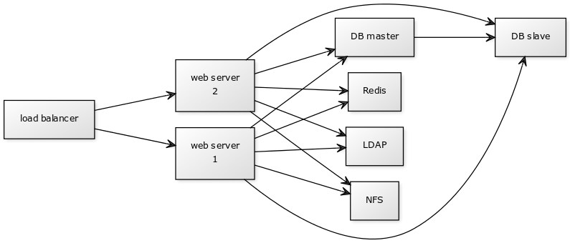
150 to 1,000 users
High availability level
Every component is fully redundant and can fail without service interruption.
Backups without service interruption

Slide 46
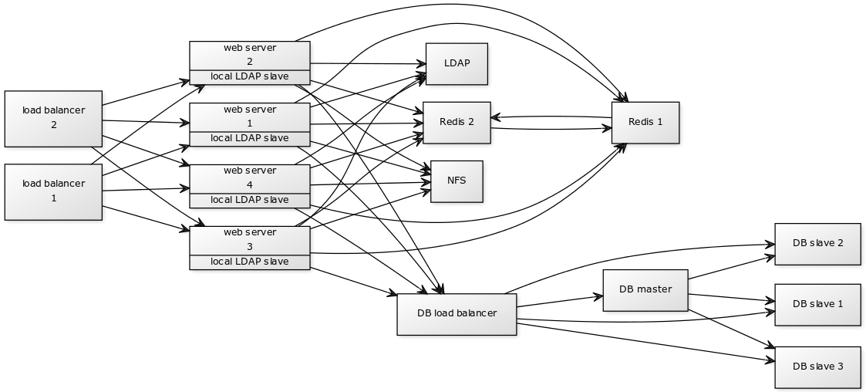
5,000 to >100,000 users
4 to 20 application/Web servers.
A cluster of two or more database servers
behind a load balancer to send all writes to the master and reads to the slaves.
Storage is an NFS server, or an object store that is S3 compatible.

Slide 47
Appendix
phpMyAdmin
lighttpd
FastCGI

Slide 48
phpMyAdmin
phpMyAdmin can manage a whole MySQL server as well as a single database over the World Wide Web.
Official Site: http://www.phpmyadmin.net/
Documentation: http://www.phpmyadmin.net/documentation/
Features
  Browser-based, Supporting PHP5.3+, MySQL 5.0+, Open Source
There are four authentication modes offered:
  http
  cookie
  signon
  config (the less secure one, not recommanded).

Slide 49
Installing phpMyAdmin (1)
databases/phpmyadmin
  # make install clean
Installed…
phpMyAdmin-4.7.4 has been installed into:
/usr/local/www/phpMyAdmin
Please edit config.inc.php to suit your needs.
To make phpMyAdmin available through your web site, I suggest
that you add something like the following to httpd.conf:
Alias /phpmyadmin/ "/usr/local/www/phpMyAdmin/"
<Directory "/usr/local/www/phpMyAdmin/">
Options none
AllowOverride Limit
Order Deny,Allow
Deny from all
Allow from 127.0.0.1 .example.com
</Directory>

Slide 50
Installing phpMyAdmin (2)
config.inc.php
  Override libraries/config.default.php
config.sample.inc.php
  $cfg['blowfish_secret']

Slide 51
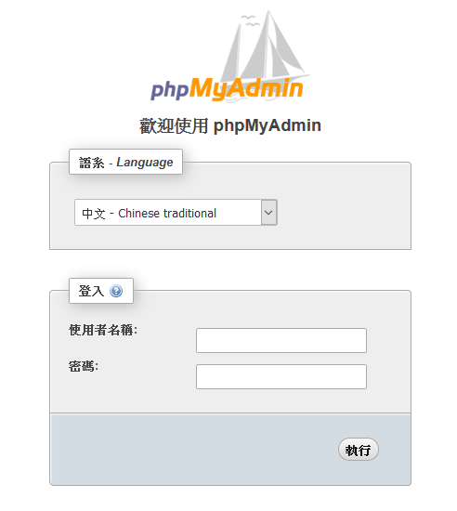
Administrating MySQL –
Using phpMyAdmin (2)

Slide 52
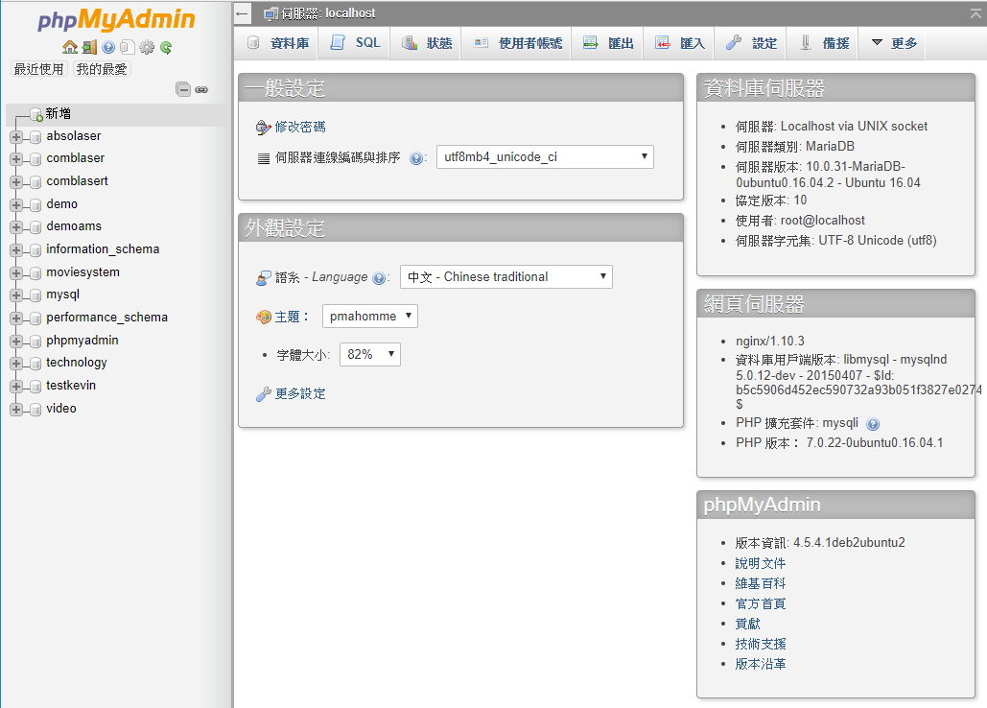
Administrating MySQL –
Using phpMyAdmin (3)

Slide 53
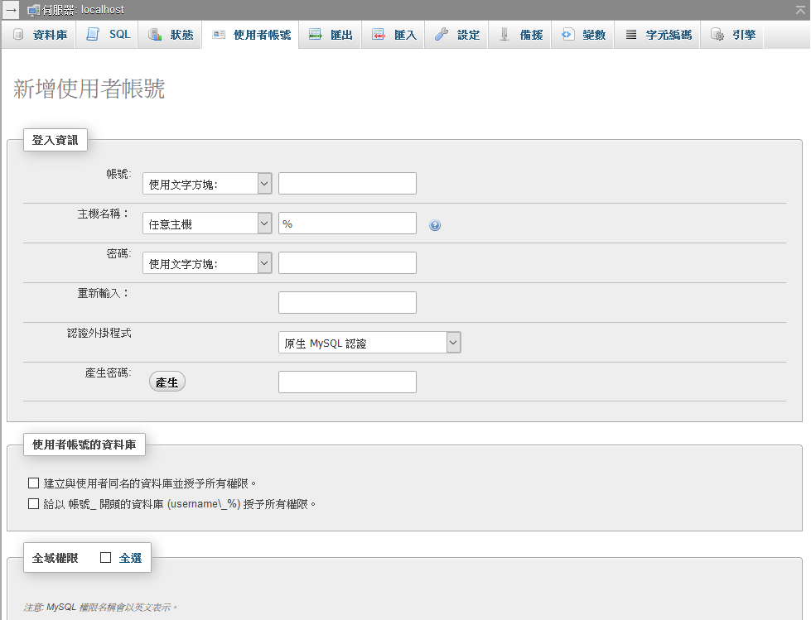
Administrating MySQL –
Using phpMyAdmin (4)
Create another user with limited privilege

Slide 54
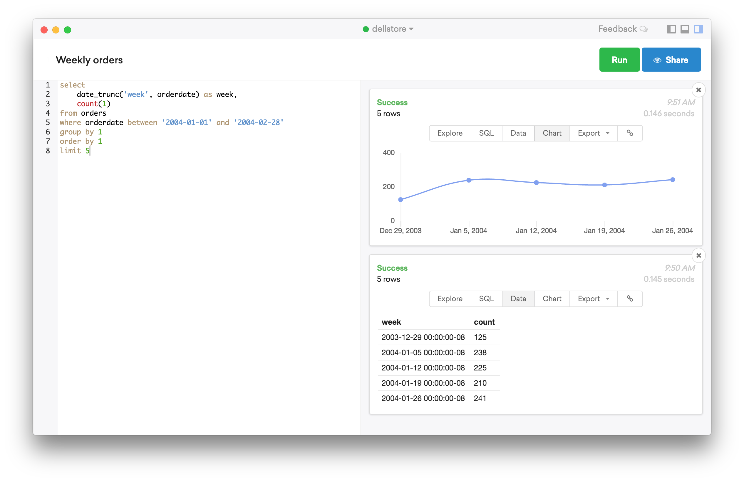

PopSQL & SQLpro (1)
https://popsql.io/

Slide 55
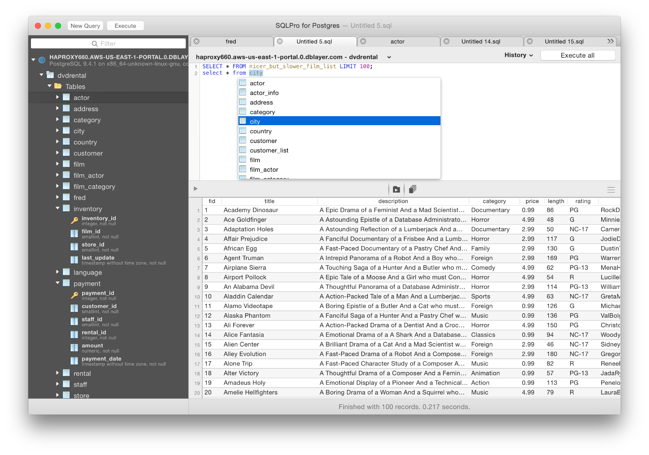

PopSQL & SQLpro (2)
https://www.compose.com/articles/tooltime-sqlpro-for-postgres-and-keylord-for-redis/

Slide 56
Installing lighttpd
www/lighttpd
  Official: http://www.lighttpd.net/
Configuration files
  /usr/local/etc/lighttpd/{lighttpd,modules}.conf
  /usr/local/etc/lighttpd/{vhosts,conf}.d/
Startup script
  /usr/local/etc/rc.d/lighttpd
Documentation:
  /usr/ports/www/lighttpd/work/lighttpd-1.4.28/doc/*.txt
  alias, cgi, dirlisting, fastcgi, ssl, userdir
  Virtual hosts: evhost, mysqlvhost, simple-vhost

Slide 57
FastCGI
FastCGI is actually CGI with only a few extensions.
  FastCGI is language-independent.
  FastCGI run applications in processes isolated from the core Web server, which provides greater security than APIs.
  FastCGI developers are committed to propagating FastCGI as an open standard. (C/C++, Java, Perl, Tcl)
  FastCGI is not tied to the internal architecture of any Web server and is therefore stable even when server technology changes.
Benefits:
  Distributed computing
  Multiple and extensible roles
Official site: http://www.fastcgi.com/drupal/

