Slide 1
Web
kuohh

Slide 2
Outline
Web hosting
  Basics
  Client-Server architecture
  HTTP protocol
  Static vs. dynamic pages
  Virtual hosts
Proxy
  Forward proxy
  Reverse proxy

Slide 3
Web Hosting
– Basics (1)
Three major techniques in WWW (World Wide Web) System
  HTML
  HTTP
  URL
HTML (1) – HyperText Markup Language
  Providing a means to describe the structure of text-based information in a document.
  The original HTML is created by Tim Berners-Lee.
  Published in 1993 by the IETF as a formal "application" of SGML (with an SGML Document Type Definition defining the grammar).
  The HTML specifications have been maintained by the World Wide Web Consortium (W3C).
    http://www.w3.org/

Slide 4
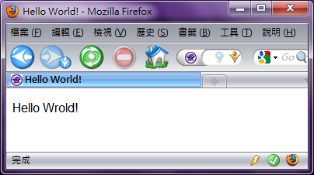
Web Hosting
– Basics (2)
HTML (2)
  Mark-up the text and define presentation effect by HTML Tags.
<!DOCTYPE HTML PUBLIC "-//W3C//DTD HTML 4.01//EN">
<html>
<head>
<title>Hello World!</title>
</head>
<body>
<p>Hello Wrold!</p>
</body>
</html>

Slide 5

Web Hosting
– Basics (3)
HTML 5
  Published in October 2014 by the World Wide Web Consortium (W3C)
  Many new syntactic features are included.
  article, aside, footer, header, nav, section, …
  include and handle multimedia and graphical content
  video, canvas, audio
  <!DOCTYPE html>
header
nav
section
aside
article
article
footer

Slide 6
Web Hosting
– Basics (4)
HTTP – Hyper-Text Transfer Protocol
  A TCP-based protocol
  Communication method between client and server. All browsers and web servers have to follow this standard.
  Originally designed to transmit HTML pages.
  Now it is used to format, transmit, and link documents of variety media types
    Text, picture, sound, animation, video, …
  HTTPS – secured version.

Slide 7
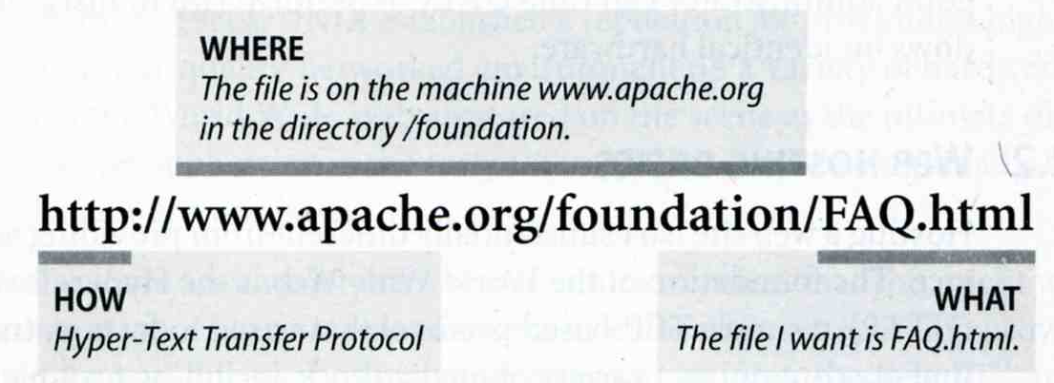
Web Hosting
– Basics (5)
URL – Uniform Resource Locator
  Describe how to access an object shared on the Internet (RFC 1738)
  Format
    Protocol :// [ [ username [ :password ] @ ] hostname [ :port ] ] [ /directory ] [ /filename ]
  e.g.,
    http://www.cs.nctu.edu.tw/
    ftp://ftp.cs.nctu.edu.tw/
    telnet://bs2.to/

Slide 8
Web Hosting
– Basics (6)
URL Protocols
Proto | What it does | Example
http | Accesses a remote file via HTTP | http://www.cs.nctu.edu.tw
https | Accesses a remote file via HTTP/SSL | https://www.cs.nctu.edu.tw
ftp | Accesses a remote file via FTP | ftp://ftp.cs.nctu.edu.tw/
file | Access a local file | file:///home/lwhsu/.tcshrc
mailto | Sends mail | mailto:liuyh@cs.nctu.edu.tw
news | Accesses Usenet newsgroups | news:tw.bbs.comp.386bsd

Slide 9
Web Hosting
– Client-Server Architecture (1)
Client-server architecture
  Web Server: Answer HTTP request
  Web Client: Request certain page using URL
1. Send the request to server which URL point to
3. Respond the HTML resource pointed by URL
Client
Browser
Web Server
2. HTTP Request
4. HTTP Response
5. Show the data which HTML resource describes.

Slide 10
Web Hosting
– Client-Server Architecture (2)
Using “telnet” to retrieve data from web server
liuyh@bsd5 ~/public_html $ telnet www.cs.nctu.edu.tw 80
Trying 140.113.235.47...
Connected to www.cs.nctu.edu.tw.
Escape character is '^]'.
GET /~liuyh/sa.html HTTP/1.0
HTTP/1.1 200 OK
Server: nginx/0.7.62
Date: Sat, 12 Dec 2009 02:14:45 GMT
Content-Type: text/html
Connection: close
Last-Modified: Sat, 12 Dec 2009 02:14:09 GMT
Accept-Ranges: bytes
Content-Length: 201
Vary: Accept-Encoding
<!DOCTYPE HTML PUBLIC "-//W3C//DTD HTML 4.01//EN">
<html>
<head>
<title>Hello World!</title>
</head>
<body>
<p>Hello Wrold!</p>
</body>
</html>

Slide 11
Web Hosting
– The HTTP Protocol (1)
HTTP: Hypertext Transfer Protocol
  RFCs: (HTTP 1.1)
    http://www.faqs.org/rfcs/rfc2068.html
    http://www.faqs.org/rfcs/rfc2616.html (Updated Version)
  Useful Reference: http://jmarshall.com/easy/http/
  A network protocol used to deliver virtually all files and other data on the World Wide Web.
    HTML files, image files, query results, or anything else.
  Client-Server Architecture
    A browser is an HTTP client because it sends requests to an HTTP server (Web server), which then sends responses back to the client.

Slide 12
Web Hosting
– The HTTP Protocol (2)
  Clients:
    ※ Send Requests to Servers
    Action “path or URL” Protocol
      Actions: GET, POST, HEAD
      Ex. GET /index.php HTTP/1.1
    Headers
      Header_Name: value
      Ex.
      Host: www.cs.nctu.edu.tw
    (blank line)
    Data …
  Servers:
    ※ Respond to the clinets
    Status:
      200: OK
      403: Forbidden
      404: Not Found
      426: Upgrade Required
      …
      Ex. HTTP/1.1 200 OK
    Headers
      Same as clients
      Ex.
      Content-Type: text/html
    (blank line)
    Data…

Slide 13
Web Hosting
– The HTTP Protocol (3)
liuyh@bsd5 ~/public_html $ telnet www.cs.nctu.edu.tw 80
Trying 140.113.235.47...
Connected to www.cs.nctu.edu.tw.
Escape character is '^]'.
GET /~liuyh/sa.html HTTP/1.0
HTTP/1.1 200 OK
Server: nginx/0.7.62
Date: Sat, 12 Dec 2009 02:14:45 GMT
Content-Type: text/html
Connection: close
Last-Modified: Sat, 12 Dec 2009 02:14:09 GMT
Accept-Ranges: bytes
Content-Length: 201
Vary: Accept-Encoding
<!DOCTYPE HTML PUBLIC "-//W3C//DTD HTML 4.01//EN">
<html>
<head>
<title>Hello World!</title>
</head>
<body>
<p>Hello Wrold!</p>
</body>
</html>
action
Headers
status
Headers
Data

Slide 14
Web Hosting
– The HTTP Protocol (4)
Get vs. Post (client side)
  Get:
    Parameters in URL
      GET /get.php?a=1&b=3 HTTP/1.1
    No data content
    Corresponding in HTML files
      Link URL: http://nasa.cs.nctu.edu.tw/get.php?a=1&b=3
      Using Form:
      <form method=“GET” action=“get.php”> … </form>
  Post:
    Parameters in Data Content
      POST /post.php HTTP/1.1
    Corresponding in HTML files
      Using Form:
      <form method=“POST” action=“post.php”> … </form>

Slide 15
Web Hosting
– The HTTP Protocol (5)
Get vs. Post Security Issue
  Get:
    GET requests can be cached
    GET requests remain in the browser history
    GET requests can be bookmarked
    GET requests should never be used when dealing with sensitive data
    GET requests have length restrictions
    GET requests should be used only to retrieve data
  Post:
    POST requests are never cached
    POST requests do not remain in the browser history
    POST requests cannot be bookmarked
    POST requests have no restrictions on data length
  https://www.w3schools.com/tags/ref_httpmethods.asp

Slide 16
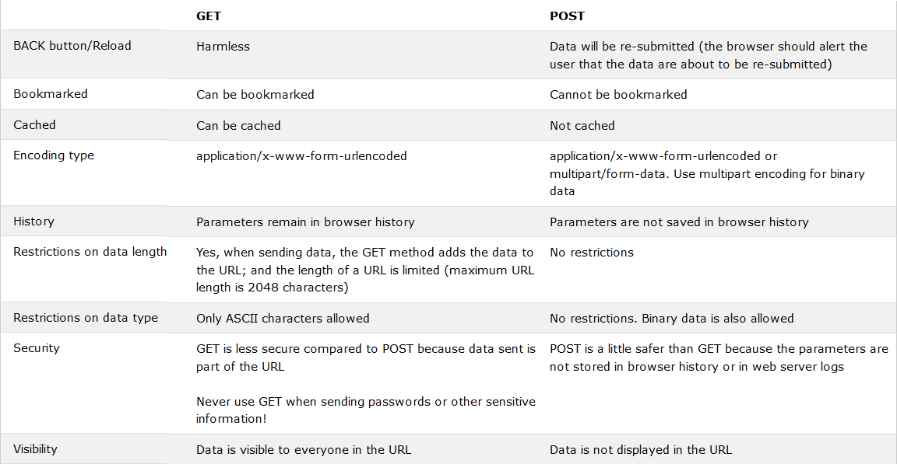
Web Hosting
– The HTTP Protocol (6)
https://www.w3schools.com/tags/ref_httpmethods.asp

Slide 17
Web Hosting
– The HTTP Protocol (7)
HTTP Headers:
  What HTTP Headers can do?
    [Ref] http://www.cs.tut.fi/~jkorpela/http.html
    Content information (type, date, size, encoding, …)
    Cache control
    Authentication
    URL Redirection
    Transmitting cookies
    Knowing where client come from
    Knowing what software client use
    …

Slide 18
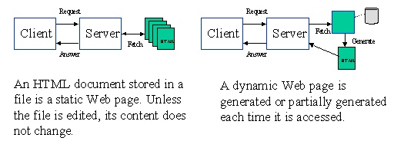
Web Hosting
– Static vs. Dynamic Pages (1)
Static vs. Dynamic Pages
  Technologies of Dynamic Web Pages
    Client Script Language
      JavaScript, Jscript, VBScript
    Client Interactive Technology
      Java Applet, Flash, XMLHTTP,AJAX
    Server Side
      CGI
      Languages: Perl, ASP, JSP, PHP, C/C++, …etc.
Static vs. Dynamic

Slide 19
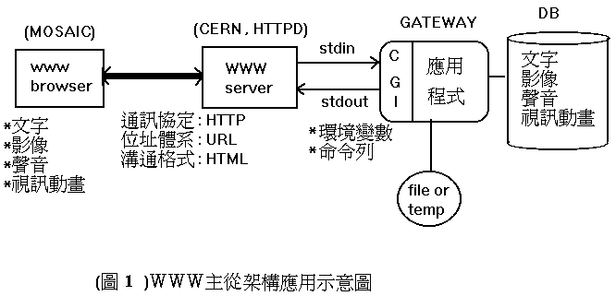
Web Hosting
– Static vs. Dynamic Pages (2)
CGI (Common Gateway Interface)
  A specification that allows an HTTP server to exchange information with other programs

Slide 20
Web Hosting
– Virtual Hosting (1)
Providing services for more than one domain-name (or IP) in one web server.
IP-Based Virtual Hosting vs. Name-Based Virtual Hosting
  IP-Base – Several IPs (or ports)
  Name-Base – Singe IP, several hostnames
Example (Apache configuration)
NameVirtualHost 140.113.17.225
<VirtualHost 140.113.17.225>
ServerName nabsd.cs.nctu.edu.tw
DocumentRoot "/www/na"
</VirtualHost>
<VirtualHost 140.113.17.225>
ServerName sabsd.cs.nctu.edu.tw
DocumentRoot "/www/sa"
</VirtualHost>
<VirtualHost 140.113.17.215:80>
DocumentRoot /www/sabsd
ServerName sabsd.cs.nctu.edu.tw
</VirtualHost>
<VirtualHost 140.113.17.221:80>
DocumentRoot /www/tphp
ServerName tphp.cs.nctu.edu.tw
</VirtualHost>

Slide 21
Web Hosting
– Virtual Hosting (2)
  Q: How Name-Based Virtual Hosting works?
  A: It takes use of HTTP Headers.
$ telnet www.cs.nctu.edu.tw 80
Trying 140.113.235.47...
Connected to www.cs.nctu.edu.tw.
Escape character is '^]'.
GET / HTTP/1.0
Host: www.cs.nctu.edu.tw
HTTP/1.1 301 Moved Permanently
Server: nginx/0.7.62
Date: Sat, 12 Dec 2009 02:50:22 GMT
Content-Type: text/html
Connection: close
Cache-Control: no-cache, must-revalidate
Location: cht/announcements/index.php
Vary: Accept-Encoding
Connection closed by foreign host.
$ telnet www.cs.nctu.edu.tw 80
Trying 140.113.235.47...
Connected to www.cs.nctu.edu.tw.
Escape character is '^]'.
GET / HTTP/1.0
Host: www.ccs.nctu.edu.tw
HTTP/1.1 200 OK
Server: nginx/0.7.62
Date: Sat, 12 Dec 2009 02:51:43 GMT
Content-Type: text/html
Connection: close
Vary: Accept-Encoding
<!DOCTYPE html PUBLIC "-//W3C//DTD HTML 4.01//EN" "http://www.w3.org/TR/html4/strict.dtd">
<html lang="zh-Hant">
<head>
<meta http-equiv="content-type" content="text/html; charset=utf-8">
<title>國立交通大學資訊學院</title>
...

Slide 22


Proxy
Proxy
  A proxy server is a server which services the requests of its clients by:
    Making requests to other servers
    Caching some results for further same requests
  Goals:
    Performance
    Stability
    Central Control
    …etc.
  Roles:
    Forward Proxy
    Reverse Proxy
  Targets
    Web pages/FTP files
    TCP/IP Connections
    …etc.
Proxy
Server
Request
Request
client
Reply
Reply
Original
Server
Request
Reply
(using cached result)
client

Slide 23
Proxy
– The Forward Proxy
Forward Proxy
  Proxy the outgoing requests, for the reason of
    Bandwidth saving
    Performance
    Central control
  When objects requested are
    In cache, return the cached objects
    Otherwise, proxy server requests object from origin server, then cache it and return to client
Proxy
Server
Request
Request
client
Reply
Reply
Original
Server
Request
Reply
(using cached result)
client

Slide 24
Proxy
– The Reverse Proxy
Reverse Proxy
  Proxy the incoming requests, for the reason of
    Reducing Server Load (by caching)
    Load Balance
    Fault Tolerant
  Reverse proxy acts as the original server, accept incoming requests, reply corresponding result. SEAMLESS for clients!
Reverse
Proxy
Server
Request
Internet
Reply
client
Server1
Request
Reply
client
Server1

Slide 25
Proxy
– The Reverse Proxy - Cont.
Modem Hardware Server Load Balance
  Application layer load balancing (L7)
  Application layer service health check
  Global server load balancing
  SSL off load
  Data acceleration
    Cache
    Compression (gzip)
  Programmable server load balancing
    F5 iRule
    A10 aFlex

Slide 26
Appendix

Slide 27

Proxy
– SQUID
A web proxy server & cache daemon.
  Supports HTTP, FTP
  Limited support for TLS, SSL, Gopher, HTTPS
Port install: /usr/ports/www/squid{,30,31}
Startup:
  /etc/rc.conf
    squid_enable="YES"
  /usr/local/etc/rc.d/squid start
Configuration Sample/Documents:
  /usr/local/etc/squid/squid.conf.default

Slide 28
Proxy
– SQUID Configuration (1)
Listen Port
  Service Port
    http_port 3128
  Neighbored Communication
    icp_port 3130
Logs
  access_log
    access_log /var/log/squid/access.log squid
  cache_log
    cache_log /var/log/squid/cache.log
  cache_store_log
    cache_store_log /var/log/squid/store.log

Slide 29
Proxy
– SQUID Configuration (2)
Access Control
  acl – define an access control list
    Format: acl acl-name acl-type data
      acl all src 0.0.0.0/0.0.0.0
      acl NCTU srcdomain .nctu.edu.tw
      acl YAHOO dstdomain .yahoo.com
      acl allowhost src “/usr/local/etc/squid.squid.allow”
  http_access – define the control rule
    Format: http_access allow|deny acl-name
      http_access allow NCTU
      http_access allow allowhost
      http_access deny all

Slide 30
Proxy
– SQUID Configuration (3)
Proxy Relationship
  Protocol: ICP (Internet Cache Protocol)
  RFC 2186 2187, using UDP
  Related Configuration
    cache_peer hostname type http_port icp_port [options]
    cache_peer_domain cache-host domain [domain …]
    cache_peer_access cache-host allow|deny acl-name

Slide 31
Proxy
– SQUID Configuration (4)
Cache Control
  cache_mem 256 MB
  cache_dir ufs /usr/local/squid/cache 100 16 256
  cache_swap_low 93
  cache_swap_high 98
  maximum_object_size 4096 KB
  maximum_object_size_in_memory 8 KB

Slide 32
Proxy
– SQUID Configuration (5)
Sample: Proxy Configuration
http_port 3128
icp_port 3130
cache_mem 32 MB
cache_dir ufs /usr/local/squid/cache 100 16 256
access_log /var/log/squid/access.log squid
cache_log /var/log/squid/cache.log
cache_store_log /var/log/squid/store.log
pid_filename /usr/local/squid/logs/squid.pid
visible_hostname nabsd.cs.nctu.edu.tw
acl allowhosts src "/usr/local/etc/squid/squid.allow“
http_access allow allowhosts
http_access deny all

Slide 33
Proxy
– SQUID Configuration (6)
Sample: Reverse Proxy Configuration
http_port 80 vhost
icp_port 3130
cache_mem 32 MB
cache_dir ufs /usr/local/squid/cache 100 16 256
access_log /var/log/squid/access.log squid
cache_log /var/log/squid/cache.log
cache_store_log /var/log/squid/store.log
pid_filename /usr/local/squid/logs/squid.pid
visible_hostname nabsd.cs.nctu.edu.tw
url_rewrite_program /usr/local/squid/bin/redirect.sh
acl cswww dstdomain csws1 csws2
http_access allow all cswww
always_direct allow cswww

Slide 34
Proxy
– SQUID Configuration (7)
% cat /usr/local/squid/bin/redirect.sh
#!/bin/sh
while read line
do
TIME=`date "+%S"`
SERV=`expr $TIME % 2 + 1`
echo $line | sed -e \ "s/^http:\/\/www\.cs\.nctu\.edu\.tw\//http:\/\/csws$SERV\.cs\.nctu\.edu\.tw\//"
done

