Slide 1
Version Control System - Git
zswu

Slide 2
Overview
Why VCS ?
Why Git ?
Using Git Personally
Using Git with Others
Etiquette Rules of Using Git
Tools & Services
Tips

Slide 3
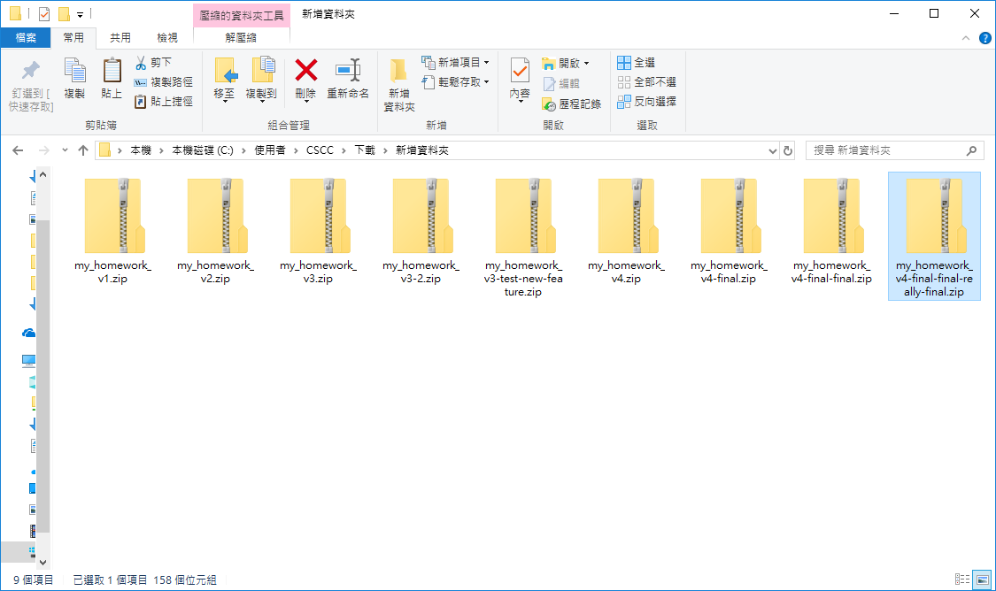
Why VCS (1/3)
How do you manage your homework ?

Slide 4
Why VCS (2/3)
How the people do version control ?
Share files with CD, USB or Network
Patch
What is the problem ?
Many different version
Hard to maintaining, debugging

Slide 5
Why VCS (3/3)
A tool help you manage you project
Commit, Rollback, Checkout
Branch, Tag
Merge
Clone, Push, Pull
Common VCS
CVS
RCS
SVN
…
Git

Slide 6
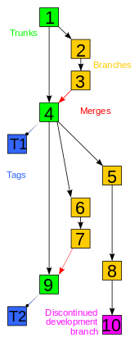
Git
Not a software only for you to download code from Github
Distributed revision control system (DVCS)
P2P instead of Client-Server
No Trunk (主幹)
Fast
Everything is at local, no need to sync with server
Convenient
You can easily create branch without modify the server side repository

Slide 7
Using Git Personally
Base version control
Init
Status
Add, Commit
Reset
View history
Log
Blame
Develop different feature
Branch, Tag, Checkout
Rebase, Merge

Slide 8
Config
You need to add basic config before using git
Position
Global (~/.gitconfig)
Local (project-root/.gitconfig)
System (/etc/gitconfig)
Basic config
$ git config --global user.name “zswu“
$ git config --global user.email zswu@cs.nctu.edu.tw
Other config
core.editor vim
merge.tool vimdiff

Slide 9
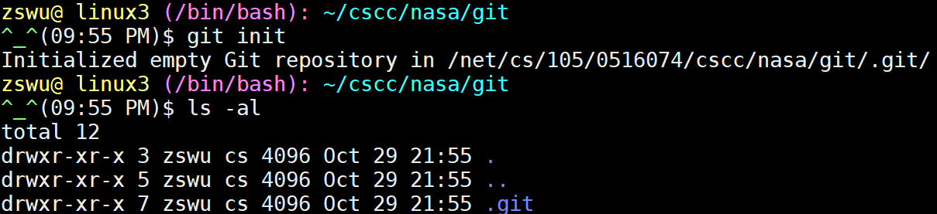
Init
Init a empty local repository
Create a .git directory, everything about version control is inside this directory

Slide 10
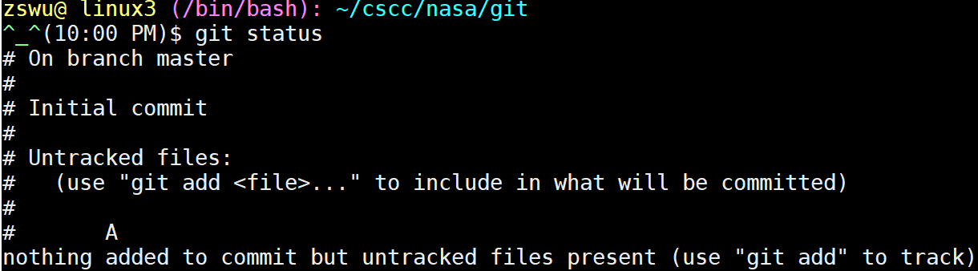
Status
Show the status
Untracked files
Modified files
Deleted files
Intermediately state
Rebase
Merge

Slide 11
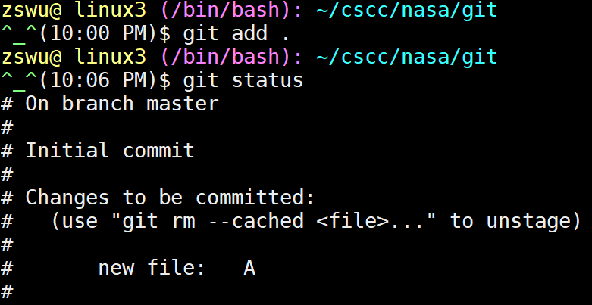
Add
Add files to the temporary area (to be commited)
You don’t need to commit all the thing at the same time
Use .gitignore file to prevent some files to be added

Slide 12
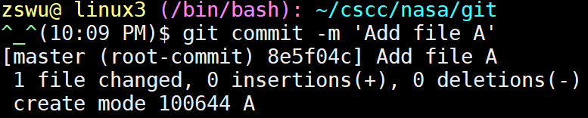
Commit
Save your current state
Has a hash ID
Which hash ID is the previous state
What you modified
Write some log to help people know what have you done

Slide 13
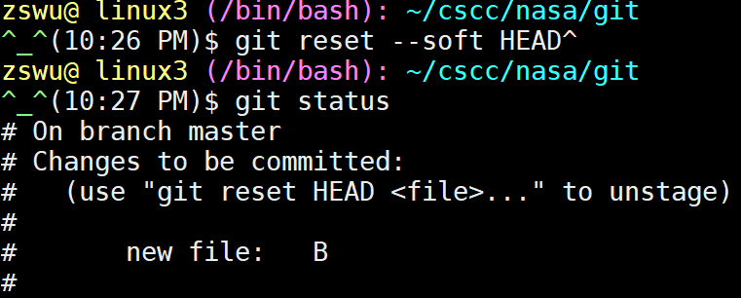
Reset
Reset a commit or reset temporary area
If you regret, you can remove all change from temporary area, or remove a commit
HEAD^ / HEAD~1, the previous commit of HEAD
https://gitbook.tw/chapters/using-git/reset-commit.html

Slide 14
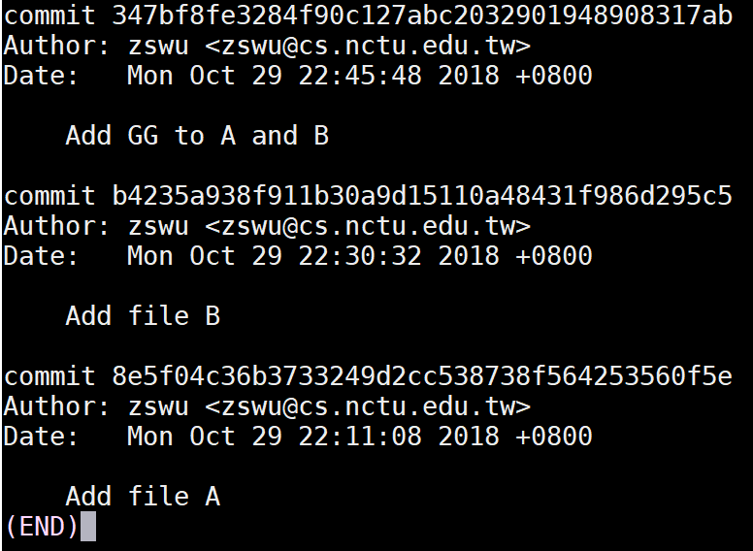
Log
List history of the repository
Commit message
Commit Hash ID
Commit author

Slide 15
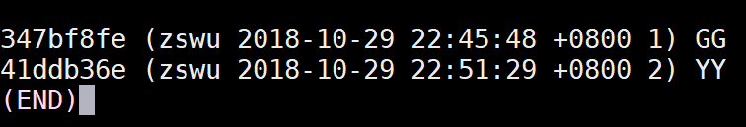
Blame
History of a file
Show the latest commit of each line
To find who added this line into your code

Slide 16
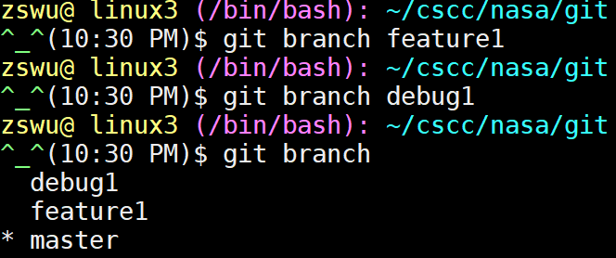
Branch
Work on multiple thing at the same time
Add feature or debug individually
Keep master branch stable

Slide 17
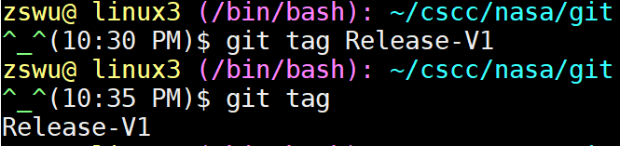
Tag
Tag specific commit
Release commit, e.g., v1.0.1, v1.2.3rc, v2.5b3
Tag point to only one commit

Slide 18
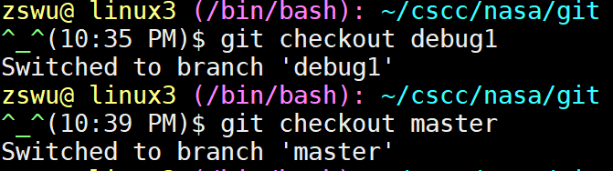
Checkout
Checkout something
Branch, Tag
Commit (by Hash ID)

Slide 19
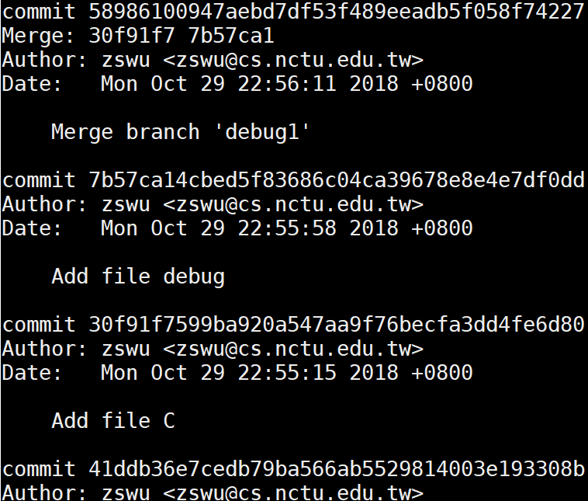
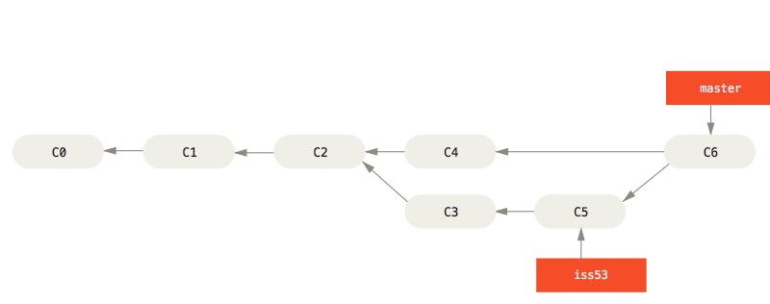
Merge
Merge branch B to branch A
If B is based on A, Fast-forward is applied
If both A and B is changed, a merge commit is added
If auto merge failed, you need to solve the conflict yourself

Slide 20
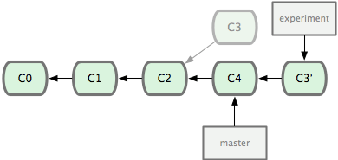
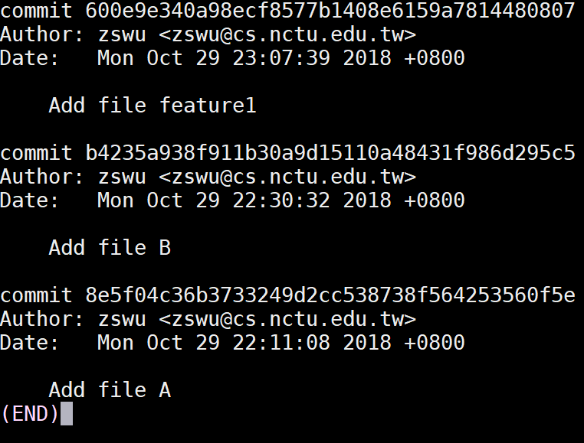
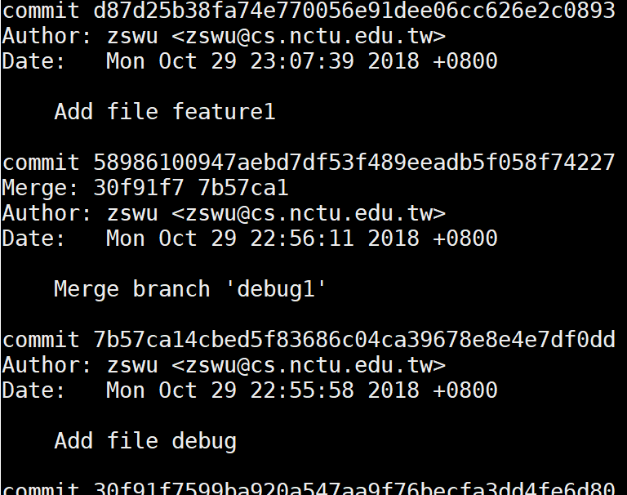
Rebase
Rebase branch B onto branch A
Add each commit of branch B onto branch A
No merge commit
If you branch B is forked from branch A, you can use rebase to apply the latest branch A commits

Slide 21
Using Git with Others
Remote repository
Clone
Remote
Fetch
Push
Pull => Fetch + Merge 、Fetch + Rebase
Conflict
Rebase/Merge --about/--skip/--continue
Stash / Stash pop
Revert

Slide 22
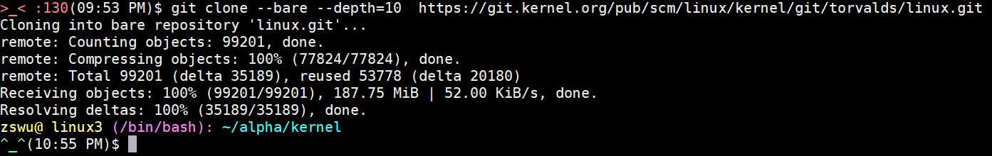
Clone
Clone a git repository
Copy all things including history, branch, tag

Slide 23
Remote
About remote repository
You can add many remote repository
Usually, origin is your default remote repository

Slide 24

Fetch
Fetch new commits from remote
Remote branch will be placed at remote-name/branch-name
origin/master
origin/debug1
Usually, we will do this after fetch
$ git rebase origin/master

Slide 25
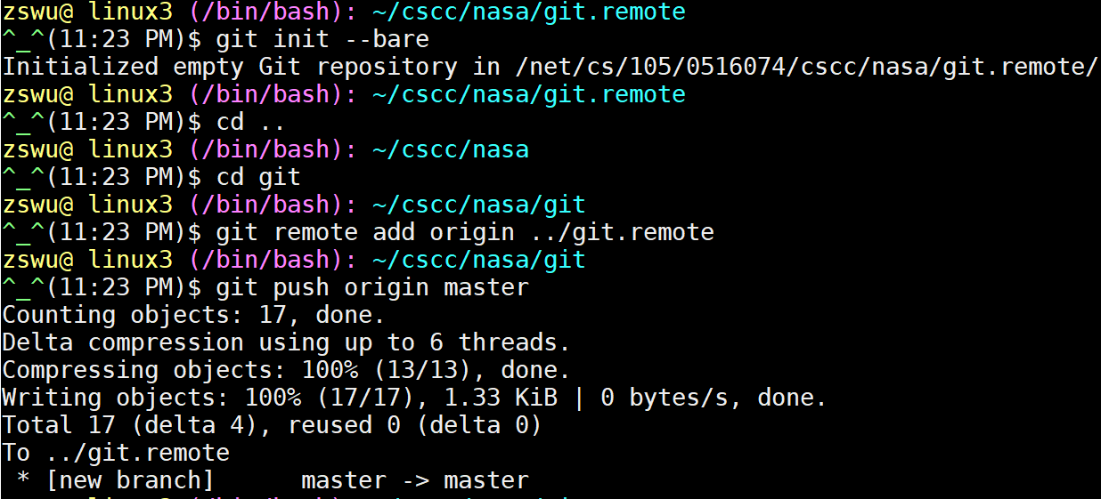
Push
Push things to remote branch
You must have write permission on remote server
Push a branch to remote
If exist, update it

Slide 26
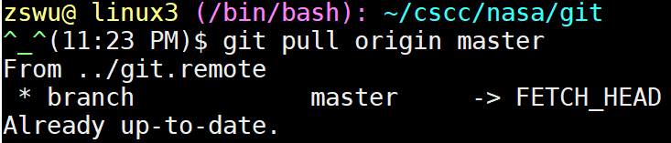
Pull
Pull is equal to fetch + merge, or fetch + rebase
Defaults to fetch + merge
Pull something add a lots of marge message into your project
Use fetch + rebase instead

Slide 27
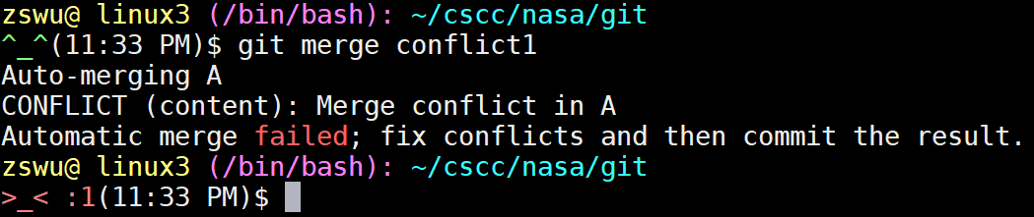
Conflict
Why
Modify same file
Auto merge failed
Squash commits
Squash will change commits history
$ git push -f
Try to not do this

Slide 28
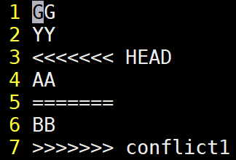
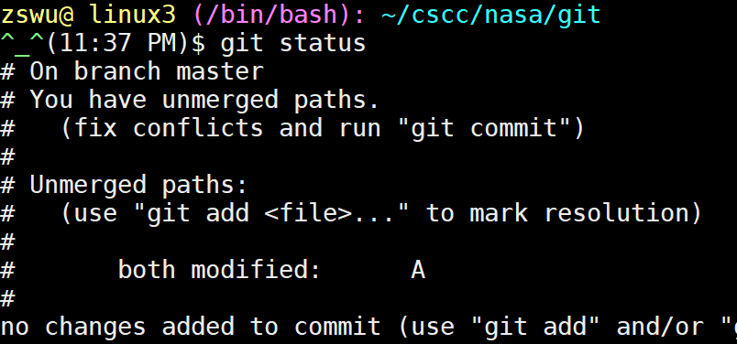
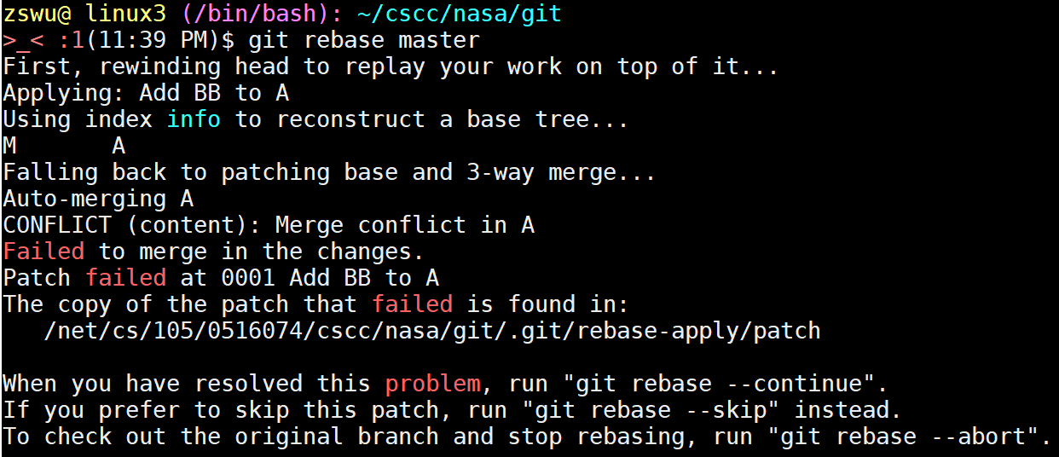
Merge/Rebase Conflict
Continue
After you fixed the conflict, continue the action (Merge/Rebase)
Skip
Skip this commit, it won’t be merge into target branch
Abort
Abort, nothing will change ☺

Slide 29
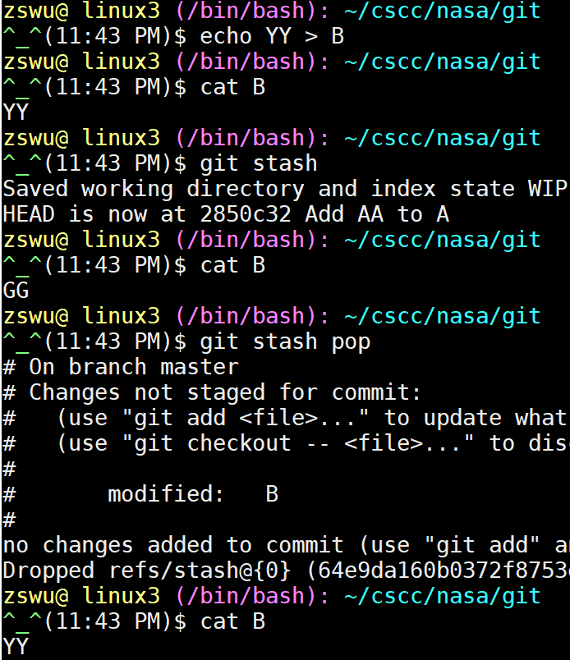
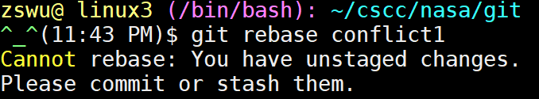
Stash / Stash Pop
Stash things not yet commit
Like a stack, first in last out
Convenient when rebasing/merging

Slide 30
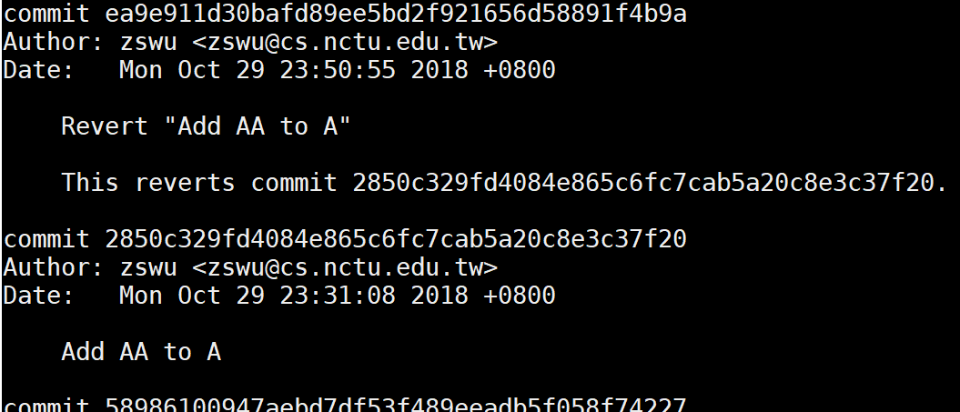
Revert
Revert a commit
Revert a commit by adding a new commit
Won’t break the history
The new commit offset the old one

Slide 31
Etiquette Rules of Using Git (1/5)
Commit Message
What you done
Why
How
Format is important
$ git rebase -i HEAD~x
Don’t modify master directly
Master branch may become unstable
Others need to solve the conflict that cause by your temporary code
To keep history clean

Slide 32
Etiquette Rules of Using Git (2/5)
Keep history clean
Don’t change the history if you share branch with others
A lots of conflicts
Try to not use $ git push -f
A lots of conflicts
Try to not use merge (use reabase), except you are on master branch
Branch may become incapable of being merge
Try to not do $ git pull (fetch + merge)
Will add unnecessary merge commit
Use rebase -i
Rewrite your history

Slide 33
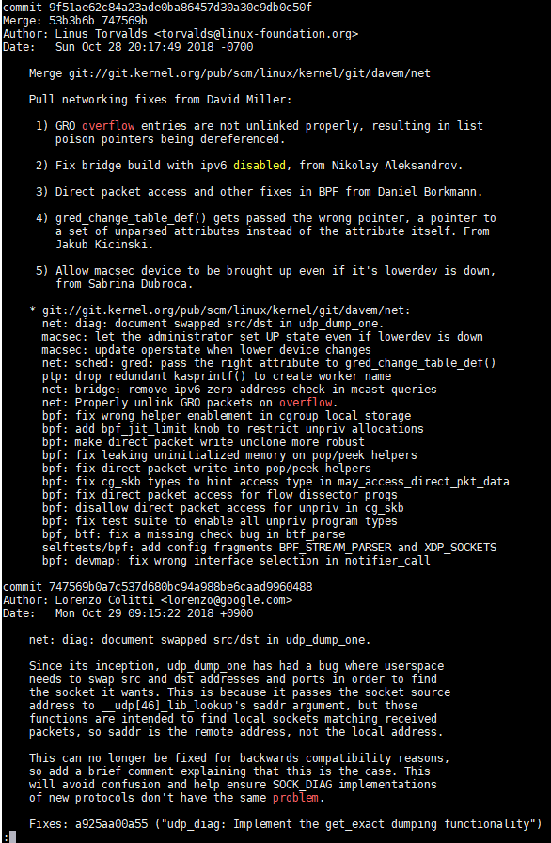
Etiquette Rules of Using Git (3/5)
Good commit message

Slide 34
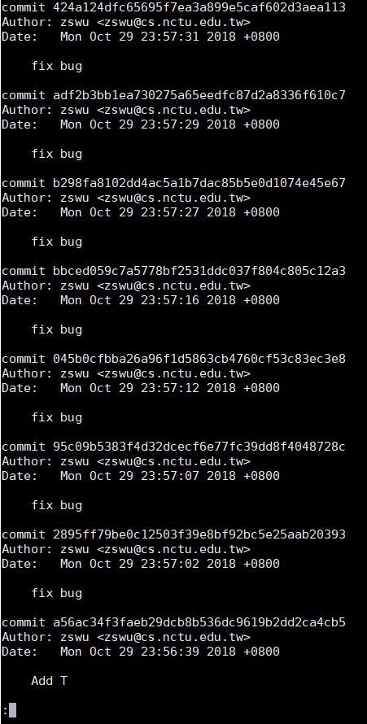
Etiquette Rules of Using Git (4/5)
Bad commit message

Slide 35
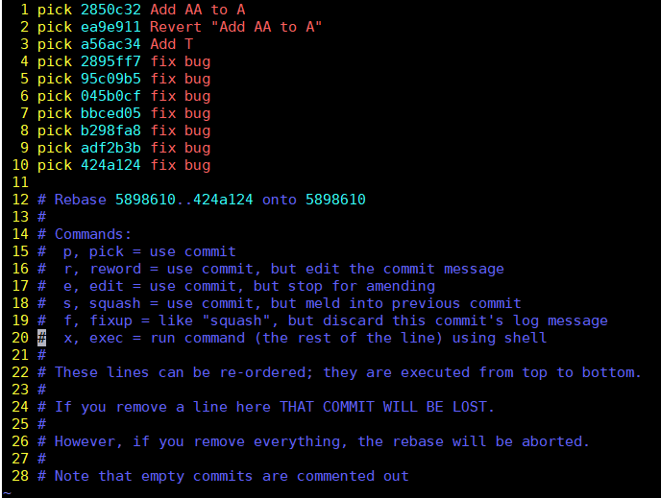
Etiquette Rules of Using Git (5/5)
Use rebase -i to create clean history
$ git rebase -i HEAD~10

Slide 36
Tools & Services (1/2)
Online Git Service
Web interface
Remote repository
Issue, Pull Requests (or Merge Requests… etc.)
Code Review
Community
CI/CD
Example
GitHub
GitLab
Bitbucket

Slide 37
Tools & Services (2/2)
Tools
Gerrit
Web-based code review tool
Tig
ncurses-based text-mode interface for Git
https://www.jianshu.com/p/e4ca3030a9d5
Git GUI
GUI-based interface for Git
KDiff3 / vimdiff / meld
Help users to solve conflict
etc.

Slide 38
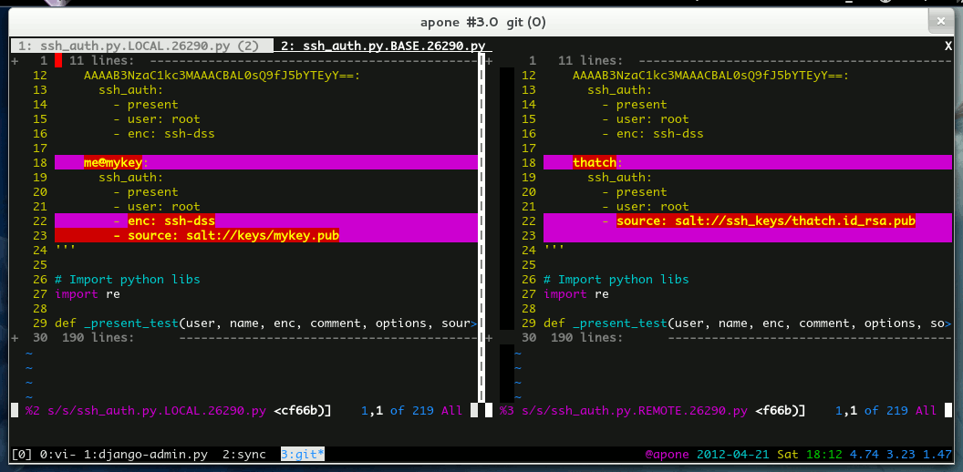
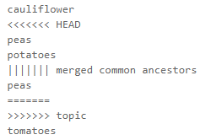
Tips (1/3)
Conflict Solving
Use merge tools
$ git config --global merge.tool kdiff3
Show common ancestor
$ git config --global merge.conflictstyle diff3
Change merge algorithm
$ git merge --strategy-option=patience
More...
https://developer.atlassian.com/blog/2015/12/tips-tools-to-solve-git-conflicts/

Slide 39
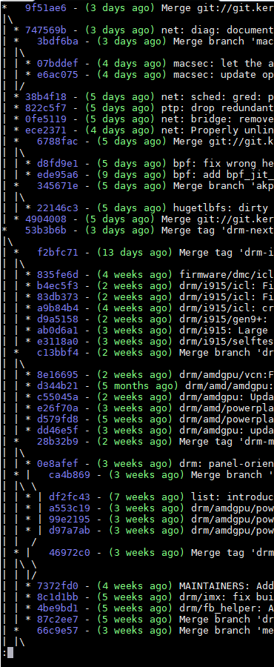
Tips (2/3)
History visualize
Use git log
$ git log --decorate --graph [--oneline]
$ git log --graph --abbrev-commit --decorate --format=format:'%C(bold blue)%h%C(reset) - %C(bold green)(%ar)%C(reset) %C(white)%s%C(reset) %C(dim white)- %an%C(reset)%C(bold yellow)%d%C(reset)' --all
$ man git-log

Slide 40
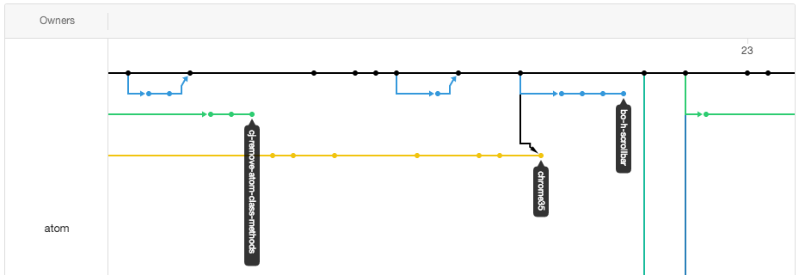
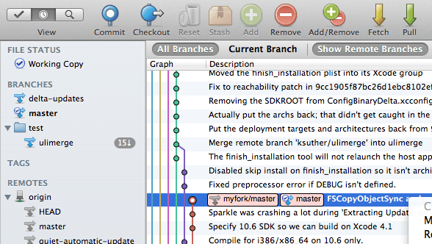
Tips (3/3)
History visualize (cont.)
GitHub / Online tools
Git GUI

