Slide 1
TCP/IP Networking

Slide 2
Overview
Introduction
Layers of TCP/IP
  Link Layer
  Network Layer
  Transport Layer
  Application Layer
Network Interface and Hardware
Networking
ARP
Setting up Network

Slide 3
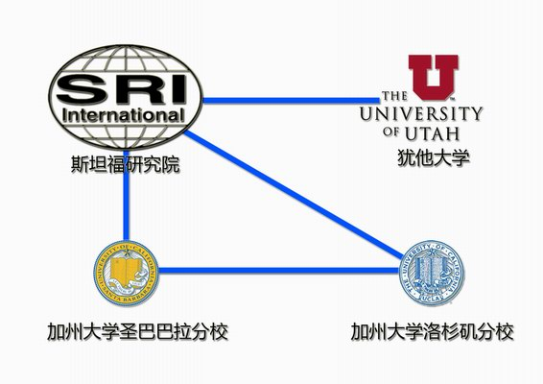
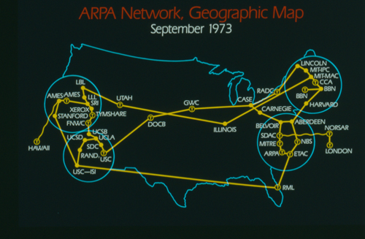
Introduction
– ARPANET
Advanced Research Projects Agency Network
  NCP (Network Control Protocol)
    Allow an exchange of information between separated computers
Stanford Research Institute
University of Utah
UC Santa Barbara
UCLA

Slide 4
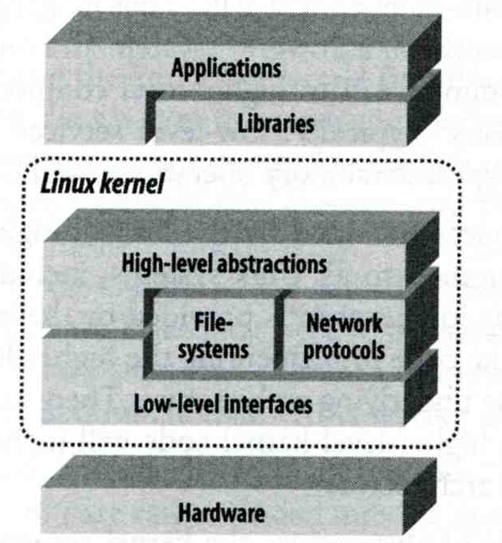
Introduction
– Why TCP/IP ?
Transmission Control Protocol / Internet Protocol
The gap between applications and Network
  Network
    802.3 Ethernet
    802.4 Token bus
    802.5 Token Ring
    802.11 Wireless
    802.16 WiMAX
  Application
    Reliable
    Performance

Slide 5
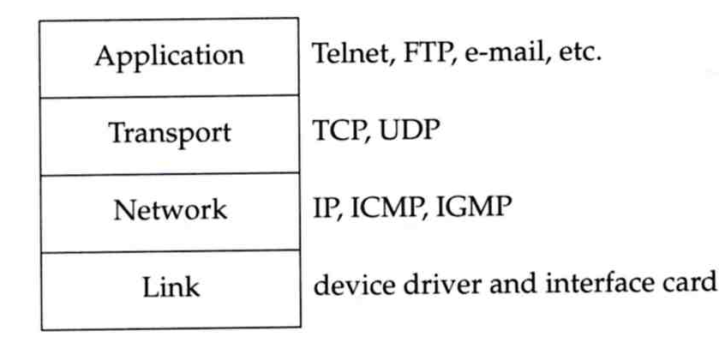
Introduction
– Layers of TCP/IP (1)
TCP/IP is a suite of networking protocols
  4 layers Layering architecture
    Link layer (data-link layer)
      Include device drivers to handle hardware details
    Network layer (IP)
      Handle the movement of packets around the network
    Transport layer (Port)
      Handle flow of data between hosts
    Application

Slide 6
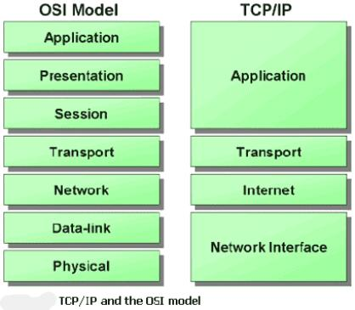
Introduction
– Layers of TCP/IP (2)
ISO/OSI Model
(International Organization for Standardization /
Open System Interconnection Reference Model)
TCP/IP Model

Slide 7
Introduction
– Layers of TCP/IP (3)
Encapsulation (Multiplexing)
  Gathering data from multiple sockets, enveloping data
  with header
Application data
Data
Transport
Header
Application data
Segment
Network
Header
Transport
Header
Application data
Packet
Frame
Header
Network
Header
Transport
Header
Application data
Frame
CRC
0110101………………………………………………
Bits

Slide 8
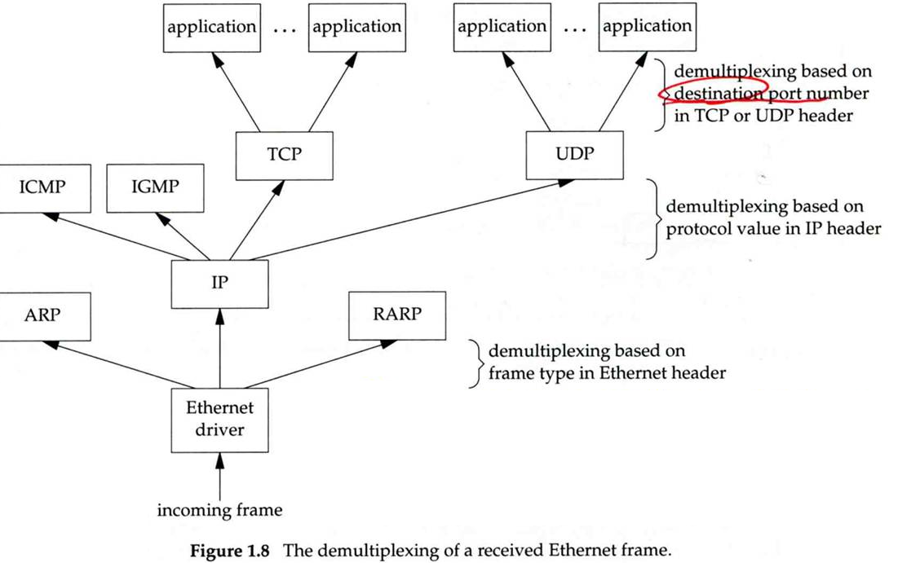
Introduction
– Layers of TCP/IP (4)
Decapsulation (Demultiplexing)
  Delivering received segments to correct socket

Slide 9
Introduction
–TCP/IP Family
arp
FTP
HTTP
SMTP
DNS
DNS
TFTP
traceroute
TCP
UDP
IP
ICMP
ARP, Device drivers
Copper, optical fiber, radio waves

Slide 10
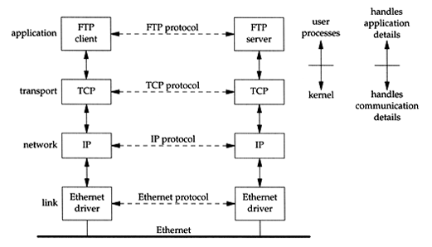
Introduction
– Addressing
Addressing
  Nearby (same network)

Slide 11
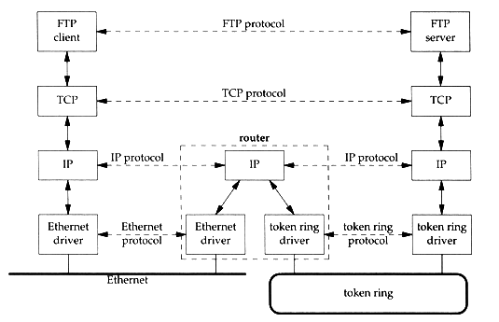
Introduction
– Addressing
Addressing
  Faraway (across network)

Slide 12
Introduction
– Addressing
IP
  32-bits, Unique Internet Address of a host
Port
  16-bits, Uniquely identify application
MAC Address
  Media Access Control Address
  48-bits, Network Interface Card (NIC) Hardware address
sabsd [/home/chwong] -chwong- ifconfig
sk0: flags=8843<UP,BROADCAST,RUNNING,SIMPLEX,MULTICAST> mtu 1500
options=b<RXCSUM,TXCSUM,VLAN_MTU>
inet 140.113.17.215 netmask 0xffffff00 broadcast 140.113.17.255
inet 140.113.17.221 netmask 0xffffffff broadcast 140.113.17.221
ether 00:11:d8:06:1e:81
media: Ethernet autoselect (100baseTX <full-duplex,flag0,flag1>)
status: active
lo0: flags=8049<UP,LOOPBACK,RUNNING,MULTICAST> mtu 16384
inet 127.0.0.1 netmask 0xff000000

Slide 13
Link Layer

Slide 14
Network Interface and Hardware
LAN (Local), WAN (Wide), MAN (Metropolitan)
  Ethernet, Token-Ring, FDDI
  PPP, xDSL, ISDN
Physical Topologies (see next slide)
Logical Topologies
  Broadcast, Token-passing
Common LAN Devices
  NIC, Repeater, Hub, Bridge, Switch, Router
Common LAN Media
  UTP, STP, Coaxial Cable, Fiber Optic Cable

Slide 15
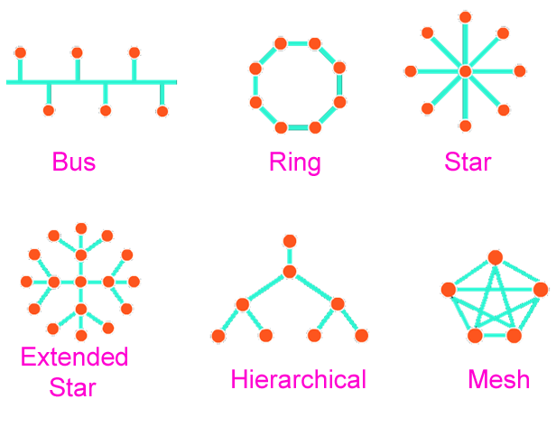
Network Interface and Hardware
– Physical Topologies

Slide 16
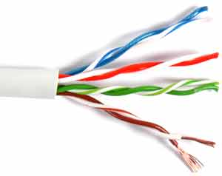
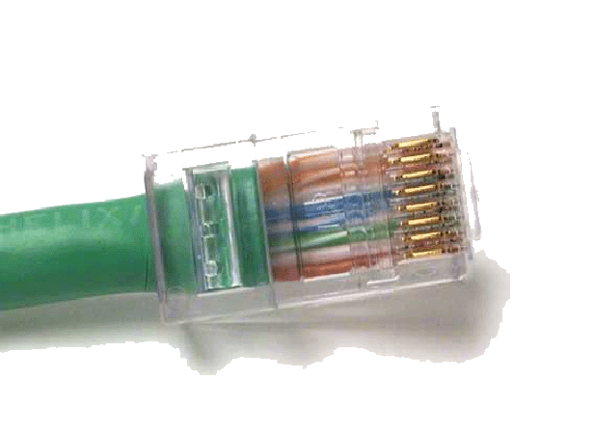
Network Interface and Hardware
– Media
Media
  Coaxial Cable
    Thicknet v.s. thinnet
    BNC connector
  Twisted Pair Standards
    Straight-through v.s. Crossover
    RJ-45 connector
  Fiber Optic Cable
    Multimode v.s. single mode
  Wireless
    IrDA, Radio (2.4GHz, 5GHz)
Pin# | 1 | 2 | 3 | 4 | 5 | 6 | 7 | 8
T568-A | W/G | Green | W/O | Blue | W/Blue | Orange | W/Br | Brown
T568-B | W/O | Orange | W/G | Blue | W/Blue | Green | W/Br | Brown

Slide 17
The Link Layer
Ethernet: the common LAN
  10 Mb/s → 100 Mb/s → 1Gb/s
  802.3 → 802.3u → 802.3z
  CSMA/CD (Carrier Sense Multiple Access/Collision Detect)
Ethernet Address (48bits)
  00:80:c8:92:0e:e1
Ethernet Frame
  Ethernet MTU (Maximum Transmission Unit) is 1500 bytes
  IP fragmentation
  Path MTU
    MTU of various physical device
Preamble
64 bits
D addr
48 bits
S addr
48 bits
Type
16 bits
Data
(max 1500 bytes)
CRC
32 bits

Slide 18
Network Layer

Slide 19
The Network Layer
Path Determination
  The Internet Protocol (IP)
    IP address (32 bits)
Topics
  IP Address
  Subnetting and netmask
  Address types
  Routing

Slide 20
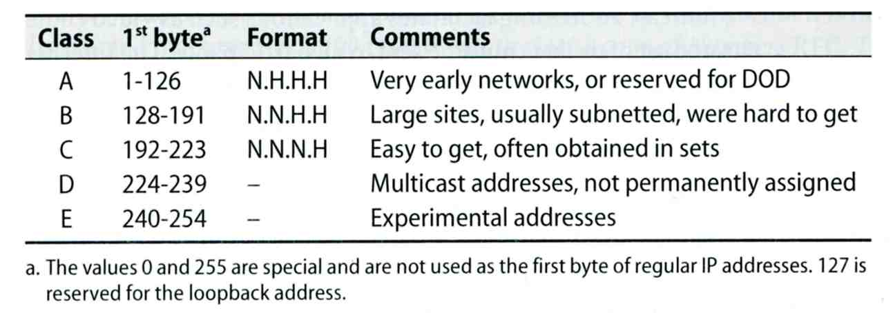
The Network Layer
– IP Address
32-bit long
  Network part
    Identify a logical network
  Host part
    Identify a machine on certain network
IP address category
Ex:
  NCTU
    Class B address: 140.113.0.0
    Network ID: 140.113
    Number of hosts: 256*256 = 65536

Slide 21
The Network Layer
– Subnetting and Netmask (1)
Subnetting
  Borrow some bits from network ID to extends hosts ID
  Ex:
    ClassB address : 140.113.0.0
    = 256 ClassC-like IP addresses
    in N.N.N.H subnetting method
    140.113.209.0 subnet
Netmask
  Specify how many bits of network-ID are used for network-ID
  Continuous 1 bits form the network part
  Ex:
    255.255.255.0 in NCTU-CS example
      256 hosts available
    255.255.255.248 in ADSL example
      Only 8 hosts available

Slide 22
The Network Layer
– Subnetting and Netmask (2)
How to determine your network ID?
  Bitwise-AND IP and netmask
  Ex:
    140.113.214.37 & 255.255.255.0 ➔ 140.113.214.0
    140.113.209.37 & 255.255.255.0 ➔ 140.113.209.0
    140.113.214.37 & 255.255.0.0 ➔ 140.113.0.0
    140.113.209.37 & 255.255.0.0 ➔ 140.113.0.0
    211.23.188.78 & 255.255.255.248 ➔ 211.23.188.72
      78 = 01001110
      78 & 248= 01001110 & 11111000 =72

Slide 23
The Network Layer
– Subnetting and Netmask (3)
In a subnet, not all IP are available
  The first one IP ➔ network ID
  The last one IP ➔ broadcast address
  Ex:
Netmask 255.255.255.0
140.113.209.32/24
140.113.209.0 ➔ network ID
140.113.209.255 ➔ broadcast address
1 ~ 254, total 254 IPs are usable
Netmask 255.255.255.252
211.23.188.78/29
211.23.188.72 ➔ network ID
211.23.188.79 ➔ broadcast address
73 ~ 78, total 6 IPs are usable

Slide 24
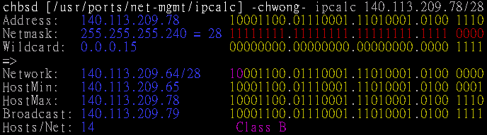
The Network Layer
– Subnetting and Netmask (4)
The smallest subnetting
  Network portion : 30 bits
  Host portion : 2 bits
  ➔ 4 hosts, but only 2 IPs are available
ipcalc
  /usr/ports/net-mgmt/ipcalc

Slide 25
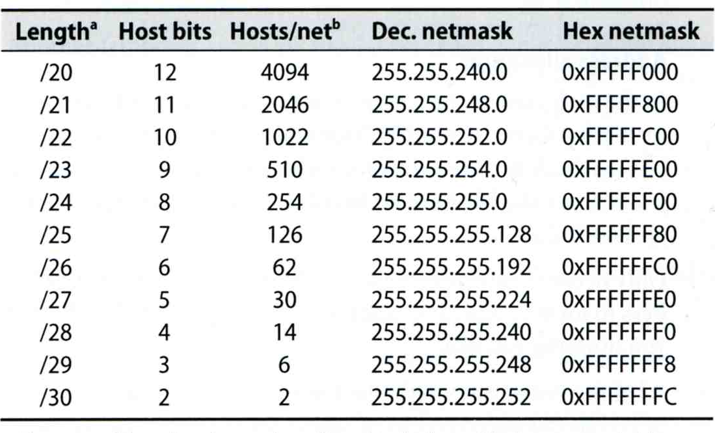
The Network Layer
– Subnetting and Netmask (5)
Network configuration for various lengths of netmask

Slide 26
The Network Layer
– IP address crisis
IP address crisis
  Run out of class B address
    The most desirable ones for moderately large organizations
  IP address were being allocated on a FCFS
    With no locality of reference
Solutions
  Short term
    Subnetting and CIDR (classless inter-domain routing)
    NAT (network address translation)
  Long term
    IPv6

Slide 27
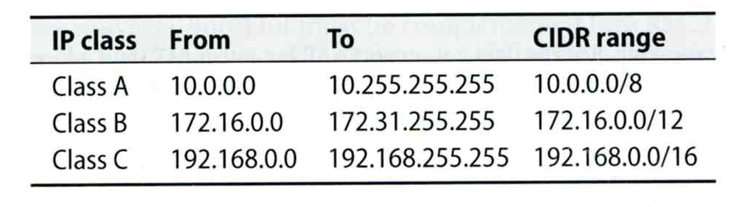
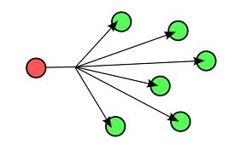
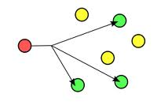
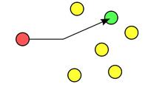
The Network Layer
– NAT (1)
Private Address
  Packets that bearing private address will not go out to the Internet
  3 private addresses range
    Depend on the size of your organization

Slide 28
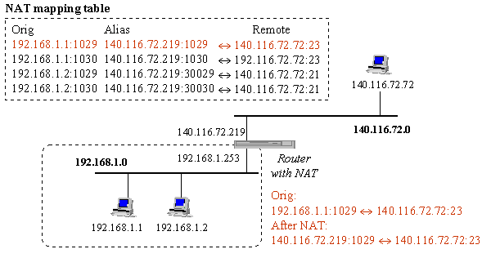
The Network Layer
– NAT (2)
  NAT
    Network Address Translation
    Allow hosts using private address to talk with outside

Slide 29
The Network Layer
– Routing (1)
Goal: Direct a packet closer to the destination
Flat v.s. Hierarchical
Routing table
  Routing information (which kind of packets to which way)
  Rule-based information
  Kernel will pick the most suitable way to route the packets
chbsd [/home/chwong] -chwong- netstat -rn
Routing tables
Internet:
Destination Gateway Flags Refs Use Netif Expire
default 140.113.17.254 UGS 0 4439610 dc0
127.0.0.1 127.0.0.1 UH 0 3887 lo0
140.113.17/24 link#1 UC 0 0 dc0
140.113.17.209 00:0d:61:21:02:54 UHLW 1 38 dc0 477
140.113.17.212 00:90:96:23:8f:7d UHLW 1 22558 lo0
140.113.17.215 00:11:d8:06:1e:81 UHLW 1 17 dc0 1188
140.113.17.248 00:0b:ac:d7:93:40 UHLW 1 0 dc0 1170
140.113.17.254 00:90:69:64:ec:00 UHLW 2 0 dc0 1200

Slide 30
The Network Layer
– Routing (2)
Static route
  Statically configured by “route” command
  Ex:
    % route add default 140.113.235.254
    % route add 192.168.1.0/24 192.168.1.254
Dynamic route
  gated

Slide 31
The Network Layer
– Routing (3)
“ping -R” and “traceroute”
chbsd [/home/chwong] -chwong- ping -c 1 -R www.nctu.edu.tw
PING www.nctu.edu.tw (140.113.250.5): 56 data bytes
64 bytes from 140.113.250.5: icmp_seq=0 ttl=61 time=2.249 ms
RR: ProjE27-253.NCTU.edu.tw (140.113.27.253)
140.113.0.57
CC250-gw.NCTU.edu.tw (140.113.250.253)
www.NCTU.edu.tw (140.113.250.5)
www.NCTU.edu.tw (140.113.250.5)
140.113.0.58
ProjE27-254.NCTU.edu.tw (140.113.27.254)
e3rtn.csie.nctu.edu.tw (140.113.17.254)
chbsd.csie.nctu.edu.tw (140.113.17.212)
--- www.nctu.edu.tw ping statistics ---
1 packets transmitted, 1 packets received, 0% packet loss
round-trip min/avg/max/stddev = 2.249/2.249/2.249/0.000 ms
chbsd [/home/chwong] -chwong- traceroute www.nctu.edu.tw
traceroute to www.nctu.edu.tw (140.113.250.5), 64 hops max, 40 byte packets
1 e3rtn (140.113.17.254) 0.524 ms 0.406 ms 0.512 ms
2 ProjE27-254.NCTU.edu.tw (140.113.27.254) 0.574 ms 0.501 ms 0.422 ms
3 140.113.0.58 (140.113.0.58) 0.487 ms 0.583 ms 0.541 ms
4 www.NCTU.edu.tw (140.113.250.5) 0.673 ms 0.611 ms 0.621 ms

Slide 32
Transport Layer

Slide 33
The Transport Layer
– ports
16-bits number
Preserve ports
  1 ~ 1024 (root access only)
Well-known port
    /etc/services
    IANA Service Name and Transport Protocol Port Number Registry
      https://www.iana.org/assignments/service-names-port-numbers
…
chargen 19/tcp ttytst source #Character Generator
chargen 19/udp ttytst source #Character Generator
ftp-data 20/tcp #File Transfer [Default Data]
ftp-data 20/udp #File Transfer [Default Data]
ftp 21/tcp #File Transfer [Control]
ftp 21/udp #File Transfer [Control]
ssh 22/tcp #Secure Shell Login
ssh 22/udp #Secure Shell Login
telnet 23/tcp
telnet 23/udp
…

Slide 34
The Transport Layer
UDP v.s. TCP
Function | UDP | TCP
Connection-oriented | No | Yes
Message boundaries | Yes | No
Data checksum | Optional | Yes
Positive acknowledgement | No | Yes
Time-out and retransmit | No | Yes
Duplicate detection | No | Yes
Sequencing | No | Yes
Flow control | No | Yes

Slide 35
The Transport Layer
– useful commands
tcpdump, sniffit, trafshow, netstat -s
chbsd [/home/chwong] -chwong- sudo tcpdump -n host 140.113.235.131
tcpdump: verbose output suppressed, use -v or -vv for full protocol decode
listening on dc0, link-type EN10MB (Ethernet), capture size 96 bytes
11:25:50.996542 IP 140.113.17.212.61233 > 140.113.235.131.22: P 266166194:266166226(32) ack 938637316 win 33304 <nop,nop,timestamp 3368918203 130908112>
11:25:50.998247 IP 140.113.235.131.22 > 140.113.17.212.61233: P 1:33(32) ack 32 win 33304 <nop,nop,timestamp 134993614 3368918203>
11:25:50.998396 IP 140.113.235.131.22 > 140.113.17.212.61233: P 33:65(32) ack 32 win 33304 <nop,nop,timestamp 134993614 3368918203>
11:25:50.998438 IP 140.113.17.212.61233 > 140.113.235.131.22: . ack 65 win 33288 <nop,nop,timestamp 3368918205 134993614>
11:26:36.935422 IP 140.113.17.212 > 140.113.235.131: ICMP echo request, id 28124, seq 0, length 64
11:26:36.935761 IP 140.113.235.131 > 140.113.17.212: ICMP echo reply, id 28124, seq 0, length 64
^C
6 packets captured
697 packets received by filter
0 packets dropped by kernel

Slide 36
The Application Layer
The Client-Server Model
  Port Numbers:
    /etc/services
    The first 1024 ports are reserved ports
  Internet Services
    inetd and /etc/inetd.conf
  DNS

Slide 37
The Application Layer
– inetd
inetd – internet ``super-server'‘
  add inetd_enable="YES" into /etc/rc.conf
  /etc/inetd.conf
  /etc/services
daytime stream tcp nowait root internal
ftp stream tcp nowait root /usr/libexec/ftpd ftpd -l
ssh stream tcp nowait root /usr/sbin/sshd sshd -i -4
telnet stream tcp nowait root /usr/libexec/telnetd telnetd
pop3 stream tcp nowait root /usr/local/libexec/popper popper
daytime 13/tcp
ftp-data 20/tcp #File Transfer [Default Data]
ftp 21/tcp #File Transfer [Control]
ssh 22/tcp #Secure Shell Login
telnet 23/tcp
pop3 110/tcp #Post Office Protocol - Version 3

Slide 38
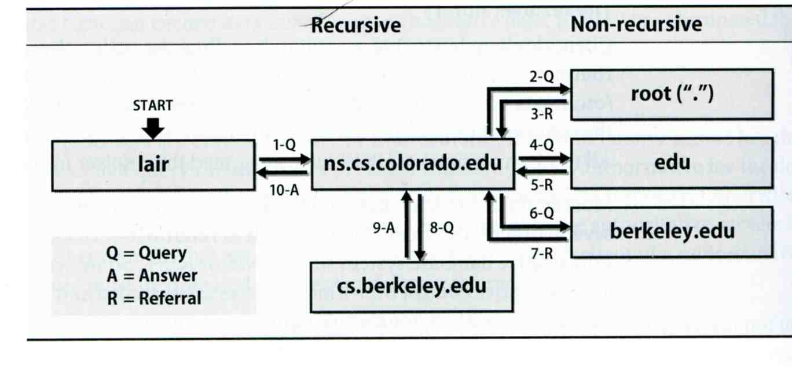
The Application Layer
– DNS
Domain Name System
  Record IP-hostname mapping
  DNS query
    “what is the IP of vangogh.cs.berkeley.edu” from lair.cs.colorado.edu
  Hierarchical architecture

Slide 39
ARP (1)
Address Resolution Protocol
  Ask MAC address of certain IP
  Broadcast
  Any one receiving ARP packet and having this IP will reply to the sender
  When the host owing this IP is not on the same network, sender will use the MAC address of next-hop router to send the packet

Slide 40
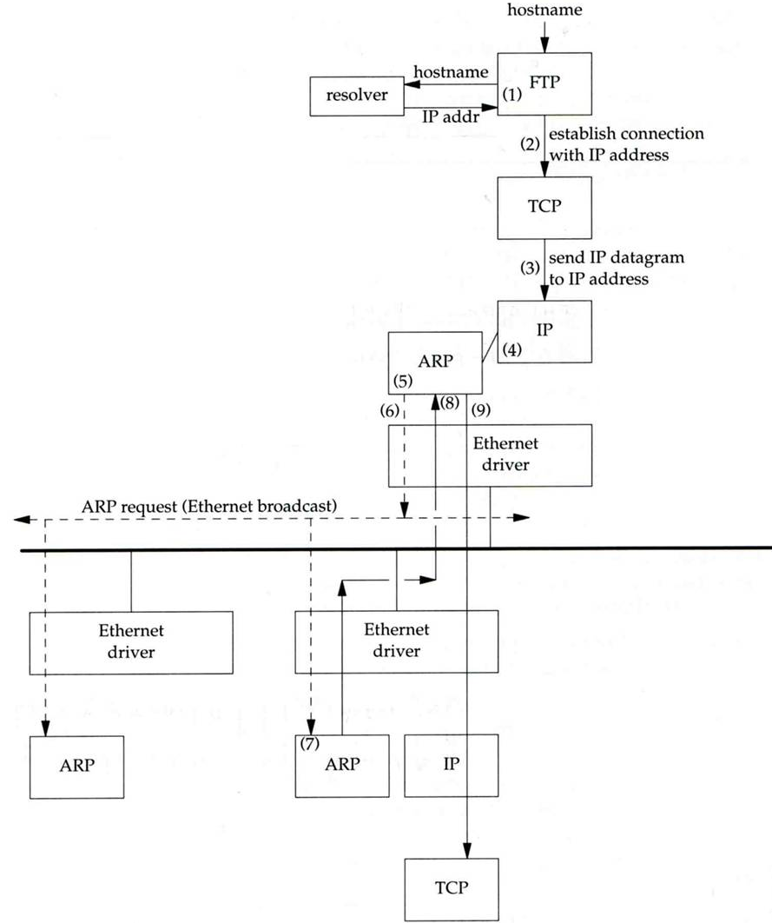
ARP (2)

Slide 41
ARP (3)
Maintain recent ARP results
  come from both ARP request and reply
  expiration time
    Complete entry = 20 minutes
    Incomplete entry = 3 minutes
  Use arp command to see the cache
  Ex:
    % arp -a
    % arp -da
[chwong@mg-215]~> arp -a
crypto23.csie.nctu.edu.tw (140.113.208.143) at 00:16:e6:5b:fa:e9 on fxp1 [ethernet]
e3rtn-208.csie.nctu.edu.tw (140.113.208.254) at 00:0e:38:a4:c2:00 on fxp1 [ethernet]
e3rtn-210.csie.nctu.edu.tw (140.113.210.254) at 00:0e:38:a4:c2:00 on fxp2 [ethernet]
winpc7.csie.nctu.edu.tw (140.113.215.187) at 00:17:31:84:6c:0f on fxp3 [ethernet]
e3rtn-215.csie.nctu.edu.tw (140.113.215.254) at 00:0e:38:a4:c2:00 on fxp3 [ethernet]
e3rtn-216.csie.nctu.edu.tw (140.113.216.254) at 00:0e:38:a4:c2:00 on fxp0 [ethernet]

Slide 42
Setup network connection
Steps
  Assign an IP address and hostname
  Default route
  DNS
  Utility to test whether you connect to the Internet

Slide 43
Setup network connection
– assign IP, hostname and default route (1)
FreeBSD
  In /etc/rc.conf
Linux
  /etc/sysconfig/network
  /etc/sysconfig/network-scripts/ifcfg-eth0
defaultrouter="140.113.17.254"
hostname="chbsd.csie.nctu.edu.tw"
ifconfig_fxp0="inet 140.113.17.212 netmask 255.255.255.0“
ifconfig_fxp0_alias0="inet 140.113.17.214 netmask 255.255.255.255“
ifconfig_fxp1="inet 192.168.1.254 netmask 255.255.255.0"
NETWORKING=yes
HOSTNAME=linux3
GATEWAY=140.113.209.254
DEVICE=eth0
BOOTPROTO=static
BROADCAST=140.113.209.255
IPADDR=140.113.209.143
NETMASK=255.255.255.0
NETWORK=140.113.209.0
ONBOOT=yes

Slide 44
Setup network connection
– assign IP, hostname and default route (2)
/etc/hosts
  Host name database
  Each line is a host
    Internet address
    Official host name
    aliases
chwong@qkmj:~> less /etc/hosts
127.0.0.1 localhost
140.113.209.72 ccbsd12 ccbsd12.csie.nctu.edu.tw
140.113.209.2 ccserv
140.113.209.6 ccduty
140.113.209.7 mailgate
140.113.209.32 qkmj

Slide 45
Setup network connection
– assign IP, hostname and default route (3)
Solaris
  /etc/inet/netmasks (network and netmask)
  /etc/inet/hosts (hosts)
  /etc/defaultrouter (default router)
  /etc/nodename (host name)
  /etc/resolv.conf (domain, nameserver, search)
  /etc/hostname.interface (IP, either hostname in hosts or IP)
sun1 [/etc] -chwong- cat hostname.rtls0 nodename defaultrouter resolv.conf
sun1
sun1.cs.nctu.edu.tw
140.113.235.254
domain cs.nctu.edu.tw
nameserver 140.113.235.107
nameserver 140.113.6.2
sun1 [/etc] -chwong- cat /etc/inet/netmasks /etc/inet/hosts
140.113.235.0 255.255.255.0
127.0.0.1 localhost
140.113.235.102 csduty
140.113.235.171 sun1
140.113.235.101 cshome

Slide 46
Setup network connection
– assign IP, hostname and default route (4)
Change IP manually
  Ex:
    % ifconfig fxp0 inet 140.113.235.4 netmask 255.255.255.0
    % ifconfig fxp0 up
    % ifconfig fxp0 down
Specify default route manually
  Ex:
    % route add default 140.113.235.254

Slide 47
Setup network connection
– configuring DNS
FreeBSD, Linux
  /etc/resolv.conf
Host lookup order
  FreeBSD, Linux
    /etc/nsswitch.conf
chbsd [/etc] -chwong- cat resolv.conf
domain cs.nctu.edu.tw
nameserver 140.113.235.107
search cs.nctu.edu.tw csie.nctu.edu.tw nctu.edu.tw
chbsd [/etc] -chwong- cat nsswitch.conf
group: compat
group_compat: nis
hosts: files dns
networks: files
passwd: compat
passwd_compat: nis
shells: files
services: compat
services_compat: nis
protocols: files
rpc: files

Slide 48
Utilities for network connection
ping
  Send ICMP ECHO_REQUEST to a host
traceroute
  Print the route packets take to network host
chbsd [/etc] -chwong- ping -c 1 www.nctu.edu.tw
PING www.nctu.edu.tw (140.113.250.5): 56 data bytes
64 bytes from 140.113.250.5: icmp_seq=0 ttl=60 time=3.022 ms
--- www.nctu.edu.tw ping statistics ---
1 packets transmitted, 1 packets received, 0% packet loss
round-trip min/avg/max/stddev = 3.022/3.022/3.022/0.000 ms
chbsd [/etc] -chwong- traceroute www.nctu.edu.tw
traceroute to www.nctu.edu.tw (140.113.250.5), 64 hops max, 40 byte packets
1 e3rtn-235 (140.113.235.254) 0.640 ms 0.449 ms 0.474 ms
2 140.113.0.210 (140.113.0.210) 0.465 ms 0.310 ms 0.361 ms
3 140.113.0.166 (140.113.0.166) 0.415 ms 0.379 ms 0.403 ms
4 140.113.0.149 (140.113.0.149) 0.678 ms 0.536 ms 0.574 ms
5 www.NCTU.edu.tw (140.113.250.5) 0.533 ms 0.415 ms 0.438 ms

Slide 49
Useful Utilities in ports
net/mtr
  Traceroute and ping in a single graphical network diagnostic tool
net/nload
  Console application which monitors network traffic in real time
net/wireshark
net/tshark
  A powerful network analyzer/capture tool

Slide 50
Other issues
The following issues will be given in NA (Network Administration)
  DHCP
  PPP
  NAT
  DNS
  Mail
  …

