Slide 1
ZFS The Last Word in Filesystem
tzute

Slide 2
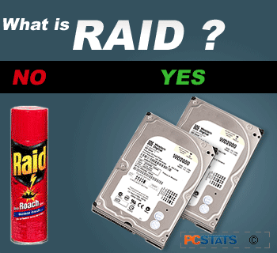
What is RAID?

Slide 3
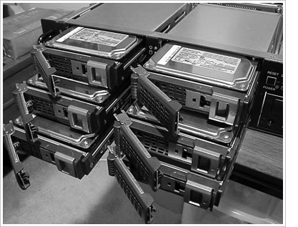
RAID
Redundant Array of Independent Disks
A group of drives glue into one

Slide 4
Common RAID types
JBOD
RAID 0
RAID 1
RAID 5
RAID 6
RAID 10
RAID 50
RAID 60

Slide 5
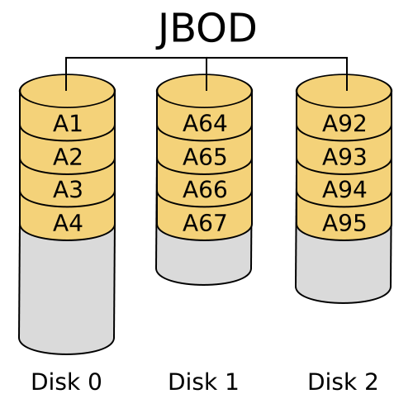
JBOD (Just a Bunch Of Disks)
https://zh.wikipedia.org/zh-tw/RAID
Notes:
循序使用硬碟
空間：N
速度：1 / 1
容錯：0

Slide 6
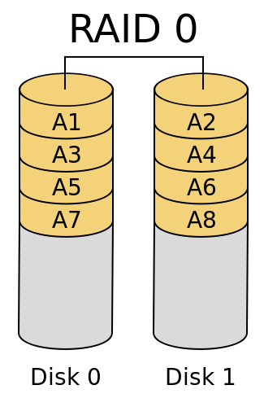
RAID 0 (Stripe)
https://zh.wikipedia.org/zh-tw/RAID
Notes:
分散資料至不同硬碟
空間：N
速度：N / N
容錯：0

Slide 7
RAID 0 (Stripe)
Striping data onto multiple devices
High write/read speed
Data corrupt if ANY of the device fail
Notes:
分散資料至不同硬碟
空間：N
速度：N / N
容錯：0

Slide 8
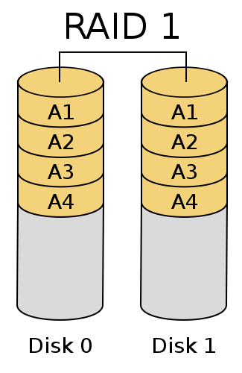
RAID 1 (Mirror)
https://zh.wikipedia.org/zh-tw/RAID
Notes:
完全拷貝資料至所有硬碟
空間：1
速度：N / 1
容錯：N - 1

Slide 9
RAID 1 (Mirror)
Devices contain identical data
100% redundancy
Fast read
Notes:
完全拷貝資料至所有硬碟
空間：1
速度：N / 1
容錯：N - 1

Slide 10
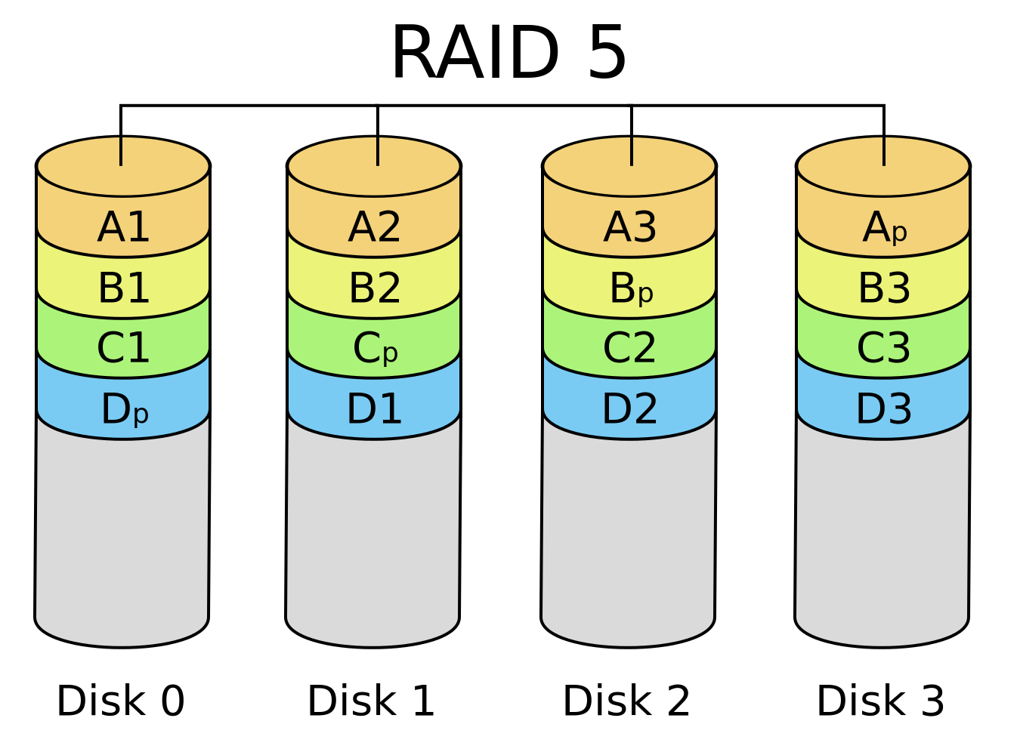
RAID 5
https://zh.wikipedia.org/zh-tw/RAID
Notes:
分散資料及校驗碼至所有硬碟
空間：N - 1
速度：N - 1 / N - 1
容錯：1

Slide 11
RAID 5
Slower than RAID 0 / RAID 1
Higher CPU usage
Notes:
分散資料及校驗碼至所有硬碟
空間：N - 1
速度：N - 1 / N - 1
容錯：1

Slide 12
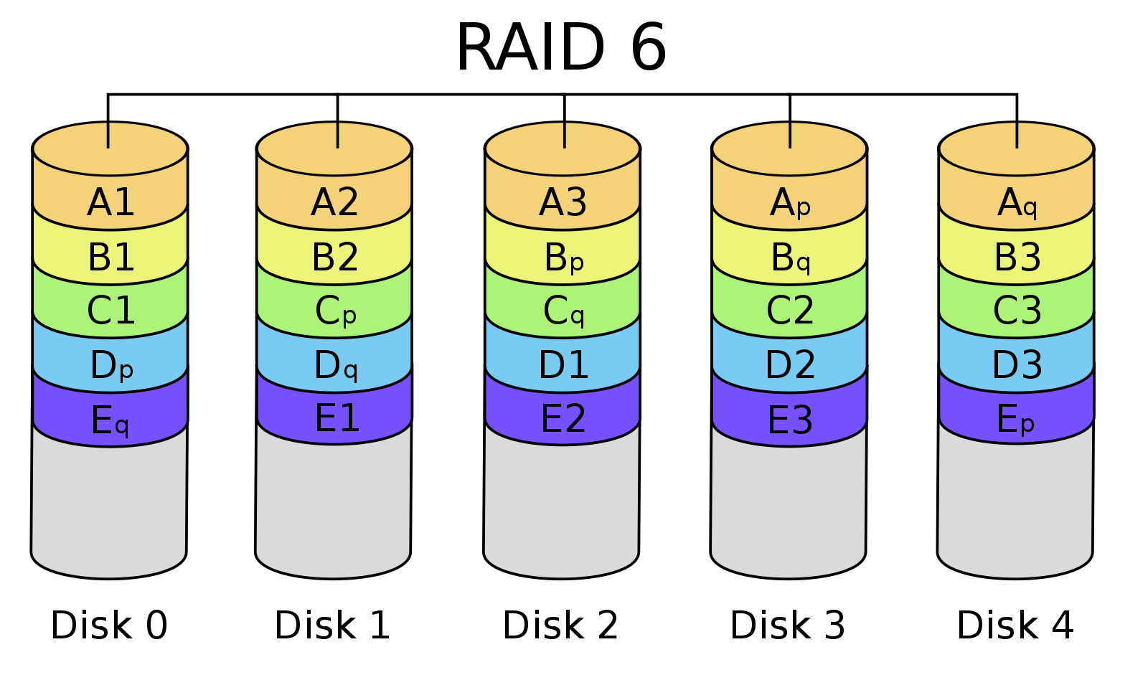
RAID 6
https://zh.wikipedia.org/zh-tw/RAID
Notes:
分散資料及兩種校驗碼至所有硬碟
空間：N - 2
速度：N - 2 / N - 2
容錯：2

Slide 13
RAID 6
Slower than RAID 5
Use two different correcting algorithm
Usually implemented via hardware
Notes:
分散資料及兩種校驗碼至所有硬碟
空間：N - 2
速度：N - 2 / N - 2
容錯：2

Slide 14
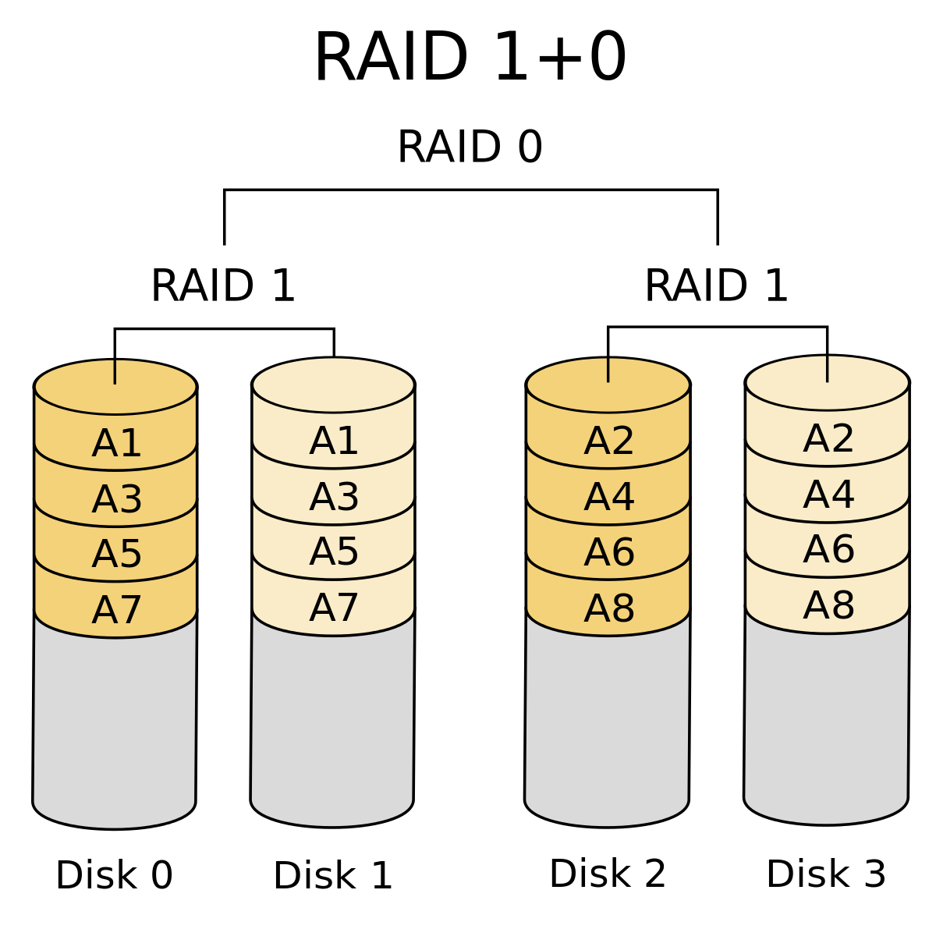
RAID 10
RAID 1+0
https://zh.wikipedia.org/zh-tw/RAID
Notes:
在 RAID 1 的基礎上建立 RAID 0
空間：N / 2
速度：(N / 2) / (N / 2)
容錯：N – 1 / per RAID 1

Slide 15
RAID 50?
https://www.icc-usa.com/wp-content/themes/icc_solutions/images/raid-calculator/raid-50.png

Slide 16
RAID 60?
https://www.icc-usa.com/wp-content/themes/icc_solutions/images/raid-calculator/raid-60.png

Slide 17
Here comes ZFS

Slide 18
Why ZFS?
Easy adminstration
Highly scalable (128 bit)
Transactional Copy-on-Write
Fully checksummed
Revolutionary and modern
SSD and Memory friendly

Slide 19
ZFS Pools
ZFS is not just filesystem
ZFS = filesystem + volume manager
Work out of the box
Zuper zimple to create
Controlled with single command
zpool

Slide 20
ZFS Pools Components
Pool is create from vdevs (Virtual Devices)
What is vdevs?
disk: A real disk (sda)
file: A file
mirror: Two or more disks mirrored together
raidz1/2: Three or more disks in RAID5/6*
spare: A spare drive
log: A write log device (ZIL SLOG; typically SSD)
cache: A read cache device (L2ARC; typically SSD)

Slide 21
RAID in ZFS
Dynamic Stripe: Intelligent RAID 0
Mirror: RAID 1
Raidz1: Improved from RAID5 (parity)
Raidz2: Improved from RAID6 (double parity)
Raidz3: triple parity
Combined as dynamic stripe

Slide 22
Create a simple zpool
zpool create mypool /dev/sda /dev/sdb
zpool create mypool
mirror /dev/sda /dev/sdb
mirror /dev/sdc /dev/sdd
What is this?
Dynamic Stripe (RAID 0)
|- /dev/sda
|- /dev/sdb

Slide 23
WT* is this
zpool create mypool
mirror /dev/sda /dev/sdb
mirror /dev/sdc /dev/sdd
raidz /dev/sde /dev/sdf /dev/sdg
log mirror /dev/sdh /dev/sdi
cache /dev/sdj /dev/sdk
spare /dev/sdl /dev/sdm

Slide 24
Zpool command
zpool list
list all the zpool
zpool status [pool name]
show status of zpool
zpool export/import [pool name]
export or import given pool
zpool set/get <properties/all>
set or show zpool properties
zpool online/offline <pool name> <vdev>
set an device in zpool to online/offline state
zpool attach/detach <pool name> <device> <new device>
attach a new device to an zpool/detach a device from zpool
zpool replace <pool name> <old device> <new device>
replace old device with new device
zpool scrub
try to discover silent error or hardware failure
zpool history [pool name]
show all the history of zpool
zpool add <pool name> <vdev>
add additional capacity into pool
zpool create/destroy
create/destory zpool

Slide 25
Zpool properties
Each pool has customizable properties
NAME PROPERTY VALUE SOURCE
zroot size 460G -
zroot capacity 4% -
zroot altroot - default
zroot health ONLINE -
zroot guid 13063928643765267585 default
zroot version - default
zroot bootfs zroot/ROOT/default local
zroot delegation on default
zroot autoreplace off default
zroot cachefile - default
zroot failmode wait default
zroot listsnapshots off default
Notes:
大小
使用率
掛載點 root
狀態
default bootable dataset
Auto `replace`

Slide 26
Zpool Sizing
ZFS reserve 1/64 of pool capacity for safe-guard to protect CoW
RAIDZ1 Space = Total Drive Capacity -1 Drive
RAIDZ2 Space = Total Drive Capacity -2 Drives
RAIDZ3 Space = Total Drive Capacity -3 Drives
Dynamic Stripe of 4* 100GB= 400 / 1.016= ~390GB
RAIDZ1 of 4* 100GB = 300GB - 1/64th= ~295GB
RAIDZ2 of 4* 100GB = 200GB - 1/64th= ~195GB
RAIDZ2 of 10* 100GB = 800GB - 1/64th= ~780GB
http://cuddletech.com/blog/pivot/entry.php?id=1013

Slide 27
ZFS Dataset

Slide 28
ZFS Datasets
Two forms:
filesystem: just like traditional filesystem
volume: block device
Nested
Each dataset has associated properties that can be inherited by sub-filesystems
Controlled with single command
zfs

Slide 29
Filesystem Datasets
Create new dataset with
zfs create <pool name>/<dataset name>
New dataset inherits properties of parent dataset

Slide 30
Volumn Datasets (ZVols)
Block storage
Located at /dev/zvol/<pool name>/<dataset>
Used for iSCSI and other non-zfs local filesystem
Support “thin provisioning”

Slide 31
Dataset properties
NAME PROPERTY VALUE SOURCE
zroot type filesystem -
zroot creation Mon Jul 21 23:13 2014 -
zroot used 22.6G -
zroot available 423G -
zroot referenced 144K -
zroot compressratio 1.07x -
zroot mounted no -
zroot quota none default
zroot reservation none default
zroot recordsize 128K default
zroot mountpoint none local
zroot sharenfs off default
Notes:
filesystem, volume, or snapshot

Slide 32
zfs command
zfs set/get <prop. / all> <dataset>
set properties of datasets
zfs create <dataset>
create new dataset
zfs destroy
destroy datasets/snapshots/clones..
zfs snapshot
create snapshots
zfs rollback
rollback to given snapshot
zfs promote
promote clone to the orgin of filesystem
zfs send/receive
send/receive data stream of snapshot with pipe

Slide 33
Snapshot
Natural benefit of ZFS’s Copy-On-Write design
Create a point-in-time “copy” of a dataset
Used for file recovery or full dataset rollback
Denoted by @ symbol

Slide 34
Create snapshot
# zfs snapshot tank/something@2015-01-02
Done in seconds
No additional disk space consume

Slide 35
Rollback
# zfs rollback zroot/something@2015-01-02
IRREVERSIBLY revert dataset to previous state
All more current snapshot will be destroyed

Slide 36
Recover single file?
hidden “.zfs” directory in dataset mount point
set snapdir to visible

Slide 37
Clone
“copy” a separate dataset from a snapshot
caveat! still dependent on source snapshot

Slide 38
Promotion
Reverse parent/child relationship of cloned dataset and referenced snapshot
So that the referenced snapshot can be destroyed or reverted

Slide 39
Replication
# zfs send tank/somethin@123 | zfs recv ….
dataset can be piped over network
dataset can also be received from pipe

Slide 40
Performance Tuning

Slide 41
General tuning tips
System memory
Access time
Dataset compression
Deduplication
ZFS send and receive

Slide 42
Random Access Memory
ZFS performance depends on the amount of system
recommended minimum: 1GB
4GB is ok
8GB and more is good

Slide 43
Dataset compression
Save space
Increase cpu usage
Increase data throughput

Slide 44
Deduplication
requires even more memory
increases cpu usage

Slide 45
ZFS send/recv
using buffer for large streams
misc/buffer
misc/mbuffer (network capable)

Slide 46
Database tuning
For PostgreSQL and MySQL users recommend using a different recordsize than default 128k.
PostgreSQL: 8k
MySQL MyISAM storage: 8k
MySQL InnoDB storage: 16k

Slide 47
File Servers
Disable access time
keep number of snapshots low
dedup only of you have lots of RAM
for heavy write workloads move ZIL to separate SSD drives
optionally disable ZIL for datasets (beware consequences)

Slide 48
Webservers
Disable redundant data caching
Apache
EnableMMAP Off
EnableSendfile Off
Nginx
Sendfile off
Lighttpd
server.network-backend="writev"

Slide 49
Cache and Prefetch

Slide 50
ARC
Adaptive Replacement Cache
Resides in system RAM
major speedup to ZFS
the size is auto-tuned
Default:
arc max: memory size - 1GB
metadata limit: ¼ of arc_max
arc min: ½ of arc_meta_limit (but at least 16MB)

Slide 51
Tuning ARC
Disable ARC on per-dataset level
maximum can be limited
increasing arc_meta_limit may help if working with many files
# sysctl kstat.zfs.misc.arcstats.size
# sysctl vfs.zfs.arc_meta_used
# sysctl vfs.zfs.arc_meta_limit
http://www.krausam.de/?p=70

Slide 52
L2ARC
L2 Adaptive Replacement Cache
is designed to run on fast block devices (SSD)
helps primarily read-intensive workloads
each device can be attached to only one ZFS pool
# zpool add <pool name> cache <vdevs>
# zpool add remove <pool name> <vdevs>

Slide 53
Tuning L2ARC
enable prefetch for streaming or serving of large files
configurable on per-dataset basis
turbo warmup phase may require tuning (e.g. set to 16MB)
vfs.zfs.l2arc_noprefetch
vfs.zfs.l2arc_write_max
vfs.zfs.l2arc_write_boost

Slide 54
ZIL
ZFS Intent Log
guarantees data consistency on fsync() calls
replays transaction in case of a panic or power failure
use small storage space on each pool by default
To speed up writes, deploy zil on a separate log device(SSD)
Per-dataset synchonocity behavior can be configured
# zfs set sync=[standard|always|disabled] dataset

Slide 55
File-level Prefetch (zfetch)
Analyses read patterns of files
Tries to predict next reads
Loader tunable to enable/disable zfetch: vfs.zfs.prefetch_disable

Slide 56
Device-level Prefetch (vdev prefetch)
reads data after small reads from pool devices
useful for drives with higher latency
consumes constant RAM per vdev
is disabled by default
Loader tunable to enable/disable vdev prefetch: vfs.zfs.vdev.cache.size=[bytes]

Slide 57
ZFS Statistics Tools
# sysctl vfs.zfs
# sysctl kstat.zfs
using tools:
zfs-stats: analyzes settings and counters since boot
zfsf-mon: real-time statistics with averages
Both tools are available in ports under sysutils/zfs-stats

Slide 58
References
ZFS tuning in FreeBSD (Martin Matuˇska):
Slide
http://blog.vx.sk/uploads/conferences/EuroBSDcon2012/zfs-tuning-handout.pdf
Video
https://www.youtube.com/watch?v=PIpI7Ub6yjo
Becoming a ZFS Ninja (Ben Rockwood):
http://www.cuddletech.com/blog/pivot/entry.php?id=1075
ZFS Administration:
https://pthree.org/2012/12/14/zfs-administration-part-ix-copy-on-write

