Slide 1
Controlling Processes

Slide 2
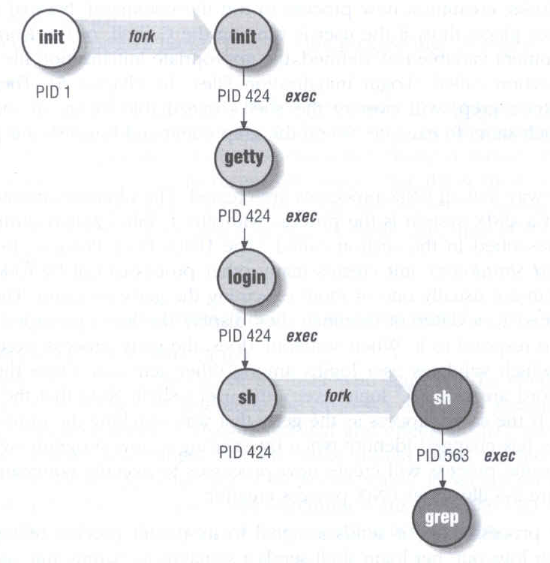
Program to Process
Program is dead
  Just lie on disk
  “grep” is a program
    /usr/bin/grep
    $ file /usr/bin/grep
      ELF 32-bit LSB executable
      Executable and Linkable Format
When you execute it
  It becomes a process
Process is alive
  It resides in memory

Slide 3
Components of a Process
An address space in memory
  Code and data of this process
A set of data structures within the kernel
  Used to monitor, schedule, trace, …., this process
    Owner, Group (Credentials)
    Current status
    VM space
    Execution priority (scheduling info)
    Information of used resource
    Resource limits
    Syscall vector
    Signal actions

Slide 4
Attributes of the Process
PID, PPID
  Process ID and parent process ID
UID, EUID
  User ID and Effective user ID
GID, EGID
  Group ID and Effective group ID
Niceness
  The suggested priority of this process

Slide 5
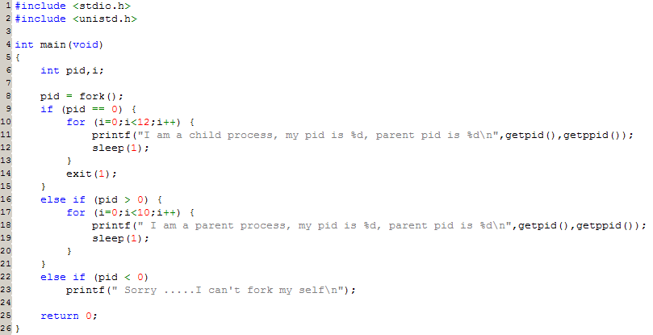
Attributes of the process –
PID and PPID
PID – process id
  Unique number assigned for each process in increasing order when they are created
PPID – parent PID
  The PID of the parent from which it was cloned
  UNIX uses fork-and-exec model to create new process

Slide 6
Process Lifecycle
fork
  child has the same program context – fork(2)
exec
  child use exec to change the program context – execve(2)
exit
  child use _exit to tell kernel that it is ready to die and this death should be acknowledged by the child’s parent – _exit(2)
wait
  parent use wait to wait for child’s death
  If parent died before child, this orphan process will have init as it’s new parent – wait(2)

Slide 7
Attributes of the process –
UID、GID、EUID and EGID
UID, GID, EUID, EGID
  The effective uid and gid can be used to enable or restrict the additional permissions
  Effective uid will be set to
    Real uid if setuid bit is off
    The file owner’s uid if setuid bit is on
Ex:
/etc/master.passwd is “root read-write only” and
/usr/bin/passwd is a “setuid root” program
sabsd [/etc] -chwong- ls -al | grep passwd
-rw------- 1 root wheel 2946 Sep 24 00:26 master.passwd
-rw-r--r-- 1 root wheel 2706 Sep 24 00:26 passwd
sabsd [/usr/bin] -chwong- ls -al /usr/bin/passwd
-r-sr-xr-x 2 root wheel 5860 Sep 17 15:19 passwd

Slide 8
Signal
A way of telling a process something has happened
Signals can be sent
  among processes as a means of communication
  by the terminal driver to kill, interrupt, or suspend process
    <Ctrl-C>、<Ctrl-Z>
    bg, fg
  by the administrator to achieve various results
    With kill
  by the kernel when a process violate the rules
    divide by zero
    Illegal memory access

Slide 9

Signal –
Actions when receiving signal
Depend on whether there is a designated handler routine for that signal
  If yes, the handler is called
  If no, the kernel takes some default action
“Catching” the signal
  Specify a handler routine for a signal within a program
Two ways to prevent signals from arriving
  Ignored
    Just discard it and there is no effect to process
  Blocked
    Queue for delivery until unblocked
    The handler for a newly unblocked signal is called only once

Slide 10
Signal –
FreeBSD signals
signal(3) or see /usr/include/sys/signal.h
FreeBSD
# | Name | Description | Default | Catch | Block | Dump core
1 | SIGHUP | Hangup | Terminate
2 | SIGINT | Interrupt (^C) | Terminate
3 | SIGQUIT | Quit | Terminate
9 | SIGKILL | Kill | Terminate
10 | SIGBUS | Bus error | Terminate
11 | SIGSEGV | Segmentation fault | Terminate
15 | SIGTERM | Soft. termination | Terminate
17 | SIGSTOP | Stop | Stop
18 | SIGTSTP | Stop from tty (^Z) | Stop
19 | SIGCONT | Continue after stop | Ignore
Notes:
Quit, kill, segv 是同一組

Slide 11
Signal –
Send signals: kill
kill(1) – terminate or signal a process
% kill [-signal] pid
  Ex:
    First, find out the pid you want to kill
      (ps, top, sockstat, lsof…)
    $ kill -l (list all available signals)
    $ kill 49222
    $ kill -TERM 49222
    $ kill -15 49222
  killall(1)
    kill processes by name
    $ killall tcsh
    $ killall -u chwong

Slide 12
Niceness
How kindly of you when contending CPU time
  High nice value ➔ low priority
  Related to CPU time quantum
Inherent Property
  A newly created process inherits the nice value of its parent
    Prevent processes with low priority from bearing high-priority children
Root has complete freedom in setting nice value
  Use “nice” to start a high-priority shell to beat berserk process
Notes:
@ be nice
@ low priority parent has high priority children

Slide 13
Niceness – nice and renice
nice format
  OS nice : $ /usr/bin/nice [range] utility [argument]
  csh nice(built-in) : $ nice [range] utility [argument]
    $ nice +10 ps -l
renice format
  % renice [prio | -n incr] [-p pid] [-g gid] [-u user]
    % renice 15 -u chwong
System | Prio. Range | OS nice | csh nice | renice
FreeBSD | -20 ~ 20 | -incr | -n incr | +prio | -prio | prio | -n incr
Red Hat | -20 ~ 20 | -incr | -n incr | +prio | -prio | prio
Solaris | 0 ~ 39 | -incr | -n incr | +incr | -incr | prio | -n incr
SunOS | -20 ~ 19 | -incr | +prio | -prio | prio

Slide 14
cpuset command
A system may have more than one CPU core
How many CPU resource a process can use
cpuset(1)

Slide 15
cpuset command
To see how many CPUs on your machine
  cpuset -g
Run commands with less CPUs
  cpuset -l cpus cmd
  cpuset -l 8-15 ./hw1.out
Change number of CPUs for current processes
  cpuset -l cpus -p pid
  cpuset -l 8-15 -p 5566
Combine with nice
  cpuset -l 8-15 /usr/bin/nice -n 20 cmd

Slide 16
Process States
man “ps” and see “state” keyword
State | Meaning
I | Idle (20+ second)
R | Runnable
S | Sleeping (~20 second)
T | Stopped
Z | Zombie
D | in Disk

Slide 17
ps command (BSD、Linux)
ps
ps aux
ps auxww
sabsd [/home/chwong] -chwong- ps
PID TT STAT TIME COMMAND
52363 p0 Ss 0:00.01 -tcsh (tcsh)
52369 p0 R+ 0:00.00 ps
sabsd [/home/chwong] -chwong- ps aux
USER PID %CPU %MEM VSZ RSS TT STAT STARTED TIME COMMAND
chwong 52362 0.0 0.4 6536 3852 ?? S 5:02PM 0:00.01 sshd: chwong@ttyp0 (sshd)
root 52380 0.0 0.3 3756 3224 ?? Ss 5:08PM 0:00.00 sendmail: accepting connections (s
smmsp 52384 0.0 0.3 3644 2968 ?? Ss 5:08PM 0:00.00 sendmail: Queue runner@00:30:00 fo
sabsd [/home/chwong] -chwong- ps auxww
USER PID %CPU %MEM VSZ RSS TT STAT STARTED TIME COMMAND
chwong 52362 0.0 0.4 6536 3864 ?? S 5:02PM 0:00.02 sshd: chwong@ttyp0 (sshd)
root 52380 0.0 0.3 3756 3224 ?? Ss 5:08PM 0:00.00 sendmail: accepting connections (sendmail)
smmsp 52384 0.0 0.3 3644 2968 ?? Ss 5:08PM 0:00.00 sendmail: Queue runner@00:30:00 for /var/spool/clientmqueue (sendmail)
Notes:
a：all，所有程式
u：某一種顯示模式，其他還有：J
x：background，顯示包含背景執行的
w：wide：加寬顯示寬度，避免被切字，最多兩個w

Slide 18
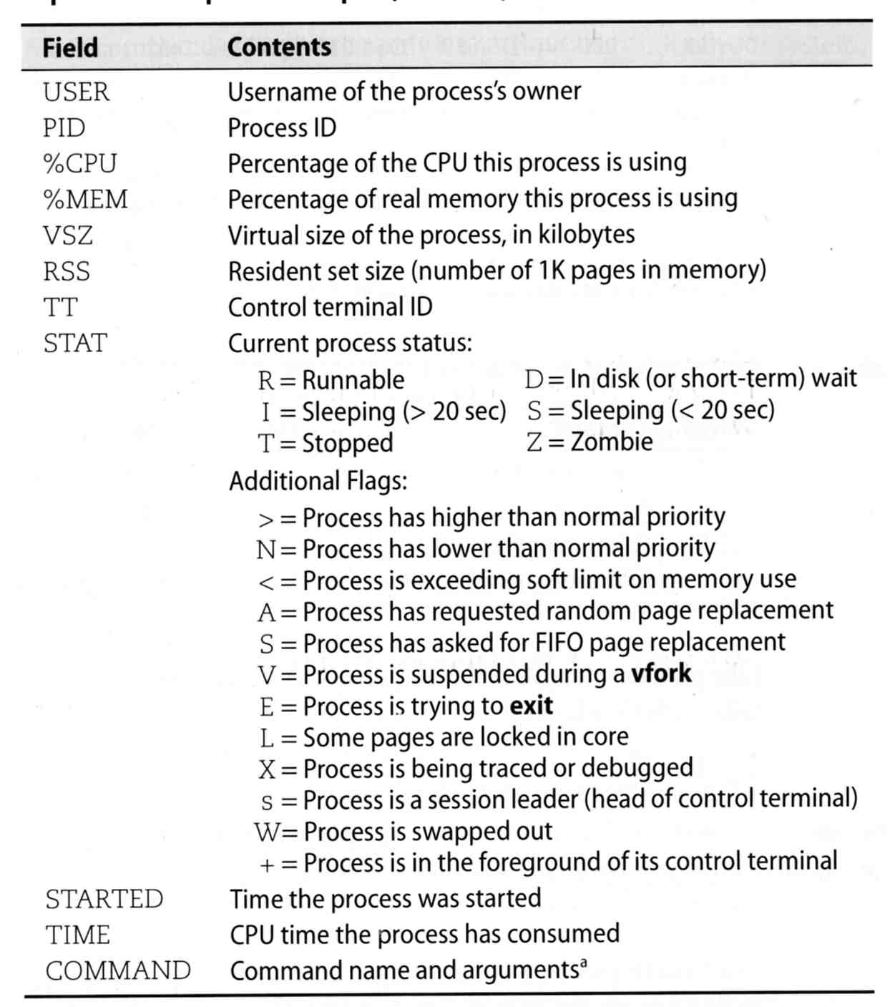
ps command –
Explanation of ps –aux (BSD、Linux)

Slide 19
ps command (BSD、Linux)
ps –j
ps –o
ps -L
Use these options with shell scripts
sabsd [/home/chwong] -chwong- ps -j
USER PID PPID PGID SID JOBC STAT TT TIME COMMAND
chwong 52363 52362 52363 52363 0 Ss p0 0:00.03 -tcsh (tcsh)
chwong 52458 52363 52458 52363 1 R+ p0 0:00.00 ps -j
sabsd [/home/chwong] -chwong- ps -o uid,pid,ppid,%cpu,%mem,command
UID PID PPID %CPU %MEM COMMAND
1001 52363 52362 0.0 0.3 -tcsh (tcsh)
1001 52462 52363 0.0 0.1 ps -o uid,pid,ppid,%cpu,%mem,command
sabsd [/home/chwong] -chwong- ps -L
%cpu %mem acflag acflg args blocked caught comm command cpu cputime emuletime f flags ignored inblk inblock jid jobc ktrace label lim lockname login logname lstart lwp majflt minflt msgrcv msgsnd mwchan ni nice nivcsw nlwp nsignals nsigs nswap nvcsw nwchan oublk oublock paddr pagein pcpu pending pgid pid pmem ppid pri re rgid rgroup rss rtprio ruid ruser sid sig sigcatch sigignore sigmask sl start stat state svgid svuid tdev time tpgid tsid tsiz tt tty ucomm uid upr uprocp user usrpri vsize vsz wchan xstat

Slide 20
top command
last pid: 52477; load averages: 0.01, 0.05, 0.02 up 0+19:38:37 17:23:38
29 processes: 1 running, 28 sleeping
CPU states: 0.4% user, 0.0% nice, 0.0% system, 0.0% interrupt, 99.6% idle
Mem: 19M Active, 308M Inact, 113M Wired, 88K Cache, 111M Buf, 556M Free
Swap: 1024M Total, 1024M Free
PID USERNAME THR PRI NICE SIZE RES STATE TIME WCPU COMMAND
697 root 1 76 0 3784K 2728K select 0:02 0.00% sshd
565 root 1 76 0 1468K 1068K select 0:00 0.00% syslogd
704 root 1 8 0 1484K 1168K nanslp 0:00 0.00% cron
Various usage
  top -q run top and renice it to -20
  top -u don’t map uid to username
  top -Uusername show process owned by user
Interactive command
  o change display order (cpu, res, size, time)
  u show only processes owned by user (“+” means all)
  m show IO information
  ? Listing available options

Slide 21
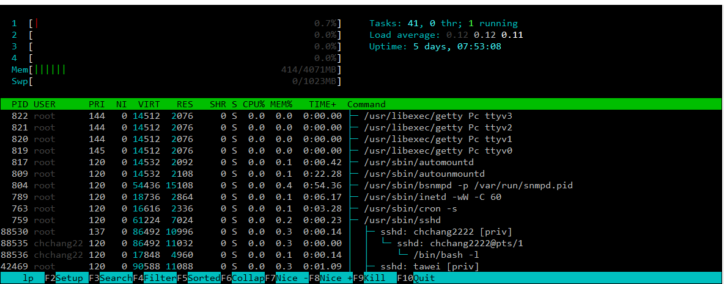
htop command
A better top
  Install it from sysutils/htop

Slide 22
Runaway process
Processes that use up excessive system resource or just go berserk
  kill -TERM for unknown process
  renice it to a higher nice value for reasonable process

Slide 23
Appendix
Fork Bomb

Slide 24

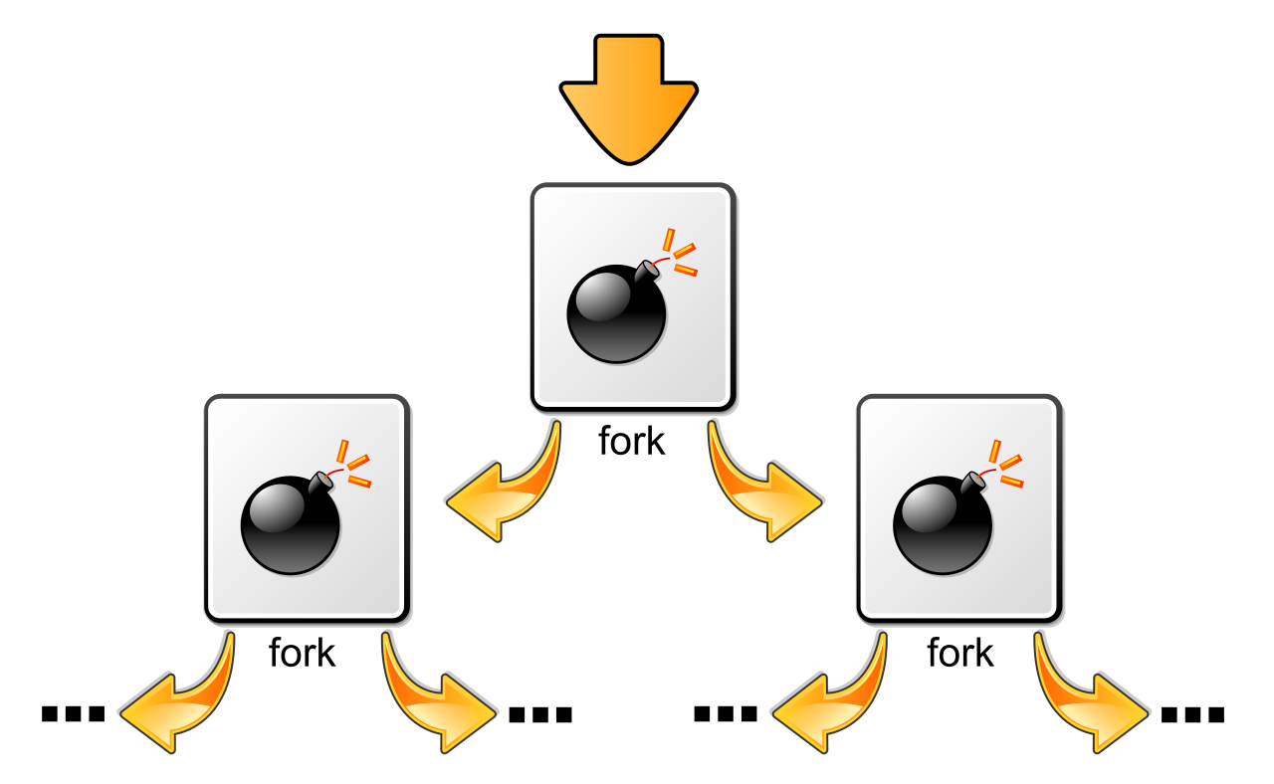
Fork Bomb
A process forking out of control
Cited from wiki

Slide 25
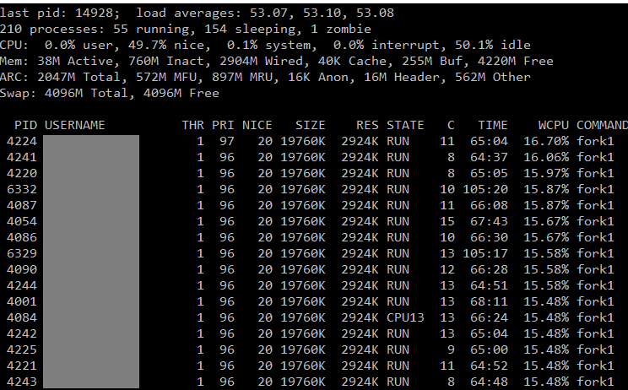
Fork Bomb
A process forking out of control

Slide 26
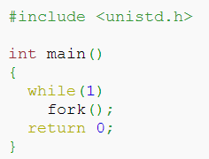
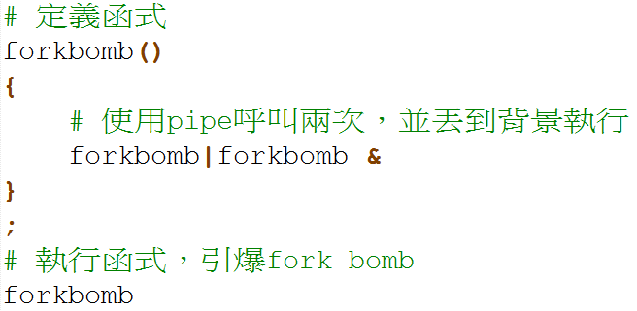

Fork Bomb –
How to create a fork bomb
  C/C++
  Perl
  Bash (Shell script)
  :(){ :|:& };:
  Windows
DON’T DO THAT!!!!

Slide 27
Fork Bomb
How to deal with fork bomb
  Just kill all of them
  $ killall -KILL bombName
When you have no more resource to fork you shell
  $ exec killall -KILL bombName
  That shell will become ‘killall’, and never goes back
‘killall’ isn’t an atomic command
  More bombs may be created when killing them
  Run multiple ‘killall’

Slide 28

Fork Bomb
Prevent fork bomb
  Limit the maximum number of processes for a specific user
/etc/login.conf

