Slide 1
Homework 4 Mail System
hwlin1414 & zjlin

Slide 2
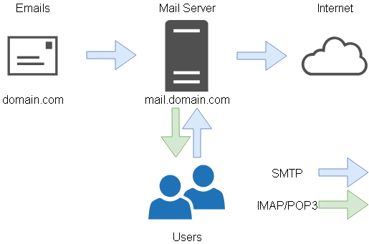
Architecture

Slide 3
Overview
Secure your SMTP server
SMTP over TLS
SMTPs
SASL
Retrieve your email
IMAP、IMAPs
POP3、POP3s
Anti-Spam
Anti-Spoofing
SPF
DKIM
DMARC

Slide 4
Preparation
Before start, you need
Public IP Address
DNS Server
MX Record
…
Mail Server

Slide 5
SMTP Server
Encrypted Connection
SMTP over TLS (25)
STARTTLS
SMTPs (465)
TLS connection
Authentication
SASL
Run SASL only based on SMTP over TLS, or SMTPs
No Open Relay

Slide 6
Retrieve your email
IMAP (143)、IMAPs (993)
Testing: https://wiki.dovecot.org/TestInstallation
nc {your_server} 143
Enable SSL support
openssl s_client -connect "{your_server:993}"
POP3 (110)、POP3s (995)
Testing: https://wiki.dovecot.org/TestPop3Installation
nc {your_server} 110
Enable SSL support
openssl s_client -connect "{your_server:995}"

Slide 7
SMTP Server
An account for sending / receiving mail
hw4user@{YourDomain} (password determined by your self)
hw4user forward mail to hw4user@naphw4.nctucs.net
hw4user left a mail copy on mail system
other user if you need…
virtual alias
for any mail to .*demo.*@{YourDomain} alias to hw4user
for any mail to {USER}+.*@{YourDomain} alias to {USER}
e.g., hw4user+abc@{YourDomain} send to hw4user
Sender Rewriting Schema
Do rewriting when mail from other domain forward to outside

Slide 8
Anti-Spam
Sender address verification
Real-time Blackhole List (RBL)
https://www.spamhaus.org
Greylisting
For incoming mail from new mail server
Greylist for 1 minute

Slide 9
Anti-Spoofing: SPF
SPF
DNS TXT and DNS SPF record for SPF that
Allow your server to send mail as your domain’s user
Deny other domains, and drop these invalid mail
Do SPF policy check to the incoming email
{your_mail_domain} [TTL] IN TXT {SPF_rules}
{your_mail_domain} [TTL] IN SPF {SPF_rules}

Slide 10
Anti-Spoofing: DKIM
DKIM
Signing your outgoing email with your private key
A DNS TXT record for DKIM
Do DKIM policy check to the incoming email
{selector}._domainkey.{your_mail_domain} IN TXT "<DKIM Information>"

Slide 11
Anti-Spoofing: DMARC
DMARC
A DNS TXT record for DMARC
When others receive mail that does not pass DMARC policy check
Drop all the invalid email
Do DMARC policy check to the incoming email
_dmarc.{your_mail_domain} IN TXT "DMARC_rules"

Slide 12
Bonus
Webmail (5%)
Roundcube, RainLoop or other Webmail Systems you like…
HTTPS

Slide 13
Hand-in
Demo
06/06 (Wed.) 18:30~21:30
Help
Register a Domain Name
nctucs.net http://www.nctucs.net (using CS account)
Email to ta@nasa.cs.nctu.edu.tw
Go to CSCC to ask professional 3F at office hour!
There will be no help on demo day.

