Slide 1
Homework 02
DNS
hwlin1414

Slide 2
Architecture
Student A:
Master zone:
exampleA.com
Delegation (from B):
sub.exampleB.net
Slave zone:
sub.exampleA.com
Student B:
Master zone:
exampleB.net
Delegation (from A):
sub.exampleA.com
Slave zone:
sub.exampleB.net
Slave
Delegation

Slide 3
Requirement
Setup a DNS server with BIND
Serve your own domain A (exampleA.com)
Serve domain delegated from your teammate B’s (sub.exampleB.net)
Serve your teammate B’s domain delegated from you as a slave
(sub.exampleA.com)
Be able to query from internet (e.g. workstations、140.113.235.1)
Delegation (20%)
Delegate a sub-domain to your teammate B
sub.{your domain} to your teammate B
E.g. sub.exampleA.com

Slide 4
Requirement (Cont.)
Common (in all view) (10%)
Add demo.sub.{teammate’s domain} CNAME of ws.sub.{teammate’s domain}
Add sub.{teammate’s domain} SSHFP record of your server’s ssh key fingerprint
View (sub.{teammate’s domain}) (20%)
Create ws.sub.{teammate’s domain} A record
For queries from bsd1-bsd4.cs.nctu.edu.tw
answer 140.113.235.131
For queries from linux1-linux4.cs.nctu.edu.tw
answer 140.113.235.151
Otherwise, answer not found

Slide 5
Requirement (Cont.)
Logging (10%)
Record all records to /var/log/named.log
Do log rotate
You might be asked to explain the meaning of each log entry
Security (15%)
Only allow AXFR request on “otherwise” view from
your teammate’s IP
bsd1.cs.nctu.edu.tw
linux1.cs.nctu.edu.tw
No recursion allowed.

Slide 6
Requirement (Cont.)
DNSSEC (15%)
Enable on sub.{teammate’s domain}
check the domain on http://dnsviz.net
Think about view and DNSSEC.
Remember to setup slave zone of sub.{your domain} (10%)
(Managed by your teammate)
Updates should be synchronized
bsd1.cs.nctu.edu.tw / linux1.cs.nctu.edu.tw no need to inform.
You might be asked to add/update a record to proof synchronization

Slide 7
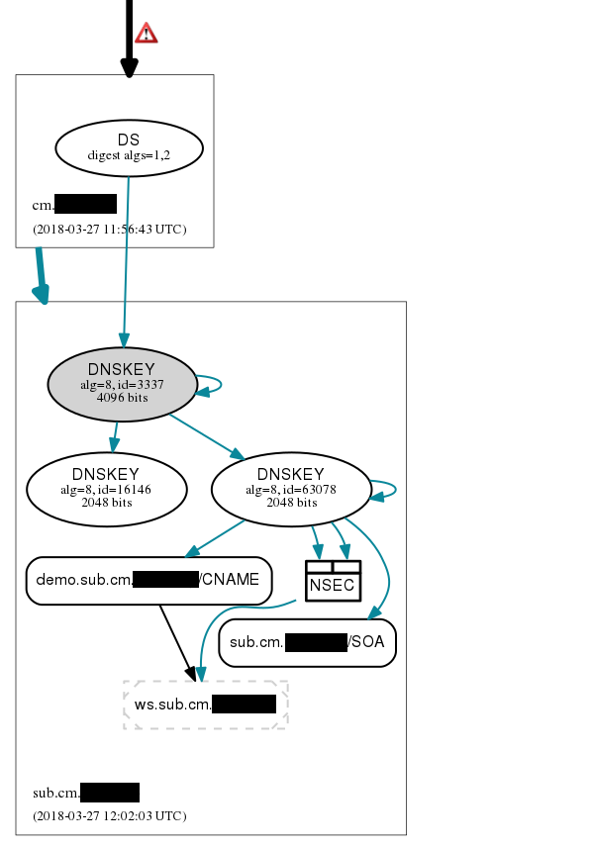
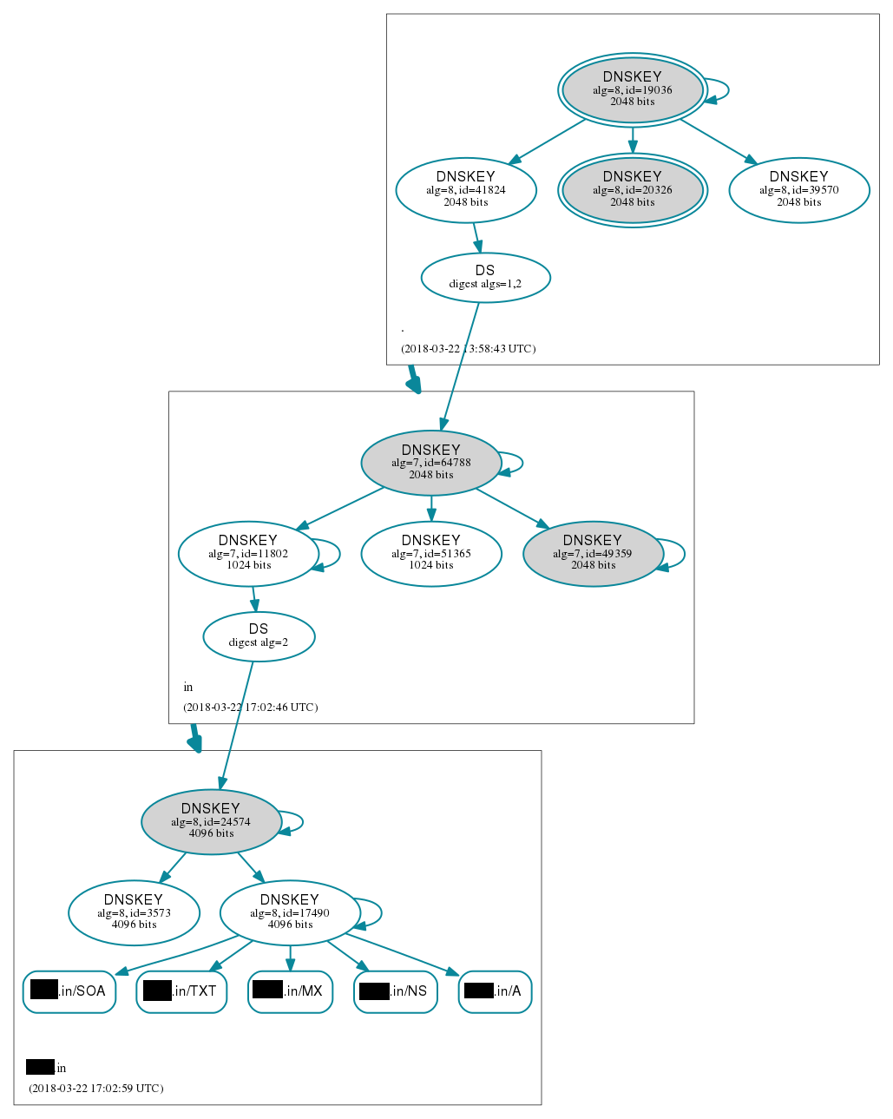
Tools: Dnsviz.net

Slide 8
Hand-in
Demo
04/25 (Wed.) 16:00~18:00 19:00~21:00
Help
domain apply
nctucs.net http://www.nctucs.net/ (using CS account)
Email ta@nasa.cs.nctu.edu.tw
Goto CSCC to ask professional 3F at office hour!
There will be no help on 04/25 (Wed.) office hour (demo).

