Slide 1
Network Administration Practice Homework 1: Python Scripts
weicc & blzhuang

Slide 2
Requirements
1-1 Web crawler (45%+5%)
Entry point: `nahw1-1_{student_ID}.py`
Login options
NCTU Portal (5% Bonus)
Course Registration System
1-2 Auth Log parser – Count ssh login failed (45%)
Entry point: `nahw1-2_{student_ID}.py`
Readme file (Readme.md) (10%)
List used Package / library for each part
Login by NCTU Portal or Course Selection System
Due data: 2018/03/22 23:59
Upload `nahw1-{$student_ID}-{$YYYYMMDD-HHMM}.tar` on New E3 (https://e3new.nctu.edu.tw)

Slide 3
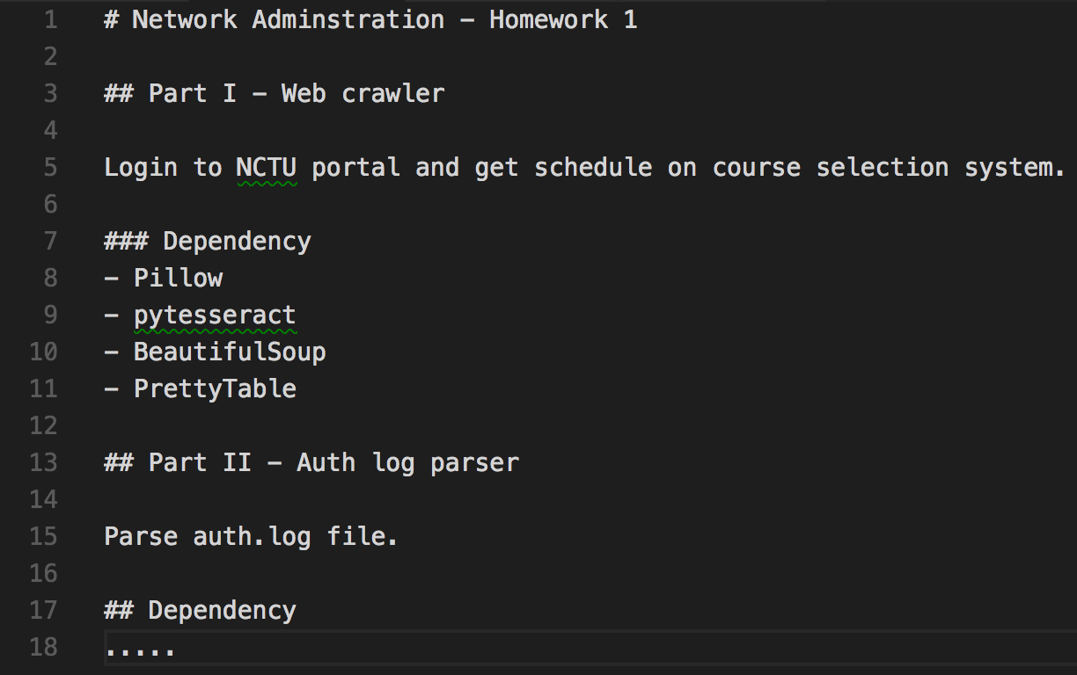
Readme File: Sample

Slide 4
1-1: Web Crawler – Requirements (1/2)
Input format
`python script_name username`
Argument parser 5%
-h show usage
Captcha Recognize 20%
Login by course selection system
Login by NCTU Portal
Parse HTML & Print Table (one of following)
Can parse schedule as list from HTML 10%
Can parse schedule as list from HTML and print as table 20%
Bonus 5% - Login by NCTU Portal
Solve all kinds of captcha
Relay login session from NCTU Portal to course selection system

Slide 5
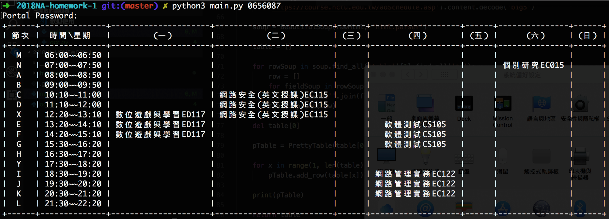
1-1: Web Crawler – Requirements (2/2)
Only Python script allowed
Call shell script is not allowed
Call NodeJS script is not allowed
`subprocess` not allowed
`os.system` not allowed
Python 3 only

Slide 6
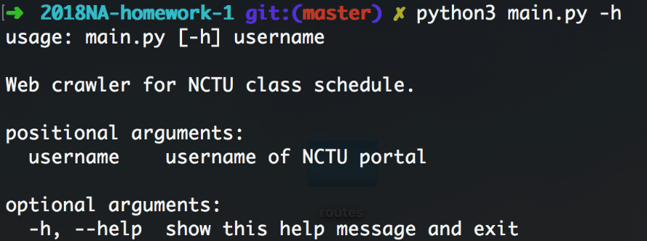
1-1: Web Crawler – Hint: Argument Parser Sample

Slide 7
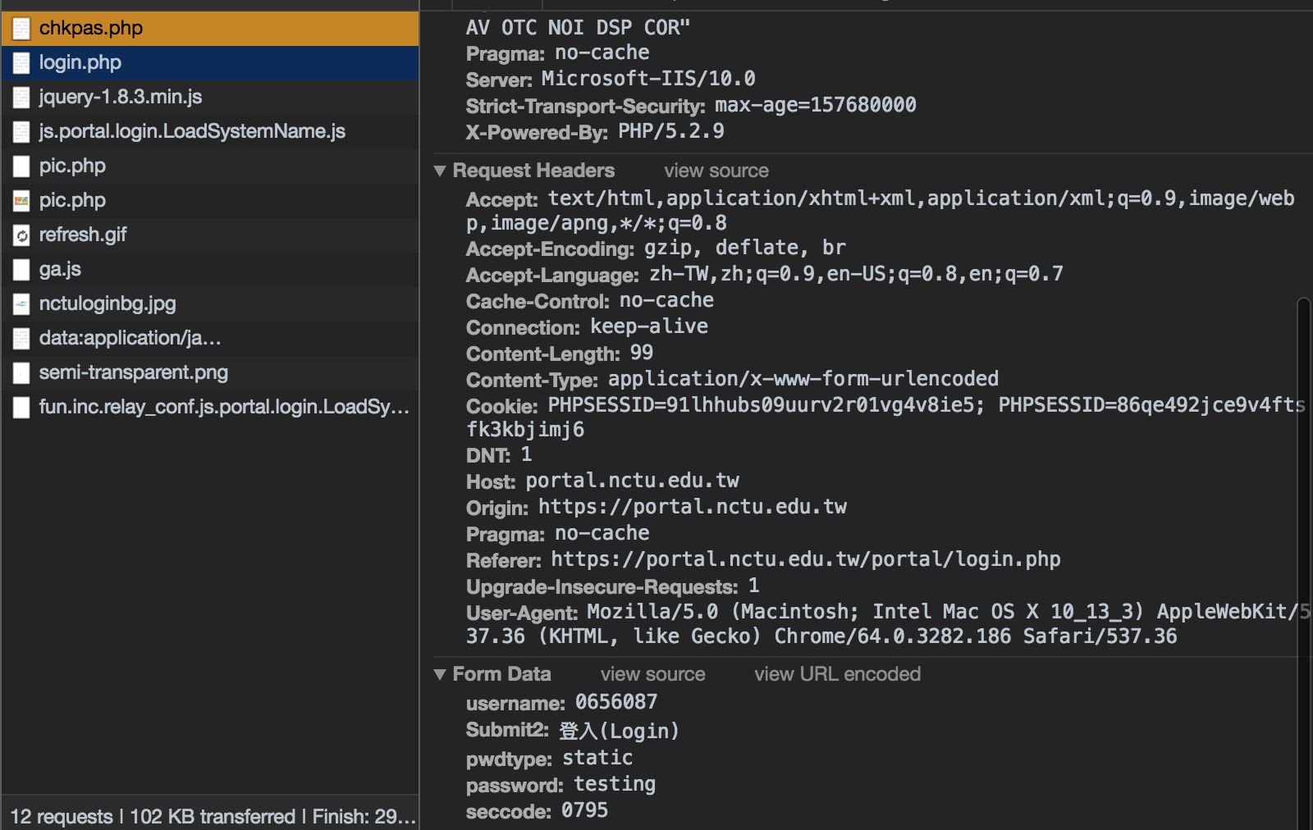
1-1: Web Crawler – Hint
善用Browser Development tool → Network

Slide 8
1-1: Web Crawler – Hint: Captcha Recognize Login Option (a): NCTU Portal
Preprocess
Convert image to grayscale
Adjust brightness and contrast
Packages may be used
Pillow
Recognize
Pytesseract (Python interface for Tesseract OCR By google)

Slide 9
1-1: Web Crawler – Hint: Captcha Recognize Login Option (b): Course Registration System
Preprocess
Convert image to grayscale
Remove salt and pepper noise
Packages may be used
Pillow
OpenCV
Recognize
Pytesseract (Python interface for Tesseract OCR By google)

Slide 10
1-2: Auth log parser – Requirements (1/6)
With following option
-h show usage 5%
-u sort by user 5%
-after filter log after special date 10%
-before filter log before special date 10%
-n show only the user of most #-th times 5%
-t show only the user of attacking equal or more than # times 5%
-r sort in reverse order 5%
Only Python script allowed
Call shell script is not allowed
Call NodeJS script is not allowed
`subprocess` not allowed
`os.system` not allowed
Python 3 only

Slide 11
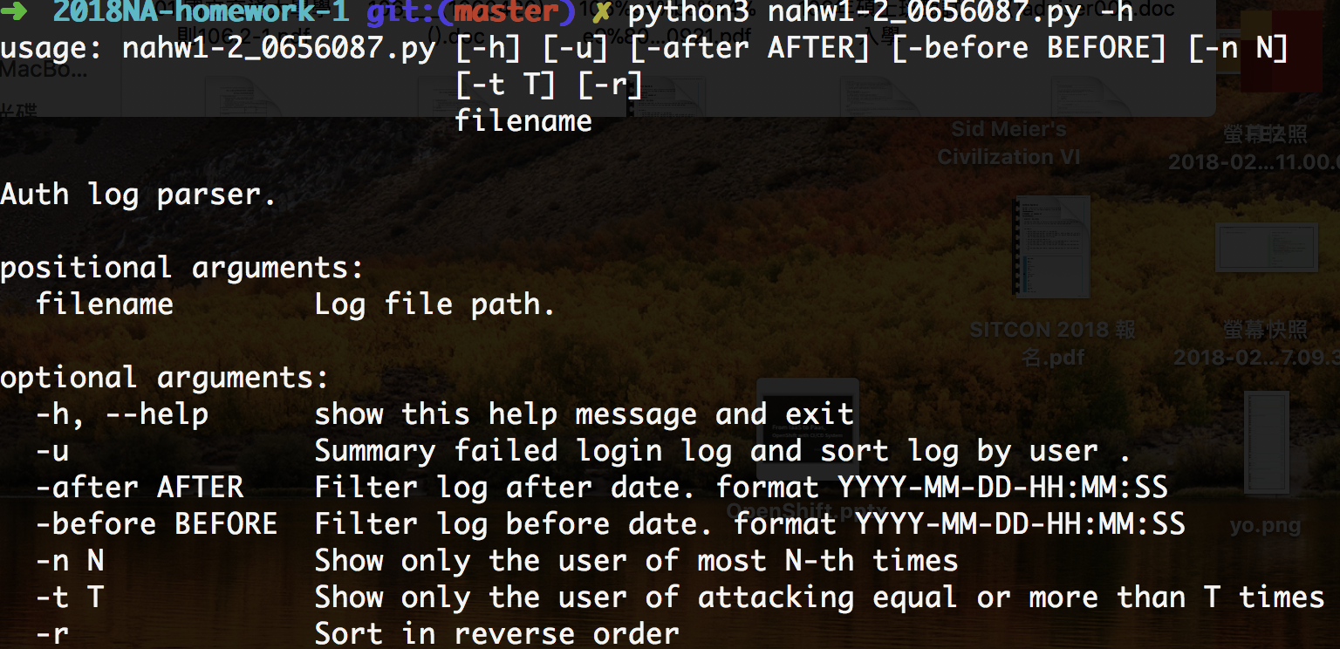
1-2: Auth log parser – Requirements (2/6) show help

Slide 12
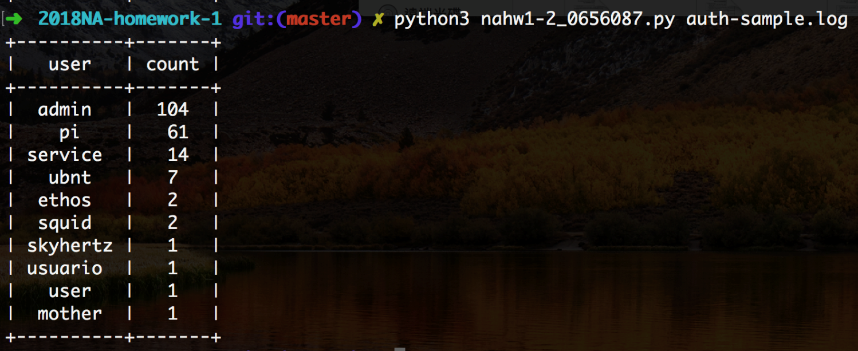
1-2: Auth log parser – Requirements (3/6) default output

Slide 13
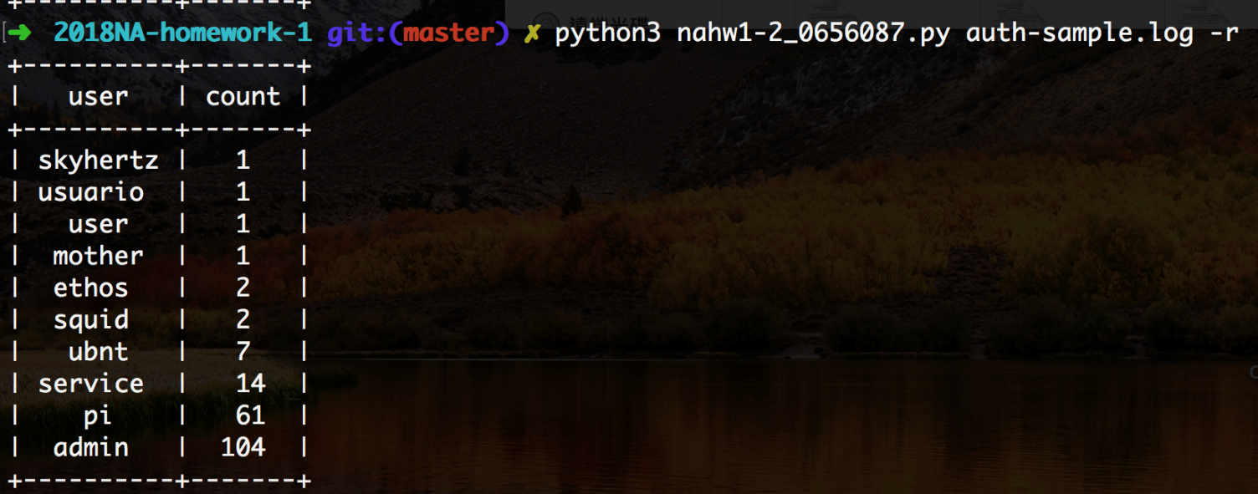
1-2: Auth log parser – Requirements (4/6) with -r output

Slide 14
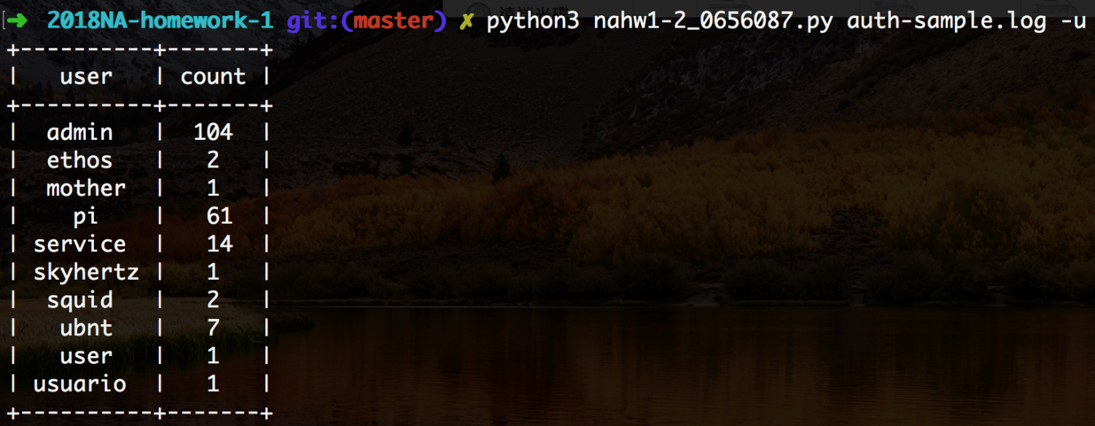
1-2: Auth log parser – Requirements (5/6) with -u output

Slide 15
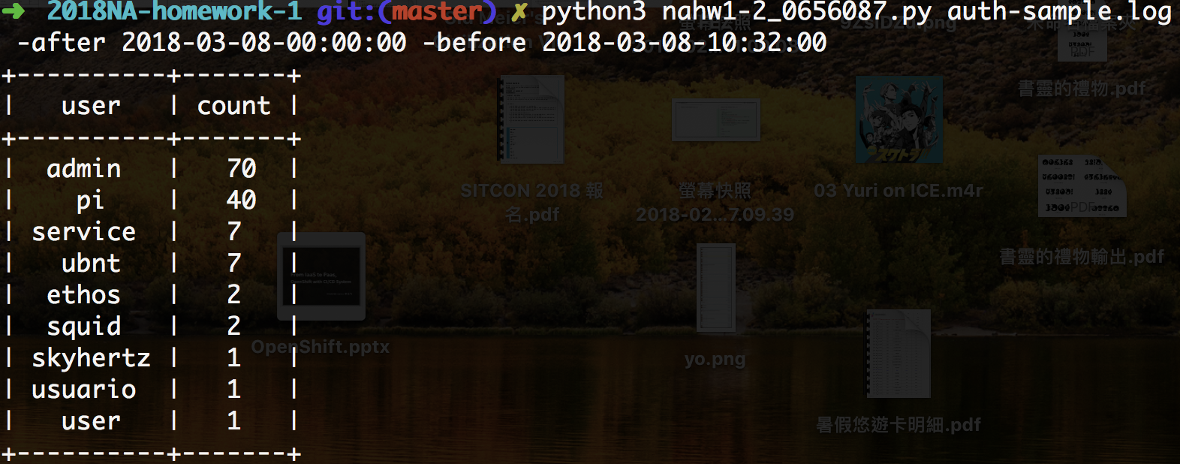
1-2: Auth log parser – Requirements (6/6) with -after -before output

Slide 16
1-2: Auth log parser – Hint: log sample
Log format (a)
Mar 8 00:48:38 <auth.info> bsd4 sshd[85194]: Invalid user Chiangmj840306 from 36.230.109.223
Log format (b) without <{facility}.{severity level}>
Mar 8 09:50:21 linux7 sshd[15899]: Invalid user ubnt from 188.187.121.68 port 47664
Set log message year as 2018, if year is not defined on log message.
No matter how many times the password is tried, each connection is only counted once.
Hint: just counting `Invalid user…`
There is different that include facility and severity level of log message or not between them.
Your script must can parse both (a) and (b).
You can get raw sample on https://goo.gl/siimub

Slide 17
Help
Email to ta@nasa.cs.nctu.edu.tw
New E3 https://e3new.nctu.edu.tw

