Slide 1
LDAP (Lightweight Directory Access Protocol)
zjlin

Slide 2
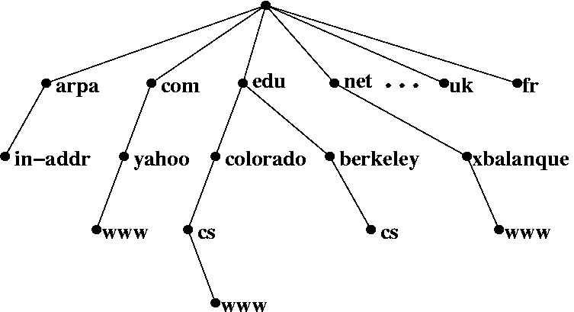
What is Directory Service?
What is Directory Service (名錄服務)
• A directory service is highly optimized for reads.
• A directory service implements a distributed model for storing information.
• A directory service has advanced search capabilities.
• A directory service has loosely consistent replication among
directory servers.
Domain Name Service
Notes:
階層式，可讀性高
分散式儲存
A directory service can extend the type of information stores. ???
search 功能強大
loosely consistent replication : 根據 traffic 決定甚麼時候同步

Slide 3
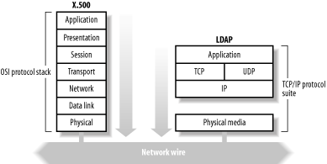
What is LDAP
Lightweight Directory Access Protocol (LDAP)
• LDAP v3: RFC 3377
• RFC 2251-2256, 2829, 2830, 3377
Why LDAP is lightweight
• subset of X.500
X.500 base on OSI stack
LDAP base on TCP/IP
LDAP omits many X.500
operations that are rarely used
Providing a smaller and
simpler set of operations

Slide 4
LDAP Directory Information Tree (DIT)
dc=net
dc=nctucs
dc=nap
ou=group
ou=people
cn=napta
cn=sapta
cn=zjlin
cn=tutu
cn=zjlin,ou=people,dc=sap,dc=nctucs,dc=net
o=“sap, nctucs, net”, c=Taiwan
o=sap.nctucs.net
Notes:
dc,dc,dc 格式 為什麼

Slide 5
LDAP Directory Information Tree (DIT)
dn: ou=People,dc=nap,dc=nctucs,dc=net
dc=net
ou: People
objectClass: top
objectClass: organizationalUnit
objectClass: domainRelatedObject
associatedDomain: cs.nctu.edu.tw
dc=nctucs
dc=nap
ou=group
ou=people
objectClass: person
cn: zjlin
sn: lin
telephoneNumber: 689-5566
cn=zjlin
DN(distinguished name):
cn=zjlin,ou=people,dc=nap,dc=nctucs,dc=net
RDN: relative distinguished name

Slide 6
LDAPv3 overview – LDIF
LDAP Interchange Format (LDIF)
Defined in RFC 2849
standard text file format for storing LDAP configuration information and directory contents
An LDIF file is
A collection of entries separated from each other by blank lines
A mapping of attribute names to values
A collection of directives that instruct the parser how to process the information
The data in the LDIF file must obey the schema rules of your LDAP directory
Notes:
3. modify 時告訴 ldaptool 怎麼做 e.g. add, delete…

Slide 7
LDAPv3 overview – LDIF
Sample LDIF
dc=net
# sample entry
dn: cn=zjlin,ou=people,dc=nap,dc=nctucs,dc=net
objectClass: person
cn: zjlin
telephoneNumber: 689-5566
dc=nctucs
dc=nap
dn: distinguished name
rdn: relative dn
ou: organizational unit
dc: domain component
cn: comman name
ou=people
ou=group
cn=zjlin
DN(distinguished name):
cn=zjlin,ou=people,dc=nap,dc=nctucs,dc=net
RDN: relative distinguished name

Slide 8
LDAPv3 overview – LDIF
Sample LDIF - Modify one dn
# modify user info
dn: cn=zjlin,ou=people,dc=nap,dc=nctucs,dc=net
changetype: modify
add: description
description : NAP TA
-
replace: telephoneNumber
telephoneNumber : 0987878787
objectClass: person
cn: zjlin
sn: lin
telephoneNumber : 0900000000
objectClass: person
cn: zjlin
sn: lin
description : NAP TA
telephoneNumber : 0987878787

Slide 9
LDAPv3 overview – LDIF
Sample LDIF - Modify more than one dn
# modify user info
dn: cn=zjlin,ou=people,dc=nap,dc=nctucs,dc=net
changetype: modify
add: description
description : NAP TA
dn: cn=tutu,ou=people,dc=nap,dc=nctucs,dc=net
changetype: modify
add: description
description : NAP TA

Slide 10
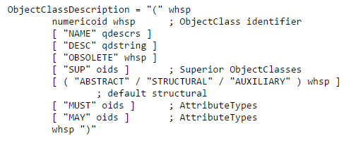
LDAPv3 overview - objectClass
/usr/local/etc/openldap/schema/core.schema
http://www.openldap.org/doc/admin24/schema.html
Notes:
SUP top SRUCTURAL

Slide 11
LDAPv3 overview - objectClass
http://www.openldap.org/doc/admin24/schema.html

Slide 12
LDAPv3 overview - Attribute
Matching rules
Type
Server should support values of this length
http://www.openldap.org/doc/admin24/schema.html
Notes:
Matching rules

Slide 13
Comparison with relational databases
It is tempting to think that having a RDBMS backend to the directory solves all problems. However, it is wrong.
This is because the data models are very different. Representing directory data with a relational database is going to require splitting data into multiple tables.
Notes:
Attr 擴展性 LDAP 較佳

Slide 14
OpenLDAP
Installation
pkg install openldap-server
cd /usr/ports/net/openldap-server24 ; make install clean
slap.conf
• Blank lines and lines beginning with a pound sign (#) are ignored
• Parameters and associated values are separated by whitespace characters
• A line with a blank space in the first column is considered to be a continuation of the previous one.

Slide 15
slap.conf
include /usr/local/etc/openldap/schema/core.schema
pidfile /var/run/openldap/slapd.pid
argsfile /var/run/openldap/slapd.args
loglevel 256
modulepath /usr/local/libexec/openldap
moduleload back_mdb
moduleload back_ldap
# ACL rules here for global
database mdb
maxsize 1073741824
suffix "dc=nap,dc=nctucs,dc=net“
rootdn "cn=Manager,dc=nap,dc=nctucs,dc=net"
roopw <generated by slappasswd>
directory /var/db/openldap-data
# Indices to maintain
index objectClass eq
# ACL rules here for specify database
Notes:
index?

Slide 16
Directory ACL
access to dn.exact="cn=Manager,dc=nap,dc=nctucs,dc=net"
by peername.ip=“127.0.0.1" auth
by users none
by anonymous none
by * none
access to attrs=userPassword
by self write
by anonymous auth
by dn.base="cn=Manager,dc=nap,dc=nctucs,dc=net" write
by * none
access to attrs=englishname,birthdate
by self write
by users read
by anonymous read
Notes:
ACL 順序?

Slide 17
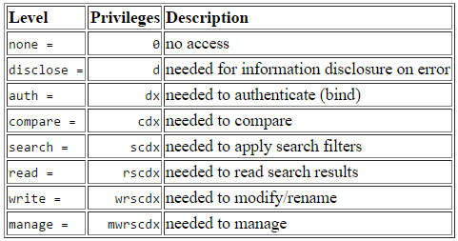
Directory ACL
http://www.openldap.org/doc/admin24/access-control.html
Notes:
代表意義

Slide 18
Overlay
Software components that provide hooks to functions analogous to those provided by backends, which can be stacked on top of the backend calls and as callbacks on top of backend responses to alter their behavior.
Frontend
handles network access and protocol processing
Backend
deals strictly with data storage
https://www.openldap.org/doc/admin24/overlays.html
https://en.wikipedia.org/wiki/OpenLDAP#Overlays
Frontend
Overlay
Backend
Notes:
vs module

Slide 19
Overlay - memberOf
dc=net
Membership
dc=nctucs
dc=nap
ou=people
ou=group
cn=zjlin
cn=gcs
objectClass: posixGroup
objectClass: top
objectClass: posixAccount
cn: zjlin
gidNumber: 1120
objectClass: posixGroup
objectClass: top
cn: gcs
displayName: gcs
description: Domain Unix group
gidNumber: 1120

Slide 20
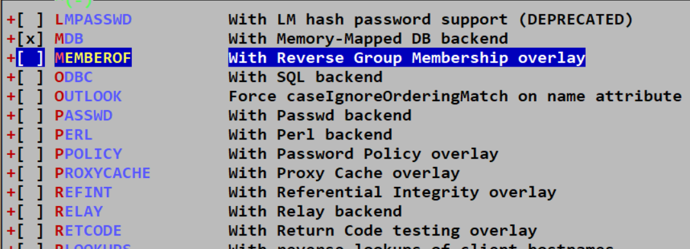
Overlay - memberOf
Installation
Ports
make config -> enable option
https://www.openldap.org/doc/admin24/overlays.html

Slide 21
Overlay - memberOf
slapd.conf
restart slapd
Schema
https://www.openldap.org/doc/admin24/overlays.html
dn: cn=testgroup,ou=MemberGroup,dc=nap,dc=nctucs,dc=net
objectclass: groupOfNames
cn: testgroup
member: cn=zjlin,ou=People,dc=nap,dc=nctucs,dc=net

Slide 22
OLC - on-line configuration
OpenLDAP version 2.3 -> new feature
OpenLDAP version 2.4 -> still optional
Uses a configuration DIT to control the operational configuration
Modifying entries in this DIT immediate changes to slapd's operational
https://www.openldap.org/doc/admin24/slapdconf2.html
http://www.zytrax.com/books/ldap/ch6/slapd-config.html
Notes:
曾經直接棄用舊設定

Slide 23
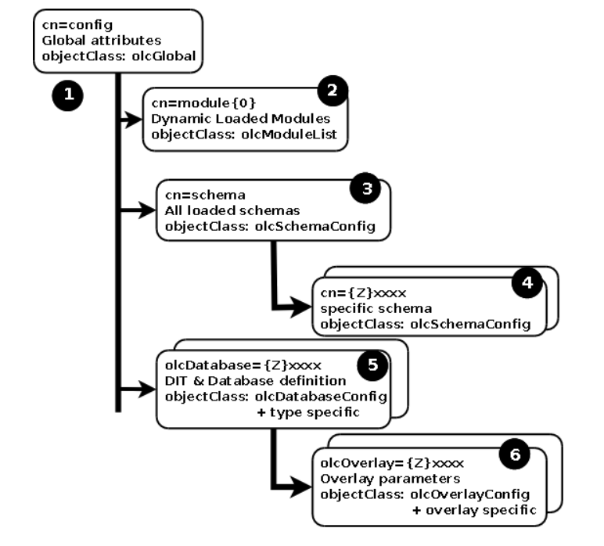
OLC - on-line configuration
Notes:
曾經直接棄用舊設定

Slide 24
OLC - on-line configuration
# {1}mdb, config
dn: olcDatabase={1}mdb,cn=config
objectClass: olcDatabaseConfig
objectClass: olcMdbConfig
olcDatabase: {1}mdb
olcDbDirectory: /var/db/openldap-data/cs
olcSuffix: dc=cs,dc=nctu,dc=edu,dc=tw
olcAddContentAcl: FALSE
olcLastMod: TRUE
olcMaxDerefDepth: 15
olcReadOnly: FALSE
olcRootDN: cn=Manager,dc=nap,dc=nctucs,dc=net
olcRootPW: password
Notes:
曾經直接棄用舊設定

Slide 25
Enable slapd
Edit /etc/rc.conf
slapd_enable=“YES”
slapd_flags for specific options
service slapd start
http://www.openldap.org/doc/admin24/runningslapd.html

Slide 26
Slapd tools
slapcat
• This tool reads records from a slapd database and writes them to a file or standard output
slapadd
• This tool reads LDIF entries from a file or standard input and writes the new records to a slapd database
slapindex
• This tool regenerates the indexes In a slapd database
slappasswd
• This tool generates a password hash suitable for use as an Lq in slapd.conf

Slide 27
LDAP tools
ldapsearch
• This tool issues LDAP search queries to directory servers
ldapadd, ldapmodify
• These tools send updates to directory servers
ldapcompare
• This tool asks a directory server to compare two values
ldapdelete
• This tool deletes entries from an LDAP directory

Slide 28
ldapsearch
Options
-b searchbase
-s {base|one|sub|children} #defult is sub
-D binddn
-x #Use simple authentication instead of SASL.
-W #password for simple authentication
-H ldapuri
ldapsearch [options] filter
default filter, (objectClass=*)
ldapsearch -H ldap://ldap.nap.nctucs.net
-D “cn=zjlin,dc=nap,dc=nctucs,dc=net”
-b “dc=nap,dc=nctucs,dc=net” -s one
man ldapsearch
dc=net
dc=nctucs
dc=nap
ou=group
ou=people
cn=napta
cn=sapta
cn=zjlin
cn=tutu

Slide 29
ldap.conf
ldapsearch -H ldap://ldap.nap.nctucs.net
-b “dc=nap,dc=nctucs,dc=net” cn=zjlin
Edit /usr/local/etc/openldap/ldap.conf
=> ldapsearch -x “cn=zjlin”
# See ldap.conf(5) for details
# This file should be world readable but not world writable.
BASE dc=nap,dc=nctucs,dc=net
URI ldaps://ldap.nap.nctucs.net

Slide 30
ldapsearch - searchbase vs filter
Seach by dn
Not work!
Use search base
It’s works!
Why?
You have get full dn, don’t need to search.
# ldapsearch dn=‘cn=zjlin,dc=nap,dc=nctucs,dc=net’
# ldapsearch -b ‘cn=zjlin,dc=nap,dc=nctucs,dc=net’ -s base

Slide 31
ldapsearch - searchbase vs filter
searchbase
dc=nap,dc=nctucs,dc=net
ou=People, dc=nap,dc=nctucs,dc=net
dc=net
dc=nctucs
dc=nap
ou=group
ou=people
cn=napta
cn=sapta
cn=zjlin
cn=tutu

Slide 32
ldapsearch - searchbase vs filter
filter - search filter string in searchbase
cn=napta
cn=napta -> can’t find
dc=net
dc=nctucs
dc=nap
ou=group
ou=people
cn=napta
cn=sapta
cn=zjlin
cn=tutu

Slide 33
LDAP authentication
pkg install nss-pam-ldapd
Edit /usr/local/etc/nslcd.conf
Edit /etc/nsswitch.conf
Edit /etc/pam.d/system

Slide 34
LDAP authentication
Edit /usr/local/etc/nslcd.conf
Just like ldap.conf
# The user and group nslcd should run as.
uid nslcd
gid nslcd
uri ldap://ldap.nap.nctucs.net
base dc=nap,dc=nctucs,dc=net

Slide 35
LDAP authentication
Edit /etc/nsswitch.conf
https://www.freebsd.org/doc/en/articles/ldap-auth/client.html
# nsswitch.conf(5) - name service switch configuration file
# $FreeBSD: releng/11.1/etc/nsswitch.conf
group: files ldap
passwd: files ldap

