Slide 1
DHCP & NAT

Slide 2
DHCP –
Dynamic Host Configuration Protocol

Slide 3
DHCP Motivation
BOOTP
  Support sending extra information beyond an IP address to a client to enable customized configuration
  Effectively solve one of the major problems that administrators have with manual configuration
Problems of BOOTP
  BOOTP normally uses a static method of determining what IP address to assign to a device
Dynamic Host Configuration Protocol (DHCP)
  DHCP is an extension of the BOOTP. The first word describe the most important new capability added to BOOTP
    Assign IP dynamically
    Move away from static, permanent IP address assignment
  Compatible with BOOTP

Slide 4
DHCP introduction
DHCP
  Dynamic address assignment
    A pool of IP address is used to dynamically allocate addresses
    Still support static mapping of addresses
  Enable a DHCP client to “lease” a variety of network parameters
    IP, netmask
    Default router, DNS servers
    A system can connect to a network and obtain the necessary information dynamically
Client-Server architecture
  DHCP client broadcasts request for configuration info.
    UDP port 68
  DHCP server reply on UDP port 67, including
    IP, netmask, DNS, router, IP lease time, etc.
RFC
  RFC 2131 – Dynamic Host Configuration Protocol
  RFC 2132 – DHCP Options
Two main function of DHCP
  Provide a mechanism for assigning addresses
  A method by which clients can request addresses and other configurations

Slide 5
DHCP Address Assignment
Address allocation mechanisms
  Provide flexibility for configuring addresses on different types of clients
  Three different address allocation mechanisms
    Manual allocation
      IP address is pre-allocated to a single device
    Automatic allocation
      Assign an IP address permanently to a device
    Dynamic allocation
      Assign an IP address from a pool for a limited period of time
Manual allocation
  Equivalent to the method BOOTP used
  For servers and routers
  Administrative benefit

Slide 6
Dynamic allocation
Benefits for dynamic allocation
  Automation
    No intervention for an administrator
  Centralized management
    An administrator can easily look to see which devices are using which addresses
  Address reuse and sharing
  Portability and universality
    Do NOT require DHCP server know the identify of each client
    Support mobile devices
  Conflict avoidance

Slide 7
DHCP Leases
Dynamic address allocation is by far the most popular
  Hosts are said to “lease” an address instead of “own” one
DHCP lease length policy
  A trade-off between stability and allocation efficiency
  The primary benefit of using long lease is that the addresses of hosts are relatively stable
    Servers
  The main drawback of using long leases is to increase the amount of time that an IP can be reused
Assigning lease length by client type
  Use long lease for desktop computers
  Use short lease for mobile devices
Factoring lease renewal into lease length selection

Slide 8
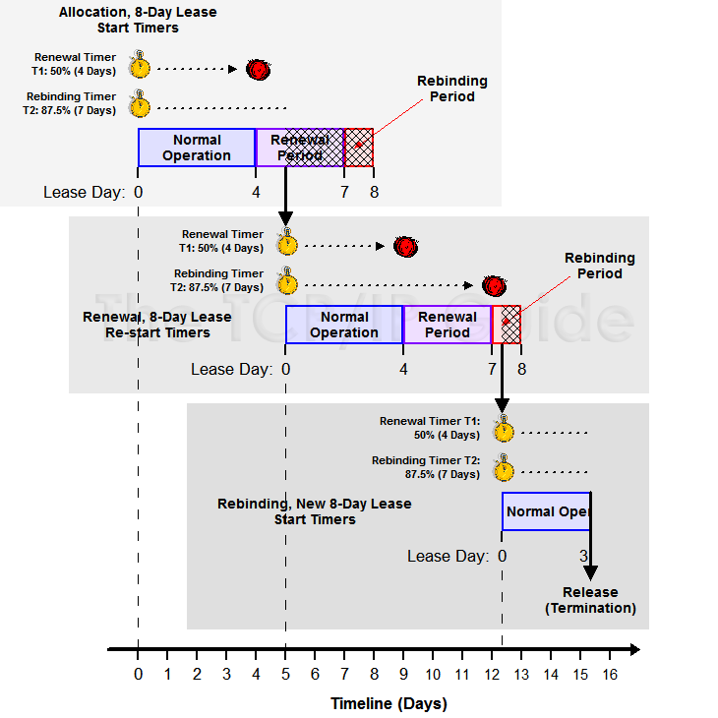
DHCP Lease “Life Cycle”
Life cycle
  Allocation
  Reallocation
  Normal operation
  Renewal
  Rebinding
  Release

Slide 9
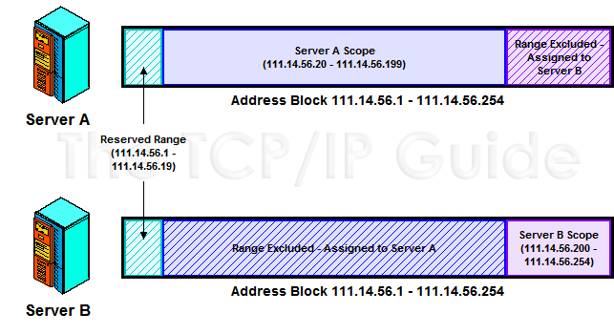
DHCP Lease Address Pools
Each DHCP server maintains a set of IP addresses
  Use to allocate leases to clients
    Most of clients are equals
      A range of addresses is normally handled as a single group defined for a particular network

Slide 10
DHCP Protocol (1)
client
server
DHCP Discover
  Broadcasted by client to find available server.
  Client can request its last-known IP, but the server can ignore it.
DHCP Offer
  Server find IP for client based on clients hardware address (MAC)
DHCP Request
  Client request the IP it want to the server.
DHCP Acknowledge
  Server acknowledges the client, admit him to use the requested IP.
※ Question
  Why not use the IP after DHCP offer?
廣播：我要IP
DHCP Discover
src: 0.0.0.0 port: 68
dst: 255.255.255.255 port: 67
你可以用 IP₁
IP=192.168.1.100
netmask=255.255.255.0
router=192.168.1.1
dns=192.168.1.1
IP lease time=1 day
DHCP Offer
src: 192.168.1.1 port: 67
dst: 255.255.255.255 port: 68
DHCP option
請給我IP₁
DHCP Request
src: 0.0.0.0 port: 68
dst: 255.255.255.255 port: 67
DHCP option
Request IP=192.168.1.100
DHCP Server=192.168.1.1
給你用 IP₁
IP=192.168.1.100
netmask=255.255.255.0
router=192.168.1.1
dns=192.168.1.1
IP lease time=1 day
DHCP Ack
src: 192.168.1.1 port: 67
dst: 255.255.255.255 port: 68
DHCP option

Slide 11
DHCP Protocol (2)
DHCP Inform
  Request more information than the server sent.
  Repeat data for a particular application.
    ex. browsers request web proxy settings from server.
  It does not refresh the IP expiry time in server’s database.
DHCP Release
  Client send this request to server to releases the IP, and the client will un-configure this IP.
  Not mandatory.

Slide 12
DHCP server on FreeBSD (1)
Kernel support
  device bpf (FreeBSD 5.x↑)
  pseudo-device bpf (FreeBSD 4.x↓)
Install DHCP server
  /usr/ports/net/isc-dhcp44-server/
  pkg install isc-dhcp44-server
Enable DHCP server in /etc/rc.conf
    dhcpd_enable="YES"
    dhcpd_flags="-q"
    dhcpd_conf="/usr/local/etc/dhcpd.conf"
    dhcpd_ifaces=""
    dhcpd_withumask="022"

Slide 13
DHCP server on FreeBSD (2)
Option definitions
  option domain-name "cs.nctu.edu.tw";
  option domain-name-servers 140.113.235.107, 140.113.1.1;
  default-lease-time 600;
  max-lease-time 7200;
  ddns-update-style none;
  log-facility local7;
/etc/syslogd.conf
/etc/newsyslog.conf

Slide 14
DHCP server on FreeBSD (3)
Subnet definition
  subnet 192.168.1.0 netmask 255.255.255.0 {
  range 192.168.1.101 192.168.1.200;
  option domain-name "cs.nctu.edu.tw";
  option routers 192.168.1.254;
  option broadcast-address 192.168.1.255;
  option domain-name-servers 140.113.17.5, 140.113.1.1;
  default-lease-time 3600;
  max-lease-time 21600;
  }
Host definition
  host fantasia {
  hardware ethernet 08:00:07:26:c0:a5;
  fixed-address 192.168.1.30;
  }
  host denyClient {
  hardware ethernet 00:07:95:fd:12:13;
  deny booting;
  }

Slide 15
DHCP server on FreeBSD (4)
Important files
  /usr/local/sbin/dhcpd
  /usr/local/etc/dhcpd.conf
  /var/db/dhcpd.leases (leases issued)
  /usr/local/etc/rc.d/isc-dhcpd

Slide 16
NAT –
Network Address Translation

Slide 17
IP address crisis
IP address crisis
  Run out of class B address
    The most desirable ones for moderately large organizations
  IP address were being allocated on a FCFS
    With no locality of reference
Solutions
  Short term
    Subnetting and CIDR (classless inter-domain routing)
    NAT (network address translation)
  Long term
    IPv6

Slide 18
Network Address Translation (NAT)
Some important characteristics of how most organizations use the internet
  Most hosts are client
  Few hosts access the internet simultaneously
  Internet communications are routed
Network Address Translation
  RFC 1631, in May 1994
  A basic implementation of NAT involves
    Using one of the private addresses for local networks
    Assigned one or more public IP addresses
  The word ‘translator’ refers to the device that implements NAT

Slide 19
Private Address Space
Private addresses space defined by RFC1918
  24-bit block (Class A)
    10.0.0.0/8
  20-bit block (16 contiguous Class B)
    172.16.0.0/12 ~ 172.31.0.0/12
  16-bit block (256 contiguous Class C)
    192.168.0.0/16 ~ 192.168.255.0/16
Operation consideration
  Router should set up filters for both inbound and outbound private network traffic

Slide 20
Network Address Translation (NAT)
What is NAT?
  Network Address Translation
  Re-write the source and/or destination addresses of IP packets when they pass through a router or firewall.
  What can be re-written?
    Source/destination IPs
    Source/destination ports
What can NAT do?
  Solve the IPv4 address shortage. (the most common purpose)
  Kind of firewall (security)
  Load balancing
  Fail over (for service requiring high availability)

Slide 21
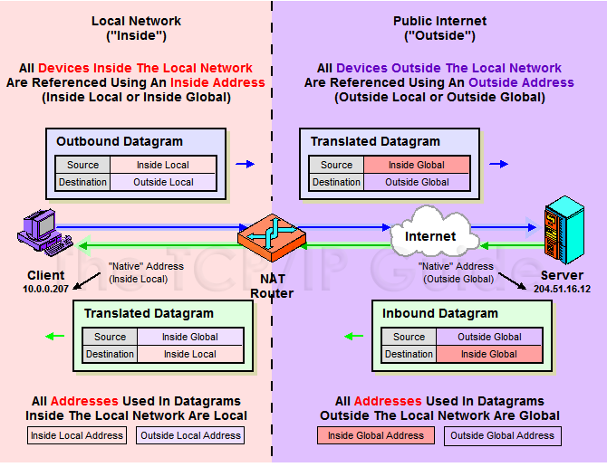
NAT Terminology

Slide 22
NAT Address Mappings
Each time a NAT router encounters an IP datagram
  It must translate addresses
  BUT, how does it know what to translate, and what to use for the translated addresses
Translation table
  Maps the inside local address to the inside global address
  Also contains mappings between outside global address and outside local address for inbound translations
Two address mappings
  Static mappings
    Allow the inside host with an inside local address to always use a inside global address
  Dynamic mappings
    Allow a pool of inside global addresses to be shared by a large number of inside hosts

Slide 23
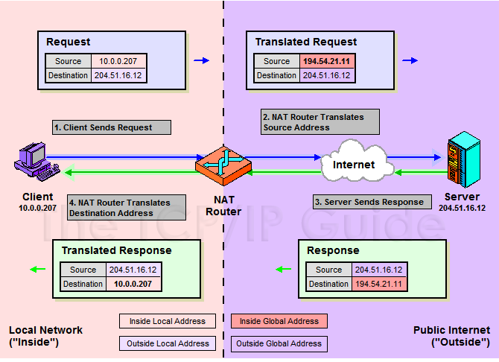
NAT Unidirectional Operation
NAT Unidirectional Operation
  Traditional/Outbound operation
  The original variety of NAT in RFC 1631
    The simplest NAT
    The client/server request/response communication would sent from the inside to outside network

Slide 24
NAT Bidirectional Operation
NAT Bidirectional Operation
  Two-Way/Inbound operation
  A host on the outside network initiate a transaction with one on the inside
The problem with inbound NAT
  NAT is inherently asymmetric
    The outside network does not know the private addresses of the inside network
    Hidden addresses are not routable
    The outbound hosts DO NOT know the identity of the NAT router
    NAT mapping table

Slide 25
NAT Bidirectional Operation
Two methods to resolve the hidden address problem
  Static mapping
  DNS
    RFC 2694, DNS extensions to NAT
The basic process is as follows
  The outside host sends a DNS request using the name of the private host
  The DNS server for the internal network resolves the name into an inside local address
  The inside local address is passed to NAT and used to create a dynamic mapping
  DNS server sends back the name resolution with the inside global address

Slide 26
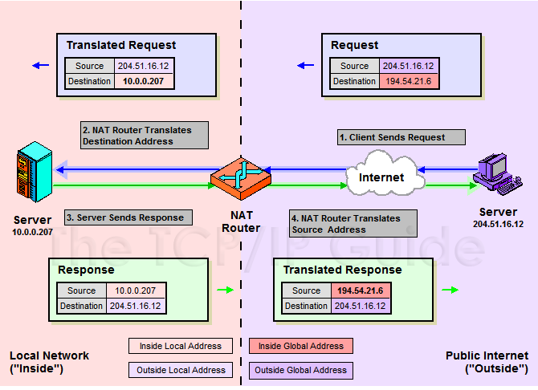
NAT Bidirectional Operation

Slide 27
NAT Port-Based Operation
NAT Port-Based Operation
  Overloaded operation
  Network Address Port Translation (NAPT)/Port Address Translation (PAT)
  Both traditional NAT and bidirectional NAT work by swapping inside network and outside network addresses
    One-to-one mapping between inside local address and inside global address
    Use dynamic address assignment to allow a large number of private hosts to share a small number of registered public addresses
Using ports to multiplex private addresses
  Also translate port addresses
  Allow 250 hosts on the private network to use only 20 IP address
  Overloading of an inside global address

Slide 28
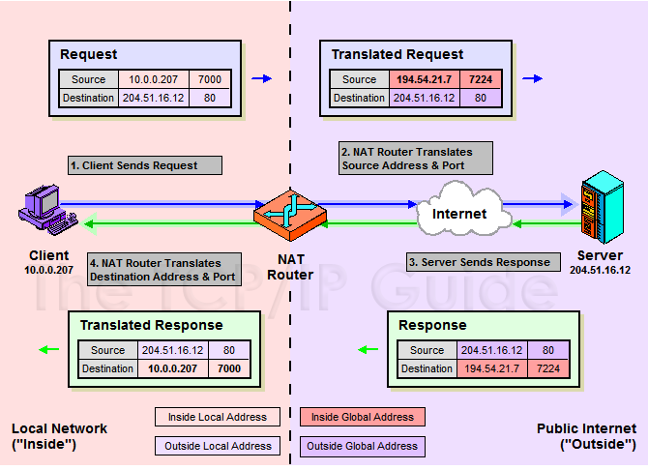
NAT Port-Based Operation

Slide 29
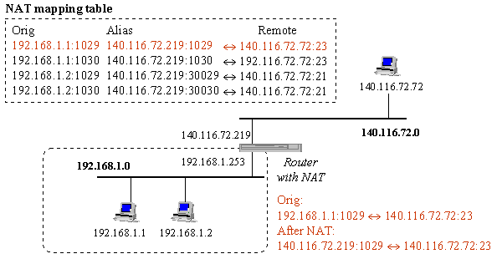
NAT Port-Based Operation
NAT example:

Slide 30
NAT Overlapping Operation
NAT Overlapping Operation
  Twice NAT Operation
  The previous three versions of NAT are normally used to connect a network using private, non-routable addresses to the public internet
    No overlap between the address spaces of the inside and outside network
Cases with overlapping private and public address blocks
  Private network to private network connections
  Invalid assignment of public address space to private network
Dealing with overlapping blocks by using NAT twice
  Translate both the source and destination address on each transition
  Rely on use of the DNS
    Let the inside network send requests to the overlapping network in a way that can be uniquely identified

Slide 31
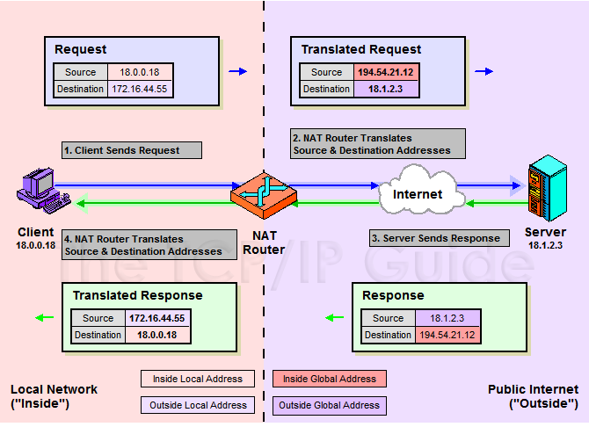
NAT Overlapping Operation
A client, 18.0.0.18, wants to send a request to the server www.twicenat.mit.edu, 18.1.2.3.
  18.0.0.18 sends a DNS request
  NAT router intercepts this DNS request
    Consult its tables to find a special mapping for this outside host
  NAT router returns 172.16.44.55 to the source client

Slide 32
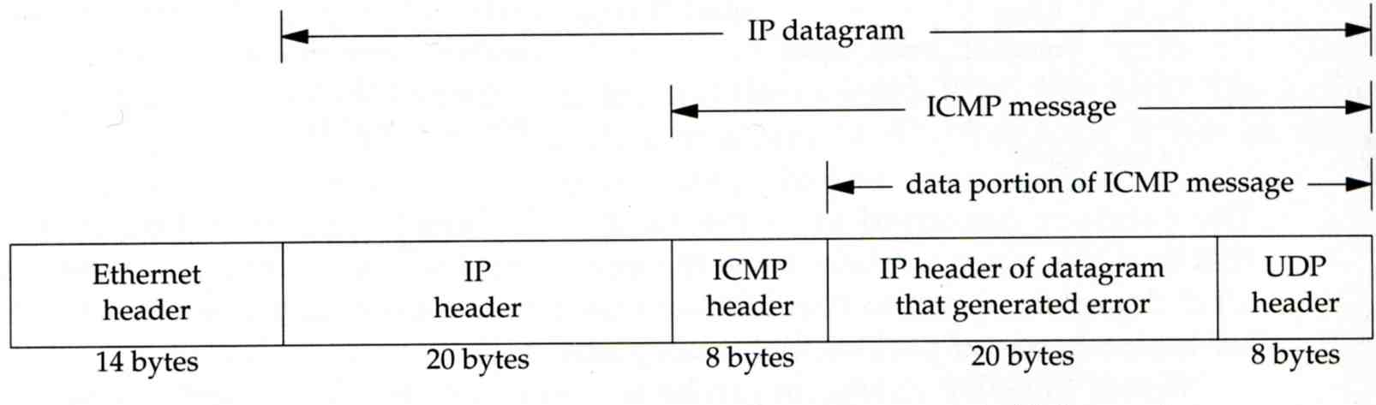
NAT Compatibility Issues
It is NOT possible for NAT to be completely transparent to the hosts that use it
  ICMP Manipulations
  Applications that embed IP address
    FTP
  Additional issues with port translation
    The issues applying to addresses now apply to ports as well
  Problems with IPSec

Slide 33
SNAT
SNAT & DNAT
  S: Source D: Destination
  SNAT
    Rewrite the source IP and/or Port.
    The rewritten packet looks like one sent by the NAT server.
S: 192.168.1.1:1234
D: 140.113.235.107:53
S: 140.113.235.250:10234
D: 140.113.235.107:53
NAT Mapping Table:
192.168.1.1:1234 – 140.113.235.250:10234
192.168.1.254
140.113.235.250
192.168.1.1
140.113.235.250

Slide 34
DNAT
  DNAT
    Rewrite the destination IP and/or Port.
    The rewritten packet will be redirect to another IP address when it pass through NAT server.
  Both SNAT and DNAT are usually used together in coordination for two-way communication.
S: 140.113.24.107:1357
D: 192.168.1.1:80
S: 140.113.24.107:1357
D: 140.113.235.107:8080
NAT Mapping Table:
140.113.235.250:8080 – 192.168.1.1:80
192.168.1.254
140.113.235.250
192.168.1.1
140.113.24.107

Slide 35
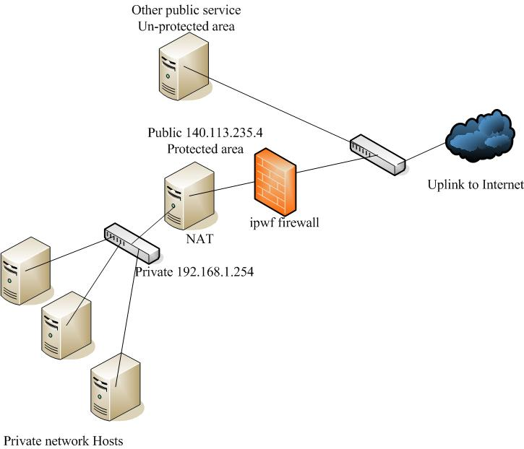
NAT on FreeBSD (1)
Setup
  Network topology
  configuration
  Advanced redirection
  configuration
192.168.1.1
Web server
192.168.1.2
Ftp Server
192.168.1.101
PC1

Slide 36
NAT on FreeBSD (2)
IP configuration (in /etc/rc.conf)
  ifconfig_fxp0="inet 140.113.235.4 netmask 255.255.255.0 media autoselect"
  ifconfig_fxp1="inet 192.168.1.254 netmask 255.255.255.0 media autoselect“
  defaultrouter="140.113.235.254“
Enable NAT
  Here we use Packet Filter (PF) as our NAT server
  Configuration file: /etc/pf.conf
    nat
    rdr
    binat
# macro definitions
extdev='fxp0‘
intranet='192.168.1.0/24‘
webserver=‘192.168.1.1’
ftpserver=‘192.168.1.2’
pc1=‘192.168.1.101’
# nat rules
nat on $extdev inet from $intranet to any -> $extdev
rdr on $extdev inet proto tcp to port 80 -> $webserver port 80
rdr on $extdev inet proto tcp to port 443 -> $webserver port 443
rdr on $extdev inet proto tcp to port 21 -> $ftpserver port 21

Slide 37
NAT on FreeBSD (3)
# macro definitions
extdev='fxp0‘
intranet='192.168.219.0/24‘
winxp=‘192.168.219.1’
server_int=‘192.168.219.2’
server_ext=‘140.113.214.13’
# nat rules
nat on $extdev inet from $intranet to any -> $extdev
rdr on $extdev inet proto tcp to port 3389 -> $winxp port 3389
binat on $extdev inet from $server_int to any -> $server_ext

