Slide 1
The BIND Software

Slide 2
BIND
BIND
  the Berkeley Internet Name Domain system
Three main versions
  BIND 4
    Announced in 1980s
    Based on RFC 1034, 1035
  BIND 8
    Released in 1997
    Improvements including:
      efficiency, robustness and security
  BIND 9
    Released in 2000
    Enhancements including:
      multiprocessor support, DNSSEC, IPv6 support, etc
  BIND 10
    Released version 1.0 and 1.1 in 2013
    Released version 1.2 in 2014
      ISC has concluded BIND 10 development with Release 1.2

Slide 3
BIND
– components
Four major components
  named
    Daemon that answers the DNS query
    Perform Zone transfer
  Library routines
    Routines that used to resolve host by contacting the servers of DNS distributed database
      Ex: res_query, res_search, …etc.
  Command-line interfaces to DNS
    Ex: nslookup, dig, host
  rndc
    A program to remotely control named

Slide 4
named in FreeBSD
Installation
  /usr/ports/dns/bind912
  pkg install bind912
Startup
  Edit /etc/rc.conf
    named_enable="YES"
  Manual utility command
    % rndc {stop | reload | flush …}
      In old version of BIND, use ndc command
See your BIND version
  % dig @127.0.0.1 version.bind txt chaos
    version.bind. 0 CH TXT "9.9.11"
  % nslookup -debug -class=chaos -query=txt version.bind 127.0.0.1
    version.bind text = "9.9.11"

Slide 5
BIND
– Configuration files
The complete configuration of named consists of
  The config file
    /usr/local/etc/namedb/named.conf
  Zone data file
    Address mappings for each host
    Collections of individual DNS data records
  The root name server hints

Slide 6
BIND Configuration
– named.conf
    /usr/local/etc/namedb/named.conf
  Roles of this host for each zone it serves
    Master, slave, stub, or caching-only
  Options
    Global options
      The overall operation of named and server
    Zone specific options
named.conf is composed of following statements:
  include, options, server, key, acl, zone,
  view, controls, logging, trusted-keys, masters

Slide 7
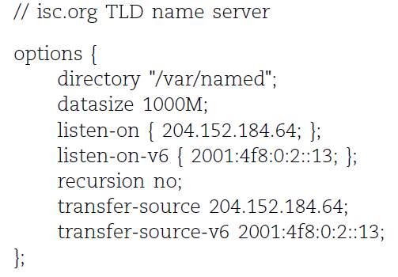
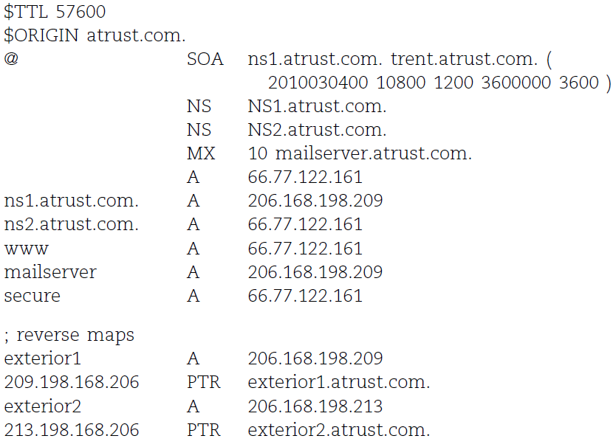
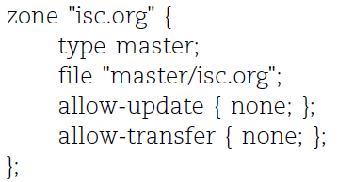
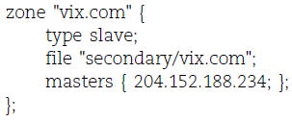
Examples of named configuration

Slide 8
DNS Database
– Zone data

Slide 9
The DNS Database
A set of text files such that
  Maintained and stored on the domain’s master name server
  Often called zone files
  Two types of entries
    Resource Records (RR)
      The real part of DNS database
    Parser commands
      Just provide some shorthand ways to enter records
      Influence the way that the parser interprets sequence orders or expand into multiple DNS records themselves

Slide 10
The DNS Database
– Parser Commands
Commands must start in first column and be on a line by themselves
$ORIGIN domain-name
  Used to append to un-fully-qualified name
$INCLUDE file-name
  Separate logical pieces of a zone file
  Keep cryptographic keys with restricted permissions
$TTL default-ttl
  Default value for time-to-live filed of records
$GENERATE start-stop/[step] lhs type rhs
  Be found only in BIND
  Used to generate a series of similar records
  Can be used in only CNAME, PTR, NS record types

Slide 11
The DNS Database
– Resource Record (1)
Basic format
  [name] [ttl] [class] type data
    name: the entity that the RR describes
      Can be relative or absolute
    ttl: time in second of this RR’s validity in cache
    class: network type
      IN for Internet
      CH for ChaosNet
      HS for Hesiod
  Special characters
    ; (comment)
    @ (The current domain name)
    () (allow data to span lines)
    * (wild card character, name filed only)

Slide 12
The DNS Database
– Resource Record (2)
Type of resource record discussed later
  Zone records: identify domains and name servers
    SOA
    NS
  Basic records: map names to addresses and route mail
    A
    PTR
    MX
  Optional records: extra information to host or domain
    CNAME
    TXT
    SRV

Slide 13
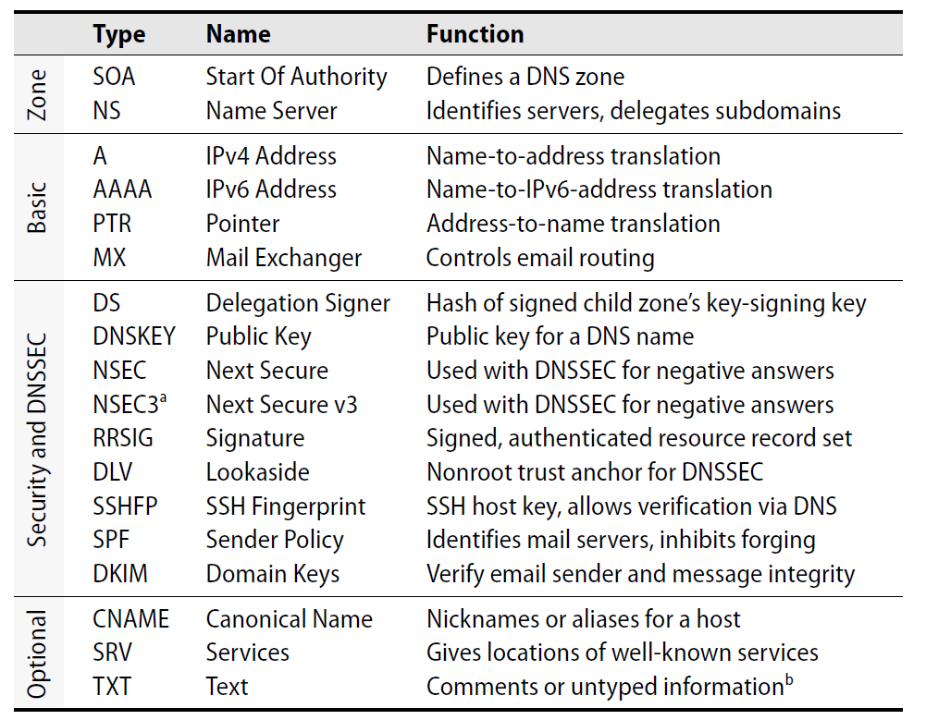
The DNS Database
– Resource Record (3)

Slide 14
The DNS Database
– Resource Record (4)
SOA: Start Of Authority
  Defines a DNS zone of authority, each zone has exactly one SOA record
  Specify the name of the zone, the technical contact and various timeout information
  Format:
    [zone] IN SOA [server-name] [administrator’s mail] ( serial, refresh, retry, expire, ttl )
  Ex:
; means comments
@ means current domain name
( ) allow data to span lines
* Wild card character
$TTL 3600;
$ORIGIN cs.nctu.edu.tw.
@ IN SOA csns.cs.nctu.edu.tw. root.cs.nctu.edu.tw. (
2012050802 ; serial number
1D ; refresh time for slave server
30M ; retry
1W ; expire
2H ) ; minimum

Slide 15
The DNS Database
– Resource Record (5)
NS: Name Server
  Format
    zone [ttl] [IN] NS hostname
  Usually follow the SOA record
  Goal
    Identify the authoritative server for a zone
    Delegate subdomains to other organizations
$TTL 3600;
$ORIGIN cs.nctu.edu.tw.
@ IN SOA dns.cs.nctu.edu.tw. root.cs.nctu.edu.tw. (
2012050802 ; serial number
1D ; refresh time for slave server
30M ; retry
1W ; expire
2H ) ; minimum
IN NS dns.cs.nctu.edu.tw.
IN NS dns2.cs.nctu.edu.tw.
test IN NS dns.test.cs.nctu.edu.tw.

Slide 16
The DNS Database
– Resource Record (6)
A record: Address
  Format
    hostname [ttl] [IN] A ipaddr
  Provide mapping from hostname to IP address
  Load balance
  Ex:
$ORIGIN cs.nctu.edu.tw.
@ IN NS dns.cs.nctu.edu.tw.
IN NS dns2.cs.nctu.edu.tw.
dns IN A 140.113.235.107
dns2 IN A 140.113.235.103
www IN A 140.113.235.111

Slide 17
The DNS Database
– Resource Record (7)
PTR: Pointer
  Perform the reverse mapping from IP address to hostname
  Special top-level domain: in-addr.arpa
    Used to create a naming tree from IP address to hostnames
  Format
    addr [ttl] [IN] PTR hostname
$TTL 259200;
$ORIGIN 235.113.140.in-addr.arpa.
@ IN SOA csns.cs.nctu.edu.tw. root.cs.nctu.edu.tw. (
2007052102 ; serial number
1D ; refresh time for secondary server
30M ; retry
1W ; expire
2H) ; minimum
IN NS dns.cs.nctu.edu.tw.
IN NS dns2.cs.nctu.edu.tw.
$ORIGIN in-addr.arpa.
103.235.113.140 IN PTR csmailgate.cs.nctu.edu.tw.
107.235.113.140 IN PTR csns.cs.nctu.edu.tw.

Slide 18
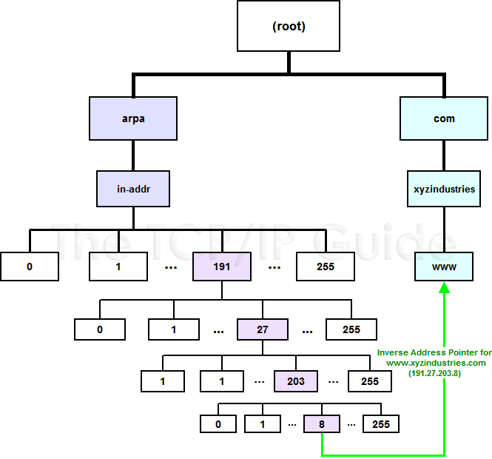
The DNS Database
– Resource Record (8)

Slide 19
The DNS Database
– Resource Record (9)
MX: Mail eXchanger
  Direct mail to a mail hub rather than the recipient’s own workstation
  Format
    host [ttl] [IN] MX preference host
  Ex:
$TTL 3600;
$ORIGIN cs.nctu.edu.tw.
@ IN SOA csns.cs.nctu.edu.tw. root.cs.nctu.edu.tw. (
2007052102 ; serial number
1D ; refresh time for slave server
30M ; retry
1W ; expire
2H ) ; minimum
IN NS dns.cs.nctu.edu.tw.
IN NS dns2.cs.nctu.edu.tw.
7200 IN MX 1 csmx1.cs.nctu.edu.tw.
7200 IN MX 5 csmx2.cs.nctu.edu.tw.
csmx1 IN A 140.113.235.104
csmx2 IN A 140.113.235.105

Slide 20
The DNS Database
– Resource Record (10)
CNAME: Canonical name
  nikename [ttl] IN CNAME hostname
  Add additional names to a host
    To associate a function or to shorten a hostname
  CNAME record can nest eight deep in BIND
  Other records must refer to its real hostname
  Not for load balance
  Ex:
www IN A 140.113.209.63
IN A 140.113.209.77
penghu-club IN CNAME www
King IN CNAME www
R21601 IN A 140.113.214.31
superman IN CNAME r21601

Slide 21
The DNS Database
– Resource Record (11)
TXT: Text
  Add arbitrary text to a host’s DNS records
  Format
    Name [ttl] [IN] TXT info
    All info items should be quoted
  They are sometime used to test prospective new types of DNS records
    SPF records
$TTL 3600;
$ORIGIN cs.nctu.edu.tw.
@ IN SOA csns.cs.nctu.edu.tw. root.cs.nctu.edu.tw. (
2007052102 ; serial number
1D ; refresh time for slave server
30M ; retry
1W ; expire
2H ) ; minimum
IN NS dns.cs.nctu.edu.tw.
IN NS dns2.cs.nctu.edu.tw.
IN TXT "Department of Computer Science"

Slide 22
The DNS Database
– Resource Record (12)
SRV: Service
  Specify the location of services within a domain
  Format:
    _service._proto.name [ttl] IN SRV pri weight port target
  Ex:
; don’t allow finger
_finger._tcp SRV 0 0 79 .
; 1/4 of the connections to old, 3/4 to the new
_ssh. _tcp SRV 0 1 22 old.cs.colorado.edu.
_ssh. _tcp SRV 0 3 22 new.cs.colorado.edu.
; www server
_http. _tcp SRV 0 0 80 www.cs.colorado.edu.
SRV 10 0 8000 new.cs.colorado.edu.
; block all other services
*. _tcp SRV 0 0 0 .
*. _udp SRV 0 0 0 .

Slide 23
IPv6 Resource Records
IPv6 forward records
  Format
    Hostname [ttl] [IN] AAAA ipaddr
  Example
IPv6 reverse records
  IPv6 PTR records are in the ip6.arpa top-level domain
  Example
    f.0.0.0.0.0.0.0.0.0.0.0.0.0.0.0.0.0.0.0.f.2.0.0.0.0.5.0.1.0.0.2.ip6.arpa. PTR f.root-servers.net.
bsd1[~] -chiahung- dig f.root-servers.net AAAA
;; ANSWER SECTION:
f.root-servers.net. 604795 IN AAAA 2001:500:2f::f

Slide 24
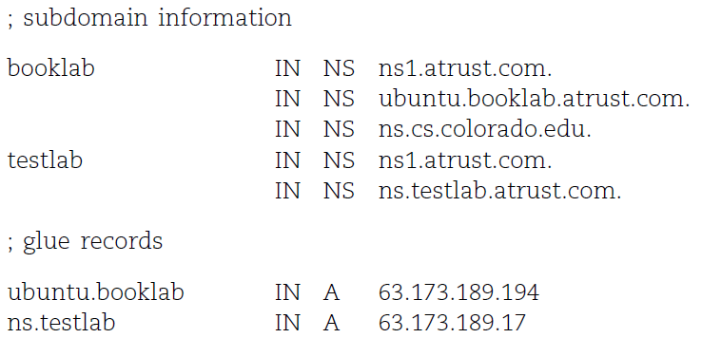
Glue Record (1/2)
Glue record – Link between zones
  DNS referrals occur only from parent domains to child domains
  The servers of a parent domain must know the IP of the name servers for all of its subdomains
    Parent zone needs to contain the NS records for each delegated zone
    Making a normal DNS query
    Having copies of the appropriate A records
    The foreign A records are called glue records

Slide 25
Glue Record (2/2)
There are two ways to link between zones
  By including the necessary records directly
  By using stub zones
Lame delegation
  DNS subdomain administration has delegate to you and you never use the domain or parent domain’s glue record is not updated

Slide 26
Statements of named.conf

Slide 27
Examples of named configuration

Slide 28
BIND Configuration
– named.conf address match list
Address Match List
  A generalization of an IP address that can include:
    An IP address
      Ex. 140.113.17.1
    An IP network with CIDR netmask
      Ex. 140.113/16
    The ! character to do negate
    The name of a previously defined ACL
    A cryptographic authentication key
  First match
  Example:
    {!1.2.3.4; 1.2.3/24;};
    {128.138/16; 198.11.16/24; 204.228.69/24; 127.0.0.1;};

Slide 29
BIND Configuration
– named.conf acl
The “acl” statement
  Define a class of access control
  Define before they are used
  Syntax
    acl acl_name {
    address_match_list
    };
  Predefined acl classes
    any, localnets, localhost, none
  Example
  acl CSnets {
  140.113.235/24; 140.113.17/24; 140.113.209/24; 140.113.24/24;
  };
  acl NCTUnets {
  140.113/16; 10.113/16; 140.126.237/24;
  };
  allow-transfer {localhost; CSnets; NCTUnets};

Slide 30
BIND Configuration
– named.conf key
The “key” statement
  Define a encryption key used for authentication with a particular server
  Syntax
    key key-id {
    algorithm string;
    secret string;
    }
  Example:
    key serv1-serv2 {
    algorithm hmac-md5;
    secret "ibkAlUA0XXAXDxWRTGeY+d4CGbOgOIr7n63eizJFHQo="
    }
  This key is used to
    Sign DNS request before sending to target
    Validate DNS response after receiving from target

Slide 31
BIND Configuration
– named.conf include
The “include” statement
  Used to separate large configuration file
  Another usage is used to separate cryptographic keys into a restricted permission file
  Ex:
    include "/etc/namedb/rndc.key";
    -rw-r--r-- 1 root wheel 4947 Mar 3 2006 named.conf
    -rw-r----- 1 bind wheel 92 Aug 15 2005 rndc.key
  If the path is relative
    Relative to the directory option

Slide 32
BIND Configuration
– named.conf option (1/3)
The “option” statement
  Specify global options
  Some options may be overridden later for specific zone or server
  Syntax:
    options {
    option;
    option;
    };
There are more than 150 options in BIND 9
  version "There is no version."; [real version num]
    version.bind. 0 CH TXT "9.3.3"
    version.bind. 0 CH TXT "There is no version."
  directory "/etc/namedb/db";
    Base directory for relative path and path to put zone data files

Slide 33
BIND Configuration
– named.conf option (2/3)
  notify yes | no [yes]
    Whether notify slave sever when relative zone data is changed
  also-notify {140.113.235.101;}; [empty]
    Also notify this non-advertised NS server
  recursion yes | no [yes]
    Recursive name server
    Open resolver
  allow-recursion {address_match_list }; [all]
    Finer granularity recursion setting
  recursive-clients number; [1000]
  max-cache-size number; [unlimited]
    Limited memory

Slide 34
BIND Configuration
– named.conf option (3/3)
  query-source address ip_addr port ip_port; [random]
    NIC and port to send DNS query
    DO NOT use port
  use-v4-udp-ports { range beg end; }; [range 1024 65535]
  avoid-v6-udp-ports { port_list }; [empty]
  forwarders {in_addr; …}; [empty]
    Often used in cache name server
    Forward DNS query if there is no answer in cache
  forward only | first; [first]
    If forwarder does not response, queries for forward only server will fail
  allow-query { address_match_list }; [all]
    Specify who can send DNS query to you
  allow-transfer address_match_list; [all]
    Specify who can request zone transfer of your zone data
  allow-update address_match_list; [none]
  blackhole address_match_list; [empty]
    Reject queries and would never ask them for answers

Slide 35
BIND Configuration
– named.conf zone (1/5)
The “zone” statement
  Heart of the named.conf that tells named about the zones that it is authoritative
  zone statement format varies depending on roles of named
    master, slave, hint, forward, stub
  The zone file is just a collection of DNS resource records
  Basically
Syntax:
zone "domain_name" {
type master | slave| stub;
file "path”;
masters {ip_addr; ip_addr;};
allow-query {address_match_list}; [all]
allow-transfer { address_match_list}; [all]
allow-update {address_match_list}; [empty]
};
allow-update cannot be used for a slave zone

Slide 36
BIND Configuration
– named.conf zone (2/5)
Master server zone configuration
Slave server zone configuration
zone "cs.nctu.edu.tw" IN {
type master;
file "named.hosts";
allow-query { any; };
allow-transfer { localhost; CS-DNS-Servers; };
allow-update { none; };
};
zone "cs.nctu.edu.tw" IN {
type slave;
file "cs.hosts";
masters { 140.113.235.107; };
allow-query { any; };
allow-transfer { localhost; CS-DNS-Servers; };
};

Slide 37
BIND Configuration
– named.conf zone (3/5)
Forward zone and reverse zone
zone "cs.nctu.edu.tw" IN {
type master;
file "named.hosts";
allow-query { any; };
allow-transfer { localhost; CS-DNS-Servers; };
allow-update { none; };
};
zone "235.113.140.in-addr.arpa" IN {
type master;
file "named.235.rev";
allow-query { any; };
allow-transfer { localhost; CS-DNS-Servers; };
allow-update { none; };
};

Slide 38
BIND Configuration
– named.conf zone (4/5)
Example
  In named.hosts, there are plenty of A or CNAME records
  In named.235.rev, there are plenty of PTR records
…
bsd1 IN A 140.113.235.131
csbsd1 IN CNAME bsd1
bsd2 IN A 140.113.235.132
bsd3 IN A 140.113.235.133
bsd4 IN A 140.113.235.134
bsd5 IN A 140.113.235.135
…
…
131.235.113.140 IN PTR bsd1.cs.nctu.edu.tw.
132.235.113.140 IN PTR bsd2.cs.nctu.edu.tw.
133.235.113.140 IN PTR bsd3.cs.nctu.edu.tw.
134.235.113.140 IN PTR bsd4.cs.nctu.edu.tw.
135.235.113.140 IN PTR bsd5.cs.nctu.edu.tw.
…

Slide 39
BIND Configuration
– named.conf zone (5/5)
Setting up root hint
  A cache of where are the DNS root servers
Setting up forwarding zone
  Forward DNS query to specific name server, bypassing the standard query path
zone "." IN {
type hint;
file "named.root";
};
zone "nctu.edu.tw" IN {
type forward;
forward first;
forwarders { 140.113.250.135; 140.113.1.1; };
};
zone "113.140.in-addr.arpa" IN {
type forward;
forward first;
forwarders { 140.113.250.135; 140.113.1.1; };
};

Slide 40
BIND Configuration
– named.conf server
The “server” statement
  Tell named about the characteristics of its remote peers
  Syntax
    server ip_addr {
    bogus no|yes;
    provide-ixfr yes|no; (for master)
    request-ixfr yes|no; (for slave)
    transfer-format many-answers|one-answer;
    keys { key-id; key-id};
    };
  ixfr
    Incremental zone transfer
  transfers
    Limit of number of concurrent inbound zone transfers from that server
    Server-specific transfers-in
  keys
    Any request sent to the remote server is signed with this key

Slide 41
BIND Configuration
– named.conf view (1/2)
The “view” statement
  Create a different view of DNS naming hierarchy for internal machines
    Restrict the external view to few well-known servers
    Supply additional records to internal users
  Also called “split DNS”
  In-order processing
    Put the most restrictive view first
  All-or-nothing
    All zone statements in your named.conf file must appear in the content of view

Slide 42
BIND Configuration
– named.conf view (2/2)
  Syntax
    view view-name {
    match_clients {address_match_list};
    view_options;
    zone_statement;
    };
  Example
view "internal" {
match-clients {our_nets;};
recursion yes;
zone "cs.nctu.edu.tw" {
type master;
file "named-internal-cs";
};
};
view "external" {
match-clients {any;};
recursion no;
zone "cs.nctu.edu.tw" {
type master;
file "named-external-cs";
};
};

Slide 43
BIND Configuration
– named.conf controls
The “controls” statement
  Limit the interaction between the running named process and rndc
  Syntax
    controls {
    inet ip_addr port ip-port allow {address_match_list} keys {key-id};
    };
  Example:
  include "/etc/named/rndc.key";
  controls {
  inet 127.0.0.1 allow {127.0.0.1;} keys {rndc_key;};
  }
key "rndc_key" {
algorithm hmac-md5;
secret "GKnELuie/G99NpOC2/AXwA==";
};

Slide 44
BIND Configuration
– rndc
RNDC – remote name daemon control
  reload, restart, status, dumpdb, …..
  rndc-confgen -b 256
# Start of rndc.conf
key "rndc-key" {
algorithm hmac-md5;
secret "qOfQFtH1nvdRmTn6gLXldm6lqRJBEDbeK43R8Om7wlg=";
};
options {
default-key "rndc-key";
default-server 127.0.0.1;
default-port 953;
};
# End of rndc.conf
SYNOPSIS
rndc [-c config-file] [-k key-file] [-s server] [-p port] [-V]
[-y key_id] {command}

Slide 45
Updating zone files
Master
  Edit zone files
    Serial number
    Forward and reverse zone files for single IP
  Do “rndc reload”
    “notify” is on, slave will be notify about the change
    “notify” is off, refresh timeout, or do “rndc reload” in slave
Zone transfer
  DNS zone data synchronization between master and slave servers
  AXFR (all zone data are transferred at once, before BIND8.2)
  IXFR (incremental updates zone transfer)
    provide-ixfr
    request-ixfr
  TCP port 53

Slide 46
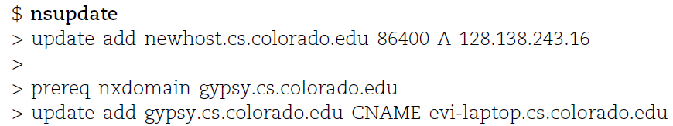
Dynamic Updates
The mappings of name-to-address are relatively stable
DHCP will dynamically assign IP addresses to the hosts
  Hostname-based logging or security measures become very difficulty
Dynamic updates
  RFC 2136
  BIND allows the DHCP daemon to notify the updating RR contents
  nsupdate
  Using allow-update, or allow-policy
    rndc frozen zone, rndc thaw zone
    allow-policy (grant | deny) identity nametype name [types]
dhcp-host1.domain IN A 192.168.0.1
dhcp-host2.domain IN A 192.168.0.2

Slide 47
Non-byte boundary (1/5)
In normal reverse configuration:
  named.conf will define a zone
  statement for each reverse subnet
  zone and
  Your reverse db will contains lots
  of PTR records
  Example:
zone "1.168.192.in-addr.arpa." {
type master;
file "named.rev.1";
allow-query {any;};
allow-update {none;};
allow-transfer {localhost;};
};
$TTL 3600
$ORIGIN 1.168.192.in-addr.arpa.
@ IN SOA chwong.csie.net chwong.chwong.csie.net. (
2007050401 ; Serial
3600 ; Refresh
900 ; Retry
7D ; Expire
2H ) ; Minimum
IN NS ns.chwong.csie.net.
254 IN PTR ns.chwong.csie.net.
1 IN PTR www.chwong.csie.net.
2 IN PTR ftp.chwong.csie.net.
…

Slide 48
Non-byte boundary (2/5)
What if you want to delegate 192.168.2.0 to another sub-domain
  Parent
    Remove forward db about 192.168.2.0/24 network
      Ex:
      pc1.chwong.csie.net. IN A 192.168.2.35
      pc2.chwong.csie.net. IN A 192.168.2.222
      …
    Remove reverse db about 2.168.192.in-addr.arpa
      Ex:
      35.2.168.192.in-addr.arpa. IN PTR pc1.chwong.csie.net.
      222.2.168.192.in-addr.arpa. IN PTR pc2.chwong.csie.net.
      …
    Add glue records about the name servers of sub-domain
      Ex: in zone db of "chwong.csie.net"
      sub1 IN NS ns.sub1.chwong.csie.net.
      ns.sub1 IN A 192.168.2.1
      Ex: in zone db of "168.192.in-addr.arpa."
      2 IN NS ns.sub1.chwong.csie.net.
      1.2 IN PTR ns.sub1.chwong.csie.net

Slide 49
Non-byte boundary (3/5)
What if you want to delegate 192.168.3.0 to four sub-domains (a /26 network)
  192.168.3.0 ~ 192.168.3.63
    ns.sub1.chwong.csie.net.
  192.168.3.64 ~ 192.168.3.127
    ns.sub2.chwong.csie.net.
  192.168.3.128 ~ 192.168.3.191
    ns.sub3.chwong.csie.net.
  192.168.3.192 ~ 192.168.3.255
    ns.sub4.chwong.csie.net.
It is easy for forward setting
  In zone db of chwong.csie.net
    sub1 IN NS ns.sub1.chwong.csie.net.
    ns.sub1 IN A 1921.68.3.1
    sub2 IN NS ns.sub2.chwong.csie.net.
    ns.sub2 IN A 192.168.3.65
    …

Slide 50
Non-byte boundary (4/5)
Non-byte boundary reverse setting
  Method1
  $GENERATE 0-63 $.3.168.192.in-addr.arpa. IN NS ns.sub1.chwong.csie.net.
  $GENERATE 64-127 $.3.168.192.in-addr.arpa. IN NS ns.sub2.chwong.csie.net.
  $GENERATE 128-191 $.3.168.192.in-addr.arpa. IN NS ns.sub3.chwong.csie.net.
  $GENERATE 192-255 $.3.168.192.in-addr.arpa. IN NS ns.sub4.chwong.csie.net.
  And
  zone "1.3.168.192.in-addr.arpa. " {
  type master;
  file "named.rev.192.168.3.1";
  };
  ; named.rev.192.168.3.1
  @ IN SOA sub1.chwong.csie.net. root.sub1.chwong.csie.net. (1;3h;1h;1w;1h)
  IN NS ns.sub1.chwong.csie.net.

Slide 51
Non-byte boundary (5/5)
  Method2
  $ORIGIN 3.168.192.in-addr.arpa.
  $GENERATE 1-63 $ IN CNAME $.0-63.3.168.192.in-addr.arpa.
  0-63.3.168.192.in-addr.arpa. IN NS ns.sub1.chwong.csie.net.
  $GENERATE 65-127 $ IN CNAME $.64-127.3.168.192.in-addr.arpa.
  64-127.3.168.192.in-addr.arpa. IN NS ns.sub2.chwong.csie.net.
  $GENERATE 129-191 $ IN CNAME $.128-191.3.168.192.in-addr.arpa.
  128-191.3.168.192.in-addr.arpa. IN NS ns.sub3.chwong.csie.net.
  $GENERATE 193-255 $ IN CNAME $.192-255.3.168.192.in-addr.arpa.
  192-255.3.168.192.in-addr.arpa. IN NS ns.sub4.chwong.csie.net.
  zone "0-63.3.168.192.in-addr.arpa." {
  type master;
  file “named.rev.192.168.3.0-63”;
  };
  ; named.rev.192.168.3.0-63
  @ IN SOA sub1.chwong.csie.net. root.sub1.chwong.csie.net. (1;3h;1h;1w;1h)
  IN NS ns.sub1.chwong.csie.net.
1 IN PTR www.sub1.chwong.csie.net.
IN PTR abc.sub1.chwong.csie.net.
…

Slide 52
BIND Security

Slide 53
Security
– named.conf security configuration
Security configuration
Feature | Config. Statement | comment
allow-query | options, zone | Who can query
allow-transfer | options, zone | Who can request zone transfer
allow-update | zone | Who can make dynamic updates
blackhole | options | Which server to completely ignore
bogus | server | Which servers should never be queried
acl bogusnet {
0.0.0.0/8 ; // Default, wild card addresses
1.0.0.0/8 ; // Reserved addresses
2.0.0.0/8 ; // Reserved addresses
169.254.0.0/16 ; // Link-local delegated addresses
192.0.2.0/24 ; // Sample addresses, like example.com
224.0.0.0/3 ; // Multicast address space
10.0.0.0/8 ; // Private address space (RFC1918)25
172.16.0.0/12 ; // Private address space (RFC1918)
192.168.0.0/16 ; // Private address space (RFC1918)
};
allow-recursion {ournets; };
blackhole { bogusnet; };
allow-transfer { myslaves; };

Slide 54
Security
– With TSIG (1)
TSIG (Transaction SIGnature)
  Developed by IETF (RFC2845)
  Symmetric encryption scheme to sign and validate DNS requests and responses between servers
  Algorithm in BIND9
    DH (Diffie Hellman), HMAC-MD5, HMAC-SHA1, HMAC-SHA224, HMAC-SHA256, HMAC-SHA384, HMAC-SHA512
  Usage
    Prepare the shared key with dnssec-keygen
    Edit “key” statement
    Edit “server” statement to use that key
    Edit “zone” statement to use that key with:
      allow-query
      allow-transfer
      allow-update

Slide 55
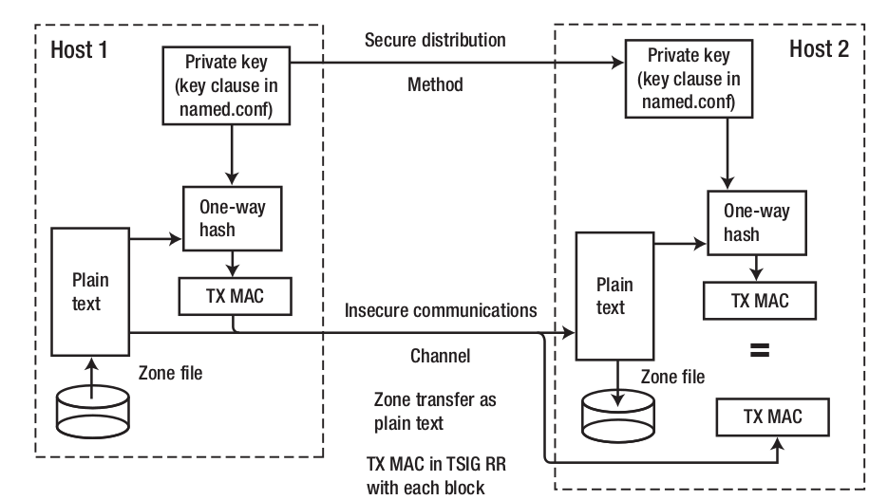
Security
– With TSIG (2)

Slide 56
Security
– With TSIG (3)
TSIG example (dns1 with dns2)
  % dnssec-keygen -a HMAC-MD5 -b 128 -n HOST cs
  Edit /etc/named/dns1-dns2.key
  Edit both named.conf of dns1 and dns2
    Suppose dns1 = 140.113.235.107 dns2 = 140.113.235.103
% dnssec-keygen -a HMAC-MD5 -b 128 -n HOST cs
Kcs.+157+35993
% cat Kcs.+157+35993.key
cs. IN KEY 512 3 157 oQRab/QqXHVhkyXi9uu8hg==
% cat Kcs.+157+35993.private
Private-key-format: v1.2
Algorithm: 157 (HMAC_MD5)
Key: oQRab/QqXHVhkyXi9uu8hg==
key dns1-dns2 {
algorithm hmac-md5;
secret “oQRab/QqXHVhkyXi9uu8hg==”
};
include “dns1-dns2.key”
server 140.113.235.103 {
keys {dns1-dns2;};
};
include “dns1-dns2.key”
server 140.113.235.107 {
keys {dns1-dns2;};
};

Slide 57
Security
– With DNSSEC (1)
DNSSEC (Domain Name System SECurity Extensions)
  Using public-key cryptography (asymmetric)
  Follow the delegation of authority model
  Provide data authenticity and integrity
    Signing the RRsets with private key
    Public DNSKEYs are published, used to verify RRSIGs
    Children sign their zones with private key
      The private key is authenticated by parent’s signing hash (DS) of the child zone’s key
RRset: Resource Record Set
RRSIG: Resource Record Signature
DS: Delegation of Signing

Slide 58
Security
– With DNSSEC (2)
Types of Resource Record for DNSSEC
  RRSIG (Resource Record Signature)
    Crypto signatures for A, AAAA, NS, etc.
    Tracks the type and number at each node.
  NSEC (Next Secure)/NSEC3
    Confirms the NXDOMAIN response
  DNSKEY
    Public keys for the entire zone
    Private side is used generate RRSIGs
  DS (Delegation Signer) Record
    Handed up to parent zone to authenticate the NS record

Slide 59
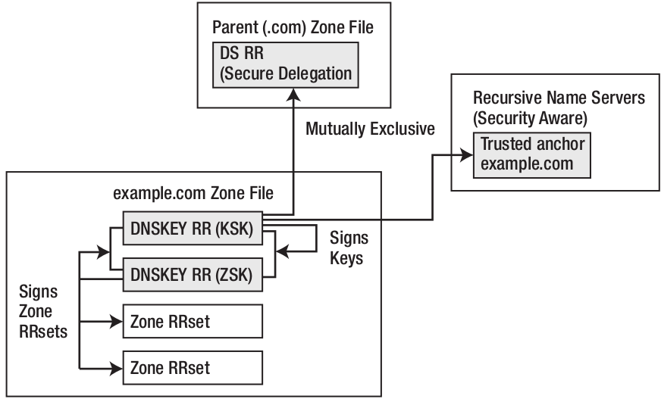
Security
– With DNSSEC (3)
KSK (Key Signing Key)
  The private key is used to generate a digital signature for the ZSK
  The public key is stored in the DNS to be used to authenticate the ZSK
ZSK (Zone Signing Key)
  The private key is used to generate a digital signature (RRSIG) for each RRset in a zone
  The public key is stored in the DNS to authenticate an RRSIG

Slide 60
BIND Debugging and Logging

Slide 61
Logging (1)
Logging configuration
  Using a logging statement
  Define what are the channels
  Specify where each message category should go
Terms
  Channel
    A place where messages can go
    Ex: syslog, file or /dev/null
  Category
    A class of messages that named can generate
    Ex: answering queries or dynamic updates
  Module
    The name of the source module that generates the message
  Facility
    syslog facility name
  Severity
    Priority in syslog
When a message is generated
  It is assigned a “category”, a “module”, a “severity”
  It is distributed to all channels associated with its category

Slide 62
Logging (2)
Channels
  Either “file” or “syslog” in channel sub-statement
    size:
      ex: 2048, 100k, 20m, 15g, unlimited, default
    facility:
      Daemon and local0 ~ local7 are reasonable choices
    severity:
      critical, error, warning, notice, info, debug (with an optional numeric level), dynamic
      Dynamic is recognized and matches the server’s current debug level
logging {
channel_def;
channel_def;
…
category category_name {
channel_name;
channel_name;
…
};
};
channel channel_name {
file path [versions num|unlimited] [size siznum];
syslog facility;
severity severity;
print-category yes|no;
print-severity yes|no;
print-time yes|no;
};

Slide 63
Logging (3)
Predefined channels
Available categories
default_syslog | Sends severity info and higher to syslog with facility daemon
default_debug | Logs to file “named.run”, severity set to dynamic
default_stderr | Sends messages to stderr or named, severity info
null | Discards all messages
default | Categories with no explicit channel assignment
general | Unclassified messages
config | Configuration file parsing and processing
queries/client | A short log message for every query the server receives
dnssec | DNSSEC messages
update | Messages about dynamic updates
xfer-in/xfer-out | zone transfers that the server is receiving/sending
db/database | Messages about database operations
notify | Messages about the “zone changed” notification protocol
security | Approved/unapproved requests
resolver | Recursive lookups for clients

Slide 64
Logging (4)
Example of logging statement
logging {
channel security-log {
file "/var/named/security.log" versions 5 size 10m;
severity info;
print-severity yes;
print-time yes;
};
channel query-log {
file "/var/named/query.log" versions 20 size 50m;
severity info;
print-severity yes;
print-time yes;
};
category default { default_syslog; default_debug; };
category general { default_syslog; };
category security { security-log; };
category client { query-log; };
category queries { query-log; };
category dnssec { security-log; };
};

Slide 65
Debug
Named debug level
  From 0 (debugging off) ~ 11 (most verbose output)
  % named -d2 (start named at level 2)
  % rndc trace (increase debugging level by 1)
  % rndc trace 3 (change debugging level to 3)
  % rndc notrace (turn off debugging)
Debug with “logging” statement
  Define a channel that include a severity with “debug” keyword
    Ex: severity debug 3
    All debugging messages up to level 3 will be sent to that particular channel

Slide 66
Tools

Slide 67
Tools
– nslookup
Interactive and Non-interactive
  Non-Interactive
    % nslookup cs.nctu.edu.tw.
    % nslookup -type=mx cs.nctu.edu.tw.
    % nslookup -type=ns cs.nctu.edu.tw. 140.113.1.1
  Interactive
    % nslookup
    > set all
    > set type=any
    > server host
    > lserver host
    > set debug
    > set d2
csduty [/u/dcs/94/9455832] -chwong- nslookup
> set all
Default server: 140.113.235.107
Address: 140.113.235.107#53
Default server: 140.113.235.103
Address: 140.113.235.103#53
Set options:
novc nodebug nod2
search recurse
timeout = 0 retry = 3 port = 53
querytype = A class = IN
srchlist = cs.nctu.edu.tw/csie.nctu.edu.tw
>

Slide 68
Tools
– dig
Usage
  % dig cs.nctu.edu.tw
  % dig cs.nctu.edu.tw mx
  % dig @ns.nctu.edu.tw cs.nctu.edu.tw mx
  % dig -x 140.113.209.3
    Reverse query
Find out the root servers
  % dig @a.root-servers.net . ns

Slide 69
Tools
– host
host command
  % host cs.nctu.edu.tw.
  % host -t mx cs.nctu.edu.tw.
  % host 140.113.1.1
  % host -v 140.113.1.1

Slide 70
Appendix

Slide 71
Security
– Configuring DNSSEC (1)
Creating DNS Keys for a Zone
  Generate KSK (Key signing key)
  Generate ZSK (Zone signing key)
$ dnssec-keygen -a RSASHA256 -b 2048 -f KSK -n zone example.com
Kexample.com.+008+34957
$ dnssec-keygen -a RSASHA256 -b 2048 -n zone example.com
Kexample.com.+008+27228

Slide 72
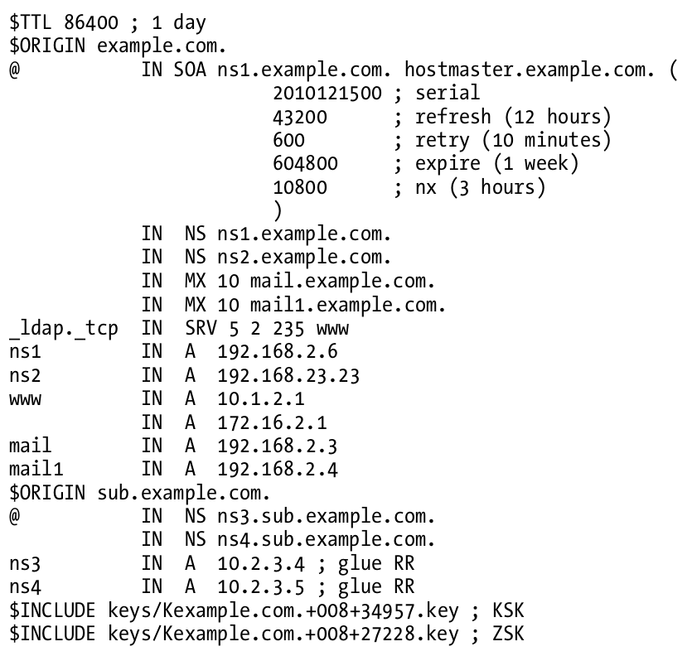
Security
– Configuring DNSSEC (2)
Publishing DNS Keys (public keys) in a Zone

Slide 73
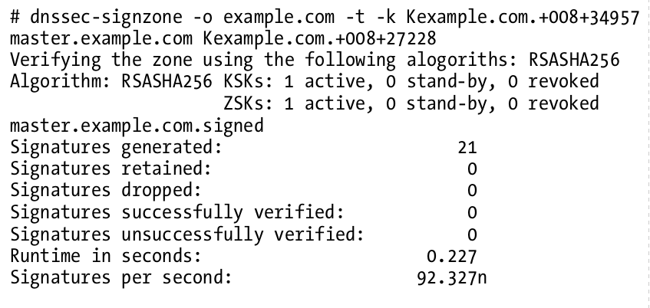
Security
– Configuring DNSSEC (3)
Signing a Zone
  When signing the zone with only ZSK, just omit the -k parameter

Slide 74
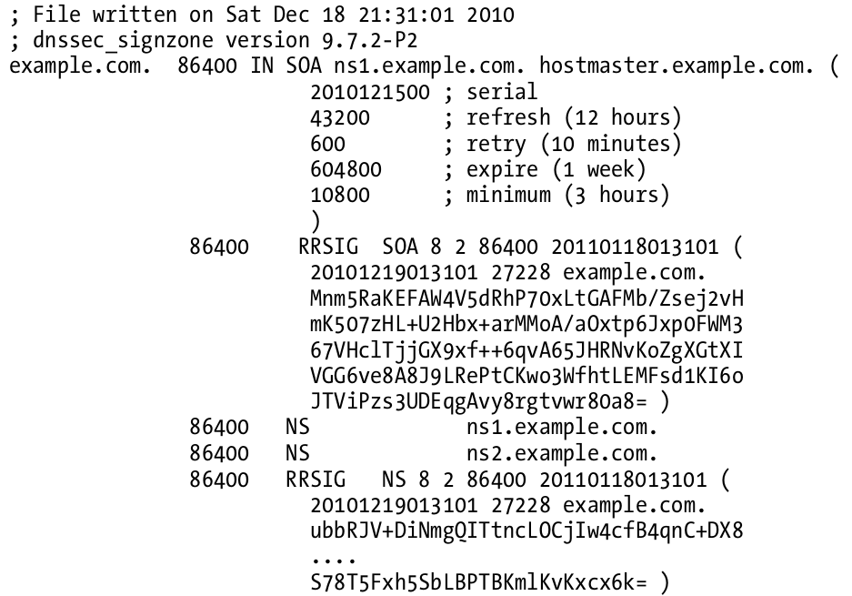
Security
– Configuring DNSSEC (4)
Signing a Zone (Cont.)
  example.com.signed

Slide 75
Security
– Configuring DNSSEC (5)
Updating the Zone file
  Edit the zone file
  Load the new zone file
    rndc reload
zone "example.com" {
type master;
file "example.com.signed”;
masters {ip_addr; ip_addr;};
allow-query {address_match_list};
allow-transfer { address_match_list};
allow-update {address_match_list};
};

Slide 76
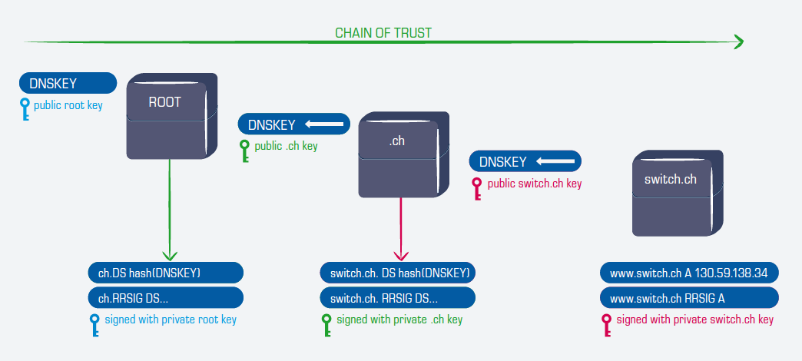
Security
– Configuring DNSSEC (6)
Create Chain of Trust
  Extract DNSKEY RR and use dnssec-dsfromkey
  Add -g parameter when signing zone using dnssec-signzone
    A file named ds-set.example.com was also created, which contains DS record
    DS records have to be entered in your parent domain
$ dnssec-signzone -g …

