Slide 1
Network Administration Practice

Slide 2
Syllabus
Website:
http://people.cs.nctu.edu.tw/~wangth/course/netadm
Instructors:
王則涵 wangth@cs.nctu.edu.tw
Time:
Thu. IJK (PM 6:30 ~ 9:20)
Place:
EC122
TAs:
We might get about 5~8 TAs (TBA)
Email to TAs: ta@nasa.cs.nctu.edu.tw
3GH every week
Textbook:
Unix and Linux System Administration Handbook (5th Edition)
Notes:
中文授課，考試題目

Slide 3
Syllabus – Course Overview
Main topics
Python Programming
Networking
TCP/IP Networking
Network Environment
NAT, DHCP, Firewall, FTP, VPN, Proxy, …
DNS – BIND (Berkeley Internet Name Domain)
Mail System - Postfix
SPF (Sender Policy Framework)
DKIM (DomainKeys Identified Mail)
DMARC (Domain-based Message Authentication, Reporting & Conformance)
Network Management

Slide 4
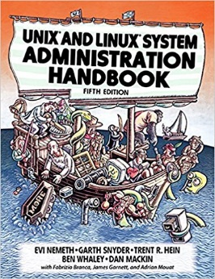
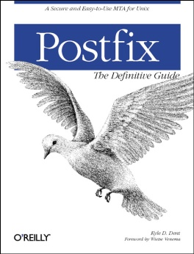
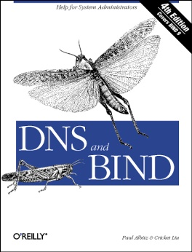
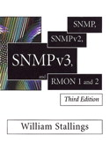
Syllabus – Course Textbook and Reference
Textbook
Unix and Linux System Administration Handbook (5th Edition)
Slides
Reference book
TCP/IP Illustrated Volume 1
Programming Perl
Postfix
DNS and BIND
SNMP, SNMPv2, SNMPv3 and RMON 1, 2

Slide 5
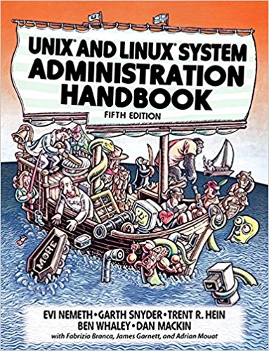
Syllabus – Content
We will cover the following chapters in this semester (NetAdmPractice):
Chapter 15 ~ 18, 21, 23 ~ 25, 30 ~ 32
NAT, DHCP, VPN, Proxy, …
Python Programming

Slide 6
Syllabus – Text book outline
Part I. Basic Administration
Chap 1 – Where to start.
Chap 2 – Booting and Shutting Down
Chap 3 – The Filesystem
Chap 4 – Access control and rootly powers
Chap 5 – Controlling processes
Chap 6 – User Management
Chap 7 – Storage
Chap 8 – Periodic processes
Chap 9 – Backups
Chap 10 – Syslog and log files
Chap 11 – Software installation and management
Chap 12 – The Kernel
Chap 13 – Scripting and the Shell
Chap 14 – Configuration Management
Part II. Networking
Chap 15 – Physical Networking
Chap 16 – TCP/IP
Chap 17 – Routing
Chap 18 – DNS: Domain Name System
Chap 19 – NFS: Network File System
Chap 20 – HTTP: Hypertext Transfer Protocol
Chap 21 – SMTP: Simple Mail Transfer Protocol
Chap 22 – Directory Services
Chap 23 – Electronic Mail
Chap 24 – Web Applications
Chap 25 – Network Management and Debugging

Slide 7
Syllabus – Text book outline (Cont.)
Part III. Operations
Chap 26 – Continuous Integration and Delivery
Chap 27 – Security
Chap 28 – Cloud Computing
Chap 29 – Containers and Virtualization
Chap 30 – Monitoring
Chap 31 – Performance Analysis
Chap 32 – Policy and Politics

Slide 8
Syllabus – Grade Policy
Mid
15 ~ 20%
Final
15 ~ 20%
Exercise
60 ~ 70%
No Delay Work
4 exercises
1 term project

Slide 9
Syllabus – Prerequisite
Background Knowledges
It is better to have taken
“System Administration Practice” (系統管理實務)
“Introduction to Networking” (計算機網路概論)
At least
Experience of using Unix-like environment
Environment
One dedicated PC (Or dual OS in your PC, VM is also accepted.)
With Unix-like OS installed (e.g., FreeBSD, Linux, Solaris, …)
FreeBSD is recommended, for the reason TA supports

Slide 10
Attitude
Attend every class
Do every exercise
As early as possible
On your own
Read book and practice at least 6 hours every week
Use Unix-like environment
Recommend: more than 1.5 hours/day averagely
Collect information on the Internet
The newer, the better.

Slide 11
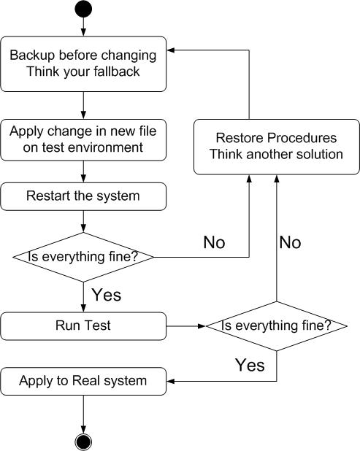
When You Perform Any Changes…
Flow of Change

Slide 12
SA-NA Junction
FreeBSD
11.1-RELEASE
http://people.cs.nctu.edu.tw/~wangth/course/sysadm/slides/01_Install_FreeBSD.pdf
Install OS and software (ports)
http://people.cs.nctu.edu.tw/~wangth/course/sysadm
http://people.cs.nctu.edu.tw/~wangth/course/sysadm/slides/02_Installing_Applications.pdf

