Slide 1
Network Administration HW4
tzute

Slide 2
Purposes
Build a basic mail service
Understand how to maintain Postfix service
Understand how to maintain Dovecot service
Understand how to protect your mail service

Slide 3
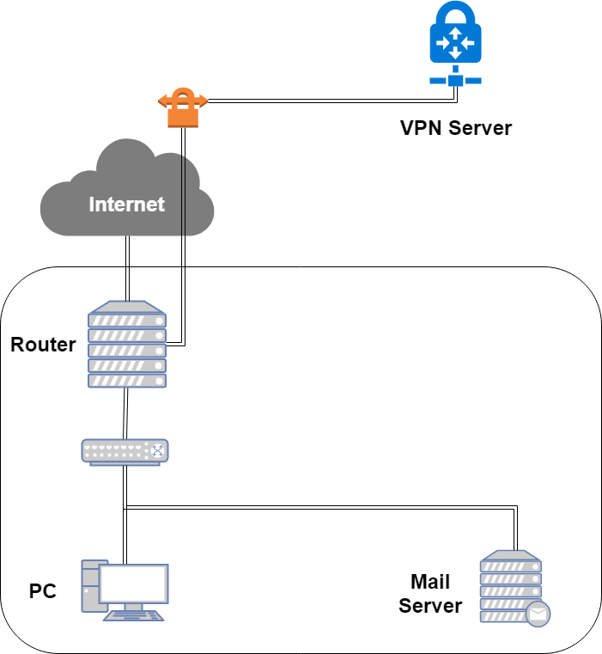
Overview

Slide 4
Overview (cont.)
One Mail Server
Providing IMAP service
Providing SMTP service
Scanning virus
Detecting spam mails

Slide 5
Requirements (1/8)
Mail Server
IP: 10.113.x.y/24 with static DHCP
Hostname: mail.<student-id>.nasa.
Mail domain:
@<student-id>.nasa.
@mail.<student-id>.nasa.
STARTTLS on IMAP/SMTP
Use self-signed certificate
User Authentication
Auth users inside LDAP in HW2
e.g. cn=TA, cn=<student-id>, etc.
No Open Relay

Slide 6
Requirements (2/8)
MX record
Set MX record on your domain
Sending mail to @<student-id>.nasa will go to mail.<student-id>.nasa
SPF
DNS TXT and DNS SPF record
Allow your server to send mail using your domain
Deny other servers from preventing your domain, and drop these invalid mail
Do SPF policy check on incoming email
<student-id>.nasa. [TTL] IN TXT <SPF-rules>
<student-id>.nasa. [TTL] IN SPF <SPF-rules>

Slide 7
Requirements (3/8)
DKIM
Signing your outgoing email with your private key
A DNS TXT record for DKIM
DKIM policy check on the incoming email
<selector>._domainkey.<student-id>.nasa. IN TXT <DKIM-Information>

Slide 8
Requirements (4/8)
DMARC
A DNS TXT record for DMARC
Let others drop mails that does not pass DMARC policy check
Do DMARC policy check to the incoming email
_dmarc.<student-id>.nasa. IN TXT <DMARC-Rules>

Slide 9
Requirements (5/8)
Greylisting
For incoming mail from new mail server
Greylist for 30 seconds

Slide 10
Requirements (6/8)
Specific user TA, TA2
Add TA2 into your LDAP server
Set password to your VPN private key in HW1
Retrieve the key in WireGuard config if you forget it
Keep all mails that TA and TA2 received on your server
Virtual alias
for any mail to TA3@ alias to TA@
for any mail to <sth>|<user>@ alias to <user>@
e.g., i-am-a|TA@ send to TA@
Sender rewrite
Rewrite @mail.<student-id>.nasa to @<student-id>.nasa

Slide 11
Requirements (6/8)
Ingoing mail filter
Add "*** SPAM ***" in front of the subject if the mail contains virus or spam message
You can use amavisd-new
Test cases
http://www.eicar.org/download/eicar.com
https://github.com/apache/spamassassin/blob/trunk/sample-spam.txt

Slide 12
Requirements (7/8)
Outgoing mail filter
Reject mails whose subject contains keyword "小熊維尼"

Slide 13
Test your email services
IMAP (143) Testing
https://wiki.dovecot.org/TestInstallation
openssl s_client -connect mail.<student-id>.nasa:143 -starttls imap
SMTP (25) Testing
http://www.postfix.org/INSTALL.html
openssl s_client -connect mail.<student-id>.nasa:25 -starttls smtp
Or just install a GUI mail client in your client PC

Slide 14
Demo
TAs will try to…
Login via SMTP and send some mails
Login via IMAP and retrieve mails that TA@ and TA2@ received
Send some mails to @<student-id>.nasa and @mail.<student-id>.nasa
Due date: 6/20 18:30

Slide 15
Help!
Email to ta@nasa.cs.nctu.edu.tw
Don’t send email by E3new
EC 3F CSCC

