Slide 1
Network Administration HW3
yca

Slide 2
Purpose
Knowing the basic usage of DNS server.
Knowing the basic configuration of BIND.

Slide 3
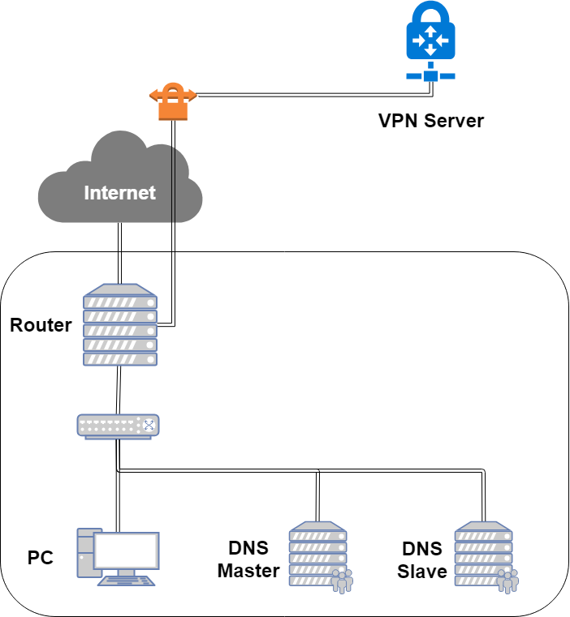
Overview
...

Slide 4
Overview (Cont.)
Use “{student_ID}.nasa.” as your domain name.
ns1.{student_ID}.nasa.
IP: 10.113.x.1
Master zone
{student_ID}.nasa.
sec.{student_ID}.nasa.
ns2.{student_ID}.nasa.
Slave zone
{student_ID}.nasa.
sec.{student_ID}.nasa.
You can find a teammate and do this homework together.

Slide 5
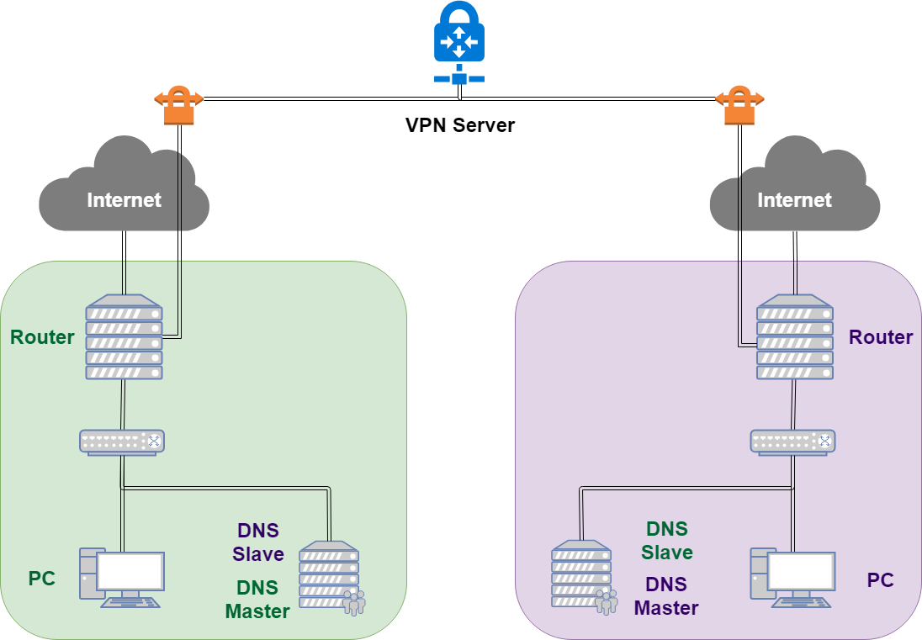
Overview (Cont.)

Slide 6
Requirements
Setup a DNS servers with BIND.
ns1.{student_ID}.nasa.
Serve your own domain.
{student_ID}.nasa.
Be able to query from the intranet. (10.113.x.x/16)
Setup another DNS server with BIND
ns2.{student_ID}.nasa.
Slave zone for “{student_ID}.nasa.” synchronized from ns1.
Updates should be synchronized
SOA must have same Serial number
Properly query for zone “nasa.” with 10.113.0.254.
You may use slave zone to implement it.
Security
Only allow zone transfer from Slave and 10.113.0.0/21.
No open recursion.

Slide 7
Requirements (Cont.)
Add A record for the machines in HW[1-3].
router
ldap1 (LDAP Master)
ldap2 (LDAP Slave)
ns1 (DNS Master)
ns2 (DNS Slave)
Add CNAME record
nasa => nasa.cs.nctu.edu.tw.
friend => ns2
VIEW
Add A record for view.{your_domain}.
For queries from 10.113.2.x/24, 10.113.3.x/24
Answer 140.113.235.131
For queries from 10.113.1.x/24, 10.113.4.x/24
Answer 140.113.235.151
For other queries
Answer 10.113.x.87

Slide 8
Requirements (Cont.)
Allow reverse lookup from the intranet.
nslookup 10.113.x.y
y.x.113.10.in-addr.arpa
Add SSHFP record of your machines’ ssh key fingerprint.
router
ldap1 (LDAP Master)
ldap2 (LDAP Slave)
ns1 (DNS Master)
ns2 (DNS Slave)
DNSSEC
Delegate sec.{your_domain} to yourself.
Add {student_ID} TXT record to id.sec.{your_domain}
Enable on sec.{your_domain}
You must use NSEC3 to implement it.
https://github.com/dnsviz/dnsviz.git

Slide 9
DEMO
Demo
Due date: 2019/5/30 18:30
Help
Email to ta@nasa.cs.nctu.edu.tw
Don’t send email by E3new
EC 3F CSCC

