Slide 1
Network Administration HW2 Checkpoints
yysung

Slide 2
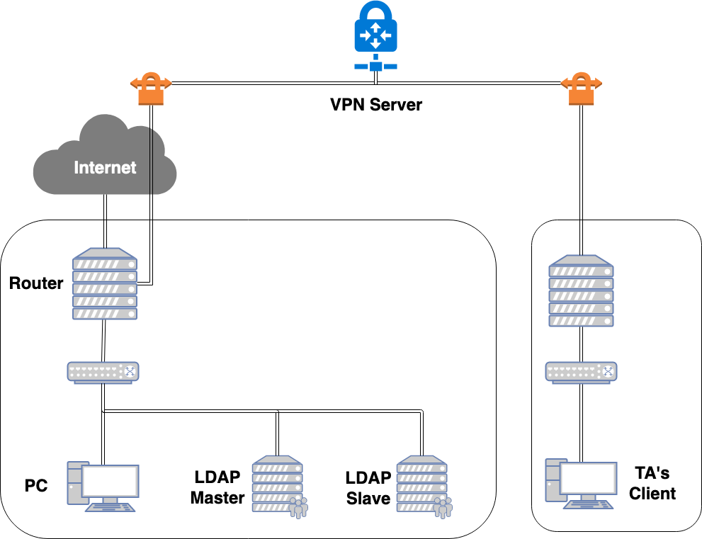
Overview

Slide 3
Overview
clusterInfo check
uidNumber check
Login check
Bind to DN "cn=Syncer” Check
Slave check
TLS check
Slave Sync check
15% Custom schema
15% Basic LDIF usage
15% Integrated with SSH
15% ACL
10%
15% STARTTLS
15% overlay syncrepl

Slide 4
Checkpoints (1/7)
clusterInfo check
TA will send query requests
“-b cn=master,ou=ldap,dc=<student-id>,dc=nasa”
“-b cn=slave,ou=ldap,dc=<student-id>,dc=nasa”
to your LDAP Master from TA’s Client
Your address attribute in cn=master should be 10.113.{your ip}.11, cn=slave should not be 10.113.{your ip}.11

Slide 5
Checkpoints (2/7)
uidNumber check
TA will send the query request
“uidNumber=3001”
to your LDAP Master from TA’s Client and check the cn attribute
cn should be your student id

Slide 6
Checkpoints (3/7)
Login check
TA will login your {LDAP Master, LDAP Slave, Router} with TA's private key from TA’s Client.

Slide 7
Checkpoints (4/7)
Bind to DN "cn=Syncer” Check
Only slave server can bind to DN "cn=Syncer”
TA will send query requests
“-b cn=Syncer,dc=<student-id>,dc=nasa -x -W hahaYouCatchMe -D cn=Syncer,dc=<student-id>,dc=nasa”
to your {LDAP Master, LDAP Slave}
from {TA’s Client, Router, LDAP Master, LDAP Slave}
Only query requests from your LDAP Slave can bind successfully

Slide 8
Checkpoints (5/7)
Slave check
TA will send query requests
“-b cn=master,ou=ldap,dc=<student-id>,dc=nasa”
“-b cn=slave,ou=ldap,dc=<student-id>,dc=nasa”
“uidNumber=3001”
to your LDAP Slave from TA’s Client

Slide 9
Checkpoints (6/7)
TLS check
TA will send query requests to {LDAP Master, LDAP Slave} from TA’s Client with TLS encryption
Will add LDAPTLS_REQCERT=never to environment so don’t worry about that verification fails on self signed certificate

Slide 10
Checkpoints (7/7)
Slave Sync check
TA will send a query request to LDAP Master to change the password of cn=Syncer,dc=<student-id>,dc=nasa
After 60 seconds, TA will send a query request
”-b cn=Syncer,dc=<student-id>,dc=nasa”
to LDAP Slave and bind cn=Syncer,dc=<student-id>,dc=nasa with new password
After testing, TA will change the password of cn=Syncer back to ”hahaYouCatchMe”
Backup your LDAP Master and LDAP Slave before the demo!

Slide 11
Demo
TAs will try to login via public key and execute some script to validate your works.
Due date: 5/16 18:30

Slide 12
Help!
Email to ta@nasa.cs.nctu.edu.tw
Don’t send email by E3new
EC 3F CSCC

