Slide 1
Network Administration HW2
tzute

Slide 2
Purposes
Build a primary-replica architecture LDAP service
Understand how to define LDAP schema from scratch
Understand how to manage LDAP datas using LDIF
Understand how to integrate other applications with LDAP

Slide 3
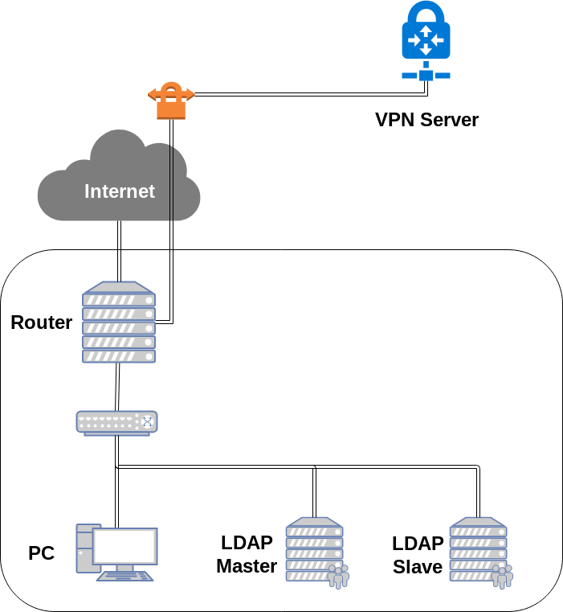
Overview

Slide 4
Overview (cont.)
One LDAP master server
Providing LDAP service
Connecting into your intranet
One LDAP slave server
Providing LDAP service
Connecting into your intranet
Auto-sync datas from master
You can find a teammate and do this homework together

Slide 5
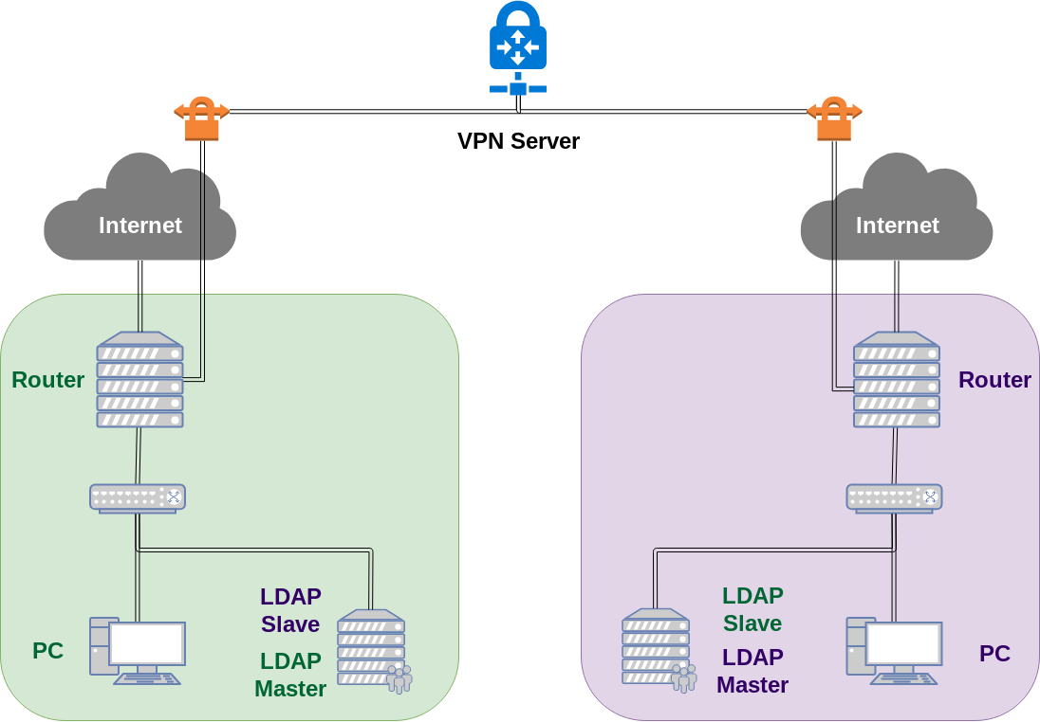
Overview (cont.)

Slide 6
Requirements (1/6)
LDAP master
IP: 10.113.x.11/24 with static DHCP
Which means you have to re-configure your DHCP server to offer this server static IP
Base DN: dc=<student-id>,dc=nasa
StartTLS on LDAP service
Use self-signed certificate
Support SASL
Store hashed password into each DN's userPassword

Slide 7
Requirements (2/6)
LDAP master (cont.)
Enable ACL
Everyone can read all datas expect userPassword
Authenticated users can write their own userPassword
Only slave server can bind to DN "cn=Syncer"
"cn=Syncer" can read all datas
Specific DN "cn=Syncer"
Set credential to "hahaYouCatchMe" (excluding double-quotes)

Slide 8
Requirements (3/6)
LDAP slave
Same as master, but
Choose any IP you want but bind with static DHCP
Bind to "cn=Syncer" while syncing from master
Sync from master every 60 seconds

Slide 9
Requirements (4/6)
objectClass "clusterInfo"
attributeType "address"
Specific DN "cn=master,ou=ldap,dc=<student-id>,dc=nasa"
objectClass: clusterInfo
address should be LDAP master server address (10.113.x.11)
Specific DN "cn=slave,ou=ldap,dc=<student-id>,dc=nasa"
objectClass: clusterInfo
address should be LDAP slave server address

Slide 10
Requirements (5/6)
Router, Client, LDAP master, LDAP slave
Should can login with LDAP posixAccount
At least, login via SSH should be worked
Users can execute passwd to change their own password
Specific user "cn=<student-id>"
uidNumber: 3001
set your own password

Slide 11
Requirements (6/6)
objectClass "publicKeyLogin"
attributeType "sshPublicKey"
Specific DN "cn=TA"
objectClass: posixAccount
objectClass: publicKeyLogin
uidNumber: 3000
sshPublicKey: <TA's public key>
Should can login SSH with sshPublicKey
Retrieve TA's public key here
http://navpn.nctucs.cc/ta_rsa.pub (or access via 10.113.0.254)

Slide 12
Demo
TAs will try to login via public key and execute some script to validate your works.
Due date: 5/9 18:30

Slide 13
Tips
Google "How to get your own OID"
Google "sshd_config AuthorizedKeysCommand"

Slide 14
Help!
Email to ta@nasa.cs.nctu.edu.tw
Don’t send email by E3new
EC 3F CSCC

