Slide 1
Network Administration HW1
zswu

Slide 2
Purposes
Building an intranet with DHCP, NAT, VPN, DNS, LDAP, Mail, WWW… services
Understanding and managing all these services

Slide 3
HW1 Overview
One “Router”
Provides NAT, DHCP, VPN
Connecting your “ClientPC” to the outside world
Connecting to VPN Server and transfer packets from/to TAs and classmates
One “ClientPC”
Simulate a simple PC inside the intranet
Help you verify your results

Slide 4
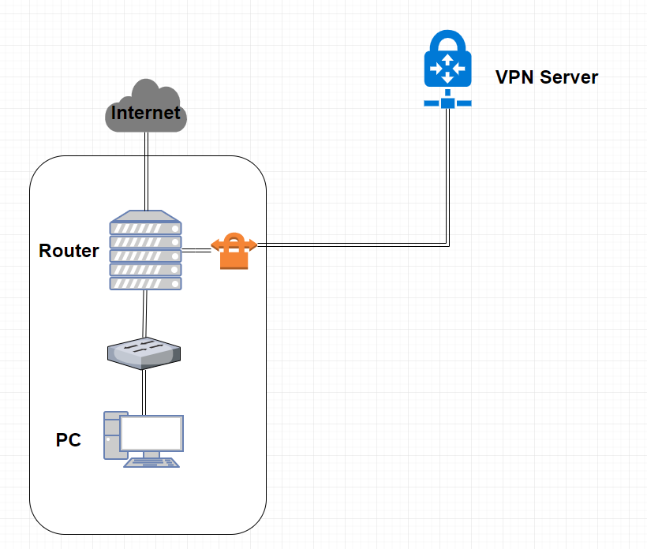
NA Intranet Schematic Diagram

Slide 5
Requirements (1/4)
“Router”
You will be arranged a 10.113.x.0/24 subnet by TA for you to do your homework during this semester
Don’t change your subnet by yourself! Your grade is based on the services in your subnet, and you may crash the whole intranet due to IP collision
Router must have these three network interfaces
Public : To Internet
Provides NAT on this interfaces, so the packets from the internal network can go to the outside world
Private : To the internal network
Provides DHCP on this interfaces, with IP between 10.113.x.100 and 10.113.x.200
VPN : To VPN Server (navpn.nctucs.cc)
Send the packets to this interfaces if it's target is 10.113.0.0/16

Slide 6
Requirements (2/4)
About VPN
Use Wireguard (https://www.wireguard.com/)
You will get a pre-generate private key and the public key of server for you to connect to navpn.nctucs.cc:51820
You can create your own vpn peer so you can connect to your intranet from outside world
About VM
We use Virtualbox by default. You can choose another VM engine or use VPS, but you must satisfy the requirements (Network interfaces, intranet, vpn…etc)
With Virtualbox network card settings, you can use “NAT” as the public interface, use “Internal Network” as the private interface
Except “Router”, all servers inside the internal network can only have one network interface connect to “Router”, second interfaces on the servers is not allowed

Slide 7
Requirements (3/4)
Routing and Firewall
You may need additional settings for the routing table
By default, all the packets from/to 10.113.0.0/16 are allowed
By default, the packets from Internet are denied, the packets to Internet are allowed
“Router” has two IP address
10.113.0.x/16 on VPN interfaces
10.113.x.254/24 on private interfaces
Address on public interfaces are not limited, but make sure it won’t impact IPs of the intranet
About OS
You can choose any UNIX-like OS, but make sure it supports all the feature we need
We use CentOS by default. Archlinux, Ubuntu and FreeBSD should be fine
You can choose different OS for each servers

Slide 8
Requirements (4/4)
“ClientPC”
This VM can help you debug and verify your results
You can use any OS on this VM
We use Ubuntu by default
Linux, BSD, even Windows are allowed
GUI is suggested
Connect to the network by default DHCP client
For example, if you use Ubuntu, the network should be connected without any additional configuration
After all configuration, your “ClientPC” should be able to ping your classmates’ “ClientPC”

Slide 9
DEMO
TA will ping “Router” and “ClientPC”
Ping 10.113.0.x and 10.113.x.254
Ping the IP which “ClientPC” get from the DHCP server
Due date: 2019/4/11 18:30

Slide 10
FAQ
How to check NAT connectivity?
Ping 8.8.8.8 from ClientPC
Ping www.google.com from ClientPC
How to check VPN work correctly?
Ping 10.113.0.254 from Router/ClientPC
How to check DHCP work correctly?
$ ip addr or $ ifconfig
Ping 10.113.x.254 (Router) from ClientPC

Slide 11
Help!
Email to ta@nasa.cs.nctu.edu.tw
Don’t send email by E3new
EC 3F CSCC

