Slide 1
FTP
File Transfer Protocol

Slide 2
FTP
FTP
File Transfer Protocol
Used to transfer data from one computer to another over the internet.
Client-Server Architecture.
FTP connections
Control connection
Created when an FTP session is established
Only for passing control information
Data connection
Each time that data is sent, a distinct TCP data connect is established
Data connection Modes:
Active Mode
Passive Mode

Slide 3
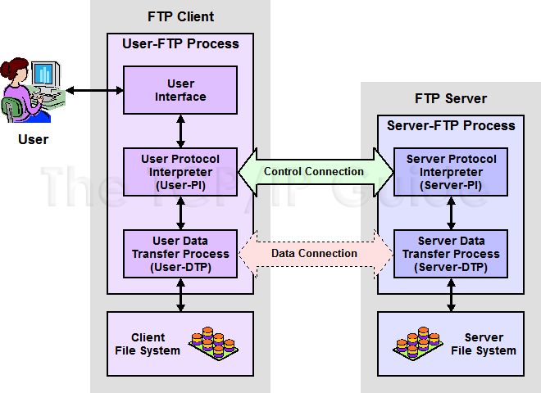
FTP
FTP RFCs:
RFC 959 – File Transfer Protocol
RFC 2228 – FTP Security Extensions
RFC 2428 – FTP Extensions for IPv6 and NATs
RFC 2640 – UTF-8 support for file name

Slide 4
FTP – Flow (1)
Client
Connect to server port 21 from port A.
USER ####
PASS ********
EPRT |1|ip|portnum|
Send some requests get return data from portnum
Quit
Server
Binding on port 21
Accepts connection from client, output welcome messages.
331 User name okay, need password.
230 User logged in, proceed.
200 PORT Command successful.
Binding source port 20, connect to client port portnum, send data.
…

Slide 5
FTP – Flow (2)
% telnet freebsd.cs.nctu.edu.tw 21
Trying 140.113.17.209...
Connected to freebsd.cs.nctu.edu.tw.
Escape character is '^]'.
220---------- Welcome to Pure-FTPd [privsep] ----------
220-You are user number 7 of 1000 allowed.
220-Local time is now 16:25. Server port: 21.
220-Only anonymous FTP is allowed here
220-IPv6 connections are also welcome on this server.
220 You will be disconnected after 15 minutes of inactivity.
USER ftp
331 Any password will work
PASS ftp
230 Any password will work
EPRT |1|140.113.235.135|65000|
200 PORT command successful
list
150 Connecting to port 65000
226-Options: -l
226 2 matches total
quit
221-Goodbye. You uploaded 0 and downloaded 0 kbytes.
221 Logout.
Connection closed by foreign host.
Example
Control Connection

Slide 6
FTP – Flow (3)
Example (contd.)
Retrieving Data
Client must bind the random port
% nc -l 65000
drwxr-xr-x 852 888 2010 80328 Mar 28 11:39 distfiles
drwxr-xr-x 16 888 2010 34 May 11 2008 pub

Slide 7
FTP – commands, responses
Commands
USER username
PASS password
LIST
Return list of file in current dir.
CWD dirname
Change working directory
RETR filename
Retrieves (gets) file.
STOR filename
Stores (puts) file onto server.
EPRT |1|ip|port|
Set to active mode
PASV(EPSV)
Set to passive mode
DELE
Remove file on the server.
QUIT
Return Codes
First code
1: Positive Preliminary reply
2: Positive Completion reply
3: Positive Intermediate reply
4: Transient Negative Completion reply
5: Permanent Negative Completion reply
Second code
0: The failure was due to a syntax error
1: A reply to a request for information.
2: A reply relating to connection information
3: A reply relating to accounting and authorization.
5: The status of the Server file system

Slide 8
FTP – Active Mode vs. Passive Mode (1)
Active Mode
FTP client bind a random port (>1023) and sends the random port to FTP server using “EPRT” command.
When the FTP server initiates the data connection to the FTP client, it binds the source port 20 and connect to the FTP client the random port sent by client.
EPRT |1|ip|port|
EPRT |2|ipv6|port|
Passive Mode
FTP client sends “EPSV/PASV” command to the server, make the server bind a random port (>1023) and reply the random port back.
When initializing the data connection, the FTP client connect to the FTP Server the random port, get data from that port.
EPSV ➔ Server reply: 229 Entering Extended Passive Mode (|||1868|)
PASV ➔ Server reply: 227 Entering Passive Mode (h1,h2,h3,h4,p1,p2)
※ IP:port (6 bytes) → h1,h2,h3,h4,p1,p2
Ex. 140.113.17.215:45678 → 140,113,17,215,178,110

Slide 9
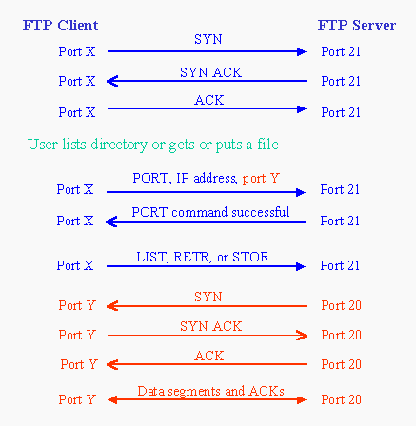
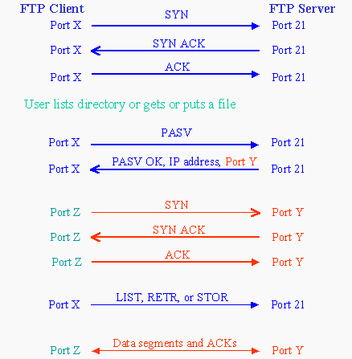
FTP – Active Mode vs. Passive Mode (2)
Active mode
Passive mode

Slide 10
FTP – When FTP meets NAT/Firewall (1)
Firewall behavior
Generally, the NAT/Firewall permits all outgoing connection from internal network, and denies all incoming connection from external network.
Problem when FTP meets NAT/Firewall
Due to the separated command/data connection, the data connections are easily blocked by the NAT/Firewall.
Problem Cases:
Active mode, NAT/Firewall on client side.
Passive mode can solve this problem.
Passive mode, NAT/Firewall on server side.
Active mode can solve this problem.
Both client side and server side have NAT/Firewall
The real problem.

Slide 11


FTP – When FTP meets NAT/Firewall (2)
Active mode, NAT/Firewall on client side.
Passive mode can solve this problem.
NAT/Firewall
NAT/Firewall
Client
Server
Client
Server
PORT IP, port Y
PASV
reply IP, port Z
Connect to port Y BLOCKED
Connect to port Z
PASS
Active Mode
Passive Mode

Slide 12
FTP – When FTP meets NAT/Firewall (3)
Passive mode, NAT/Firewall on Server side.
Active mode can solve this problem.
NAT/Firewall
NAT/Firewall
Client
Server
Client
Server
PASV
PORT IP, port Y
reply IP, port Z
Connect to port Z
BLOCKED
Connect to port Y PASS
Passive Mode
Active Mode

Slide 13
FTP – When FTP meets NAT/Firewall (4)
Real Problem: Firewall on both sides.
Solution: ftp-proxy running on NAT/Firewall
NAT/Firewall
NAT/Firewall
NAT/Firewall
NAT/Firewall
Client
Server
Client
Server
PORT IP, port Y
PASV
reply IP, port Z
Connect to port Y BLOCKED
Connect to port Z
BLOCKED
Active Mode
Passive Mode

Slide 14
FTP – Security
Security concern
As we seen, FTP connections (both command and data) are transmitted in clear text.
What if somebody sniffing the network?
We need encryption.
Solutions
FTP over SSH
So called secure-FTP(sftp).
Both commands and data are encrypted while transmitting.
One connection, but poor performance.
FTP over TLS
Only commands are encrypted while transmitting.
Better performance.

Slide 15
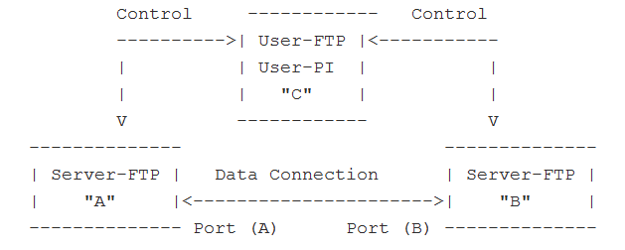
FXP
FXP
File eXchange Protocol/Proxy FTP
A user on one host performs a file transfer from one server to another
Two control connections
One each from User-PI to the two Server-PI
One data connections
Server-DTPs are invoked on each server to send data

Slide 16
FTP – Pure-FTPd (1)
Introduction
A small, easy to set up, fast and secure FTP server
Support chroot
Restrictions on clients, and system-wide.
Verbose logging with syslog
Anonymous FTP with more restrictions
Virtual Users, and Unix authentication
FXP (File eXchange Protocol)
FTP over TLS
UTF-8 support for filenames

Slide 17
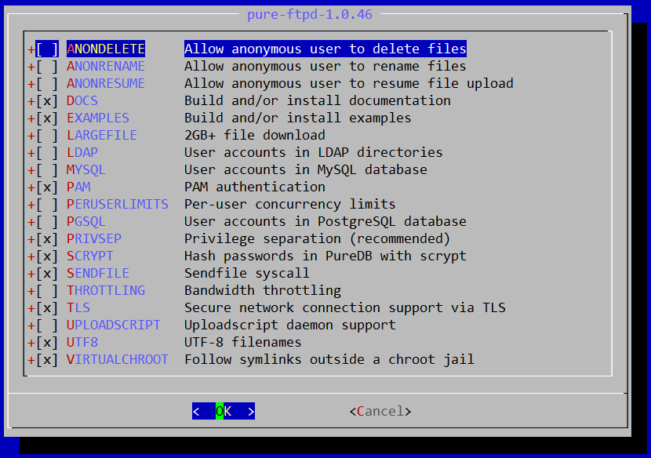
FTP – Pure-FTPd (2)
Installation
Ports: /usr/ports/ftp/pure-ftpd
Options

Slide 18
FTP – Pure-FTPd (3)
nctucs [/usr/ports/ftp/pure-ftpd] -wangth- sudo make extract
…
You can use the following additional options:
LANGUAGE=lang (default: english)
- Enable compilation of one language support
available lang: brazilian-portuguese, catalan, czech, danish, dutch,
english, french, french-funny, german, hungarian, italian, korean,
norwegian, polish, romanian, russian, simplified-chinese, slovak,
spanish, swedish, traditional-chinese, Turkish
Other options
WITH_LANG
Change the language of output messages
Startup:
Add pureftpd_enable="YES" in /etc/rc.conf

Slide 19
FTP – Pure-FTPd Configurations(1)
nctucs [/usr/local/share/doc/pure-ftpd] -wangth- ls
AUTHORS pureftpd.schema README.PGSQL
CONTACT README README.TLS
COPYING README.Authentication-Modules README.Virtual-Users
HISTORY README.Configuration-File THANKS
NEWS README.LDAP
pure-ftpd.png README.MySQL
Configurations:
File: /usr/local/etc/pure-ftpd.conf
Documents
Configuration sample: /usr/local/etc/pure-ftpd.conf.sample
All options are explained clearly in this file.
Other documents
See /usr/local/share/doc/pure-ftpd/*

Slide 20
FTP – Pure-FTPd Configurations(2)
# Cage in every user in his home directory
ChrootEveryone yes
# If the previous option is set to "no", members of the following group
# won't be caged. Others will be. If you don't want chroot()ing anyone,
# just comment out ChrootEveryone and TrustedGID.
TrustedGID 0
# PureDB user database (see README.Virtual-Users)
PureDB /usr/local/etc/pureftpd.pdb
# If you want simple Unix (/etc/passwd) authentication, uncomment this
UnixAuthentication yes
# Port range for passive connections replies. - for firewalling.
PassivePortRange 30000 50000
# This option can accept three values :
# 0 : disable SSL/TLS encryption layer (default).
# 1 : accept both traditional and encrypted sessions.
# 2 : refuse connections that don't use SSL/TLS security mechanisms,
# including anonymous sessions.
# Do _not_ uncomment this blindly. Be sure that :
# 1) Your server has been compiled with SSL/TLS support (--with-tls),
# 2) A valid certificate is in place,
# 3) Only compatible clients will log in.
TLS 2
# UTF-8 support for file names (RFC 2640)
# Define charset of the server filesystem and optionnally the default charset
# for remote clients if they don't use UTF-8.
# Works only if pure-ftpd has been compiled with --with-rfc2640
FileSystemCharset big5
# ClientCharset big5

Slide 21
FTP – Pure-FTPd Problem Shooting
Logs Location
In default, syslogd keeps ftp logs in /var/log/xferlog
Most frequent problem
pure-ftpd: (?@?) [ERROR] Unable to find the 'ftp' account
It’s ok, but you may need it for Virtual FTP Account.
pure-ftpd: (?@?) [ERROR] Sorry, but that file doesn't exist: [/etc/ssl/private/pure-ftpd.pem]
If you set TLS = 2, then this file is needed.
How to generate a pure-ftpd.pem?
See README.TLS

Slide 22
FTP – Pure-FTPd Tools
nctucs [~] -wangth- pure-
pure-alwaysfail pure-ftpd pure-mrtginfo pure-pwconvert pure-statsdecode
pure-authd pure-ftpwho pure-pw pure-quotacheck pure-uploadscript
pure-*
pure-ftpwho
List information of users who use the FTP server now.
pure-pw
To create Virtual Users using PureDB
pure-pw(8)
See README.Virtual-Users

Slide 23
FTP – More Tools
ftp/pureadmin
Management utility for the PureFTPd
ftp/lftp
A powerful functional client
Support TLS
ftp/wget
Retrieve files from the Net via HTTP(S) and FTP
ftp/mget
Multithreaded commandline web-download manager
FileZilla
An FTP Client for Windows
Support TLS

Slide 24
FTP – PF: Issues with FTP (1)
Reference: http://www.openbsd.org/faq/pf/ftp.html
FTP Client Behind the Firewall
Problem
Clients cannot use active mode
Use ftp-proxy(8)
ftpproxy_enable="YES"
In pf.conf
nat-anchor "ftp-proxy/*"
rdr-anchor "ftp-proxy/*"
rdr on $int_if proto tcp from any to any port 21 -> 127.0.0.1 port 8021
anchor "ftp-proxy/*"

Slide 25
FTP – PF: Issues with FTP (2)
PF “Self-Protecting” an FTP Server
Problem
Clients cannot use passive mode
Open holes so that clients can connect into the data channel
In pf.conf
pass in on $ext_if proto tcp from any to any port 21 keep state
pass in on $ext_if proto tcp from any to any port > 49151 keep state

Slide 26
FTP – PF: Issues with FTP (3)
FTP Server Protected by an External PF Firewall Running NAT
Problem
Clients cannot use passive mode
Use ftp-proxy(8)
Need some flags of ftp-proxy
ftpproxy_flags="-R 10.10.10.1 -p 21 -b 192.168.0.1"
In pf.conf
nat-anchor "ftp-proxy/*"
nat on $ext_if inet from $int_if -> ($ext_if)
rdr-anchor "ftp-proxy/*"
pass in on $ext_if inet proto tcp to $ext_ip port 21 flags S/SA keep state
pass out on $int_if inet proto tcp to $ftp_ip port 21 user proxy flags S/SA keep state
anchor "ftp-proxy/*"

