Slide 1
Postfix

Slide 2
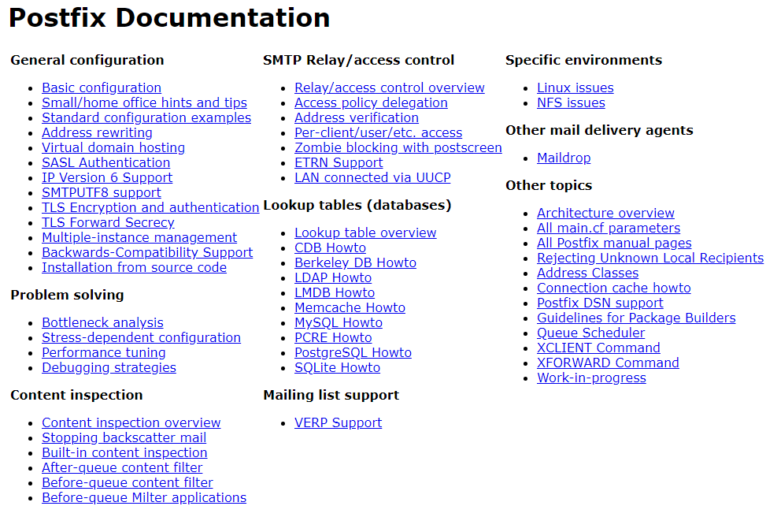
Postfix
Postfix v3.4.5
/usr/ports/mail/postfix
pkg install postifx
http://www.postfix.org
http://www.postfix.org/documentation.html
2

Slide 3
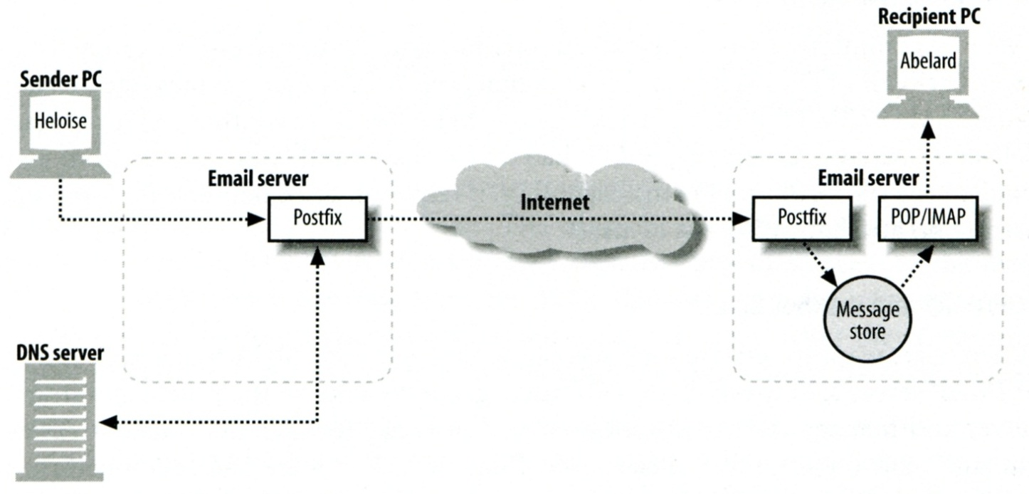
Role of Postfix
MTA that
Receive and deliver email over the network via SMTP
Local delivery directly or use other mail delivery agent
http://www.postfix.org/OVERVIEW.html

Slide 4
Postfix Architecture
Modular-design MTA
Not like sendmail of monolithic system
Decompose into several individual program that each one handle specific task
The most important daemon: master daemon
Reside in memory
Get configuration information from master.cf and main.cf
Invoke other process to do jobs
Major tasks
Receive mail and put in queue
Queue management
Delivery mail from queue

Slide 5
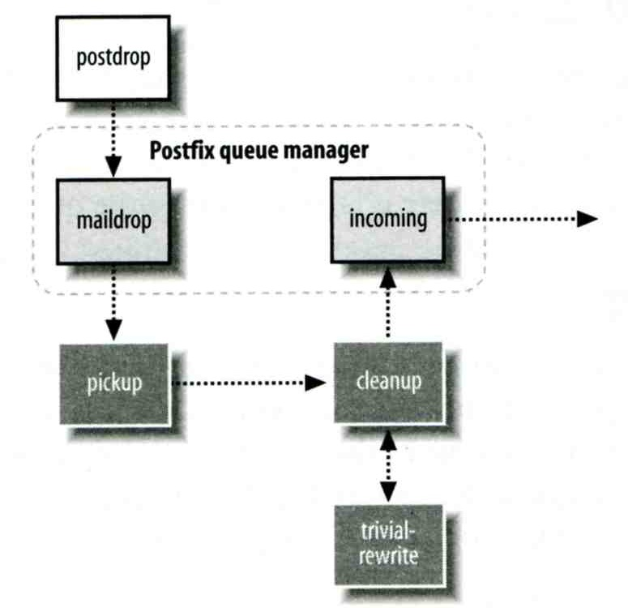
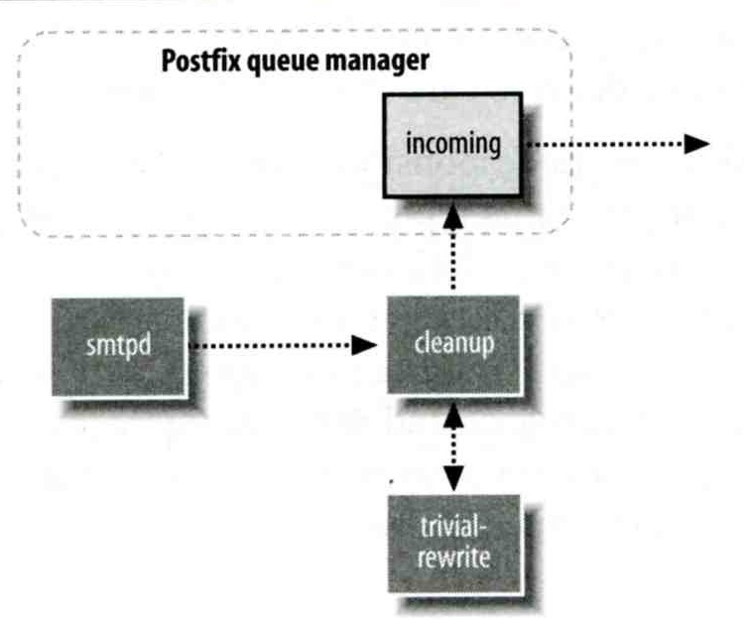
Postfix Architecture – Message IN
Four ways
Local submission
postdrop command
maildrop queue
pickup daemon
cleanup daemon
Header validation
address translation
incoming queue
Network submission
smtpd daemon
Local forwarding
Resubmit for such as .forward
Envelope “to” is changed
Notification
Local submission
Network submission

Slide 6
Postfix Architecture – Queue
Five different queues
incoming
The first queue that every incoming email will stay
active
Queue manager will move message into active queue whenever there is enough system resources
Queue manager then invokes suitable DA to delivery it
deferred
Messages that cannot be delivered are moved here
These messages are sent back either with bounce or defer daemons
corrupt
Used to store damaged or unreadable message
hold
http://www.postfix.org/QSHAPE_README.html#queues

Slide 7
Postfix Architecture – Message OUT – Part I
Address classes
Used to determine which destinations to accept for delivery
How the delivery take place
Main address classes
Local delivery
Domain names in “mydestination” is local delivered
Ex:
mydestination = nasa.cs.nctu.edu.tw localhost
It will check alias and .forward file to do further delivery
Relay
Transfer mail for others to not your domain
It is common for centralize mail architecture to relay trusted domain
Deliver mail to other domains for authorized user
The queue manager will invoke the smtp DA to deliver this mail
Virtual alias
Virtual mailbox

Slide 8
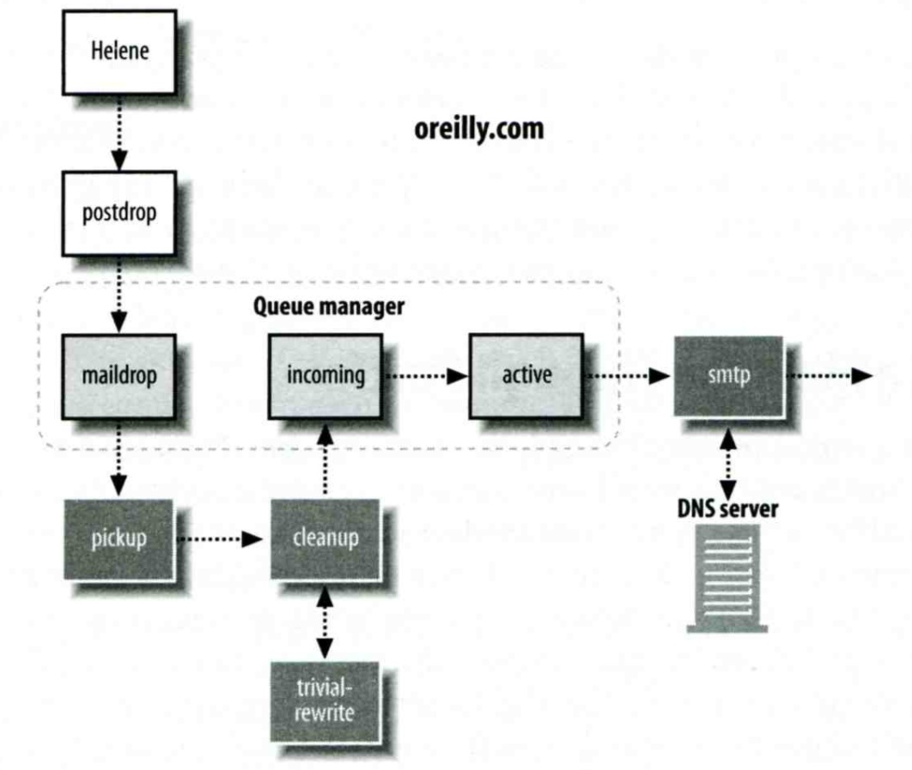
Message Flow in Postfix (1)
Example
helene@oreilly.com → frank@postfix.org (doel@onlamp.com)
Phase1:
Helene compose mail using her MUA, and then call postfix’s sendmail command to send it

Slide 9
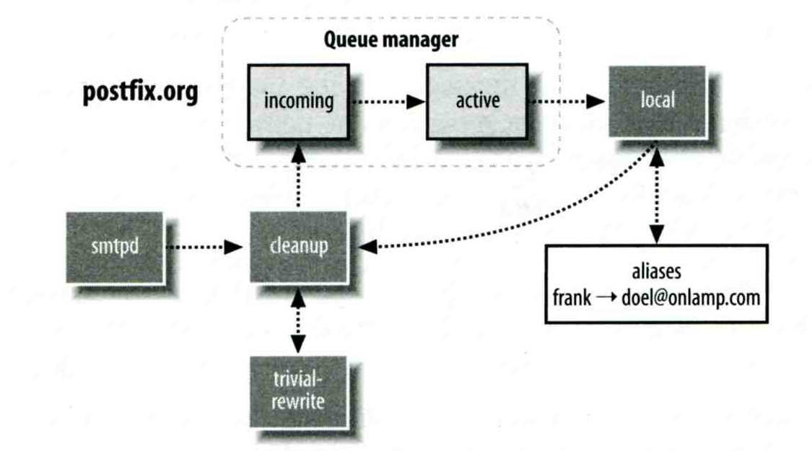
Message Flow in Postfix (2)
Example
frank@postfix.org → doel@onlamp.com
Phase2:
The smtpd on postfix.org takes this message and invoke cleanup then put in incoming queue
The local DA find that frank is an alias, so it resubmits it through cleanup daemon for further delivery

Slide 10
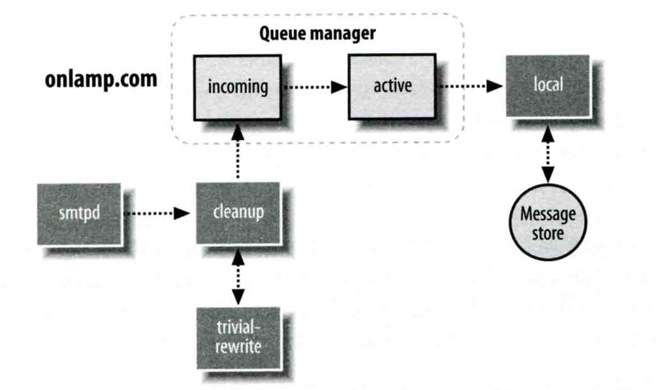
Message Flow in Postfix (3)
Example
frank@postfix.org → doel@onlamp.com
Phase3
The smtpd on onlamp.com takes this message and invoke cleanup then put in incoming queue
Local delivery to message store

Slide 11
Message Store Format
The Mbox format
Store messages in single file for each user
Each message start with “From ” line and continued with message headers and body
Mbox format has file-locking problem
The Maildir format
Use structure of directories to store email messages
Each message is in its owned file
Three subdirectories - cur, new, and tmp
Maildir format has scalability problem
locate and delete mails quickly, but waste amounts of fd, inodes, space
Problems of quota and backup
Related parameters (in main.cf)
mail_spool_directory = /var/mail (Mbox)
mail_spool_directory = /var/mail/ (Maildir)

Slide 12
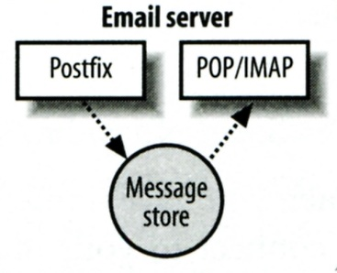
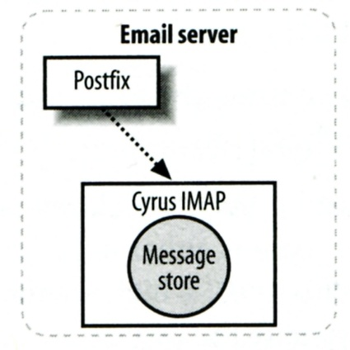
Postfix & POP3/IMAP
POP3 vs. IMAP
Both are used to retrieve mail from server for remote clients
POP3 has to download entire message, while IMAP can download headers only
POP3 can download only single mailbox, while IMAP can let you maintain multiple mailboxes and folders on server
Postfix works together with POP3/IMAP
Postfix and POP3/IMAP must agree on the type of mailbox format and style of locking
Standard message store
Non-standard message store (using LMTP)
Such as Cyrus IMAP or Dovecot

Slide 13
Postfix Configuration
Two most important configuration files
/usr/local/etc/postfix/main.cf – postconf(5)
Core configuration
/usr/local/etc/postfix/master.cf – master(5)
Which postfix service should invoke which program
Edit main.cf
Using text editor
postconf
% postconf [-e] "myhostname = nasa.cs.nctu.edu.tw"
% postconf -d myhostname (print default setting)
% postconf myhostname (print current setting)
Reload postfix whenever there is a change
# postfix reload

Slide 14
Postfix Configuration – Lookup tables (1)
Parameters that use external files to store values
Such as mydestination, mynetwork, relay_domains
Text-based table is ok, but time-consuming when table is large
Lookup tables syntax
Key values
Database format
% postconf -m
List all available database format
In main.cf
default_database_type
http://www.postfix.org/DATABASE_README.html
% postconf -m
btree
cidr
environ
hash
internal
proxy
regexp
static
tcp
texthash
unix
% postconf default_database_type
default_database_type = hash
% postconf -h default_database_type
hash

Slide 15
Postfix Configuration – Lookup tables (2)
Use databased-lookup table in main.cf
syntax
parameter = type:name
Ex:
In main.cf canonical_maps = hash:/usr/local/etc/postfix/canonical
After execute postmap /usr/local/etc/postfix/canonical.db
postmap command
Generate database
# postmap hash:/usr/local/etc/postfix/canonical
Query
% postmap -q nctu.edu.tw hash:/usr/local/etc/postfix/canonical

Slide 16
Postfix Configuration – Lookup tables (3)
Regular expression tables
More flexible for matching keys in lookup tables
Sometimes you cannot list all the possibilities
Two regular expression libraries used in Postfix
POSIX extended regular expression (regexp, default)
Perl-Compatible regular expression (PCRE)
Usage
/pattern/ value
Do some content checks, such as
header_checks
body_checks
Design some features
/(\S+)\.(\S+)@nasa\.cs\.nctu\.edu\.tw/ $1@nasa.cs.nctu.edu.tw

Slide 17
Postfix Configuration – Categories
Categories
Server identities
my...
Mail rewriting
for incoming/outgoing mails
Access control
restrictions
Mail processing
filter
Operation details
…

Slide 18
Postfix Configuration – MTA Identity
Four related parameters
myhostname
myhostname = nasa.cs.nctu.edu.tw
If un-specified, postfix will use ‘hostname’ command
mydestination
List all the domains that postfix should accept for local delivery
mydestination = $myhostname, localhost.$mydomain $mydomain
This is the CS situation that mx will route mail to mailgate
mydestination = $myhostname www.$mydomain, ftp.$mydomain
mydomain
mydomain = cs.nctu.edu.tw
If un-specified, postfix use myhostname minus the first component
myorigin
myorigin = $mydomain (default is $myhostname)

Slide 19
Postfix Configuration – System-wide aliases files
Using aliases in Postfix (first-matching)
alias_maps = hash:/etc/aliases
alias_maps = hash:/etc/aliases, nis:mail.aliases
alias_database = hash:/etc/aliases
Tell newaliases command which aliases file to build
To Build alias database file
% postalias /etc/aliases
Alias file format (same as sendmail)
RHS can be
Email address, filename, |command, :include:
Alias restriction
allow_mail_to_commands = alias, forward
allow_mail_to_files = alias, forward

Slide 20
Postfix Configuration – Virtual Alias Maps
Virtual Alias Map
It recursively rewrites envelope recipient addresses for all local, all virtual, and all remote mail destinations.
virtual_alias_domains = $virtual_alias_maps (default)
virtual_alias_maps = hash:/usr/local/etc/postfix/virtual
src-address dst-address
chwong@csie.nctu.edu.tw @chbsd.cs.nctu.edu.tw
chwong ch0nsi@gmai1.com
@csie.nctu.edu.tw @cs.nctu.edu.tw
Applying regular expression
virtual_alias_maps = pcre:/usr/local/etc/postfix/virtual
/^root(\..+)?@(t)?(cs|np)?bsd\d*\.cs\.nctu\.edu\.tw$/ bsdta@cs.nctu.edu.tw
/^root(\..+)?@(t)?(cs|np)?linux\d*\.cs\.nctu\.edu\.tw$/ linuxta@cs.nctu.edu.tw
/^root(\..+)?@(t)?csmail\w*\d*\.cs\.nctu\.edu\.tw$/ mailta@cs.nctu.edu.tw

Slide 21
Postfix Configuration – Relay Control (1)
Open relay
A mail server that permit anyone to relay mails
By default, postfix is not an open relay
A mail server should
Relay mail for trusted user
Such as liuyh@smtp.cs.nctu.edu.tw
Relay mail for trusted domain
Ex. smtp.cs.nctu.edu.tw trusts nctu.edu.tw

Slide 22
Postfix Configuration – Relay Control (2)
Restricting relay access by mynetworks_style
mynetworks_style = subnet
Allow relaying from other hosts in the same subnet, configured in this machine
mynetworks_style = host
Allow relaying for only local machine
mynetworks_style = class
Any host in the same class A, B or C
Restricting relay access by mynetworks (override mynetworks_style)
List individual IP or subnets in network/netmask notation
Ex: in /usr/local/etc/postfix/mynetworks
127.0.0.0/8
140.113.0.0/16
10.113.0.0/16
Relay depends on the type of your mail server
smtp.cs.nctu.edu.tw will be different from csmx1.cs.nctu.edu.tw

Slide 23
Postfix Configuration – Receiving limits
Enforce limits on incoming mail
The number of recipients for single delivery
smtpd_recipient_limit = 1000
Message size
message_size_limit = 10240000

Slide 24
Postfix Configuration – Rewriting address (1)
For unqualified address
To append “myorigin” to local name.
append_at_myorigin = yes
To append “mydomain” to address that contain only host.
append_dot_mydomain = yes
Masquerading hostname
Hide the names of internal hosts to make all addresses appear as if they come from the same mail server
It is often used in out-going mail gateway
masquerade_domains = cs.nctu.edu.tw
masquerade_domains = !chairman.cs.nctu.edu.tw cs.nctu.edu.tw
masquerade_exceptions = admin, root
Rewrite to all envelope and header address excepts envelope recipient address
masquerade_class = envelope_sender, header_sender, header_recipient

Slide 25
Postfix Configuration – Rewriting address (2)
Canonical address – canonical(5)
Rewrite both header and envelope recursively invoked by cleanup daemon
In main.cf
canonical_maps = hash:/usr/local/etc/postfix/canonical
canonical_classes = envelope_sender, envelope_recipient, header_sender, header_recipient
In canonical
/^(.*)@(t)?(cs)?(bsd|linux|sun)\d*\.cs\.nctu\.edu\.tw$/ $1@cs.nctu.edu.tw
Simlar configurations
sender_canonical_maps、sender_canonical_classes
recipient_canonical_maps、recipient_canonical_classes

Slide 26
Postfix Configuration – Rewriting address (3)
Relocated users
Used to inform sender that the recipient is moved
In main.cf
relocated_maps = hash:/usr/local/etc/postfix/relocated
In relocated
andy@nasa.cs.nctu.edu.tw andyliu@abc.com
liuyh EC319, NCTU, ROC
@nabsd.cs.nctu.edu.tw zfs.cs.nctu.edu.tw
Unknown users
Not local user and not found in maps
Default action: reject

Slide 27
Postfix Configuration – master.cf (1)
/usr/local/etc/postfix/master.cf
Define services that master daemon can invoke
Each row defines a service and
Each column contains a specific configuration option
# ==========================================================================
# service type private unpriv chroot wakeup maxproc command + args
# (yes) (yes) (yes) (never) (100)
# ==========================================================================
smtp inet n - n - - smtpd
pickup fifo n - n 60 1 pickup
cleanup unix n - n - 0 cleanup
rewrite unix - - n - - trivial-rewrite
smtp unix - - n - - smtp
local unix - n n - - local
virtual unix - n n - - virtual
relay unix - - n - - smtp
-o smtp_fallback_relay=
lmtp unix - - n - - lmtp
maildrop unix - n n - - pipe
flags=DRhu user=vmail argv=/usr/local/bin/maildrop -d ${recipient}

Slide 28
Postfix Configuration – master.cf (2)
Configuration options
Service name
Service type
inet, unix, fifo, or pass
Private
Access to this component is restricted to the Postfix system
inet cannot be private
Unprivileged
Run with the least amount of privilege required
y will run with the account defined in “mail_owner”
n will run with root privilege
local, pipe, spawn, and virtual

Slide 29
Postfix Configuration – master.cf (3)
Configuration options
Chroot
chroot location is defined in “queue_directory”
Wake up time
Automatically wake up the service after the number of seconds
Process limit
Number of processes that can be executed simultaneously
Default count is defined in “default_process_limit”
command + args
Default path is defined in “daemon_directory”
/usr/libexec/postfix

Slide 30
Postfix Architecture – Message OUT – Part II
Local delivery
Relay to the destinations
Other delivery agent (MDA)
Specify in /usr/local/etc/postfix/master.cf
How a client program connects to a service and what daemon program runs when a service is requested
lmtp
Local Mail Transfer Protocol (Limited SMTP)
No queue
One recipient at once
Used to deliver to mail systems on the same network or even the same host
pipe
Used to deliver message to external program

Slide 31
Mail Relaying – Transport Maps (1)
Transport maps – transport(5)
It override default transport method to deliver messages
In main.cf
transport_maps = hash:/usr/local/etc/postfix/transport
In transport file
domain_or_address transport:nexthop
csie.nctu.edu.tw smtp:[mailgate.csie.nctu.edu.tw]
cs.nctu.edu.tw smtp:[csmailgate.cs.nctu.edu.tw]
cis.nctu.edu.tw smtp:[mail.cis.nctu.edu.tw]
example.com smtp:[192.168.23.56]:20025
orillynet.com smtp
ora.com maildrop
kdent@ora.com error:no mail accepted for kdent

Slide 32
Mail Relaying – Transport Maps (2)
Usage in transport map
MX → Local delivery mail server
mailpost to bbs/news
Postponing mail relay
Such as ISP has to postpone until customer network is online
In transport: abc.com ondemand
In /usr/local/etc/postfix/master.cf ondemand unix - - n - - smtp
In /usr/local/etc/postfix/main.cf defer_transports = ondemand transport_maps = hash:/usr/local/etc/postfix/transport
Whenever the customer network is online, do
# postqueue -s abc.com

Slide 33
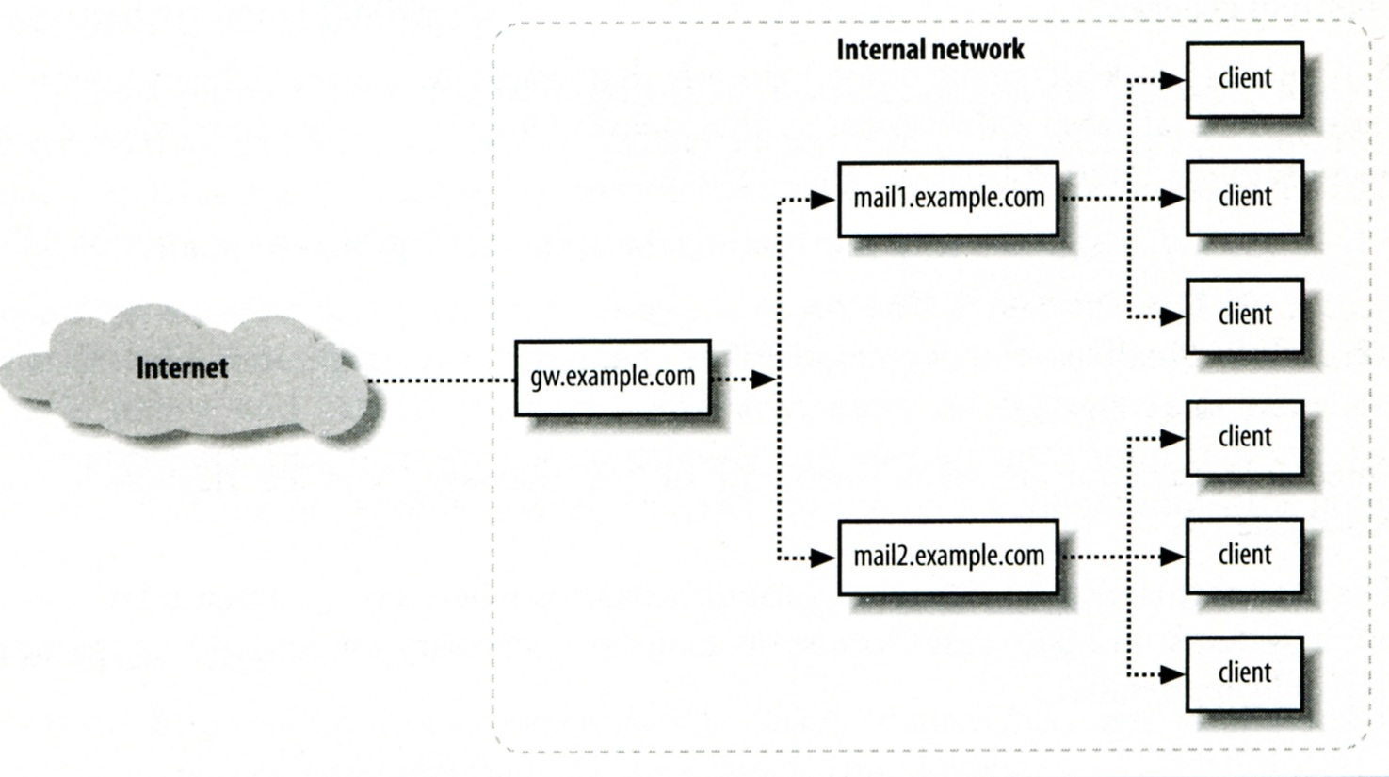
Mail Relaying – Inbound Mail Gateway (1)
Inbound Mail Gateway (MX)
Accept all mail for a network from the Internet and relays it to internal mail systems
Ex:
csmx1.cs.nctu.edu.tw is a IMG
csmailgate.cs.nctu.edu.tw is internal mail system

Slide 34
Mail Relaying – Inbound Mail Gateway (2)
To be IMG, suppose
You are administrator for cs.nctu.edu.tw
You have to be the IMG for secureLab.cs.nctu.edu.tw and javaLab.cs.nctu.edu.tw
Firewall only allow outsource connect to IMG port 25
The MX record for secureLab.cs.nctu.edu.tw and javaLab.cs.nctu.edu.tw should point to csmx1.cs.nctu.edu.tw
In csmx1.cs.nctu.edu.tw,
relay_domains = secureLab.cs.nctu.edu.tw javaLab.cs.nctu.edu.tw
transport_maps = hash:/usr/local/etc/postfix/transport
secureLab.cs.nctu.edu.tw relay:[secureLab.cs.nctu.edu.tw]
javaLab.cs.nctu.edu.tw relay:[javaLab.cs.nctu.edu.tw]
In secureLab.cs.nctu.edu.tw ( and so do javaLab.cs.nctu.edu.tw)
mydestination = secureLab.cs.nctu.edu.tw
Notes:
1

Slide 35
Mail Relaying – Outbound Mail Gateway
Outbound Mail Gateway
Accept mails from inside network and relay them to Internet hosts
To be OMG, suppose
You are administrator for cs.nctu.edu.tw
You have to be the OMG for secureLab.cs.nctu.edu.tw and javaLab.cs.nctu.edu.tw
In main.cf of csmailer.cs.nctu.edu.tw
mynetworks = hash:/usr/local/etc/postfix/mynetworks
secureLab.cs.nctu.edu.tw
javaLab.cs.nctu.edu.tw
All students in secureLab/javaLab will configure there MUA to use secureLab/javaLab.cs.nctu.edu.tw to be the SMTP server
In main.cf of secureLab/javaLab.cs.nctu.edu.tw,
relayhost = [csmailer.cs.nctu.edu.tw]

Slide 36
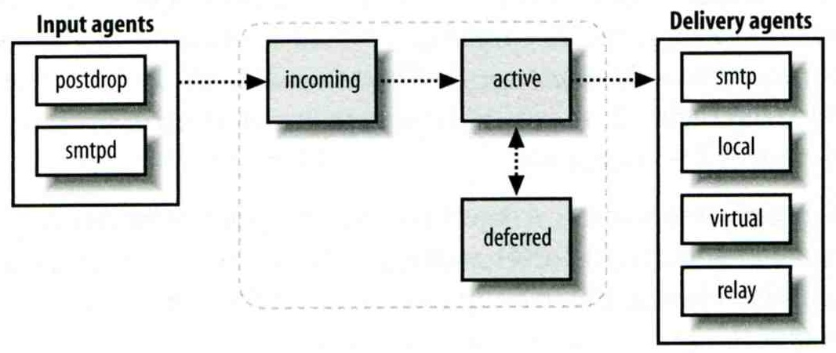
Queue Management
The queue manage daemon
qmgr daemon
Unique queue ID
Queue directories (/var/spool/postfix/*)
active, bounce, corrupt, deferred, hold
Message movement between queues
Temporary problem → deferred queue
qmgr takes messages alternatively between incoming and deferred queue to active queue

Slide 37
Queue Management – Queue Scheduling
Double delay in deferred messages
Between
minimal_backoff_time = 300s
maximal_backoff_time = 4000s
qmgr daemon periodically scan deferred queue for reborn messages
queue_run_delay = 300s
Deferred → bounce
maximal_queue_lifetime = 5d

Slide 38
Queue Management – Message Delivery
Controlling outgoing messages
When there are lots of messages in queue for the same destination, it should be careful not to overwhelm it
If concurrent delivery is success, postfix can increase concurrency between:
initial_destination_concurrency = 5
default_destination_concurrency_limit = 20
Under control by
maxproc in /usr/local/etc/postfix/master.cf
You can override the default_destination_concurrency_limit for any transport mailer:
smtp_destination_concurrency_limit = 25
local_destination_concurrency_limit = 10
Control how many recipients for a single outgoing message
default_destination_recipient_limit = 50
You can override it for any transport mailer in the same idea:
smtp_destination_recipient_limit = 100

Slide 39
Queue Management – Error Notification
Sending error messages to administrator
Set notify_classes parameter to list error classes that should be generated and sent to administrator
Ex: notify_classes = resource, software
Error classes
Error Class | Description | Noticed Recipient (all default to postmaster)
bounce | Send headers of bounced mails | bounce_notice_recipient
2bounce | Send undeliverable bounced mails | 2bounce_notice_recipient
delay | Send headers of delayed mails | delay_notice_recipient
policy | Send transcript when mail is reject due to anti-spam restrictions | error_notice_recipient
protocol | Send transcript that has SMTP error | error_notice_recipient
resource | Send notice because of resource pro. | error_notice_recipient
software | Send notice because of software pro. | error_notice_recipient

Slide 40
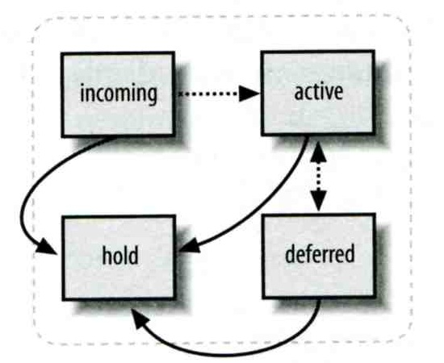
Queue Management – Queue Tools (1)
postqueue command
postqueue –p
Generate sendmail mailq output
postqueue –f
Attempt to flush(deliver) all queued mail
postqueue –s cs.nctu.edu.tw
Schedule immediate delivery of all mail queued for site
postsuper command
Delete queued messages
postsuper –d E757A3428C6 (from incoming, active, deferred, hold)
postsuper –d ALL
Put messages “on hold” so that no attempt is made to deliver it
postsuper –h E757A3428C6 (from incoming, active, deferred)
Release messages in hold queue
postsuper –H ALL
Requeue messages into maildrop queue (maildrop → pickup → cleanup → incoming)
postsuper –r E757A3428C6
postsuper –r ALL

Slide 41
Queue Management – Queue Tools (2)
postcat
Display the contents of a queue file
nasa [/home/liuyh] -liuyh- mailq
-Queue ID- --Size-- ----Arrival Time---- -Sender/Recipient-------
3314234284A 602 Sat May 19 04:16:20 root@nasa.cs.nctu.edu.tw
(connect to csmx1.cs.nctu.edu.tw[140.113.235.104]:25: Operation timed out)
liuyh@cs.nctu.edu.tw
nasa [/home/liuyh] -liuyh- sudo postcat -q 3314234284A
*** ENVELOPE RECORDS deferred/3/3314234284A ***
message_size: 602 214 1 0 602
message_arrival_time: Sat May 19 04:16:20 2012
create_time: Sat May 19 04:16:20 2012
sender: root@nasa.cs.nctu.edu.tw
named_attribute: rewrite_context=local
original_recipient: root
recipient: liuyh@cs.nctu.edu.tw
*** MESSAGE CONTENTS deferred/3/3314234284A ***
Received: by nasa.cs.nctu.edu.tw (Postfix)
id 3314234284A; Sat, 19 May 2012 04:16:20 +0800 (CST)
Delivered-To: root@nasa.cs.nctu.edu.tw
Received: by nasa.cs.nctu.edu.tw (Postfix, from userid 0)
id 2CB713427A5; Sat, 19 May 2012 04:16:20 +0800 (CST)
To: root@nasa.cs.nctu.edu.tw
Subject: nasa.cs.nctu.edu.tw weekly run output
Message-Id: <20120518201620.2CB713427A5@nasa.cs.nctu.edu.tw>
Date: Sat, 19 May 2012 04:16:20 +0800 (CST)
From: root@nasa.cs.nctu.edu.tw (NASA Root)
Rebuilding locate database:
Rebuilding whatis database:
…

Slide 42
Multiple Domains
Use single system to host many domains
Ex:
We use csmailgate.cs.nctu.edu.tw to host both
cs.nctu.edu.tw
csie.nctu.edu.tw
Purpose
Can be used for final delivery on the machine or
Can be used for forwarding to destination elsewhere
Important considerations
Does the same user id with different domain should go to the same mailbox or different mailbox ?
YES (shared domain)
NO (Separate domain)
Does every user require a system account in /etc/passwd ?
YES (system account)
NO (virtual account)

Slide 43
Multiple Domains – Shared Domain with System Account
Situation
The mail system should accept mails for both canonical and virtual domains and
The same mailbox for the same user id
Procedure
Modify “mydomain” to canonical domain
Modify “mydestination” parameter to let mails to virtual domain can be local delivered
Ex:
mydomain = cs.nctu.edu.tw
mydestination = $myhostname, $mydomain, csie.nctu.edu.tw
※ In this way, mail to both chwong@cs.nctu.edu.tw and chwong@csie.nctu.edu.tw will go to csmailgate:/var/mail/chwong
Limitation
Can not separate chwong@cs.nctu.edu.tw from chwong@csie.nctu.edu.tw

Slide 44
Multiple Domains – Separate Domains with System Accounts
Situation
The mail system should accept mails for both canonical and virtual domains and
Mailboxes are not necessarily the same for the same user id
Procedure
Modify “mydomain” to canonical domain
Modify “virtual_alias_domains” to accept mails to virtual domains
Create “virtual_alias_maps” map
Ex:
mydomain = cs.nctu.edu.tw
virtual_alias_domains = abc.com.tw, xyz.com.tw
virtual_alias_maps = hash:/usr/local/etc/postfix/virtual
In /usr/local/etc/postfix/virtual
CEO@abc.com.tw andy
@xyz.com.tw jack
Limitation
Need to maintain UNIX account for virtual domain user

Slide 45
Multiple Domains – Separate Domains with Virtual Accounts (1)
Useful when users in virtual domains:
Do not need to login to system
Only need to retrieve mail through POP/IMAP server
Procedure
Modify “virtual_mailbox_domains” to let postfix know what mails it should accepts
Modify “virtual_mailbox_base” and create related directory to put mails
Create “virtual_mailbox_maps” map
Ex:
virtual_mailbox_domain = abc.com.tw, xyz.com.tw
virtual_mailbox_base = /var/vmail
Create /var/vmail/abc-domain and /var/vmail/xyz-domain
virtual_mailbox_maps = hash:/usr/local/etc/postfix/vmailbox
In /usr/local/etc/postfix/vmailbox
CEO@abc.com.tw abc-domain/CEO (Mailbox format)
CEO@xyz.com.tw xyz-domain/CEO/ (Maildir format)

Slide 46
Multiple Domains – Separate Domains with Virtual Accounts (2)
Ownerships of virtual mailboxes
Simplest way:
The same owner of POP/IMAP Servers
Flexibility in postfix
virtual_uid_maps and virtual_gid_maps
Ex:
virtual_uid_maps = static:1003
virtual_gid_maps = static:105
virtual_uid_maps = hash:/usr/local/etc/postfix/virtual_uids
virtual_uid_maps = hash:/usr/local/etc/postfix/virtual_uids static:1003
In /usr/local/etc/postfix/virtual_uids
CEO@abc.com.tw 1004
CEO@xyz.com.tw 1008

