Slide 1
E-Mail System
yca

Slide 2
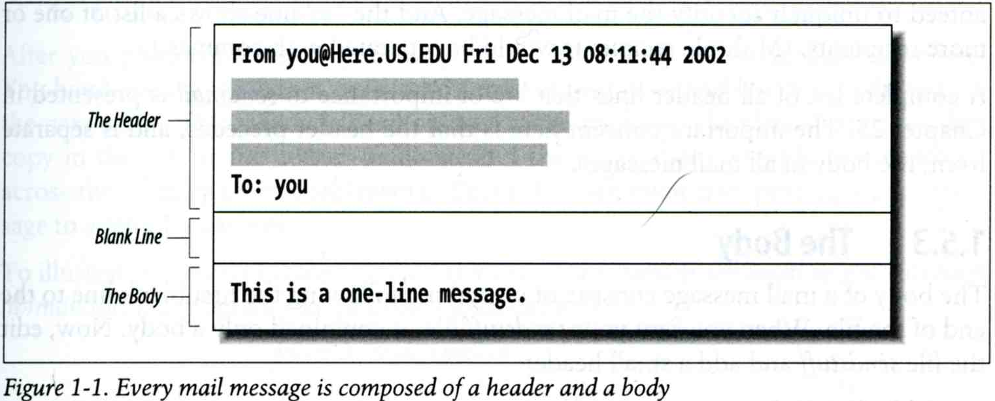
Components of an E-Mail (1)
You can really see …
  Headers, which can be forged, altered, etc.
  Body

Slide 3
Components of an E-Mail (2)
Three major components
  The envelope
    Invisible to users
    Determine where the message should be delivered, or to whom it should be returned
  The headers
    Information about the messages, defined in RFC2822
      Date, From, To, Content-Type, charset
      Content-Length, MessageID, …
      No checking consistent “To” in envelope and header
  The message body
    Plain text only
    Various MIME contents (attachments)
      7bit, quoted-printable, base64
      8bit, binary

Slide 4
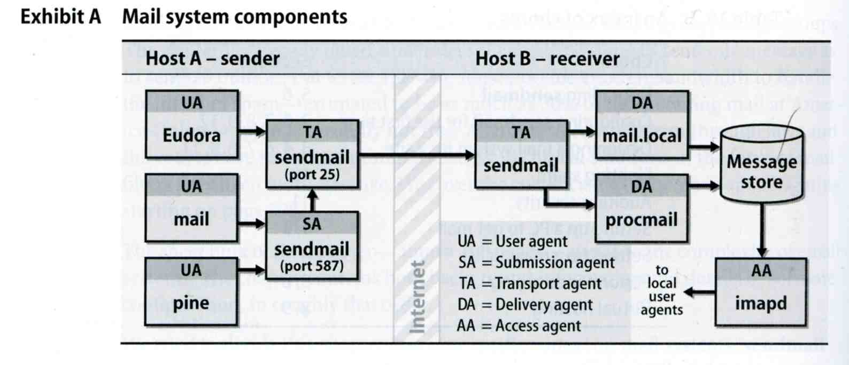
Mail System
Major components
  Mail User Agent (MUA)
    Help user read and compose mails
  Submission Agent (SA)
    Route mails to local MTA
  Mail Transport Agent (MTA)
    Route mails among machines
  Delivery Agent (DA)
    Place mails in users’ mail boxes
  Access Agent (AA)
    Connects the user agent to the mail box using POP3 or IMAP protocols

Slide 5
Mail System
– The User Agent (1)
Help user read and compose mails
  UA must know mail format
    Originally: Text only
    Now: MIME
  ※ MIME (Multipurpose Internet Mail Extensions)
    Include several types of content that can be encoded in the mail
      image, video, virus, …

Slide 6
Mail System
– The User Agent (2)
  Popular Mail User Agents
User Agent | System Config. | User Config. | MIME | POP | IMAP | SMTP
mail | mail.rc | .mailrc
mutt | /etc/Muttrc | .muttrc
Netscape | - | -
Outlook Ep. | - | -
MS Outlook | - | -
Thunderbird | - | -
In Smartphones | - | -

Slide 7
Mail System
– The Submission Agent
Route mails to local MTA
  Typical works that a MTA must do:
    Ensuring that all hostname are fully qualified
    Modifying headers
      MessageID
      Date
      DomainKeys/DKIM
    Logging errors
    …
  RFC2476 introduces the idea of splitting MTA
    Let SA to share the load

Slide 8
Mail System
– The Transport Agent (1)
Route mails among machines
  Accept mail from UA, examine the recipients’ addresses, and delivery the mail to the correct host
  Protocols
    SMTP (Simple Mail Transport Protocol)
      RFC 821
    ESMTP (Extended SMTP)
      RFC 2821 → … → 5321 (2008)
  Popular transport agents
    sendmail http://www.sendmail.org/
    Postfix http://www.postfix.org/
    exim, qmail, …

Slide 9
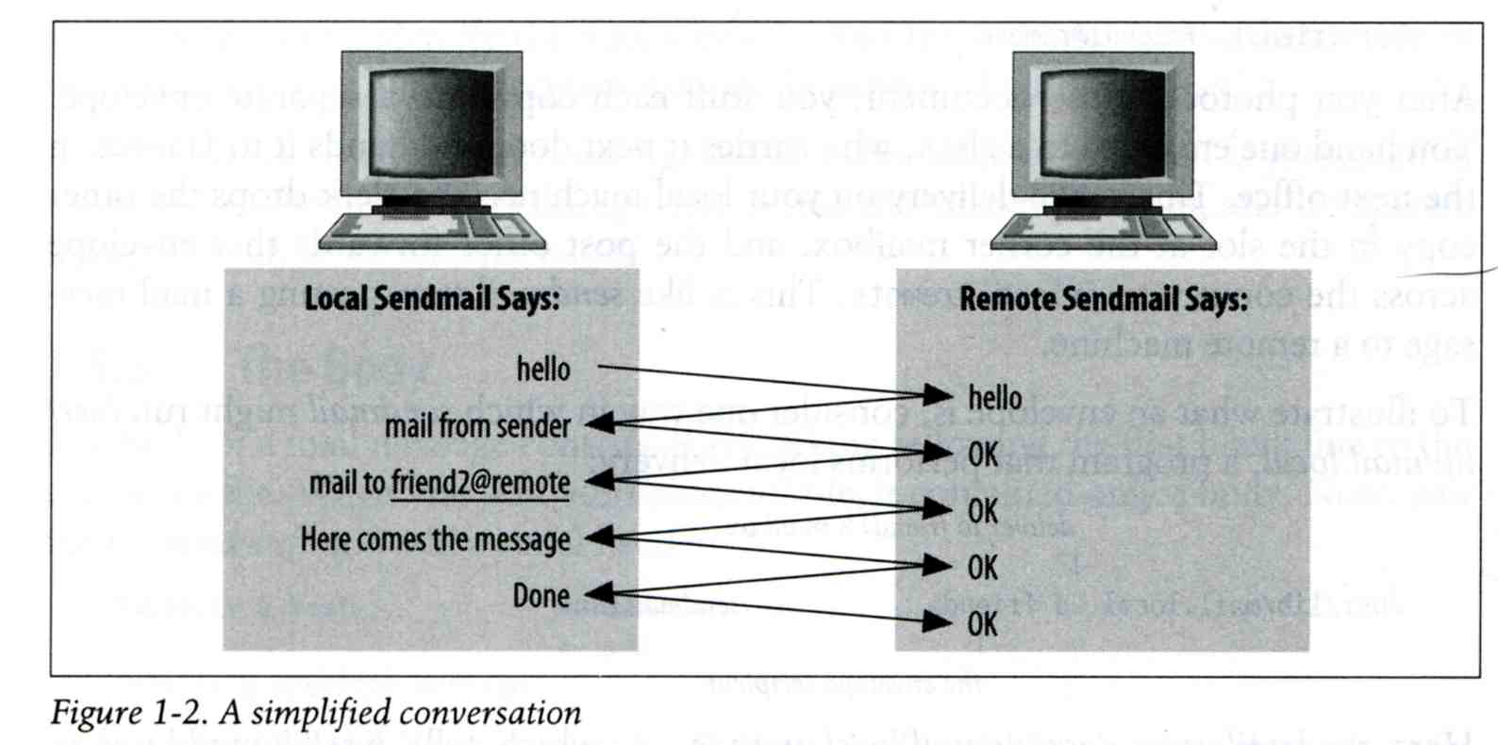
Mail System
– The Transport Agent (2)
Conversation between MTAs
  Threat of eavesdropping

Slide 10
Mail System
– The Transport Agent (3)
Protocol: SMTP
$ telnet csmailgate 25
Trying 140.113.235.103...
Connected to csmailgate.
Escape character is '^]'.
220 csmailgate.cs.nctu.edu.tw ESMTP Postfix
ehlo bsd5.cs.nctu.edu.tw
250-csmailgate.cs.nctu.edu.tw
250-PIPELINING
250-SIZE 204800000
250-VRFY
250-ETRN
250-ENHANCEDSTATUSCODES
250-8BITMIME
250 DSN
mail from: <liuyh@cs.nctu.edu.tw>
250 2.1.0 Ok
rcpt to: <liuyh@cs.nctu.edu.tw>
250 2.1.5 Ok
data
354 End data with <CR><LF>.<CR><LF>
From: haha <devnull@cs.nctu.edu.tw>
To: admin@hinet.net
hehe... I spammed you!
.
250 2.0.0 Ok: queued as 81BD4FB4
quit
221 2.0.0 Bye
Connection closed by foreign host.
From: haha <devnull@cs.nctu.edu.tw>
To: admin@hinet.net
Message-Id: <20120501070002.81BD4FB4@csmailgate.cs.nctu.edu.tw>
Date: Tue, 1 May 2012 14:59:53 +0800 (CST)
hehe... I spammed you!

Slide 11
Mail System
– The Delivery Agent
Place mails in users’ mailboxes
  Accept mail from MTA and deliver the mail to the local recipients
  Type of recipients
    User
    Program
      procmail
      bogofilter
  procmail
    Do something between mail coming in and stored in mail box
    https://help.cs.nctu.edu.tw/help/index.php/設定_-_郵件過濾設定

Slide 12
Mail System
– The Access Agent
Help user download mail from server
  Protocols
    IMAP (Internet Message Access Protocol)
    POP3 (Post Office Protocol – Version 3)

Slide 13
Mail Addressing – Domain (1)
Two kinds of email addresses:
  Route based address (obsolete)
    Message will travel through several intermediate hosts to the destination
    Format: host!path!user
      Ex: castle!sun!sierra!hplabs!ucbvax!winsor
      This mail is sent from “castle” host to the user “winsor” at “ucbvax” host
  Location independent address
    Simply identify the final destination
    Format: user@host.domain
      Ex: liuyh@nasa.cs.nctu.edu.tw

Slide 14
Mail Addressing – Domain (2)
Where to send the mail?
  When you want to send a mail to liuyh@cs.nctu.edu.tw, the MTA will:
    First, lookup up the mail exchanger of “cs.nctu.edu.tw”
      If there is any servers, try until success from the higher preference one to the lower
      If no MX records, mail it directly to the host (A record)
$ dig mx cs.nctu.edu.tw
;; ANSWER SECTION:
cs.nctu.edu.tw. 3600 IN MX 5 csmx2.cs.nctu.edu.tw.
cs.nctu.edu.tw. 3600 IN MX 10 csmx3.cs.nctu.edu.tw.
cs.nctu.edu.tw. 3600 IN MX 5 csmx1.cs.nctu.edu.tw.

Slide 15
Mail Addressing – Domain (3)
Why using “Mail eXchanger”?
  We can centralize all the mail tasks to group of servers
  Multiple mail exchangers make it more robust

Slide 16
Mail Addressing – Alias
Alias
  Map a username to something else
    Be careful of mail looping
Several mechanisms to define aliases:
  Traditional method: in files
  Traditional method with NIS
  LDAP (Light-weight Directory Access Protocol)
When the mail server wants to resolve name
  File-based method
    look up files to resolve by itself
  LDAP-based method
    call LDAP server to resolve the name and return the results

Slide 17
Mail Alias
– Traditional aliasing mechanism (1)
Aliases can be defined in three places
  In MUA’s configuraiton file
    Read by MUA and expand the alias before injecting the message into the mail system
  In the system-wide /etc/mail/aliases file
    Read by DA
    The path to the system-wide alias file can be specified in mail server’s configuration file
  In user’s forwarding file, ~/.forward
    Read by DA after system-wide alias file
    forward(5)

Slide 18
Mail Alias
– Traditional aliasing mechanism (2)
The format of an entry in aliases file
  Local-name: recipient1,recipient2,…
  Ex:
    admin: huanghs,chiahung,liuyh
    liuyh: liuyh@cs.nctu.edu.tw
    root: ta
  Local-name: :include:filename
  Ex:
    ta: :include:/usr/local/mail/TA
Contents of TA
chiahung
huanghs
liuyh
changlp
cychao
wangth
pmli

Slide 19
Mail Alias
– Traditional aliasing mechanism (3)
The format of an entry in aliases file
  Local-name: absolute-path-file
  Mails will be appended to this file
  Ex:
    complaints: /dev/null
    troubles: trouble_admin,trouble_log
    trouble_admin: :include:/usr/local/mail/troadm
    trouble_log: /usr/local/mail/logs/troublemail
  Local-name: "|program-path"
  Route mail to stdin of program
  Ex:
    autoftp: “|/usr/local/bin/ftpserver”
    nahw1: “|/home/nahw1/receive.pl”

Slide 20
Mail Alias
– Traditional aliasing mechanism (4)
The hashed aliases DB
  /etc/mail/aliases is the plaintext aliases information
  /etc/mail/aliases.db is the hashed version for efficiency
  Use “newaliases” command to rebuild the hashed version when you change the aliases file
    The file read from “:include:” is outside the aliases file

Slide 21
Mail Alias
– Traditional aliasing mechanism (5)
User maintainable forwarding file
  In ~/.forward
  Format: comma-separated
  Ex:
    liuyhh@gmail.com
    \liuyh, liuyhh@gmail.com, liuyhh00@yahoo.com.tw
  Must be owned by user and with permission of 600
    The path to .forward file should be writable only to user

Slide 22
Mail Alias
– Traditional aliasing mechanism (6)
Alias must
  postmaster and MAILER-DAEMON
    Mail system maintainer
  bin, sys, daemon, nobody, …
    System accounts (root)
  root
    forward root mail to the administrator
      /root/.forward
      aliases
MAILER-DAEMON: postmaster
postmaster: root
bin: root
bind: root
daemon: root
games: root
kmem: root
mailnull: postmaster
nobody: root
operator: root
…

Slide 23
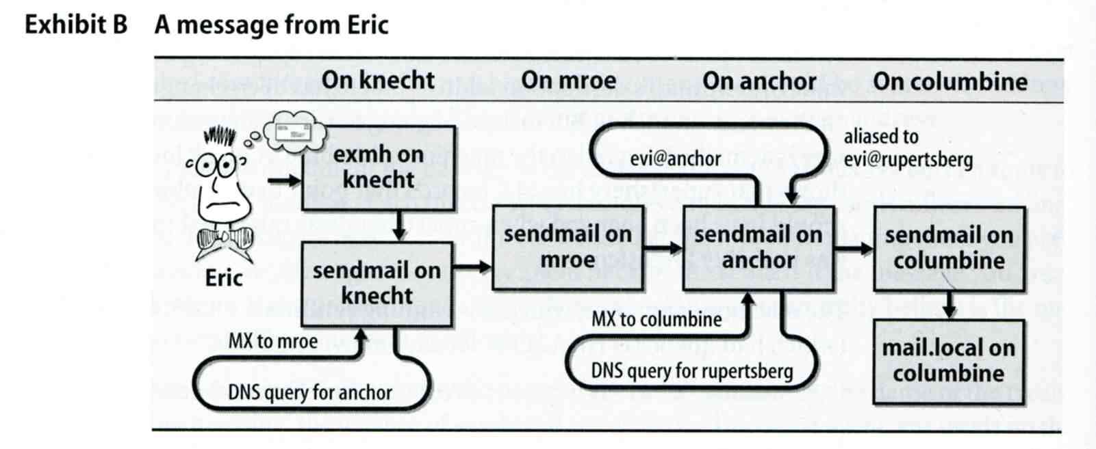
Mail Transport Example
User eric@knecht.sendmail.org sends a email to user evi@anchor.cs.colorado.edu
  % dig mx anchor.cs.colorado.edu
    mroe.cs.colorado.edu

Slide 24
Mail Headers (1)
Defined by RFC2822
  Mail reader will hide some uninteresting header information
Date: Wed, 18 Apr 2007 14:05:04 +0800
From: 大小姐 <lkkg-girl@mail.richhome.net>
Subject: 笑狗好可怕
To: Yung-Hsiang Liu <liuyh@nabsd.cs.nctu.edu.tw>
User-Agent: Mutt/1.5.15 (2007-04-06)
你趕快把牠趕跑好不好？

Slide 25
Mail Headers (2)
From chwong@chbsd.cs.nctu.edu.tw Wed Apr 18 14:07:21 2007
Return-Path: <chwong@chbsd.cs.nctu.edu.tw>
X-Original-To: liuyh@nasa.cs.nctu.edu.tw
Delivered-To: liuyh@nasa.cs.nctu.edu.tw
Received: from chbsd.cs.nctu.edu.tw (chbsd.csie.nctu.edu.tw [140.113.17.212])
by nasa.cs.nctu.edu.tw (Postfix) with ESMTP id 22EC73B4D51
for <chwong@nabsd.cs.nctu.edu.tw>; Wed, 18 Apr 2007 14:07:21 +0800 (CST)
Received: from chbsd.cs.nctu.edu.tw (localhost [127.0.0.1])
by chbsd.cs.nctu.edu.tw (8.13.8/8.13.8) with ESMTP id l3I654P3060925
for <chwong@nabsd.cs.nctu.edu.tw>; Wed, 18 Apr 2007 14:05:04 +0800 (CST)
(envelope-from chwong@chbsd.cs.nctu.edu.tw)
Received: (from chwong@localhost)
by chbsd.cs.nctu.edu.tw (8.13.8/8.13.8/Submit) id l3I654AY060924
for chwong@nabsd.cs.nctu.edu.tw; Wed, 18 Apr 2007 14:05:04 +0800 (CST)
(envelope-from chwong)
Date: Wed, 18 Apr 2007 14:05:04 +0800
From: =?utf-8?B?5aSn5bCP5aeQ?= <lkkg-girl@mail.richhome.net>
To: Yung-Hsiang Liu <liuyh@nasa.cs.nctu.edu.tw>
Subject: =?utf-8?B?56yR54uX5aW95Y+v5oCV?=
Message-ID: <20070418060503.GA60903@chbsd.csie.nctu.edu.tw>
MIME-Version: 1.0
Content-Type: text/plain; charset=utf-8
Content-Disposition: inline
Content-Transfer-Encoding: 8bit
User-Agent: Mutt/1.5.15 (2007-04-06)
Status: RO
Content-Length: 23
Lines: 1
你趕快把牠趕跑好不好？

Slide 26
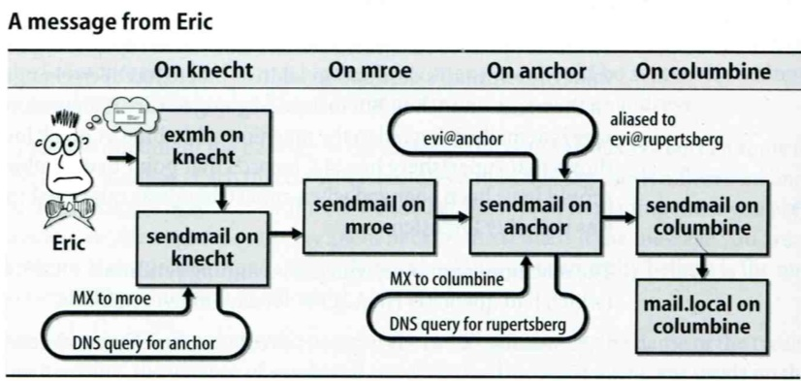
Mail Headers (3)
Headers in the example
  From eric@knecht.sendmail.org
    Added by mail.local when the mail is put in user’s mailbox
    Used to separate message boundary
  Return-Path: eric@knecht.sendmail.org
    The envelope “mail from”
    Used to send the error message to this address
    May be different to the “From” address
  Delivered-To: evi@rupertsberg
    Final envelope “rcpt to”
  Received: from knecht.sendmail.org (localhost [127.0.0.1]) by knecht.sendmail.org (8.9.3/8.9.2) with ESMTP id GAA18984; Fri 1 Oct 1999 06:04:02 -800 (PST)
    Every machine that is ever processed this mail will add a “Received” record in top of headers
      Sending machine、Receiving machine、Mail server software in receiving machine
      Unique queue identifier of mail server in receiving machine、Date and time

Slide 27
Mail Headers (4)
  Received: from anchor.cs.Colorado.EDU (root@anchor.cs.colorado.edu [128.138.242.1]) by columbine.cs.colorado.edu (8.9.3/8.9.2) with ESMTP id HAA21741 for <evi@rupertsberg.cs.colorado.edu>; Fri, 1 Oct 1999 07:04:25 -0700 (MST)
  Received: from more.cs.colorado.edu (more.cs.colorado.edu [128.138.243.1]) by anchor.cs.colorado.edu (8.9.3/8.9.2) with ESMTP id HAA26176 for <evi@anchor.cs.colorado.edu>; Fri, 1 Oct 1999 07:04:24 -0700 (MST)
  Received: from knecht.sendmail.org (knecht.sendmail.org [209.31.233.160]) by more.cs.colorado.edu (8.9.3/8.9.2) with ESMTP id HAA09899 fro <evi@anchor.cs.colorado.edu>; Fri, 1 Oct 1999 07:04:23 -700 (MST)
  Received: from knecht.sendmail.org (localhost [127.0.0.1]) by knecht.sendmail.org (8.9.3/8.9.2) with ESMTP id GAA18984; Fri 1 Oct 1999 06:04:02 -800 (PST)

Slide 28
Mail Headers (5)
  Message-Id: <199910011404.GAA18984@knecht.sendmail.org)
    Add by sender’s MTA
  X-Mailer: exmh version 2.0.2 2/24/98
    MUA
    Non-standard header information
  To: Evi Nemeth <evi@anchor.cs.colorado.edu>
  Subject: Re: hi
  Date: Fri, 1 Oct 1999 06:04:02 -800

Slide 29
Mail Storage
The place on the local machine where email is stored
  Usually the directory: /var/mail or /var/spool/mail
    Users’ mails are stored in files named with each user’s login name
      Eg. /var/mail/liuyh
    Permission “775” and root:mail as the owner and group owner
      drwxrwxr-x 2 root mail 512 Dec 16 15:51 mail/
  Using database
    When the organization is large or for ISP with millions of customers
    Easy to search, categorize

Slide 30
Mail System Architecture
Simplest architecture
  Only one machine
    Has MTA to let you send and receive mail
    Provides storage for mailboxes
    Provides IMAP or POP3 to let you download mail from PC
Components in a mail system architecture
  Mail servers for incoming and/or outgoing mails
  Storage for mailboxes
  IMAP or POP3 to integrate PC and remote clients
    The issue of file locking

Slide 31
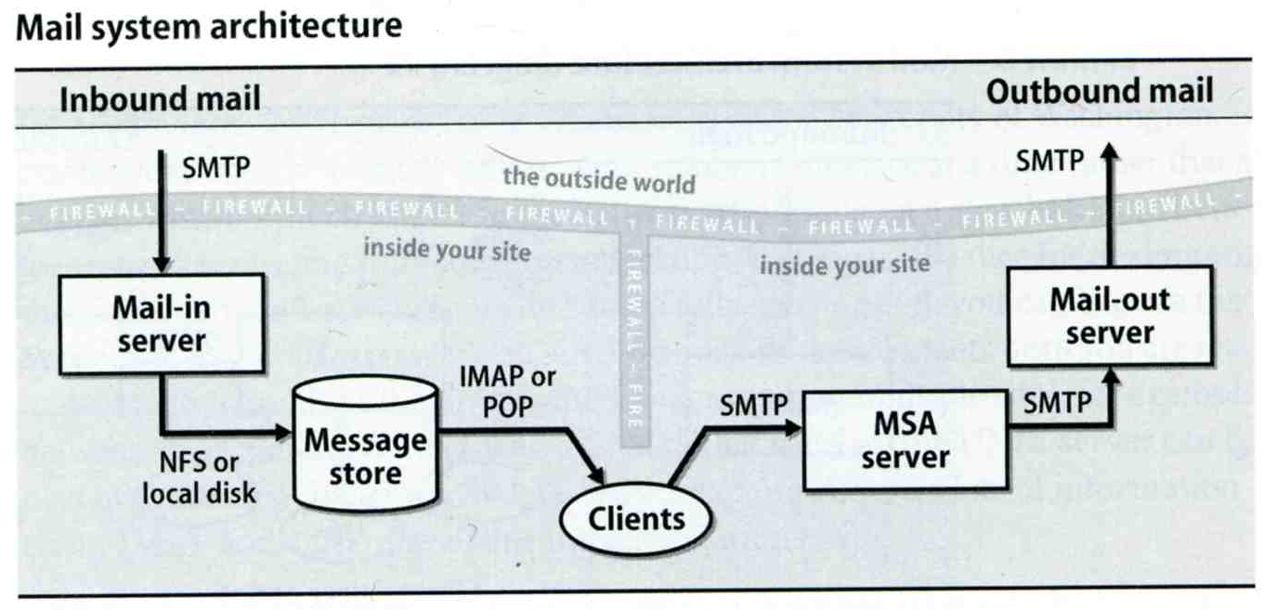
Mail System Architecture –
Scalable architecture for medium sites
Centralize
  At least one machine for incoming message and
    Mail home can be the same host or another one
  At least one machine for outgoing message
    Each host run MSA and forward mail to the same mail-out server or send the mail directly

Slide 32
To, Cc, and Bcc
You should always make sure you e-mail the right people
  The To field is for people that the message directly affects, and that you require action from.
  The Cc (or carbon copy) field is for people you want to know about the message, but are not directly involved.
  The Bcc field (Blind Carbon Copy) is used when you want other people to receive the message, but you don't want the other recipients to know they got it.
There are “To” and “Cc,” but not “Bcc” in the email headers.
  Why “No checking consistent “To” in envelope and header”

Slide 33
vacation(1)
E-mail auto-responder
  returns a message, ~/.vacation.msg by default
  ~/.vacation.db
    default database file for db(3)
  ~/.vacation.{dir,pag}
    default database file for dbm(3)
  ~/.vacation.msg
    default message to send
Use with forward(5)
  \liuyh, |/usr/bin/vacation
33

