Slide 1
The Domain Name System

Slide 2
History of DNS
What and Why is DNS?
  IP is not easy to remember
  Domain Name ↔ IP Address(es)
Before DNS
  ARPANET
    HOSTS.txt contains all the hosts’ information (/etc/hosts)
    Maintained by SRI’s Network Information Center
      Register → Distribute DB
  Problems: Not scalable!
    Traffic and Load
    Name Collision
    Consistency
Domain Name System
  Administration decentralization
  Paul Mockapetris (University of Southern California)
    RFC 882, 883 (1983) → 1034, 1035 (1984)
Notes:
SRI – Stanford Research Institute In Menlo Park, California

Slide 3
DNS Specification
Tree architecture – “domain” and “subdomain”
  Divide into categories
    Solve name collision
Distributed database
  Each site maintains segment of DB
  Each site open self information via network
Client-Server architecture
  Name servers provide information (Name Server)
  Clients make queries to server (Resolver)

Slide 4
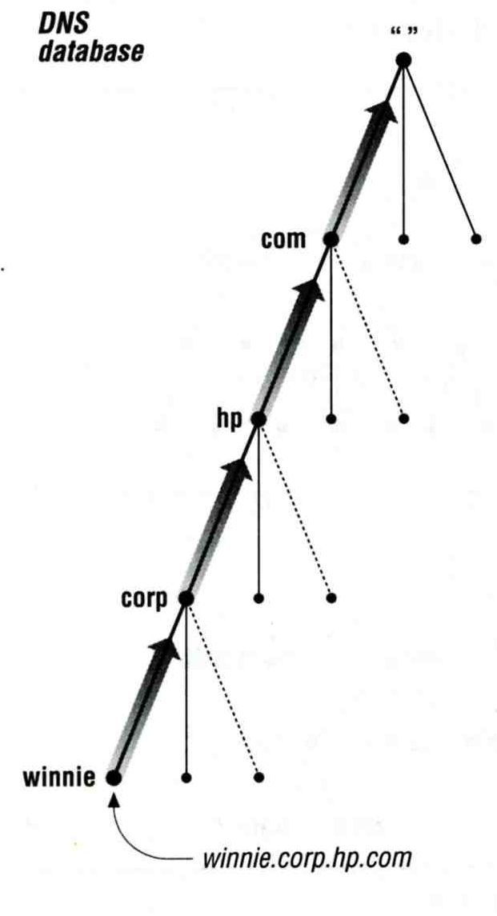
The DNS Namespace – (1)
Domain name is
  A inverted tree (Rooted tree)
    Root with label “.”
    Root with label “” (Null)
Domain and subdomain
  Each domain has a “domain name” to identify
  its position in database
    domain: nctu.edu.tw
    subdomain: cs.nctu.edu.tw

Slide 5
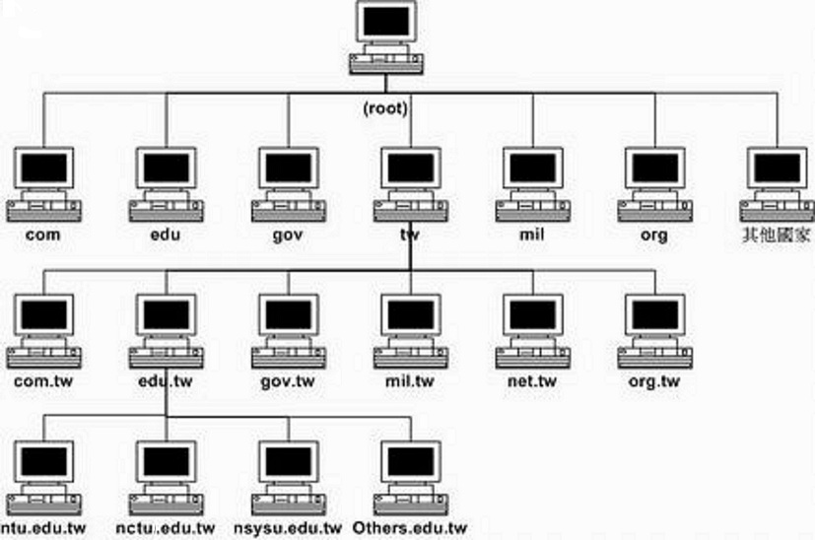
The DNS Namespace – (2)

Slide 6
The DNS Namespace – (3)
Domain level
  Top-level / First level
    Child of “root”
    Maintained by ICANN
  Second-level
    Child of a Top-level domain
Domain name limitation
  63-characters in each component
  Up to 255-characters in a complete name

Slide 7
The DNS Namespace – (4)
gTLDs (3 alphabets)
  generic Top-Level Domains, including:
  com: commercial organization, such as ibm.com
  edu: educational organization, such as purdue.edu
  gov: government organization, such as nasa.gov
  mil: military organization, such as navy.mil
  net: network infrastructure providing organization,
  such as hinet.net
  org: noncommercial organization, such as x11.org
  int: International organization, such as nato.int

Slide 8
The DNS Namespace – (5)
New gTLDs launched in year 2000:
  aero: for air-transport industry
  biz: for business
  coop: for cooperatives
  info: for all uses
  museum: for museum
  name: for individuals
  pro: for professionals
  xxx: for adult entertainment industry (sTLD)
    On March 31st , 2011
  https://www.iana.org/domains/root/db

Slide 9
The DNS Namespace – (6)
Other than US, ccTLD
  country code TLD (ISO 3166)
    Taiwan → tw
    Japan → jp
    United States → us
  Follow or not follow US-like scheme
    US-like scheme example
      edu.tw, com.tw, gov.tw
    Other scheme
      ac.jp, co.jp

Slide 10
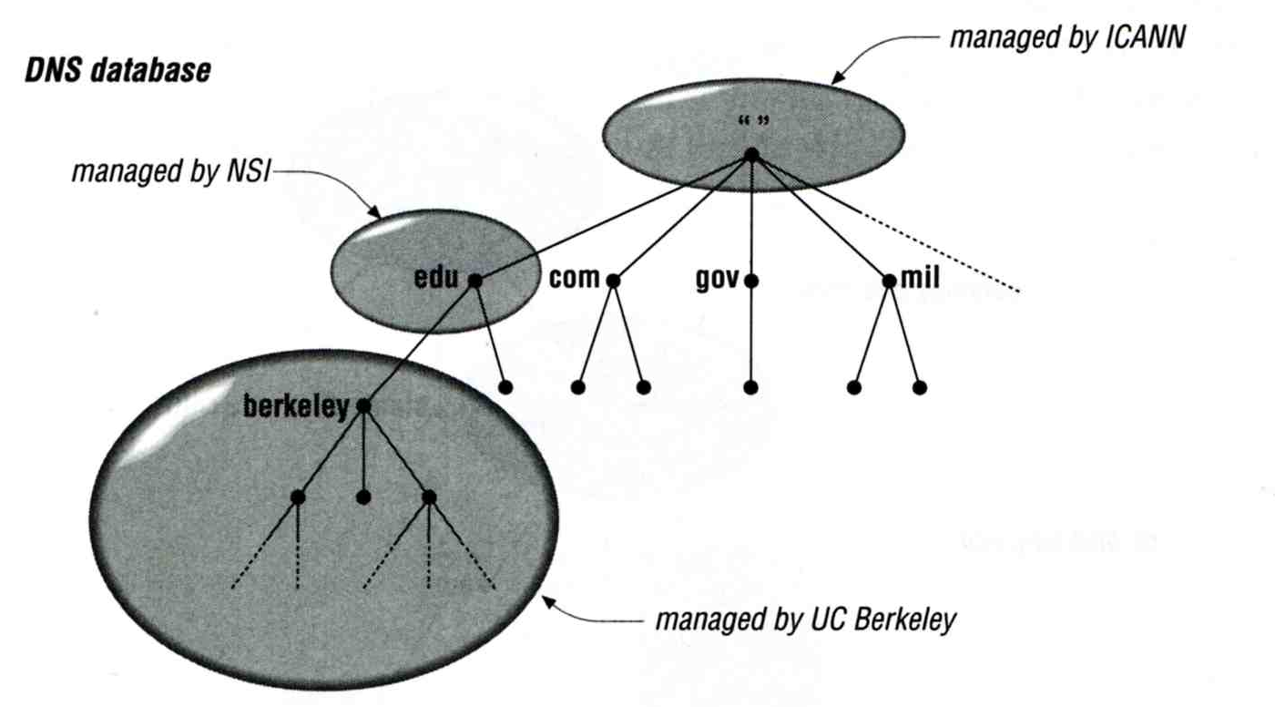
How DNS Works
– DNS Delegation
Administration delegation
  Each domain can delegate responsibility to subdomain
    Specify name servers of subdomain

Slide 11
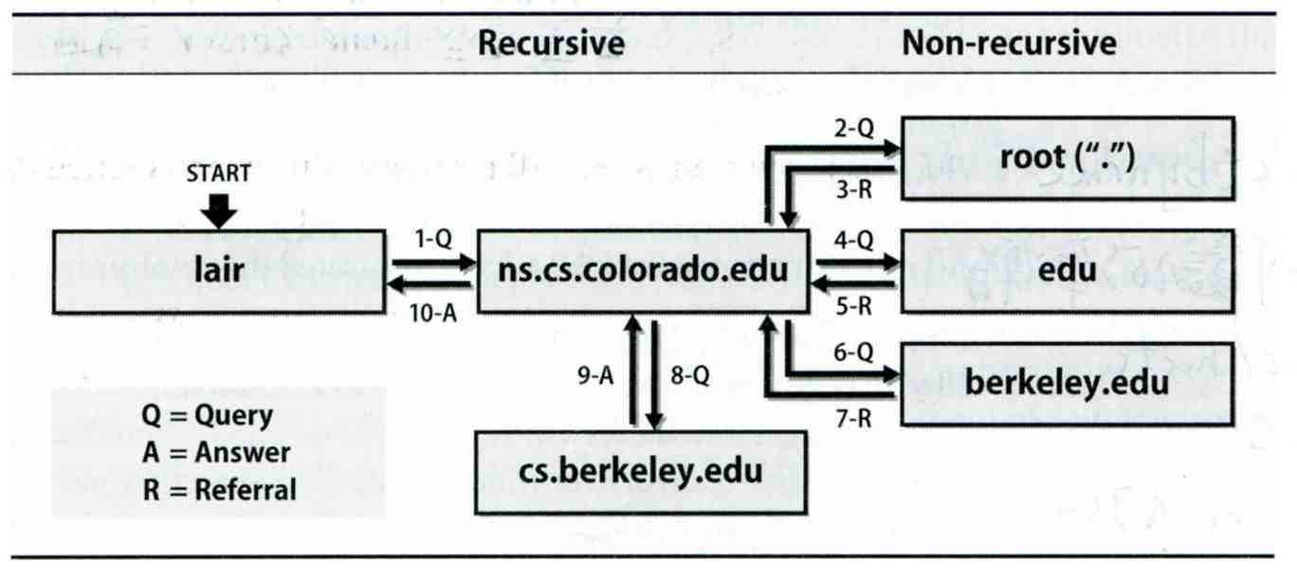
How DNS Works
– DNS query process
Recursive query process
  Ex: query lair.cs.colorado.edu → vangogh.cs.berkeley.edu,
  name server “ns.cs.colorado.edu” has no cache data

Slide 12
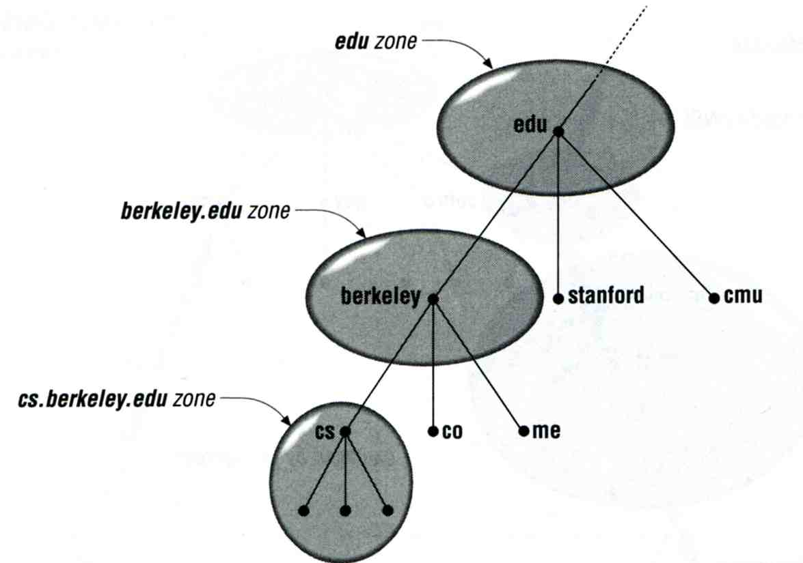
DNS Delegation
– Administrated Zone
Zone
  Autonomously administered piece of namespace
    Once the subdomain becomes a zone, it is independent to it’s parent
      Even parent contains NS’s A record

Slide 13
DNS Delegation
– Administrated Zone
Two kinds of zone files
  Forward Zone files
    Hostname-to-Address mapping
    Ex:
      bsd1.cs.nctu.edu.tw. IN A 140.113.235.131
  Reverse Zone files
    Address-to-Hostname mapping
    Ex:
      131.235.113.140.in-addr.arpa. IN PTR bsd1.cs.nctu.edu.tw.

Slide 14
The Name Server Taxonomy (1)
Categories of name servers
  Based on the source of name server’s data
    Authoritative: official representative of a zone (master/slave)
      Master: get zone data from disk
      Slave: copy zone data from master
    Nonauthoritative: answer a query from cache
      caching: caches data from previous queries
  Based on the type of answers handed out
    Recursive: do query for you until it return an answer or error
    Nonrecursive: refer you to the authoritative server
  Based on the query path
    Forwarder: performs queries on behalf of many clients with large cache
    Caching: performs queries as a recursive name server

Slide 15
The Name Server Taxonomy (2)
Nonrecursive referral
  Hierarchical and longest known domain referral with cache data of other zone’s name servers’ addresses
  Ex:
    Query lair.cs.colorado.edu from a nonrecursive server
    Whether cache has
      IP of lair.cs.colorado.edu
      Name servers of cs.colorado.edu
      Name servers of colorado.edu
      Name servers of edu
      Name servers of root
  The resolver libraries do not understand referrals mostly. They expect the local name server to be recursive

Slide 16
The Name Server Taxonomy (3)
Caching
  Positive cache (Long TTL)
  Negative cache (Short TTL)
    No host or domain matches the name queried
    The type of data requested does not exist for this host
    The server to ask is not responding
    The server is unreachable of network problem
Negative cache
  60% DNS queries are failed
  To reduce the load of root servers, the authoritative negative answers must be cached

Slide 17
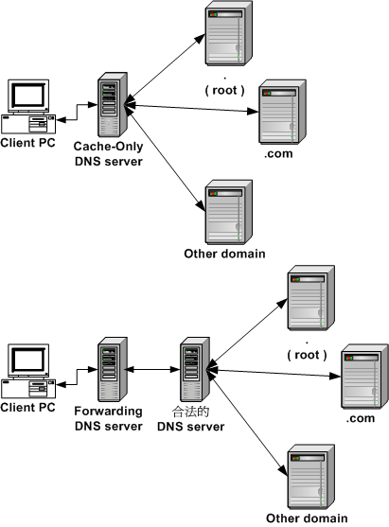
The Name Server Taxonomy (4)
Caching and forwarder
DNS server

Slide 18
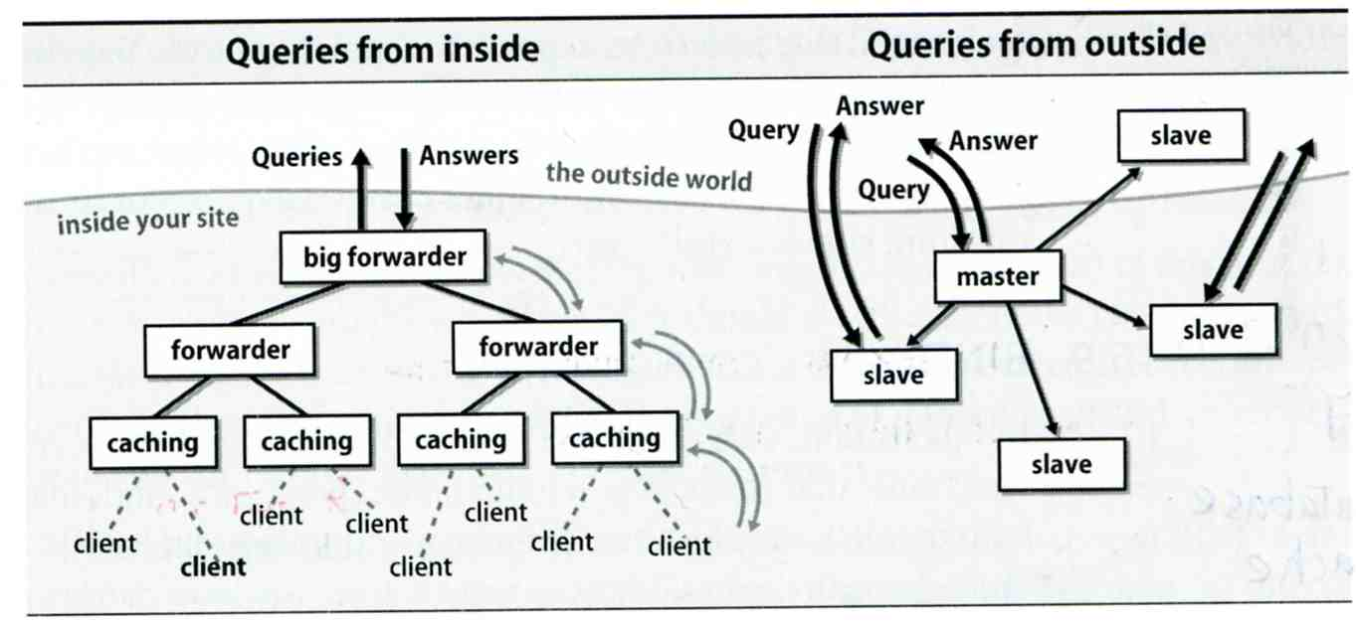
The Name Server Taxonomy (5)
How to arrange your DNS servers?
  Ex:

Slide 19
The Name Server Taxonomy (6)
  . 3600000 IN NS A.ROOT-SERVERS.NET.
  A.ROOT-SERVERS.NET. 3600000 A 198.41.0.4
  A.ROOT-SERVERS.NET. 3600000 AAAA 2001:503:BA3E::2:30
  . 3600000 NS B.ROOT-SERVERS.NET.
  B.ROOT-SERVERS.NET. 3600000 A 199.9.14.201
  B.ROOT-SERVERS.NET. 3600000 AAAA 2001:500:200::b
  . 3600000 NS C.ROOT-SERVERS.NET.
  C.ROOT-SERVERS.NET. 3600000 A 192.33.4.12
  C.ROOT-SERVERS.NET. 3600000 AAAA 2001:500:2::c
  . 3600000 NS D.ROOT-SERVERS.NET.
  D.ROOT-SERVERS.NET. 3600000 A 199.7.91.13
  D.ROOT-SERVERS.NET. 3600000 AAAA 2001:500:2d::d
  . 3600000 NS E.ROOT-SERVERS.NET.
  E.ROOT-SERVERS.NET. 3600000 A 192.203.230.10
  E.ROOT-SERVERS.NET. 3600000 AAAA 2001:500:a8::e
  . 3600000 NS F.ROOT-SERVERS.NET.
  F.ROOT-SERVERS.NET. 3600000 A 192.5.5.241
  F.ROOT-SERVERS.NET. 3600000 AAAA 2001:500:2F::F
  . 3600000 NS G.ROOT-SERVERS.NET.
  G.ROOT-SERVERS.NET. 3600000 A 192.112.36.4
  G.ROOT-SERVERS.NET. 3600000 AAAA 2001:500:12::d0d
  . 3600000 NS H.ROOT-SERVERS.NET.
  H.ROOT-SERVERS.NET. 3600000 A 198.97.190.53
  H.ROOT-SERVERS.NET. 3600000 AAAA 2001:500:1::53
  . 3600000 NS I.ROOT-SERVERS.NET.
  I.ROOT-SERVERS.NET. 3600000 A 192.36.148.17
  I.ROOT-SERVERS.NET. 3600000 AAAA 2001:7FE::53
  . 3600000 NS J.ROOT-SERVERS.NET.
  J.ROOT-SERVERS.NET. 3600000 A 192.58.128.30
  J.ROOT-SERVERS.NET. 3600000 AAAA 2001:503:C27::2:30
  . 3600000 NS K.ROOT-SERVERS.NET.
  K.ROOT-SERVERS.NET. 3600000 A 193.0.14.129
  K.ROOT-SERVERS.NET. 3600000 AAAA 2001:7FD::1
  . 3600000 NS L.ROOT-SERVERS.NET.
  L.ROOT-SERVERS.NET. 3600000 A 199.7.83.42
  L.ROOT-SERVERS.NET. 3600000 AAAA 2001:500:3::42
  . 3600000 NS M.ROOT-SERVERS.NET.
  M.ROOT-SERVERS.NET. 3600000 A 202.12.27.33
  M.ROOT-SERVERS.NET. 3600000 AAAA 2001:DC3::35
Root name servers
  In named.root
  file of BIND
https://www.iana.org/domains/root/files

Slide 20
DNS Client Configurations
/etc/resolv.conf
  nameserver: max 3 default name servers
  domain
  search
/etc/hosts
  IP FQDN Aliases
  C:\Windows\system32\drivers\etc\hosts
/etc/nsswitch.conf
  hosts: files (nis) (ldap) dns

Slide 21
DNS Client Commands – host
$ host nasa.cs.nctu.edu.tw
  nasa.cs.nctu.edu.tw has address 140.113.17.225
$ host 140.113.17.225
  225.17.113.140.in-addr.arpa domain name pointer nasa.cs.nctu.edu.tw.

Slide 22
DNS Client Commands – nslookup
$ nslookup nasa.cs.nctu.edu.tw
  Server: 140.113.235.1
  Address: 140.113.235.1#53
  Name: nasa.cs.nctu.edu.tw
  Address: 140.113.17.225
$ nslookup 140.113.17.225
  Server: 140.113.235.1
  Address: 140.113.235.1#53
  225.17.113.140.in-addr.arpa name = nasa.cs.nctu.edu.tw.

Slide 23
DNS Client Commands – dig (1)
$ dig nasa.cs.nctu.edu.tw
  ;; Got answer:
  ;; ->>HEADER<<- opcode: QUERY, status: NOERROR, id: 47883
  ;; flags: qr aa rd ra; QUERY: 1, ANSWER: 1, AUTHORITY: 3, ADDITIONAL: 3
  ;; QUESTION SECTION:
  ;nasa.cs.nctu.edu.tw. IN A
  ;; ANSWER SECTION:
  nasa.cs.nctu.edu.tw. 3600 IN A 140.113.17.225
  ……

Slide 24
DNS Client Commands – dig (2)
$ dig -x 140.113.17.225
  ;; Got answer:
  ;; ->>HEADER<<- opcode: QUERY, status: NOERROR, id: 5514
  ;; flags: qr aa rd ra; QUERY: 1, ANSWER: 1, AUTHORITY: 3, ADDITIONAL: 3
  ;; QUESTION SECTION:
  ;225.17.113.140.in-addr.arpa. IN PTR
  ;; ANSWER SECTION:
  225.17.113.140.in-addr.arpa. 86400 IN PTR nasa.cs.nctu.edu.tw.
  ……

Slide 25
DNS Security
DNSSEC
  Provide
    Origin authentication of DNS data
    Data integrity
    Authenticated denial of existence
  Not provide
    Confidentiality
    Availability
  $ dig +dnssec bsd1.cs.nctu.edu.tw
    ;; ANSWER SECTION:
    bsd1.cs.nctu.edu.tw. 3600 IN A 140.113.235.131
    bsd1.cs.nctu.edu.tw. 3600 IN RRSIG A 7 5 3600 …
RRSIG: Resource Record Signature

