Slide 1
MPD
Multi-link PPP daemon
zswu

Slide 2
mpd
Mpd is a netgraph(4) based implementation of the multi-link PPP protocol for FreeBSD
/usr/ports/net/mpd5
pkg install mpd5
It supports several of the numerous PPP sub-protocols and extensions, such as:
Multi-link PPP capability
PAP, CHAP, MS-CHAP and EAP authentication
PPP compression and encryption
Mpd have support for many link types:
Serial port modem
Point-to-Point Tunnelling Protocol (PPTP)
Layer Two Tunnelling Protocol (L2TP)
PPP over Ethernet (PPPoE)

Slide 3
mpd - setup
/etc/rc.conf
Configuration files
/usr/local/etc/mpd5/
mpd.conf
mpd.secret
Start
gateway_enable="YES"
mpd_flags="-b"
mpd_enable="YES"
# sysctl net.inet.ip.forwarding=1
# /usr/local/etc/rc.d/mpd5 start

Slide 4
mpd - authentication
mpd.secret
Syntax: username password [ip_address | CIDR]
plain text
chmod 600 mpd.secret
userA "hello123"
foo1 "foobar" 192.168.1.100
vpnuser "vpn_passwd" 192.168.1.128/25
# An external password access program
* "!/usr/local/bin/mpd/vpn_passwd.sh"

Slide 5
mpd - configuration (1)
mpd.conf
Consists of a label followed by a sequence of mpd commands
A label begins at the first column and ends with a colon character
Commands are indented with a tab character and follow the label on the next and subsequent lines.
client:
create bundle template B1
create link static L1 modem
set modem device /dev/cuad0
set modem speed 115200
set modem script DialPeer
set modem idle-script AnswerCall
set modem var $DialPrefix "DT"
set modem var $Telephone "1234567"
set link no pap chap eap
set link accept pap
set auth authname "MyLogin"
set auth password "MyPassword"
set link max-redial 0
set link action bundle B1
open

Slide 6
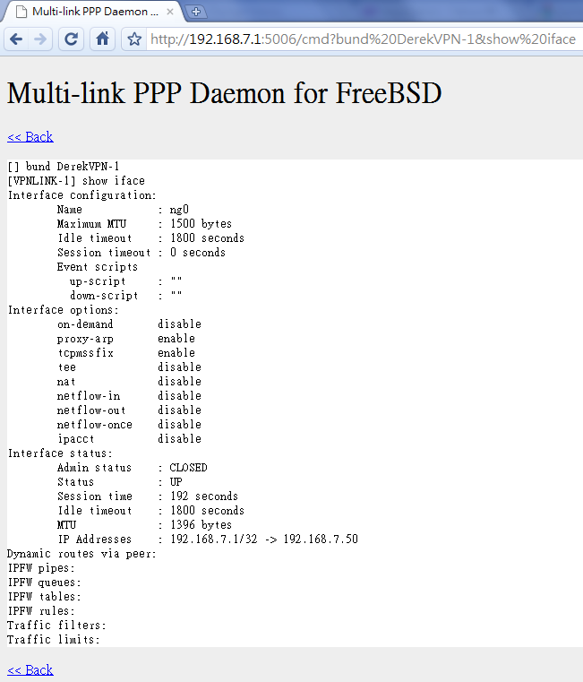
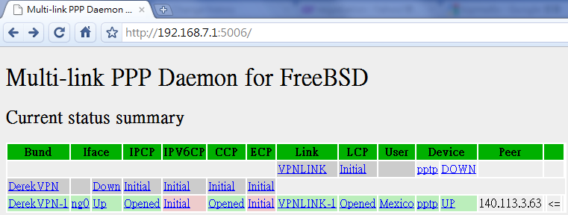
mpd - configuration (2)
startup section
Added a new startup section to the config-file, which is loaded once at startup.
startup:
# configure mpd console users
set user foo1 bar1
# configure the console
set console self 127.0.0.1 5005
set console open
# configure the web server
set web self 0.0.0.0 5006
set web open

Slide 7
mpd - configuration (3)
default section
Set interface
ip range
Set bundle name
Link layer configuration
default:
load pptp_server
pptp_server:
# Define dynamic IP address pool.
set ippool add VPNPOOL 192.168.1.50 192.168.1.99
# Create clonable bundle template
create bundle template VPN
set iface enable proxy-arp
set iface idle 1800
set iface enable tcpmssfix # adjust incoming and outgoing TCP SYN segments (MTU)
set ipcp yes vjcomp # Van Jacobson TCP header compression
# Specify IP address pool for dynamic assigment.
set ipcp ranges 192.168.1.1/32 ippool VPNPOOL

Slide 8
mpd - configuration (4)
default section
Link layer configuration
pptp_server:
…. (skip)
# Create clonable link template named L
create link template VPNLINK pptp
# Set bundle template to use
set link action bundle VPN
# Multilink adds some overhead, but gives full 1500 MTU.
set link enable multilink
# Address and control field compression, save 2 bytes,
# Protocol field compression, save 1 byte
set link yes acfcomp protocomp
set link keep-alive 10 60
# Configure PPTP
set pptp self 1.2.3.4
set link enable incoming

Slide 9
mpd - encryption
Microsoft Point-to-point compression (MPPC) CCP subprotol
'mppc' option should be enabled at the CCP layer
# The five lines below enable Microsoft Point-to-Point encryption
# (MPPE) using the ng_mppc(8) netgraph node type.
set bundle enable compression
set ccp yes mppc
set mppc yes e40
set mppc yes e128
set mppc yes stateless

Slide 10
mpd - configuration (5)
Minimum configuration
startup:
default:
set ippool add VPNPOOL 192.168.1.11 192.168.1.15
create bundle template NAVPN
set ipcp ranges 192.168.1.1/32 ippool VPNPOOL
create link template VPNLINK pptp
set link action bundle NAVPN
set link no pap chap eap
set link enable chap-msv2
set pptp self 1.2.3.4
set link enable incoming

Slide 11
syslog
Modify /etc/syslog.conf
touch /var/log/mpd.log
/etc/rc.d/syslogd reload
Maybe firewall need some configuration.
Allow 1723 port, and GRE packets.
!mpd
*.* /var/log/mpd.log

Slide 12
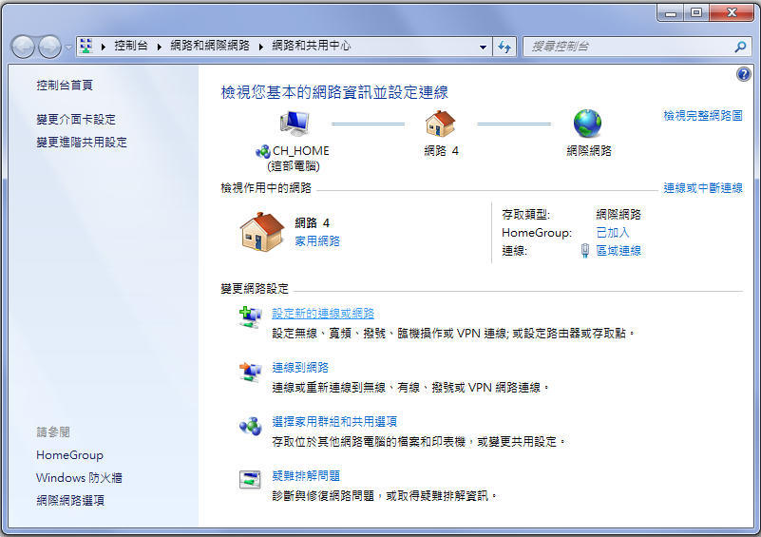
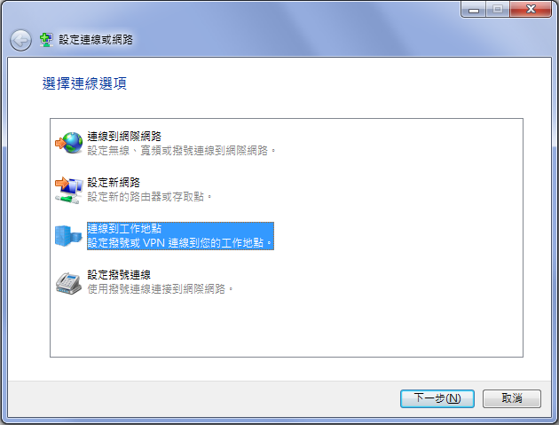
VPN client
建立新的連線

Slide 13
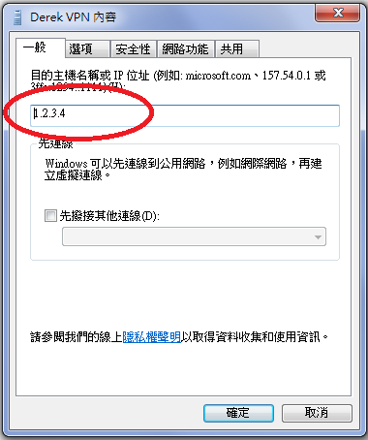
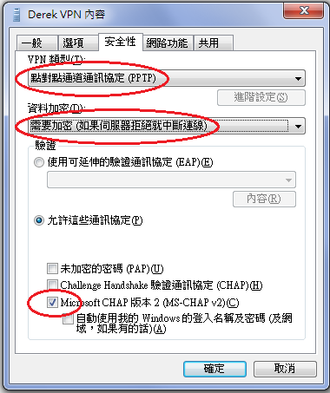
VPN client

Slide 14
Reference
Mpd User Manual
ports: net/pptpclient
http://pptpclient.sourceforge.net/

