Slide 1
Computer Network Administration

Slide 2
Syllabus
Website:
http://people.cs.nctu.edu.tw/~wangth/course/netadm
Instructors:
王則涵 wangth@cs.nctu.edu.tw
Time:
Thu. IJK (PM 6:30 ~ 9:20)
Place:
EC122
TAs:
We might get about 4 TAs
Email to TAs: ta@nasa.cs.nctu.edu.tw
3GH every week
Textbook:
Unix and Linux System Administration Handbook (5th Edition)
Notes:
中文授課，考試題目

Slide 3
Syllabus – Course Overview
Main topics
Python Programming (TBC)
Networking
TCP/IP Networking
Network Environment
NAT, DHCP, Firewall, FTP, VPN, Proxy, …
DNS – BIND (Berkeley Internet Name Domain)
Mail System - Postfix
SPF (Sender Policy Framework)
DKIM (DomainKeys Identified Mail)
DMARC (Domain-based Message Authentication, Reporting & Conformance)
Network Management

Slide 4
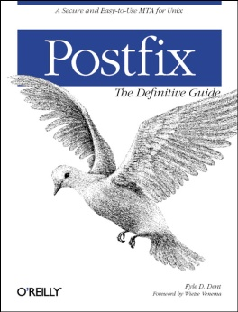
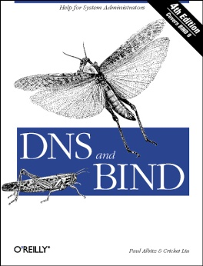
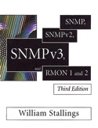
Syllabus – Course Textbook and Reference
Textbook
Unix and Linux System Administration Handbook (5th Edition)
Slides
Reference book
TCP/IP Illustrated Volume 1
Programming Perl
Postfix
DNS and BIND
SNMP, SNMPv2, SNMPv3 and RMON 1, 2

Slide 5
Syllabus – Content
We will cover the following chapters in this semester (NetAdm):
Chapter 15 ~ 18, 21, 23 ~ 25, 30 ~ 32
NAT, DHCP, VPN, Proxy, …
Python Programming (TBC)

Slide 6
Syllabus – Text book outline
Part I. Basic Administration
Chap 1 – Where to start.
Chap 2 – Booting and Shutting Down
Chap 3 – The Filesystem
Chap 4 – Access control and rootly powers
Chap 5 – Controlling processes
Chap 6 – User Management
Chap 7 – Storage
Chap 8 – Periodic processes
Chap 9 – Backups
Chap 10 – Syslog and log files
Chap 11 – Software installation and management
Chap 12 – The Kernel
Chap 13 – Scripting and the Shell
Chap 14 – Configuration Management
Part II. Networking
Chap 15 – Physical Networking
Chap 16 – TCP/IP
Chap 17 – Routing
Chap 18 – DNS: Domain Name System
Chap 19 – NFS: Network File System
Chap 20 – HTTP: Hypertext Transfer Protocol
Chap 21 – SMTP: Simple Mail Transfer Protocol
Chap 22 – Directory Services
Chap 23 – Electronic Mail
Chap 24 – Web Applications
Chap 25 – Network Management and Debugging

Slide 7
Syllabus – Text book outline (Cont.)
Part III. Operations
Chap 26 – Continuous Integration and Delivery
Chap 27 – Security
Chap 28 – Cloud Computing
Chap 29 – Containers and Virtualization
Chap 30 – Monitoring
Chap 31 – Performance Analysis
Chap 32 – Policy and Politics

Slide 8
Syllabus – Grade Policy
Mid
15 ~ 20%
Final
15 ~ 20%
Exercise
60 ~ 70%
No Delay Work
4 exercises
1 term project

Slide 9
Syllabus – Prerequisite
Background Knowledges
It is better to have taken
“Computer System Administration” (計算機系統管理)
“Introduction to Networking” (計算機網路概論)
At least
Experience of using Unix-like environment
Environment
One dedicated PC (Or dual OS in your PC, VM is also accepted.)
With Unix-like OS installed (e.g., FreeBSD, Linux, Solaris, …)

Slide 10
Attitude
Attend every class
Do every exercise
As early as possible
On your own
Read book and practice at least 6 hours every week
Use Unix-like environment
Recommend: more than 1.5 hours/day averagely
Collect information on the Internet
The newer, the better.

Slide 11
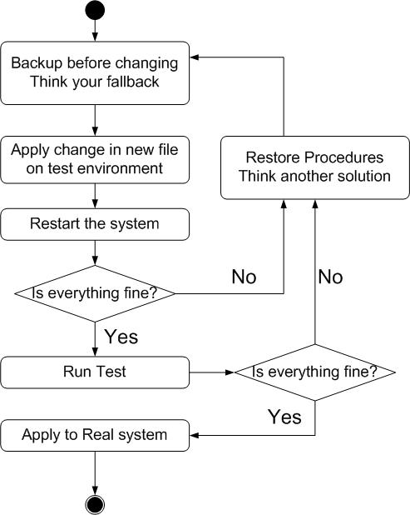
When You Perform Any Changes…
Flow of Change

Slide 12
SA-NA Junction
FreeBSD
11.2-RELEASE
http://people.cs.nctu.edu.tw/~wangth/course/sysadm/slides/01_Install_FreeBSD.pdf
Install OS and software (ports)
http://people.cs.nctu.edu.tw/~wangth/course/sysadm
http://people.cs.nctu.edu.tw/~wangth/course/sysadm/slides/02_Installing_Applications.pdf

