Slide 1
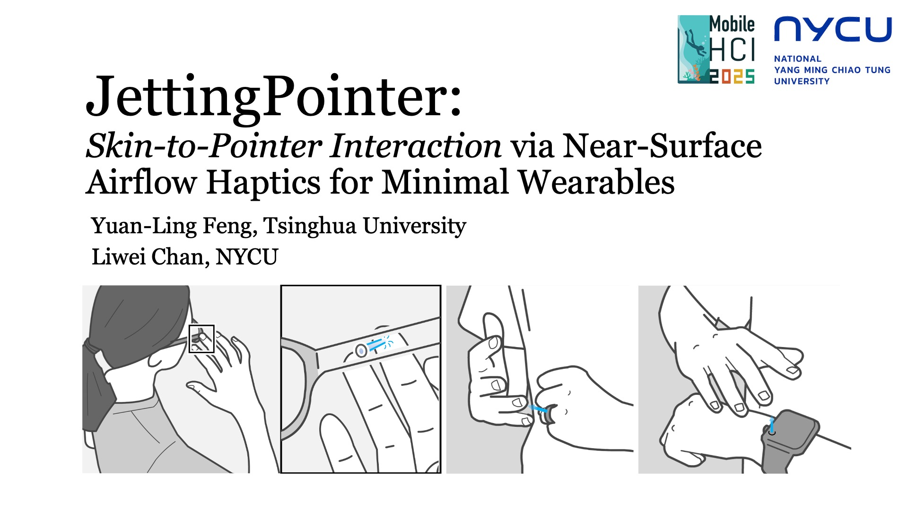
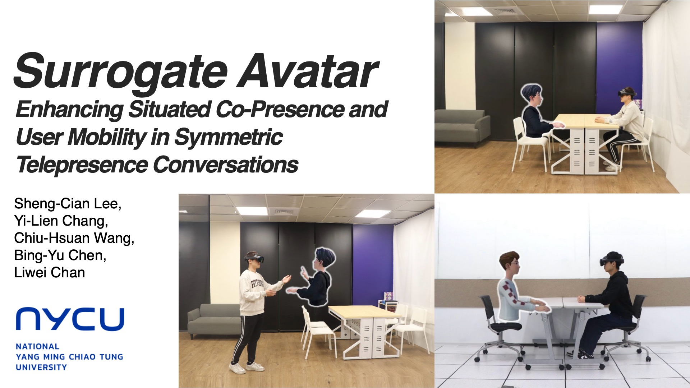

Slide 2


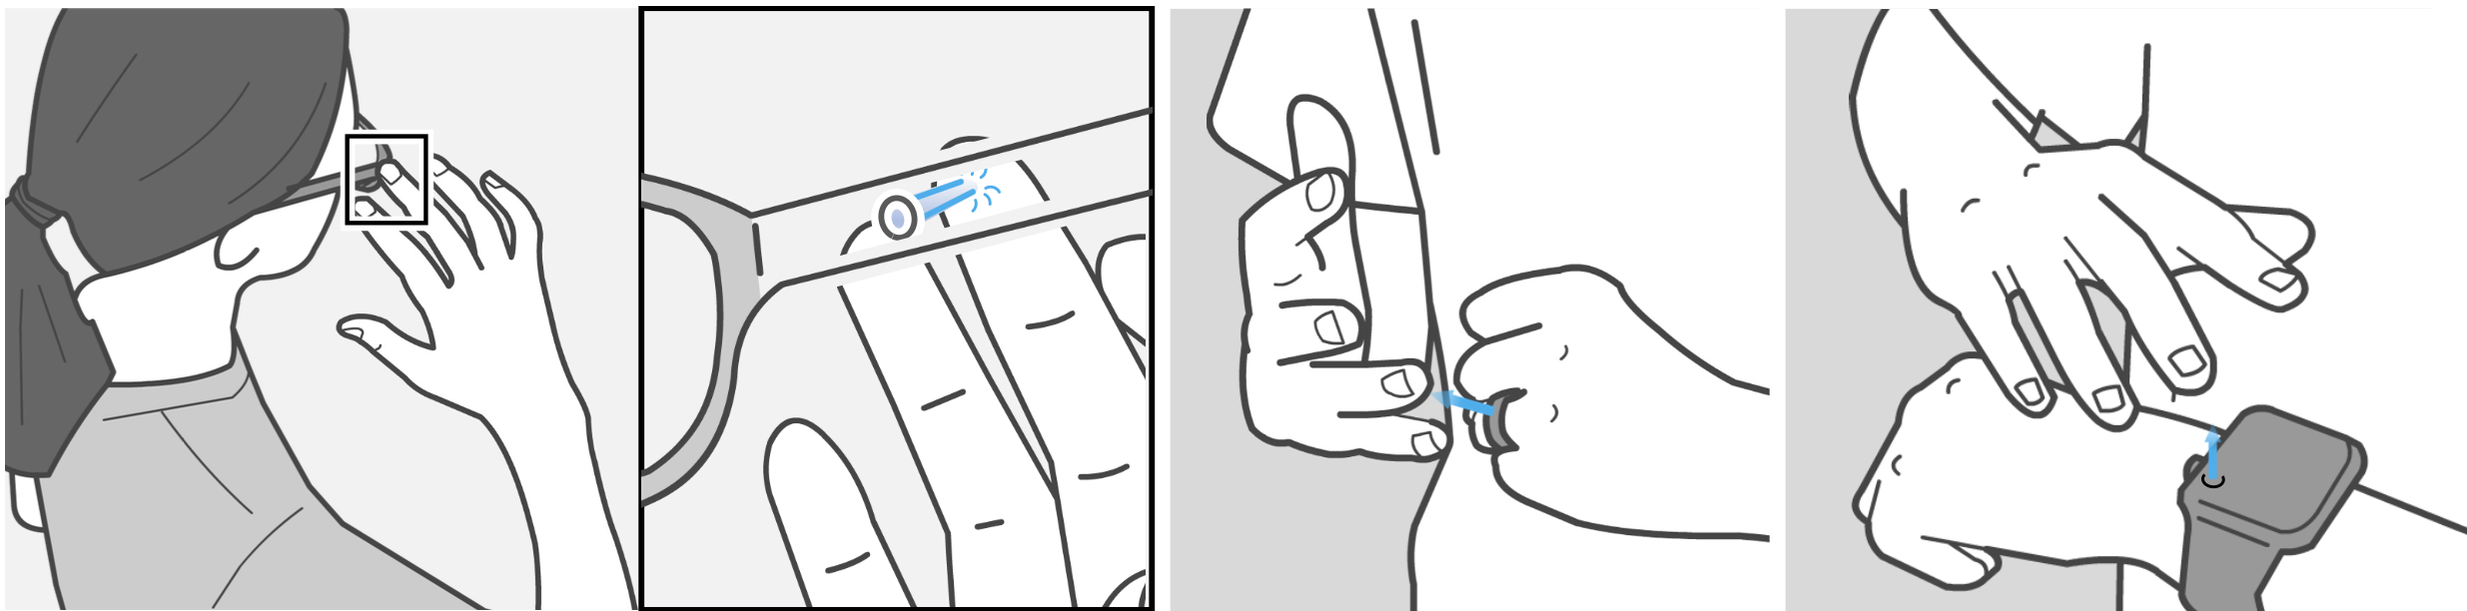
JettingPointer: Skin-to-Pointer Interaction via Near-Surface Airflow Haptics for Minimal Wearables
Yuan-Ling Feng, Tsinghua University
Liwei Chan, NYCU
Notes:
Sichuan Fine Arts Institute
Hi everyone. I am Liwei Chan, from NYCU in Taiwan,
Im’ presenting to you, JettingPointer, which enables a new type of touch interaction model that we called skin-to-pointer interaction.
Yuan-Ling is the first author, who unfortunately can not be here.
She did this work with me as an intern.
And she just recently turned into an assistant professor in Sichuan Fine Arts Institute.

Slide 3
Motivation
Notes:
Lets start with the motivation

Slide 4


Wearables (e.g., smart glasses) have limited input surfaces. Conventional touch bars restrict interaction.
Limited Input Space
Fat Finger Pointer
Notes:
Wearables, such as smart glasses, have very limited input surfaces for the deployment of touch interfaces. Typically, interaction relies on small touch bars that are built into the frame. But these are restrictive — the surface is too small, is concerned with ‘fat finger’ problem, and turns out

Slide 5
Limits number of functions.
Limited Input Space
Fat Finger Pointer
Notes:
very limited functions can be supported.

Slide 6
Concept: Skin-to-Pointer
Notes:
We proposed a new approach that flips the conventional model.

Slide 7

Concept: Skin-to-Pointer
Device emits localized airflow a haptic pointer.
User aligns finger phalanx with airflow to trigger functions.
Pointer
Sufficient Input Space
Notes:
Instead of deploying touch function on the device, we deploy touch functions on the skin of the user’s hand.
To enable touch navigation, the device projects an airflow that acts as a haptic pointer.
Then, the user can align their finger phalanx with this airflow. Once the alignment is done, it triggers the associated function.
This way, the spacious skin of the hand becomes the site for function deployment.

Slide 8
Concept: Skin-to-Pointer
Device emits localized airflow a haptic pointer.
User aligns finger phalanx with airflow to trigger functions.
Interaction shifts from device surface → user’s skin.
Notes:
And it is important to note that… the haptic pointer is the key to assits users in navigating the hand for a certain function with priproception and skin sensation eye-freely.

Slide 9
Concept: Skin-to-Pointer
Device emits localized airflow a haptic pointer.
User aligns finger phalanx with airflow to trigger functions.
Interaction shifts from device surface → user’s skin.
Notes:
for a certain function with priproception and skin sensation eye-freely.

Slide 10
Notes:
We investigate the concept by integrating it into the glasses frame.

Slide 11
Notes:
But the concept can be applied to smaller wearables, such as smart watch and even smart ring.

Slide 12
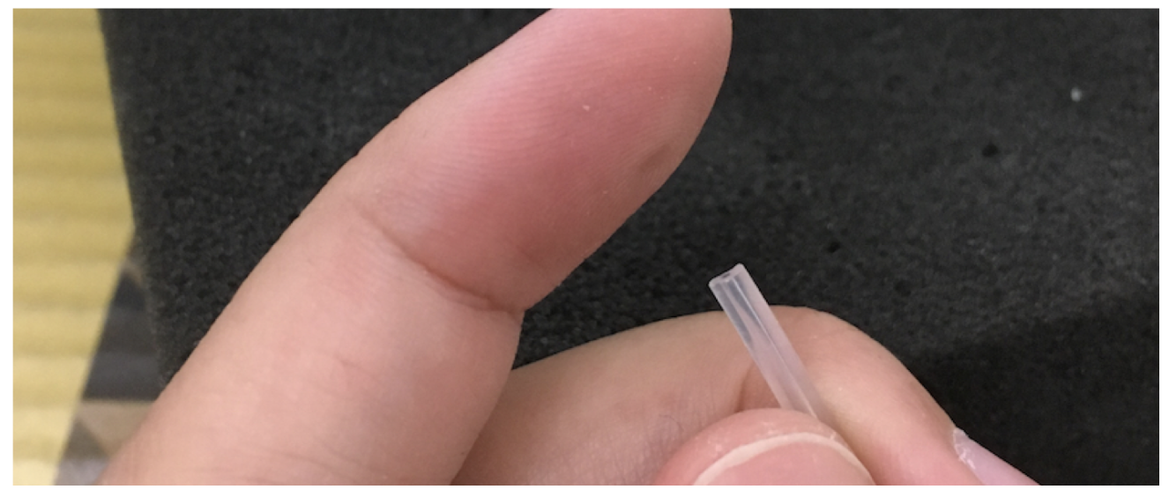
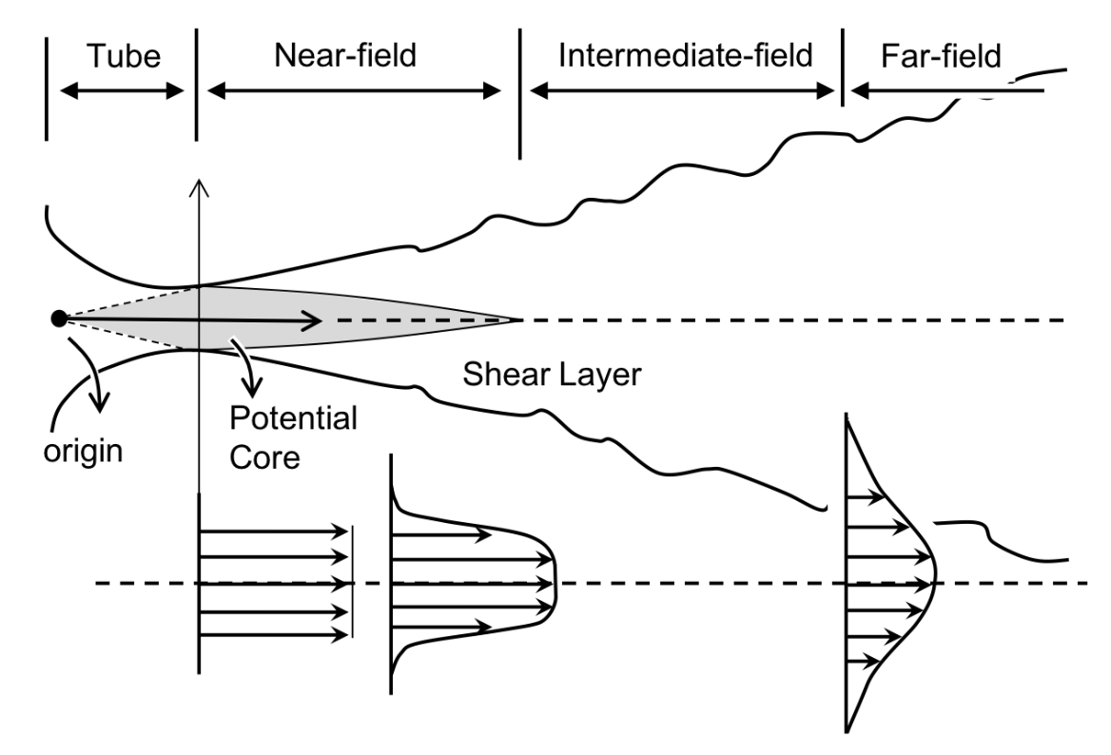
Fluid Mechanics
x
nozzle
Notes:
To make the concept work, we studied the fluid mechanics of airflow.
Here, a free air jet has a high-pressure central stream near the nozzle.
In this near field you can feel a sharp ‘point’ with a finger.

Slide 13
Fluid Mechanics
x
x
nozzle
flow rate
Notes:
In a farther field, it diffuses into just a feel of wind.
Therefore, by shaping nozzle size and flow rate, we aim for creating a sharp point that can be perceived by the finger.

Slide 14
0.5mm tube
x
24V Air pump
Point of measure
Notes:
With the setup of 0.5 mm tube and 24V air pump, we measure air flow at the exit of the nozzle.

Slide 15
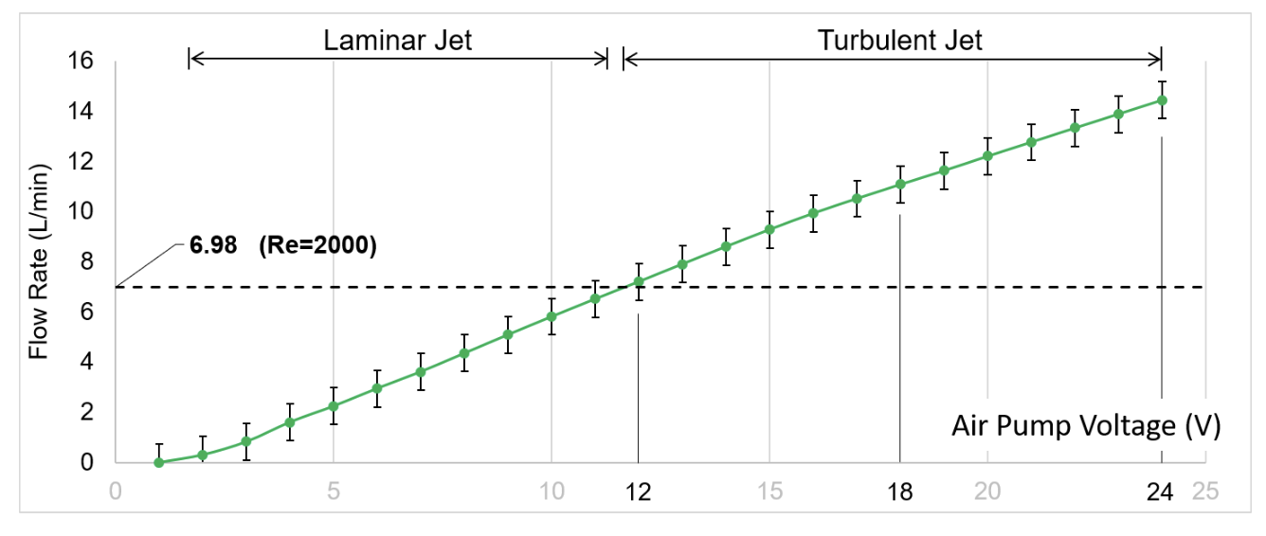
Airflow vs. Pump voltage
Notes:
And this chart shows airflow vs. pump voltage. Here you can see, as voltage rises, flow rate increases linearly.
And the threshold here indicates the necessary flow rate to push the jet from laminar into turbulent jet, boosting the central-stream pressure that we need for the formation of a point sensation.
Based on the chart, driving the pump at 12V is necessary, and for the studies that follow, we operate at 24 V for extending the sensation range.

Slide 16
Study 1
Investigate perceptual clarity of airflow cues.
Assess range and stability of point sensation.
Notes:
In Study 1, we tested whether users perceive a clear point sensation af their index finger tip, and what’s the required distance for that point sensation to appear.

Slide 17
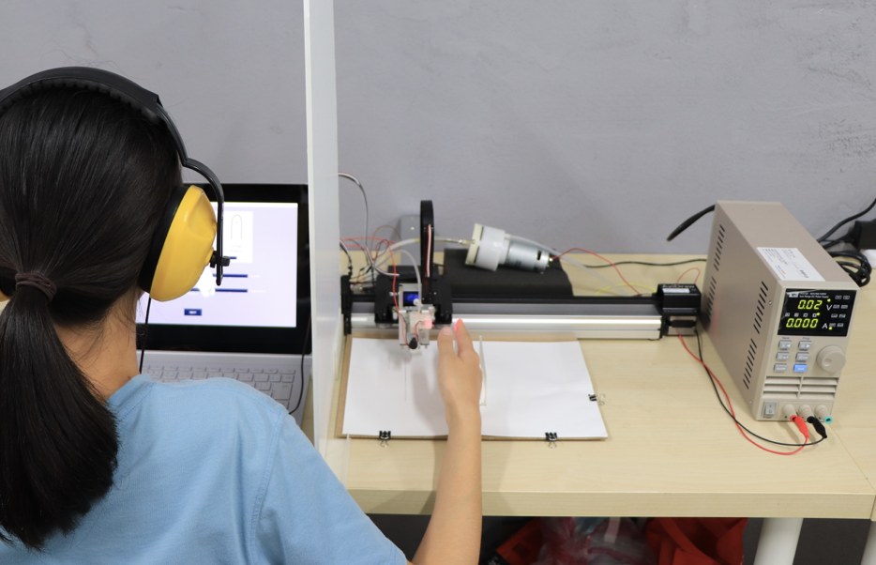
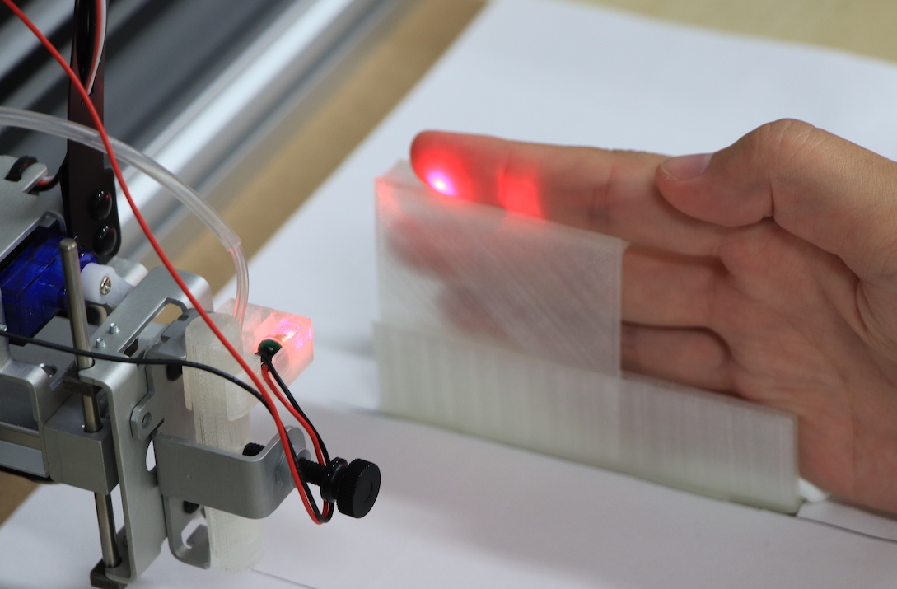
Apparatus
0.5 mm tube
Air pump run at 24V
Airflow applied to the fingertip at varying distances (5–30 mm).
Earmuffs and blocker ensures participants judge only haptics.
air pump
blocker
placeholder
earmuffs
XY-platform
Notes:
We used the same 0.5 mm tube, driven by an air pump running at 24V.
and deploy the air flow at various distance to the fingertip.
Earmuff and blocker ensures that participants can only judge the sensation by their haptic channel.

Slide 18
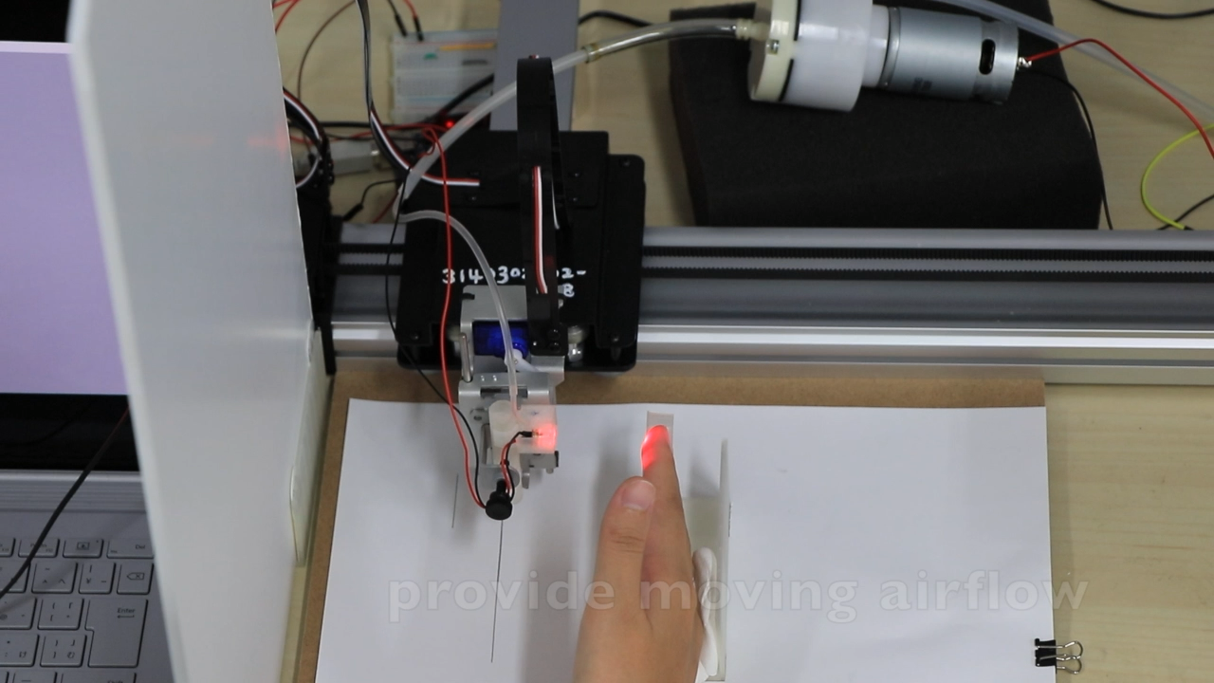
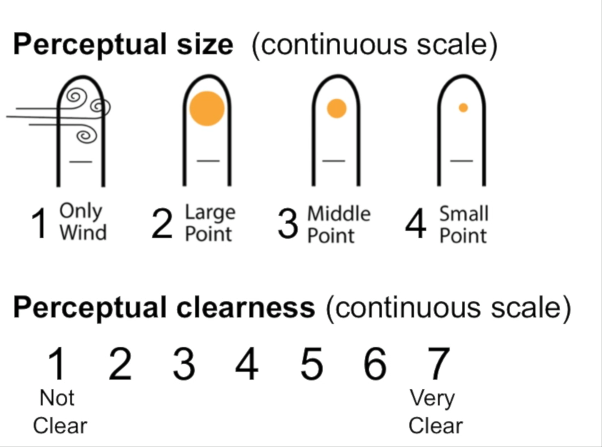
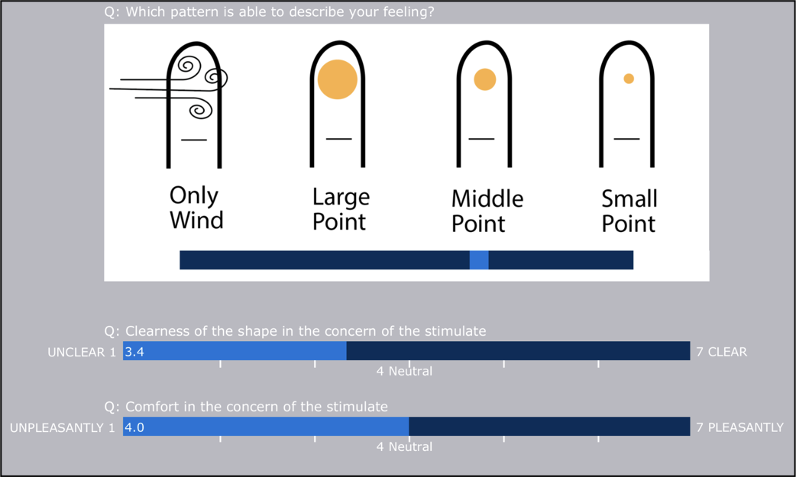
1
2
3
4

Slide 19
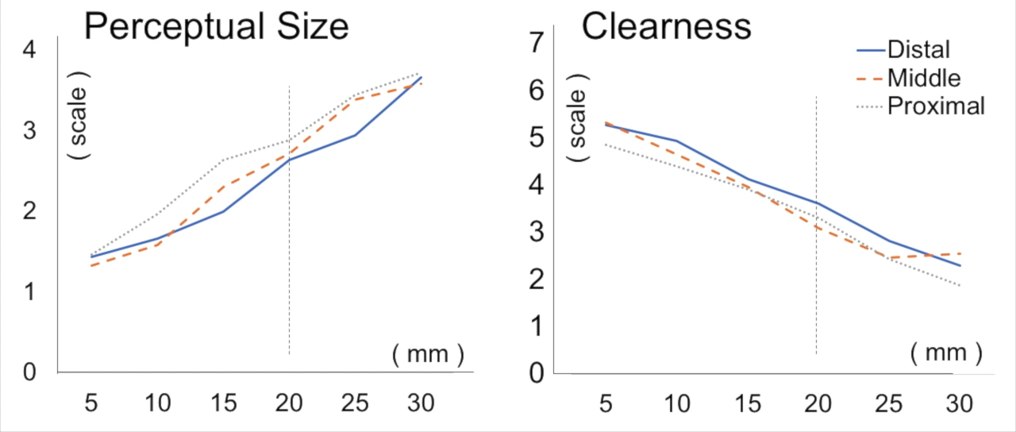
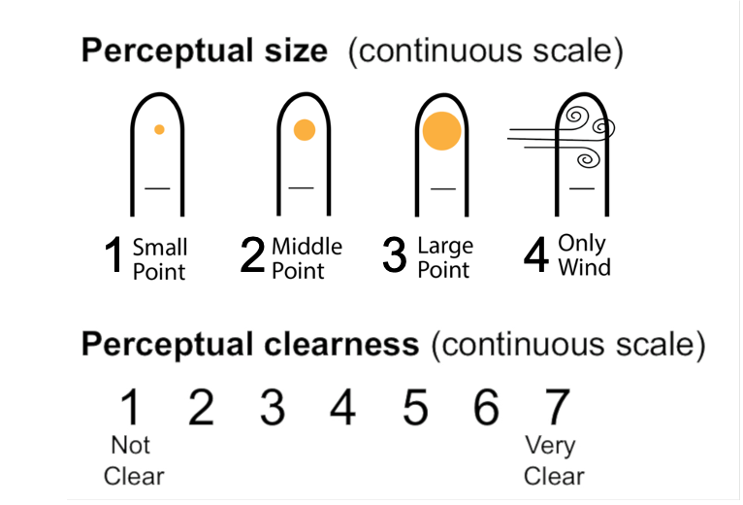
Results
Clear point sensation up to 20 mm.
Clarity decreases beyond 15 mm.
Distal phalanges more sensitive.
Notes:
This is results from12 participants.
Participants reported a distinct point sensation up to 20 mm from the nozzle; clarity drops beyond ~15 mm.
This suggests that participants did feel a point sensation on their finger within 20 mm.

Slide 20
Study 2
Evaluate JettingPointer in eye-free target acquisition.
Compare with vs. without haptic support.
Notes:
In Study 2, we ask: does airflow guidance actually improve eyes-free target acquisition on the skin?

Slide 21
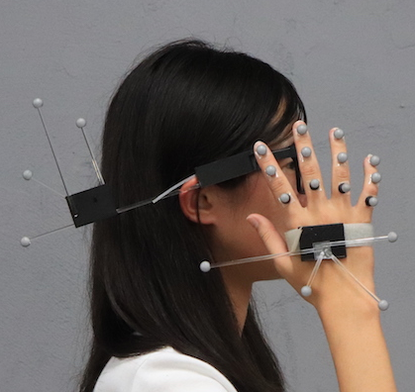
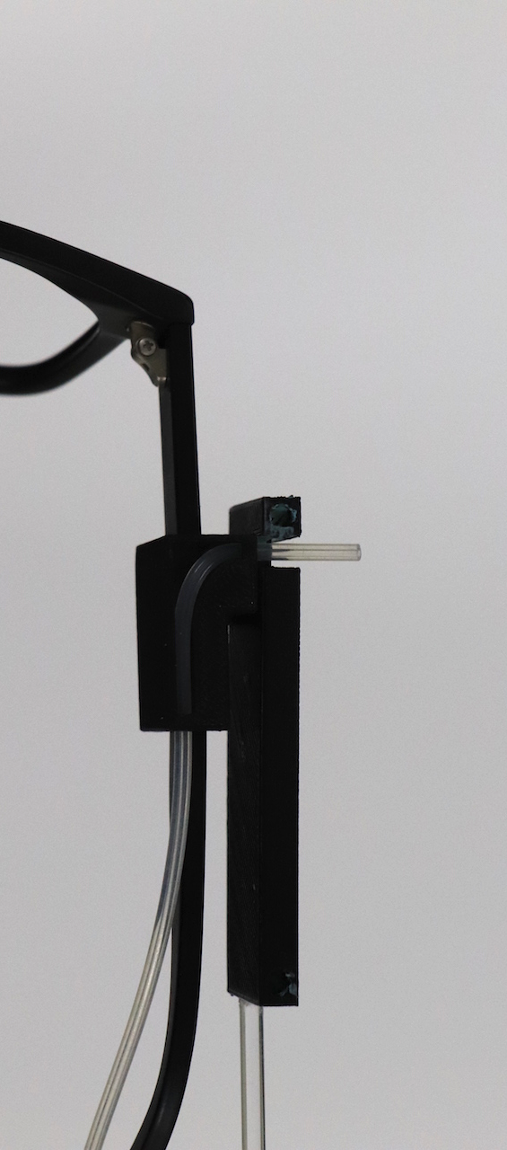
Apparatus
Prototype integrated into glasses frame.
Vicon system tracked finger phalanges.
Notes:
We embedded the nozzle at the glasses’ temple position, and tracked the hand with Vicon.

Slide 22
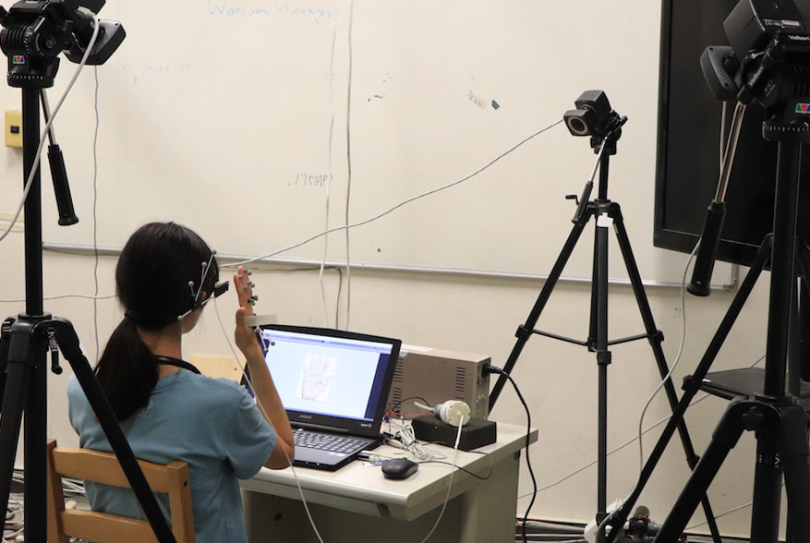
Apparatus
Prototype integrated into glasses frame.
Vicon system tracked finger phalanges.

Slide 23
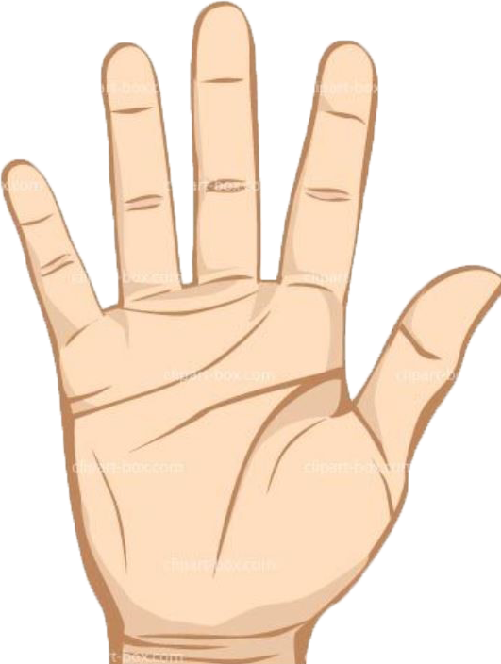
Experiment Design
18 participants.
12 finger phalanx targets, repeated 5 times each.
Conditions: with haptics vs. without haptics.
Measure: time and spatial error
Notes:
We recruited 18 participants.
The task includes targeting 12 phalanx locations with 5 repetitions.
The conditions were with and without assistance of JettingPointer.
For each target acquisition, the confirmation was done with the other hand pressing a button, at which moment, we measured time and spatial error.

Slide 24
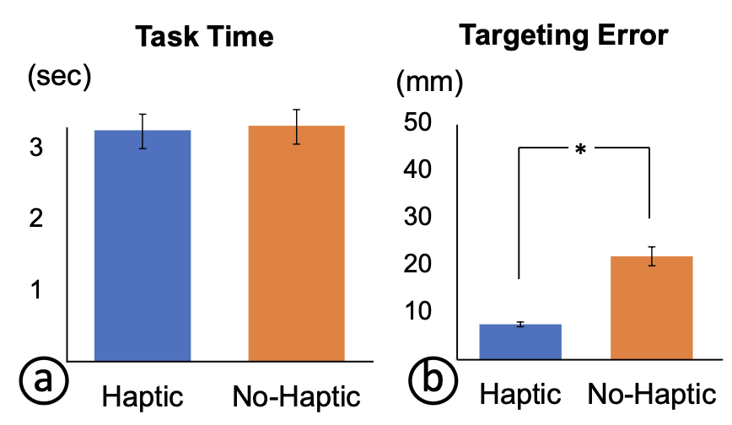
Results
Targeting error reduced nearly 3× with haptic cues (7.5 mm vs. 21.9 mm).
Notes:
We found no difference in task time. As for the errors, with haptics, targeting error dropped nearly 3 times than without the haptic assistance. This shows stationary airflow cues plus proprioception enable accurate, eyes-free input.

Slide 25
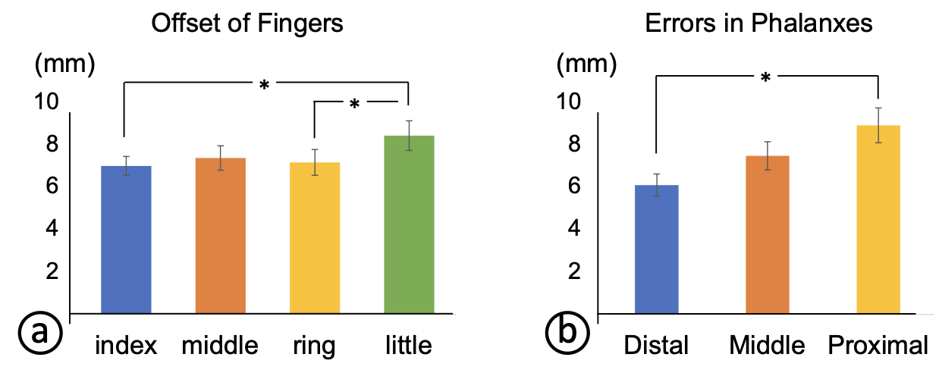
Results
Little finger has worse accuracy
Accuracy highest on distal phalanges.
Errors across Fingers
Errors across Phalanges
Notes:
We then look into errors across finger and finger phalanges.
The little finger has worse accuracy than the ring and index fingers.
The proximal has worse accuracy than the distal phalanges.

Slide 26
Qualitative Feedback
Participants found airflow cues intuitive.
Airflow helped sense where input was engaging.
Some difficulty on little finger edges.
Notes:
People called the airflow intuitive—they could ‘feel where it loads on the finger’ and which segment was being addressed, especially without looking. The little finger were trickier due to lower sensitivity.

Slide 27
Recommended Design
Notes:
Ditching the proximal phalages.
Ditching the little finger.

Slide 28
Limitations & Future Work
Range of Haptic Feedback
Environmental & Noise Constraints
Miniaturization Challenges
Perceptual Evaluation Bias

Slide 29
Range of Haptic Feedback
~20 mm effective; accuracy drops farther.
Environmental & Noise Constraints
e.g., wind disrupts; audible hiss
Miniaturization Challenges
needs external pump; explore piezo blowers.
Perceptual Evaluation Bias
Likert bias; need ADT/JND psychophysics.
Extending to other body sites
E.g., palm, arm, etc.
Notes:
The point sensation in our setup is topped at 20 mm. (extending this range allows to accommodate more flexible interaction).
However, this distance is also intentional to make the interaction intimate for wearables.

Slide 30
Range of Haptic Feedback
~20 mm effective; accuracy drops farther.
Environmental & Noise Constraints
e.g., wind disrupts; audible hiss
Miniaturization Challenges
needs external pump; explore piezo blowers.
Perceptual Evaluation Bias
Likert bias; need ADT/JND psychophysics.
Extending to other body sites
E.g., palm, arm, etc.
Notes:
The point sensation is rather weak, that can be affected by external winds such as situated in strong natural winds or sitting in front of fans.
This influence should be studied in future works.

Slide 31
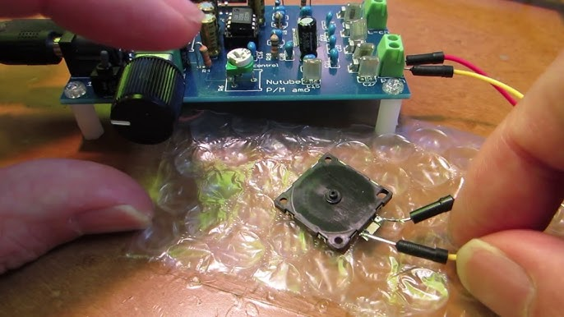
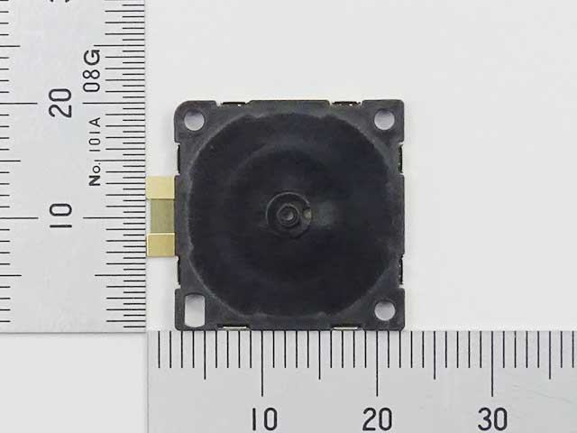
Range of Haptic Feedback
~20 mm effective; accuracy drops farther.
Environmental & Noise Constraints
e.g., wind disrupts; audible hiss
Miniaturization Challenges
needs external pump; explore piezo blowers.
Perceptual Evaluation Bias
Likert bias; need JND psychophysics.
Extending to other body sites
E.g., palm, arm, etc.
Notes:
Our prototype needs an external pump, which is apparently not desirable.
A promising direction going forward, is using piezo blowers.
This model in the photo is measured 20 mm by 20 mm and is thin enough.

Slide 32
Range of Haptic Feedback
~20 mm effective; accuracy drops farther.
Environmental & Noise Constraints
e.g., wind disrupts; audible hiss
Miniaturization Challenges
needs external pump; explore piezo blowers.
Perceptual Evaluation Bias
Likert bias; need JND psychophysics.
Extending to other body sites
E.g., palm, arm, etc.
Notes:
Also, Study 1 used Likert ratings—future work should add JND (Just Noticeable Discrimination)
Study for objective thresholds.

Slide 33
Range of Haptic Feedback
~20 mm effective; accuracy drops farther.
Environmental & Noise Constraints
e.g., wind disrupts; audible hiss
Miniaturization Challenges
needs external pump; explore piezo blowers.
Perceptual Evaluation Bias
Likert bias; need JND psychophysics.
Extending to other body sites
E.g., palm, arm, etc.

Slide 34
Conclusion

Slide 35

Conclusion
Introduces skin-to-pointer paradigm.
Demonstrates airflow haptics as practical feedback.
Expands dense input for compact wearables.
Notes:
JettingPointer demonstrates a skin-to-pointer paradigm: a minimal device emits a stationary airflow cue; the user aligns a phalanx to trigger precise, eyes-free input. While we demonstrate the concept on glasses, we believe it can be generalized to other smaller wearable forms such as smart watches and smart rings, with miniature airflow being realized.

Slide 36
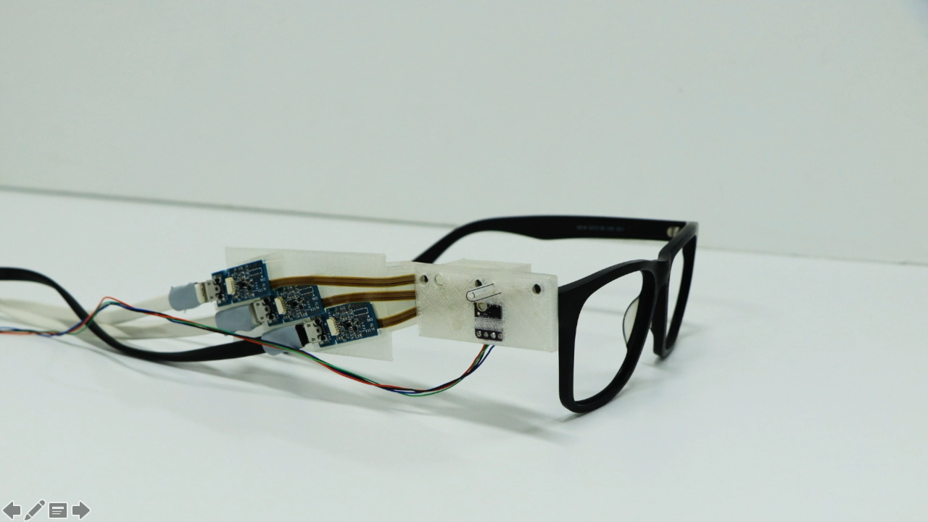

Slide 37
