Slide 1
Wireless Communication Systems
@CS.NCTU
Lecture 9: MAC Protocols for WLANs
Instructor: Kate Ching-Ju Lin (林靖茹)
Notes:
Review purpose

Slide 2


Reference
A Technical Tutorial on the IEEE 802.11 Protocol
By Pablo Brenner
online: http://www.sss-mag.com/pdf/802_11tut.pdf
IEEE 802.11 Tutorial
By Mustafa Ergen
online: http://wow.eecs.berkeley.edu/ergen/docs/ieee.pdf
802.11 Wireless Networks: The Definitive Guide
By Matthew Gast
802.11ac: A Survival Guide
By Matthew Gast
online: http://chimera.labs.oreilly.com/books/1234000001739
Notes:
Check frame format: what’s the purpose of each field, how many bits in each field

Slide 3
Agenda
Basic 802.11 Operation
Collision Avoidance (CSMA/CA)
Hidden Terminal
QoS guarantee
Other Issues
Performance Analysis

Slide 4
Why MAC for WLANs is Challenging?
Wireless medium is prone to errors
One station cannot “hear” all other stations
  Local view != global view
Channel quality, and thereby the achievable data rate, is closely related to link distance, and could change with time due to mobility
Again, because of mobility, need management mechanisms to (de)associating with APs as location changes
  Need efficient handoff to ensure seamless access

Slide 5
What is MAC?
Medium access control
Layer 2 (link layer)
Allowing multiple stations in a network to share the spectrum resources and communicate (1-hop)
Type of communications
  Unicast: one-to-one
  Multicast: one-to-many
  Broadcast: one-to-all
LLC
LLC
MSDU
MSDU
MAC
MPDU
MAC
PSDU
PSDU
PHY
PPDU
PHY
STA 1
STA 2
Notes:
MAC SDU (service data unit)
PDF (protocol data unit)
PLCP (physical layer convergence procedure)

Slide 6
Basic Service Set (BSS)
BSS
  Basic building block
  Infrastructure mode
IBSS (independent BSS)
  Ad-hoc network
ESS (extended service set)
  Formed by interconnected BSSs

Slide 7



Infrastructure Mode
AP
BSS (Basic Service Set)
STA
Each station (STA) associates with a central station Access point (AP)
An AP and its stations form a basic service set (BSS)
AP announces beacons periodically

Slide 8
Infrastructure Mode
ESS (Extended Service Set)
AP
AP
STA
Several BSSs could form an ESS
A roaming user can move from one BSS to another within the ESS by re-association
Notes:
Take NCTU Wireless as example

Slide 9
Infrastructure Mode
ESS (Extended Service Set)
AP
AP
STA
Issues
  Inter-BSS interference: via proper channel assignment
  Load balancing: via user management

Slide 10
Ad-Hoc Networks
IBSS (independent BSS)
Clients form a peer-to-peer network without a centralized coordinator
Clients communicate with each other via multi-hop routing
  Will introduce ad-hoc routing

Slide 11
Beacon and Association
100 ms
The AP in each BSS broadcasts beacon frames periodically (every 100ms by default)
Each beacons includes information such as SSID and AP’s address
A STA discovers a BSS by switching channels and scanning to look for beacons → Associate

Slide 12
Two Operational Modes
Distributed coordination function (DCF)
  Stations contend for transmission opportunities in a distributed way
  Rely on CSMA/CA
Point coordination function (PCF)
  AP sends poll frames to trigger transmissions in a centralized manner
Less used

Slide 13
CSMA/CA
Carrier sense multiple access with collision avoidance
Similarity and difference between CSMA/CD and CSMA/CA
  Both allow a STA to send if the medium is sensed to be “idle”
  Both defer transmission if the medium is sensed to be “busy”
  CD: immediately stop the transmission if a collision is detected
  CA: apply random backoff to avoid collisions!
same
diff
  Why?
  → a half-duplex STA cannot detect collisions during transmission
Notes:
Collision detection

Slide 14
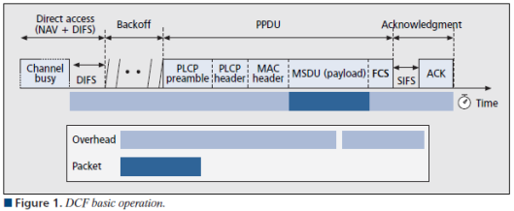
DCF
Start contention after the channel keeps idle for DIFS
Avoid collisions via random backoff
AP responds ACK if the frame is delivered correctly (i.e., passing the CRC check) → No NACK
Retransmit the frame until the retry limit is reached

Slide 15
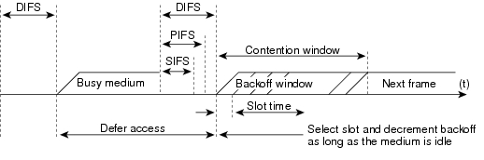
Prioritized Interframe Spacing
Find specific timing in the Spec. or Wiki
Latency: SIFS < PIFS < DIFS
Priority: SIFS > PIFS > DIFS
SIFS (Short interframe space): control frames, e.g., ACK and CTS
PIFS (PCF interframe space): CF-Poll
DIFS (DCF interframe space): data frame

Slide 16
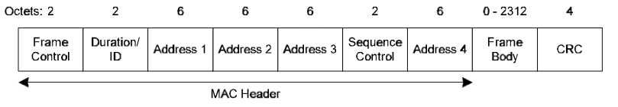
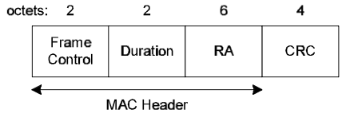
Frame Format
Data
ACK
Check other frame format in Spec.
How to estimate protocol overhead without considering backoff
  1 - T_{Data} / (T_{DIFS} + T_{PLCP} + T_{MAC} + T_{Data} + T_{SIFS} + T_{ACK})
  Control frames are sent at the base rate (lowest bit-rate)

Slide 17
Overhead vs. Throughput
Effective throughput
number of successfully delivered bits
total occupied time
Packet size vs. Effective throughput
Bit-rate vs. Effective throughput
?
header
1500-byte data
tail
✘
header
1-byte data
tail
Effective throughput ~ 0
header
1500-byte data sent at 24 mb/s
tail
header
1500-byte data
tail
Throughput(48) !=
2 x Throughput (24)
Sent at 48 mb/s
(halve the tx time)

Slide 18
Fragmentation and Aggregation
Success probability v.s. frame size
  Large frame reduces overhead, but is less reliable
  Discard the frame even if only one bit is in error
  Packet delivery ratio of an N-bit packet: (1-BER)^{N}
Fragmentation
  Break a frame into into small pieces
  All are of the same size, except for the last one
  Interference only affects small fragments
Aggregation
  Aggregate multiple small frames in order to reduce the overhead
  Supported in 802.11e and 802.11n

Slide 19
Agenda
Basic 802.11 Operation
Collision Avoidance
Hidden Terminal
QoS guarantee
Other Issues
Performance Analysis

Slide 20
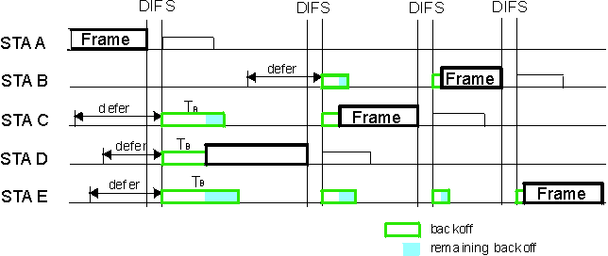
Random Backoff
STAs listen to the channel before transmission after DIFS
Avoid collision by random backoff

Slide 21
Exponential Random Backoff
Each STA maintains a contention window
  Initialized to CW_{min} = 32
Randomly pick a number, say k, between [0,CW-1]
Count down from k when the channel becomes idle
Start transmission when k = 0 if the channel is still idle
Double CW for every unsuccessful transmission, up to CW_{max} (1024)
CW is reset to CW_{min} after every successful transmission
When will collisions occur?
What’s the probability a collision occurs?

Slide 22
Agenda
Basic 802.11 Operation
Collision Avoidance
Hidden Terminal
QoS guarantee
Other Issues
Performance Analysis

Slide 23
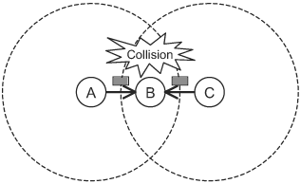
Hidden Terminal Problem
Two nodes hidden to each other transmit at the same time, leading to collision

Slide 24
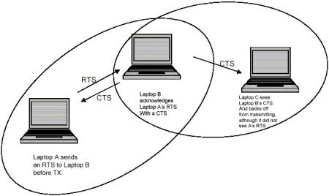
802.11’s Solution: RTS/CTS
AP
STA2
STA1
STA1 sends RTS whenever it wins contention
AP broadcasts CTS
Other STAs that receive CTS defer their transmissions

Slide 25
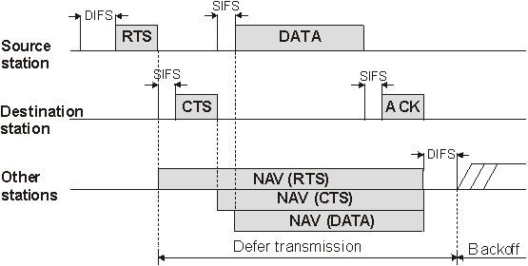
802.11’s Solution: RTS/CTS
NAV (Network allocation vector): STA performs virtual carrier sense for the specified time interval
Usually disabled in practice due to its expensive overhead

Slide 26
Recent Solutions to Hidden Terminals
Embrace collisions and try to decode collisions
  ZigZag decoding
  S. Gollakota and D. Katabi, “ZigZag decoding: combating hidden terminals in wireless networks,” ACM SIGCOMM, 2008
Rateless code
  Continuously aggregate frames and stop until decoding succeeds
  A. Gudipati and S. Katti, “Strider: automatic rate adaptation and collision handling,” ACM SIGCOMM, 2011

Slide 27
Agenda
Basic 802.11 Operation
Collision Avoidance
Hidden Terminal
QoS guarantee
Other Issues
Performance Analysis

Slide 28
802.11 Family
802.11a/b/g: conventional DCF
802.11e: support quality of service (QoS) enhancements for wireless LANs
802.11n: support single-user MIMO (lecture 4)
802.11ac: support multi-user MIMO (lecture 5)
802.11ad: define a new physical layer in the 60GHz (mmWave, last lecture)
802.11p: for vehicular networks

Slide 29
802.11e EDCA MAC
Enhance distributed channel access (EDCA)
Support prioritized quality of service (QoS)
Define four access categories (ACs)
priority
low
high

Slide 30
802.11e EDCA MAC – Priority Queues
Manage frames using priority queues

Slide 31
How to Prioritize Frames in 802.11e?
Again, by controlling the waiting time
  A higher-priority frame waits for shorter time
  Frames with the same priority contend as usual
priority
high
low

Slide 32
How to Prioritize Frames in 802.11e?
Again, by controlling the waiting time
  A higher-priority frame waits for shorter time
  Frames with the same priority contend as usual
AIFS (Arbitration Inter-Frame Spacing)
probabilistic
guarantee
(Within an AC)
(between ACs)

Slide 33
Agenda
Basic 802.11 Operation
Collision Avoidance
Hidden Terminal
QoS guarantee
Other Issue
Performance Analysis

Slide 34
Other Issues
Performance anomaly
  M. Heusse, et al., "Performance anomaly of 802.11b," IEEE INFOCOM, 2003
Expensive overhead as the PHY rate increases
  K. Tan, et al., "Fine-grained channel access in wireless LAN," ACM SIGCOMM, 2011
  S. Sen, et al., “No time to countdown: migrating backoff to the frequency domain,” ACM MobiCom, 2011
  Unequal band-width and flexible channelization
  20MHz in 802.11a/b/g/n/ac, 40MHz in 802.11n/ac, 80MHz and 160Hz in 802.11ac
  S. Rayanchu, et al., ”FLUID: improving throughputs in enterprise wireless LANs through flexible channelization,“ ACM MOBICOM, 2012

Slide 35
Performance Anomaly
The throughput of a STA sending at a high rate (e.g., 54Mbps) is degraded by that sending at a low rate (e.g., 6Mbps)
Root causes?
  802.11 supports multiple transmission bit-rates, each of which has a different modulation and coding scheme
  802.11 ensure packet fairness, instead of time fairness
  Packet fairness: each STA has an equal probability to win the contention → the average number of delivered packets for all STAs are roughly the same (802.11)
  Time fairness: each STA occupies roughly the same proportion of channel time

Slide 36
Performance Anomaly
r_{ij}=54 Mb/s
r_{uv}=6 Mb/s
b₅₄=36.2 Mb/s when l₅₄ sends alone
c₅₄=4.14 Mb/s as contending with l₆
b₆=5.4 Mb/s when l₆ sends alone
c₆=4.37 Mb/s as contending with l₅₄
p/b₅₄
p/b₆
t
Channel is almost occupied by low-rate links
➔ Everyone gets a similar throughput,
regardless of its bit-rate

Slide 37
Agenda
Basic 802.11 Operation
Collision Avoidance
Hidden Terminal
QoS guarantee
Other Issues
Performance Analysis

Slide 38
Performance Analysis for CSMA/CA
  G. Bianchi, "Performance analysis of the IEEE 802.11 distributed coordination function," Selected Areas in Communications, IEEE Journal on 18, no. 3 (2000): 535-547
Model to compute the 802.11 DCF throughput
Assumptions
  Finite number of stations
  Ideal channel, i.e., no packet errors and no hidden terminals
  Consider “saturation throughput”, i.e., the maximal load a system can achieve
Core ideas:
  At each transmission attempt (either first transmission or retransmissions), each packet collides with constant and independent probability p
  p: conditional probability related to contention window W and number of stations N

Slide 39
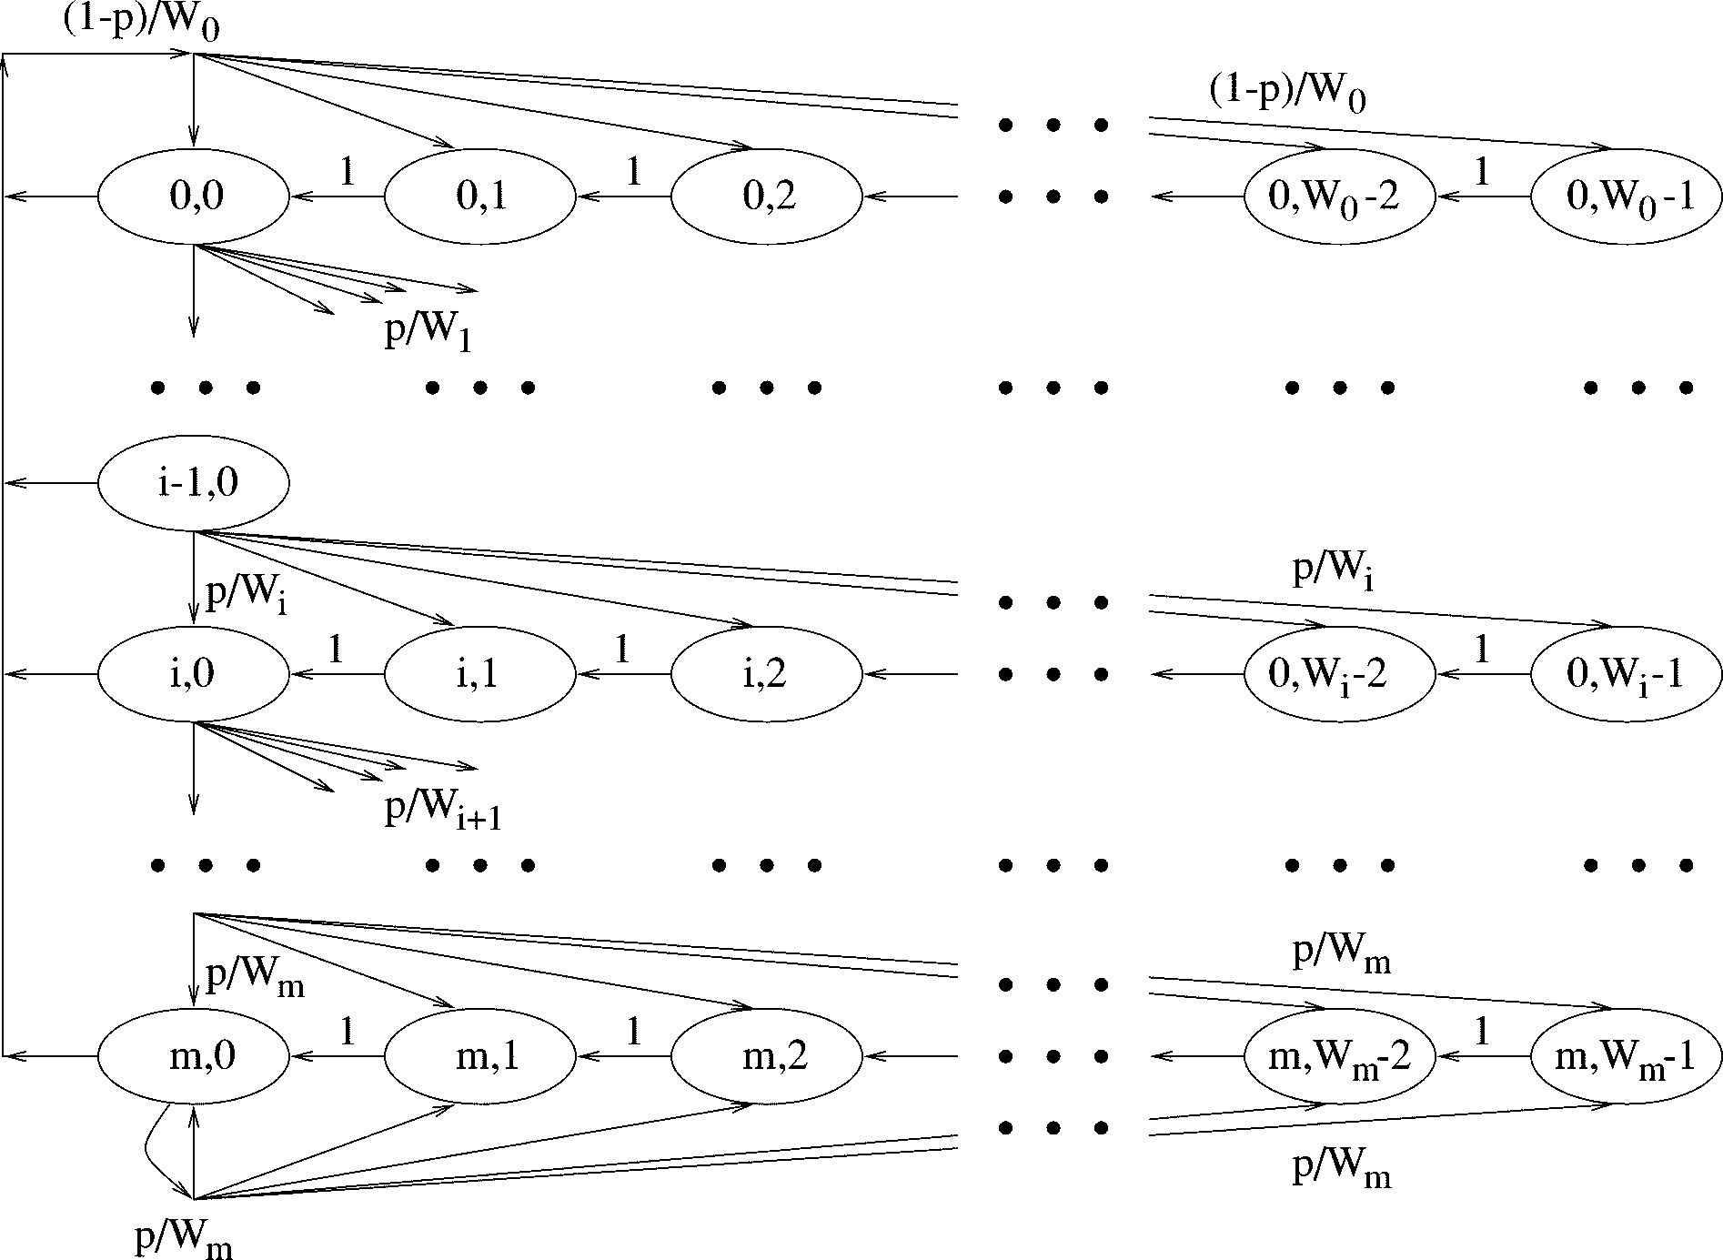
Performance Analysis for CSMA/CA
  Model as a bi-dimensional discrete-time Markov chain {s(t), b(t)}
  s(t): backoff stage at time t, b(t): backoff time counter at time t
Random backoff
Stage 0
count down
succeed
fail
Stage 1
Stage m

Slide 40
Performance Analysis for CSMA/CA
  Model as a bi-dimensional discrete-time Markov chain {s(t), b(t)}
  s(t): backoff stage at time t, b(t): backoff time counter at time t
Random backoff
Stage 0
count down
succeed
fail
Stage 1
Find the stationary distribution of the chain: b_{i,k} = lim_{t→∞}P{s(t)=i, s(t)=k}
Stage m

Slide 41
Performance Analysis for CSMA/CA
Find the stationary distribution of the chain
The probability that a station transmits in a randomly chosen slot time
The probability that there is at least one transmission
The success probability of a transmission
Notes:
b_{i,k}=\lim_{t\rightarrow \infty}P\{s(t)=i,s(t)=k\}
\tau = \sum_{i=0}^m b_{i,0} = \frac{b_{0,0}}{1-p} = \frac{2}{W+1}
P_{tr}=1-(1-\tau)^n
P(\text{exactly one transmission}|\text{at least one transmission})=\frac{n\tau(1-\tau)^{(n-1)}}{P_{tr}}

Slide 42
Summary
Nice properties of WiFi
  Unlicensed band → Free!!
  Distributed random access and no coordination
  Ensuring fairness
Common issues
  Expensive overhead and lower spectrum efficiency
  Hard to avoid collisions
  No QoS guarantee
Every protocol balances the trade-off between
performance and overhead

Slide 43
Quiz
Assume the control frames and the overhead occupies the channel time of 100us
Compare the throughput if a 135-byte (1080 bits) packet is sent at 6 Mb/s and 54 Mb/s, respectively
  (Hint:1080/54 = 20, 1080/6=180)

