Slide 1
Wireless Communication Systems @CS.NCTU
Lecture 7: MobileHCI
Instructor: Kate Ching-Ju Lin (林靖茹)

Slide 2
Traditionally, wireless signals are used for …
Data communication among devices
011001…...
100101…...

Slide 3
Now, we have internet of Things
More and more sensing/wearable devices,
wireless signals everywhere

Slide 4
Can we use wireless signals to create human-centric applications, not just for data communication?

Slide 5
Why Device-Free?

Slide 6

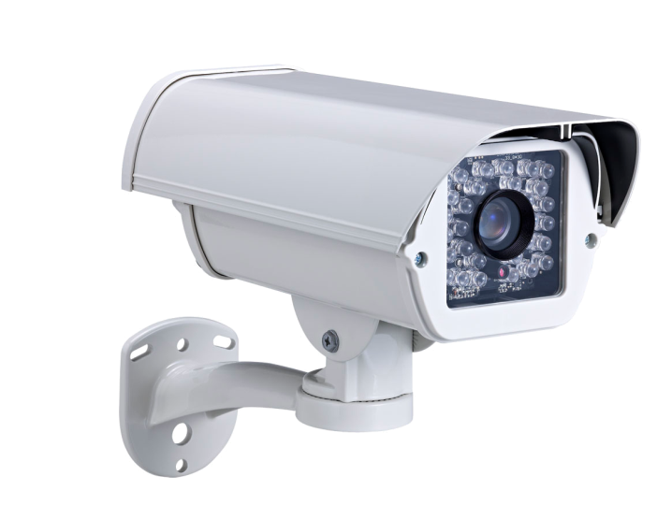

Limitation of Cameras
Privacy issues
Line of sight limitation
Lighting requirement

Slide 7

Limitation of Wearable Devices
Inconvenient
High deployment cost
Feedback overhead
Notes:
Inconvenience
shower, etc.

Slide 8
Device-Free MobileHCI Apps
Gesture recognition
[MobiCom’13]
Handwriting
[MobiCom’15]
Keystroke
[Mobicom’15]

Slide 9
Device-Free HealthCare Apps
Fall detection
[NSDI’14]
Breathing and heart-rate
monitoring
Emotion detection
[CHI’15, MobiCom’16]
Sleep Apnea Diagnosis
[MobiSys’15]

Slide 10
WiSee Device-free gesture recognition using wireless signals [MobiCom’13] Qifan Pu, Sidhant Gupta, Shyam Gollakota, Shwetak Patel University of Washington

Slide 11
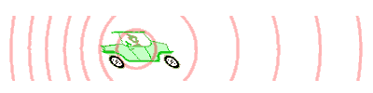
Idea: Doppler shift
Frequency change of a wave occurs as its source moves relative to the observer
source: https://en.wikipedia.org/wiki/Doppler_effect
Velocity of the signal receiver (observer)
v_{r}⬆ Δf ⬆
Speed of light
Notes:
f' = \left( \frac{ c + v_r}{c}\right) f
\Delta f = f'-f = \frac{f}{c}v_r

Slide 12
Doppler Effect Caused by Human Mobility
When a user is mobile, Rx will observe the Doppler effect even if Rx itself is static
Why?
If the moving speed is v, what’s the Doppler effect
Δf ≤ (2f/c) * v → Why?
The length of the reflected path varies over time
Velocity of Rx along the reflected path is at most 2v
Detect the gesture by measuring the Doppler effect at Rx → Device-free!
Notes:
f' = \left( \frac{ c + v_r}{c}\right) f
\Delta f = f'-f = \frac{f}{c}v_r

Slide 13
Is it that Simple?
Challenge 1
The velocity of a human gesture is VERY SMALL (e.g., 0.5 m/s)
Correspond to a small Doppler shift e.g., Δf=2fv/C = 17Hz when v = 0.5 m/s and f = 5GHz
Challenge 2
WiFi operates in the 20MHz wide band → Corse resolution!!
Each 802.111 OFDM symbol includes 64 subcarriers → bandwidth of each subcarrier = 20*10⁶/64 ~ 313KHz
Δf = 17Hz
Cannot observe 17Hz within a 312.5KHz band
f1
f2
f3
313KHz

Slide 14
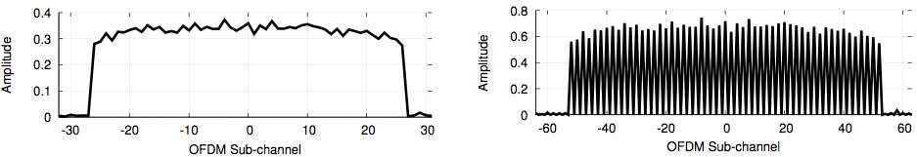
How to Identify Small Shift
even in Wideband Channels?
Idea: Transform the WiFi signals to narrowband pulses via large FFT!
FFT over one symbol
FFT over two identical symbol

Slide 15
Large FFT
IFFT
FFT
Assume Tx sends two identical symbols, each with N sample
If Rx performs a 2N point FFT
Even sub-ch
Odd sub-ch
Bandwidth of each subcarrier is halved!
In theory, odd subcarriers must be 0. Then, if Rx receives pulse in odd subcarriers → Doppler effect!!
Notes:
x_k = \sum_{n=1}^N X_ne^{i2\pi k n/N}
X_n = \sum_{k=1}^N x_ke^{-i2\pi k n/N}
X_n & = \sum_{k=1}^N x_ke^{-i2\pi k n/{\color[rgb]{0.200000,0.400000,0.800000}2N}} + \sum_{k=N+1}^{\color[rgb]{0.200000,0.400000,0.800000}2N} x_ke^{-i2\pi k n/{\color[rgb]{0.200000,0.400000,0.800000}2N}} \\
& \sum_{k=1}^N x_ke^{-i2\pi k n/{\color[rgb]{0.200000,0.400000,0.800000}2N}} + \sum_{k=1}^{\color[rgb]{0.200000,0.400000,0.800000}N} x_ke^{-i2\pi (k+N) n/{\color[rgb]{0.200000,0.400000,0.800000}2N}} \\
& = \sum_{k=1}^N x_ke^{-i2\pi k n/2N}(1+e^{-i\pi n})

Slide 16
How Large is FFT Required?
2N points FFT → halve the bandwidth
Each subcarrier is (20/64) /2 = 10(MHz)
MN points FFT → reduce the bandwidth by M times
Each subcarrier is 20/M (MHz)
To get a resolution of 10Hz, we need (20/64)*10⁶/M = 10 → M = 31,250

Slide 17
Capturing Movement via Large FFT
FFT over 31,250 symbols → 10Hz per subcarrier
Without movement
Doppler shift
With movement

Slide 18
Capturing over Time
Velocity
time
Frequency-time Doppler profile of an example gesture (push)

Slide 19
Detection by Classification
Different gestures correspond to various frequency-time Doppler profiles

Slide 20
Classification
Partition signals into segments
Represent the moving pattern as a sequence of positive/negative Doppler Effects
Doppler Effect | Value
Positive | 1
Negative | -1
Both Positive/Negative | 2
Compare the received sequence with the set of pre-defined sequenced

Slide 21
Practical Issue
Tx never sends the identical symbols over time
Solution: Decode and re-encode
Decode the data symbol as usual
Re-encode the frequency-domain symbols Y₁ = H₁X₁ Y₂ = H₂X₂ → Y₂’= Y₂*(X₁/X₂) ~= H₂X₁ Y_{M} = H_{M}X_{M} → Y_{M}’= Y_{M}*(X₁/X_{M}) ~= H_{M}X₁
Convert it back to time-domain y’(m) = IFFT(Y’_{m})
Perform large FFT for y’(0)~y’(M)
…

Slide 22
Performance – Accuracy
Confusion matrix
Accuracy: .88~1

Slide 23
Performance – False Detection
False detection can be almost eliminated if the subject repeats the preamble (pre-defined gesture) several times

Slide 24
Concluding Remark
First device-free wireless-based gesture recognition
Leverage the Doppler Effect to detect gestures
Improve the resolution using large FFT
How to detect multiple persons?
Use multiple antennas
Limitation: a finite set of detectable gesture
The Doppler shift patterns of different gestures should be distensible

Slide 25
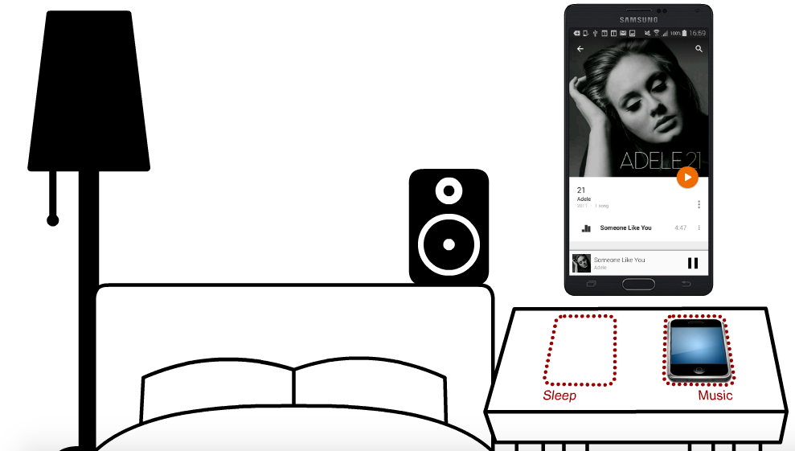
EchoTag Infrastructure-free indoor localization tagging [MobiCom’15] Yu-Chih Tung and Kang Shin University of Michigan, Ann Arbor

Slide 26
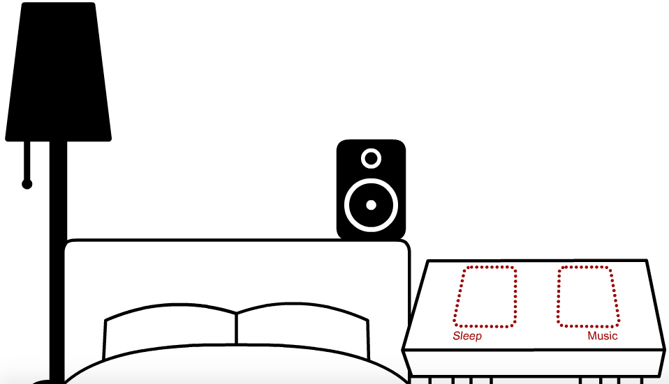
What is Location Tagging?

Slide 27
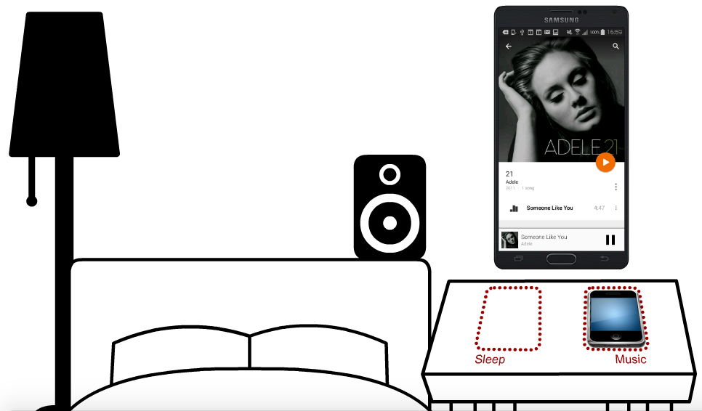
What is Location Tagging?

Slide 28
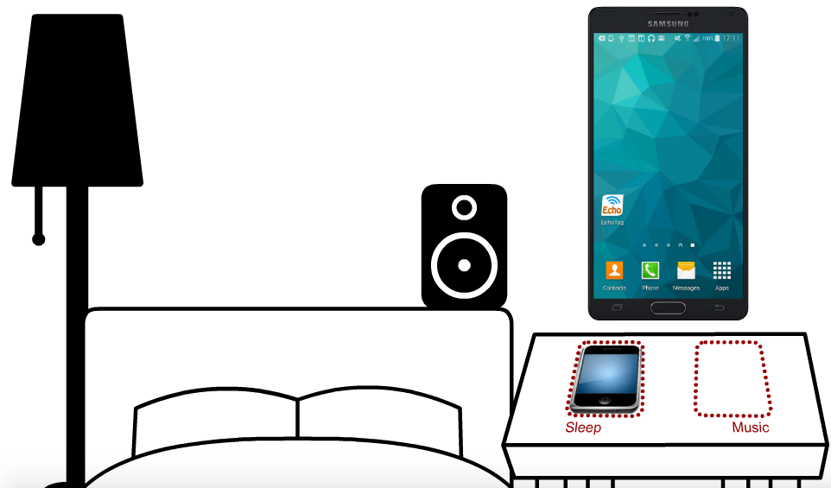
What is Location Tagging?
HOW?
Locate the position using Acoustic Signals!

Slide 29
Existing Solutions
Infrastructure free
Infrastructure-based

Slide 30
Existing Solutions
Not accurate
Infrastructure free
SurroundSense [Mobisys’09] room-level
Batphone [Mobisys’11] room-level
RoomSense [AH’11] 300cm
Horse [Mobisys’05] 200cm
Geo [Mobisys’11] 100cm
FM [Mobisys’12] 30cm
Infrastructure-based
Luxapose [Mobisys’14] 10cm
Cricket [Mobicom’00] 10cm
Guoguo [Mobisys’13] 6-25cm
Hard to deploy

Slide 31
EchoTag
Active acoustic sensing
Fine sensing resolution based on built-in sensors (microphone and speaker)
Low cost and easy deployment

Slide 32
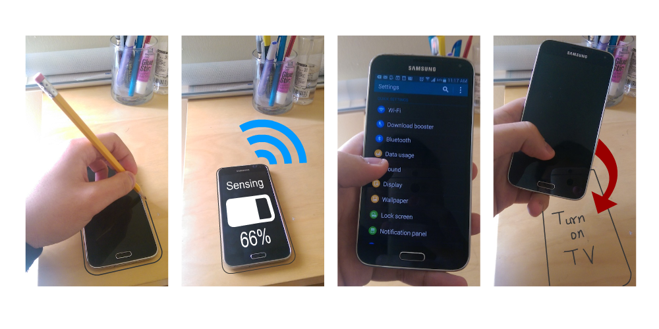
How to Use EchoTag?
(a) Outline contour
(b) Sense w/ sound
(c) Select app
(d) Replay tag

Slide 33
EchoTag
Active acoustic sensing
Classification and optimization

Slide 34
Sound Fingerprint
(a) Hardware imperfection
(b) Surface absorption
(c) Multipath fading by reflections from surfaces and near objects
Notes:
https://yctung.github.io/files/slide/mobicom15_echotag.swf

Slide 35
Sound Fingerprint – Example

Slide 36
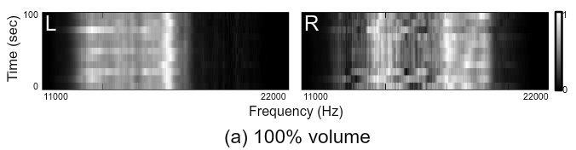
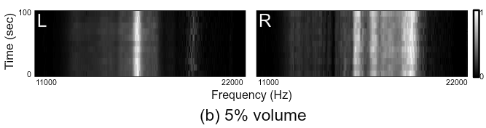
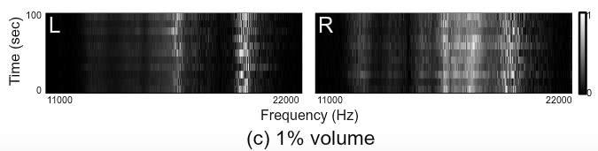
Volumn Control
Similar to the linearity problem in WiFi

Slide 37
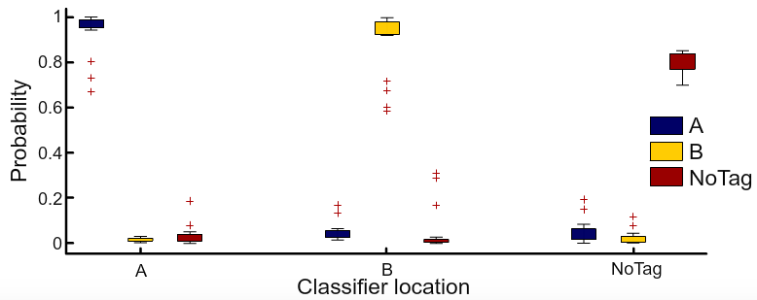
Classification
Support Vector Machine (SVM)
One-against-all multi-class SVM
NoTag Classifier

Slide 38
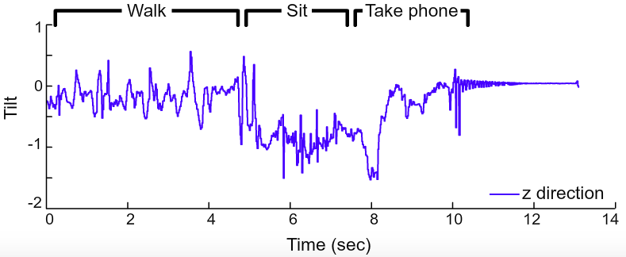
Sensing Optimization
Acoustic sensing is triggered selectively
Save energy and reduce annoyance
Based on WiFi beacons and tilt
Trigger EchoTag

Slide 39
FCC Electronic Frog Eye: Counting Crowd Using WiFi [INFOCOM’14] Wei Xi, Jizhong Zhao, Xiang-Yang Li, Kun Zhao, Shaojie Tang, Xue Liu, Zhiping Jiang Xi’an Jiaotong University, Tsinghua University, Illinois Institute of Technology, Temple University, McGill University

Slide 40
People Counting
Application
Crowd control, marketing research, etc
Existing solutions
Camera-based: line-of-sight limitation, lighting requirement, vulnerable to object overlap, privacy concern
Device-based (RFID tags, sensors, mobile phones): not scalable, high deployment cost
http://www.axis.com/dk/en/solutions-by-application/people-counting

Slide 41
Device-free RF-based Counting
RSS-based
Leverage attenuation models to localize users
Poor performance in a multipath-rich environment
PHY-based
Exploit raw physical-layer information
Need special hardware, such as USRP
CSI-based
Use fine-grained channel state information (attenuation and phase information of OFDM subcarriers)
Can be captured by commodity NICs

Slide 42
Key Idea: # of People vs. CSI Variance
More mobile users → Higher CSI variation

Slide 43
Why?
Each user can be regarded as a virtual antenna, which reflects the signal toward Rx
Y = Y_{static} + Y_{from_user}
= HX
→
H = H_{static} + H_{from_user}
H = H_{static} + ∑_{u=1..N}H_{u}
N↑ ⟺ Var(H)↑

Slide 44
Challenge
Why it is difficult?
Should be resistant to environmental changes
But sensitive to human motion
Need to learn “short-term” CSI variance
Long-term average variance is helpless when the crowd number changes frequently
Problem: How to get short-term variance when the sample size is small?
i

Slide 45
PEM
Percentage of non-zero element in the dilated CSI matrix
M
Normalize |h_{ij}| to (h_{min}, h_{max})
k = (|h_{ij}|- h_{min} )/ (h_{max} - h_{min} ) * M

Slide 46
PEM
Percentage of non-zero element in the dilated CSI matrix
i
 |  |  |  |  |  |  |  |  | 1
M
k
Normalize |h_{ij}| to (h_{min}, h_{max})
k = (|h_{ij}|- h_{min} )/ (h_{max} - h_{min} ) * M
→ set M[k][j]=1

Slide 47
PEM
Var(H)↑ ⟺ #(1)↑
Count the percentage of non-zero elements
1 |  | 1 |  | 1 |  | 1 |  |  | 1 |  | 1 | 1 |  | 1 |  | 1 |  | 1 | 1
1 |  | 1 |  |  | 1 |  |  | 1 |  |  |  |  | 1 |  | 1 |  | 1 |  | 1
 | 1 |  | 1 | 1 |  |  | 1 | 1 | 1 | 1 | 1 | 1 | 1 |  |  |  | 1 | 1
1 |  | 1 | 1 | 1 | 1 | 1 | 1 | 1 | 1 | 1 | 1 | 1 | 1 | 1 | 1 | 1 |  | 1 | 1
 | 1 | 1 |  |  | 1 | 1 | 1 |  | 1 |  | 1 |  | 1 |  | 1 |  | 1 | 1 | 1
1 | 1 | 1 | 1 |  | 1 |  | 1 | 1 |  | 1 |  | 1 |  | 1 |  | 1 | 1 |  | 1
1 |  | 1 |  |  |  | 1 |  | 1 | 1 | 1 | 1 |  | 1 | 1 | 1 | 1 | 1 | 1 | 1
 |  |  |  |  |  |  | 1 | 1 |  |  |  |  | 1 |  |  | 1 |  | 1
 |  |  |  |  |  |  |  |  |  | 1 |  | 1 |  |  | 1 |  | 1
 |  |  |  | 1 |  |  |  |  |  |  | 1 |  | 1 | 1 |  |  |  | 1 | 1
 |  | 1 | 1 |  |  |  |  |  |  |  |  |  |  |  |  | 1
1 | 1 | 1 |  | 1 | 1 | 1 |  | 1 | 1 |  | 1 | 1 |  |  | 1 |  | 1 |  | 1
1 |  |  | 1 |  | 1 | 1 | 1 |  |  | 1 |  | 1 |  | 1 |  |  |  | 1
 | 1 |  |  |  |  |  | 1 | 1 |  | 1 | 1 |  | 1 |  |  | 1 | 1 |  | 1

Slide 48
Map PEM to Number of People
Use fringerprint to find the relationship between PEM and people number
How to use fewer samples (less effort of measurements) to find the fitting curve?
Verhulst model (check the paper)
Quasi-monotonous relationship

