Slide 1
Wireless Communication Systems @CS.NCTU
Lecture 6: Localization
Instructor: Kate Ching-Ju Lin (林靖茹)

Slide 2
Type of Approaches
RSSI-based
Angle of Arrival (AoA)
Time of Flight (ToF)
Time Difference of Arrival (TDoA)

Slide 3
RF-based Localization
See through walls
WiVi (SIGCOMM’13)
ToF-based localization
WiTrack (NSDI’14, NSDI’15)
AoA-based localization
ArrayTrack (NSDI’13)

Slide 4
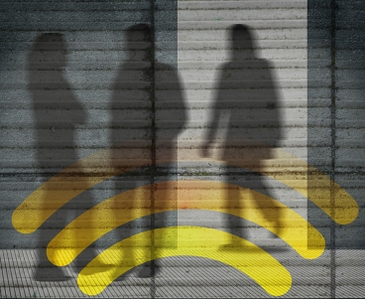
Can you use WiFi to get X-ray vision?
Notes:
seeing what’s going on behind the wall
unable to see the details of the face of a person
sort of or bright spot on our screens, just like in radar

Slide 5

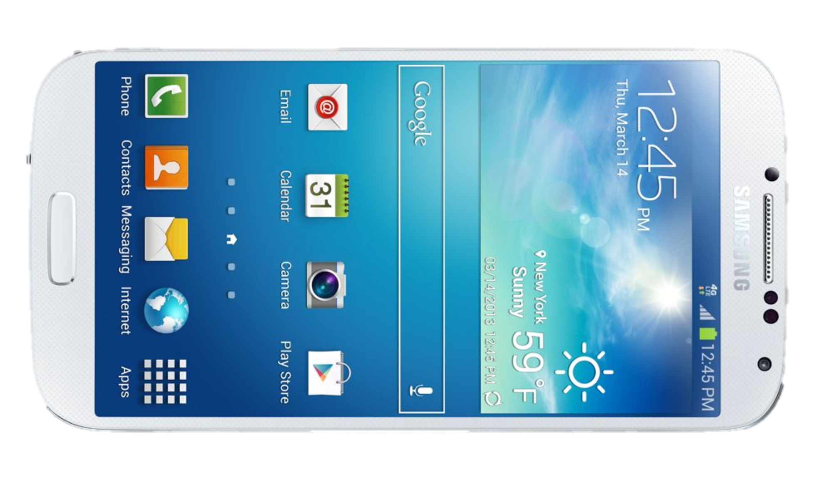


Key Idea
Tracking people from their reflections
Notes:
Wi-Fi signals go through walls.
Signal reflects off different things in the environment: walls, furniture, floors, and so on. It also reflect off our bodies.
a very small fraction of his reflections will come back to us through the wall.

Slide 6
Challenges
Wall refection is 10,000x stronger than reflections coming from behind the wall
How to separate the person’s reflections from the reflections of other objects?
Notes:
a very small fraction of his reflections will come back to us through the wall.
Of course, it’s not that simple.
a huge amount of reflection is going to come from the wall itself.
reflected off the wall is 10,000 to 100,000 times stronger than any reflection coming from behind the wall.
Second, we will get reflections from everything in the environment: the chairs, tables, and so on. How can we tease out the person’s reflections from all of these reflections?

Slide 7
WiVi [SIGCOMM’13]
How to eliminate the wall’s reflections?
Leverage multiple antennas to perform interference nulling
How to track users using reflections?
Deem a mobile user as a virtual antenna array reflecting the signals

Slide 8
Eliminating Static Reflection
Idea: transmit two waves that cancel each other when they reflect off static objects but not moving objects
Wall is static
disappears
People tend
to move
detectable
Notes:
transmit 2 waves that have a very specific property:
these waves cancel each other out with they reflect off static objects,
but not when they reflect off moving objects.

Slide 9
Eliminating via Multiple Antennas
Receive antenna
x
Transmit antennas
αx
Notes:
uses 3 antennas: two antennas for transmitting and one of them for receiving.

Slide 10
Eliminating via Multiple Antennas
Cancel strong reflections from walls
0
y = h₁ x + h₂αx
h₁
x
α = -h₁ / h₂
αx
h₂
Notes:
transmit a signal x on the first antenna, and transmit the same signal on the second antenna, multiplying it by alpha.
These 2 transmitted waves are going to reflect off the wall and come back to the receive antenna.
So, the receive antenna gets y=h1x + h2.alha.x

Slide 11


Eliminating All Static Reflections
Only the reflections from mobile users survive → Why?
✘
✘
Notes:
also cancel reflections from all static objects like couches, tables, chairs, and
only thing that will survive is the human’s reflection.

Slide 12
Eliminating All Static Reflections
x
h₁
αx
y = h₁ x + h₂αx
h₂
Static objects (wall, furniture, etc.) have constant channels
People move, therefore their channels change
0
y = h₁ x + h₂(- h₁/ h₂)x
y = h’₁ x + h’₂ (- h₁/ h₂)x
Not Zero

Slide 13
WiVi [SIGCOMM’13]
How to eliminate the wall’s reflections?
Leverage multiple antennas to perform interference nulling
How to track users using reflections?
Deem a mobile user as a virtual antenna array reflecting the signals

Slide 14
Tracking Motion
RF source
θ
Direction of reflection
Antenna Array
Notes:
The first thing to note is that when the human reflects the signal, it’s as if he is the source of that signal.
We know from wireless textbooks that if you want to track an RF source, you can do that using an antenna array.
[animate].
By steering the beam of the array, we can find the direction of from which the signal is coming.
[animate]
Now, when a person moves, that direction would change, and we are able to track him.

Slide 15
Tracking Motion
Direction of motion
θ
At any point in time, we have a single measurement
Antenna Array
Notes:
Clearly, we cannot build an antenna array on a small device.
To address this challenge, we borrow a technique which has been traditionally used to map different planets from Earth. The technique uses the movement of the target to emulate an antenna array.
So, what do I mean by that.
[animate]
We have only one receive antenna, which means that at any point in time, we have a single measurement.
Nevertheless, the target is moving.
[animate]

Slide 16
Tracking Motion
Direction of motion
θ
θ
Direction
of motion
Antenna Array
Notes:
This means that at different points in time, he is reflecting the signal from different points in space.
[animate]
If we consider all of these measurements together, it is as if the person is emulating an antenna array.
[animate]
Because consecutive measurements in time emulate an antenna array, we can use standard antenna array beam steering to identify the direction motion of a person.

Slide 17
Tracking Motion
Direction of motion
θ
θ
Human motion emulates antenna array
→ Inverse synthetic aperture radar (ISAR)
Antenna Array
Notes:
We can use these successive time measurements and apply standard beamforming equations to obtain the direction of motion.
In fact, what I just described to you is the dual of what Dina described in her talk. Over there, the receiver had to move to emulate an antenna array, whereas here the movement of the source naturally emulates the array.

Slide 18
How to Calculate the Direction?
Say we have w consecutive channel measures h[n], …, h[n+w] from time n to (n + w)
The signal along the direction θ at time n is given by
The direction can be found by
spatial separation between successive antennas
How to get Δ given that user location is unknown?
Notes:
A[\theta, n] = \sum_{i=1}^w h[n+i]e^{j\frac{2\pi}{\lambda}i\Delta \sin \theta}
\theta^* = \arg\max_\theta A[\theta,n]

Slide 19
Tracking Users
Rough estimation Δ = vT, where v is user mobility (~1m/s)
WiVi only tracks users, instead of localizing them
Only need to know whether the user is moving closer or away from the device
positive angle, decreasing → moving closer
negative angle, increasing → moving away
Notes:
A[\theta, n] = \sum_{i=1}^w h[n+i]e^{j\frac{2\pi}{\lambda}i\Delta \sin \theta}
\theta^* = \arg\max_\theta A[\theta,n]

Slide 20
Tracking Multiple Persons
Human mobility is continuous!
user 1
user 2

Slide 21
RF-based Localization
See through walls
WiVi (SIGCOMM’13)
ToF-based localization
WiTrack (NSDI’14, NSDI’15)
AoA-based localization
ArrayTrack (NSDI’13)

Slide 22
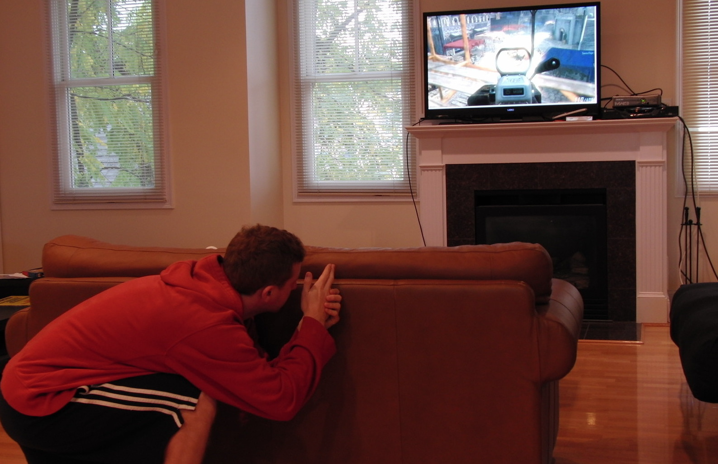
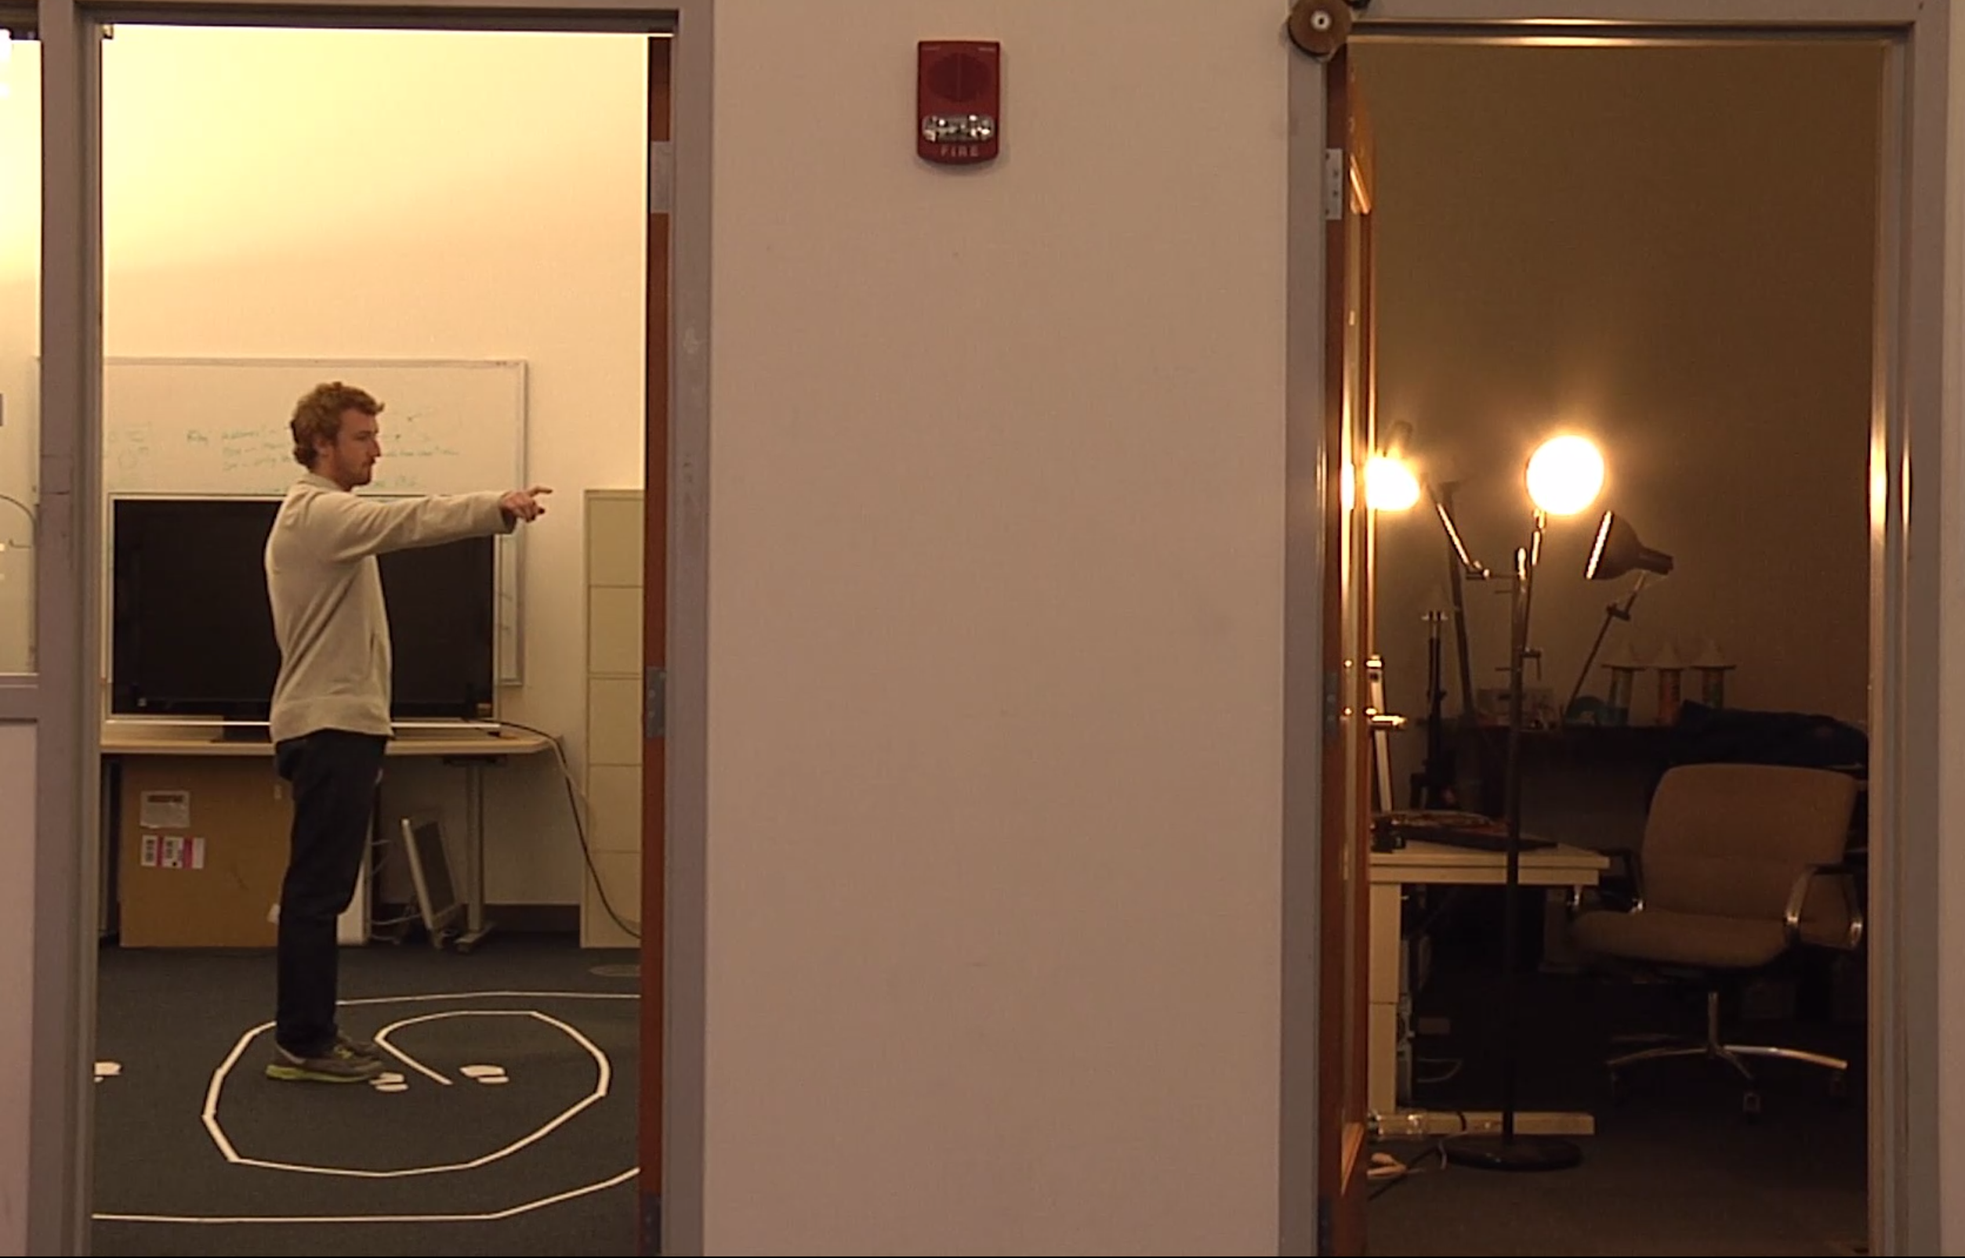
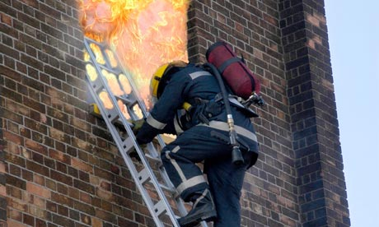

Applications
Gaming
Gesture Control
First Responders
Elderly Monitoring

Slide 23

ToF-based Localization
Tx
Rx
Distance = Reflection time x Speed of light
Notes:
So, WiTrack works using body radio reflections. It has a transmit antenna and a receive antenna. It transmits a wireless signal, part of that signal is going to traverse the wall. [animate]
Then, a minute part of that signal will reflect off a person behind the wall, and an even smaller part is going to traverse the wall back. [animate]
Using this minute reflection that we receive, we would like to localize the person – that is, we would like to know where this person is with respect to the WiTrack device. To do that, we need to measure the distance of this person from WiTrack. And, we’re going to use a very simple equation that we all know, which is: [animate] distance is equal to the reflection time multiplied by the speed of light.
So, if we can measure the reflection time, then we can get the distance. [animate]
So, how do we measure the reflection time?

Slide 24
How to Measure ToF?
Option1: Transmit short pulse and listen for echo
Tx pulse
Rx pulse
time
Reflection Time
Notes:
The most straightforward way to measure the reflection time is to transmit a very narrow pulse. The pulse gets reflected off the human body, and then comes back. And the reflection time is the time between when the pulse was transmitted and when it was received. Now, the problem is how do you measure that time.
To measure the reflection time, we need to know exactly when the reflected pulse arrives.

Slide 25
How to Measure ToF?
Option1: Transmit short pulse and listen for echo
Tx pulse
Rx pulse
signal samples
time
reflection time (3.33ns per meter)
capturing the pulse needs sub-nanosecond sampling
Need multi-GHz samplers → expensive and with high noise
Notes:
So we need to sample the received signal very densely. In fact, to get the cm-scale accuracy that we have in WiTrack, we need to sample at sub-nanosecond intervals.
[animate]
This requires multi GHz samplers; these are orders of magnitude higher sampling rate than your WiFi or LTE samplers. They are expensive, and even if you pay for them you still somehow need to process multi-Gigasamples per second, so you have an I/O problem. Add to it that they are high noise and our signals are very weak. so from all perspective they are impractical for our application.

Slide 26
How to Measure ToF?
Option2: Frequency Modulated Carrier Wave (FMCW)
Transmitted
Received
Frequency
ΔF
ΔF
slope
ToF
ToF =
t
t+ΔT
time
How to measure ΔF?
Notes:
To address this issue, we borrow a technique from radar systems, called FMCW – frequency modulated carrier waves.
So let me tell you how FMCW works. Instead of transmitting a narrow pulse, we’re going to transmit a signal whose frequency linearly increases with time like the signal over here. As you can see, time and frequency are linearly related.
Now, as we said earlier, this signal will hit a reflector and come back, so we receive the reflection of this signal after the reflection time. Recall that this reflection time is very hard to measure. The nice thing about this FMCW signal is that the transmitted and received signal are also shifted with each other in frequency by some delta f. So, if we can measure delta f, and we know the slope that we pick for our FMCW, we can obtain the reflection time using the equation reflection time is equal to delta f divided by the slope. So the question becomes, how can we subtract the two signals to obtain delta f.

Slide 27
Measuring ΔF
To find ΔF = f_{Rx} – f_{Tx},
Use mixer to subtract f_{Tx} from the received signal → the signal whose frequency is ΔF
Take FFT and identify the frequency with peak power
power
Transmitted
Mixer
FFT
received
ΔF
ΔF → Reflection Time → Distance
Notes:
You know what, subtracting signals in frequencies is very easy. In fact, this is exactly what you do when you take a WiFi signal and remove the carrier frequency. So you know that WiFi signals are transmitted at 2.4GHz, but when you operate on them, you only operate on the 20MHz channel, which means that you subtracted the 2.4GHz carrier.
That subtraction is typically done using a passive component called a mixer, which is cheap and does not consume power, and as a matter of fact, is present in all of our wireless transceivers.
So what we’re going to do is take the transmitted and received signals, feed them to the mixer – the mixer naturally subtracts the frequencies and produces a signal whose frequency is delta F. Now we’re going to pass this output through an FFT to take the fourier transform and obtain the spectrum. If we look at the power of this signal as a function of time, we will see that it spikes at delta F.
So, to summarize, because we can compute delta f easily, we can obtain from it the reflection time from delta f divided by the slope, and then multiply the reflection time by the speed of light to get the distance.

Slide 28
How to Deal with Multiple Reflections?
Tx
Rx
Reflections from different objects
→ which one is from the person?
Reflection Power
Distance
Notes:
Great, now we have a way to compute the distance to a reflector. So, are we done? Unfortunately not, because there is this problem that we all in wireless talk about: multipath. That is, when you transmit a signal, it will reflect off everything in the environment, not just the person. So, you get all of these reflections.
[animate]
So, when you transmit the signal, it will not only reflect off the person, it will also reflect off the wall, of the table, and so on.
Now, if we try to plot the reflection power as a function of distance, we obtain a plot like this one. The plot shows many different peaks due to the different reflectors at these distances – and they are caused by the multipath due to the different objects in the environment.[animate]
Now, how can we find the reflection of the person from all this clutter?

Slide 29
Subtract Static Paths
Static objects don’t move
Eliminate by subtracting consecutive measurements
multi-path
@ time t
power
multi-path
distance
-
@ time t+30ms
power
distance
2 meters
Why 2 peaks?
=
power
distance
Notes:
The idea is quite simple. All of the static objects do not move, so we can eliminate their reflections by subtracting consecutive measurements. In contrast, a human tends to move, and hence if we subtract consecutive measurements, his reflection survives.
Let’s say we take a measurement at some time t, and plot the reflection power as a function of distance. Then, let us take another measurement after 30 milliseconds. And, as we can see, both of them have the same multipath profile. [animate]
Now, let us subtract these two measurements from each other. [animate]
We will obtain a profile like this one. Indeed, it removed all of the static reflections, and the big multipaths disappeared.
But we have a weird behavior: we see 2 main peaks – which means that there are two moving reflectors, despite the fact that we have a single person. And these reflectors are about 2 meters away from each. So why is that?

Slide 30
Dynamic Multipath
Tx
Rx
Moving Person
Dynamic Multi-path
Power
Distance
Find the first peak since the direct reflection arrives before other dynamic multipaths
Notes:
This is due to dynamic multipath. Let me show you what that means.
After we do background subtraction, we still get the reflection coming back from the person. This reflection comes directly back to our receive antenna. [animate]
But, if we also have a table, then the person’s reflection may also bounce off the table before it arrives at the receive antenna. [animate]
And so this is why we get multiple peaks [animate].
But, how can know which of these peaks is due to the person and which of them is due to dynamic multipath? [pause]
Well, the direct reflection from the person will arrive earlier than the dynamic multipath, since it will travel a shorter distance. [animate]
So we can simply chose the first peak as the one that corresponds to the person, while the others are dynamic multipath.
Now, you might be wondering why don’t we take the highest peak. Well, because in some scenarios the direct reflection may have less power than the dynamic multipath, and that happens when the person is behind a piece of furniture like a couch.

Slide 31
From Distances to Localization
Person can be anywhere on an ellipse whose foci are (Tx,Rx)
One ellipse is not enough to localize!
d
Rx
Tx
Notes:
So far, we have discovered how we can measure the round-trip distance from the transmit antenna to the person and back to the receive antenna. Unfortunately, this is not enough for us to localize.
Specifically, this distance can correspond to this location, [animate] this location, [animate] or this location. In fact, geometrically, the person could be anywhere on an ellipse whose foci are Tx and Rx. But one ellipse is not enough to localize.

Slide 32
From Distances to Localization
Use two Rx antennas to find the intersection
WiTrack uses directional antennas so only one point is in-beam
Extend to 3D by using 3 Rx antennas and taking the intersection of ellipsoids
in beam
d
d’
Rx
Tx
Rx’
Notes:
To localize a person in WiTrack, we add a second receive antenna and compute the distance d’. Now we will have another ellipse, and we know that the person is at one of the two intersections of these 2 ellipses.
Because WiTrack uses directional antennas, we know that the person is at the intersection point in front of the antennas. So, using one transmit antenna and two receive antennas, we can localize a person into a plane.
It is straightforward to extend this to 3D motion tracking. We just add a third antenna, and now instead of ellipses, we have ellipsoids. So, we take the intersection of these ellipsoids to localize in 3D

Slide 33
Key Issue of FMCW
Don’t need a high sampling rate
But, need a very wide band channel
Bandwidth of 1.69GHz to support a distance resolution of 8.8cm
Transmitted
Received
Frequency
ΔF
ΔF
slope
ToF
ToF =
t
t+ΔT
time
Cannot be applied in the unlicensed WiFi band

Slide 34
RF-based Localization
See through walls
WiVi (SIGCOMM’13)
ToF-based localization
WiTrack (NSDI’14, NSDI’15)
AoA-based localization
ArrayTrack (NSDI’13)

Slide 35
Angle of Arrival
Determine the direction of propagation of a radio-frequency wave using an antenna array
Key idea:
The phase of the received signal is determined by the length of a path
The path lengths to different elements of an antenna array vary slightly
Leverage TDOA (time difference of arrival) at individual elements of the array to measure AoA

Slide 36
Time Difference of Arrival
Rx
d_{A}
d_{A}
…
Δ
2Δ
3Δ
≈ d
…
≈ d
≈ d
NΔ
≈ d
…
≈ d
Assumption: d ≫ d_{A}! Then, the distance from Tx to the k-th Rx antennas is close do (d+kΔ)
Tx

Slide 37
Time Difference of Arrival
Signal received at 1st antenna:
Signal received at 2nd antenna:
…
Signal received at N^{th} antenna:
Notes:
&\exp(\frac{-2j\pi (d+\Delta)}{\lambda})
\\&=\exp(\frac{-2j\pi d}{\lambda})\exp(\frac{-2j\pi \Delta}{\lambda})

Slide 38
Time Difference of Arrival
Signal from angle θ:
Notes:
a(\theta) = \exp(\frac{-j2 \pi d}{\lambda})
\begin{bmatrix}
1\\
\exp(-j \pi \sin \theta)\\
\exp(-j \pi 2\sin \theta)\\
\vdots\\
\exp(-j \pi (N-1)\sin \theta)\\
\end{bmatrix}
\mathbf{x}(t) = [\mathbf{a}(\theta_1)~\mathbf{a}(\theta_2) ~\cdots~\mathbf{a}(\theta_D)]
\begin{bmatrix}
s_1(t) \\
s_2(t) \\
\vdots \\
s_D(t) \\
\end{bmatrix} + n

Slide 39
Combined Signals from D paths
If the Rx receives signals from D different paths
Final received signal:
Notes:
x(t) = e^{\frac{-j2 \pi d}{\lambda}}
\begin{bmatrix}
1 & 1 & \cdots\\
e^{-j \pi \sin \theta_1}& \cdots & e^{-j \pi \sin \theta_D} \\
e^{-j \pi 2\sin \theta_1} & \cdots& e^{-j \pi 2\sin \theta_D} \\
\vdots & \ddots & \cdots\\
e^{-j \pi (N-1)\sin \theta_1}& \cdots & e^{-j \pi (N-1)\sin \theta_D} \\
\end{bmatrix}
\begin{bmatrix}
s_1(t) \\
s_2(t) \\
\vdots \\
s_D(t) \\
\end{bmatrix} + n

Slide 40
MUSIC Algorithm
MUltiple SIgnal Classification (MUSIC)
Find the direction of the LOS path from
High level idea:
We collect N received signals (N equations)
Assume there exist only D paths, D ≤ N, (D unknowns)
Use linear algebra to find the D components from N measures
Notes:
\mathbf{x}(t) = [\mathbf{a}(\theta_1)~\mathbf{a}(\theta_2) ~\cdots~\mathbf{a}(\theta_D)]
\begin{bmatrix}
s_1(t) \\
s_2(t) \\
\vdots \\
s_D(t) \\
\end{bmatrix} + n

Slide 41
MUSIC Algorithm
Find the N x N source correlation matrix
N eigenvalues of R_{xx} →E = [e₁ e₂ … e_{N-D} e_{N-D+1} … e_{N}]
D components with large eigenvalues → from D paths (angles)
(N – D) components with near-zero eigenvalues → noise
source correlation matrix
sorted

Slide 42
MUSIC Algorithm
Distance in the vector space, instead of the distance between Tx-Rx
The distance between a signal coming from the arrival direction θ and the noise subspace
D major components are orthogonal to the subspace of (N - D) noise components
dist(θ)~0 for the D paths from θ
Power function
E_{N} = [e₁ e₂ … e_{N-D}]
AoA = max_{θ} P(θ)
Notes:
\text{dist}(\theta) = a(\theta)^*\mathbf{E}_N\mathbf{E}_N^*a(\theta)
P(\theta) = \frac{1}{\text{dist}(\theta)} = \frac{1}{ a(\theta)^*\mathbf{E}_N\mathbf{E}_N^*a(\theta)}
This means that when the client sends a signal, the AP receives it with a phase determined by the path length d from the client. P
Using the I-Q plot, we see that a distance d adds a phase of 2πd/λ as shown by the angle measured from the I axis to the cross labeled x1 (representing the signal received at antenna one). Since there is a λ/2 separation between the two antennas, the distance along a path arriving at bearing θ is a fraction of a wave- length greater to the second antenna than it is to the first, that fraction depending on θ. Assuming d>>λ/2, the added distance is 1 λ sin θ.
D signals s1 (t), . . . , sD (t) arrive from bearings θ1,...,θD at M antennas
t xj(t) is the received signal at jth antenna element at time t.
array steering vector a(θ) to characterize how much added phase (relative to the first antenna) we see at each of the other antennas, as a function of the incoming signal’s bearing.
See eq.!
Rss = E [ss∗ ] is the source correlation matrix, which has M eigenvalues λ1 , . . . , λM associated respectively with M eigenvectors E = [e1 e2 ··· eM].
the smallest M − D correspond to the noise while the next D correspond to the D incoming signals.
The D value depends on how many eigenvalues are considered big enough to be signals. We choose D value as how many eigenvalues are larger than a thresh- old
From MUSIC: When the number of incident wavefronts D is less than the number of array elements M, then APA* is singular. It has a rank less than M. Then, APA* = S-lambda S = 0.
This equation is only satisfied with X equal to one of the eigenvalues of S in the metric of So.
(for A full rank and P positive definite, APA* must be nonnegative definite)
Since the minimum eigenvalue of APA* is zero (being singular), Amin must occur repeated N times. Therefore, the number of incident signals estimator is D=M-Jg
That is, the eigenvectors associated with X,,(S, So) are orthogonal to the space spanned by the columns of A; the incident signal mode vectors!
Euclidean distance (squared) from a vector Y to the signal subspace is d2 = Y*E_NE_N*Y,
因為noise vector會orthogonal to signal, 又因為一個signal Y到En subspace的距離d^2 = Y*En En* Y, 所以某個訊號a(theta)是真的有path, 到En距離d就會為0,
其他非path的a(theta)因為沒有跟En orthogonal, 所以distance可能就比較小
所以某個如果我們用一個function來表示P(theta) = 1/d^2, 那有peak的signal一定是LoS path

Slide 43
AoA-based Localization
Find location via trigonometry
AP₂
AP₁
θ₂
θ₁
AP₃
θ₃

Slide 44
Quiz
While interference nulling can only cancel static reflections, but not body reflections?

