Slide 1
Wireless Communication Systems
@CS.NCTU
Lecture 3: 802.11 PHY and OFDM
Instructor: Kate Ching-Ju Lin (林靖茹)

Slide 2
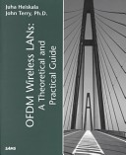

Reference
OFDM Tutorial
online: http://home.iitj.ac.in/~ramana/ofdm-tutorial.pdf
OFDM Wireless LWNs: A Theoretical and Practical Guide
By John Terry, Juha Heiskala
Next Generation Wireless LANs: 802.11n and 802.11ac
By Eldad Perahia

Slide 3
Agenda
Packet Detection
OFDM
(Orthogonal Frequency Division Modulation)
Synchronization

Slide 4
What is Packet Detection
Detect where is the starting time of a packet
It might be easy to detect visually, but how can a device automatically find it?
  Simplest way: find the energy burst using a threshold
  Difficulty: hard to determine a good threshold
✔
✘

Slide 5
Packet Detection
Packet
Packet
Packet
A_{n}
B_{n}
Power ratio M_{n}=A_{n}/B_{n}
threshold
Double sliding window packet detection
Optimal threshold depends on the receiving power
Notes:
Q: what’s the problem?

Slide 6
Packet Detection in 802.11
Each packet starts with a preamble
  First part of the preamble is exactly the same with the second part
Use cross-correlation to detect the preamble
  Use double sliding window to calculate the auto-correlation of the signals received in two windows
  Leverage the key properties: 1) noise is uncorrelated with the preamble, and 2) data payload is also uncorrelated with the preamble
preamble
header and data

Slide 7
Packet Detection in 802.11
preamble
preamble
preamble
preamble
preamble
preamble
preamble
preamble
preamble
preamble
preamble
preamble
A_{n}
B_{n}
Correlation
over time
threshold
Noise is uncorrelated with noise
Noise is uncorrelated with preamble
Get a peak exactly when the double windows receives the entire preamble
Data is again uncorrelated with noise

Slide 8
Agenda
Packet Detection
OFDM
(Orthogonal Frequency Division Modulation)
Synchronization

Slide 9
Narrow-Band Channel Model
Signal over wireless channels
  y[n] = Hx[n]
H = α*exp^{2jπfδ} is the channel between Tx and Rx
  α: received amplitude, δ: propagation delay
How to decode x[n]?
  x[n] = y[n]/H
  How to learn H?
  Re-use the known preamble to learn H
  → since y[n] = Hp[n], we get H = y[n]/p[n]
The procedure of finding H is called channel estimation

Slide 10
Why OFDM?
Signal over wireless channels
  y[n] = Hx[n] → Decoding: x[n] = y[n]/H
Work only for narrow-band channels, but not for wide-band channels, e.g., 20 MHz for 802.11
  Channels of different narrow bands will be different!
Capacity = BW * log(1+SNR)
20MHz
frequency
2.45GHz (Central frequency)

Slide 11

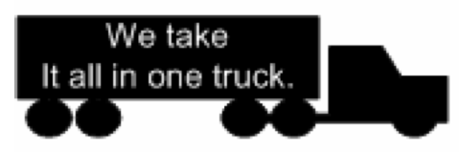
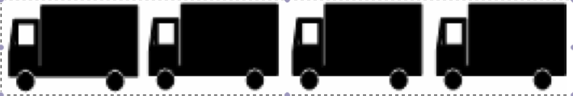
Basic Concept of OFDM
Wide-band channel
Multiple narrow-band channels
Send a sample using the entire band
Send samples concurrently using multiple orthogonal sub-channels

Slide 12
Why OFDM is Better?
t
t
0
1
0
0
f
1
1
f
0
0
1
1
0
0
0
1
…........
Wide-band
OFDM: Narrow-band
Multiple sub-channels (sub-carriers) carry samples sent at a lower rate
  Almost same bandwidth with wide-band channel
Only some of the sub-channels are affected by interferers or multi-path effect

Slide 13
Importance of Orthogonality
Why not just use FDM (frequency division multiplexing)
  Not orthogonal
Need guard bands between adjacent frequency bands
Individual sub-channel
Leakage interference from adjacent sub-channels
f
→ extra overhead and lower utilization
guard band
Guard bands protect leakage interference
f

Slide 14
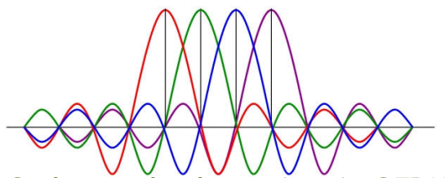
Difference between FDM and OFDM
guard band
f
Frequency division multiplexing
Don’t need guard bands
f
Orthogonal sub-carriers in OFDM

Slide 15
Key to Achieve Orthogonality: FFT
Fast Fourier Transform (FFT)
All Signal Are the Sum of Sines
  Fourier’s theorem: ANY waveform in the time domain can be represented by the weighted sum of sines
e^{f1}+e^{f2}
e^{f1}+ 0.5*e^{f2}
a*e^{f1}+b*e^{f2}+c*e^{f3}+…
Frequency-domain
How to generate
a square wave?
Time-domain

Slide 16
Primer of FFT/iFFT
iFFT: from frequency-domain signals to time-domain signals
FFT: from time-domain signals to frequency-domain signals
time-domain signal
Frequency-domain signal:
Amplitude of each freq.
a, b, c, d, …
iFFT
How can we know the frequency-domain components (a, b, c ,…) from this time-domain signal?
c
a
FFT
amplitude
b
f1
f2
f3
frequency

Slide 17
Primer of FFT/iFFT
iFFT: from frequency to time
  Use periodical waveforms to generate signals
FFT: from time to frequency
  Extract frequency components of any signal
c
a
iFFT( )=
amplitude
b
f1
f2
f3
frequency
c
FFT( )=
a
amplitude
b
f1
f2
f3
frequency

Slide 18
OFDM Transmitter and Receiver
c
a
Transmitter
amplitude
b
f1
f2
f3
freq
a
Modulation
(BPSK, QAM, etc)
b
iFFT
D/A
Data in
c
a, b, c, d, …
d
…
channel
Frequency-domain
signal
time-domain
signal
+
noise
a
Demodulation
(BPSK, QAM, etc)
b
FFT
A/D
a, b, c, d, …
c
Data out
d
c
…
a
amplitude
Receiver
b
Represent information bits as
the amplitudes of orthogonal subcarriers
f1
f2
f3
freq

Slide 19
OFDM Basic
Partition the wide band to multiple narrow sub-carriers f₁, f₂, f₃, …, f_{N}
Represent information bits as the frequency-domain signal (amplitude of each sub-carrier)
  Example: if we want to send 1, -1, 1, 1, we let 1, -1, 1, 1 be the frequency-domain signals
Use iFFT to convert the information to the time-domain sent over the air
  Example: Transmit 1*e^{f1} + (-1)*e^{f2} + 1*e^{f3} + 1*e^{f4}
Rx uses FFT to extract information
  Example: [1 -1 1 1] = FFT(1*e^{f1} + (-1)*e^{f2} + 1*e^{f3} + 1*e^{f4})

Slide 20
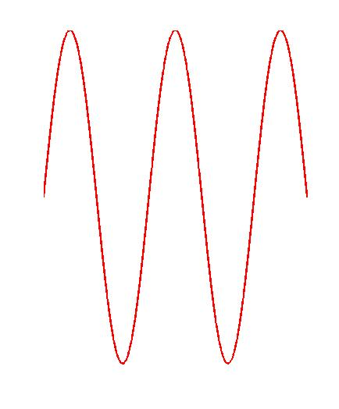
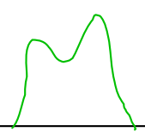
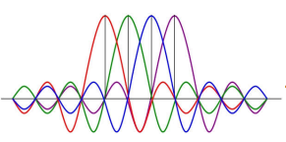
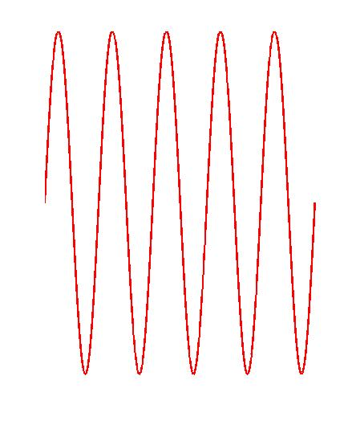
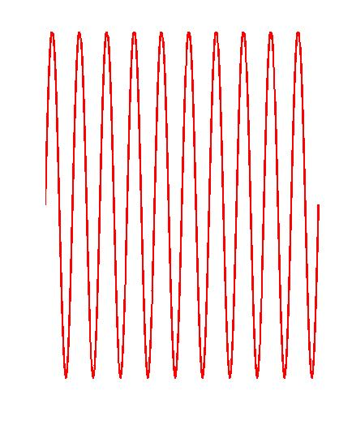
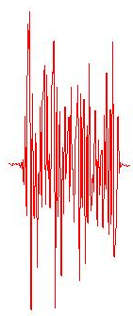
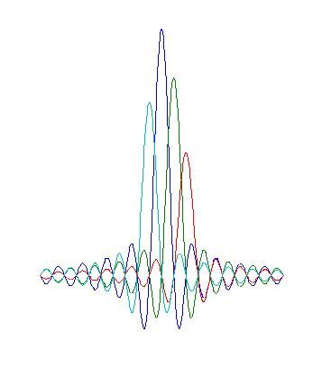
Orthogonal Frequency Division Modulation
* X[1]
IFFT
* X[2]
transmit
f
f
* X[3]
…
t
Data X[n] coded in frequency domain
Transformation to time domain: each frequency is a sine wave
in time, all added up
Decode each subcarrier separately
receive
FFT
t
X’[N] = amplitude of each sub-carrier
f
Time domain signal
Frequency domain signal
Notes:
http://rfmw.em.keysight.com/wireless/helpfiles/89600b/webhelp/subsystems/wlan-ofdm/Content/ofdm_basicprinciplesoverview.htm

Slide 21
Orthogonality of Sub-carriers
Time-domain signals: x(t) Frequency-domain signals: X[k]
IFFT
Encode: frequency-domain samples → time-domain samples
k-th subcarrier
FFT
Decode: time-domain samples → frequency-domain sample
Orthogonal →
inner product = 0
Orthogonality of any two bins :
Notes:
x(t)=\frac{1}{N}\sum_{k=-N/2}^{N/2-1}X[k]e^{j2\pi kt/N}
X[k]=\sum_{t=-N/2}^{N/2-1}x(t)e^{-2j\pi kt/N}
\sum_{k=-N/2}^{N/2-1}e^{j2\pi kt/N}e^{-j2\pi pt/N}= 0, \forall p\neq k

Slide 22
Orthogonality between Subcarriers
Subcarrier frequencies (k/N, k=-N/2,…, N/2-1) are chosen so that the subcarriers are orthogonal to each other
  No guard band is required
Two signals are orthogonal if their inner product equals zero
Notes:
&\sum_{k=-N/2}^{N/2-1}e^{j2\pi kt/N}e^{-j2\pi pt/N}=\sum_{k=-N/2}^{N/2-1}e^{2j\pi(k-p)t/N}\\
&= N\delta(k,p) = \begin{cases} N & \mbox{ if } p=k \\ 0 & \mbox{ if } p\neq k\end{cases}
X[k] \bot X[p], k \neq p

Slide 23
Serial to Parallel Conversion
Say we use BPSK and 4 sub-carriers to transmit a stream of samples
Serial-to-parallel conversion of samples
Send time-domain samples after parallel-to-serial conversion
1, 1, -1, -1, 1, 1, 1, -1, 1, -1, -1, -1, -1, 1, -1, -1, -1, 1, 1, -1, -1, -1, 1, 1
Frequency-domain signal
Time-domain signal
c1 c2 c3 c4
symbol1 1 1 -1 -1
symbol2 1 1 1 -1
symbol3 1 -1 -1 -1
symbol4 -1 1 -1 -1
symbol5 -1 1 1 -1
symbol6 -1 -1 1 1
IFFT
0 2 - 2i 0 2 + 2i
2 0 - 2i 2 0 + 2i
-2 2 2 2
-2 0 - 2i -2 0 + 2i
0 -2 - 2i 0 -2 + 2i
0 -2 + 2i 0 -2 - 2i
0, 2 - 2i, 0, 2 + 2i, 2, 0 - 2i, 2, 0 + 2i, -2, 2, 2, 2, -2, 0 - 2i, -2, 0 + 2i, 0, -2 - 2i, 0, -2 + 2i, 0, -2 + 2i, 0, -2 - 2i, …
Notes:
Talk about reverse direction

Slide 24
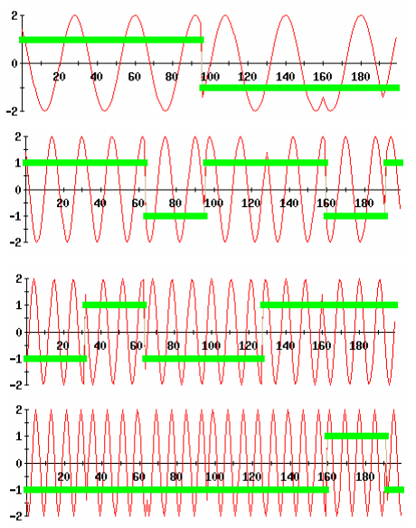
t1-4
t5-8
t9-12
t13-16
t17-20
t21-24
f1
symbol1 1 1 -1 -1
symbol2 1 1 1 -1
symbol3 1 -1 -1 -1
symbol4 -1 1 -1 -1
symbol5 -1 1 1 -1
symbol6 -1 -1 1 1
f2
f3
f4

Slide 25
t1-4
t5-8
t9-12
t13-16
t17-20
t21-24
f1
symbol1 1 1 -1 -1
symbol2 1 1 1 -1
symbol3 1 -1 -1 -1
symbol4 -1 1 -1 -1
symbol5 -1 1 1 -1
symbol6 -1 -1 1 1
f2
f3
Send four samples simultaneously in each time-slot
but send the same four samples using four time slots
→ same data rate
f4
Send the combined signal as the time-domain signal

Slide 26
Why OFDM? combat multipath fading

Slide 27
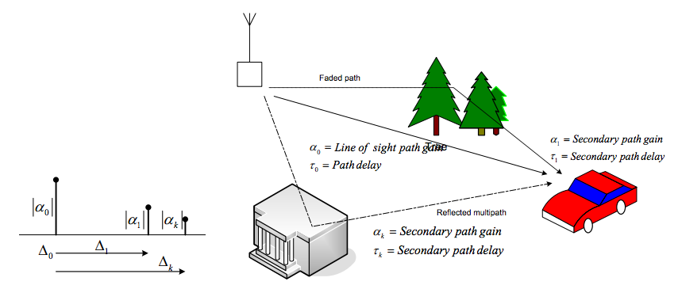
Multi-Path Effect
time-domain
convolution
frequency-domain
Notes:
為什麼轉到freq.沒事
Freq. 只有某些是deconstructive
y(t)&=h(0)x(t)+h(1)x(t-1)+h(2)x(t-2)+\cdots \\
&=\sum_{\triangle}h(\triangle)x(t-\triangle)=h(t)\otimes x(t)
\Leftrightarrow
Y(f)=H(f)X(f)

Slide 28
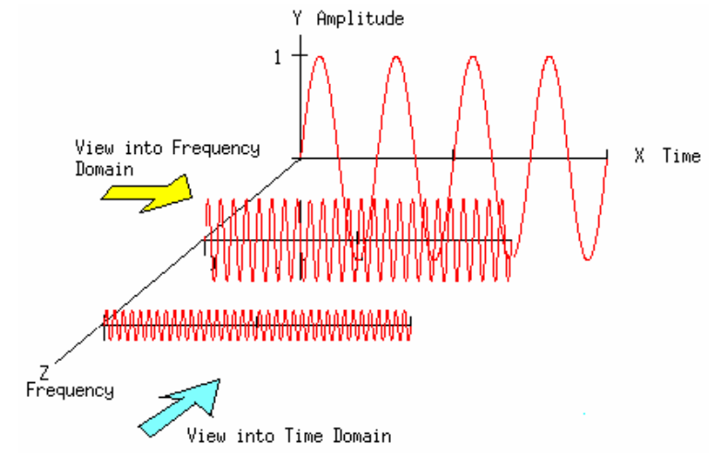
Current symbol + delayed-version symbol
→ Signals are destructive in only certain frequencies

Slide 29
direct
delay
✘
f1
✔
f2
✔
f3
Current symbol + delayed-version symbol
→ Signals are destructive in only certain frequencies

Slide 30
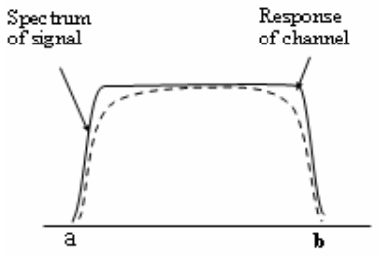
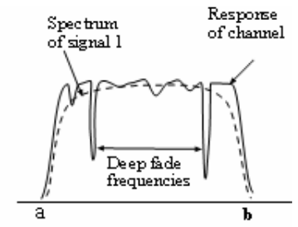
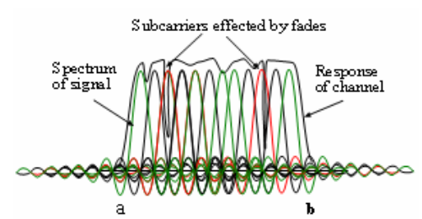
Frequency Selective Fading
frequency
frequency
Frequency selective fading: Only some sub-carriers get affected
Can be recovered by proper coding!

Slide 31
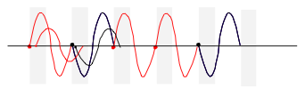
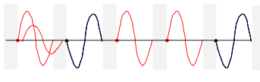
Inter Symbol Interference (ISI)
The delayed version of a symbol overlaps with the adjacent symbol
One simple solution to avoid this is to introduce a guard-band
Guard band

Slide 32
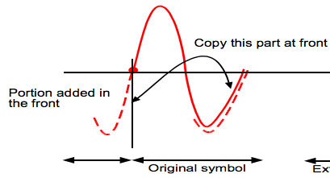
Cyclic Prefix (CP)
However, we don’t know the delay spread exactly
  The hardware doesn’t allow blank space because it needs to send out signals continuously
Solution: Cyclic Prefix
  Make the symbol period longer by copying the tail and glue it in the front
CP
Symbol i
CP
Symbol i+1
…
In 802.11, each symbol with 64 samples
CP:data = 1:4
→ CP: last 16 samples

Slide 33

Cyclic Prefix (CP)
Because of the usage of FFT, the signal is periodic
Delay in the time domain corresponds to phase shift in the frequency domain
  Can still obtain the correct signal in the frequency domain by compensating this rotation
FFT( ) = exp(-2jπΔ_{f})*FFT( )
delayed version
original signal

Slide 34
Cyclic Prefix (CP)
w/o multipath
y(t) → FFT( ) →Y[k] = H[k]X[k]
original signal
w multipath
y(t) → FFT( ) →Y[k] = (H[k] + exp(-2jπΔ_{k})H[k])X[k]
= (H [k] +H₂[k])X[k]
= H’[k]X[k]
original signal
+ delayed-version signal
Lump the phase shift in H
Notes:
If there are l paths, H’ = H1+ H2 + … + Hl

Slide 35
Side Benefit of CP
Allow the signal to be decoded even if the packet is detected not that accurately
decodable
undecodable
FFT_OFFSET
The point you think the first symbol ends
The last sample you
actually use for FFT
Check the parameter FFT_OFFSET in the WARP code.
Try to modify it!

Slide 36
OFDM Diagram
Transmitter
S/P
IFFT
Insert
CP
P/S
D/A
Modulation
channel
+
noise
P/S
FFT
remove
CP
S/P
A/D
De-mod
Receiver

Slide 37
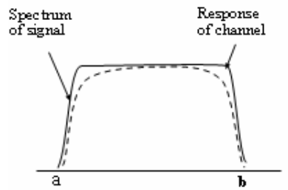
Unoccupied Subcarriers
Edge sub-carriers are more vulnerable
  Frequency might be shifted due to noise or multi-path
Leave them unused
  In 802.11, only 48 of 64 bins are occupied bins
Is it really worth to use OFDM when it costs so many overheads (CP, unoccupied bins)?
Notes:
困為什麼會distortion假設有點noise of phase shift
f 可能會便f + delta
如果適中間的f
shift後可能還在-N/2 to N/2之內
但兩邊的 shift後可能就超過了

Slide 38
Agenda
Packet Detection
OFDM
(Orthogonal Frequency Division Modulation)
Synchronization

Slide 39
OFDM Diagram
Transmitter
20MHz
S/P
IFFT
Insert
CP
P/S
D/A
baseband
passband
2.4GHz
Modulation
Oscillator
channel
+
noise
P/S
FFT
remove
CP
S/P
A/D
De-mod
Oscillator
2.4GHz
Receiver
20MHz
baseband
passband

Slide 40
Overview
Carrier Frequency Offset (CFO)
  f^{c}_{tx} ≠ f^{c}_{rx} (e.g., TX: 2.45001GHz, RX: 2.44998GHx)
  CFO: Δ_{f} = f_{tx} – f_{rx}
  Time-domain signals:
  y’(t) = y(t) * exp(2jπΔ_{f}t)
Sample Frequency Offset (SFO)
  Sampling rates in Tx and Rx are slightly different
  (e.g., TX: 20.0001MHz, RX: 19.99997MHz)
  Freq.-domain signals: Y’[k] = Y[k] * exp(2jπδkφ)
Error accumulates over time
real
theoretical
Phase rotates 2jπδkφ in the k-th subcarrier
constant
Notes:
http://dsp.stackexchange.com/questions/17968/sampling-rate-in-wifi-802-11-20-mhz-enough-with-a-bw-of-20-mhz

Slide 41
Overview
Carrier Frequency Offset (CFO)
  Calibrate in time-domain
  How: Use the preamble
Sample Frequency Offset (SFO)
  Calibrate in frequency-domain
  How: Use the pilot subcarriers
Notes:
http://dsp.stackexchange.com/questions/17968/sampling-rate-in-wifi-802-11-20-mhz-enough-with-a-bw-of-20-mhz

Slide 42
Carrier Frequency Offset (CFO)
frequency
f_{rx}
f_{tx}
Δ_{f}
The oscillators of Tx and Rx are not perfectly synchronized
  Carrier frequency offset (CFO) Δ_{f} = f_{tx} – f_{rx}
  Leading to inter-carrier interference (ICI)
OFDM is sensitive to CFO

Slide 43
CFO Estimation
Up/Down conversion at Tx/Rx
  Up-convert baseband signal s(t) to passband signal
  Down-convert passband signal r(t) back to
Error caused by CFO, accumulated with time nT_{s}
Notes:
r(t) = s(t)e^{j2\pi {\color[rgb]{0.000000,0.501961,1.000000}f_{tx}} t} \otimes h(t,\tau)
y_n&=r(nT_s)e^{-j2\pi {\color[rgb]{0.000000,0.501961,1.000000}f_{rx}}t} \\
&=s(nT_s)e^{j2\pi {\color[rgb]{0.000000,0.501961,1.000000}f_{tx}}t}e^{-j2\pi {\color[rgb]{0.000000,0.501961,1.000000}f_{rx}}t}\otimes h(nT_s,\tau) \\
&=s(nT_s) e^{j2\pi{\color[rgb]{0.000000,0.501961,1.000000}\Delta_f}nT_s} \otimes h(nT_s,\tau) \\

Slide 44
CFO Correction in 802.11
s_{n}
S_{n+N}
Symbol 1
Symbol 2
Reuse the preamble to calibrate CFO
The first half part of the preamble is identical to the second half part
  The two transmitted signals are identical:
  But, the received signals contain different errors
→ Additional phase rotation Δ_{f}nT_{s}
→ Additional phase rotation Δ_{f}(n+N)T_{s}
Find Δ_{f} by taking y_{n+N} / y_{n}
Notes:
y_n &= (s_n \otimes h) e^{j2\pi \Delta_f {\color[rgb]{0.000000,0.501961,1.000000}n} T_s} \\
y_{n+N}&= (s_n \otimes h) e^{j2\pi \Delta_f {\color[rgb]{0.000000,0.501961,1.000000}(n+N) }T_s} \\

Slide 45
CFO Correction in 802.11
To learn CFO Δ_{f}, find the angle of (y_{n}y*_{n+N})
Calibrate the signals to remove phase rotation
Received signals
calibration
Notes:
y_ny^*_{n+N} & = (s_n\otimes h)e^{j2\pi\Delta_fnT_s}(s_n\otimes h)e^{-j2\pi\Delta_f(n+N)T_s}\\
&={\color[rgb]{0.000000,0.501961,1.000000}e^{-j2\pi\Delta_fNT_s}}|(s_n\otimes h)|^2
&\angle\left(\sum_n y_ny^*_{N+n}\right) = -2\pi\Delta_fNT_s \\
\Rightarrow ~ & \tilde{\Delta}_f T_s = \frac{-1}{2 \pi N}\angle\left(\sum_n y_ny^*_{N+n}\right) \\
{\color[rgb]{0.000000,0.501961,1.000000}y_n e^{-j2\pi \tilde{\Delta}_fnT_s}} &= ({s}_n \otimes h) e^{j2\pi \Delta_f nT_s}e^{-j2\pi \tilde{\Delta}_f nT_s} \approx ({s}_n \otimes h)

Slide 46
Sampling Frequency Offset (SFO)
DAC (Tx)
ADC (Rx)
DAC (at Tx) and ADC (at Rx) never have exactly the same sampling period (T_{tx} ≠ T_{rx})
  Tx and Rx may sample the signal at slightly different timing offset
Notes:
&\text{SFO}: \delta = \frac{T_{rx} - T_{tx}}{T_{tx}}

Slide 47
Phase errors due to SFO
Assuming no residual CFO, the k-th subcarrier in the received symbol i becomes
All subcarriers experience the same sampling offset, but applied on different frequencies k
  φ is a constant
  Each subcarrier is rotated by a constant
  phase shift
  Lead to Inter Carrier interference (ICI), which causes loss of the orthogonality of the subcarriers
See proof in the next slide
Notes:
Y_{i,n} = H_kX_{i,k} e^{j2\pi {{\color[rgb]{1.000000,0.501961,0.000000}\delta k}} \phi}
{\color[rgb]{1.000000,0.501961,0.000000} 2 \pi \delta \phi}

Slide 48
Proof of phase errors due to SFO
Time-domain
Up-convert:
Down-convert:
Frequency-domain
Residual CFO
SFO
FFT
Number of samples in CP
FFT window size
Symbol size
a constant indicating the initial phase error of symbol i
Notes:
r(t) = s(t)e^{j2\pi f_{tx} t} \otimes h(t,\tau) + n(t)
y_{i,n}=r(t)e^{-j2\pi f_{rx}t}|_{t=(iN_S+N_{CP}+n)T_{rx}}
Y_{i,k} = H_kX_{i,k} e^{j\pi ({\color[rgb]{0.000000,0.501961,1.000000}\Delta_fT_{FFT}} + {{\color[rgb]{1.000000,0.501961,0.000000}\delta k}}) \phi}
&N_{CP}:\\
&N_{FFT}:\\
&N_S = N_{FFT}+N_{CP}:\\
&\phi = 0.5+\frac{iN_S+N_{CP}}{N_{FFT}}:

Slide 49
Sample Rotation due to SFO
Incremental phase errors in different subcarriers
→ Signals keep rotating in the I-Q plane
subcarrier 3
Q
x
subcarrier 2
subcarrier 1
x
x
x
x
x
x
x
x
x
x
x
x
I
x
x
x
x
x
x
Ideal BPSK signals (No rotation)

Slide 50
Phase Errors due to SFO and CFO
phase of H
x
x
2πδkφ (SFO)
x
1
x
x
x
x
2πΔ_{f}T_{FFT} φ (Residual CFO)
x
Subcarrier index k
x
Subcarrier i of the received frequency domain signals in symbol n
SFO: slope; residual CFO: intersection of y-axis

Slide 51
Data-aided Phase Tracking
x
2πδkφ = 2π θk (SFO)
1
x
x
x
2πΔ_{f}T_{FFT} φ = 2π η (Residual CFO)
regression
WiFi reserves 4 known pilot bits (subcarriers) to compute
H_{k}e^{j2π(η+θk)}=Y_{k}/X_{k}
Estimate SFO θ_{k} and CFO η by finding the linear regression of the phase changes experienced by the pilot bits
Update the channel by H’_{k} = H_{k}e^{2jπ(η+θk)} for every symbol k, and then decode the remaining non-pilot subcarriers
Notes:
&Y_{i,k} = {\color[rgb]{0.000000,0.501961,1.000000}H_k}X_{i,k} {\color[rgb]{0.000000,0.501961,1.000000}e^{j2\pi (\eta + \theta k)}} = {\color[rgb]{1.000000,0.501961,0.000000}H'_k}X_{i,k} \\
\Rightarrow & \hat{X}_{i,k} = Y_{i,k}/H'_{k}

Slide 52
After Phase Tracking
Q
x
x
x
x
x
x
x
x
x
x
x
x
x
x
x
x
x
I
x
x
x
x
x
x
x
x
x
x
x
x
x
x
x
Decoded signals in the I-Q plane after phase tracking
Notes:
X_{i,k} {\color[rgb]{0.200000,0.4,0.800000}e^{j2\pi (\eta + \theta k)}}

Slide 53
OFDM Diagram
Transmitter
S/P
IFFT
Insert
CP
P/S
D/A
Modulation
channel
+
noise
P/S
FFT
remove
CP
S/P
A/D
De-mod
Phase track
Correct CFO
frequency-domain
Receiver
time-domain

Slide 54
Quiz
Say we want to send (1, -1, 1, 1, -1),
and transmit over the air
(1,-1,1,1,-1) is the (a) frequency-domain or
(b) time-domain signal?
is the (a) frequency-domain or
(b) time-domain signal
What is the Multipath Effect? Why does it cause Deep Fading?

