Slide 1
Wireless Communication Systems
@CS.NCTU
Lecture 2: Modulation and Demodulation
Reference: Chap. 5 in Goldsmith’s book
Instructor: Kate Ching-Ju Lin (林靖茹)

Slide 2
Modulation
From Wikipedia:
The process of varying one or more properties of a periodic waveform with a modulating signal that typically contains information to be transmitted.
modulate

Slide 3
Example 1
= bit-stream?
(a) 10110011
(b) 00101010
(c) 10010101

Slide 4
Example 2
= bit-stream?
(a) 01001011
(b) 00101011
(c) 11110100

Slide 5
Example 3
= bit-stream?
(a) 11010100
(b) 00101011
(c) 01010011
(d) 11010100 or
00101011

Slide 6
Types of Modulation
Amplitude
ASK
Frequency
FSK
Phase
PSK

Slide 7
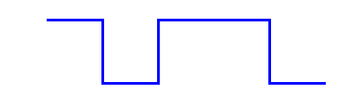
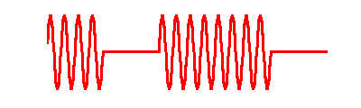
Modulation
Map bits to signals
TX
bit stream
1
0
1
1
0
modulation
transmitted
Signal s(t)
wireless
channel

Slide 8
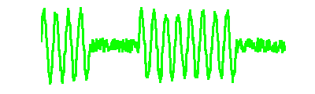
Demodulation
Map signals to bits
TX
RX
bit stream
1
0
1
1
0
1
0
1
1
0
modulation
demodulation
transmitted
Signal s(t)
received
signal x(t)
wireless
channel

Slide 9
Analog and Digital Modulation
Analog modulation
  Modulation is applied continuously
  Amplitude modulation (AM)
  Frequency modulation (FM)
Digital modulation
  An analog carrier signal is modulated by a discrete signal
  Amplitude-Shift Keying (ASK)
  Frequency-Shift Keying (FSK)
  Phase-Shift Keying (PSK)
  Quadrature Amplitude
  Modulation (QAM)

Slide 10
Advantages of Digital Modulation
Higher data rate (given a fixed bandwidth)
More robust to channel impairment
  Advanced coding/decoding can be applied to make signals less susceptible to noise and fading
  Spread spectrum techniques can be applied to deal with multipath and resist interference
Suitable to multiple access
  Become possible to detect multiple users simultaneously
Better security and privacy
  Easier to encrypt

Slide 11
Modulation and Demodulation
modulate
demodulate
Modulation
  Encode a bit stream of finite length to one of several possible signals
Delivery over the air
  Signals experience fading and are combined with AWGN (additive white Gaussian noise)
Demodulation
  Decode the received signal by mapping it to the closest one in the set of possible transmitted signals

Slide 12



Band-pass Signal Representation
General form
Amplitude is always non-negative
  Or we can switch the phase by 180 degrees
Called the canonical representation of a band-pass signal
amplitude
frequency
phase
$$s\left(t\right)$$
$$a\left(t\right)$$
$$2πf_{c}t+φ\left(t\right)$$
Notes:
s(t)=a(t)cos(2\pi f(t)t+\phi(t))

Slide 13
In-phase and Quadrature Components
: In-phase component of s(t)
: Quadrature component of s(t)
Amplitude:
Phase:
Notes:
s(t)&=a(t)\cos(2\pi f(t)t+\phi(t))\\
& = a(t)[\cos(2\pi f(t)t)\cos(\phi(t))-\sin(2\pi f(t)t)\sin(\phi(t))]\\
& = s_I(t)\cos(2\pi f(t)t)-s_Q(t)\sin(2\pi f(t)t)
a(t) &= \sqrt{s_I^2(t)+s_Q^2(t)}\\
\phi(t) &= \tan^{-1}(\frac{s_Q(t)}{s_I(t)})

Slide 14



Band-Pass Signal Representation
We can also represent s(t) as
s’(t) is called the complex envelope of the band-pass signal
This is to remove the annoying in the analysis
Q
$$s′\left(t\right)$$
exp(iθ) = cos(θ)+jsin(θ)
$$a\left(t\right)$$
$$φ\left(t\right)$$
I
Notes:
s(t)=\Re[s'(t)e^{2j\pi fc t}]
s'(t) = s_I(t) + js_Q(t)

Slide 15
Types of Modulation
s(t) = Acos(2πf_{c}t+𝜙)
Amplitude
  M-ASK: Amplitude Shift Keying
Frequency
  M-FSK: Frequency Shift Keying
Phase
  M-PSK: Phase Shift Keying
Amplitude + Phase
  M-QAM: Quadrature Amplitude Modulation

Slide 16
Amplitude Shift Keying (ASK)
A bit stream is encoded in the amplitude of the transmitted signal
Simplest form: On-Off Keying (OOK)
  ‘1’→A=1, ‘0’→A=0
TX
RX
bit stream
b(t)
1
0
1
1
0
1
0
1
1
0
modulation
demodulation
signal
s(t)

Slide 17
M-ASK
M-ary amplitude-shift keying (M-ASK)
Notes:
s(t) =
\begin{cases}
A_i\cos(2\pi f_c t) & \quad , \text{if } 0 \le t\le T\\
0 & \quad , \text{otherwise},\\
\end{cases}
\text{where } &i=1, 2, \cdots, M \\
&A_i \text{ is the amplitude corresponding to bit pattern } i

Slide 18
Example: 4-ASK
Map ‘00’, ‘01’, ‘10’, ’11’ to four different amplitudes

Slide 19
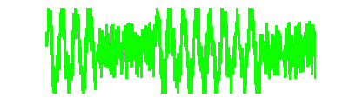
Pros and Cons of ASK
Pros
  Easy to implement
  Energy efficient
  Low bandwidth requirement
Cons
  Low data rate
    bit-rate = baud rate
  High error probability
    Hard to pick a right threshold
Bandwidth is the difference between the upper and lower frequencies in a continuous set of frequencies.
1 baud
1 second
Notes:
http://www.ele.uri.edu/Courses/ele436/labs/ASKnFSK.pdf

Slide 20
Types of Modulation
s(t) = Acos(2πf_{c}t+𝜙)
Amplitude
  M-ASK: Amplitude Shift Keying
Frequency
  M-FSK: Frequency Shift Keying
Phase
  M-PSK: Phase Shift Keying
Amplitude + Phase
  M-QAM: Quadrature Amplitude Modulation

Slide 21
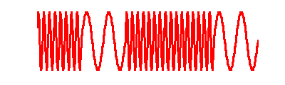
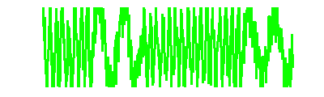
Frequency Shift Keying (FSK)
A bit stream is encoded in the frequency of the transmitted signal
Simplest form: Binary FSK (BFSK)
  ‘1’→f=f₁, ‘0’→f=f₂
TX
RX
bit stream
1
0
1
1
0
1
0
1
1
0
modulation
demodulation
signal
s(t)

Slide 22
M-FSK
M-ary frequency-shift keying (M-FSK)
Example: Quaternary Frequency Shift Keying (QFSK)
  Map ‘00’, ‘01’, ‘10’, ’11’ to four different frequencies
Notes:
s(t) =
\begin{cases}
A\cos(2\pi f_{c,i} t) & \quad , \text{if } 0 \le t\le T\\
0 & \quad , \text{otherwise},\\
\end{cases}
\text{where } &i=1, 2, \cdots, M \\
&f_{c,i} \text{ is the center frequency corresponding to bit pattern } i

Slide 23
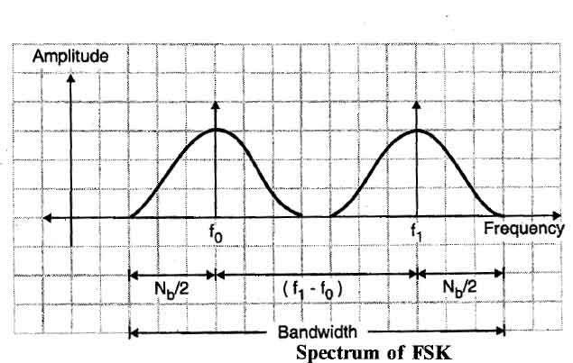
Pros and Cons of FSK
Pros
  Easy to implement
  Better noise immunity than ASK
Cons
  Low data rate
    Bit-rate = baud rate
  Require higher bandwidth
    BW(min) = N_{b} + N_{b}
Notes:
http://ecomputernotes.com/computernetworkingnotes/computer-network/frequency-shift-keying

Slide 24
Types of Modulation
s(t) = Acos(2πf_{c}t+𝜙)
Amplitude
  M-ASK: Amplitude Shift Keying
Frequency
  M-FSK: Frequency Shift Keying
Phase
  M-PSK: Phase Shift Keying
Amplitude + Phase
  M-QAM: Quadrature Amplitude Modulation

Slide 25
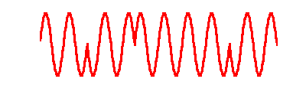
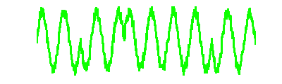
Phase Shift Keying (PSK)
A bit stream is encoded in the phase of the transmitted signal
Simplest form: Binary PSK (BPSK)
  ‘1’→𝜙=0, ‘0’→𝜙=π
TX
RX
bit stream
s(t)
1
0
1
1
0
1
0
1
1
0
modulation
demodulation
signal
s(t)

Slide 26
Constellation Points for BPSK
‘1’→𝜙=0
cos(2πf_{c}t+0)
= cos(0)cos(2πf_{c}t)-sin(0)sin(2πf_{c}t)
= s_{I}cos(2πf_{c}t) – s_{Q}sin(2πf_{c}t)
‘0’→𝜙=π
cos(2πf_{c}t+π)
= cos(π)cos(2πf_{c}t)-sin(π)sin(2πf_{c}t)
= s_{I}cos(2πf_{c}t) – s_{Q}sin(2πf_{c}t)
𝜙=0
Q
𝜙=π
Q
I
I
  (s_{I},s_{Q}) = (1, 0)
  ‘1’→ 1+0i
  (s_{I},s_{Q}) = (-1, 0)
  ‘0’→ -1+0i

Slide 27
Demodulate BPSK
Map to the closest constellation point
Quantitative measure of the distance between the received signal s’ and any possible signal s
  Find |s’-s| in the I-Q plane
Q
‘0’
‘1’
s’=a+bi
  n₁=|s’-s₁|=|s’-(1+0i)|
  n₀=|s’-s₀|=| |s’-(-1+0i)|
  since n₁ < n_{0,} map s’ to (1+0i)→‘1’
n₀
n₁
I
s₀=-1+0i
s₁=1+0i

Slide 28
Demodulate BPSK
Decoding error
  When the received signal is mapped to an incorrect symbol (constellation point) due to a large error
Symbol error rate
  P(mapping to a symbol s_{j}, j≠i | s_{i} is sent )
Q
‘0’
‘1’
  Given the transmitted symbol s₁
s’=a+bi
I
  → incorrectly map s’ to
  s₀=(-1+0)→‘0’, when the error is too large
s₀=-1+0i
s₁=1+0i

Slide 29
SNR of BPSK
SNR: Signal-to-Noise Ratio
Example:
  Say Tx sends (1+0i) and Rx receives (1.1 – 0.01i)
  SNR?
Q
s’ = a+bi
n
I
Notes:
&SNR=\frac{|s|^2}{n^2}=\frac{|s|^2}{|s'-s|^2}\\
&~~~~~~~ =\frac{|1+0i|^2}{|(a+bi)-(1+0i)|^2} \\
&SNR_{dB}= 10\log_{10}(SNR)
BER = P_b = Q\left( \frac{d_{\min}}{\sqrt{2N_0}}\right)= Q\left( \sqrt{\frac{2E_b}{N_0}}\right) = Q(\sqrt{2SNR})

Slide 30
SER/BER of BPSK
BER (Bit Error Rate) = SER (Symbol Error Rate)
Minimum distance of any two cancellation points
From Wikipedia:
Q(x) is the probability that a normal (Gaussian) random variable will obtain a value larger than x standard deviations above the mean.

Slide 31
Constellation point for BPSK
Say we send the signal with phase delay π
Band-pass representation
Illustrate this by the constellation point (-1 + 0i) in an I-Q plane
𝜙=π
Q
I
-1+0i
Notes:
&\cos(2j\pi f_c t + {\color[rgb]{0.200000,0.400000,0.800000}\pi}) \\
= & \cos(2j\pi f_c t)\cos(\pi) - \sin(2j\pi f_c t)\sin(\pi)\\
= & -1 * \cos(2j\pi f_c t) - 0 * \sin(2j\pi f_c t) \\
= & {\color[rgb]{0.200000,0.400000,0.800000}(-1 + 0i)} e^{2j\pi f_c t}

Slide 32
Quadrature PSK (QPSK)
Use four phase rotations 1/4π, 3/4π, 5/4π, 7/4π to represent ‘00’, ‘01’, ‘11’, 10’
Q
‘01’
‘00’
I
‘11’
‘10’
Notes:
&A\cos(2j\pi f_c t + {\color[rgb]{0.200000,0.400000,0.800000}3\pi/4}) \\
= & A\cos(2j\pi f_c t)\cos(3\pi/4) - A\sin(2j\pi f_c t)\sin(3\pi/4)\\
= & -1 * \cos(2j\pi f_c t) - 1* \sin(2j\pi f_c t) \\
= & {\color[rgb]{0.200000,0.400000,0.800000}(-1 + 1i)} e^{2j\pi f_c t}

Slide 33
Quadrature PSK (QPSK)
Use 2 degrees of freedom in I-Q plane
Represent two bits as a constellation point
  Rotate the constellations by π/2
  Demodulation by mapping the received signal to the closest constellation point
  Double the bit-rate
No free lunch:
  Higher error probability (Why?)
Q
‘01’
‘00’
I
‘11’
‘10’

Slide 34
Quadrature PSK (QPSK)
Maximum power is bounded
  Amplitude of each constellation point should still be 1
Q
Bits | Symbols
‘00’ | 1/√2+1/√2i
’01’ | -1/√2+1/√2i
‘10’ | 1/√2-1/√2i
‘11’ | -1/√2-1/√2i
‘01’
‘00’ = 1/√2(1+1i)
I
‘11’
‘10’

Slide 35
Higher Error Probability in QPSK
For a particular error n, the symbol could be decoded correctly in BPSK, but not in QPSK
  Why? Each sample only gets half power
Q
Q
‘0’
‘1’
‘x1’
‘x0’
n
I
I
1
n
1/√2
✔ in BPSK
✗ In QPSK

Slide 36
Trade-off between Rate and SER
Trade-off between the data rate and the symbol error rate
  Denser constellation points
  → More bits encoded in each symbol
  → Higher data rate
  Denser constellation points
  → Smaller distance between any two points
  → Higher decoding error probability

Slide 37
SEN and BER of QPSK
SNR_{s}: SNR per symbol; SNR_{b}: SNR per bit
SER: The probability that each branch has a bit error
BER
QPSK: M=4
E_{s} is the bounded maximum power
Notes:
SNR_b \approx \frac{SNR_s}{\log_2M} \\
P_b \approx \frac{P_s}{\log_2M}
SER = P_s &= 1-[1-Q(\sqrt{2SNR_b})]^2=1-[1-Q(\sqrt{\frac{2E_b}{N_0}})]^2\\
&=1-[1-Q(\sqrt{SNR_s})]^2=1-[1-Q(\sqrt{\frac{E_s}{N_0}})]^2

Slide 38
M-PSK
BPSK
Q
QPSK
Q
‘01’
I
I
‘0’
‘1’
‘11’
‘10’
8-PSK
16-PSK
Q
Q
‘010’
‘011’
‘100’
I
‘0000’
I
‘001’
‘111’
‘1111’
‘000’
‘101’
‘100’

Slide 39
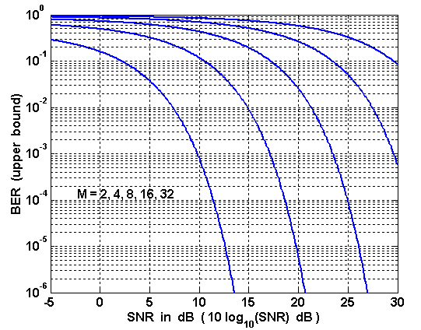
M-PSK BER versus SNR
Denser constellation points → higher BER
Acceptable reliability

Slide 40
Types of Modulation
s(t) = Acos(2πf_{c}t+𝜙)
Amplitude
  M-ASK: Amplitude Shift Keying
Frequency
  M-FSK: Frequency Shift Keying
Phase
  M-PSK: Phase Shift Keying
Amplitude + Phase
  M-QAM: Quadrature Amplitude Modulation

Slide 41
Quadrature Amplitude Modulation
Change both amplitude and phase
s(t)=Acos(2πf_{c}t+𝜙)
64-QAM: 64 constellation points, each with 8 bits
Q
Bits | Symbols
‘1000’ | s₁=3a+3ai
’1001’ | s₂=3a+ai
‘1100’ | s₃=a+3ai
‘1101’ | s₄=a+ai
‘0000’
‘0100’
‘1100’
‘1000’
‘0001’
‘0101’
‘1101’
‘1001’
I
a
3a
‘0011’
‘0111’
‘1111’
‘1011’
‘0010’
‘0110’
‘1110’
‘1010’
16-QAM

Slide 42
M-QAM BER versus SNR

Slide 43
Modulation in 802.11
802.11a
  6 mb/s: BPSK + ½ code rate
  9 mb/s: BPSK + ¾ code rate
  12 mb/s: QPSK + ½ code rate
  18 mb/s: QPSK + ¾ code rate
  24 mb/s: 16-QAM + ½ code rate
  36 mb/s: 16-QAM + ¾ code rate
  48 mb/s: 64-QAM + ⅔ code rate
  54 mb/s: 64-QAM + ¾ code rate
FEC (forward error correction)
  k/n: k-bits useful information among n-bits of data
  Decodable if any k bits among n transmitted bits are correct

Slide 44






Band-Pass Signal Transmitter
s_{I}(t)
mixer
$$×$$
$$∼$$
Map each bit into s_{I}(t) and s_{Q}(t)
cos(2πf_{c}t)
$$+$$
Message Source
Signal Encoder
90 degree shift
Band-pass
Signal s(t)
$$Σ$$
$$+$$
sin(2πf_{c}t)
$$×$$
s_{Q}(t)

Slide 45



Band-Pass Signal Receiver
Low-pass Filter
$$×$$
Filters out out-of-band signals and noises
$$∼$$
0.5[A_{c}s_{I}(t) + n_{I}(t)]
cos(2πf_{c}t)
Received Signal
plus noise
Band-pass Filter
90 degree shift
Signal Detector
Message Sink
x(t) = s(t) + n(t)
0.5[A_{c}s_{Q}(t) + n_{Q}(t)]
sin(2πf_{c}t)
Low-pass Filter
$$×$$
Notes:
A filter that passes signals with a frequency lower than a certain cutoff frequency and attenuates signals with frequencies higher than the cutoff frequency

Slide 46
Detection
Map the received signal to one of the possible transmitted signal with the minimum distance
Find the corresponding bit streams
possible transmitted signals
corresponding bit streams
received signal
…
closest
…
Notes:
{\color[rgb]{0.000000,0.501961,1.000000}[s_I(t)+n(t)]} + j{\color[rgb]{0.000000,0.501961,1.000000}[s_Q(t)+n(t)]}
s_I^1(t)&+js_Q^1(t)\\
s_I^2(t)&+js_Q^2(t)\\
&\vdots\\
s_I^k(t)&+js_Q^k(t)\\
&\vdots
'000&..00'\\
'000&..01'\\
&\vdots\\
'001&..10'\\
&\vdots\\
'111&..11'

Slide 47
Announcement
Install Matlab
Teaming
  Elevator pitch: 2 per group (Each group talks about 3-5 minutes. Each member needs to talk)
  Lab and project: 3-4 members per group
  Send your team members to the TA (張威竣)
Sign up for the talk topic
  Pick the paper (topic) according to your preference or schedule
  Sign up from 18:00@Thu (will announce the url in the announcement tab of the course website)
  Pick your top five choices (from Lectures 4-18)
  FIFS

Slide 48
Quiz
What are the four types of modulation introduced in the class?
Say Tx sends (-1 + 0i) and Rx receives -(0.95+0.01i). Calculate the SNR.

