Slide 1
Wireless Communication Systems @CS.NCTU
Lecture 14: Full-Duplex Communications
Instructor: Kate Ching-Ju Lin (林靖茹)

Slide 2
Outline
What’s full-duplex
Self-Interference Cancellation
Full-duplex and Half-duplex Co-existence
Full-duplex relaying

Slide 3
What is Duplex?
Simplex
Half-duplex
Full-duplex

Slide 4
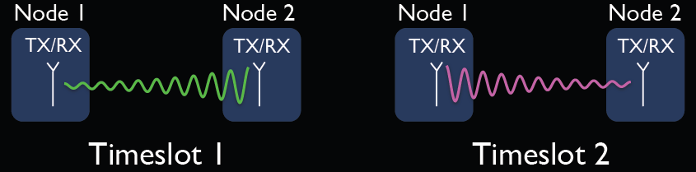
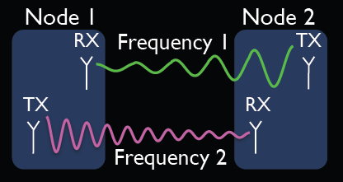
How Half-duplex Works?
Time-division half-duplex
Frequency-devision half-duplex

Slide 5
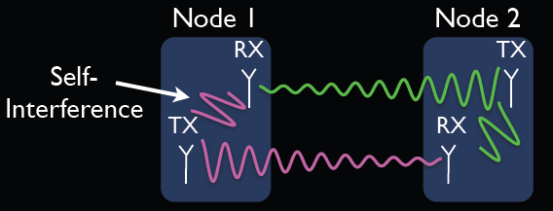
Co-Channel (In-band) Full-duplex
Very strong self-interference (~70dB for 802.11)
The transmitted signals will be an interference of the received signals!
But, we know what we are transmitting → Cancel it!
Notes:
http://khorshid.ut.ac.ir/~mo.ghassemi/resume/presentation_fd/#/step-9

Slide 6
Benefits beyond 2x Gain
Can solve some fundamental problems
Hidden terminal
Primary detection for cognitive radios
Network congestion and WLAN fairness
Excessive latency in multihop wireless

Slide 7
Mitigating Hidden Terminal
Current network have hidden terminals
CSMA/CA cannot solve this
Schemes like RTS/CTS introduce significant overhead
Full-duplex solves hidden terminals
Since both slides transmit at the same time, no hidden terminals exist
X

Slide 8
Primary Detection in Whitespaces

Slide 9
Primary Detection in Whitespaces

Slide 10
Network Congestion and Fairness

Slide 11
Network Congestion and Fairness

Slide 12
Reducing Round-Trip Time

Slide 13
Outline
What’s full-duplex
Self-Interference Cancellation
Full-duplex and Half-duplex Co-existence
Full-duplex relaying

Slide 14
Self-Interference Cancellation
H_{serlf}
H
Y = Hx + H_{self}x_{self} + n
Wanted signals
Unwanted
self-interference
Challenge1: self-interference is much stronger than wanted signals, i.e.,|H_{self}|²≫|H|²
Challenge 2: hard to learn real H_{self}

Slide 15
Self-Interference Cancellation
Analog interference cancellation
RF cancellation (~25dB reduction)
Active
Digital interference cancellation
Baseband cancellation (~15dB reduction)
Active
Antenna cancellation
Passive
Notes:
digital: self-interference is too strong, quantize away the received signals -> unrecoverable
analog: introduce non-linearity and distortion, making digital more complicated
antenna: 1) bandwidth: subcarrier OFDM. 2) require three antennas. 3) tune the phase and amplitute

Slide 16
What Makes Cancellation Non-Ideal?
Transmitter and receiver phase noise
LNA (low-noise amplifier) and Mixer noise figure
Tx/Rx nonlinearity
ADC quantization error
Self-interference channel
Noise figure (NF) is the measure of degradation of SNR caused by components in a RF chain

Slide 17
Analog Cancellation
Why important?
Before digital cancellation, we should avoid saturating the Low Noise Amplifier and ADC
Eg., Tx power = 20 dBm and LNA with a saturation level -25dB → at least need -45 dB of analog cancellation
Major drawback
Need to modify the radio circuitry
Should be added after RF down-converter but before the analog-to-digital converter, usually not accessible

Slide 18
Analog Cancellation
Objective is to achieve exact 0 at the Rx antenna
Cancellation path = negative of interfering path
These techniques need analog parts

Slide 19
Digital Cancellation
Cancel interference at baseband
Conceptually simpler – requires no new “parts”
Useless if interference is too strong (ADC bottleneck)

Slide 20
How Digital Cancellation Works?
Assume only Tx is transmitting → Tx receives self-interference
Estimate the self-channel
When Rx starts transmitting → Tx now receives
Cancel self-interference by
Node 1 (Tx)
X_{tx}
H_{tx,tx}
DAC
Y_{tx}
ADC
H_{rx,tx}
Node2 (Rx)
X_{rx}
DAC
Notes:
Y = H_{\text{tx,tx}} X_{\text{tx}} + n
\hat{H}_{\text{tx,tx}} = \frac{Y}{X_{\text{tx}}}
Y = H_{\text{rx,tx}} X_{\text{rx}} + {\color[rgb]{0.200000,0.400000,0.800000}H_{\text{tx,tx}} X_{\text{tx}} }+ n
Y_{\text{rx}}\approx Y - {\color[rgb]{0.200000,0.400000,0.800000}\hat{H}_{\text{tx,tx}} X_{\text{tx}} }

Slide 21
Digital Cancellation for OFDM
Cancel for each subcarrier separately
But, can’t just perform cancellation in the frequency domain → Why
Hard to do iFFT → Cancellation → FFT in real-time
How can we do digital cancellation for each subcarrier in the time-domain?
See FastForward [Sigcomm’14]
Notes:
Y_{\text{rx}}[k]\approx Y[k] - {\color[rgb]{0.200000,0.400000,0.800000}\hat{H}[k]_{\text{tx,tx}} X_{\text{tx}}[k] } = H_{\text{rx,tx}}[k] X_{\text{rx}}[nk] + n

Slide 22
Combine RF/Digital Cancellation
Tx
Rx
Analog
Cancellation
Tx signal
RF canceler
DAC
ADC
Digital
Cancellation
Adapter
Σ
Tx samples
Rx samples

Slide 23
Antenna Cancellation
Separate the antennas such that the two signals become deconstructive
The distance different = λ/2
~30dB self-interference cancellation
combined with analog/digital cancellation → 70 dB
Notes:
digital: self-interference is too strong, quantize away the received signals -> unrecoverable
analog: introduce non-linearity and distortion, making digital more complicated
antenna: 1) bandwidth: subcarrier OFDM. 2) require three antennas. 3) tune the phase and amplitute

Slide 24
Antenna Cancellation: Block Diagram
Tx
Rx
Tx
Attenuator
Power splitter
Rx
RF Frontend
Tx
RF Frontend
Digital processor

Slide 25
Performance

Slide 26
Impact of Bandwidth

Slide 27
Bandwidth v.s. SIC Performance

Slide 28
Outline
What’s full-duplex
Self-Interference Cancellation
Full-duplex and Half-duplex Co-existence
Full-duplex relaying

Slide 29
Full-Duplex Radios
self interference
AP
send
receive
Transmit and receive simultaneously in the same frequency band
Suppress self-interference (SI) [Choi et al. 2010, Bharadia et al. 2013]

Slide 30
Three-Node Full-Duplex
AP
downlink
uplink
Alice
Bob
interference
Commodity thin clients might only be half-duplex
Inter-client interference (ICI)
Uplink transmission interferes downlink reception

Slide 31
Access Control for 3-Node FD
AP
Rx2
Small ICI
Rx1
Tx1
Tx2
Rx3
ICI might degrade the gain of full-duplex
Appropriate client pairing is required
Always enabling full-duplex may not good due to inter-client interference
Switch adaptively between full-duplex and half-duplex

Slide 32
Existing Works
Only allow hidden nodes to enable full-duplex [Sahai et al. 2011]
Favor only part of clients, e.g., hidden nodes
Pair clients based on historical transmission success probability [Singh et al. 2011]
Statistics takes time and might not be accurate due to channel dynamics
Schedule all the transmissions based on given traffic patterns [Kim et al. 2013]
Need centralized coordinator and expensive overhead of information collection

Slide 33
Our Proposal: Probabilistic-based MAC
Flexible adaptation
Adaptively switch between full-duplex and half-duplex
Fully utilizing of full-duplex gains
Assign a pair of clients a probability of full-duplex access
Find the probabilities so as to maximize the expected overall network throughput
Distributed random access
Clients still contend for medium access based on the assigned probability in a distributed way

Slide 34
Candidate Pairing Pairs
Full-duplex pairs
Only allows those with both clients with non-negligible rates
Half-duplex virtual pairs
Let ‘0’ denote the index of a virtual empty node
All candidate pairs
Assign each pair a probability p^{(i,j)}

Slide 35
Linear Programming Model
Expected total rate
Downlink fairness
Uplink fairness
Sum probability

Slide 36
Probabilistic Contention
AP
1. AP selects downlink user first
Rx2
Rx1
Tx1
Tx2
2. Uplink clients contend by CSMA/CA
Rx3
AP selects downlink user i with probability
Given downlink user i, uplink users adjust its priority by changing its contention window to

Slide 37
Outline
What’s full-duplex
Self-Interference Cancellation
Full-duplex and Half-duplex Co-existence
Full-duplex relaying

Slide 38

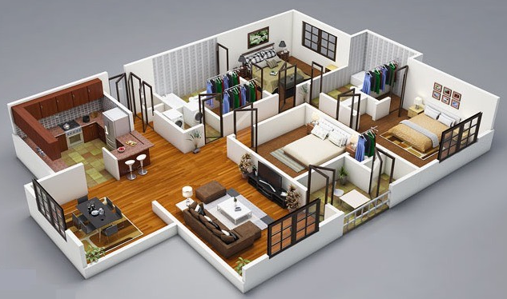
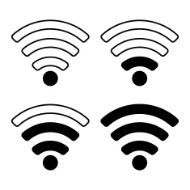


Today’s Wireless Networks
Ideally, 802.11ac and 802.11n support up to 780 Mb/s and 150 Mb/s, respectively
In reality, signals experience propagation loss

Slide 39
What Can We Do?
Increase capacity and coverage using relay
relay

Slide 40
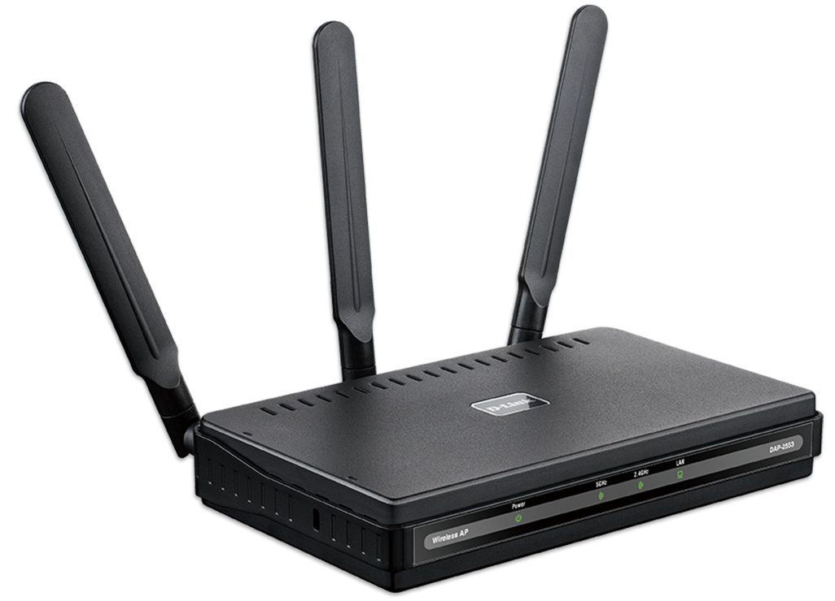

Traditional Half-Duplex Relaying
TX and RX in a time/frequency division manner
Half Duplex
relayed
TX
RX
buffer or switch frequency
direct
direct
symbol 1
symbol 2
…
symbol n
relayed
symbol 1
symbol 2
…
symbol n
time
Improve SNR, but also halve the bandwidth

Slide 41

Full-Duplex Relaying!
Simultaneous TX and RX on the same frequency
Full Duplex
relayed
TX
RX
self-interference cancellation
direct
direct
symbol 1
symbol 2
…
symbol n
relayed
symbol 1
symbol 2
…
symbol n
time
Improve SNR without halving the bandwidth

Slide 42
[FastForward, SIGCOMM’14]
Amplify-and-forward or Construct-and-forward
Demodulate-and-forward
Q
Q
combined
direct
direct
relayed
I
I
relayed
may amplify destructively
rotate before forward
combined
rather decrease the SNR
amplify constructively
[DelayForward, MobiHoc’16]

Slide 43

Pros and Cons of Amplify-and-Forward
Negligible processing delay at relay
direct
CP
symbol1
CP
symbol2
Still decodable with OFDM
relayed
CP
symbol1
CP
symbol2
Δt
Also amplifying the noise at the relay
combined
noise
noise
S↑
N↑
noise
relayed
noise
direct
noise

Slide 44

[FastForward, SIGCOMM’14]
Amplify-and-forward or Construct-and-forward
Demodulate-and-forward
Q
Q
combined
direct
direct
relayed
I
I
relayed
may amplify destructively
rotate before forward
combined
rather decrease the SNR
amplify constructively
only amplify the signal
01
Q
11
S↑
N
I
noise
x’
x
N_{r}
00
10
relayed
denoise at the relay
direct
noise

Slide 45
Challenges: Mixed Symbols
Demodulation takes a much longer time
Receive the whole symbol → FFT → demodulation → modulation → IFFT
It’s unlikely to fast forward within a CP interval
direct
CP
symbol 1
CP
symbol 2
relayed
CP
symbol 1
CP
symbol 2
Δt
Inter-symbol interference at the destination
Need to recover from mixed symbols

Slide 46
How to Ensure Decodability?
Introduce delay to enable symbol-level alignment
Structure of combined signals is analogous to convolutional code
direct
x₁
x₂
x₃
x₄
x₅
x₆
…
x_{n-1}
x_{n}
relayed
x₁
x₂
x₃
x₄
…
x_{n-3}
x_{n-2}
x_{n-1}
x_{n}
reception + processing + delay
→ Viterbi-type Decoding
+
combined
direct
relayed
x_{i}
x_{i-1}
x_{i-2}

Slide 47
Pros and Cons of Delay-and-Forward
Negligible processing delay at relay
direct
CP
symbol1
CP
symbol2
Still decodable with OFDM
relayed
CP
symbol1
CP
symbol2
Δt
Also amplifying the noise at the relay
combined
noise
noise
S↑
N↑
noise
relayed
noise
direct
noise
Notes:
The benefits of such construct-and-forward is that it introduce negligible processing delay
because the operation is very simple and can be done in the time-domain.
(Specifically, FastForward tries to make such construct-and-forward be done within an OFDM CP interval.)
This means that the forwarded signal can be thought of just one of the multiple paths in the environment.
So, with OFDM, the combined signal will still be decodable.
However, the problem of such a simple forwarding mechanism is that the relay simply amplifies the received signal.
Hence, the noise at the relay is also amplified and forwarded to the destination.
As a result, the SNR might not improve as much as we expect.

