Slide 1
Wireless Communication Systems @CS.NCTU
Lecture 12: Soft Information
Instructor: Kate Ching-Ju Lin (林靖茹)

Slide 2
PPR: Partial Packet Recovery for Wireless Networks
ACM SIGOCMM, 2017
Kyle Jamieson and Hari Balakrishnan
CSAIL, MIT

Slide 3
What is Partial Packet Error?
Lots of packets lost due to collisions and noise in wireless networks
Non-colliding bits
(P1)
(P2)
Non-colliding bits
Time
Can’t receive non-colliding bits today!

Slide 4
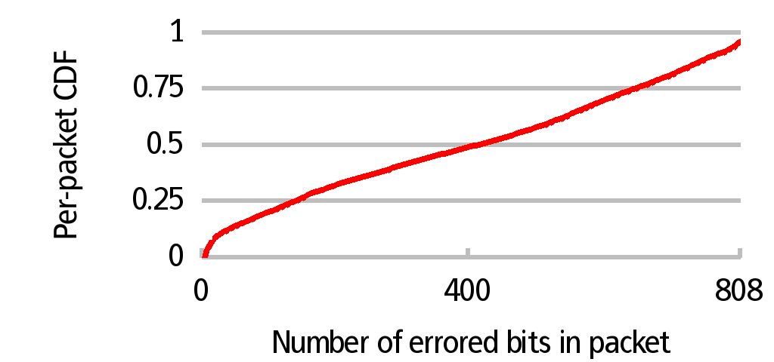
Bits in a packet don’t share fate
(30 node testbed, CSMA on)
Many bits from corrupted packets are correct,
but status quo receivers don’t know which!

Slide 5
Three Key Questions
How does receiver know which bits are correct?
How does receiver know P2 is there at all?
How to design an efficient ARQ protocol?

Slide 6
Can Receiver Identify Correct Bits?
: SoftPHY
Use physical layer (PHY) hints
Receiver PHY has the information!
Pass this confidence information to higher layer as a hint
SoftPHY implementation is PHY-specific; interface is PHY-independent
Implemented for direct sequence spread spectrum (DSSS) over MSK and other modulations

Slide 7
Can We Leverage Soft Info?
PHY conveys uncertainty in each bit it delivers up
Low uncertainty
High uncertainty

Slide 8
Direct Sequence Spread Spectrum
Transmitter:
Receiver:
Demodulate MSK signal
Decide on closest codeword to received (Hamming distance)
Many 32-bit chip sequences are not valid codewords
Codewords separated by at least 11 in Hamming distance
802.11 similar

Slide 9
SoftPHY Hint for Spread Spectrum
Hamming distance between received chips and decided-upon codeword
Receive: 11101101000111000011010110100010
C₁: 11101101100111000011010100100010
→ SoftPHY hint is 2
Receive: 11001101000111010111011110110111
C₁: 11101101100111000011010100100010
→ SoftPHY hint is 9

Slide 10
Three Key Questions
How does receiver know which bits are correct?
A: SoftPHY:
How does receiver know P2 is there at all?
How to design an efficient ARQ protocol?

Slide 11
Postamble decoding

Slide 12
Receiver Design with Postamble
Codeword synchronization
Translate stream of chips to codewords
Search for postamble at all chip offsets
Offset 0:
Codeword 1
Codeword 2
Codeword 3
Chips:
010101001010011101010001011101001010…
Offset 3:
Codeword 1
Codeword 2
Codeword 3

Slide 13
Three Key Questions
How does receiver know which bits are correct?
How does receiver know P2 is there at all?
A: Postamble:
Partial Packets
How to design an efficient ARQ protocol?

Slide 14
ARQ with partial packets
ARQ today: correctly-received bits get resent
PP-ARQ key idea: resend only incorrect bits
Efficiently tell sender about what happened
Feedback packet
Hamming distance
1010001101010111101101010101

Slide 15
Labeling Bits “good” or “bad”
Threshold test: pick a threshold η
Label codewords with SoftPHY hint > η “bad”
Label codewords with SoftPHY hint ≤ η “good”
Hamming distance
η
10101011010100001001010101010101
“good”
“bad”

Slide 16
PP-ARQ protocol
Assuming hints correct, which ranges to ask for?
Dynamic programming problem
Forward and feedback channels
“Good” bits
Codewords are in fact correct
or incorrect
Two possibilities for mistakes
Labeling a correct codeword “bad”
Labeling an incorrect codeword “good”
“Bad” bits

Slide 17
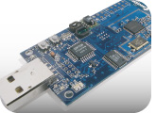
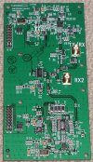
Implementation
Sender: telos tmote sky sensor node
Radio: CC2420 DSSS/MSK (Zigbee)
Modified to send postambles
[moteiv.com]
Receiver: USRP software radio with
2.4 GHz RFX 2400 daughterboard
Despreading, postamble synchronization, demodulation
SoftPHY implementation
[ettus.com]
PP-ARQ: trace-driven simulation

Slide 18
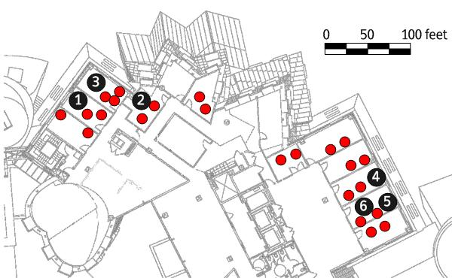
Experimental design
25 senders
6 receivers
Live wireless testbed experiments
Senders transmit 101-byte
packets, varying traffic rate
Evaluate raw PPR
throughput
Evaluate SoftPHY and
postamble improvements
Trace-driven experiments
Evaluate end-to-end PP-ARQ performance
Internet packet size distribution
802.11-size preambles

Slide 19
PP-ARQ performance comparison
Packet CRC (no postamble)
Fragmented CRC (no postamble)
Tuned against traces for optimal fragment size
Preamble
Checksum
Preamble
Checksum
Checksum

Slide 20
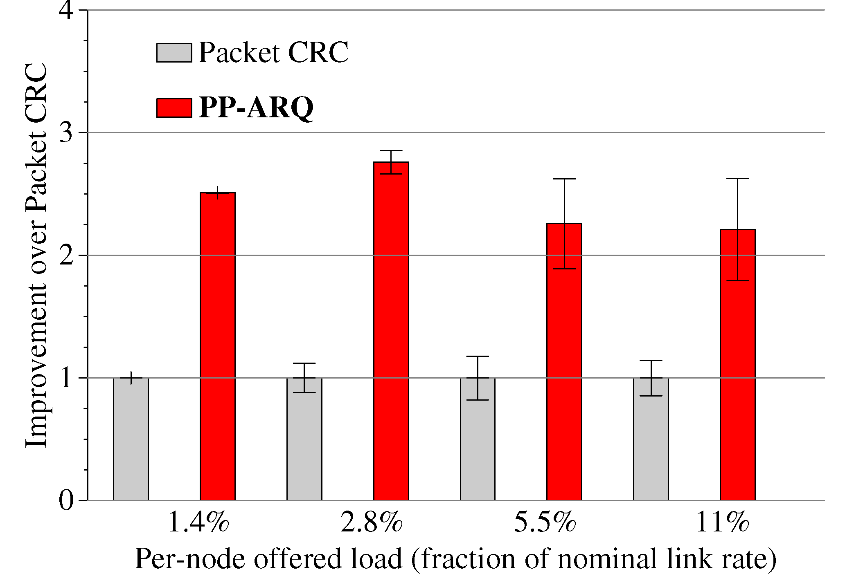
Throughput Gain: 2.3-2.8x

Slide 21
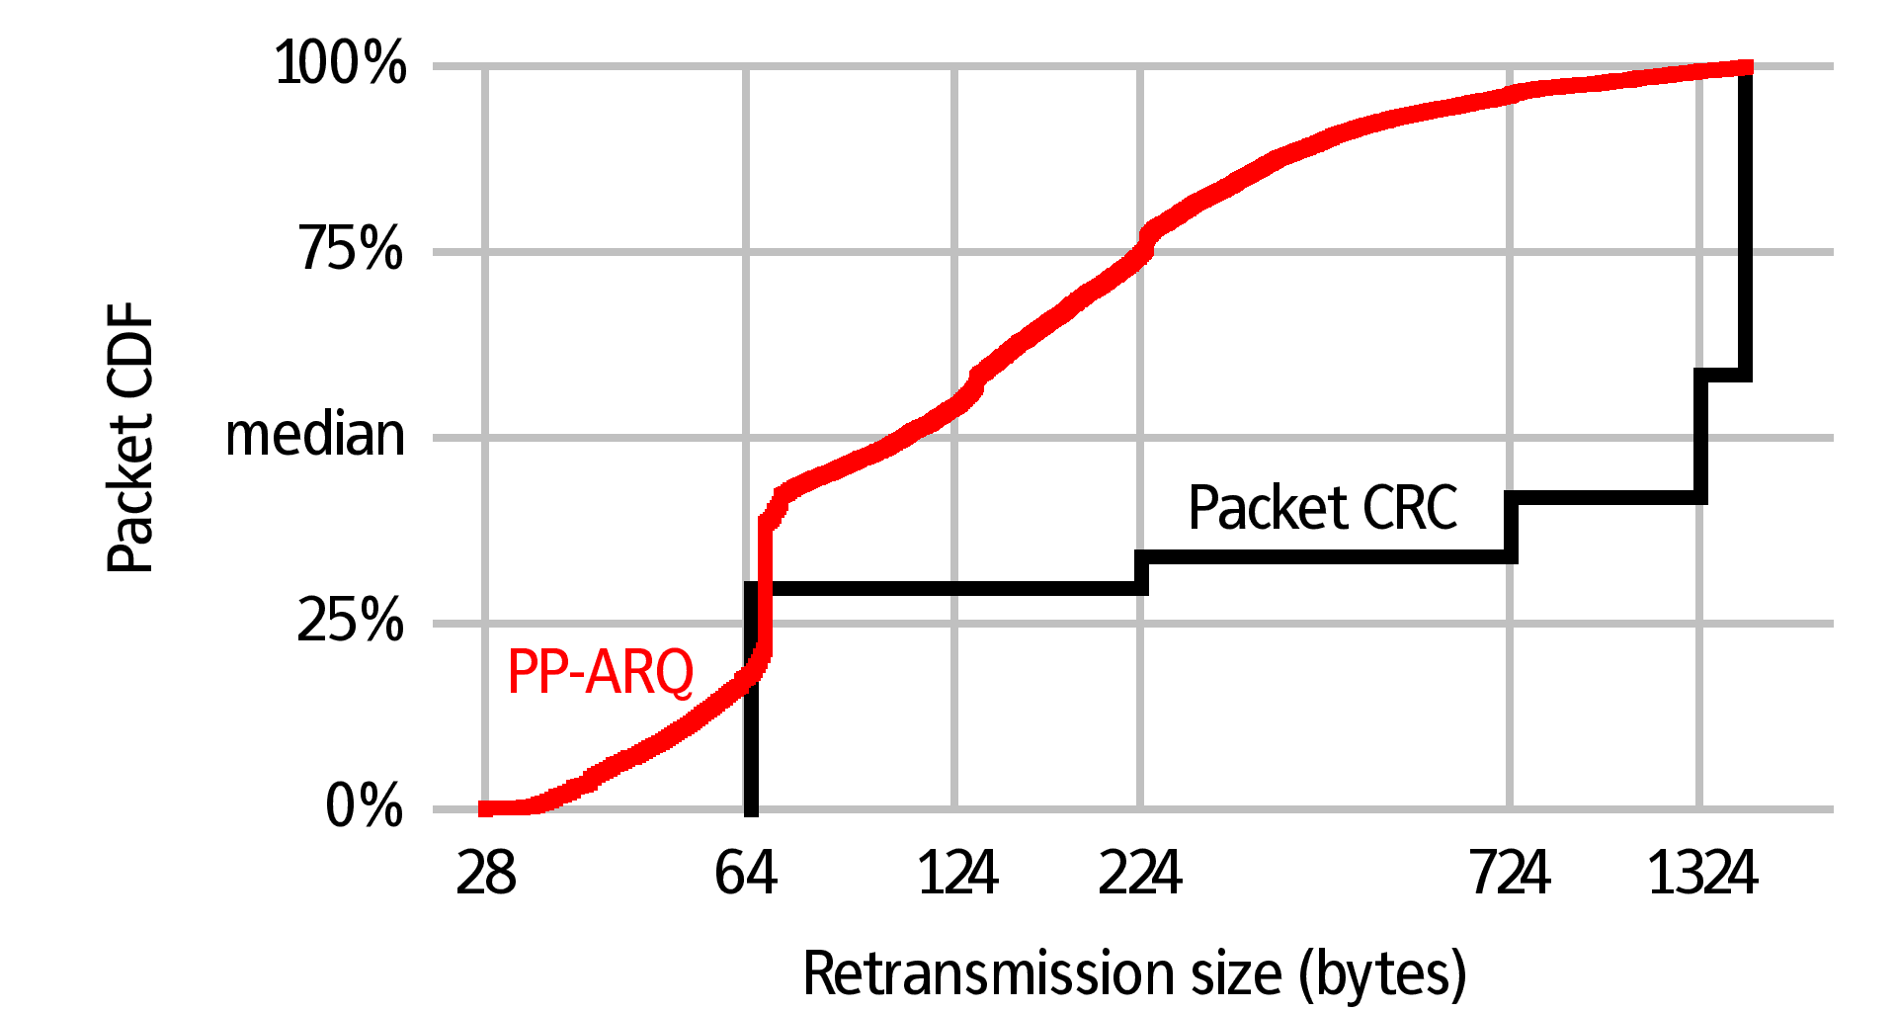
PP-ARQ Retransmissions are Short

Slide 22
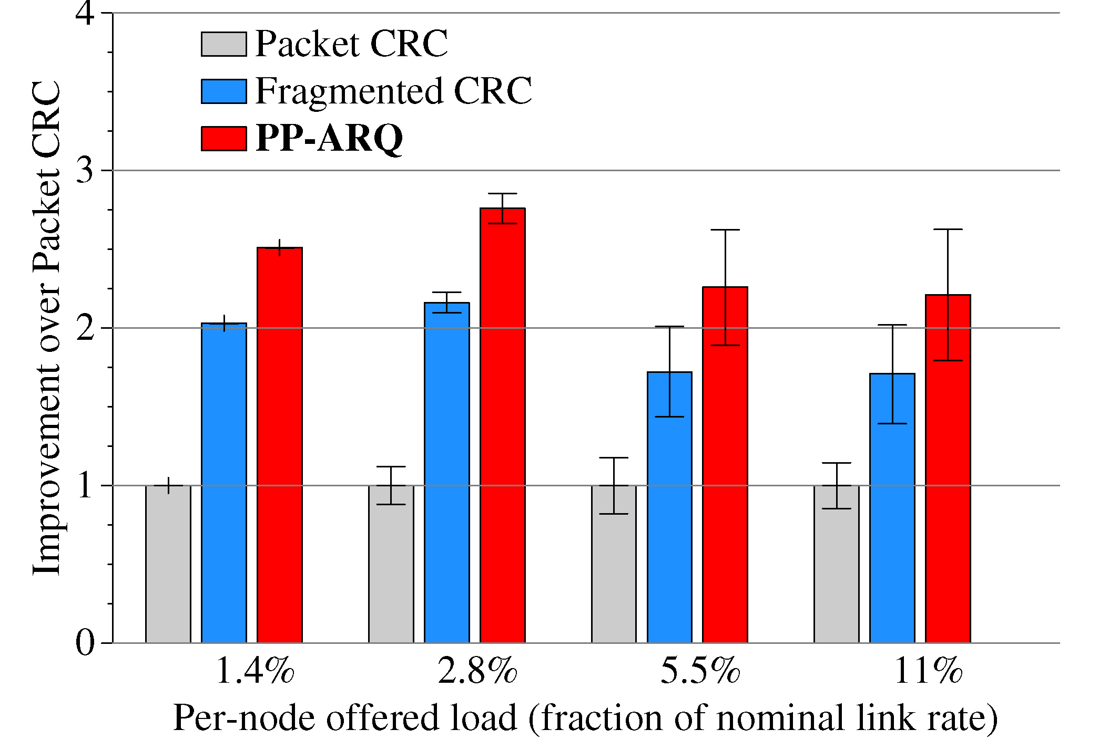
25% Gain over Fragmented

Slide 23
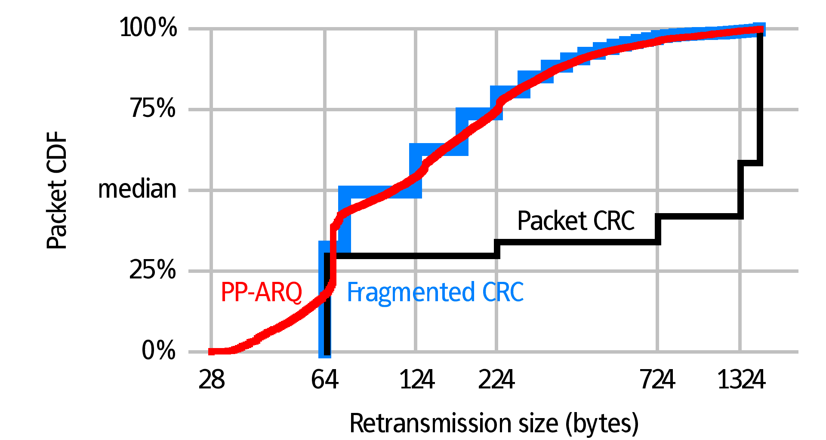
PP-ARQ Retransmissions are Short

Slide 24
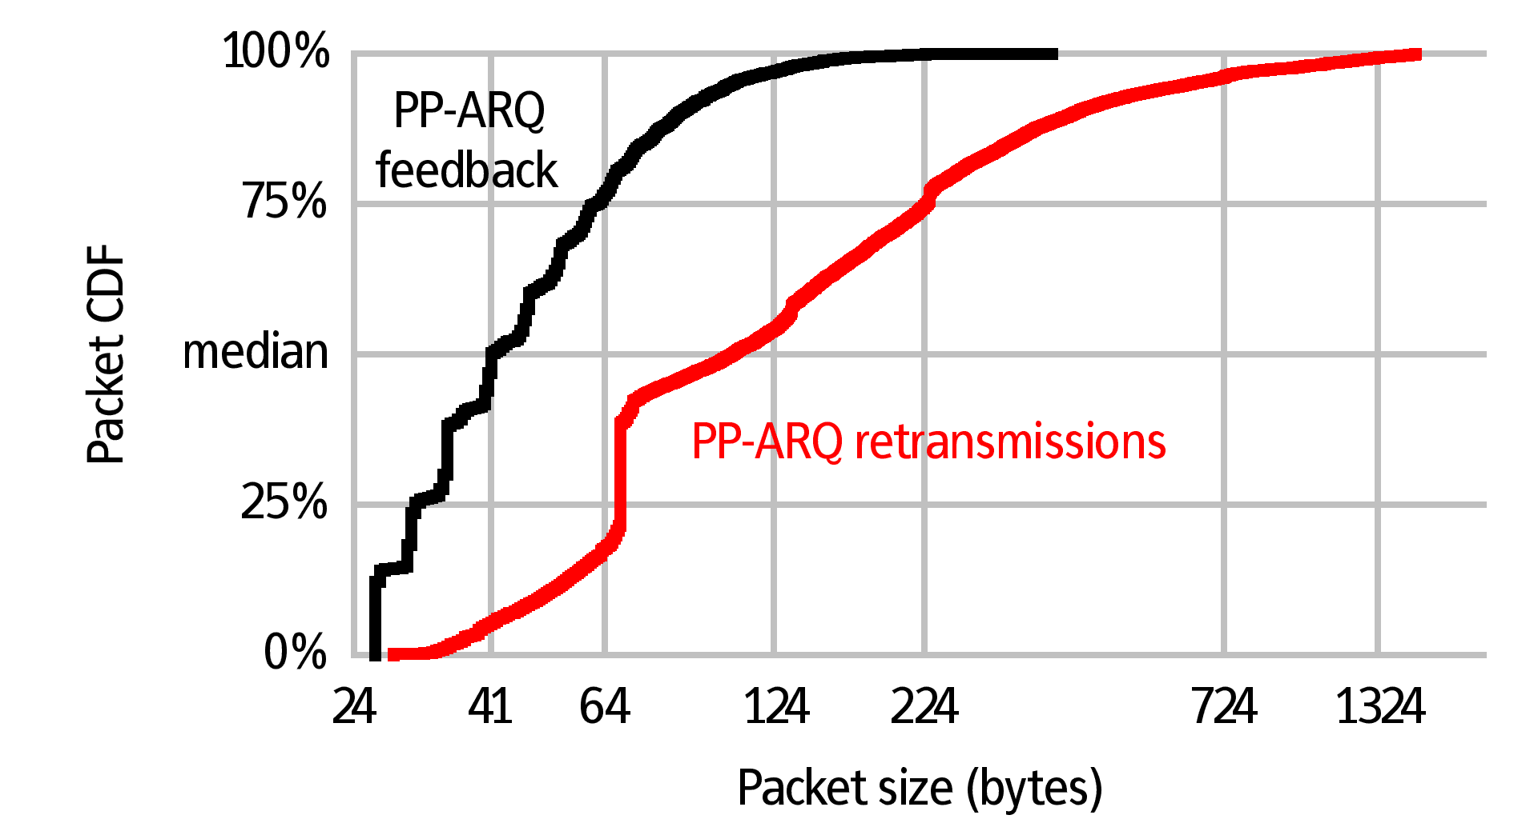
Low PP-ARQ Feedback Overhead
802.11 ACK size

Slide 25
Related work
ARQ with memory [Sindhu, IEEE Trans. On Comm. ’77]
Incremental redundancy [Metzner, IEEE Trans. On Comm. ’79]
Code combining [Chase, IEEE Trans. On Comm. ’85]
Combining retransmissions
SPaC [Dubois-Ferrière, Estrin, Vetterli; SenSys ’05]
Diversity combining
Reliability exchanging [Avudainayagam et al., IEEE WCNC ’03]
MRD [Miu, Balakrishnan, Koksal; MobiCom ’05]
SOFT [Woo et al.; MobiCom ’07]
Fragmented CRC
Seda [Ganti et al.; SenSys ’06], 802.11 fragmentation

Slide 26
Conclusion
Mechanisms for recovering correct bits from parts of packets
SoftPHY interface (PHY-independent)
Postamble decoding
PP-ARQ improves throughput 2.3–2.8× over the status quo
PPR Useful in other apps, e.g. opportunistic forwarding

